Slide 1
Roaming Remote Sensing – Quantification of Seasonal Bias
Wiebke Langreder¹, Bayram Mercan²
Wind Solutions (1), re-consult Ltd. (2)
September 2016

Slide 2
Concept of roaming remote sensing (RS)
A “fixed” mast paired with a mobile (roaming) unit, which typically a couple of months.
Motivation for Roaming Lidar (or RS):
Kill two birds with one stone: More + higher measurements
Reduce spatial extrapolation error
Consequently reduce uncertainty = lower LCOE

Slide 3
Is there a crux?
BUT:
You need MCP (Measure-Correlate-Predict) of some sort to “connect” the roaming data string with fixed mast data string
…which will be seasonally biased?
So, we trade spatial extrapolation error seasonal bias
Pest Cholera

Slide 4
Contents
How can we find out if there is an issue with seasonality?
The bad news
Consequences for AEP (annual energy prediction)
The good news

Slide 5
How can we find out?
Treat two masts on one site as if one of the two were a roaming lidar
6 sites (Turkey, South Africa) with ≥ 2 masts
Maximum distance between masts 10km
Minimum 80m measurement height
IEC compliant mounting
Measnet calibrated First Class anemometer
Minimum 1 year data, high recovery rate
For most masts tower shadow could be removed
First Aim:
Check seasonality

Slide 6
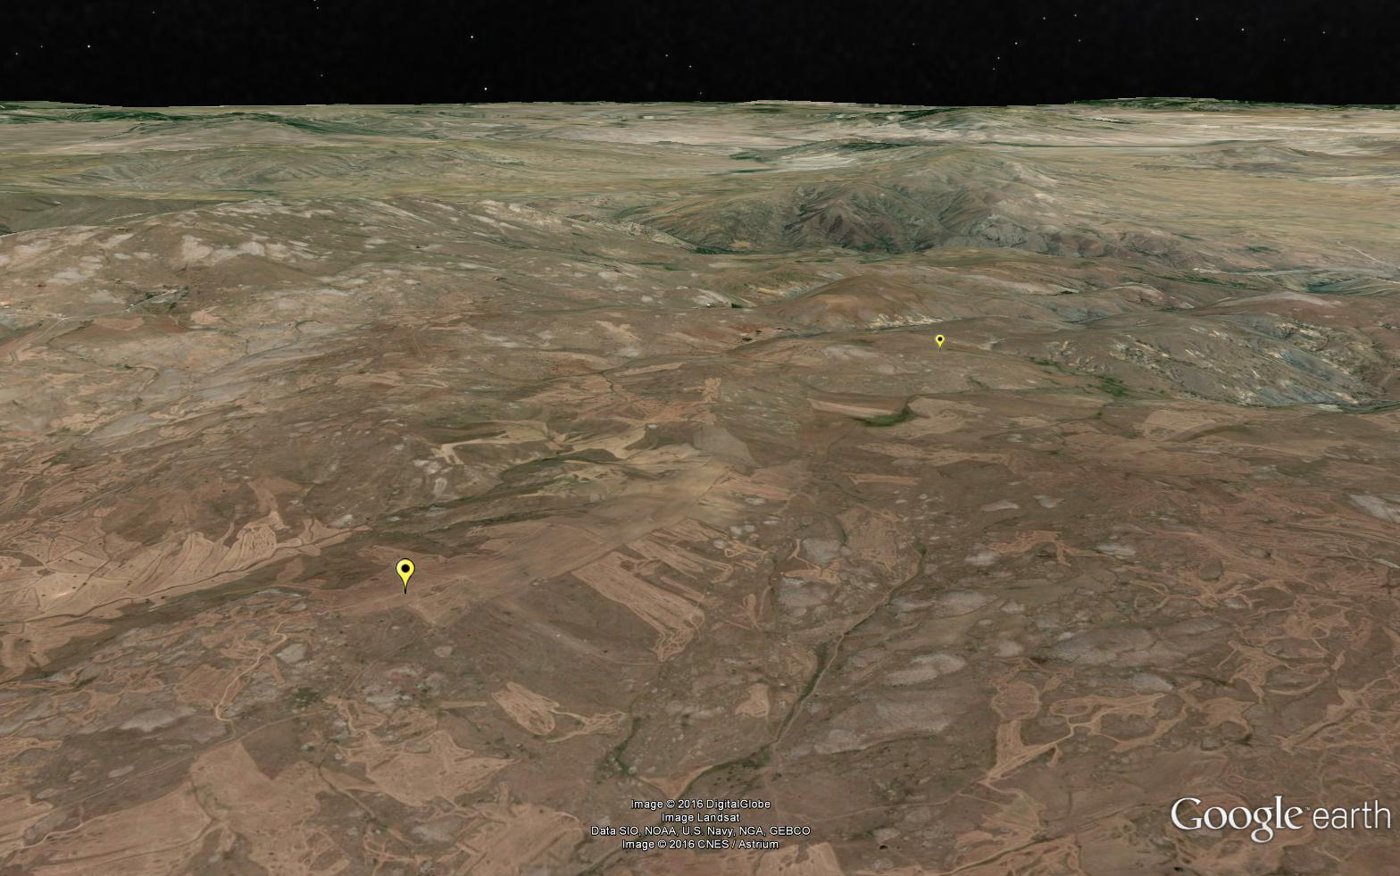
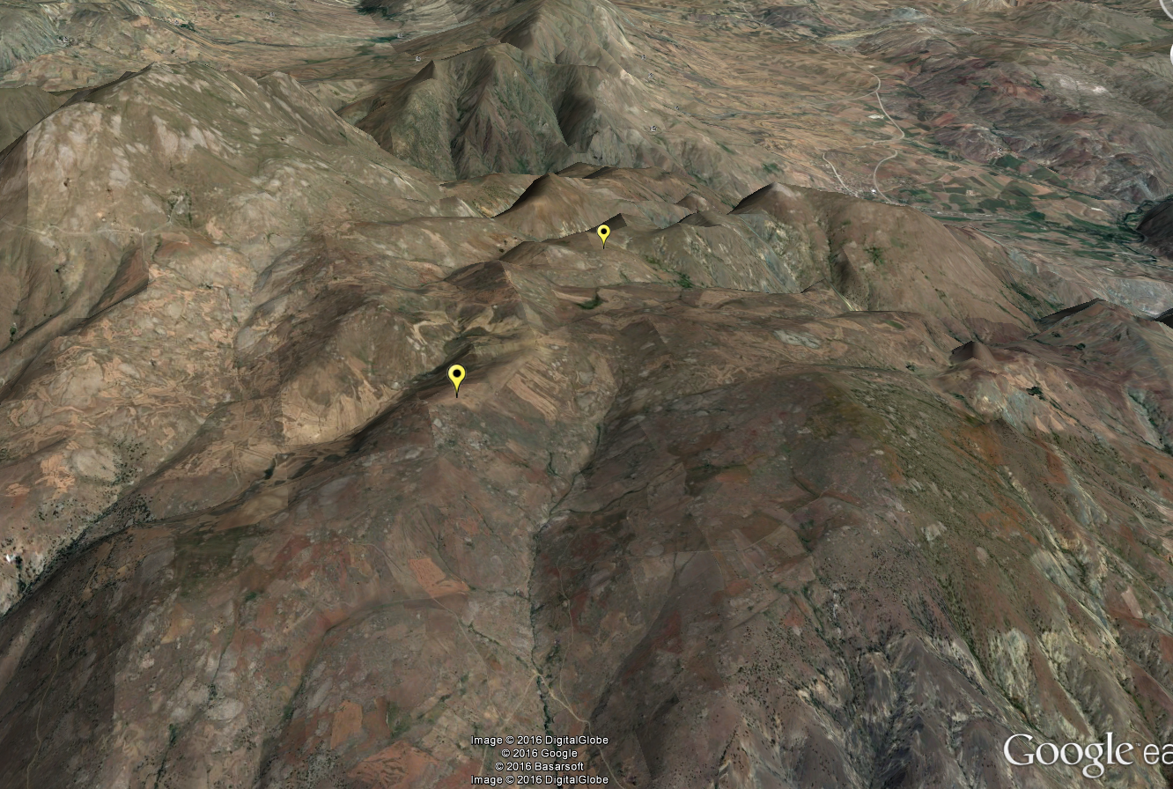
Stretched factor 3
1. Example:
Turkey
Mast distance 3km
Moderate terrain, maximum delta RIX 1.6%

Slide 7
How to find out?
Plot ratio of top anemometers from each mast against time
Describes variations in space and time: “Spatial seasonality”
1 year
Daily variations
Seasonal variations
Consequently, a roaming unit measuring less than a year will suffer from a seasonal bias when MCPed ☹
How bad is it?
Daily average
30 days moving average
Lidar campaign

Slide 8
Methodology
MCP
Keep one mast (A) as “permanent” – full period
Pretend second mast (B) to be “roaming”
Chop data from second mast (B) in subsets
3 months
6 months
Extent subset (B) to full period by using MCP: linear regression, 30˚ sectors, residuals (WindPRO default settings)
Compare resulting wind speed with real wind speed measured at B
And the other way round…
A
B

Slide 9
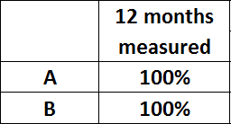
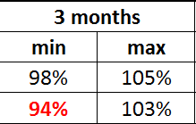
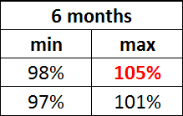
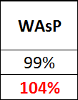
Impact on wind speed
Percentage wind speed
6 months do not necessarily fix the problem
WAsP is not always worse
Possibly 2 x 3 months?

Slide 10
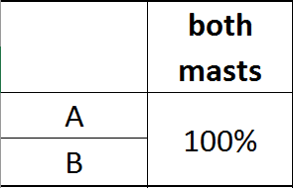
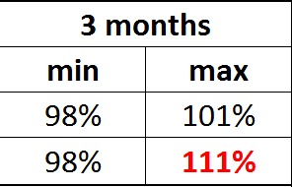
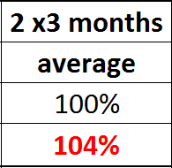
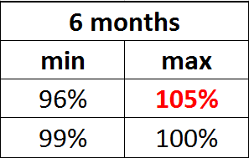
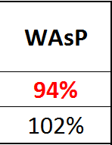
Impact on AEP
AEP important to catch wind direction issues
Fictive layout with approximately same number WTGs per mast
Either 2 x 3 months or 6 months, but still up to 5% error in AEP!
WAsP similar risk level in this example
But you might have guessed: There is a second example…

Slide 11
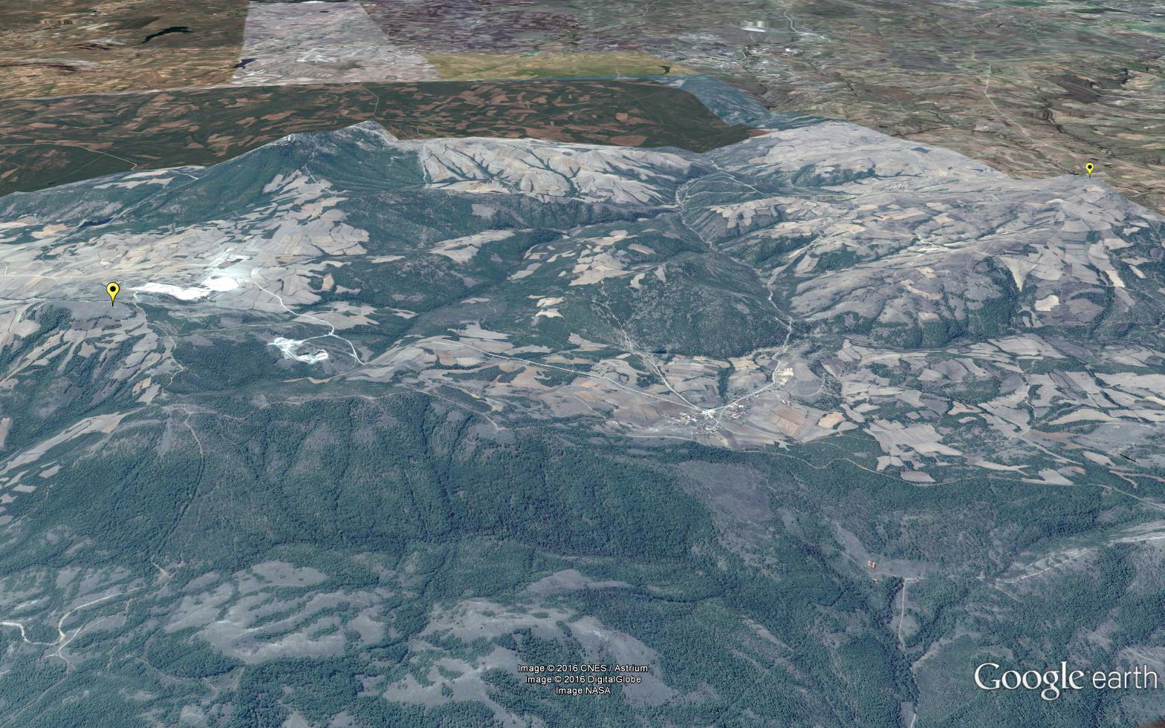
When things go well: Forested
Turkey
Mast distance 8km
Moderate terrain, delta RIX negligible
Stretched factor 3

Slide 12
Example 2: Forested
Less variation
Daily
Seasonal
Other examples confirmed this
High roughness “overwhelms” stability effects
Here a roaming RS is much less subject to seasonal bias

Slide 13
And now?
Example 1: Open landscape: Critical for roaming RS
Example 2: Forested: Not critical for roaming RS
How do we know if there is an issue or not?
Solution: meso-scale data (Vortex)

Slide 14
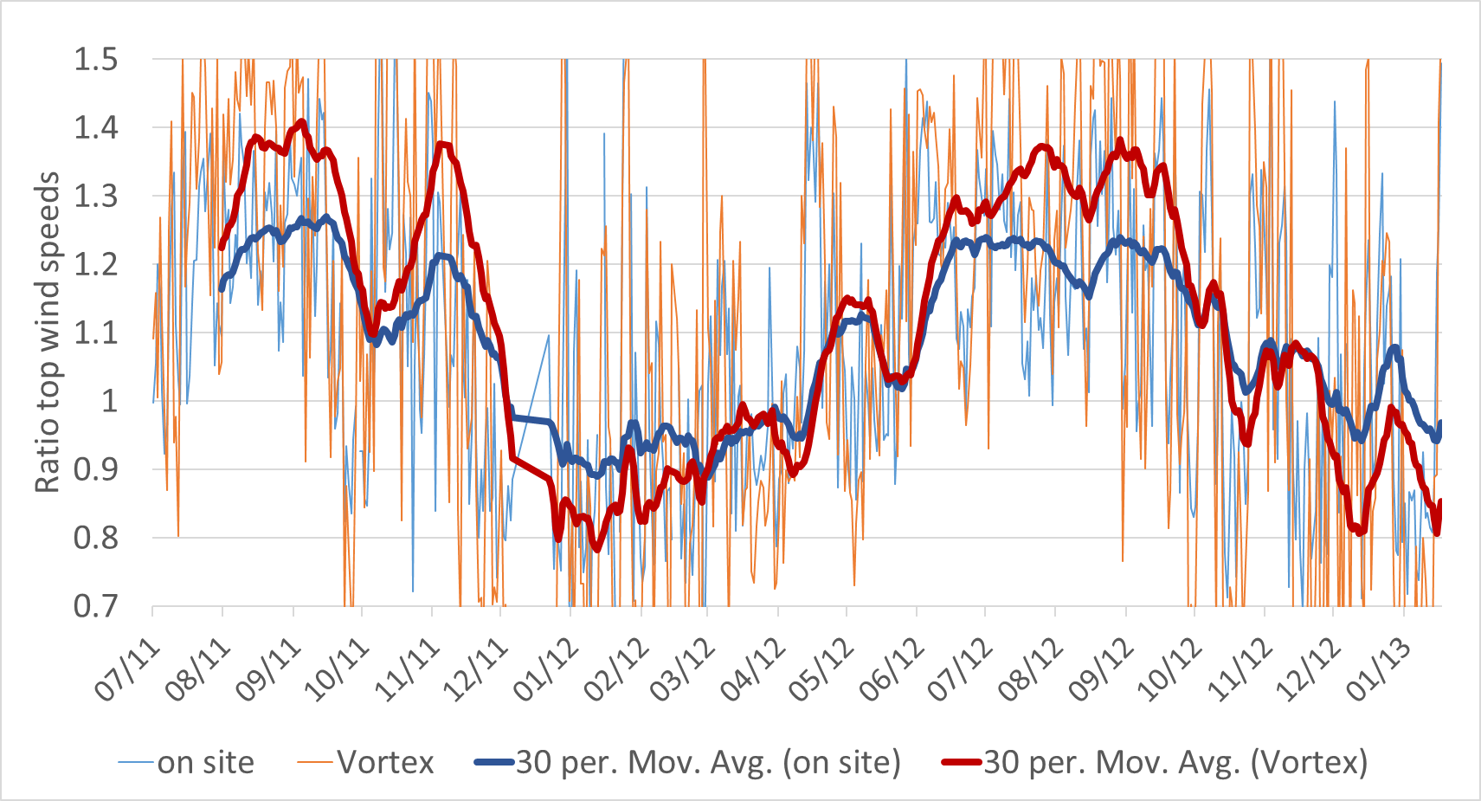
Example 1: Open landscape

Slide 15
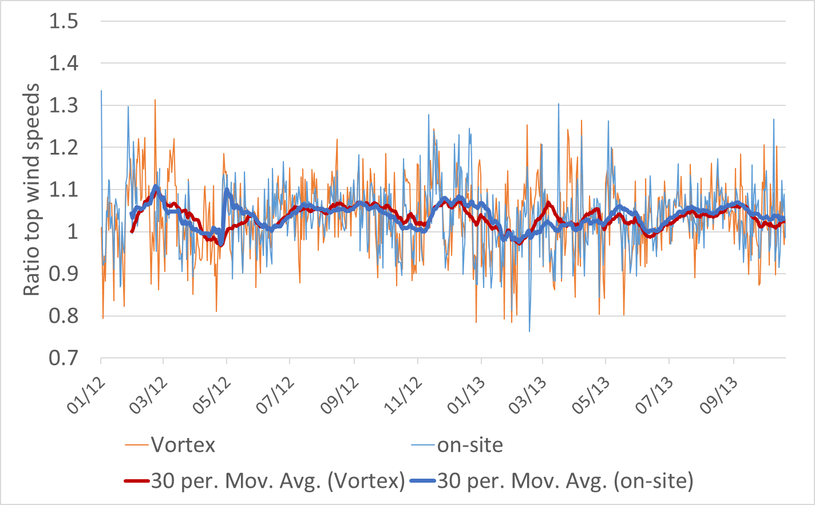
Example 2: Forested

Slide 16
Summary
Prior to designing a measurement campaign:
Check meso-scale data across the site for spatial seasonal variations
Large spatial seasonal variations: roaming RS might not add value
Small spatial seasonal variations: roaming RS beneficial

Slide 17
Acknowledgement
Thanks to re-consult Ltd. for providing data!
For more information on Wind Solutions
www.wind-solutions.com
Experts in wind resource since 1975

