Slide 1
The impact of geometric non-linearities on the fatigue analysis of trailing edge bond lines in wind turbine rotor blades
Andree Stephan, 2007
Pablo Noever Castelos, M.Sc.

Slide 2
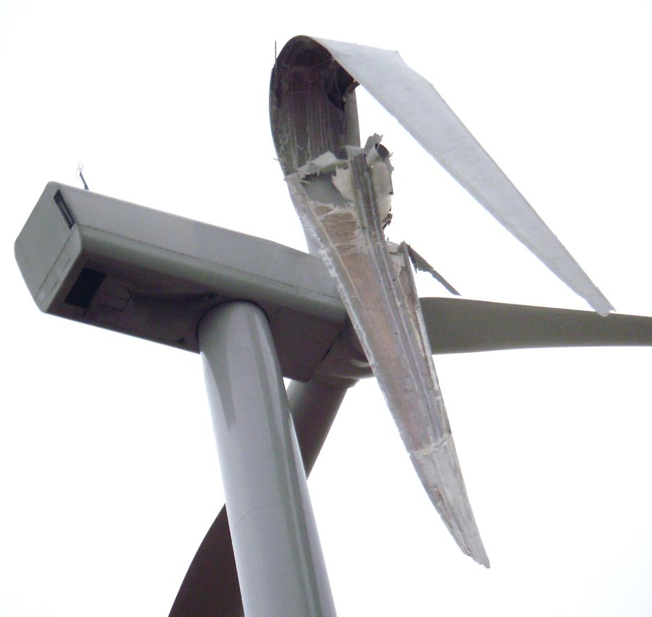
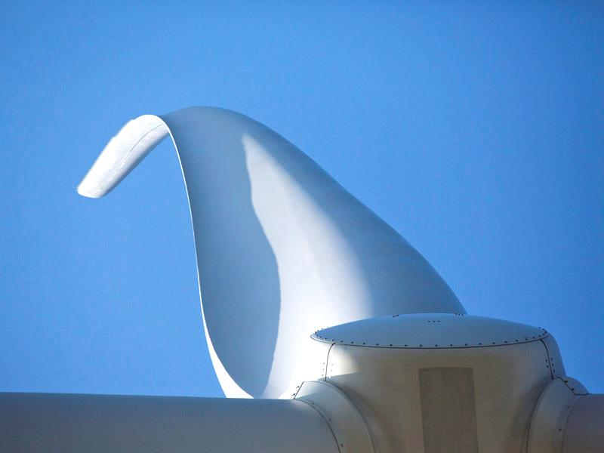
Motivation
Source: www.wind-watch.org; 08.09.2016
Source: www.energy.siemens.com; 08.09.2016

Slide 3
Motivation
High flexibility of modern wind turbine blades Large structural deformations Geometrically non-linear effects | <≠>
 |  | Linear superposition principle for the evaluation of fatigue stress histories

Slide 4
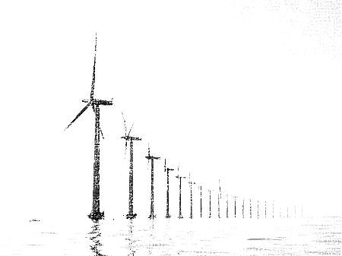
Content
Finite element model and load application
Superposition principle in fatigue analysis
Alternative load application
Conclusion & Outlook

Slide 5
Content
Finite element model and load application
Superposition principle in fatigue analysis
Alternative load application
Conclusion & Outlook

Slide 6
Finite element model
Reference blade: IWES IWT-7.5-164 wind turbine

Slide 7
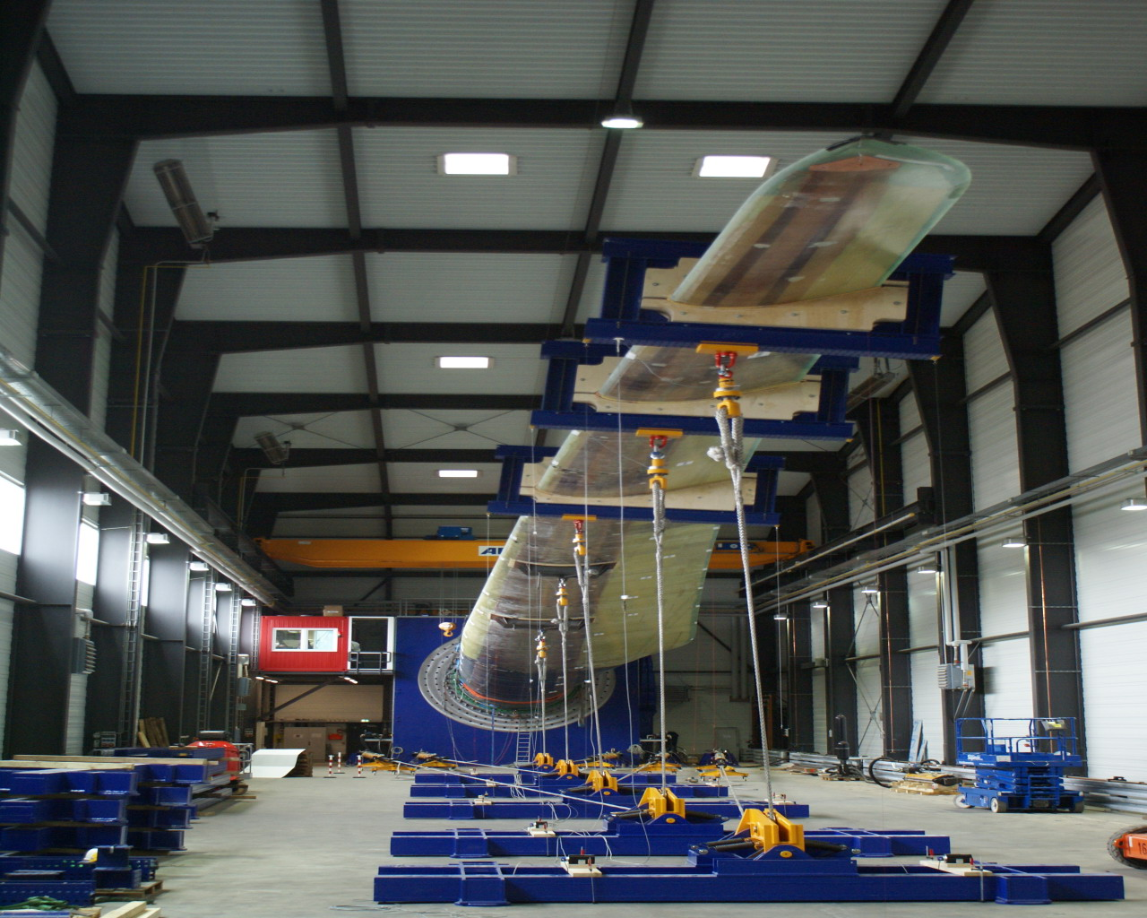
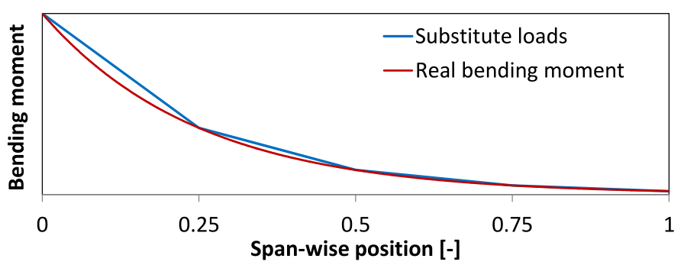
Load application
Approximation of bending moments with concentrated forces
$$M_{appr,i}=\sum_{j=i+1}^{n}{Q_{Subst,j}∙\left(r_{j}−r_{i}\right)}$$
Source: Fraunhofer IWES

Slide 8
Content
Finite element model and load application
Superposition principle in fatigue analysis
Alternative load application
Conclusion & Outlook

Slide 9
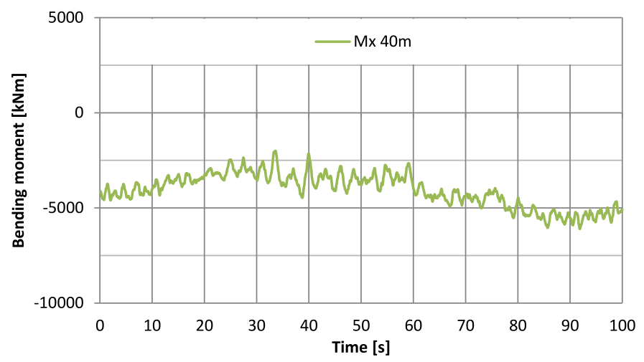
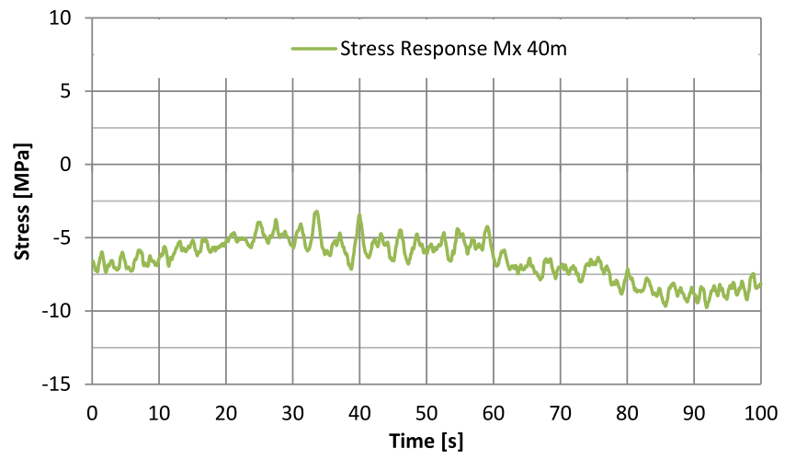
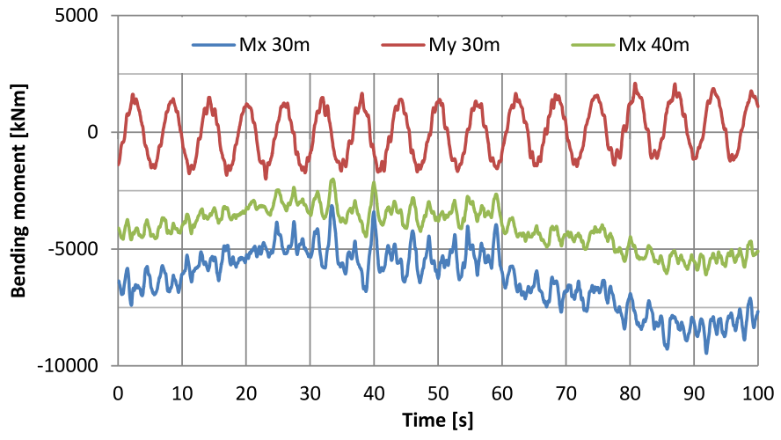
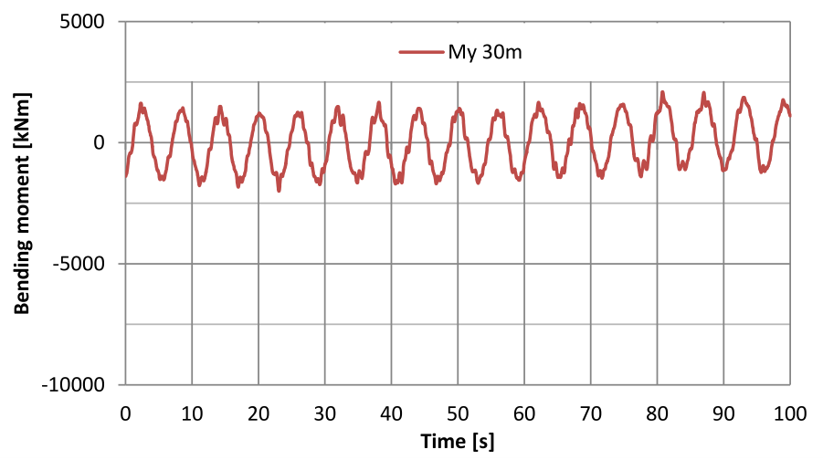
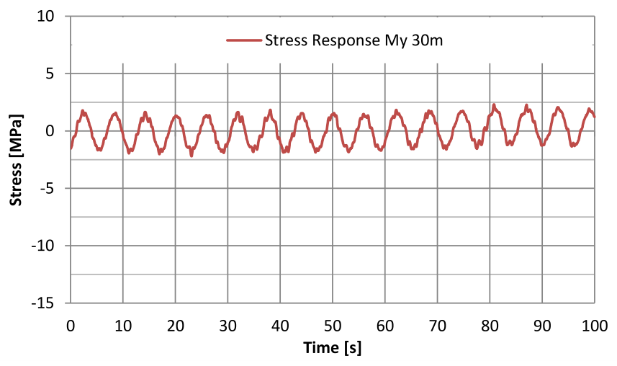
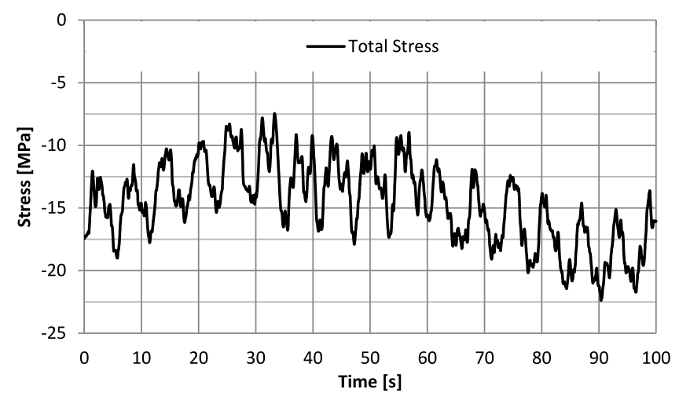
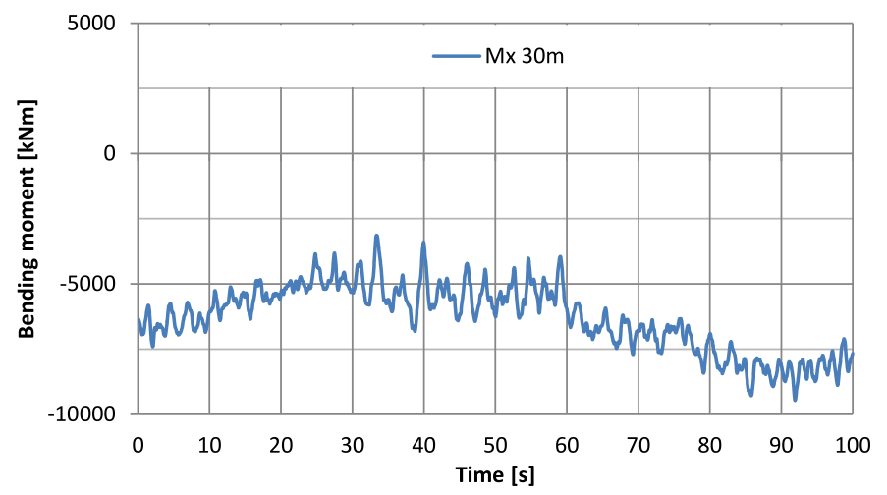
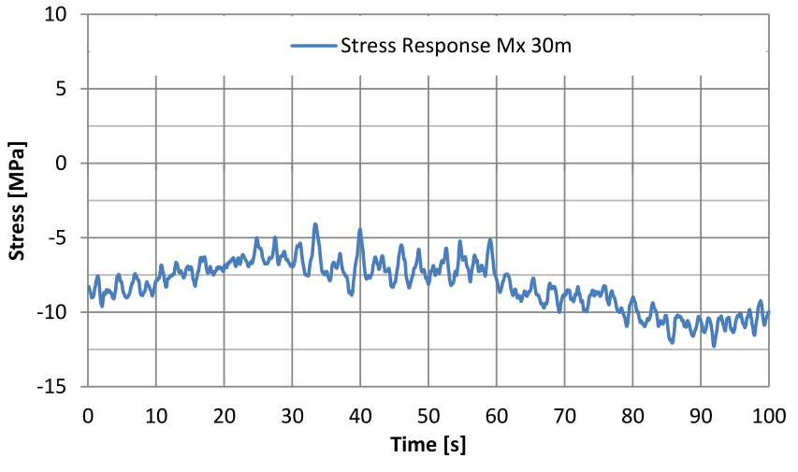
Superposition principle in fatigue analysis
Load history on blade
Individual loads
Individual responses
Total stress history
Superposition
Linear behaviour is a requirement

Slide 10
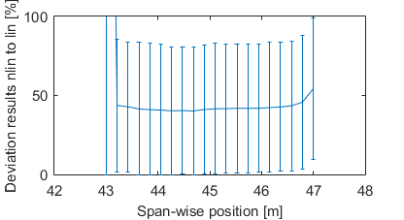
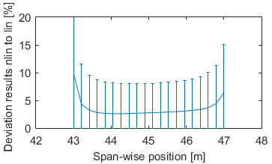
Geometrically non-linear vs. linear analysis
Shear Stress (GL 2010)
(b) Drucker-Prager equivalent stress
(DNV-GL 2015)
➔ Linear superposition principle theoretically not applicable!

Slide 11
Content
FE-model and load application
Superposition principle in fatigue analysis
Alternative load application
Conclusion & Outlook

Slide 12
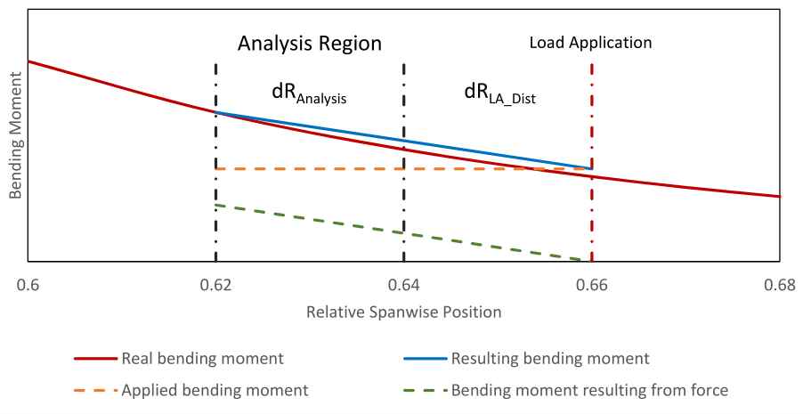
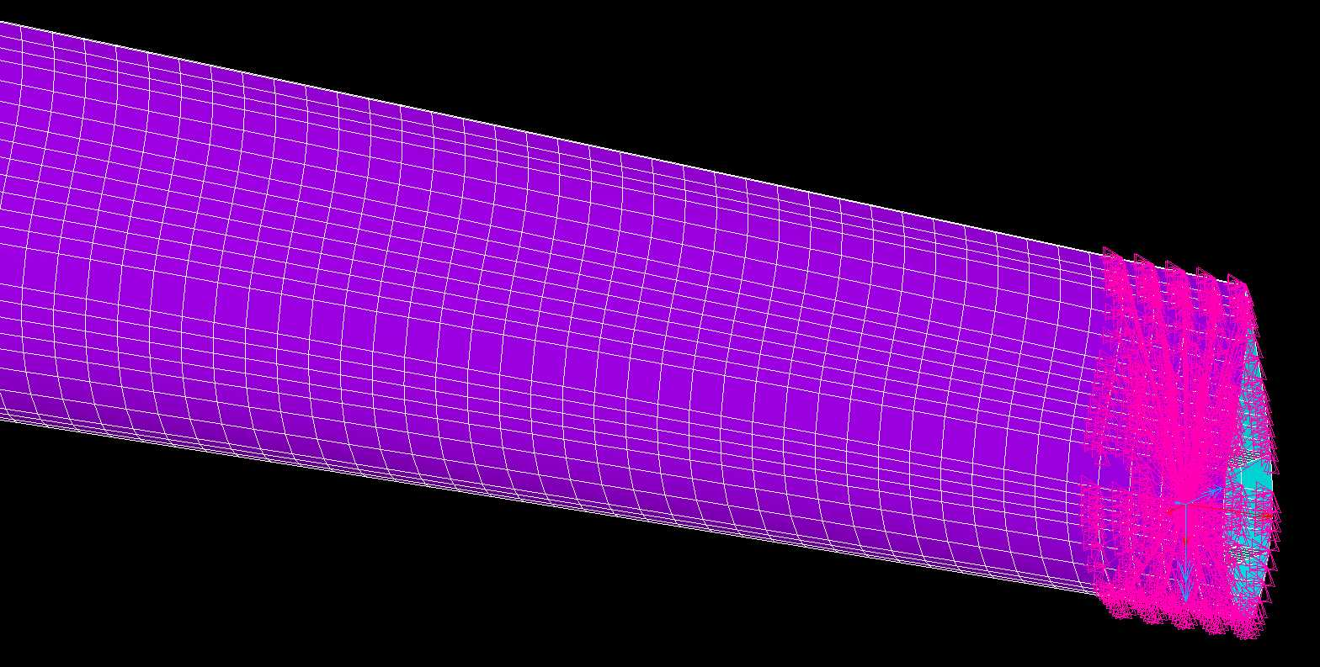
Alternative load application
Direct application of internal forces and moments
All loads can be applied
Just a small analysis region, repetition necessary

Slide 13
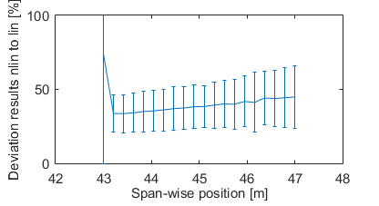
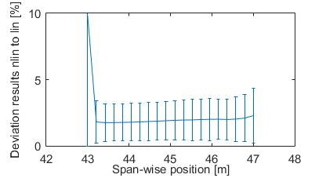
Geometrically non-linear vs. linear analysis Only bending moments
Shear Stress (GL 2010)
(b) Drucker-Prager equivalent stress
(DNV-GL 2015)

Slide 14
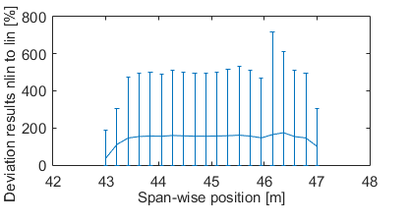
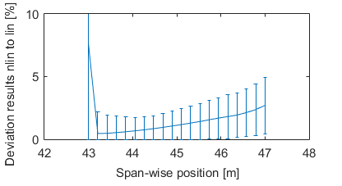
Geometrically non-linear vs. linear analysis All internal forces and moments
Shear Stress (GL 2010)
(b) Drucker-Prager equivalent stress
(DNV-GL 2015)

Slide 15
Content
Finite element model and load application
Superposition principle in fatigue analysis
Alternative load application
Conclusion & Outlook

Slide 16
Conclusion
Geometric non-linearities appear within fatigue load history in 3D FE-analysis
Non-linearities important to be captured for a save blade design
Impact of non-linearities less severe in multi-axial stress proof
Alternative load application can help to reduce geometric non-linearities

Slide 17
Outlook
Evaluation of the non-linearities’ relevance with respect to fatigue life
Validate geometric non-linearities in real blade tests
Develop and evaluate new load application strategies for FE analysis

Slide 18
Contact details
Pablo Noever Castelos, M. Sc.
Institute for Wind Energy Systems
Leibniz Universität Hannover
Appelstraße 9A
D-30167 Hannover, Germany
Phone: +49 511 762 14415
Fax: +49 511 762 4379
E-mail: pablo.noever@iwes.uni-hannover.de

