Slide 1
Environmental and non-technical impacts of lean principles applied to offshore wind farms
28th September 2016
Mihaela DRAGAN
Environment & Planning Analyst, WindEurope

Slide 2
Presentation outline
Introduction
Methodology
Construction phase – positive and adverse environmental impacts
Mitigating wind farm construction impacts
Social acceptance of offshore wind farm

Slide 3
Introduction
Objective: examine the environmental and non-technical impacts of lean principles applied to offshore wind farms with a particular focus on life cycle analysis.
environmental impacts resulted from new foundation systems: fixed and floating, from installation activities, operation and maintenance strategies deployed as well as decommissioning activities.
non-technical impacts refers to creation of local employment, local growth, training and skills as wells as synergies with other sea users.
Community engagement for offshore wind farms.

Slide 4
Methodology
EWEA proceedings 2010 to 2015 (sessions dedicated to environment and social acceptance)
Scientific papers and journals
Policy reports and studies
EU funded projects
Input from industry environmental experts

Slide 5
Positive environmental impacts of Offshore Wind Farms
Effectively mitigating climate change, the single largest threat to biodiversity
Trawling exclusion and impacts on fish
Artificial reef effects
Habitat enhancement
Synergies with aquaculture

Slide 6
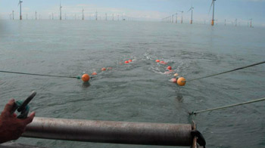
Trawling exclusion and impacts on fish
Ban on fishing, especially demersal trawling in the wind farm area is resulting in increased local fish populations.
Source: Shooting otter trawl in Thanet Wind Farm, Fisherman’s voice, June 2014, Vol. 19, No. 6
Notes:
In DK there is a 200 m protective zone against bottom-trawl fishing and raw material extraction around sub-sea power cables, which in general excludes these activities within a wind farm area that will function, temporarily or permanently, as a refuge for different fish species.
Short-term effects of fishery exclusion in offshore wind farms on macrofaunal communities in the Belgian part of the North Sea, 2016 – results show increased abundances within the No Fishery area.
Trawling exclusion is applied also in Belgium, in Scotland
UK policy-fishing in wind farms :
Standard Marine Coast Guard Agency (MCA) Policy is that there should not be either navigation or fishing exclusion within operational wind farms.
Fishing exclusion zones of 50m around turbines

Slide 7
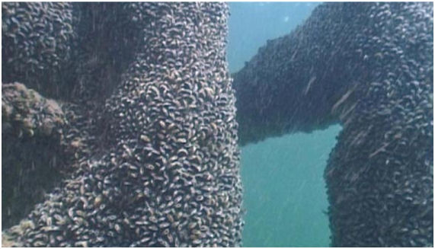
Artificial reef effects
Jens Christensen. Common mussel on turbine structures at Horns Rev. Danish Offshore Wind - Key Environmental Issues
Notes:
Monitoring programmes in Horns Rev 1 offshore wind farm show that the stock of some fish species increased. After a 7 year monitoring programme, scientists from the Aquatic Department of the Technical University of Denmark mapped the fish life in the area. The survey showed that the offshore project had no negative effects on the fish life and that boulder structures functioned as artificial reefs, providing good breeding conditions with a wide selection of food and shelter from currents. (DTUAqua, 2012).

Slide 8
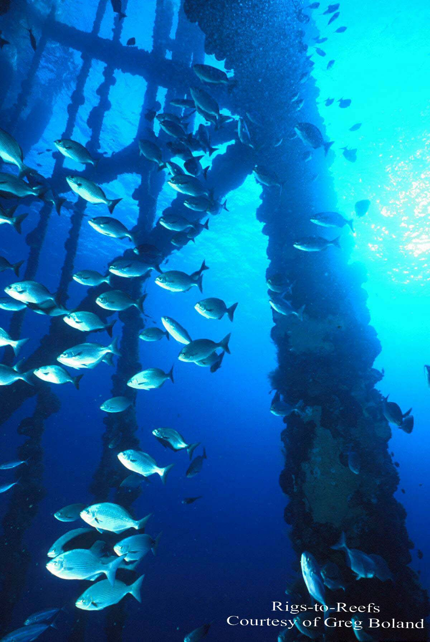
Habitat enhancement
At Thanet (UK) offshore wind farm, marine research suggests that certain fish species, such as cod found shelter inside the farm.
New hard substratum and the scouring protection led to the establishment of new species and new fauna.
Wind farm acts as a new type of habitat with a higher biodiversity of benthic organisms
Notes:
At Thanet (UK) offshore wind farm, marine research suggests that offshore wind farms could have a positive impact on species living beneath the waves. Certain fish species, such as cod, were found to shelter inside the farm. Moreover, the new hard substratum and the scouring protection led to the establishment of new species and new fauna. It is indicated that the wind farm acts as a new type of habitat with a higher biodiversity of benthic organisms (see above). The study speculates that there may be an increased use of the area by fish, marine mammals and certain bird species (Cox, 2011).

Slide 9
Synergies with aquaculture
Source: Lacroix and Pioch, 2011, p.133
Notes:
Ecofys is experimenting seaweed cultivation at an offshore wind farm off the Dutch island of Texel. The aim is to harvest biomass for producing fish and animal feed, biofuels and energy. Since the offshore wind farm area is closed for shipping and commercial fishing, there are favourable conditions for aquaculture and it can be used as a sort of marine conservation area. Fish are likely to be attracted to the seaweed fields and use them for shelter or as a nursery. In addition, the seaweed will provide nutrients and energy (Ecofys, 2012).
Figure 2: Example of multi-use management of a wind farm. The wind turbine density is artificially high to facilitate the presentation of the concept. From left to right: diving, scientific studies, aquaculture, fishing, tourism. © Denis Lacroix, Ifremer and Malo Lacroix

Slide 10
Substructures installed in EU waters (end 2015)
Source: WindEurope
Notes:
At end 2015, 80% of the installed offshore wind substructures were monopiles, 9% were gravity based foundations, jackets accounted for 5%, tripods accounted for 4% and tripiles made up 2%. This information is extremely relevant when looking at the environmental impacts associated with each type of foundation.
Monopiles detain the highest share of installed substructures in European waters because they present a series of advantages. Their weight usually falls within a range of 500 to around 800 tonnes, making them one of the lightest choices for the offshore foundations and they can be installed in water depths of up to 30m – 35m, although work is underway to extend the operational range of monopiles to include larger turbines in deeper waters. But despite all their proven qualities, easy design and manufacturing, light weight, as well as low cost compared with other technological alternatives they have one main environmental constraint which is the pilling acoustic disturbance that occurs during the installation phase of each unit into the sea bed.

Slide 11
Range of applicability of the available foundation technologies
Floating concepts
Source DNV
Notes:
(source DNV)
Various types of foundations are available today for the construction of offshore wind farms. Figure 1 below shows that in waters with relatively shallow to medium water depth (0m to 65m), bottom-fixed steel or concrete foundations are usually employed. However, the trend in the industry is to go for deeper waters where the wind resources are higher, in this case floating platforms become also a viable option (50m to 150m).

Slide 12
Foundation concepts and their associated impact upon local environment
Monopile
Piling noise disturbance -highest
Gravity based
Moderate underwater noise
Jackets
Piling noise disturbance - high
Floating
No underwater noise from piling thus lower environmental impact
Hydrodynamics and sedimentology
Hydrodynamics and sedimentology
Hydrodynamics and sedimentology
Hydrodynamics and sedimentology
Disturbance to sea bed
Disturbance to sea bed
Disturbance to sea bed – dredging
Magnetic fields
Magnetic fields
Magnetic fields
Magnetic fields
Habitat loss
Habitat loss
Habitat loss
Habitat loss
Notes:
http://www.leanwind.eu/wp-content/uploads/LEANWIND_D2.1_WP-Framework_Industry-Challenges-Report_construction-deployment-and-installation1.pdf
Construction effects on the sediment regime could result from the excavation or release of sea bed sediments during foundation installation works as a consequence of bed levelling (for example, for gravity base structures) or drilling (for monopiles and steel jackets).
The maximum adverse scenario, in terms of the volume of sediments released per foundation during a installation, is provided by the drilling operations associated with 8 MW concrete monopile. GBF release less sediments in thre column of water. Triton Knoll Wind Fram

Slide 13
A Review of Marine Environmental Considerations associated with Concrete Gravity Base Foundations in Offshore Wind Developments
Source: Ian Reach, Principal Marine Ecologist, Marine Space
Notes:
Foundation footprint (m2)
Physical footprint – habitat loss and habitat alteration due to shading
Steel monopile – 57 m2
CGBF – 1,257 m2
Steel Jacket (piled) – 201 m2
Tripod (piled) – 177 m2
Suction caisson – 380 m2

Slide 14
Example of detailed environmental impact: underwater noise
Sensitive species
Certain fish (incl. eggs and larvae) and marine mammals
Disturbance
Displacement
Behaviour reactions
Reduced predation success
Damage, Mortality
Population and Ecosystem-scale effects
Notes:
Many marine organisms including marine mammals and many fish species use sound as a mechanism of communication, to either locate mates, search for food or avoid predators.
Anthropogenic sound emitted during the construction or operation of offshore windfarms can mask biologically relevant signals for marine organisms which can lead to behavioural reactions. At very high levels sound can injure or even kill marine life.

Slide 15
Underwater noise thresholds per country
Source: WindEurope
Notes:
In Denmark a cumulative SEL 183 dB on harbour porpoises.
In Germany since 2008, a dual threshold value has been defined by the approving authority – the Federal Maritime and Hydrographic Agency. The observance of this threshold value of 160 dB SEL / 190 dB (peak-to-peak) at 750 m from the source is mandatory for the installation of offshore wind turbines in the German exclusive economic zone (EEZ).
Similarly in the Netherlands there is also a noise threshold set by the authorities at 160 – 172 dB SEL at 750 m from the pilling event.

Slide 16
Measured underwater noise levels at fixed offshore wind substructures – Belgium
Difference of 57 dB between the lowest noise levels of jackets and the highest noise levels of GBFs.
Source: Environmental impacts of offshore wind farms
in the Belgian part of the North Sea, Degraer Steven
Notes:
According to the Royal Belgian Institute of Natural Sciences that conducted a study on the “Environmental impacts of offshore wind farms in the Belgian part of the North Sea” the pilling of jackets generated almost as much noise as monopiles, reaching the range of 172 - 189 dB, while monopile piling produced excessive underwater noise levels of 179-194 dB at 750m from the pilling event. In contrast underwater noise generated during the installation of gravity based foundations was about 115 dB, this value being close to ambient noise levels (105-115 dB at wind speeds higher than 12m /s). Despite the significant underwater noise levels that jackets produce they affect less the sea bed compared to gravity based as their installation does not require any dredging.
Environmental impacts of offshore wind farms in the Belgian part of the North Sea: Learning from the past to optimize future monitoring programmes - Degraer Steven

Slide 17
Overview of noise mitigation measures
Noise mitigation measures
Country | Exclusion zone | Acoustic Deterrent Devices | Seasonal restrictions | Soft start | Noise threshold | Passive acoustic monitoring
Belgium |  | x | x | x | 185 dB SEL at 750m | x
Denmark |  | x |  | x | 183 dB SEL
Germany |  | x |  | x | 160 dB SEL - 190 dB SPL at 750m | x
The Netherlands |  | x | x | x | 160 dB SEL - 172 dB SEL at 750m
The United Kingdom | x | x |  | x |  | x (incl. MMOs)
Source: Underwater noise caused by pile driving. Impacts on marine mammals, regulations and offshore wind developments, Pondera Consult, 2014.
Notes:
In the United Kingdom, the direct costs to comply to the conditions of the Marine License were about £3,6 million = 4.2 million euros specified as follows: Marine Mammal Observer: £970.000, Dedicated vessel £1.100.000, Subacoustics measured £60.000, Onshore monitoring stations £95.000.
In Germany the costs of mitigating concepts to construct an OWF of 288MW consisting of 80 monopiles, were in the region of €20 million. These costs were made on the deployment of 2 dedicated vessels, 12 compressors, 3 Big Bubble Curtains, pingers, seal scarers an measurements of hydrosound and C-PODS. Up to 60 people were directly involved in the monitoring process of this OWF. With these substantial efforts, it was possible to comply to the German noise thresholds in the German Bight while constructing a monopile foundation with a diameter of 6 meters.

Slide 18
Noise Mitigation Measures Applied at GWYNT Y MÔR Offshore Wind farm - UK
Combination of mitigation measure applied, established through the Conditions of the Marine Licence:
Piling restrictions in sole spawning periods
Noise modelling at consent application stage
Noise measurements on first piling
Marine mammal observers
Soft start piling
Acoustic deterrent devices used
Onshore noise monitoring

Slide 19
Noise potential reduction of different mitigation techniques used mostly in Germany – very strict noise levels!
Source: Development of Noise Mitigation Measures in Offshore Wind Farm Construction 2013, Federal Agency for Nature Conservation (Germany).
Notes:
Conclusion:
Project developers are complying with very strict regulations and providing mitigation.
Once a project is identified with the right mitigation in place developers comply. is consented it is considered by the competent authorities that the impact of the project is either negligible or low and even when moderate or high local impact is identified with the right mitigation in place the adverse environmental effects can be controlled.

Slide 20
Noise mitigation - Bubble curtain
Notes:
The big bubble curtain is a ring of perforated pipes positioned on the sea floor around the foundation to be piled. This can either be a monopile, a tripile, a tripod or a jacket. Compressors located on the construction vessel or on a platform feed air into the pipe. The air passes into the water column by regularly arranged holes. Freely rising bubbles form a large curtain around the entire structure, thus shielding the environment from the noise source.

Slide 21
Community engagement strategy
Providing Information
Engaging local communities
Innovative Financing / Benefit sharing
2 way interaction: dialogue & exchange of views.
1 way information to targeted stakeholders.
Partnership models.
Community benefit for onshore wind received positively, transfer of the experience to offshore?
However, differences in identifying nearby communities, maturity of the industry, technology and project economics?

Slide 22
Community engagement
An example of supporting local development: Gwynt y Môr (576MW)
Community fund: £19 mln over 25 years
Privately funded grant and loan scheme
Fully flexible fund objectives
Tourism fund: £690,000
Facilitating pier upgrade for cruise liners
Achieving blue flag status for beach
RNLI partnership: £3.8 mln
5 year partnership to support lifeguards
Source: RWE Innogy
Notes:
Other similar examples are available:
Triton Knoll – consented, RWE UK 750-900 MW
Members of the public were asked for feedback on where and how they would like both a one-off fund of £500,000 and an annual fund of £40,000 to be spent. Improving rural transport, large grants for community projects and small grants to local community projects.
RWE Rhyl Flats Offshore Wind Farm Community Fund: Rhyl Flats was constructed throughout 2008 and 2009 and began generating energy in July 2009. It is currently the largest operating renewable energy scheme in Wales and one of the most powerful offshore wind farms in the UK. The Rhyl Flats Wind Farm fund will invest over £2 million into local activities and projects in communities surrounding the site.
Page 21
http://www.localenergyscotland.org/media/77721/Good-Practice-Principles-for-Offshore-Community-Benefits.pdf

Slide 23
Co-ownership
Co-ownership
Legal obligation of 20% ownership for nearshore wind farms in Denmark
Municipal utilities ownership and citizen participation possible in Germany
Developer of Dutch Westermeerwind Offshore Wind park grants the possibility of community buy-in
Notes:
Co-ownership through coastal communities, co-operatives or nonlocal energy utilities is very rare • Benefits are generated through revenues from partial ownership of wind farm • Legal obligation of 20% ownership for nearshore wind farms in Denmark • Revenues generated through ownership are also administered by funds and trusts • Municipal utilities ownership and citizen participation possible in Germany (community buy-in) • Developer of Dutch Westermeerwind Offshore Windpark grants the possibility of community buy-in
Denmark: Middelgrunden, Samso, (non-voluntarily) • Germany: Global Tech 1, Windreich • Netherlands: Westermeerwind

Slide 24
Conclusions
Well documented positive impacts of offshore wind farms,
All types of foundations have an environmental impact but recovery from these effects is expected within the lifespan of the windfarm project,
Several mitigation solutions available for underwater noise but bear in mind the costs,
Community engagement and benefit sharing are core aspects of a successful social acceptance strategy.

