Slide 1
The consideration of atmospheric stability
within wind farm AEP calculations
J. Schmidt¹, C.-Y. Chang¹, M. Salimi², T. Teichmann³, B. Stoevesandt¹
¹Fraunhofer IWES, Oldenburg, Germany
²Technical University Cottbus, Cottbus, Germany
³Nordex Energy GmbH, Hamburg, Germany

Slide 2
Content
Motivation
Mesoscale simulation
AEP calculation with CFD
AEP calculation with flapFOAM
Comparision to SCADA data
Summary

Slide 3
Content
Motivation
Mesoscale simulation
AEP calculation with CFD
AEP calculation with flapFOAM
Comparision to SCADA data
Summary

Slide 4
Motivation
Thermal stratification is literally an every-day phenomenon
Most wind farm modelling approaches ignore thermal stratification
How large is the corresponding error?
Themal stratification is still not standard in CFD
For mesoscale codes like WRF it is a crucial topic
Stratification effects on wakes are a research topic
Idea for modelling:
Transform neutral model into stratified model
Notes:
The realistic simulation of loads from the rotor and grid side due to particularly dynamic force application is possible in our nacelle test rig. This test rig is characterized by the combination of mechanical tests with a virtual grid with 44 MVA installed inverter power. The goal in the future is the complete electrical certification of wind turbines on the nacelle test rig.
With this rig, pitch systems and main bearings can also be tested subject to permanent loading. Access to smaller test systems is already available and further test fields are currently being developed.
The issue of the reliability of power electronics for wind turbines is being investigated in a dedicated innovation cluster.

Slide 5
Content
Motivation
Mesoscale simulation
AEP calculation with CFD
AEP calculation with flapFOAM
Comparision to SCADA data
Summary

Slide 6
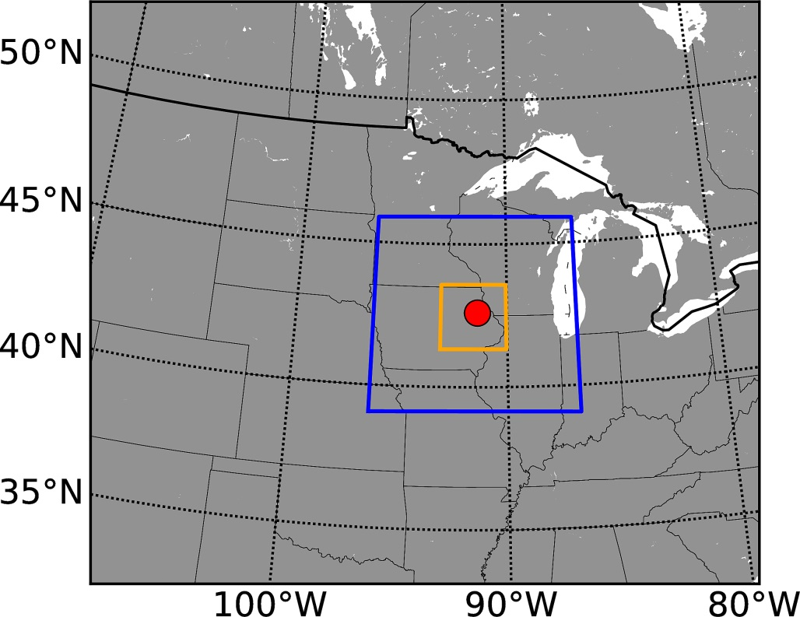
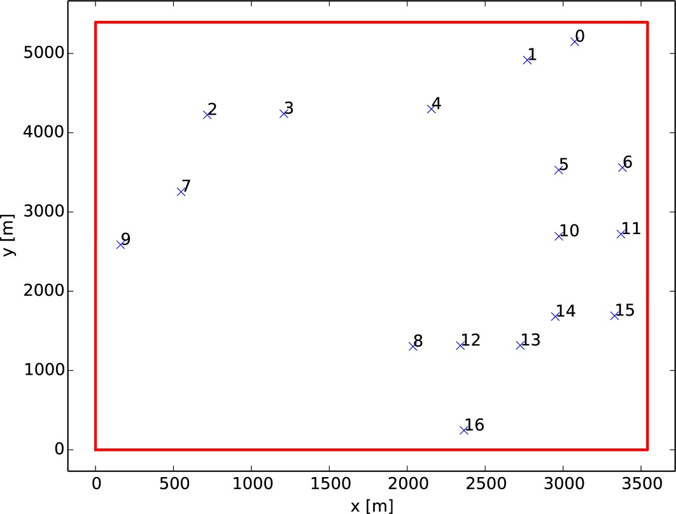
The site
We consider a wind farm with 17 Nordex turbines in the USA
D = H = 100 m, P = 2.5 MW, flat terrain
Full year 2015 was simulated with WRF, 3 nested domains
Notes:
The realistic simulation of loads from the rotor and grid side due to particularly dynamic force application is possible in our nacelle test rig. This test rig is characterized by the combination of mechanical tests with a virtual grid with 44 MVA installed inverter power. The goal in the future is the complete electrical certification of wind turbines on the nacelle test rig.
With this rig, pitch systems and main bearings can also be tested subject to permanent loading. Access to smaller test systems is already available and further test fields are currently being developed.
The issue of the reliability of power electronics for wind turbines is being investigated in a dedicated innovation cluster.

Slide 7
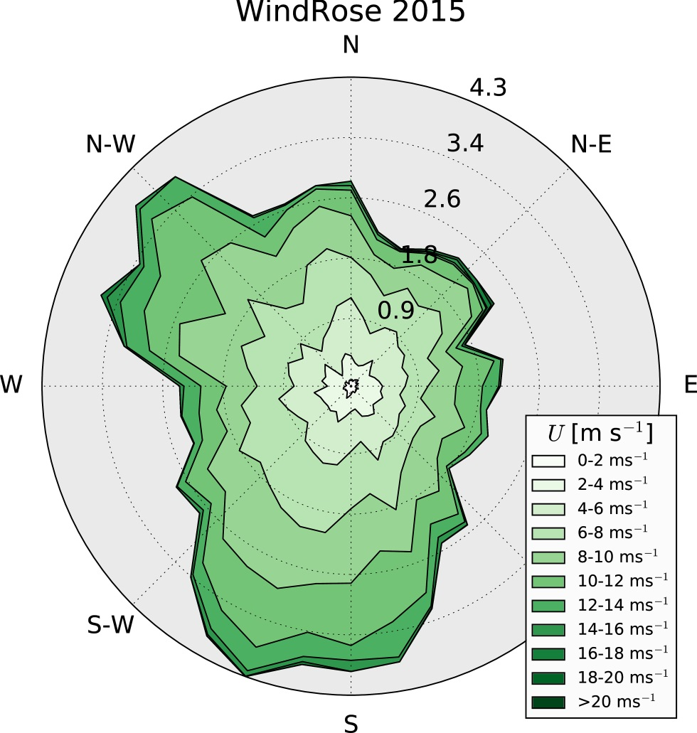
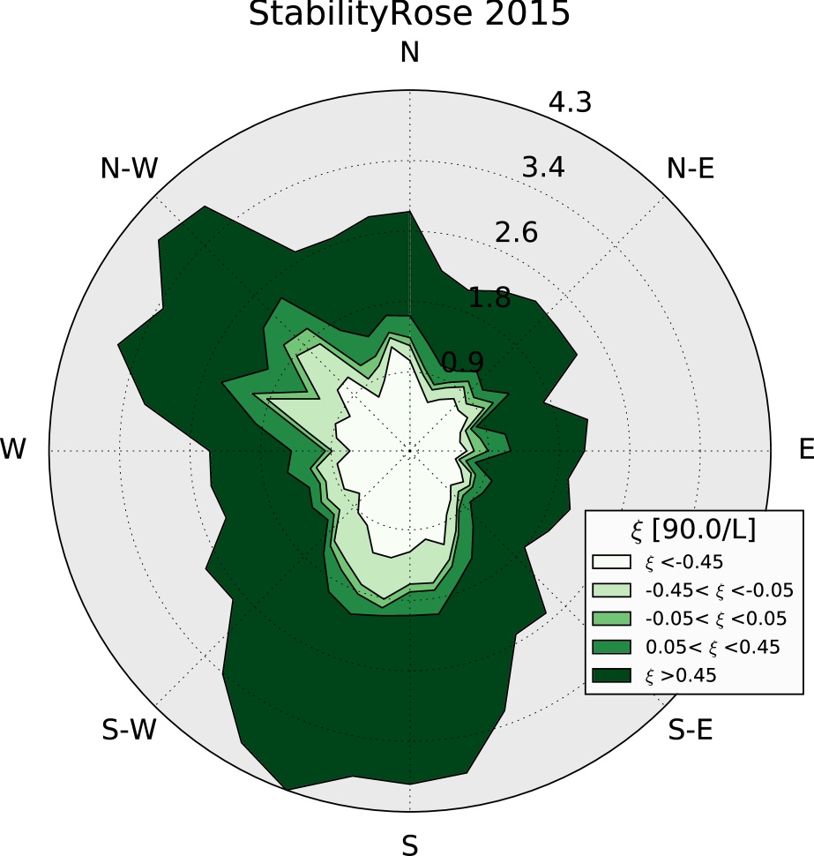
Mesoscale simulation with WRF
Results: Very broad wind and thermal stratification roses (H/MoL)
Notes:
The realistic simulation of loads from the rotor and grid side due to particularly dynamic force application is possible in our nacelle test rig. This test rig is characterized by the combination of mechanical tests with a virtual grid with 44 MVA installed inverter power. The goal in the future is the complete electrical certification of wind turbines on the nacelle test rig.
With this rig, pitch systems and main bearings can also be tested subject to permanent loading. Access to smaller test systems is already available and further test fields are currently being developed.
The issue of the reliability of power electronics for wind turbines is being investigated in a dedicated innovation cluster.

Slide 8
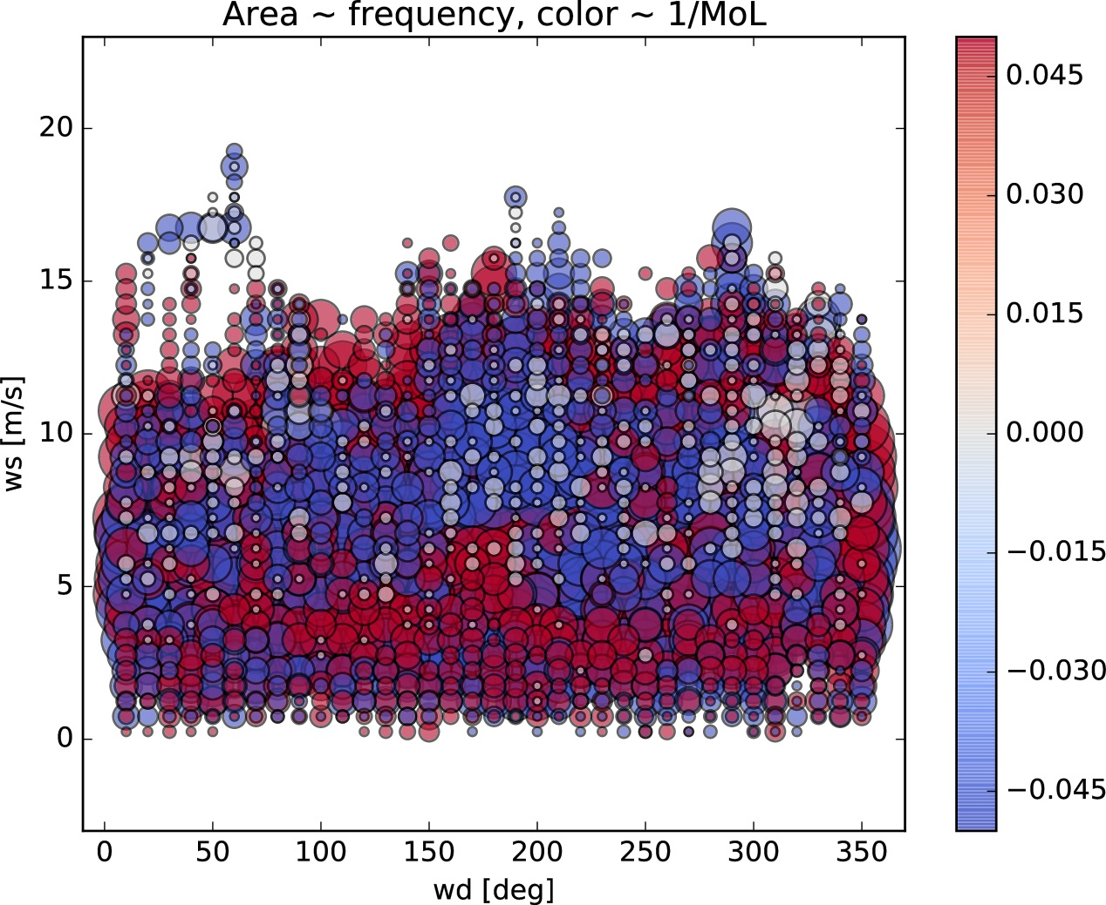
Mesoscale simulation with WRF
Results: Very broad wind and thermal stratification roses (H/MoL)
The whole spectrum contributes
Neutral states (white) are rare
Stratification is significant
Notes:
The realistic simulation of loads from the rotor and grid side due to particularly dynamic force application is possible in our nacelle test rig. This test rig is characterized by the combination of mechanical tests with a virtual grid with 44 MVA installed inverter power. The goal in the future is the complete electrical certification of wind turbines on the nacelle test rig.
With this rig, pitch systems and main bearings can also be tested subject to permanent loading. Access to smaller test systems is already available and further test fields are currently being developed.
The issue of the reliability of power electronics for wind turbines is being investigated in a dedicated innovation cluster.

Slide 9
Content
Motivation
Mesoscale simulation
AEP calculation with CFD
AEP calculation with flapFOAM
Comparision to SCADA data
Summary

Slide 10
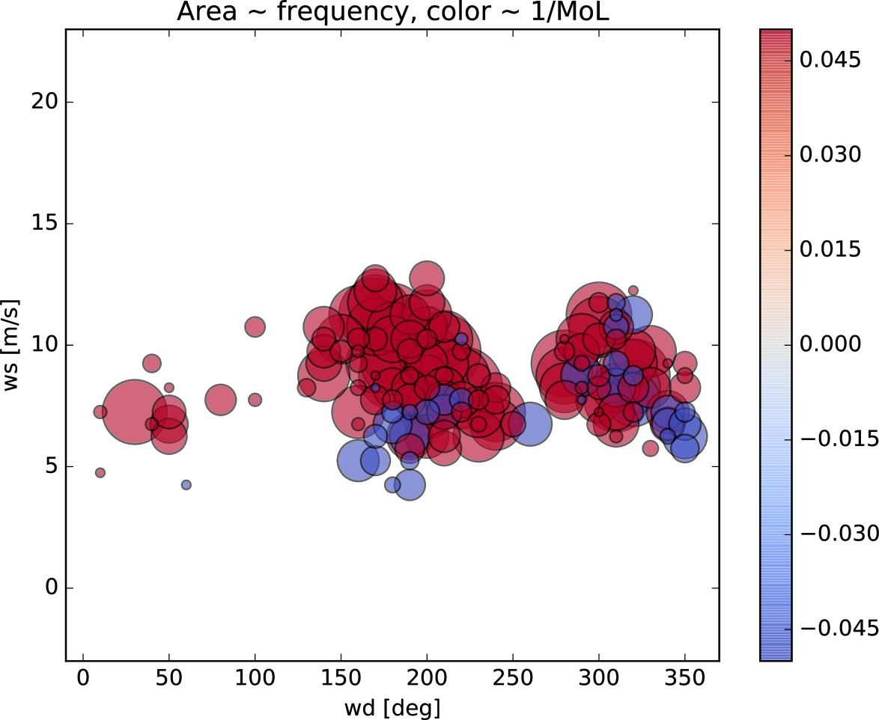
CFD simulation strategy
We fix the total number of simulations to N = 180
First approach: Pick N states with highest frequency
This covers only 35%
Notes:
The realistic simulation of loads from the rotor and grid side due to particularly dynamic force application is possible in our nacelle test rig. This test rig is characterized by the combination of mechanical tests with a virtual grid with 44 MVA installed inverter power. The goal in the future is the complete electrical certification of wind turbines on the nacelle test rig.
With this rig, pitch systems and main bearings can also be tested subject to permanent loading. Access to smaller test systems is already available and further test fields are currently being developed.
The issue of the reliability of power electronics for wind turbines is being investigated in a dedicated innovation cluster.

Slide 11
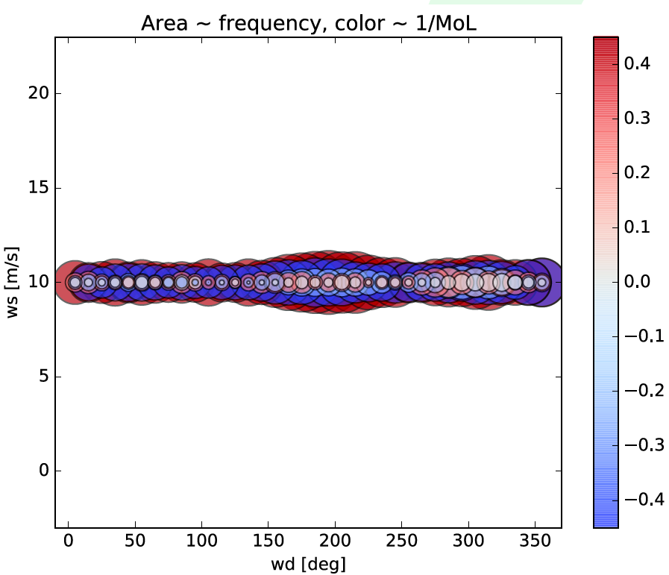
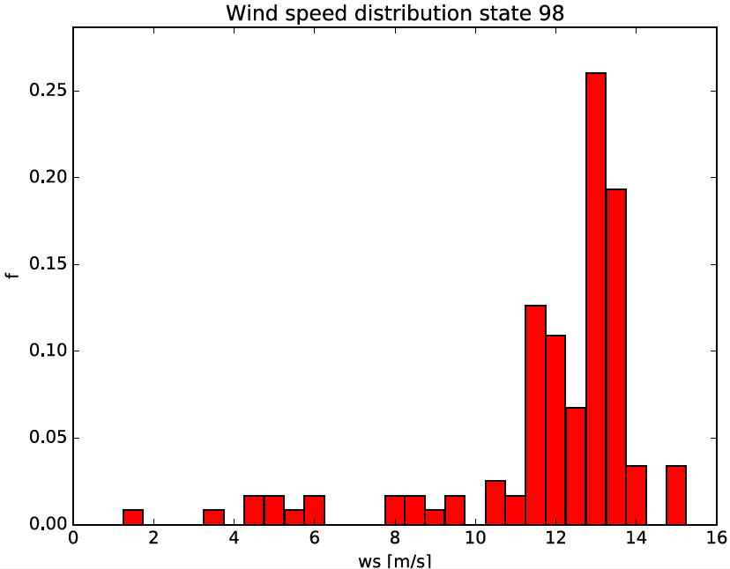
CFD simulation strategy
We fix the total number of simulations to N = 180
New approach: Apply Reynolds-Similarity
Extract wind speed distribution for each sector/stratification state from WRF
Simulate CFD for one wind speed only: v₀ = 10 m/s. Obtain 3D wind field U(x).
Rescale results for all other wind speeds v: U*(x) = v/v₀ U(x)
Notes:
The realistic simulation of loads from the rotor and grid side due to particularly dynamic force application is possible in our nacelle test rig. This test rig is characterized by the combination of mechanical tests with a virtual grid with 44 MVA installed inverter power. The goal in the future is the complete electrical certification of wind turbines on the nacelle test rig.
With this rig, pitch systems and main bearings can also be tested subject to permanent loading. Access to smaller test systems is already available and further test fields are currently being developed.
The issue of the reliability of power electronics for wind turbines is being investigated in a dedicated innovation cluster.

Slide 12
CFD simulation strategy
We fix the total number of simulations to N = 180
New approach: Apply Reynolds-Similarity
Extract wind speed distribution for each sector/stratification state from WRF
Simulate CFD for one wind speed only: v₀ = 10 m/s. Obtain 3D wind field U(x).
Rescale results for all other wind speeds v: U*(x) = v/v₀ U(x)
This is a crude but well-known simplification
Performs well for test cases in complex terrain
Questionable for wake situations
Slope of correlation depends on stability class
Here: Practical solution for broad distribution problem
See PO.211
Notes:
The realistic simulation of loads from the rotor and grid side due to particularly dynamic force application is possible in our nacelle test rig. This test rig is characterized by the combination of mechanical tests with a virtual grid with 44 MVA installed inverter power. The goal in the future is the complete electrical certification of wind turbines on the nacelle test rig.
With this rig, pitch systems and main bearings can also be tested subject to permanent loading. Access to smaller test systems is already available and further test fields are currently being developed.
The issue of the reliability of power electronics for wind turbines is being investigated in a dedicated innovation cluster.

Slide 13
CFD simulation strategy
We fix the total number of simulations to N = 180
Each simulation:
24 cores of FLOW cluster of University of Oldenburg, Germany
Rectangular mesh with 2.3 mio cells, oriented wrt wind direction
In-house thermal RANS solver ablSimpleFoam for OpenFOAM version 2.3.1
Consistent boundary profiles by 1D precursor runs (in-house ablBoundaryFoam)
Wind turbines modelled by uniformly loaded actuator disks
Turbulence model: k-epsilon-fp [van der Laan et al., Wind Energy 2015]
Notes:
The realistic simulation of loads from the rotor and grid side due to particularly dynamic force application is possible in our nacelle test rig. This test rig is characterized by the combination of mechanical tests with a virtual grid with 44 MVA installed inverter power. The goal in the future is the complete electrical certification of wind turbines on the nacelle test rig.
With this rig, pitch systems and main bearings can also be tested subject to permanent loading. Access to smaller test systems is already available and further test fields are currently being developed.
The issue of the reliability of power electronics for wind turbines is being investigated in a dedicated innovation cluster.

Slide 14
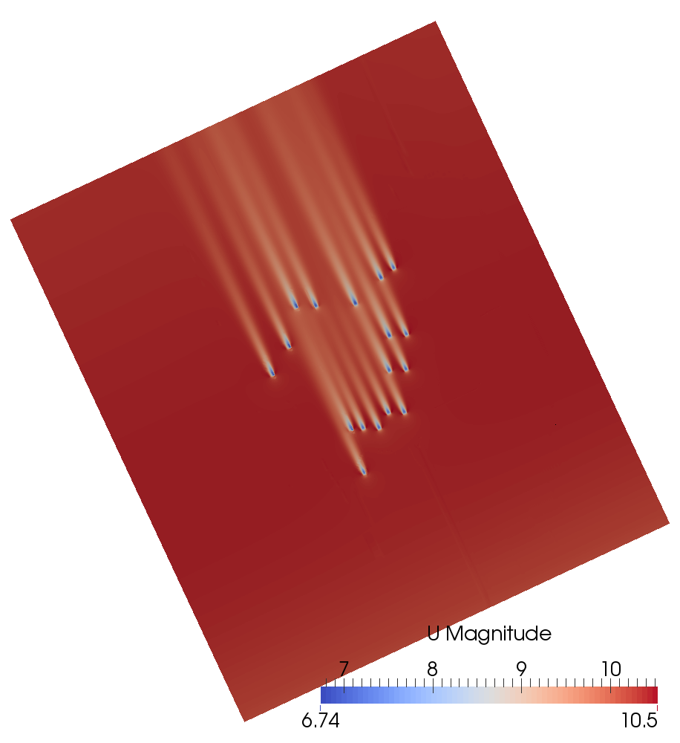
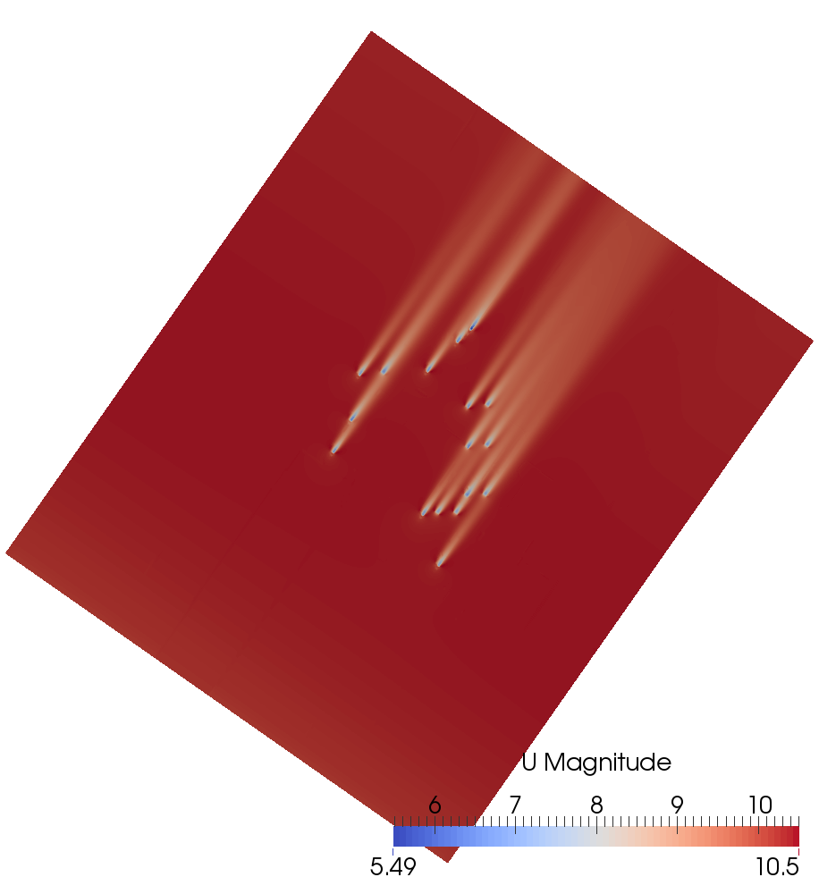
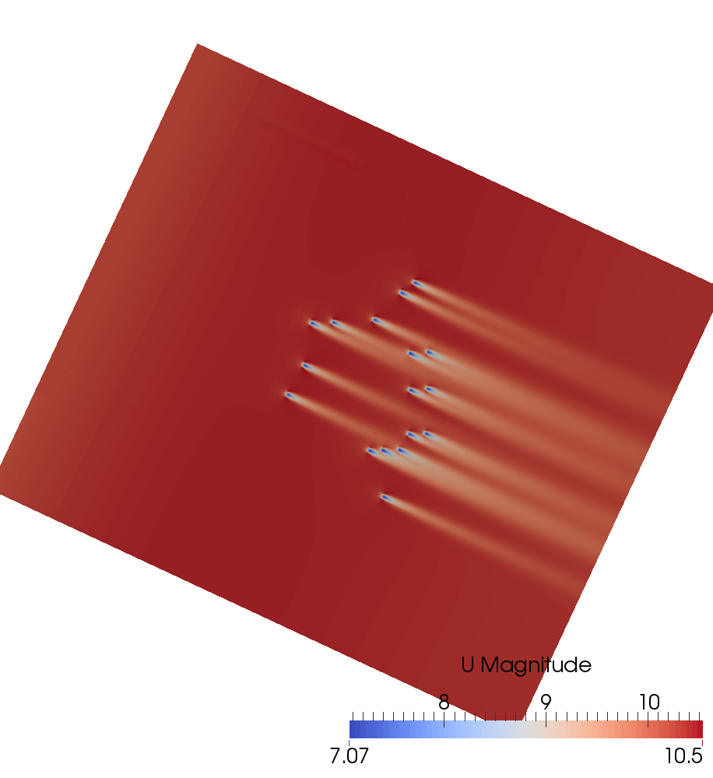
CFD simulation results
State | 76
Wind direction | 155°
MoL | 1e20
State | 106
Wind direction | 215°
MoL | 1e20
State | 146
Wind direction | 295°
MoL | 1e20
Notes:
The realistic simulation of loads from the rotor and grid side due to particularly dynamic force application is possible in our nacelle test rig. This test rig is characterized by the combination of mechanical tests with a virtual grid with 44 MVA installed inverter power. The goal in the future is the complete electrical certification of wind turbines on the nacelle test rig.
With this rig, pitch systems and main bearings can also be tested subject to permanent loading. Access to smaller test systems is already available and further test fields are currently being developed.
The issue of the reliability of power electronics for wind turbines is being investigated in a dedicated innovation cluster.

Slide 15
Content
Motivation
Mesoscale simulation
AEP calculation with CFD
AEP calculation with flapFOAM
Comparision to SCADA data
Summary

Slide 16
[JS EWEA 2014]
[JS EWEA 2015]
[JS TORQUE 2014]
[JS WakeConference 2015]
flapFOAM
flapFOAM is an in-house wake modelling software by IWES
Jensen model, Ainslie model, Larsen model, …
Additionally: Wake models from CFD lookup-tables
Wind farm optimisation via Dakota
New: Inclusion of thermal stratification
effects for arbitrary wake model
flapFOAM is fast: Simulate 2104 states
Notes:
The realistic simulation of loads from the rotor and grid side due to particularly dynamic force application is possible in our nacelle test rig. This test rig is characterized by the combination of mechanical tests with a virtual grid with 44 MVA installed inverter power. The goal in the future is the complete electrical certification of wind turbines on the nacelle test rig.
With this rig, pitch systems and main bearings can also be tested subject to permanent loading. Access to smaller test systems is already available and further test fields are currently being developed.
The issue of the reliability of power electronics for wind turbines is being investigated in a dedicated innovation cluster.

Slide 17
Stability wake transformation
Aim: Transform arbitrary wake model such that it reflects effects of thermal stratification
Restriction to most basic effect: Wakes are more pronounced in stable stratification
Notes:
The realistic simulation of loads from the rotor and grid side due to particularly dynamic force application is possible in our nacelle test rig. This test rig is characterized by the combination of mechanical tests with a virtual grid with 44 MVA installed inverter power. The goal in the future is the complete electrical certification of wind turbines on the nacelle test rig.
With this rig, pitch systems and main bearings can also be tested subject to permanent loading. Access to smaller test systems is already available and further test fields are currently being developed.
The issue of the reliability of power electronics for wind turbines is being investigated in a dedicated innovation cluster.

Slide 18
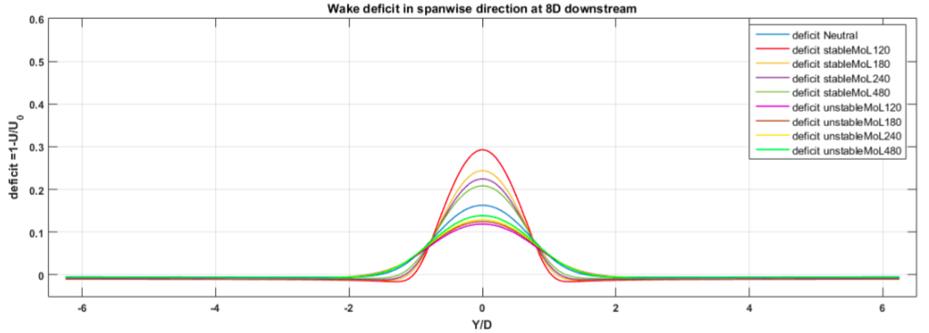
Stability wake transformation
Aim: Transform arbitrary wake model such that it reflects effects of thermal stratification
Restriction to most basic effect: Wakes are more pronounced in stable stratification
Fit Gaussian to CFD, extract change of maximum relativ to neutral case
Notes:
The realistic simulation of loads from the rotor and grid side due to particularly dynamic force application is possible in our nacelle test rig. This test rig is characterized by the combination of mechanical tests with a virtual grid with 44 MVA installed inverter power. The goal in the future is the complete electrical certification of wind turbines on the nacelle test rig.
With this rig, pitch systems and main bearings can also be tested subject to permanent loading. Access to smaller test systems is already available and further test fields are currently being developed.
The issue of the reliability of power electronics for wind turbines is being investigated in a dedicated innovation cluster.

Slide 19
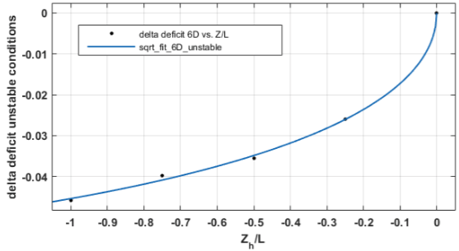
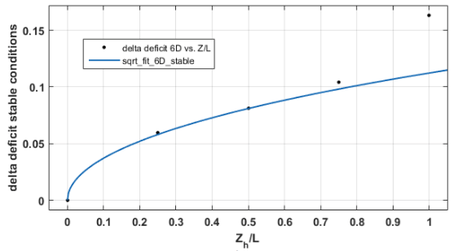
Stability wake transformation
We can fit a function to CFD results of wake deficit changes due to thermal stratification along the centre line
unstable
stable
Notes:
The realistic simulation of loads from the rotor and grid side due to particularly dynamic force application is possible in our nacelle test rig. This test rig is characterized by the combination of mechanical tests with a virtual grid with 44 MVA installed inverter power. The goal in the future is the complete electrical certification of wind turbines on the nacelle test rig.
With this rig, pitch systems and main bearings can also be tested subject to permanent loading. Access to smaller test systems is already available and further test fields are currently being developed.
The issue of the reliability of power electronics for wind turbines is being investigated in a dedicated innovation cluster.

Slide 20
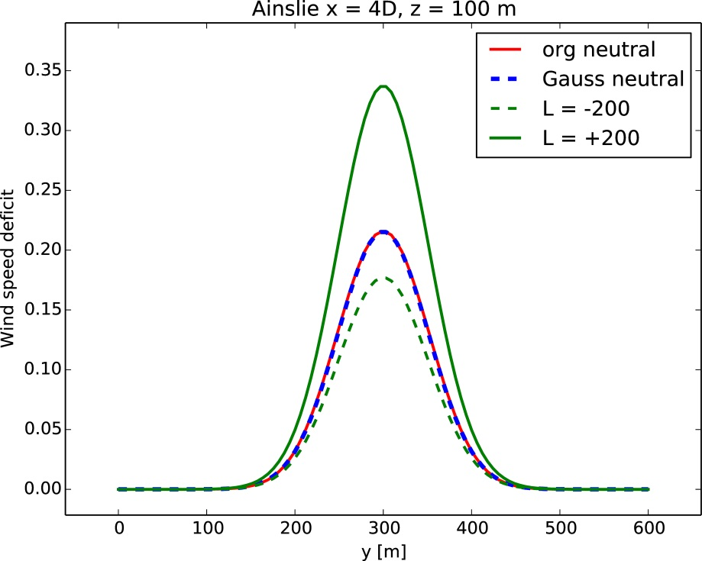
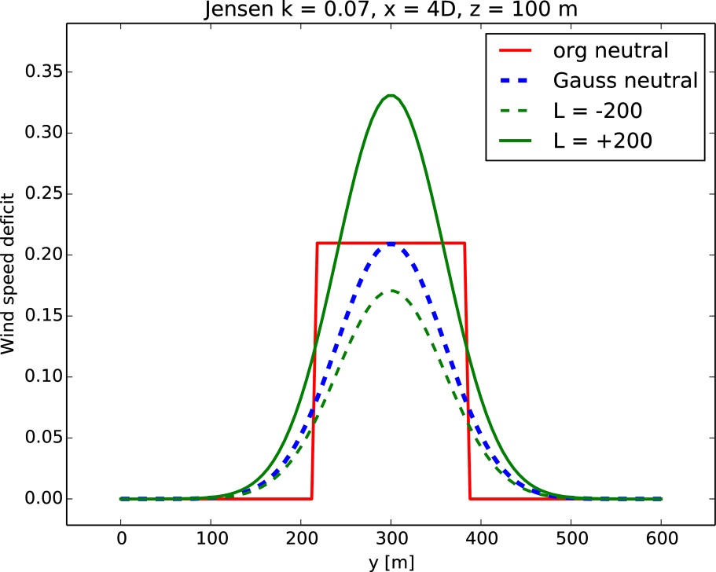
Stability wake transformation
We can fit a function to CFD results of wake deficit changes due to thermal stratification along the centre line
Ainslie
Jensen
Notes:
The realistic simulation of loads from the rotor and grid side due to particularly dynamic force application is possible in our nacelle test rig. This test rig is characterized by the combination of mechanical tests with a virtual grid with 44 MVA installed inverter power. The goal in the future is the complete electrical certification of wind turbines on the nacelle test rig.
With this rig, pitch systems and main bearings can also be tested subject to permanent loading. Access to smaller test systems is already available and further test fields are currently being developed.
The issue of the reliability of power electronics for wind turbines is being investigated in a dedicated innovation cluster.

Slide 21
Content
Motivation
Mesoscale simulation
AEP calculation with CFD
AEP calculation with flapFOAM
Comparision to SCADA data
Summary

Slide 22
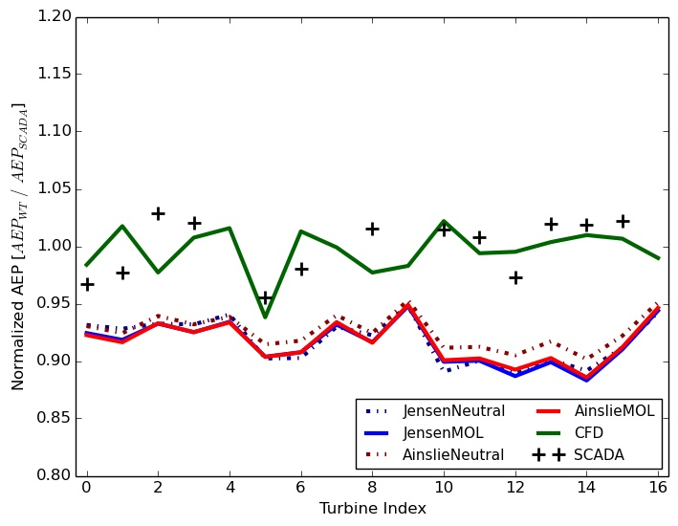
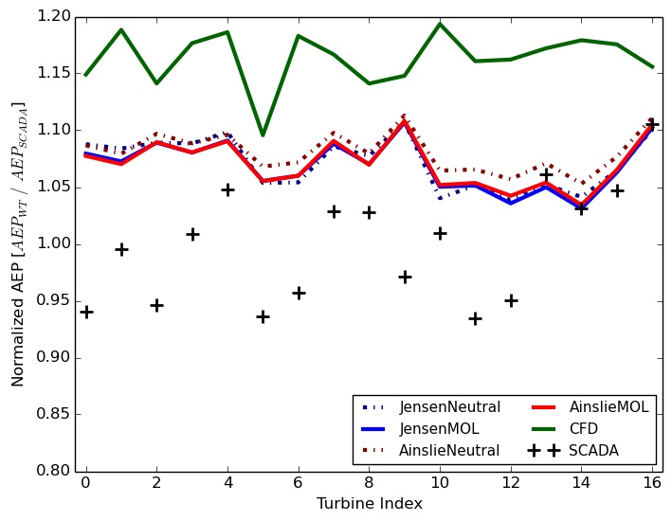
Comparison to SCADA
Two sets of SCADA measurements are available:
2011 – 2014
2015 only, improved status signal
Recall: WRF was run for year 2015
SCADA 2011 - 2014
SCADA 2015
Notes:
The realistic simulation of loads from the rotor and grid side due to particularly dynamic force application is possible in our nacelle test rig. This test rig is characterized by the combination of mechanical tests with a virtual grid with 44 MVA installed inverter power. The goal in the future is the complete electrical certification of wind turbines on the nacelle test rig.
With this rig, pitch systems and main bearings can also be tested subject to permanent loading. Access to smaller test systems is already available and further test fields are currently being developed.
The issue of the reliability of power electronics for wind turbines is being investigated in a dedicated innovation cluster.

Slide 23
Comparison to SCADA
Mean of SCADA AEP shifts between the two sets
Year 2015 data has large error > 20% due to conservative filter
flapFOAM underestimates AEP → Inflow profiles too weak?
SCADA 2011 - 2014
SCADA 2015
Notes:
The realistic simulation of loads from the rotor and grid side due to particularly dynamic force application is possible in our nacelle test rig. This test rig is characterized by the combination of mechanical tests with a virtual grid with 44 MVA installed inverter power. The goal in the future is the complete electrical certification of wind turbines on the nacelle test rig.
With this rig, pitch systems and main bearings can also be tested subject to permanent loading. Access to smaller test systems is already available and further test fields are currently being developed.
The issue of the reliability of power electronics for wind turbines is being investigated in a dedicated innovation cluster.

Slide 24
Content
Motivation
Mesoscale simulation
AEP calculation with CFD
AEP calculation with flapFOAM
Comparision to SCADA data
Summary

Slide 25
Summary
Model chain for AEP simulation with CFD: WRF → 2100 states → select 180 → run CFD → Apply Reynolds similarity → Average results
Model chain for wake modelling code flapFOAM: WRF → 2100 states → run flapFOAM → Average results
The SCADA data set for 2015 has too large error due to strong filter for trustworthy comparison
CFD compares better to SCADA data 2011 – 2014 due to larger sample
flapFOAM underestimates AEP → reason unclear, further work needed
A new thermal wake transformation of wake models was presented, based on comparison to CFD RANS actuator disk simulations. Further validation is needed.
Notes:
The realistic simulation of loads from the rotor and grid side due to particularly dynamic force application is possible in our nacelle test rig. This test rig is characterized by the combination of mechanical tests with a virtual grid with 44 MVA installed inverter power. The goal in the future is the complete electrical certification of wind turbines on the nacelle test rig.
With this rig, pitch systems and main bearings can also be tested subject to permanent loading. Access to smaller test systems is already available and further test fields are currently being developed.
The issue of the reliability of power electronics for wind turbines is being investigated in a dedicated innovation cluster.

Slide 26
Thank You For Your Attention
Any questions?
jonas.schmidt@iwes.fraunhofer.de

Slide 27
Extra slides

Slide 28
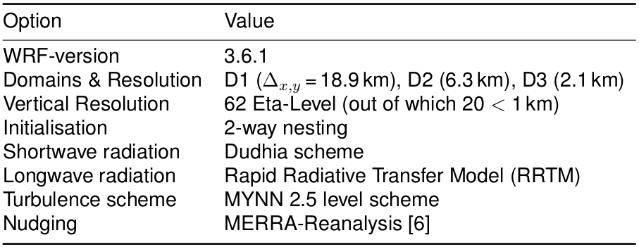
Mesoscale simulation with WRF
The full year 2015 was simulated
3 nested domains: 19.9 km, 6.3 km, 2.1 km
Notes:
The realistic simulation of loads from the rotor and grid side due to particularly dynamic force application is possible in our nacelle test rig. This test rig is characterized by the combination of mechanical tests with a virtual grid with 44 MVA installed inverter power. The goal in the future is the complete electrical certification of wind turbines on the nacelle test rig.
With this rig, pitch systems and main bearings can also be tested subject to permanent loading. Access to smaller test systems is already available and further test fields are currently being developed.
The issue of the reliability of power electronics for wind turbines is being investigated in a dedicated innovation cluster.

Slide 29
Stability wake transformation
In stable stratification, our solver reproduces trapped lee wave pattern behind test ridge
Horizontal velocity component
Vertical velocity component
Notes:
The realistic simulation of loads from the rotor and grid side due to particularly dynamic force application is possible in our nacelle test rig. This test rig is characterized by the combination of mechanical tests with a virtual grid with 44 MVA installed inverter power. The goal in the future is the complete electrical certification of wind turbines on the nacelle test rig.
With this rig, pitch systems and main bearings can also be tested subject to permanent loading. Access to smaller test systems is already available and further test fields are currently being developed.
The issue of the reliability of power electronics for wind turbines is being investigated in a dedicated innovation cluster.

