Slide 1
Environmental Impact of Repowering/Refurbishing Projects – Optimising Outcome in a Levelised Cost of Energy Marketplace
Wind Europe Conference
Hamburg
Date: 29th September2016
Produced By: John Woodruff

Slide 2
Introduction
Natural Power has lead the environmental impact assessment for repowering and tip height increase on projects in the UK
and will present the approach to scoping and delivery as well as
an overview of the holistic approach required for project optimisation.

Slide 3
What are the drivers?
The removal or reduction of subsidy means a levelised cost of energy market, where wind power must compete in the wholesale electricity price market
Drive to reduce costs and increase revenue – must look at both sides of the equation
Operational sites
Repower
Up-Power (retrofit or co-location)
Power-On (life extension)
Holistic approach required in development phase for project optimisation – consider both sides of the equation at all project phases.

Slide 4
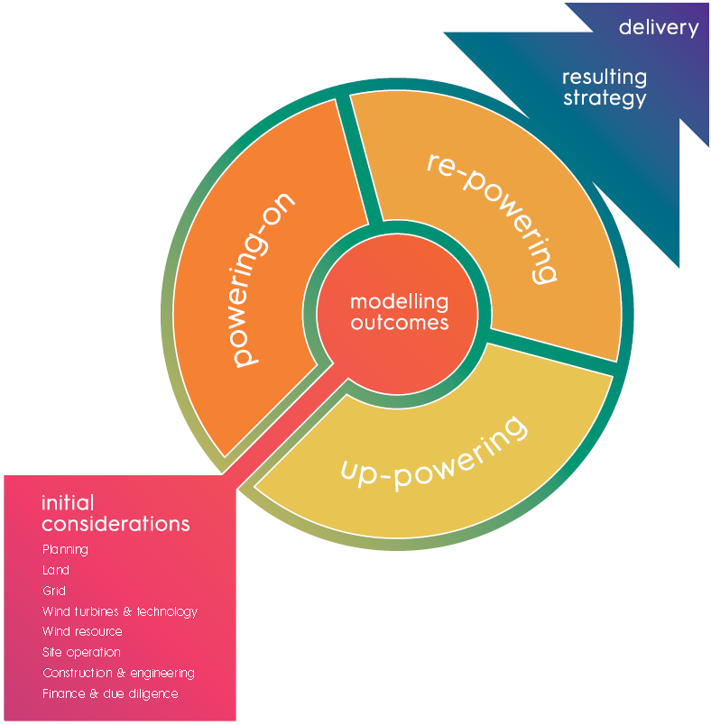
Considerations, modelling, options, outcomes

Slide 5
Redesign to meet LCoE
Increase revenue
Windier Sites – more energy to capture (individual locations within a site)
Better spacing – less wake
Fewer turbines – higher capacity
Higher hubs – less wake, better wind
Longer Blades – more energy capture
= Higher Tips/Different Proportions
Complementary generation (solar) – better use of grid
Storage – better use of grid

Slide 6
Redesign to meet LCoE
Reduce costs
Consent - scope of EIA?
Construction – turbine costs/consent requirements/forestry/existing infrastructure?
Reduce operating costs – Monitoring Requirements?

Slide 7
Approach - In a Levelised Cost of Energy market, planning and environmental constraints and assessment will need to be handled as carefully as the technical engineering and financial modelling of a project, in order to achieve the required permitting of a workable project at a viable cost.
Consider whole project lifecycle – decisions made in development phase are ones you live with for 25 years
It is important to drive down development costs – but not at the expense of CapEx or OpEx
Cost MWhr consented not cost of application/EIA is the metric to measure

Slide 8
EIA Implications
Baseline
Key to establish baseline so as to understand required scope of EIA
May well be less than normal “wish list” from consenting authorities
Focus on changes – eg increased tip height, increased swept area not on repeating assessment of existing impacts
……but do allow for changes to best practice and new areas of concern – e.g. bats or peat
Is existing development time limited? Don’t forget benefits of early removal.

Slide 9
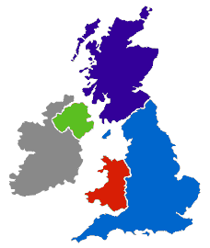
Case Studies

Slide 10
Case Study – Brenig, North Wales
Consented 16 turbine 100m tip
Long delay for grid connection
Taller turbines now consentable (wind farm landscape)
Options
Vary existing consent – cheaper, quicker, risk of additional conditions
New application – additional cost, slower, preserves existing consent
Existing layout could accommodate 10m tip increase without significant redesign

Slide 11
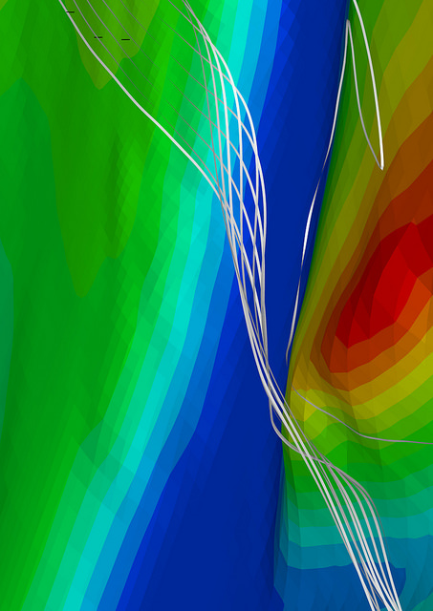
Case Study – Brenig, North Wales
Traffic and transport – longer blades
Noise
Landscape and visual
Collision risk birds/bats – greater swept area
Detailed scoping avoided need for additional surveys/assessment eg wider habitat/peat, socioeconomic, forestry
Wider turbine procurement choice
Increased output 15% depending on turbine selection
Obligation to monitor bats/curtailment

Slide 12
Case Study – Rhyd y Groes, Anglesey
Operational site since 1992
Opportunity to repower – land rights and grid connection
Turbines nearing end of life
Existing consent has no expiry date
Constraints
Extremely constrained – very little “white space”
Proximity to field boundaries (bats)
Adjacent to protected landscape of national significance (designated after wind farm built)
Adjacent to town

Slide 13
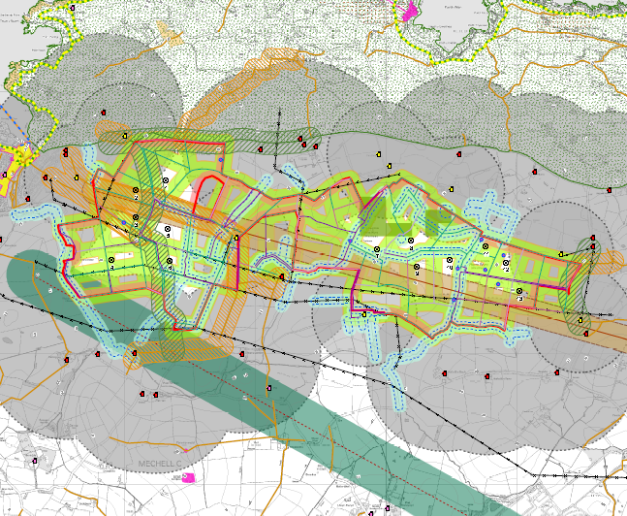
Site Constraints

Slide 14
Case Study – Rhyd y Groes, Anglesey
Full EIA – all usual aspects
Baseline existing wind farm permanent
Replace with repower scheme – fewer, larger turbines – limited life 25 yrs
Landscape and visual - existing scheme unacceptable if new
Key balance of impact on town and protected landscape v benefit of fixed life, cohesive design, slower rotation

Slide 15
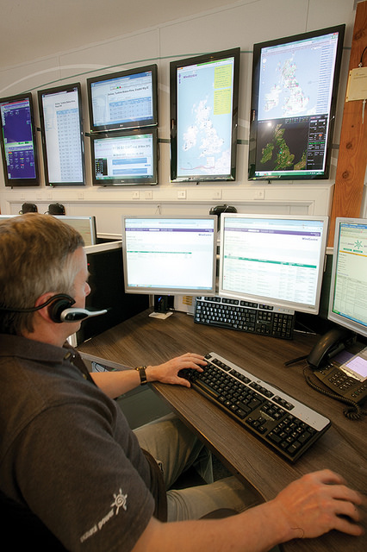
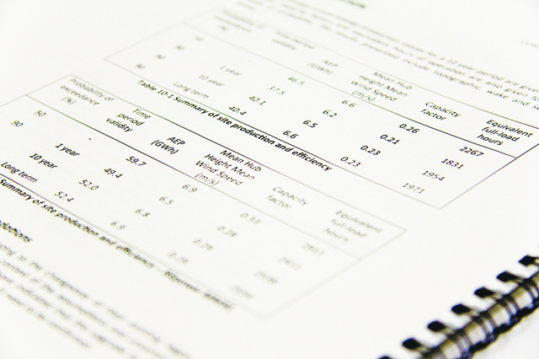
Conclusion
Need to understand…
Environmental impacts arising from a repowering or refurbishment project
The baseline – will differ from greenfield
Financial model – design and permitting can impact 25 years of operational costs!
Cost per MWhr not per application!

