Slide 2
Agenda
X-eptance: The Renewable Energy Acceptance Research Project
The Wind Turbine Noise Database
The Acoustic Camera
First Results
Conclusions

Slide 3
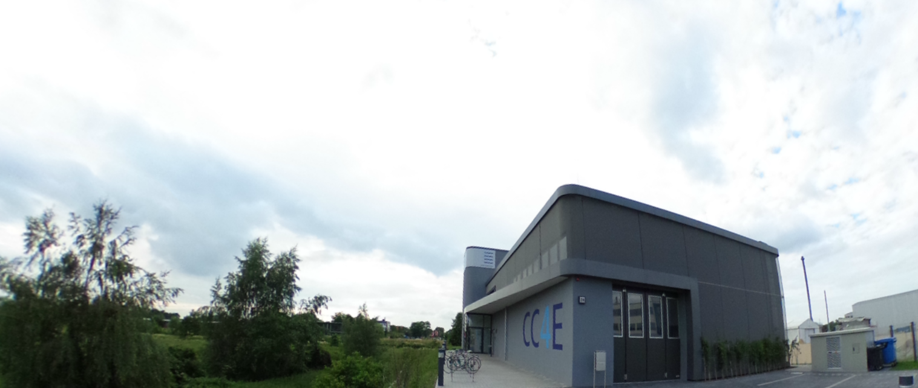
Energy-Campus Hamburg – Wind Laboratory
Environment and Acceptance
Wind Turbine Efficiency
Wind Turbine Operations
Monitoring of wind parks and environment
Wind turbine drive train innovations
Condition Monitoring System (CMS)
Acoustic measurements
Test field for small WEA
Control Room
Bat-Detector
Virtual Reality Lab
Training
CC4E – Competence Centre for Renewable Energy and Energy Efficiency

Slide 4
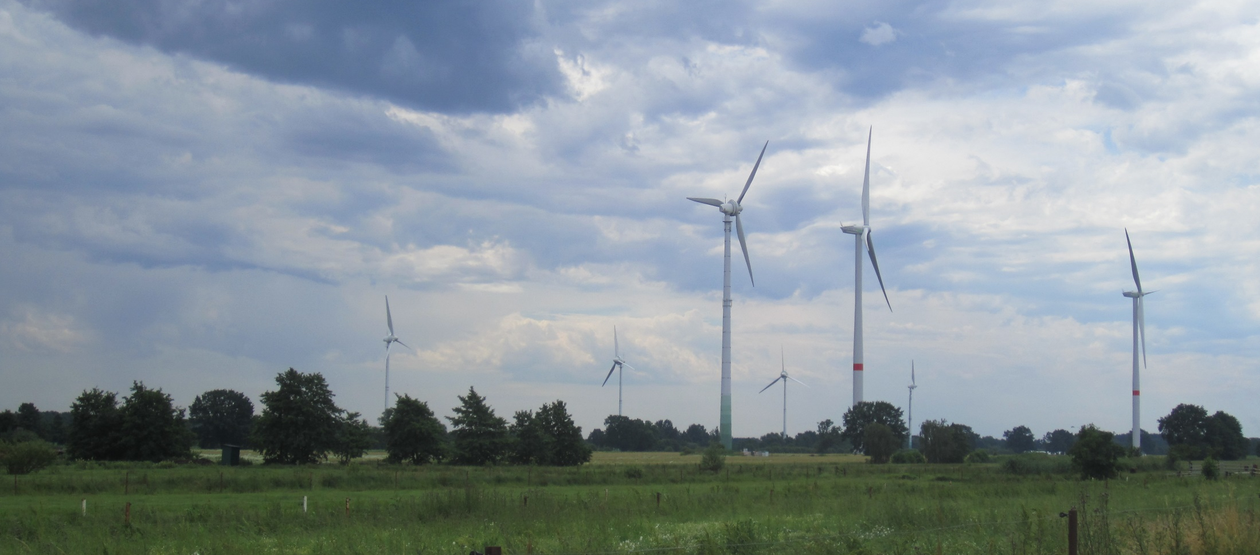
X-eptance: The Wind Turbine Noise Database
Noise measurement and recording with high spatial resolution
Acoustic monitoring of wind turbines and environment
Wind turbine noise database
Reference data for wind turbine health monitoring
Auralisation of wind turbine projects in the neighborhood

Slide 5
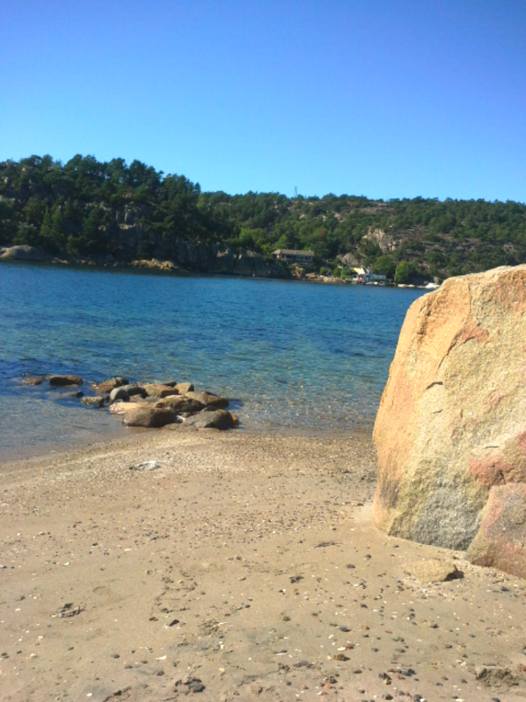
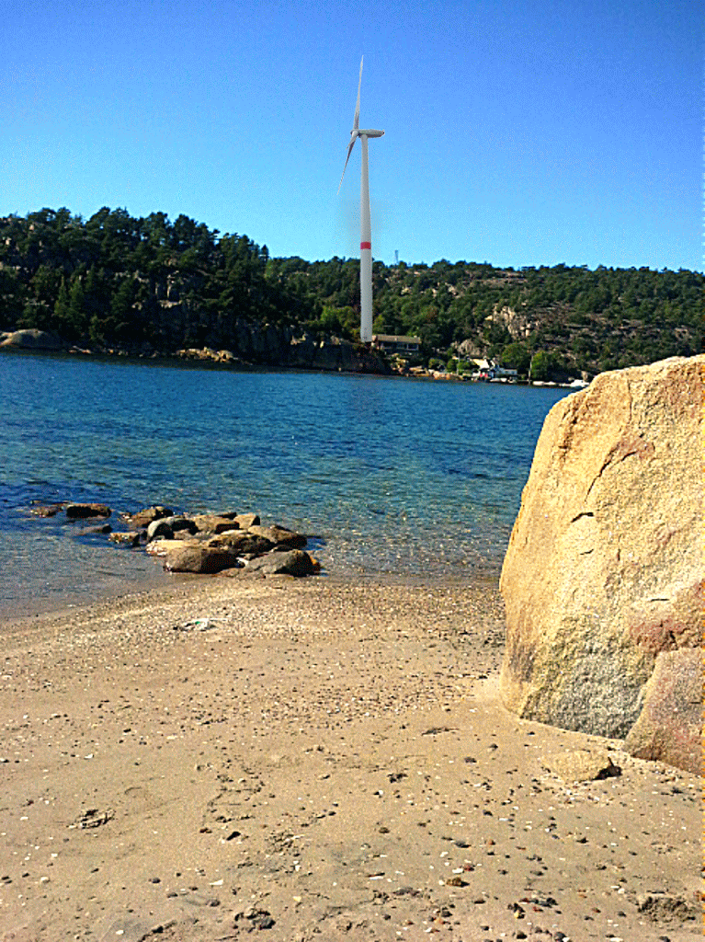
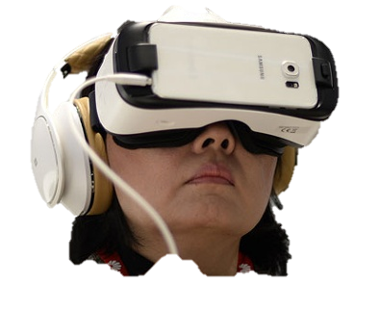
Virtual Reality Simulation of Wind Turbines
[1]

Slide 6
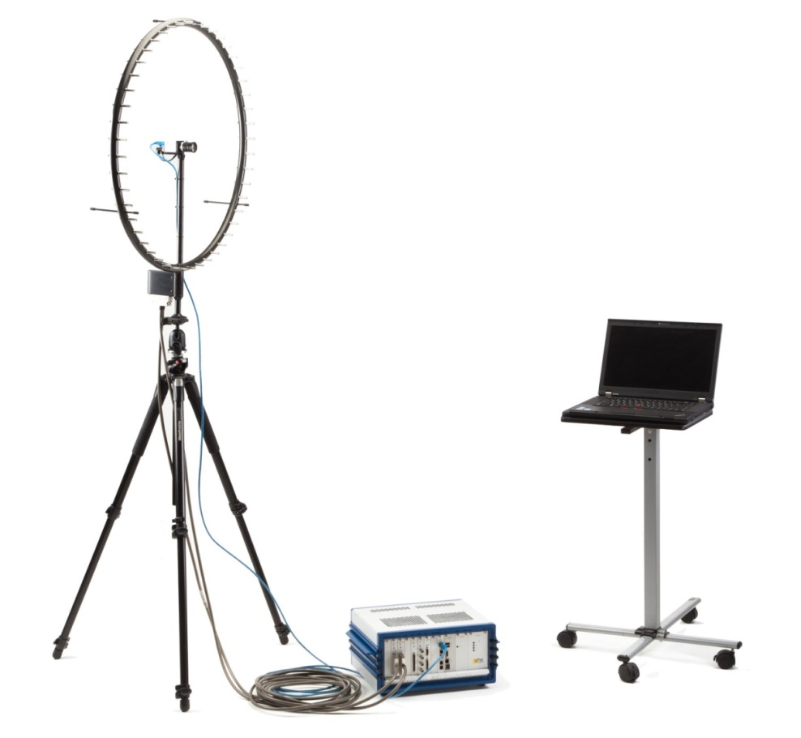
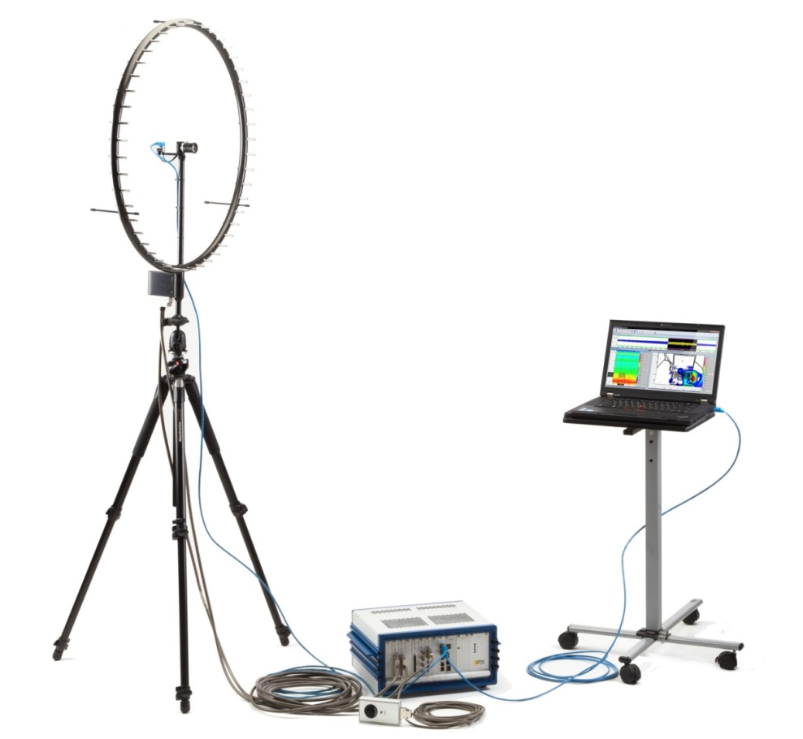
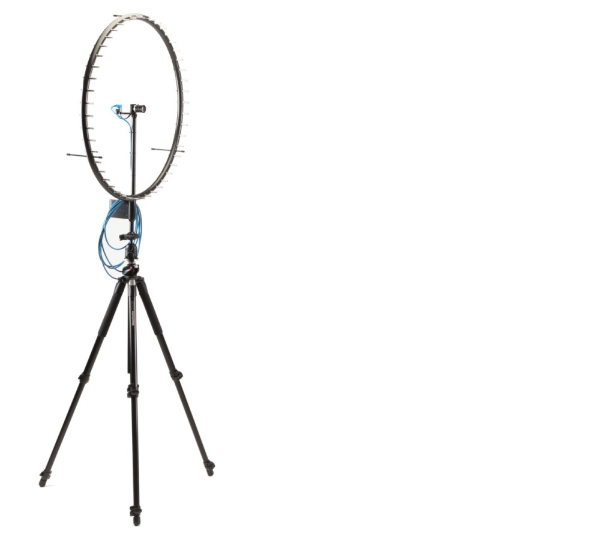
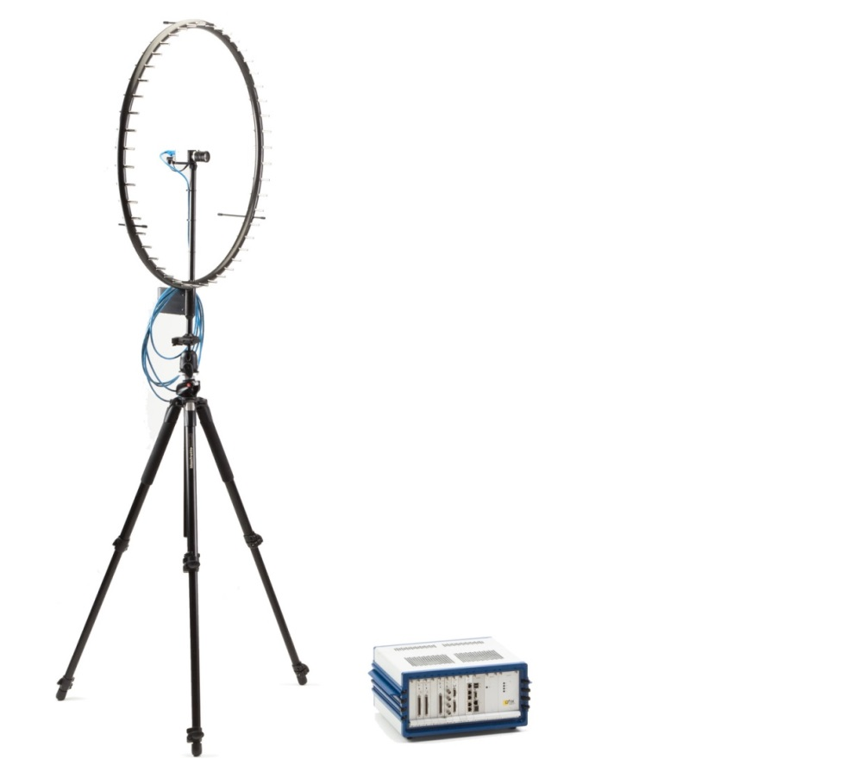
The Acoustic Camera: Sound becomes visible!

Slide 7
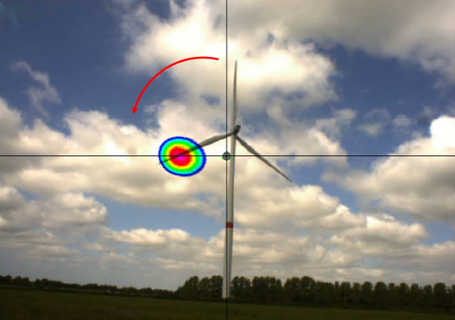
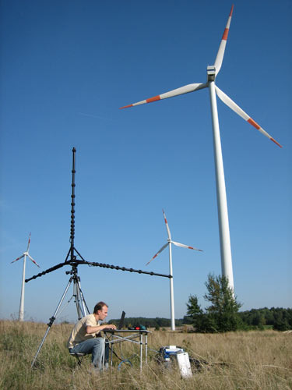
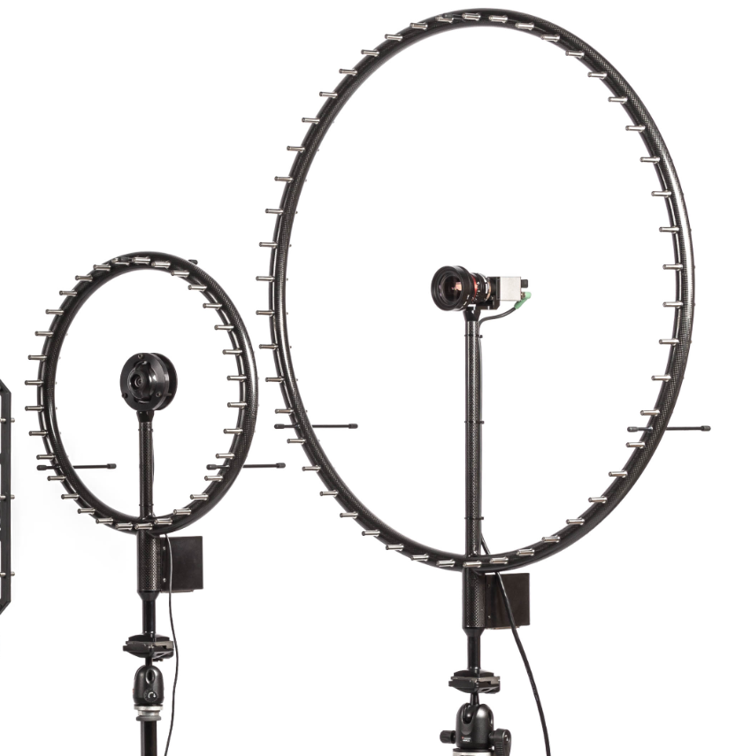
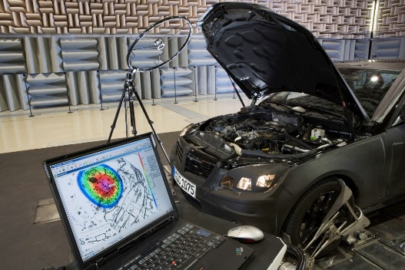
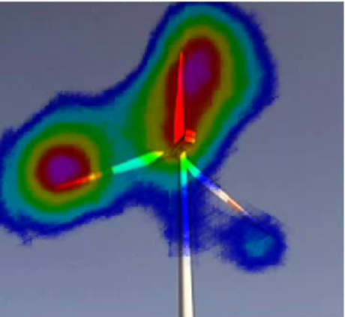
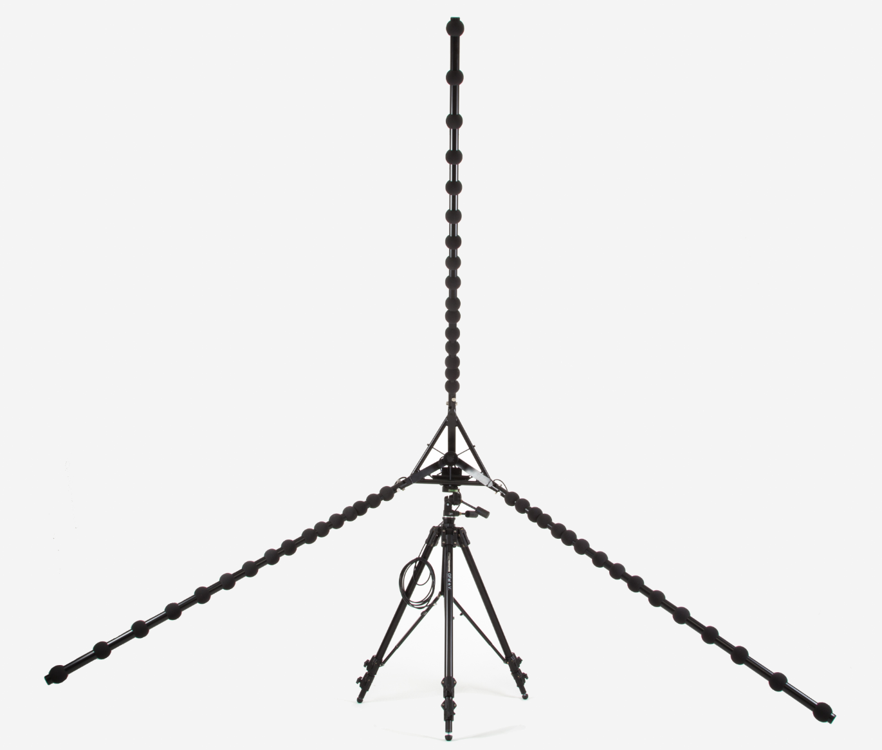
The Acoustic Camera: Sound becomes visible!

Slide 8
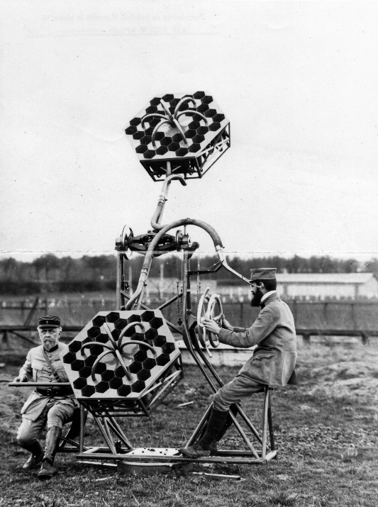
The Acoustic Camera
Delay-and-sum-beamforming:
First experiments in the late 19th and early 20th century
Localization of aircrafts
[2]

Slide 9
The Acoustic Camera
How it works: evaluation of acoustic runtime delays
source
source
left sensor
right sensor
left sensor
right sensor
runtime delay
runtime delay

Slide 10
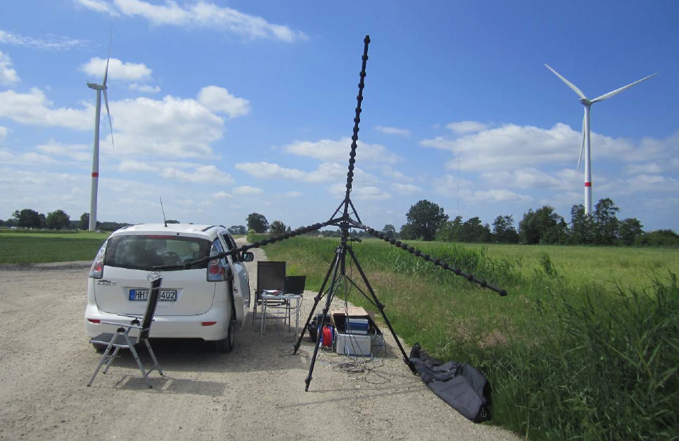
First Measurement Results
Time-domain beamforming of band-filtered signal (100Hz to 8kHz).

Slide 11
Conclusion
The X-eptance Project: wind turbine noise database
Auralization of wind park projects in planning phase
Reference data for wind turbine health monitoring
Increase the acceptance:
Take resident´s concerns seriously
Inform them in advance
Create objectivity and transparency
Maybe give them alternatives
The Acoustic Camera: a tool to make sound visible
First measurement results

Slide 12
Thanks for your attention!
gfai tech GmbH
Michael Kerscher
Benjamin Vonrhein
Volmerstraße 3
D-12489 Berlin
Tel. +49 30 814563-765
Fax. +49 30 814563-755
Mobile. +49 172 6933 -825
www.gfaitech.de
www.acoustic-camera.com
kerscher@gfaitech.de
vonrhein@gfaitech.de
HAW Hamburg
Prof. Dr. Friedrich Ueberle
Dr. Dagmar Rokita
Ulmenliet 20
D-21033 Hamburg
Tel. +49 40 42875-6291
Fax. +49 40 42875-6499
https://www.haw-hamburg.de/cc4e.html
friedrich.ueberle@haw-hamburg.de
dagmar.rokita@haw-hamburg.de

Slide 13
References
[1] http://bilder.t-online.de/b/73/12/64/94/id_73126494/610/tid_da/eine-frau-nutzt-samsungs-3d-brille-gear-vr-.jpg
[2] Gunnar Heilmann, Magdalena Böck, Dirk Döbler: Exploring the limitations and expectations of sound source localization and visualization techniques; InterNoise 2014
All other references by GFaI e.V., gfai tech GmbH and HAW Hamburg

