Slide 1
Generation and validation of spatial distribution of hourly wind speed time-series in cold climates using Machine Learning
Stefano Grassi
WindEurope Summit 2016
28.09.2016

Slide 2
Layout
Introduction
WRA methods
Case study
Icing map
Wind speed and energy production
Results and Conclusions

Slide 3
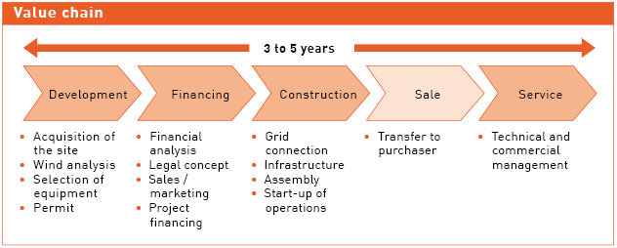
Introduction
Source: PNE Wind
Wind resource assessment is fundamental when selecting a site for wind energy projects since the early stages
Two main methods are used for mesoscale maps of wind resource
Wind flow models, mesoscale weather prediction systems
(geo)statistical and ML methods

Slide 4
Physical Wind Flow Models
Based on physical laws of mass and momentum conservations, or computational fluid-dynamics equations.
Input data: wind speed measurement and geomorphological data
Industry standard
Fairly accurate
Time-consuming and computationally demanding
Source:http://www.deskeng.com

Slide 5
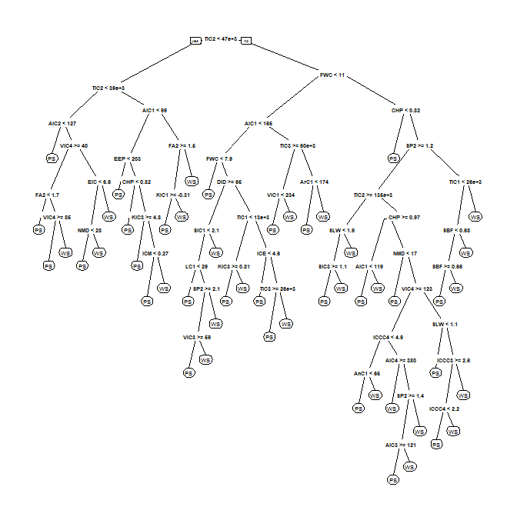
Machine learning based models
Target variable estimated based on its correlation with environmental spatio-temporal covariates (or predictors)
Input data: more wind speed measurements and spatial predictors required
10’000+ predictors used
Generally less accurate
Fast and efficient
Site-specific uncertainty
Joseph Rickert - http://blog.revolutionanalytics.com

Slide 6
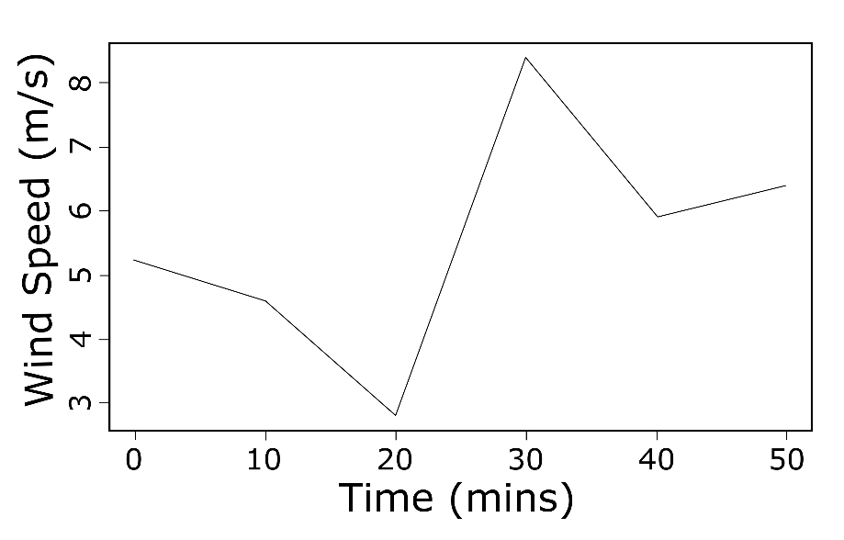
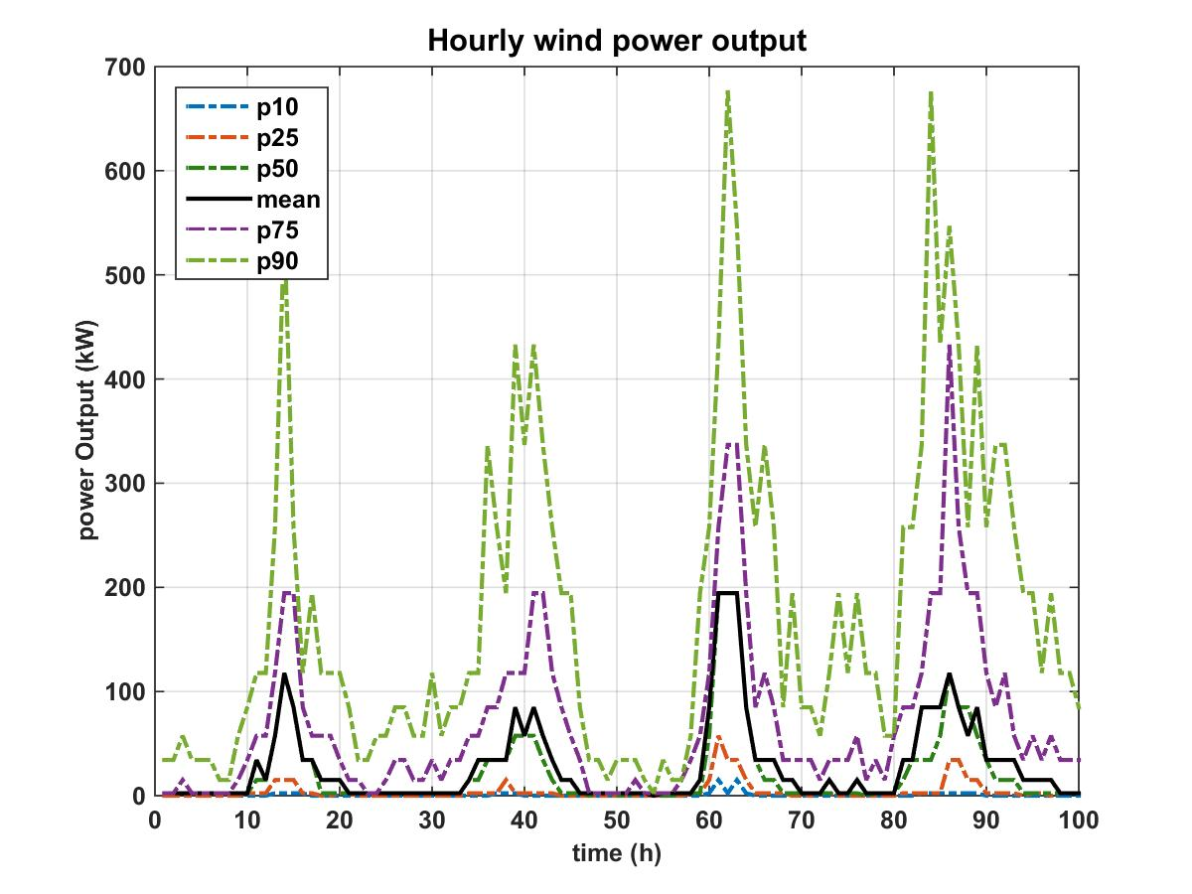
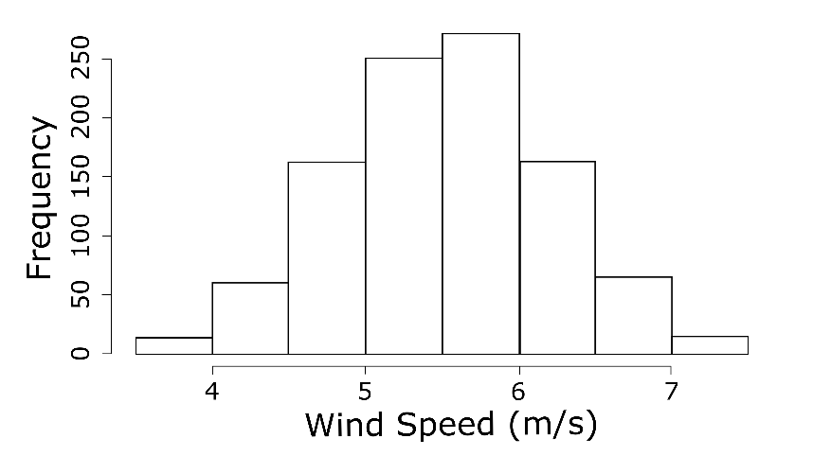
How does the method work?
10 min measurements are resampled to obtain a distribution of likely wind speeds
Data fed into machine learning algorithm
The final output is a time-series with confidence intervals

Slide 7
Study area: icing map
Source: Meteotest
based on raster of cloud water, temperature and wind from COSMO-2,
input of icing algorithm simulating ice mass accretion on rotating cylindric structure
average annual number of instrumental icing below 12 days (≈ 3.2%)
153 weather stations used for WRA
Time resolution: 10min (over 5 years)

Slide 8
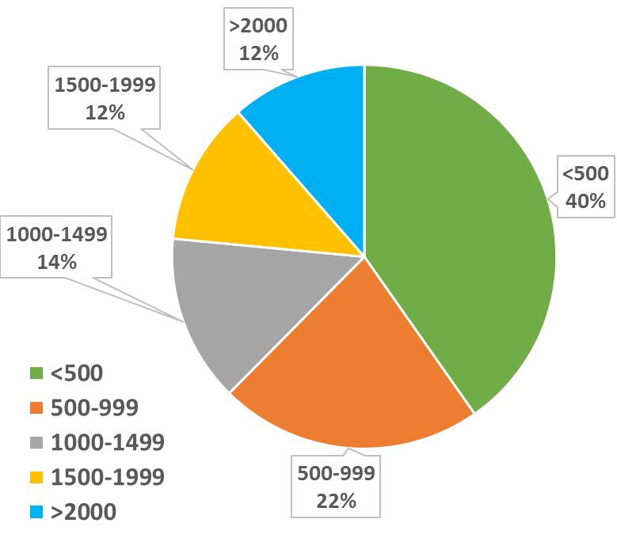
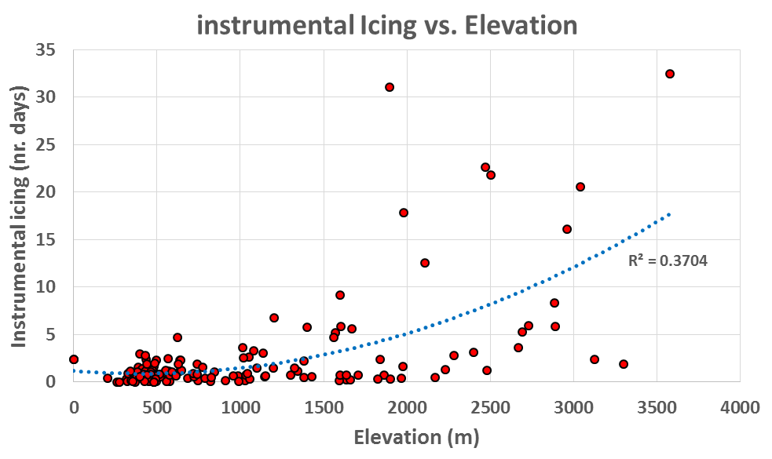
Icing issues on measurements
40% weather stations: < 500m
66% weather stations: < 1000m
Wind parks located below 2000m
Icing generates annual energy losses 0-5%

Slide 9
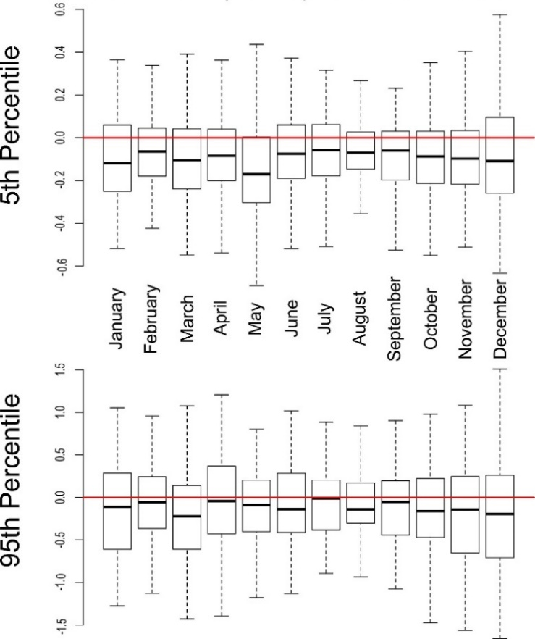
Validation
5-Folds Spatio-Temporal cross-validation
20% of the data excluded from training and used to predict wind speed in a specific time window
Bias distributions (i.e. Difference between observation and estimation), aggregated by month
Variation of bias: P95 > P5
The mean bias is:
P95: -0.11m/s
P5: -0.08m/s

Slide 10
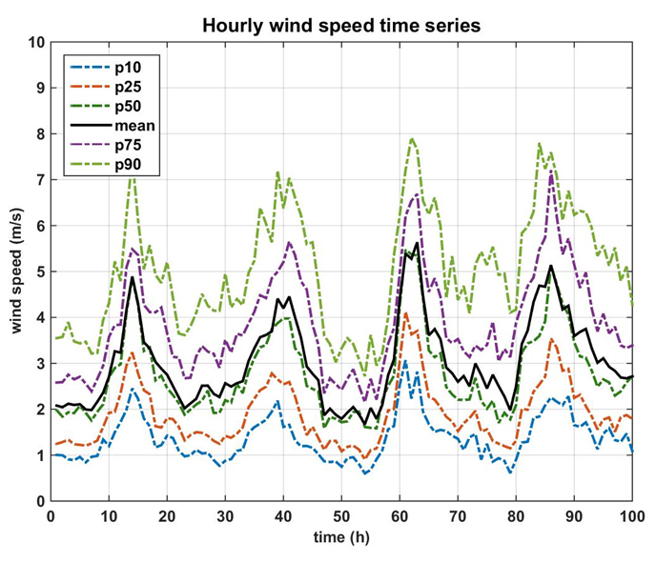
Results: wind speed profile
This method allows estimating:
Spatio-temporal distribution of the wind speed profile
10min → hourly (or greater)
the confidence intervals of wind speed
Wind direction included (but not presented)
Range of variation of long-term wind speed

Slide 11
Result: wind energy production
Estimate of the long-term probabilistic hourly variability of the electricity generation
wind direction → impact of wake effect
Energy losses due to icing effect applied as a function of temperatures profile

Slide 12
Conclusions
Machine learning methods provide spatio-temporal distribution of confidence intervals and measure of uncertainties.
Method applied in Switzerland characterized by alpine climate
Icing generates average annual energy losses up to 5% in alpine regions
Most weather stations and regions suitable for wind farms below 2000m: <10 days instrumental icing
Estimation of the wind speed variability with high temporal resolution.
Validation shows a mean bias of -0.08m/s (P5) and -0.11m/s (P95)
Wind speed profile useful to assess scenarios of long term energy production profiles

Slide 13
Thank you!!
http://www.gis.ethz.ch/

