Slide 1
Frequency Converters in Wind
Stephan Ebner, John Eckerle | ABB Switzerland Ltd | WindEurope Summit 2016 | 27-09-2016
A technical Boon or Bane?

Slide 2
Frequ.-Converters in Wind. A technical Boon or Bane?
Contents of this Presentation
Retrospection to turbines without frequency converters
Improvements to wind turbines using frequency converters
Today’s „must have“ features of wind turbine frequency converters
Additional operation modes of a wind turbine frequency converter
New features of frequency converters in the benefit for the wind turbine and the wind park
Benefits of medium-voltage converters for large offshore turbines

Slide 3
Frequ.-Converters in Wind. A technical Boon or Bane?
Traditional Power Generation
Large power plants utilizing large turbines with large fix speed static-excited synchronous generators Three Gorges Dam in China utilizing 32 turbine sets of 700 MW
Fix speed possible (no converter) because controlled stable primary power flow (steam, gas, water head), often in combination with mechanical turbine features (e.g. guide vane)
Powerfactor/voltage control by excitation
Stable operation, LVRT by mass inertia for easy grid stabilization
Highly reliable and efficient
Nobody is thinking of using a frequency converter in traditional power generation. Having a constant primary energy feed (steam, gas, water) a constant power generation is possible. Generators are DirectOnLine, synchronized with the grid.

Slide 4
Frequ.-Converters in Wind. A technical Boon or Bane?
Positive aspects of power generation w/o frequency converters
Aspect | Status | Reason
Complexity of power generation | Low | No converter, no converter control
CAPEX / OPEX cost | Low | No purchasing and maintenance cost of converter
Availability | Good | No converter = no converter failures
Losses in drivetrain | Low | No converter = no converter losses
Creation of harmonics | Low | No converter = no harmonics creation
Traditional power generation reach good LCOE levels and grid code compliance without utilizing frequency converters.
Notes:
- also space for installtion is required
vice versa: … have to deal with all this topics, that we touch throughout this presentation

Slide 5
Frequ.-Converters in Wind. A technical Boon or Bane?
History of Wind Turbines and use of frequency converters
Fix Speed Turbines
Fix Speed Turbines with resistor
No Converter
1980’s
1980’s
Fix two Speed Turbines
OptiSlip Turbines <20% Var.-Speed
Hydraulic Gear Box Var.-Speed
1980’s-1990’s
1980’s-1990’s
DFIG Turbines ±30% Var.-Speed
1990’s
Var.-Speed Turbines Full Converter Low-Voltage
Var.-Speed Turbines Full Converter Medium-Voltage
2000’s
2010’s

Slide 6
Frequ.-Converters in Wind. A technical Boon or Bane?
History of Wind Turbines and use of frequency converters
Fix Speed Turbines
Fix Speed Turbines with resistor
No Converter
1980’s
1980’s
Fix two Speed Turbines
OptiSlip Turbines <20% Var.-Speed
Hydraulic Gear Box Var.-Speed
1980’s-1990’s
1980’s-1990’s
DFIG Turbines ±30% Var.-Speed
1990’s
Var.-Speed Turbines Full Converter Low-Voltage
Var.-Speed Turbines Full Converter Medium-Voltage
2000’s
2010’s
Notes:
First generations of wind turbines have been built w/o frequency converters, realizing that improvements are needed to improve the performance
The hydraulic gear box type turbine used rarely

Slide 7
Frequ.-Converters in Wind. A technical Boon or Bane?
Negative aspects of turbines w/o frequency converters
Aspect | Status | Reason
Wind turbine yield | Highly improvable | Rarely matching wind-speed/ blade-speed optimum ratio.
Stability in power generation | Critical | Stability at high wind was challenging.
Handling of grid disturbances | Critical | Grid disturbances easily trips the turbine.
Grid support with reactive power | Very limited | Voltage stabilization is not possible.
Decoupling of mech. drivetrain vs. electrical grid | No | Mechanical oscillations hit the grid and vs. grid disturbances hit the mechanics.
Operation of other drivetrain concepts than asynchronous high speed generator | No | Generator frequency must match with grid frequency. Generator is typically a high speed induction generator.
The wind turbines of the 1980/90´s without frequency converters have been facing various drawbacks and limitations. Wind power LCOE far off the traditional power generation.

Slide 8
Frequ.-Converters in Wind. A technical Boon or Bane?
With DFIG wind turbines frequency converters got required
Fix Speed Turbines
Fix Speed Turbines with resistor
1980’s
1980’s
Fix two Speed Turbines
OptiSlip Turbines <20% Var-Speed
Hydraulic Gear Box Var.-Speed
1980’s-1990’s
1980’s-1990’s
DFIG Converter
DFIG Turbines ±30% Var.-Speed
1990’s
Var.-Speed Turbines Full Converter Low-Voltage
Var.-Speed Turbines Full Converter Medium-Voltage
2000’s
2010’s
Notes:
A nice improvement by the DFIG type turbine
The converter is sitting in the generator rotor feedback path connected by slip rings, the generator stator is still hard conected to the grid
The converter power is only a fraction of the turbine power, for ±30% Var-speed about 30% of the turbine power, example 3MW turbine = 1MW converter

Slide 9
Frequ.-Converters in Wind. A technical Boon or Bane?
Aspects of turbines with DFIG converter
Aspect | Status | Reason
Wind turbine yield | Okay | Matching wind speed / blade speed optimum ratio at ±30% of nominal speed.
Stability in power generation | Fair | Power stability at turbine nominal rating is given
Handling of grid disturbances | Okay | Grid disturbances can endanger a turbine trip. Additional crowbar is required.
Grid support with reactive power | Okay | Voltage stabilization is possible within limited converter capability.
Decoupling of mech. drivetrain vs. electrical grid | Okay | Grid disturbances hit mechanic parts.
Operation of other drivetrain concepts than high speed induction generator | No | Drive train concept is «per-se» an asynchronous high speed induction generator.
CAPEX / losses / space / harmonics | to deal with | General drawbacks of using converters are valid.
The DFIG wind turbine achieved a significant step for a better LCOE of wind power. Several drawback and limitation remain and potential for improvement remains.

Slide 10
Frequ.-Converters in Wind. A technical Boon or Bane?
Full power converters open up new possibilities in turbine design
Fix Speed Turbines
Fix Speed Turbines with resistor
1980’s
1980’s
Fix two Speed Turbines
OptiSlip Turbines <20% Var-Speed
Hydraulic Gear Box Var.-Speed
1980’s-1990’s
1980’s-1990’s
DFIG Turbines ±30% Var.-Speed
Full Converter
1990’s
Var.-Speed Turbines Full Converter Low-Voltage
Var.-Speed Turbines Full Converter Medium-Voltage
2000’s
2005´s
Notes:
The converter is sitting in the main power path of the turbine

Slide 11
Frequ.-Converters in Wind. A technical Boon or Bane?
Aspects of turbines with a full converter
Aspect | Status | Reason
Wind turbine yield | Good | Matching wind speed/ blade speed optimum ratio at full range
Stability in power generation | Good | Power stability at full turbine range rating is given.
Handling of grid disturbances | Good | Converter behavior is adjustable (mainly by SW parameters).
Grid support with reactive power | Good | Voltage stabilization is possible within converter capability.
Decoupling of mech. drivetrain vs. electrical grid | Good | Full decoupling of mechanical drivetrain and grid.
Operation of other drivetrain concepts | Yes | Low-speed (direct drive) and mid-speed generators, also with synchronous generators (e.g. PMG) gets possible.
CAPEX / losses / space / harmonics | to deal with | General drawbacks of using converters are valid
Further important improvements are achieved by using the full power converter. Various new drivetrain designs became possible, e.g. the use of efficient permanent magnet generators and the full utilization of the turbine speed range to further reduce the LCOE of wind power.

Slide 12
Frequ.-Converters in Wind. A technical Boon or Bane?
A frequency converters is a key component in each wind turbine
No Converter
DFIG Converter
Full Converter
The wind turbines of the 1980/90´s without frequency converters have been facing various drawbacks and limitations. Wind power LCOE far off the classical power generation.
The DFIG wind turbine achieved a significant step for a better LCOE of wind power. Several drawback and limitation remain and still have potential for improvement.
Further important improvements are achieved by using the full power converter. Various new drivetrain designs became possible, e.g. the use of efficient permanent magnet generators and the full utilization of the turbine speed range to further reduce the LCOE of wind power.
The performance and the achieved LCOE level of present wind turbines only becomes possible by using frequency converters.

Slide 13
Frequ.-Converters in Wind. A technical Boon or Bane?
Standard Features of a Full Converter Drivetrain Design
Full Power Curve Utilization
Fully Var.-Speed 0-100% Increased Turbine Yield
Drivetrain Decoupling Generator / Grid
No load chages at LVRT Brake Resistor power burn
Various Drivetrain Concepts possible
Perm. Magnet Generator
Low-Speed (Direct) Drive Medium-Speed Drive
Stable Grid Operation Grid Stabilization Grid Code Compliant
Reactive Power Supply
September 27, 2016
WindEurope Summit 2016 | Hamburg
Notes:
Going into the key features of a full-power converter (low-voltage or medium voltage)

Slide 14
Frequ.-Converters in Wind. A technical Boon or Bane?
Standard Features of a Full Converter Drivetrain Design
Full Power Curve Utilization
Fully Var.-Speed 0-100% Increased Turbine Yield
Drivetrain Decoupling Generator / Grid
No load chages at LVRT Brake Resistor power burn
Various Drivetrain Concepts possible
Perm. Magnet Generator
Low-Speed (Direct) Drive Medium-Speed Drive
Stable Grid Operation Grid Stabilization Grid Code Compliant
Reactive Power Supply
September 27, 2016
WindEurope Summit 2016 | Hamburg

Slide 15
Frequ.-Converters in Wind. A technical Boon or Bane?
Standard Features of a Full Converter Drivetrain Design
Full Power Curve Utilization
Fully Var.-Speed 0-100% Increased Turbine Yield
Drivetrain Decoupling Generator / Grid
No load changes at LVRT Brake Resistor power burn
Various Drivetrain Concepts possible
Perm. Magnet Generator
Low-Speed (Direct) Drive Medium-Speed Drive
Stable Grid Operation Grid Stabilization Grid Code Compliant
Reactive Power Supply
September 27, 2016
WindEurope Summit 2016 | Hamburg
Notes:
The DC-Link in the converter (see picture: one side generator/other side step-up transformer) is decoupling the mechanical and the electrical side
A constant generator torque set point is applied by the gen.-side converter
A brake chopper and a brake resistor is connected to the DC-link
A rating of the brake resistor shall pick up the active power of two consequent LVRTs (about 6 sec), if designed too small then the generator torque is released that could result in a turbine over speed

Slide 16
Frequ.-Converters in Wind. A technical Boon or Bane?
Standard Features of a Full Converter Drivetrain Design
Full Power Curve Utilization
Fully Var.-Speed 0-100% Increased Turbine Yield
Drivetrain Decoupling Generator / Grid
No load chages at LVRT Brake Resistor power burn
Various Drivetrain Concepts possible
Perm. Magnet Generator
Low-Speed (Direct) Drive Medium-Speed Drive
Stable Grid Operation Grid Stabilization Grid Code Compliant
Reactive Power Supply
September 27, 2016
WindEurope Summit 2016 | Hamburg
Notes:
DFIG was only possible with asynchronous generators (high speed), now many more concepts are possible
Permanent magnet generators increase the turbine efficiency
The low-speed (direct) drive eliminates the gear box. Also low electrical frequencies must be considered in converter design, in general possible down to 5Hz

Slide 17
Frequ.-Converters in Wind. A technical Boon or Bane?
Standard Features of a Full Converter Drivetrain Design
Full Power Curve Utilization
Fully Var.-Speed 0-100% Increased Turbine Yield
Drivetrain Decoupling Generator / Grid
No load chages at LVRT Brake Resistor power burn
Various Drivetrain Concepts possible
Perm. Magnet Generator
Low-Speed (Direct) Drive Medium-Speed Drive
Stable Grid Operation Grid Stabilization Grid Code Compliant
Reactive Power Supply
September 27, 2016
WindEurope Summit 2016 | Hamburg
Notes:
Full power converters allow full grid control

Slide 18
Frequ.-Converters in Wind. A technical Boon or Bane?
Operation modes of a state-of-the-art full converter
Production Mode
Opt. Generator Operation
Grid code compliance
Active drive train damping
Grid resonance prevention
Motor Mode
Rotor Positioning
Drivetrain Hall Test
Back-to-Back Test
StatCOM Mode
Standby Grid Stabilization
Grid Loss Mode
Island Operation
Self-supply of aux. power
September 27, 2016
WindEurope Summit 2016 | Hamburg

Slide 19
Frequ.-Converters in Wind. A technical Boon or Bane?
Operation modes of a state-of-the-art full converter
Production Mode
Opt. Generator Operation
Grid code compliance
Active drive train damping
Grid resonance prevention
Motor Mode
Rotor Positioning
Drivetrain Hall Test
Back-to-Back Test
StatCOM Mode
Standby Grid Stabilization
Grid Loss Mode
Island Operation
Self-supply of aux. power
September 27, 2016
WindEurope Summit 2016 | Hamburg
Notes:
Production Mode is the normal operation mode of a converter
Active drive train damping is a converter feature that can be switched if desired to stabililize low-frequency mechanial resonances of the wind turbine

Slide 20
Frequ.-Converters in Wind. A technical Boon or Bane?
Operation modes of a state-of-the-art full converter
Production Mode
Opt. Generator Operation
Grid code compliance
Active drive train damping
Grid resonance prevention
Motor Mode
Rotor Positioning
Drivetrain Hall Test
Back-to-Back Test
StatCOM Mode
Standby Grid Stabilization
Grid Loss Mode
Island Operation
Self-supply of aux. power
September 27, 2016
WindEurope Summit 2016 | Hamburg

Slide 21
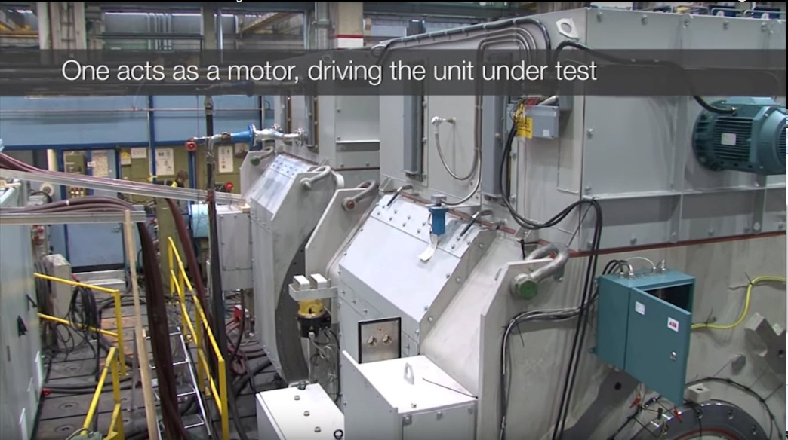
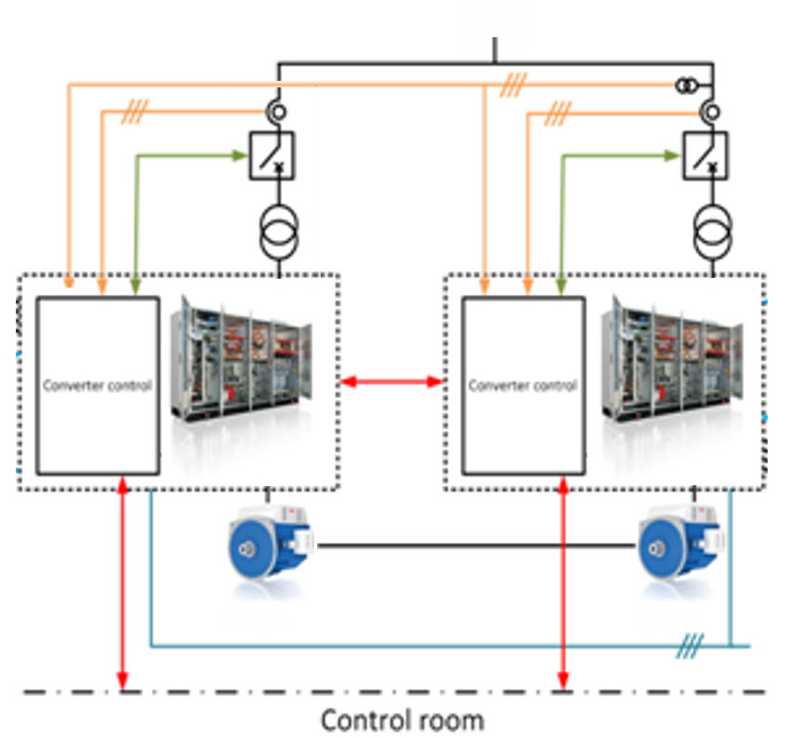
Frequ.-Converters in Wind. A technical Boon or Bane?
Use the Converter in Motor Mode for Back-to-Back testing
G
M
Using the wind turbine converter for test purpose One converter drives generator as a motor - a second converter generates the power back to the grid
Used for design verification of generator (temp.-rise, efficiency, harmonics, vibration, …)
Used for wind turbine routine test at production
WindEurope Summit 2016 | Hamburg

Slide 22
Frequ.-Converters in Wind. A technical Boon or Bane?
Operation modes of a state-of-the-art full converter
Production Mode
Opt. Generator Operation
Grid code compliance
Active drive train damping
Grid resonance prevention
Motor Mode
Rotor Positioning
Drivetrain Hall Test
Back-to-Back Test
StatCOM Mode
Standby Grid Stabilization
Grid Loss Mode
Island Operation
Self-supply of aux. power
September 27, 2016
WindEurope Summit 2016 | Hamburg
Notes:
Volatge stabilization (Supress voltage or support voltage by acting as STATCOM device) → Phase Shift

Slide 23
Frequ.-Converters in Wind. A technical Boon or Bane?
Operation modes of a state-of-the-art full converter
Production Mode
Opt. Generator Operation
Grid code compliance
Active drive train damping
Grid resonance prevention
Motor Mode
Rotor Positioning
Drivetrain Hall Test
Back-to-Back Test
StatCOM Mode
Standby Grid Stabilization
Grid Loss Mode
Island Operation
Self-supply of aux. power
September 27, 2016
WindEurope Summit 2016 | Hamburg

Slide 24
Frequ.-Converters in Wind. A technical Boon or Bane?
Grid Loss System. How does the Island Mode work?
UPS required for start of Island Mode
Pitch Control sets rotor speed.
Converter generates as much power as needed (Island Mode).
UPS will be recharged by the wind turbine.
UPS feeds auxiliary power in case of calm wind
Main and auxiliary circuit breaker are closed during Island Mode operation
Missing grid connection leave installed wind turbines without auxiliary power supply | w/o Island Mode: diesel generators provide auxiliary power but high CAPEX and OPEX
The converter creates auxiliary power directly from the wind turbine generator w/o the need for an extra diesel generator. Wind power reputation as “Green Power remains Green”
September 27, 2016
WindEurope Summit 2016 | Hamburg

Slide 25
Frequ.-Converters in Wind. A technical Boon or Bane?
Additional features of a state-of-the-art full converter
Active Drivetrain Damping Counter Torque Injection
Vibration Damping
Mech. Stress Reduction
Internal or ext. Control
Optimized Pulse Pattern Effective Filtering
Free Harmonic Location
Clear Resonance Areas
Filterless Design Avoiding Grid Resonances
Eliminating Filter Losses
Reducing Footprint Space
Resonance Prevention Passive Harm. Behavior
No Resonance Amplif.
September 27, 2016
WindEurope Summit 2016 | Hamburg

Slide 26
Frequ.-Converters in Wind. A technical Boon or Bane?
Additional features of a state-of-the-art full converter
Active Drivetrain Damping Counter Torque Injection
Vibration Damping
Mech. Stress Reduction
Internal or ext. Control
Optimized Pulse Pattern Effective Filtering
Free Harmonic Location
Clear Resonance Areas
Filterless Design Avoiding Grid Resonances
Eliminating Filter Losses
Reducing Footprint Space
Resonance Prevention Passive Harm. Behavior
No Resonance Amplif.
September 27, 2016
WindEurope Summit 2016 | Hamburg

Slide 27
Frequ.-Converters in Wind. A technical Boon or Bane?
Active drive train damping reduces turbine stress
Turbines without drive train damping
When operating the converter with a constant torque reference several wind turbines components may add oscillations to the drive train which are observable in the generator speed.
Turbine with active drive train damping
The active damping is done by adding a damping torque to the generators reference torque. Consequently the generator speed gets stabilized. The damping itself then is done by the specific current controller in the closed loop converter control.
T_Ref = torque reference
w_act = actual generator speed
The active drive train damping reduces stress on mechanical drive train and therefore increase turbines reliability
September 27, 2016
WindEurope Summit 2016 | Hamburg

Slide 28
Frequ.-Converters in Wind. A technical Boon or Bane?
Additional features of a state-of-the-art full converter
Active Drivetrain Damping Counter Torque Injection
Vibration Damping
Mech. Stress Reduction
Internal or ext. Control
Optimized Pulse Pattern Effective Filtering
Free Harmonic Location
Clear Resonance Areas
Filterless Design Avoiding Grid Resonances
Eliminating Filter Losses
Reducing Footprint Space
Resonance Prevention Passive Harm. Behavior
No Resonance Amplif.
September 27, 2016
WindEurope Summit 2016 | Hamburg

Slide 29
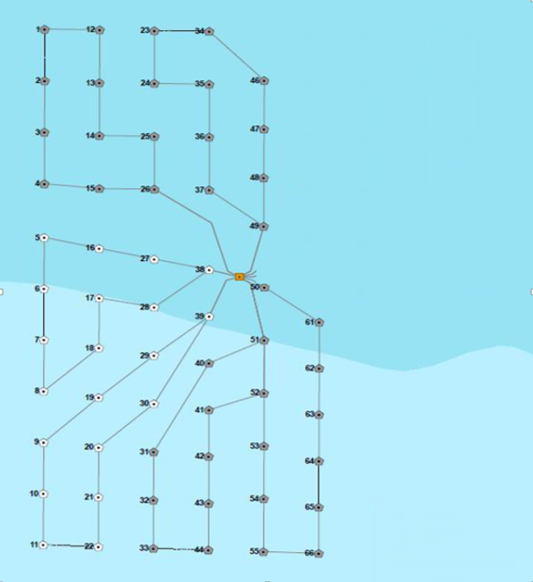
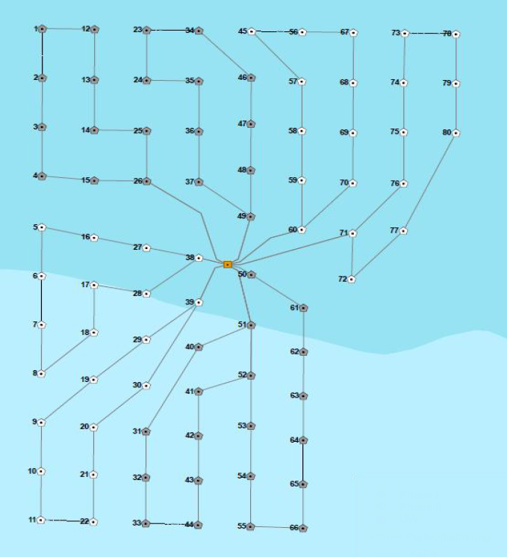
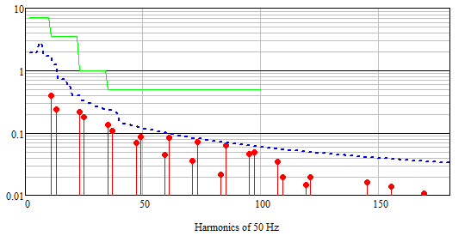
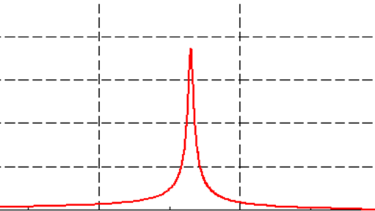
Frequ.-Converters in Wind. A technical Boon or Bane?
OPP Control adapts harmonics to grid impedance situation
Power converters create harmonics into the grid.
Turbine Converter (+HVDC)
Cables, transformers and filter banks introduce resonance poles into the collection grid.
OPP and resonance prevention mitigate the risk of harmonic amplification in the collection grid
September 27, 2016
WindEurope Summit 2016 | Hamburg
Notes:
Passives Verhalten: im Text erwähnen

Slide 30
Frequ.-Converters in Wind. A technical Boon or Bane?
Additional features of a state-of-the-art full converter
Active Drivetrain Damping Counter Torque Injection
Vibration Damping
mech. Stress Reduction
Internal or ext. Control
Optimized Pulse Pattern Effective Filtering
Free Harmonic Location
Clear Resonance Areas
Filterless Design Avoiding Grid Resonances
Eliminating Filter Losses
Reducing Footprint Space
Resonance Prevention Passive Harm. Behavior
No Resonance Amplif.
September 27, 2016
WindEurope Summit 2016 | Hamburg

Slide 31
Frequ.-Converters in Wind. A technical Boon or Bane?
Additional features of a state-of-the-art full converter
Active Drivetrain Damping Counter Torque Injection
Vibration Damping
Mech. Stress Reduction
Internal or ext. Control
Optimized Pulse Pattern Effective Filtering
Free Harmonic Location
Clear Resonance Areas
Filterless Design Avoiding Grid Resonances
Eliminating Filter Losses
Reducing Footprint Space
Resonance Prevention Passive Harm. Behavior
No Resonance Amplif.
September 27, 2016
WindEurope Summit 2016 | Hamburg

Slide 32
Frequ.-Converters in Wind. A technical Boon or Bane?
History of Wind Turbines and use of frequency converters
Fix Speed Turbines
Fix Speed Turbines with resistor
1980’s
1980’s
Fix two Speed Turbines
OptiSlip Turbines <20% Var-Speed
Hydraulic Gear Box Var.-Speed
1980’s-1990’s
1980’s-1990’s
DFIG Turbines ±30% Var.-Speed
Full Converter
1990’s
Var.-Speed Turbines Full Converter Low-Voltage
Var.-Speed Turbines Full Converter Medium-Voltage
2000’s
2005´s

Slide 33
Frequ.-Converters in Wind. A technical Boon or Bane?
Further benefits using the medium-voltage drivetrain technology
Availability Low Part Count
Fuseless Design
High MTBF
Less Maintenance
Size High Power Density
Small Footprint
Tower Location
Efficiency Efficient Semiconductors
Filterless Design
Low Cable Losses
Cabling
Small Currents
Savings on Cabling
Easy Tower Installation
WindEurope Summit 2016 | Hamburg

Slide 34
Frequ.-Converters in Wind. A technical Boon or Bane?
Further benefits using the medium-voltage drivetrain technology
Availability Low Part Count
Fuseless Design
High MTBF
Less Maintenance
Size High Power Density
Small Footprint
Tower Location
Efficiency Efficient Semiconductors
Filterless Design
Low Cable Losses
Cabling
Small Currents
Savings on Cabling
Easy Tower Installation
September 27, 2016
WindEurope Summit 2016 | Hamburg

Slide 35
Frequ.-Converters in Wind. A technical Boon or Bane?
Further benefits using the medium-voltage drivetrain technology
Availability Low Part Count
Fuseless Design
High MTBF
Less Maintenance
Size High Power Density
Small Footprint
Tower Location
Efficiency Efficient Semiconductors
Filterless Design
Low Cable Losses
Cabling
Small Currents
Savings on Cabling
Easy Tower Installation
WindEurope Summit 2016 | Hamburg

Slide 36
Frequ.-Converters in Wind. A technical Boon or Bane?
Further benefits using the medium-voltage drivetrain technology
Availability Low Part Count
Fuseless Design
High MTBF
Less Maintenance
Size High Power Density
Small Footprint
Tower Location
Efficiency Efficient Semiconductors
Filterless Design
Low Cable Losses
Cabling
Small Currents
Savings on Cabling
Easy Tower Installation
September 27, 2016
WindEurope Summit 2016 | Hamburg

Slide 37
Frequ.-Converters in Wind. A technical Boon or Bane?
Further benefits using the medium-voltage drivetrain technology
Availability Low Part Count
Fuseless Design
High MTBF
Less Maintenance
Size High Power Density
Small Footprint
Tower Location
Efficiency Efficient Semiconductors
Filterless Design
Low Cable Losses
Cabling
Small Currents
Savings on Cabling
Easy Tower Installation
September 27, 2016
WindEurope Summit 2016 | Hamburg

Slide 38
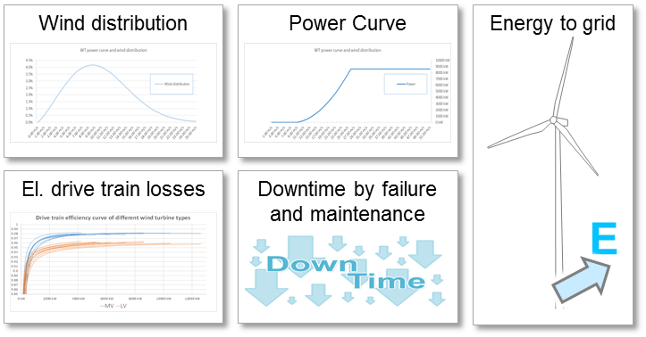
Frequ.-Converters in Wind. A technical Boon or Bane?
Result of ABB’s drivetrain study: MV drivetrains provide more energy to grid and lowering LCOE
¹) 3L/4.1kV converter with med.-speed PMG; ²) 3L/3.3kV converter with med.-speed PMG ; ³) Based on German FIT
 | 4MW¹ | 5MW² | 6MW² | 7MW² | 8MW² | 10MW² | 12MW²
Energy production MV drivetrain to grid [GWh/y] | 18.3 | 23.0 | 27.6 | 32.2 | 37.6 | 46.0 | 55.2
Discounted LCOE using MV drivetrain [€ct/kWh] ³ | 15.2 | 14.7 | 14.1 | 13.5 | 12.7 | 12.1 | 11.8
Using a medium-voltage drivetrain technology cause a substantial lowering of LCOE in large scale offshore wind power generator
September 27, 2016
WindEurope Summit 2016 | Hamburg

Slide 39
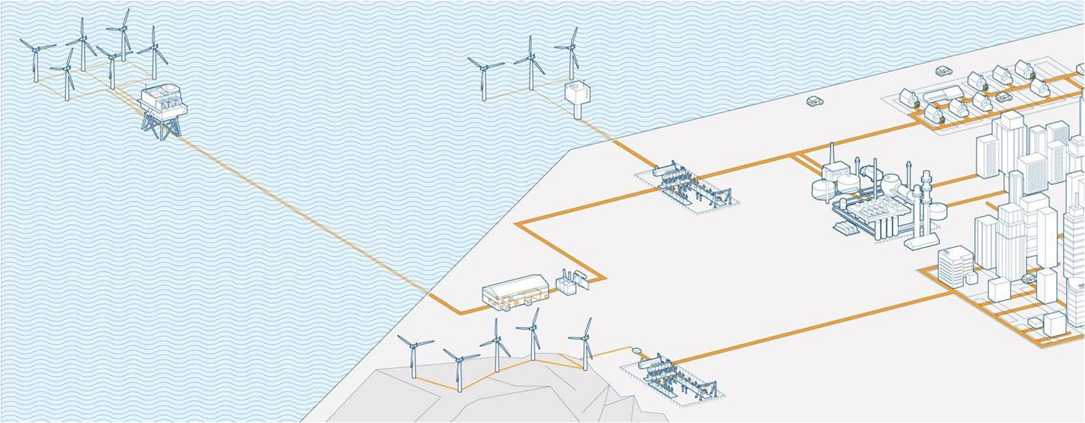
Frequ.-Converters in Wind. A technical Boon or Bane?
ABB deliveries from A to Z into the wind industry
Asset management
Substation automation and power quality optimization solutions
Collection grid products
HVAC cables
Offshore HVDC converter station
HVDC cables
Offshore AC substation
Communication
Solutions, wind
power plant control
HVDC Light
HVDC cables
PLC
Converters
Motors
Generators
Substation for onshore wind power plants
Control and network
management: SCADA,
EMS, GMS
Generators
Switchgears
Transformers
EMS: Energy Management System
GMS: Generation Mangement System
HVAC: High-voltage Alternating Current
HVDC: High-voltage Direct Current
PLC: Programmable Logic Controller
SCADA: Supervisory Control And Data Acquisition
September 27, 2016
WindEurope Summit 2016 | Hamburg

Slide 40
Frequ.-Converters in Wind. A technical Boon or Bane?
Thank you !!
Stephan Ebner and John Eckerle
ABB Switzerland
5300 Turgi
stephan.ebner@ch.abb.com john.eckerle@ch.abb.com
September 27, 2016
WindEurope Summit 2016 | Hamburg

