Slide 1
Wind-Farm-Scale Measurements Using Mobile-Based LiDAR
M. Zendehbad, N. Chokani, R.S. Abhari
ETH Zurich, Switzerland
WindEurope Summit 2016
27 September 2016

Slide 2
Overview
Introduction
Objectives
Approach
Results
Conclusions

Slide 3
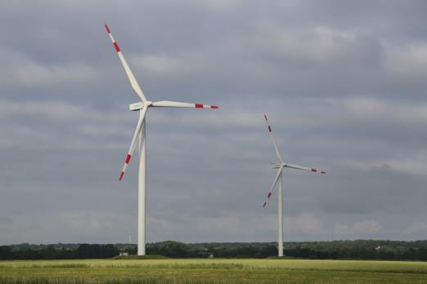
Introduction
Wind turbines operating in wakes result in upto 20% losses in wind farms
Higher turbulence in wakes results in increased maintenance of wind turbines (Zendehbad et al., Renewable Energy, 2016)
As wind and water tunnels do not simulate all full-scale non-dimensionals, field measurements of wakes and their impact are necessary.

Slide 4
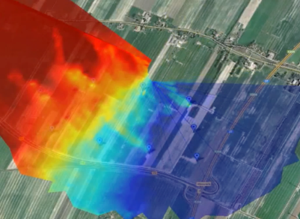
Operational Limitations Hinder Wide-Spread Usage of LiDARs
LiDARs measure line-of-sight component (LOS) of wind speed
In previous work, authors demonstrated wind-farm-scale measurements of LOS wind speed using single LiDAR
Present work extends method to wind-farm-scale measurements of 2D wind field
Wind
Radial speed (m/s)
-8 8
Line-of-sight direction
200m
Wind
Zendehbad et al., J. Solar E. Engineering, 2016

Slide 5
Objectives
Demonstrate mobile-based LiDAR measurements of Cartesian velocity field on scale of wind farm
Quantify impacts of wake on wind farm performance

Slide 6
Mobile Laboratory Equipped with LiDAR
Custom-built mobile laboratory, windRoverII, designed at ETH and equipped with 3D scanning LiDAR system to measure wind field
LiDAR
- line-of-sight wind speed
- azimuth and elevation angles
LiDAR head
Magnetic sensor
- heading
Dual-axis tilt sensor
- attitude
Data acquisition and control unit
- Data assimilation and processing
- Wind velocity vector
LiDAR system
Model | Galion LRI
Accuracy | 0.25m/s
Angular resolution | 0.1º
GPS
- position

Slide 7
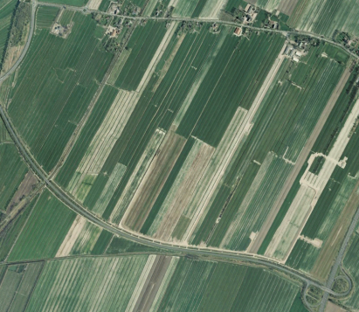
Measurements Made at 25.8MW Wind Farm
25.8MW wind farm located in northern Germany
9 turbines of three different types
Flat agricultural land
Primary wind direction during measurement is 150º
Siemens SWT3.6
Vestas V90
Vestas V80
Wind
Turbine | Hub height (m) | Rotor diameter (m) | Rated power (MW)
Siemens SWT3.6 | 93 | 107 | 3.6
Vestas V90 | 105 | 90 | 3.0
Vestas V80 | 60 | 80 | 2.0
WEA5
WEA6
WEA1
WEA7
WEA2
WEA8
WEA3
WEA4
WEA9
200m

Slide 8
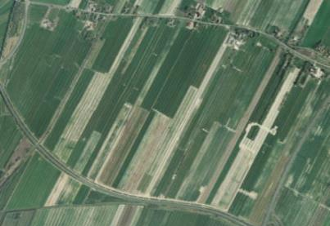
Flow Field in Wind Farm Scanned from 11 Positions
Wind farm flow field scanned from 11 positions
Fully automated software :
determines optimum scanning positions
specifies positions to driver
determines scan pattern at each position
visualises real-time measurements
Siemens SWT3.6
Vestas V90
Vestas V80
Measurement position
10
9
1
2
Wind
8
200m
3
4
5
6
11
7
Autonomous Measurement System
Optimum Scanning positions
roads
wind direction
LiDAR’s maximum range
wind farm layout
Optimum Scanning positions

Slide 9
Measured Horizontal Wind Speed Shows Multiple Wakes in Wind Farm
Wakes with average maximum deficit of 52% measured
Wakes extend in different directions
Vertical profile of wind direction shows wind veer of 13deg. per 100m
Wind veer explains differences in directions of wakes
H = 93m AGL
H = 60m AGL
Horizontal wind speed (-)
1
0
Wind
Hub heights
Vestas V90
Siemens SWT3.6
Vestas V90
Vestas V80
Siemens SWT3.6
H = 105m AGL
Vestas V80

Slide 10
Wake Extent Impacts Power Generation
Simultaneous power generation from SCADA data shows:
39% underperformance of WEA1 due to direct impact of wake from WEA2
Over-performance of WEA5 and WEA6 that operate between wakes
Wind
WEA5
WEA1
Horizontal wind speed (-)
WEA6
WEA7
1
0
WEA8
WEA2
WEA3
WEA4
WEA9

Slide 11
Rotor Yaw Misalignment Results in Underperformance
Turbine WEA2 has 6% less power than turbine WEA4
Measurements at 2D downstream of WEA2 show wake is laterally offset by 0.3D
Lateral offset of wake can be consequence of rotor yaw misalignment explaining underperformance of turbine WEA2
Normalised power
WEA2 | WEA4
0.94 | 1
Siemens SWT3.6
Vestas V90
Vestas V80
Wind
WEA2
WEA4
200m

Slide 12
Simulations Show Good Agreement with Measurements
Predictions of in-house Reynolds-Averaged Navier-Stokes solver with Immersed Wind Turbine Models shows good qualitative agreement with measurements
Measurements
Predictions
Immersed Wind Turbine Model
Wind
Outflow
Rotor
Normalized streamwise speed
Normalized streamwise speed
Inflow
0 1
0 1

Slide 13
Wake Recovery is Accurately Predicted
Excellent quantitative prediction of wake recovery downstream of turbine WEA5 with 5% RMS difference compared to measurements
Wind
WEA5
Horizontal wind speed (-)
1
0

Slide 14
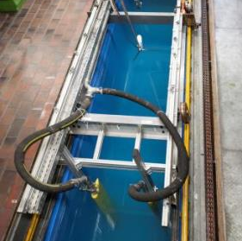
ETH Semi-Empirical Wake Model Shows Good Agreement with Measurements
ETH Wake Model is semi-empirical model based on sub-scale experiments in ETH wind turbine test facility
Predicted spanwise velocity deficit at 2D shows good agreement with full-scale measurements with only 6% RMS difference
U/U_{ref}
ETH Wind Turbine Test Facility
Spanwise position, Y/D

Slide 15
Conclusions
Measurements of Cartesian velocity components on scale of wind farm demonstrated using mobile-based LiDAR
this measurement approach can be readily deployed to assess performance in actual wind farms
Impacts of multiple wakes on turbine performance was quantified
Observed that wake skewness due to rotor yaw misalignment is also a source of underperformance
CFD and wake model predictions show very good agreement with measurements

