Slide 1
8.2 Consulting AG From fixed offshore to floating Offshore – A new challenge for QHSE
Wind Europe Summit 2016- Wednesday, 28 September 2016
Dr. Pascal Sommer / Erik Schmidt

Slide 2
8.2 Consulting AG – Company Profile
8.2 Consulting AG member of the 8.2 Group
120 experts worldwide | active in more than 50 countries
More than 20 years of experience in renewable energies
Technical Consulting:
(e.g. Due Diligence, O&M Optimization, Lenders / Owners Advisor)
Technical Inspections:
(e.g. Condition based assessments, Technical surveillance)
Grid Connection Expertise
Due Diligence of more than 2 500 MW offshore
Design review performed for most offshore turbines
Siemens / GE / ADWEN / Senvion
> 20 000 turbines inspected

Slide 3
8.2 Consulting AG – QHSE activities
QHSE-Consulting in onshore and offshore wind
Integrated services including advisory and inspection services
QHSE-Advisory during design, construction and O&M
QHSE Management Consulting
HSE Design Reviews of documentation and WTGs
References Floating Offshore
General QHSE advisory
Survey on French QHSE regulatory framework for (floating) offshore
Support of the successful French Floating Offshore Tender (EolMed)

Slide 4
8.2 Consulting AG – Learning Objectives
Major differences from fixed offshore to floating offshore
Major challenges from fixed offshore to floating offshore
Fixed vs. floating offshore → Different approaches needed
Fixed vs. floating Offshore → Different QHSE-rationale

Slide 5
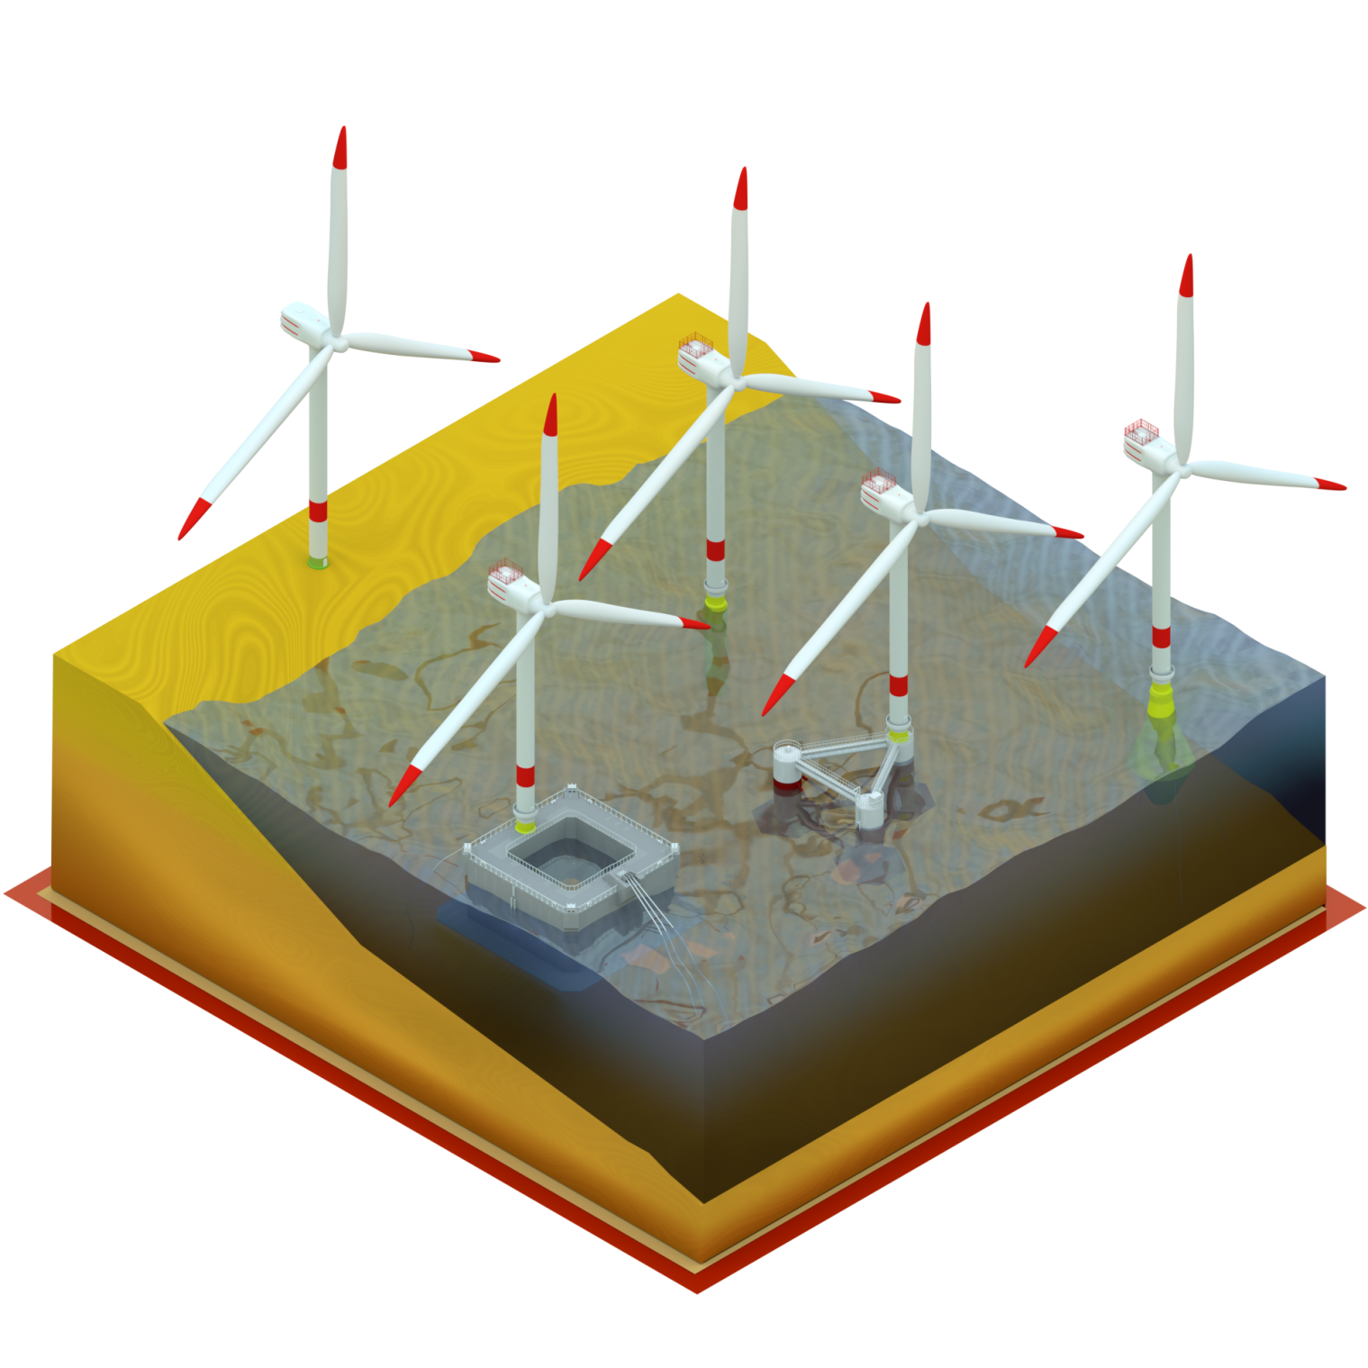
8.2 Consulting AG – Fixed vs. Floating Offshore
Fixed vs. Floating offshore→ Same but different

Slide 6
8.2 Consulting AG – Fixed Offshore: QHSE insights
German projects: today‘s reference for far-offshore
Distance to shore → Huge difference between 20km or 100km+
Floating might go even further
Quick changing environmental conditions in open waters
Different technical solutions for site specific conditions needed (e.g. accommodation platform)

Slide 7
8.2 Consulting AG – Floating Offshore: Major challenges
Installation - Towing systems
Learn from Oil & Gas
Gain experience (through research and follow ups)
Learn from different floater designs
Concepts for tilt-reduction to be developed
Installation - Anchoring Systems
Floating still needs a fixation at the ground
Learn from Oil & Gas
Installation of the mooring lines: Human vs. Robot
Reduction of human effort in deep waters (currents, pressure)

Slide 8
8.2 Consulting AG – Floating Offshore: Major challenges
Access systems
Two connected floating devices (Vessel – Floater)
Systems will depend on site condition and floater type
Adaptation of existing systems (i.e. „Ampelmann“) required
Research needed regarding wave and wind effects
Far distance to medical assistance
Long reaction times
Long transport times
Respective infrastructure to be developed

Slide 9
8.2 Consulting AG – Floating Offshore: Major challenges
Harsh environment
Water depths of 60m to 1000m+
Freak/Rogue wave scenarios
No stable/immobile infrastructure out at sea
Fatigue of technical components
Need for site specific emergency and disaster management concepts
Precaution systems
Installation of survival equipment
Potential satellite observation

Slide 10
8.2 Consulting AG - Floating Offshore: Pros & potential benefits
Assembly and commissioning in port
Massive reduction of man-hours offshore
Improved handling of difficult processes (e.g. blade installation, electrical works)
Short response time during HSE incident or catastrophe
Less weather effects for assembly phase
Major repair works possible in port
Reduction of noise due to shorter piling

Slide 11
8.2 Consulting AG – Synthesis, perspectives and conclusion
Still unknown factors → Further R&D support necessary
Site specific solutions → Most existing OWF conditions are not comparable to far offshore sites
Development of infrastructure like CTVs, Access systems, etc. needed
Research on environmental and climate change
Learn from test projects → Consequent documentation and evaluation of components and procedures
Specific Regulatory Framework needed past 2020 latest → Start international task force

Slide 12
8.2 Contact
8.2 Consulting AG
Dr. Pascal Sommer
Brandstwiete 4 | 20457 Hamburg
Office: +49 40-380 7253-29
Email: pascal.sommer@8p2.de

