Slide 1
Evaluation of ice detection systems for wind turbines
Initiated and funded by VGB PowerTech
WindEurope Summit September 28, 2016
René Cattin, Saskia Bourgeois, Ulla Heikkilä (Meteotest) Ulrtich Langnickel (VGB PowerTech)
Notes:
Anleitung:
Menu Einfügen / Kopf- & Fusszeile öffnen.
Foliennummer und Fusszeile aktivieren. Datum (Fest) sowie Titel (Fusszeile) eingeben.
Für alle übernehmen.

Slide 2
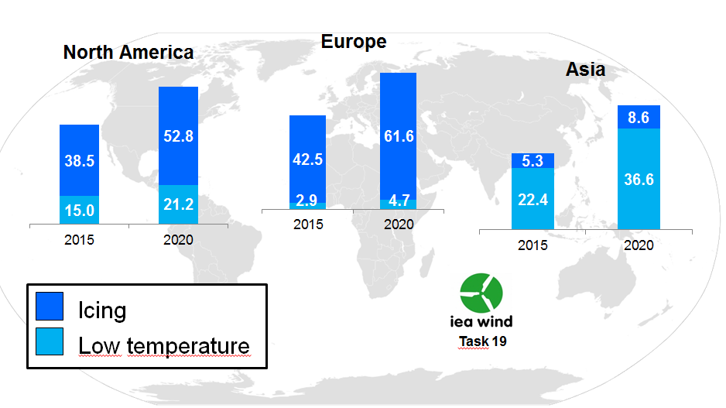
Motivation
Cold climate markets 2015-2020
http://www.windpowermonthly.com/article/1403504/emerging-cold

Slide 3
Motivation
Production
Safety
Ice Detection

Slide 4
Ideal world
as early as possible
no false alarms!
«Ice» detection Ice on the blades
Action:
Stop turbine
Start de-icing
as short as possible
«No Ice» detection
Blades are icefree
as early as possible
Action:
Restart turbine
Stop de-icing
time

Slide 5
Goals of the project
Independent overview on commercially available ice detection systems for wind turbines
Report for VGB members to review and optimize the operation of wind parks under icing conditions
Basis for the design of a field test of selected systems at a later stage
Published in 2016, 111 pages, downloadable at: https://www.vgb.org/fue_projekt392.html
No data analysis

Slide 6
Key content of evaluation
List of commercially available systems
Detailed evaluation - Sensing technique, measured parameters - Technical specifications, sensor position - Output data formats & protocols - Stage of development, technical maturity - Track record, no. of installed systems, certifications - Operational experiences (references)
Evaluation matrix: comparison of systems

Slide 7
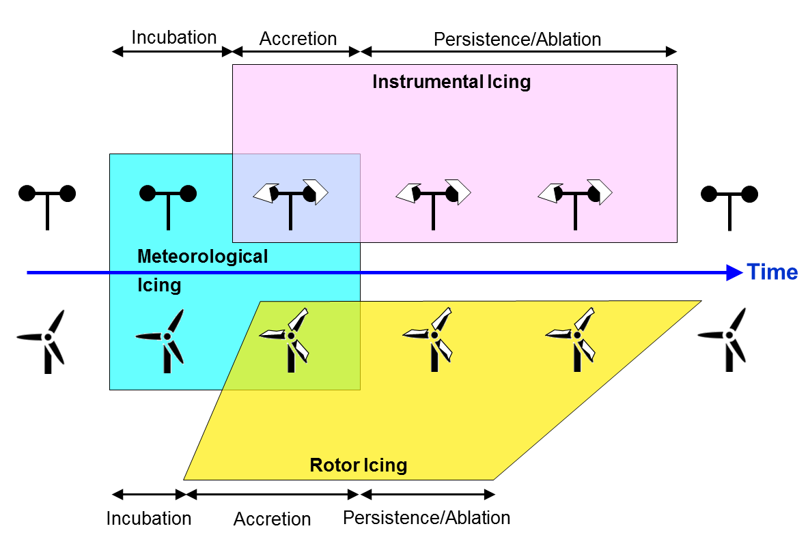
Icing basics
© IEA Wind Task 19 (2016)

Slide 8
Icing basics
Instrumental Icing is NOT rotor Icing!
Tip height >> hub height
Different size/shape of structure (sensor vs. blade)
Standstill structure vs. moving structure → Different wind speeds → Vibrations → Acceleration forces
For safe and efficient operation of wind turbines under icing conditions, information on rotor icing is required

Slide 9
Two classes of systems
Nacelle based systems
Blade based systems

Slide 10
List of methods / instruments
10 nacelle based systems
Heated / unheated anemometer
Temperature & relative humidity
Leine Linde IPMS (GER)
Combitech IceMonitor (SWE)
Goodrich 0872F1 (USA)
Holooptics T41 and T44 (SWE)
Labkotec LID-3300IP (FIN)
Sommer Messtechnik: IDS-10 (AUT)
Meteorological Monitoring Station PMS (CZE)
New Avionics Ice Meister Model 9734 (USA)

Slide 11
List of methods / instruments
5 + 3 blade based systems
Power curve / pitch angle
fos4X fos4IceDetection (GER)
Bosch Rexroth BladeControl (GER)
Wölfel SHM.Blade / IDD. Blade (GER)
Eologix (AUT)
MOOG Insensys RMS (UK)
Hainzl Haicmon_ice (AUT)
Infralytic (GER)

Slide 12
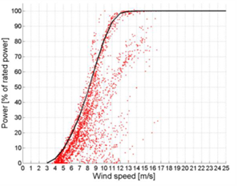
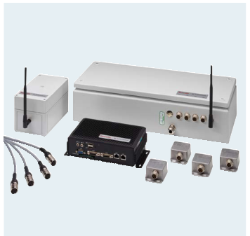
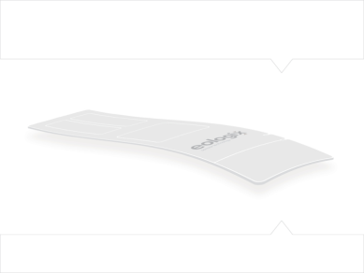
Blade based systems

Slide 13
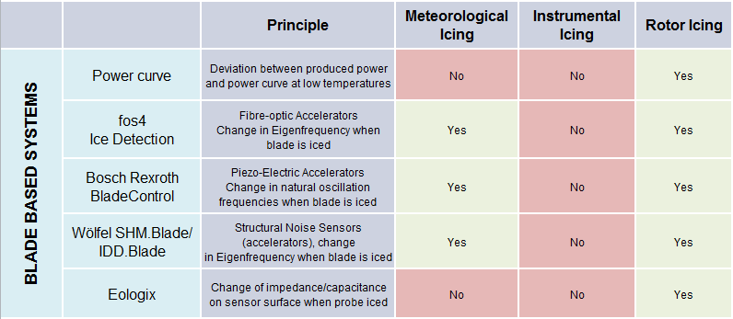
Comparison blade systems

Slide 14
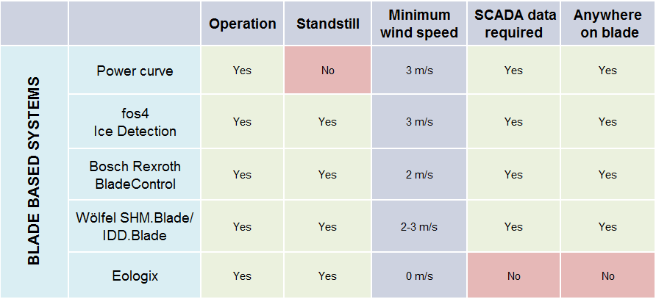
Comparison blade systems

Slide 15
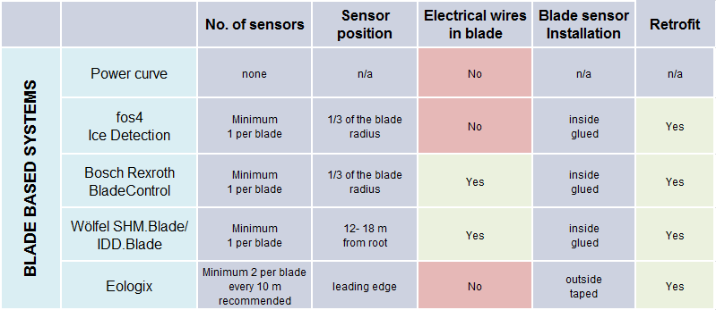
Comparison blade systems

Slide 16
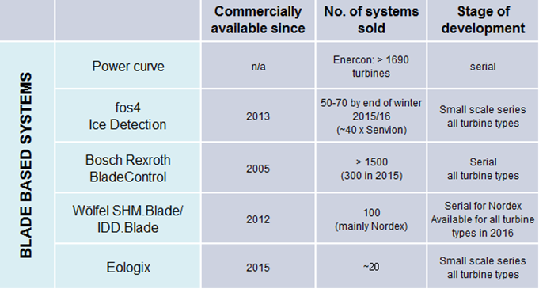
Comparison blade systems

Slide 17
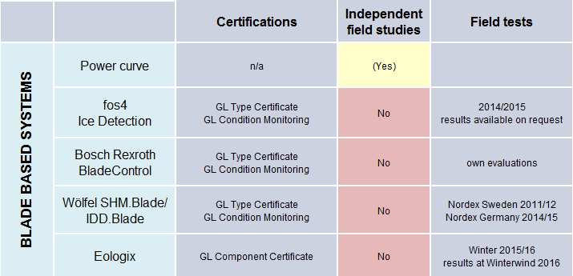
Comparison blade systems

Slide 18
Comparison blade systems
Conlusions
All systems are able to measure rotor icing
Power curve robust but doesn’t work at standstill
Bosch Rexroth with longest track record
Three new and promising systems
No independent evaluations / field tests available
No real winner, pros and cons for each system

Slide 19
Follow up project
Main objectives
Independent benchmark of four blade based systems - Fos4X fos4IceDetection (GER) - Bosch Rexroth BladeControl (GER) - Wölfel SHM.Blade / IDD.Blade (GER) - Eologix (AUT)
All systems installed in the same wind turbine in Sweden
Camera system + SCADA data as a reference
Winters 2016/17 and 2017/18
Validation against camera images and SCADA data

Slide 20
Thank you for your attention!

