Slide 1
G+ Global Offshore Wind Health & Safety Organisation

Slide 2
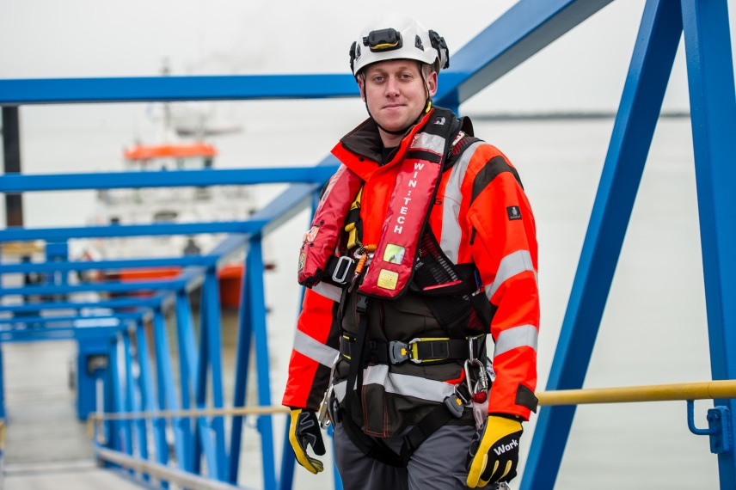
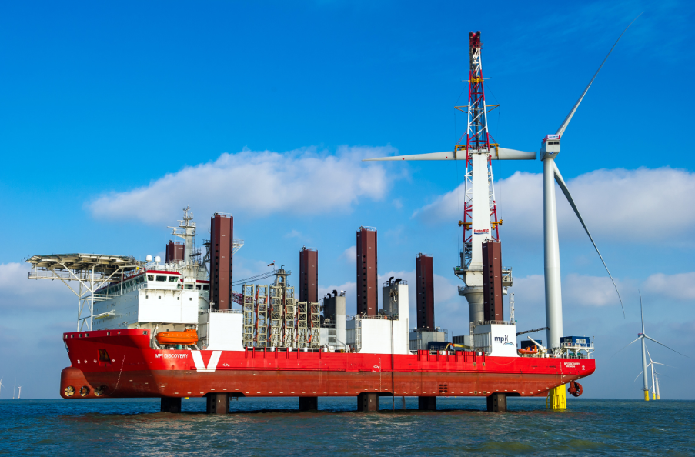
Who are the G+?
The G+ and its members are committed to promoting and maintaining the highest possible standards of health and safety throughout the life cycle of offshore wind farms

Slide 3
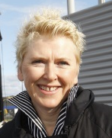
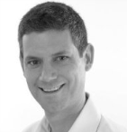
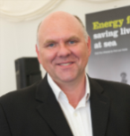
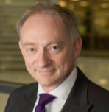
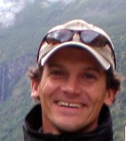
Who are the G+?
Board of Directors
Stephen Rose | Paul Cowling | Anne Marit Hansen | Anthony Wort | Jonathan Cole (Chairman) | Tony Lyon | Benj Sykes | Sven Utermöhlen | Bjørn Mo Østgren | Mark Vvyan-Robinson
Secretariat:
General Manager - Kate Harvey
HSE Focal Group
Glynn Fereday | Darren Tape | Nachaat Tahmaz | Sai-Man Li | Frank Monaghan | Steve Danson | Martin Kjær Mogensen | Marcus Peters | Aud Jorunn Skjørestad | Garry Bradford
François Bathellier
(ENGIE)
Secretariat:

Slide 4
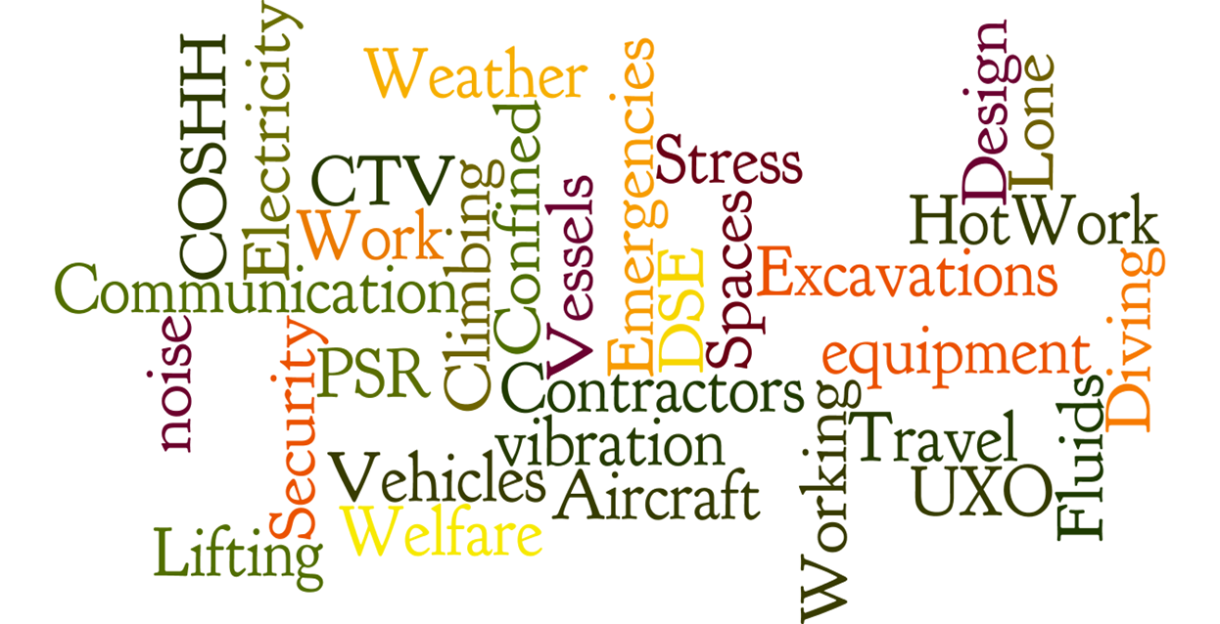
Industry hazards
Notes:
We don’t need to guess where our people are getting hurt. The data exists.
Hurting our people in relatively simple areas – manual handling / ergonomics / dropped objects
Must look at the data and go back to design of plant / remove the need to work offshore / plant reliability / don’t overly rely on personal discipline / training and PPE
Generally all staff are trained but yet there are still accidents – competent staff / risk assessment onsite / right to stop work and change work processes

Slide 5
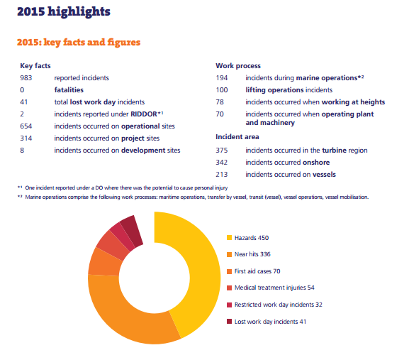
Incident data – overview

Slide 6
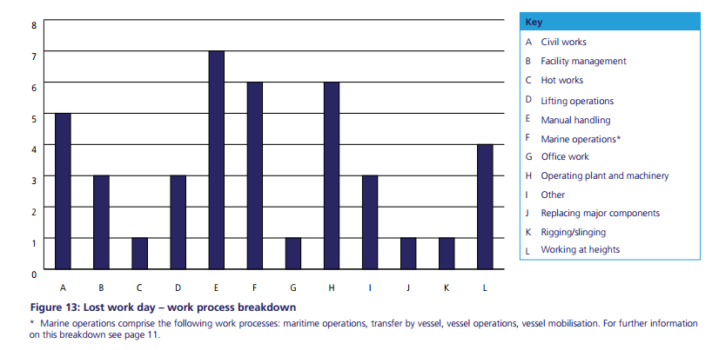
Incident data – LTI overview

Slide 7
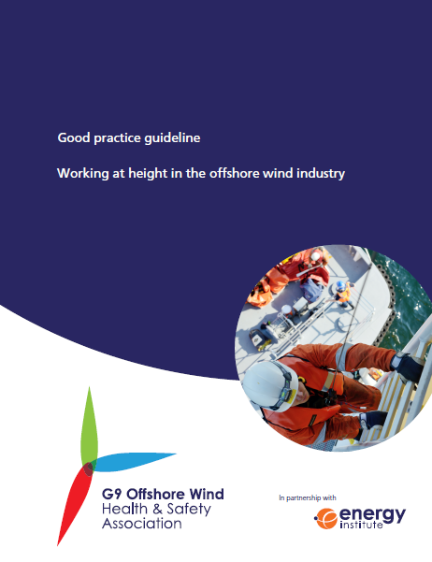
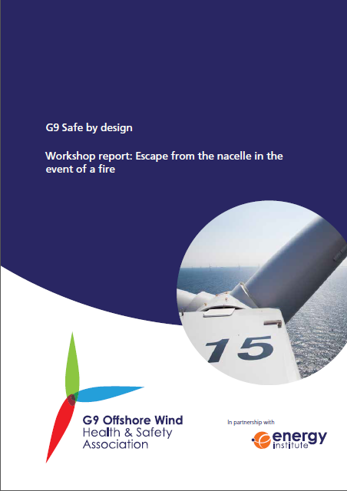
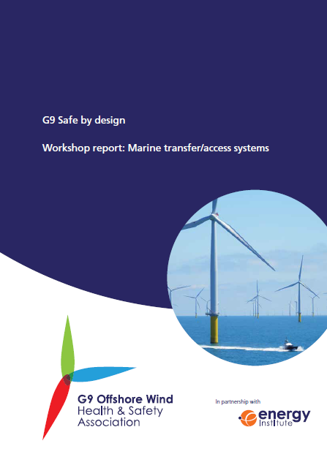
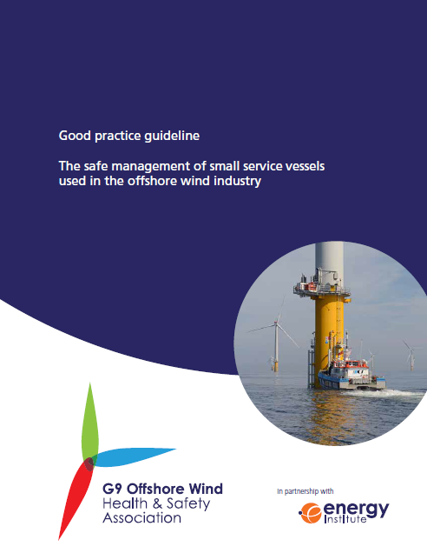
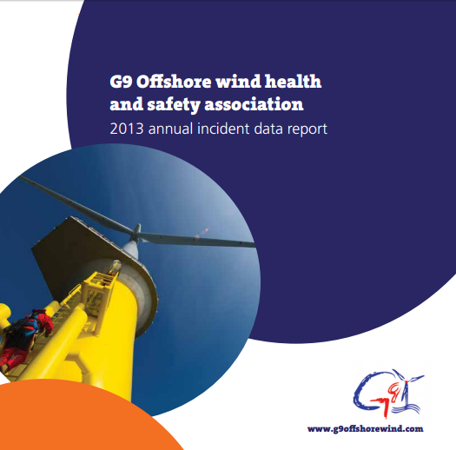
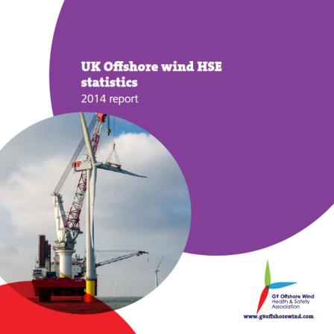
Achievements to date
2014
2015
Notes:
2014
2013 incident data report
Working at height and small service vessels – 2 Good Practice Guidelines produced
2015
2014 incident data report
HSE 2014 stats report
Safe by design – Marine transfer/access systems workshop report and Escape from nacelle in the event of a fire
Good practice guidelines
Contain minimum requirements for working at height, and small service vessel operations
Incident data reports
Provide LTIF and TRIR benchmarking statistics for assessing industry safety performance
Safe by Design workshops
Series of x1 day workshops reviewing a key HSE risk and discussing design solutions

Slide 8
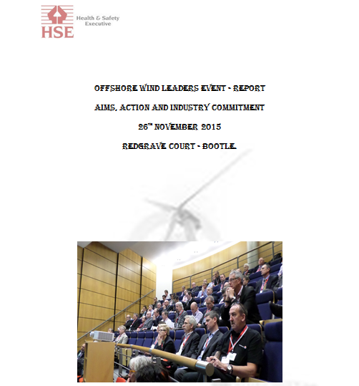
The challenge going forward
Notes:
Offshore Wind Leaders Event called for by HSE held on 26/11/15 in Bootle. Often referred to as the “Bootle Workshop”.

Slide 9
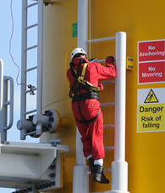
G+ response to Bootle workshop
1. Consider how to improve engagement through the supply chain to ensure it is fully involved
Further engage tier 1 supply chain companies through the FG
Develop Safe by Design workshop programme beyond 2016
Continue to promote and hold the annual G+ Stakeholder Forum
2. Recognise need to create a common, risk-based agenda for the sector
Advance the G+ risk based agenda through improved incident data
Supplement the risk based agenda with additional information e.g. from workshops, other organisations, etc.
Develop the G+ operating plan (and share at the next Stakeholder Forum)
Notes:
G+ leadership role
Data improvements – vessel split, transit to work, ORE Catapult SPARTAR, Benchmarking

Slide 10
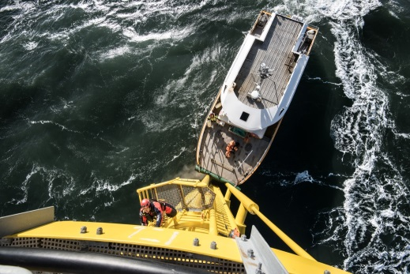
G+ response to Bootle workshop
3. Actively engage with all relevant stakeholders including trade associations and others
Prepare a G+ engagement plan covering strategic, structural and topic based engagement activity
Undertake bilateral and multilateral engagement (specific subject agreements)
4. Drive the development and proper and consistent implementation of good practice
Update our existing good practice guidelines based on user feedback
Initiate peer review process of G+ sites to support cross learning and improvements

Slide 11
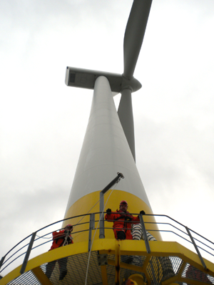
G+ response to Bootle workshop
5. Identify quick wins to provide momentum for further change
To investigate quick wins in:
equipment
training
operating practices
medical and physical fitness requirements
Formation of a new industry steering committee (comprising representation from: G+, GWO, IMCA, RUK) – chaired by G+
Agree additional resourcing through a permanent secondee placement
Rebranding to ensure that the G+ better reflects their international and inclusive remit
Information and knowledge sharing through e.g. Project Director’s forum (behavioural safety campaign material) – “Safety champions in offshore wind”

Slide 12
2016 work programme
No. | Title of work
OW 1601 | Investigation into the long term effects of ladder climbing
OW 1602 | Reducing manual handling and ergonomics related incidents in the offshore wind industry
OW 1603 | Safe by Design workshops
OW 1604 | Guideline review and development – Dropped objects in the offshore wind industry
OW 1605 | Updated of G+ good practice guidelines
OW 1606 | FMEA analysis of offshore wind turbine service lifts
OW 1607 | 2016 G+ Stakeholder Forum

Slide 13
Thank You

