Slide 1
Reducing LCOE through innovation in the design of the pitch control system
Prasad Padman - Moog
Francesco Vanni - DNV GL
Michael Wilkinson - DNV GL
Date: 29 Sept, 2016
WindEurope Hamburg

Slide 2
Key learnings
Reducing Wind LCoE is important for the industry
Improving turbine reliability can help reduce LCoE
Pitch systems currently used by the industry is a major failure component
Significant opportunity exists to improve electric pitch system reliability through design optimization
DNV GL LCoE model shows that Moog Pitch System 3 can save up to $782K/year for a typical 150MW wind farm

Slide 3
Global LCoE trends ($/MWh)
Onshore wind auction prices ($/MWh)
Utility-scale PV auction prices ($/MWh)
Source BNEF
LCoE of other renewables like solar photovoltaic have come down significantly in the recent years driving the need for more competitive LCoE for wind

Slide 4
Improving turbine reliability can significantly reduce O&M cost and in turn reduce LCoE
One of the challenges faced by the industry lies in understanding where the efforts to improve reliability will result in the largest LCoE benefits
Most research done in the past focuses on system level analysis (mechanical, electrical,…) providing very little depth in terms of failure analysis at component level
To date, the Reliawind project ¹ (2011) is the most exhaustive study that provides an in-depth failure analysis at component level
¹ “Measuring Wind Turbine Reliability – Results of the Reliawind Project” by Michael Wilkinson, Keir Harman, Ben Hendriks, Fabio Spinato, and Thomas van Delft, GL Harrad Hassan, UK.

Slide 5
The Reliawind research identifies pitch system as the #1 component contributing to turbine failure & downtime
Failure Rate
Downtime
Source: Reliability and maintenance of wind turbines challenges and perspectives, Dr.-Ing. Katharina Fischer, Fraunhofer Institute for Wind Energy and Energy System Technology

Slide 6
Pitch system facts
< 3% of wind farm CAPEX investment (source: Moog, Bloomberg)
20 to 30% of wind turbine O&M expenses (source: Top 10 Wind Turbine OEM interviews by Moog)
21% of wind turbine failure rate (source: Reliawind)
23% of wind turbine downtime (source: Reliawind)

Slide 7
This year, Moog partnered with DNV GL for a project with the following objectives:
More accurately quantify the impact of pitch system reliability on turbine failure rate and downtime
Quantify the reduction in LCoE due to improvements in pitch system reliability

Slide 8
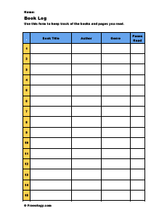
Failure rate benchmarking based on operational data
Failure tracking logs
Benchmarking Dataset
Fault logs
69 Projects
5.3GW installed capacity
4 Million Turbine Days
Europe, USA and China
Rating between 1.5MW and 3MW
Operator reports

Slide 9
Data collection
Extract relevant information from the different sources:
Installed Capacity
Number of Turbines (N_{T})
Turbine Rating
Pitch Technology (Electric vs Hydraulic)
Geographic Region
Data Coverage in Days (L_{D})
Number of Pitch Incidents (I)
Downtime Related to Pitch Incidents (D)
Challenges:
Different data sources require different analysis (e.g. extracting number of incidents from an alarm fault log and from operator reports)
Some sources (fault logs in particular) require significant processing
A consistent definition of “incident” is required: an event requiring any amount of unscheduled maintenance greater than 0.5 hours

Slide 10
Data analysis
Definition of main reliability metrics:
Average Availability Losses: A_{V}L = D/(N_{T} x L_{D} x 24) [%]
Mean Downtime per Pitch Incident: MD = D/I [hours]
Pitch Failure Rate: R_{F} = I/(N_{T} x L_{D}/365) [%]
All these are absolute values, not referred to the total number of failures
Filtering of results:
Remove outliers (projects where any of the three metrics are significantly outside the average)
Only include projects with mean downtime above 3 hours

Slide 11
Pitch system failure analysis results
 | Failure rate¹ | Projects | Turbines
North America | 0.6 | 23 | 907
China | 0.7 | 3 | 30
Europe | 0.9 | 19 | 393
All regions – 1.5 MW < X < 2.5MW | 0.5 | 38 | 1,136
All regions – 2.5 MW < X < 3.0MW | 1.6 | 7 | 194
Overall | 0.7 | 45 | 1,330
¹ Incidents per turbine per year from projects with mean downtime > 3 hours

Slide 12
Pitch system reliability benchmarking study reconfirms that:
Pitch systems (electric and hydraulic) are a major failure component in a wind turbine
The larger the turbine, the greater the failure rate of pitch systems

Slide 13
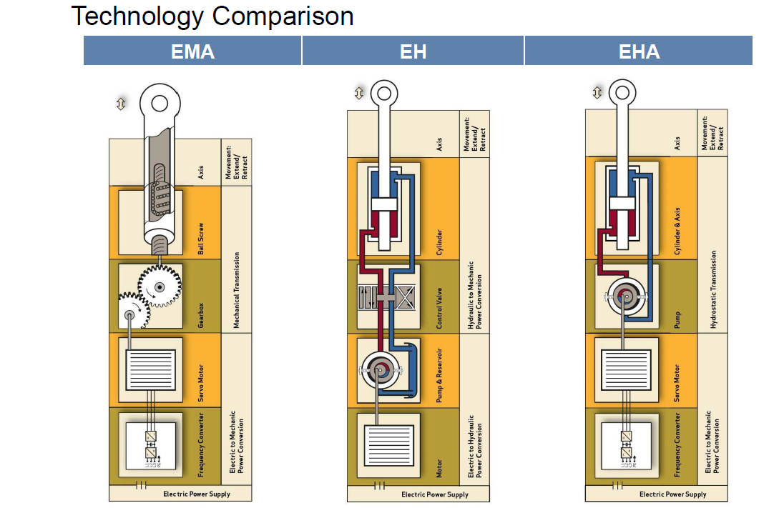
Pitch technology comparison
Moog offers all three technology options

Slide 14
Actuation technology comparison for pitch system
EM offers significant potential for reliability improvement
Attribute | EM | EH | EHA
Compactness (size, weight and reduced part count) | +++ | + | ++
Design/Supply Chain Simplicity | +++ | + | ++
Control Quality | +++ | + | ++
Pre Tested Hardware | +++ | + | ++
Force Range | ++ | +++ | +++
Ease of Maintenance | +++ | + | ++
Reliability | +++ | + | +
Legend
+ | Improvements from Next Generation Technology
+ | Current Industry Design

Slide 15
Design improvement analysis (1/2)
Feature | Current Industry Design | Moog Pitch System 3
System reliability – MTBF (hours) | 5,769 | 18,743
Predicted failures in 20 years | 33.4 | 9.3

Slide 16
Design improvement analysis (2/2)
Component Count | 3,843
Cable Connection Count | 607
System Reliability Hours | 5,769
Component Count | 1322
Cable Connection Count | 318
System Reliability Hours | 18,743

Slide 17
Moog pitch system design optimization study confirms that:
EM offers significant potential for reliability improvement due to:
Pluggable (highly integrated) electronics design for drives
AC servo motor technology
Advances in ultra capacitors design

Slide 18
DNV GL cost of energy model
Key Wind Farm Assumptions
Project Description
150 MW wind farm, 50 turbines, North America
Capacity factor: 35%
Site conditions IEC IIA
Constant Input for Scenario Analysis
Cost Assumptions
Labour rates, part costs, crane costs
Cost of materials
Other costs
Wind Turbine Technology
DFIG, partial power conversion
3 stage gearbox, turbine class IIA
Pitch system: electric or hydraulic
Current Industry Systems
Pitch System Reliability Assumptions
LCoE
Mean Time Between Failure (MTBF)
Mean Time To Repair (MTTR)
Rebuild value of spare parts
Moog Pitch System 3

Slide 19
Potential cost of energy reductions through improved pitch system design for a typical 3MW turbine
Description | LCoE [$/MWh] | LCoE Savings [$/MWh]
Current industry design | 53.31 | -
Moog Pitch System 3 | 51.61 | 1.70
Total savings/year for typical wind farm, 150MW @35% capacity factor will be:
1.70 ($/MWh) x 3.0 (MW) x 50 (turbines) x 365 (days) x 24 (hours) x 0.35 (capacity factor) = $782K/year

Slide 20
Conclusions
Average pitch systems failure rate for onshore turbines between 1.5MW and 3.0MW is 0.7 failures per turbine per year
Turbines >2.5MW experience higher pitch system failure rates than turbines <2.5MW
Tests validated by Moog shows that it is possible to improve pitch system reliability (for a typical 3MW turbine) to 0.16 failures per turbine per year through design optimization
DNV GL LCoE model shows that Moog pitch system 3 can save up to $782K/year for a typical 150MW wind farm

Slide 21
ppadman@moog.com
francesco.vanni@dnvgl.com

