Slide 1
Wind and the electrification of transport and heating
Hamburg, 28th of September 2016
Robert Brandt
Bundesverband Erneuerbare Energie e.V. (BEE)

Slide 2
The German Renewable Energy Federation BEE (Bundesverband Erneuerbare Energie)
42 associations: water, wind, biomass, solar, geothermal energy
30,000 individual members and 5,000 companies.
Our long-term goal: 100 Percent renewable energy.

Slide 3
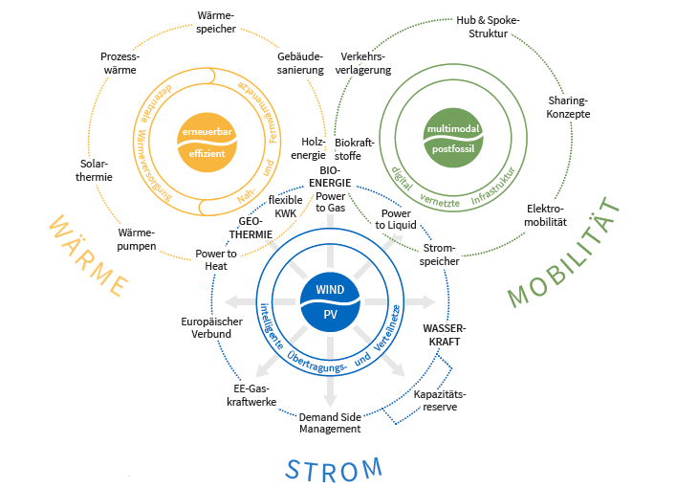
In a nutshell, a future-oriented energy market design has to…
Put wind and solar PV at the heart of the system
Guarantee that RES projects can be refinanced
Incentivize and finance grid enforcement and expansion
Develop flexibility
Back-up power generation (strategic reserve)
Send a price signal from RES to flexibility
Bring the electricity, heating and transport sectors together

Slide 4
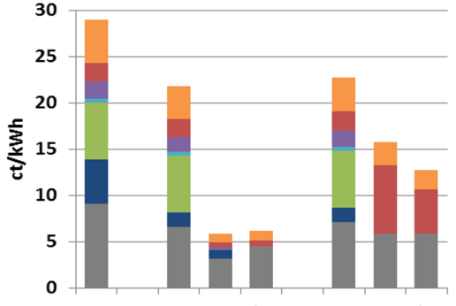
Dismantle barriers
valued-added tax
energy tax
concession
other delivery
EEG surcharge
grid charges
procurement and distribution
Petrol
Diesel
Electricity
Heat Pump
E-Mobility
Natural Gas
Light Fuel Oil

Slide 5
Quotes from A Strong Renewable Energy Directive for 2030 - A BEE consultation response
“To initiate sector coupling and use renewable electricity for heat, mobility and industry, the creation of interfaces between the sectors is essential. The aim is to allow companies – such as operating companies, utilities or industrial investors – the economical use of any renewable electricity that cannot be fed into the grid in power-to-X solutions”
“Sector coupling can be gradually driven forward by cost-neutral incentives and can lead to the development of competitive markets and industries providing both power-to-X solutions and innovative ancillary services”
“Advancing sector coupling would provide a solution to avoiding curtailment altogether. Until now, the local and district gas heating infrastructure has not been impacted by renewables‘ development”

