Slide 3
Introduction
The Wind Energy Revolution
From Uruguay to Latin America
2017 AUDEE Latam Wind Power Congress
Table of Contents

Slide 4
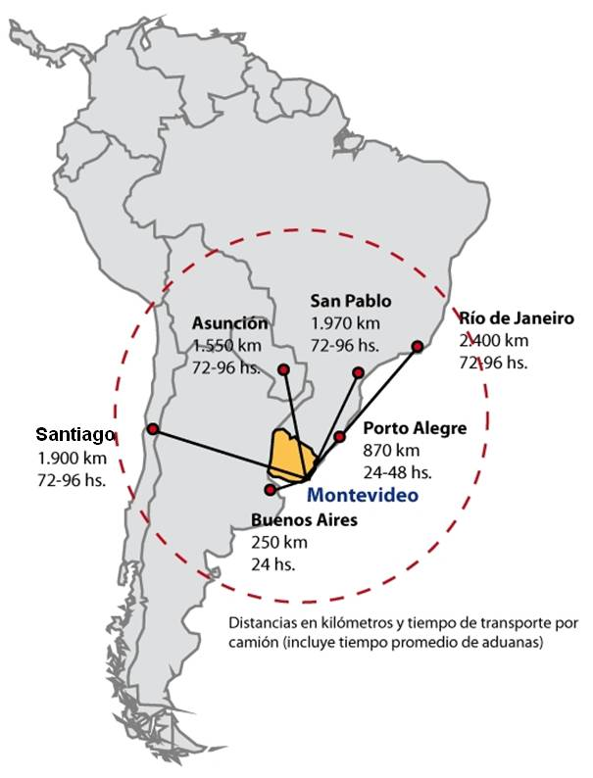
Introduction
URUGUAY
Small South American country / about 175.000 km2, strategically located between Argentina and Brazil.
AUDEE
Uruguayan Wind Power Association, integrated by people, not a chamber.
Its aim is to promote wind energy, overcome barriers, anticipate problems, coordinating between authorities and the private sector.
AUDEE annually organizes a high-impact Latin American congress where all Uruguayan and LATAM wind industry main actors meet.
UTE
Is the National Utility Company, it has the monopoly of the transmission and distribution of electricity.
UTE was, traditionally, the only company that generated electricity, but…. CHANGE: new long-term energy policy.
OPPORTUNITY
Renewables.

Slide 5
Introduction
Currency | GDP per capita | Alphabetization Rate | Life Expectancy
Uruguayan Peso | 17.000 USD | 98% | 76,41 years
General Data

Slide 6
Introduction
In May 2015 Moody’s confirmed Uruguay’s investment grade for two reasons: the absence of macroeconomic imbalances which limit vulnerabilities in a context of economic downturn and the new government’s commitment regarding fiscal consolidation.

Slide 7
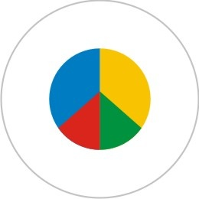
Introduction
Business Environment
# 1 in Latin America
Democracy
Index
Low
Corruption
Prosperity
Index
Rule of Law
Index
# 2 in Latin America
# 3 in Latin America
Freedom
of press
Worldwide
Governance
indicators
Global Peace
Index
Economic
Freedom

Slide 8
Introduction
The Wind Energy Revolution
From Uruguay to Latin America
2017 AUDEE Latam Wind Power Congress
Table of Contents

Slide 9
The Wind Energy Revolution
The electricity market
Approx. 2000 MW of peak power consumption.
Annual demand of 11,000 GWh.
Before 2013:
Covered by
1500 MW Hydro.
80 MW fuel oil reciprocating engines.
215 MW steam turbines (today are being dismantled)
500 MW a set of gas turbines (fueled basically with diesel).
Uruguay has no native fossil fuels.
Dry years, with the price of the barrel of oil above 100 USD, were difficult.
During an average hydrological year at least 3,500 GWh were produced with fuel, or even worse:
imported from our neighbors @ 450 USD / MWh.

Slide 10
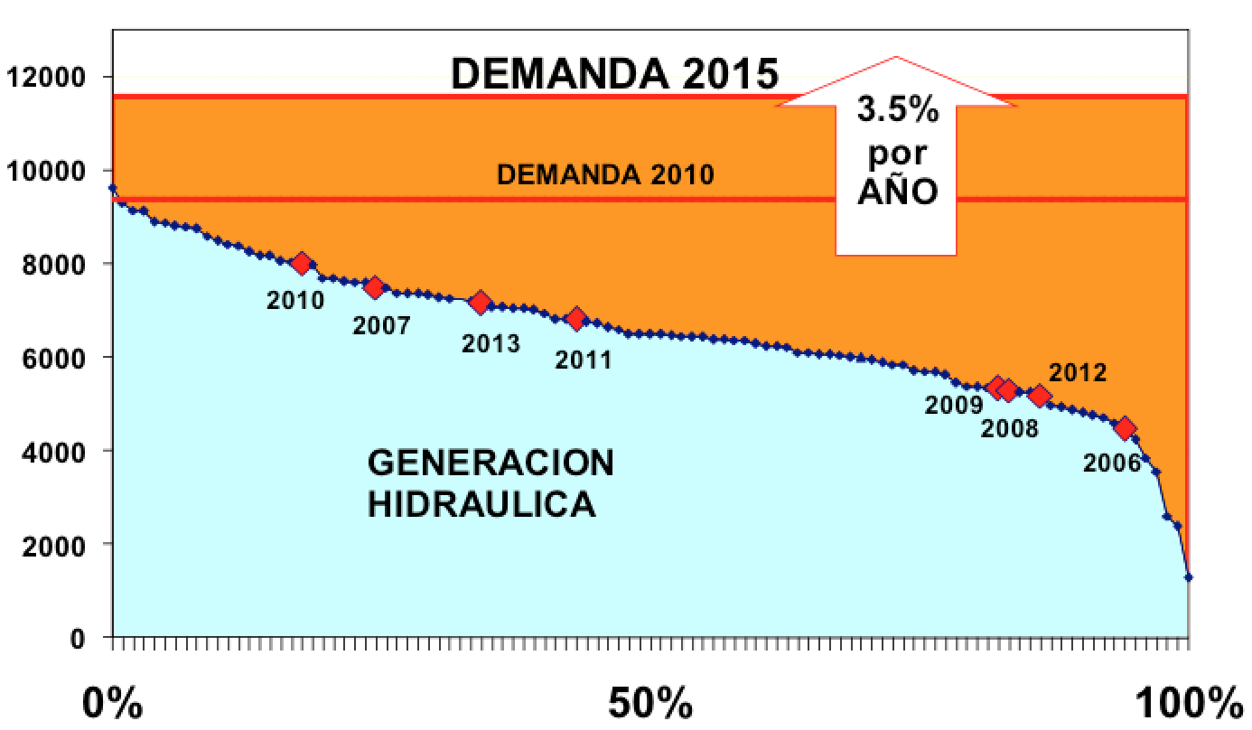
The Wind Energy Revolution
Volatility of Hydro generation

Slide 11
The Wind Energy Revolution
In:
2005
“Winds of change” for Uruguay, through new energy policies.
Uruguay and Spain signed an agreement to build a 10 MW wind farm, with Spanish equipment, as a debt repayment.
2006
First tender to install 60 MW of renewable non-conventional energy,
PPA mode. Contracts for 30 MW of biomass and 10 MW of wind
farms were signed.
2007
UTE installed 17 wind measurement stations throughout the country.

Slide 12
The Wind Energy Revolution
2008
The Ministry of Industry, Energy and Mining defines policies to
diversify the energy matrix for electricity production, including
goals on Non-Conventional Renewable Energies (NCRE).
2009
Government resolution 354/2009, establishes tax benefits for
NCR Energy.
2010 These policies became State Policy with the agreement of all political parties. Most important: simplicity!!
2010
First tender for 150 MW of wind power, PPA mode, average price:
84 USD/MWh.

Slide 13
The Wind Energy Revolution
2011
2nd. and 3rd. Tender, PPA mode, contracts for 800 MW are
signed, with an average price of 63.5 USD/MWh.
2013
UTE signed contracts for 275 MW in 6 wind farms with different
types of financing:
Operational leasing, bank financing, including in some cases
the sale of shares to small investors and institutions with
capacity of low-risk investments (retirement funds, etc).
2 of those wind farms are operating. Today UTE operates over
150 MW and will operate more than 500 for 2017.

Slide 14
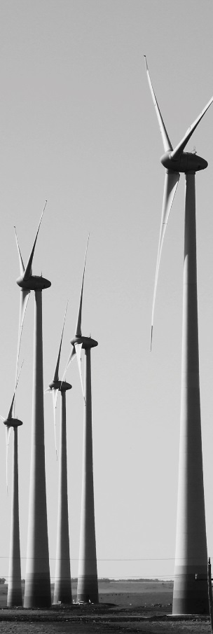
The Wind Energy Revolution
2014
3 PPA were duplicated: 150 MW were added.
Small wind farms (less than 10 MW each) to the
spot market, total: approx. 70 MW.
Today:
OPERATING WIND FARMS : 950 MW
WIND FARMS IN CONSTRUCTION : 500 MW
TOTAL: 1450 MW for 2017

Slide 15
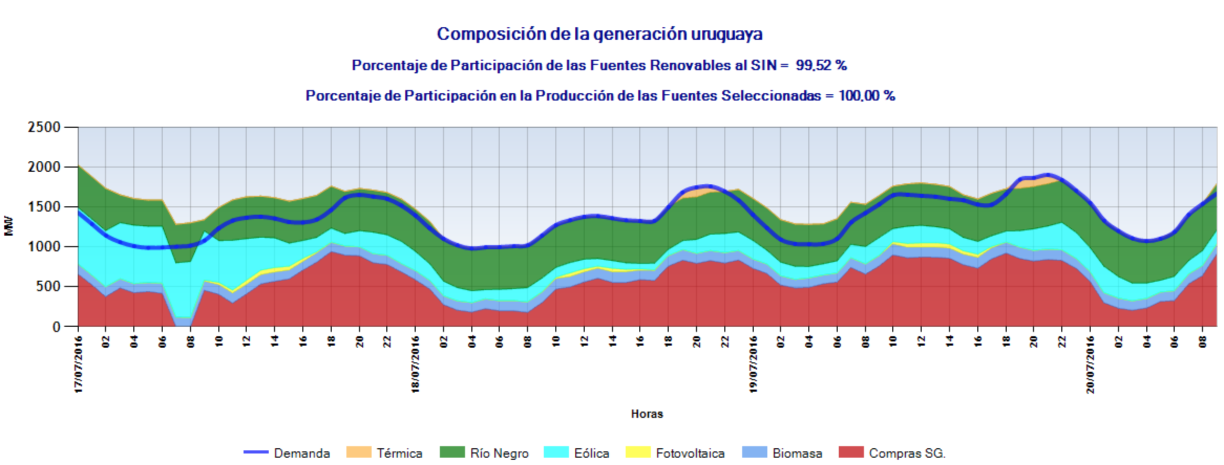
The Wind Energy Revolution
Structure of generation in Uruguay
Percentage of Participation of Renewables to the SIN = 99.52%
Notice: small fuel generation

Slide 16
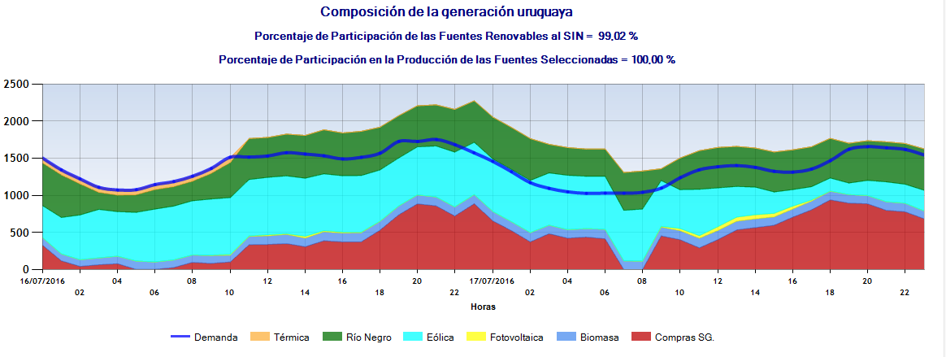
The Wind Energy Revolution
Structure of generation in Uruguay
Percentage of Participation of Renewables to the SIN = 99.02%
Typical Profile
April 25th 2016, Wind Energy covered 84% of demand at 3.00 am and 65% the whole day (26th April).

Slide 17
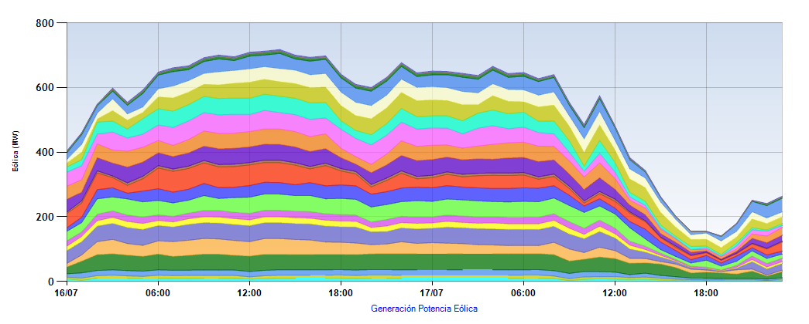
The Wind Energy Revolution
Typical Profile (same day)

Slide 18
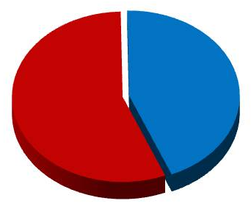
The Wind Energy Revolution
Wind power generation report for Monday 25/7/2016
All the data used in this report is from the SCADA of the Energy Dispatch
Center and is subject to confirmation.
Daily Energy
Other sources; 56%
Production
% Peak power
% Off-peak power
Max. power
Min. power
Authorized power
Average power
Use factor
16376 MWh
31%
57%
819 MW
288 MW
945 MW
682 MW
72%
Wind power; 44%
Max 10 min: maximum value of generation in each ten-minute
period considered
Min 10 min: minimum value of generation in each ten-minute
period considered
Total Wind power: average value of generation in each ten-minute
period considered
The generation of wind power is 44% of the total energy
produced in one day. 31% of the energy was from wind
sources at the peak and at the off-peak it was 57%.

Slide 19
The Wind Energy Revolution
On average, WIND GENERATION already supplies nearly 30% of the
electricity demand (950 MW in operation).
In 2016-17 (with 1500 MW in operation), more than 40% will be supplied
from wind farms.
Uruguay will have one of the world’s largest percentages of electricity
generated from wind power (second or first place close to Denmark) and
100% of the production of electricity will be covered with renewables
sources for an average hydrological year.

Slide 20
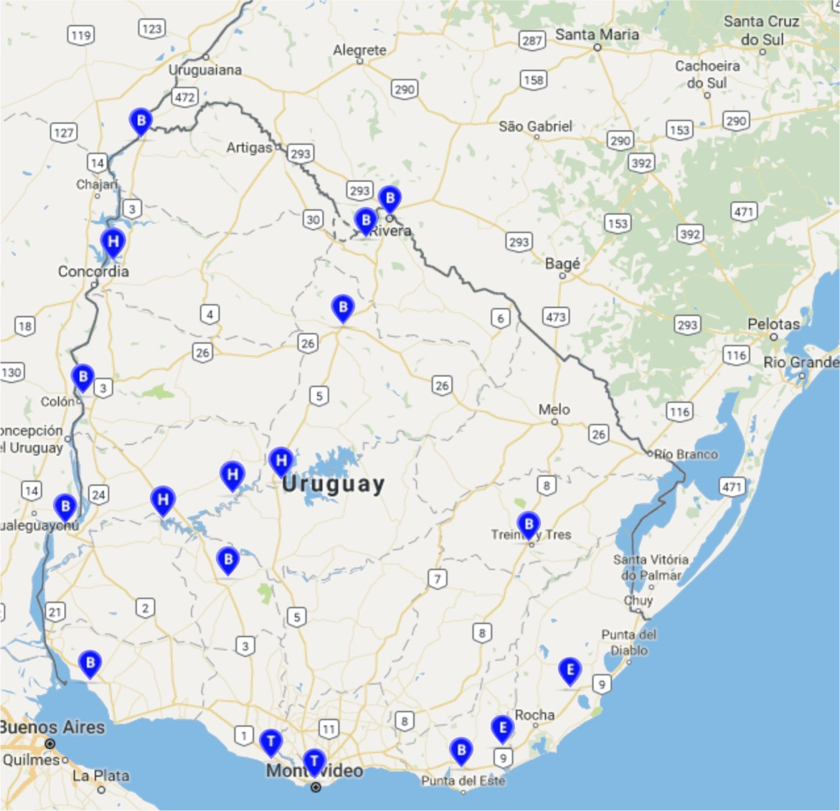
The Wind Energy Revolution
2010
Wind power
Hydro
Thermal/ Fosil
Biomass

Slide 21
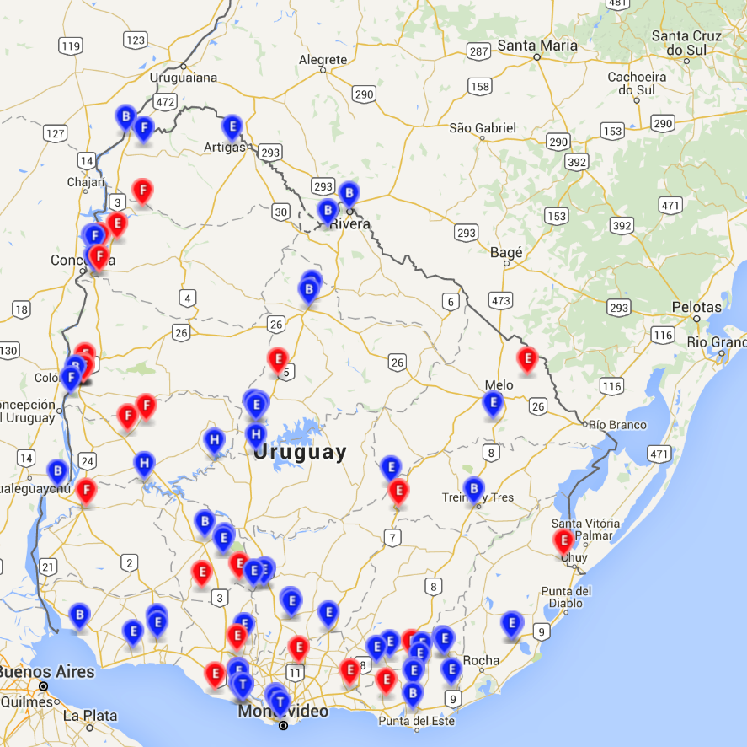
The Wind Energy Revolution
2015
Wind power
Photovoltaic
Hydro
Thermal/ Fosil
Biomass

Slide 22
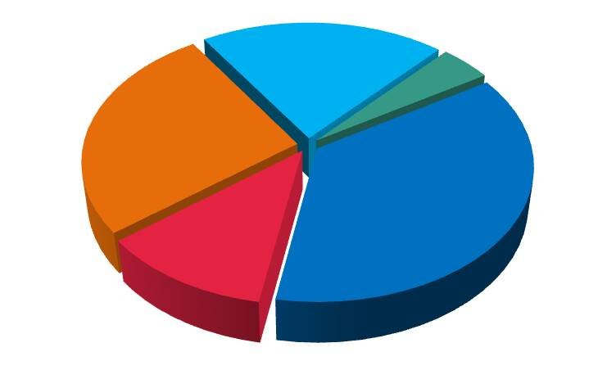
The Wind Energy Revolution
5 MANUFACTURERS
307 MW
65 MW
390 MW
540 MW
170 MW

Slide 23
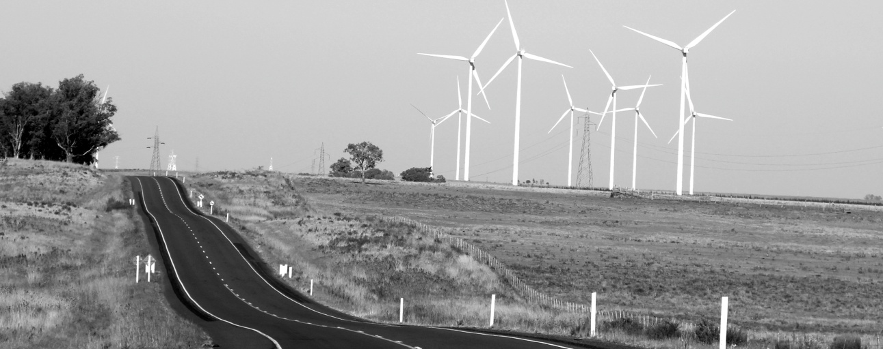
The Wind Energy Revolution
The big challenge
How to handle such a large amount of wind energy:
In the near future, wind production will exceed demand in several opportunities.

Slide 24
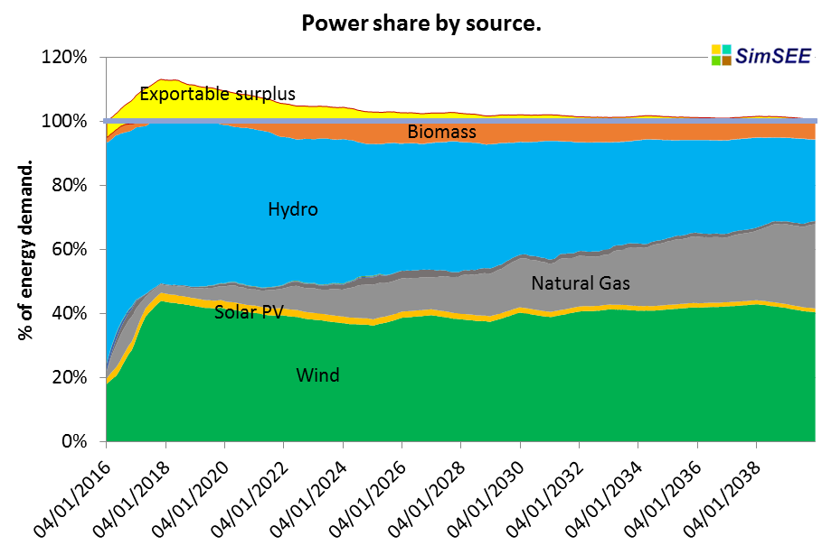
The Wind Energy Revolution
Official forecast

Slide 25
The Wind Energy Revolution
The authorities are working hard on a 7 year plan to introduce smart grids
and other policies with a goal to adapt demand to wind behavior.
Electric transport is one of the main components of this plan, but not the
only one. As much creativity as possible is needed.
Montevideo is changing its taxi fleet and 50 vehicles are now electric.

Slide 26
Introduction
The Wind Energy Revolution
From Uruguay to Latin America
2017 AUDEE Latam Wind Power Congress
Table of Contents

Slide 27
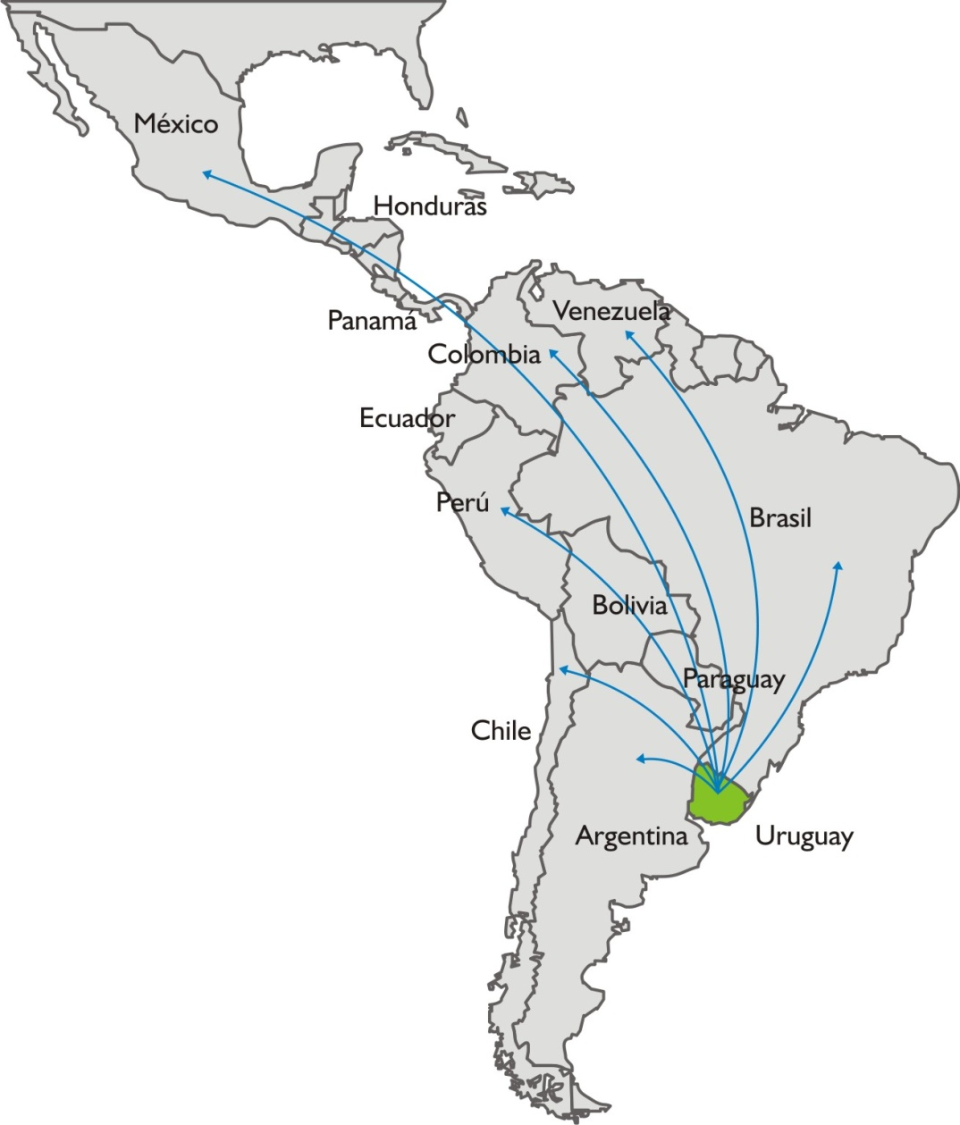
From Uruguay to Latin America
35 wind farms in total
(2017).
Many types of Uruguayan companies
(especially service companies).
Opportunities throughout Latin America from Uruguay.

Slide 28
Introduction
The Wind Energy Revolution
From Uruguay to Latin America
2017 AUDEE Latam Wind Power Congress
Table of Contents

Slide 29
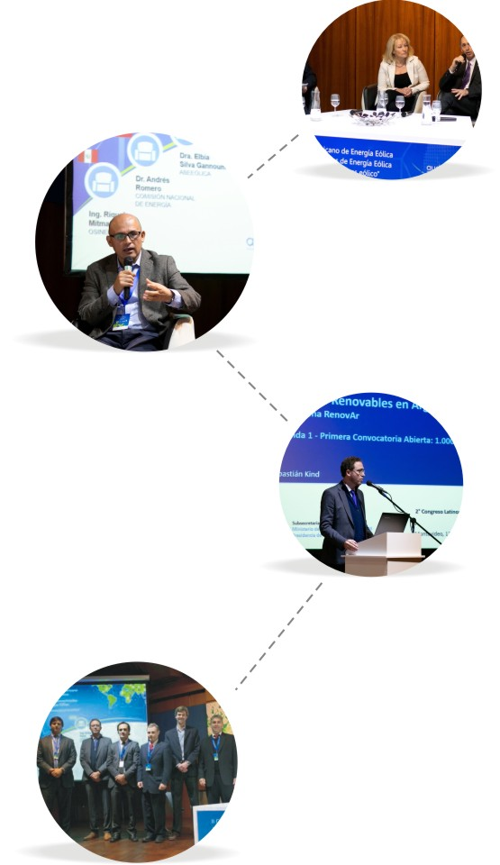
2017 AUDEE Latam Wind Power Congress

Slide 30
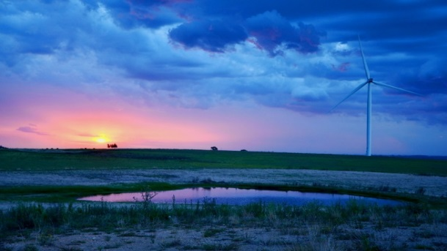
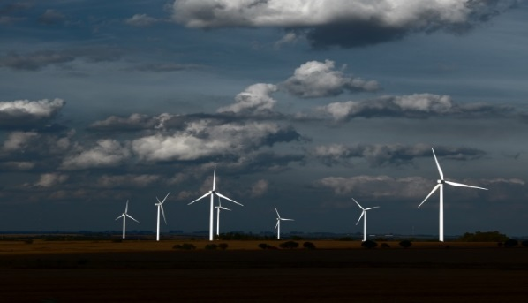
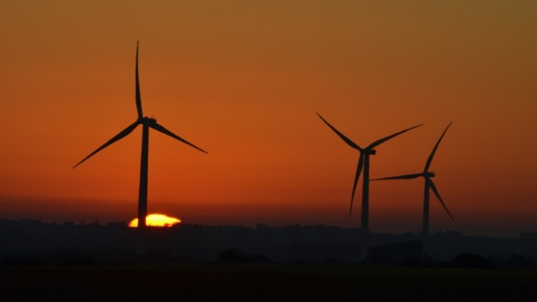
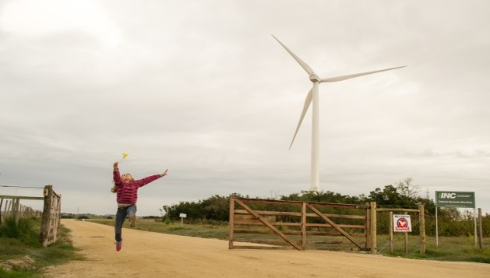
Thank you very much
Ing. Fernando Schaich
E-mail: fschaich@audee.org.uy

