Slide 2
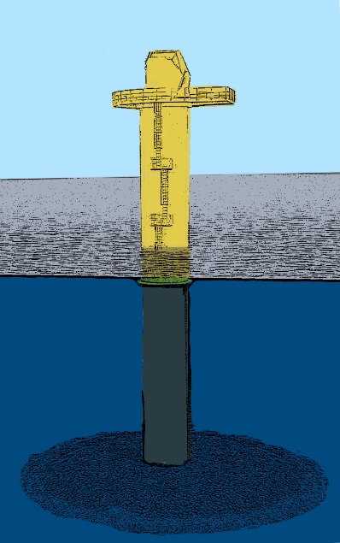
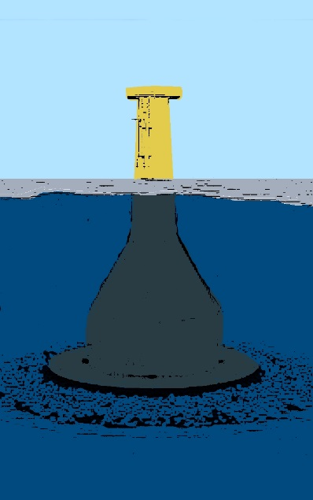
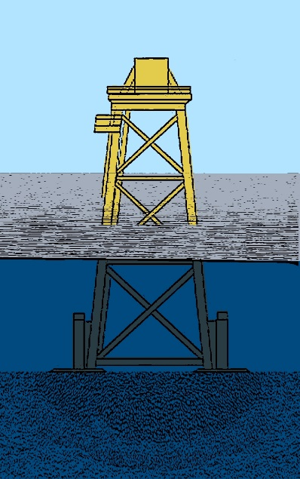
Introduction
Life cycle impacts to be considered for several LEANWIND innovations, including:
foundation design
vessel design
novel O&M methods
Initial analysis focusses on a foundation design

Slide 3
Scenarios
 | Location | Water depth | Distance to port | Foundation type
Site 1 | ~ West Gabbard | 35m | 30km | Gravity Base
 |  |  |  | XL Monopile
Site 2 | ~ Moray Firth | 50m | 100km | Gravity Base
 |  |  |  | Jacket
Rest of life cycle consistent with foundation type
4 initial scenarios were selected
Water depths are defined by available data for given foundations
Analysis includes entire support system (foundation, transition piece and scour protection)
Assume 8MW offshore turbine (Vestas V164-8) – impacts of turbine are NOT included

Slide 4
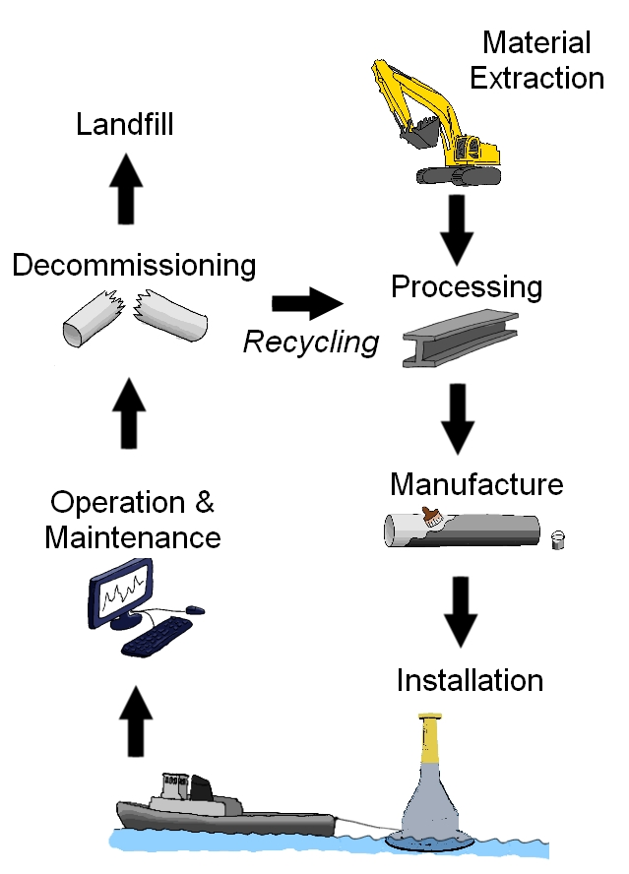
Full life cycle
Materials & Manufacture
Mass-based analysis
Welding, rolling etc.
Installation
Sea vessels
Preparation of sea bed
Operations & Maintenance
Mostly by sea vessel
Decommissioning & Disposal
Similar to installation
Recycling credit not considered

Slide 5
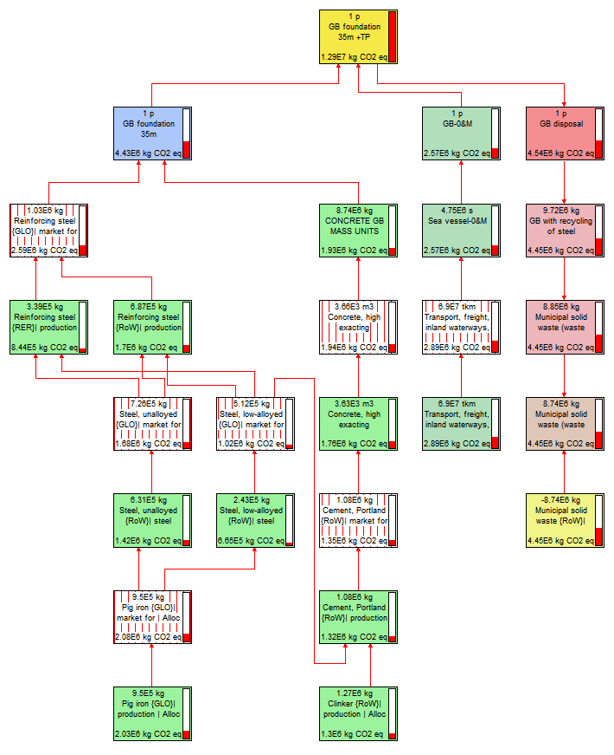
Analysis
SimaPro v8
Ecoinvent database
ReCiPe Midpoint LCIA method
Climate change impact greater than 5% of the total for gravity base foundation

Slide 6
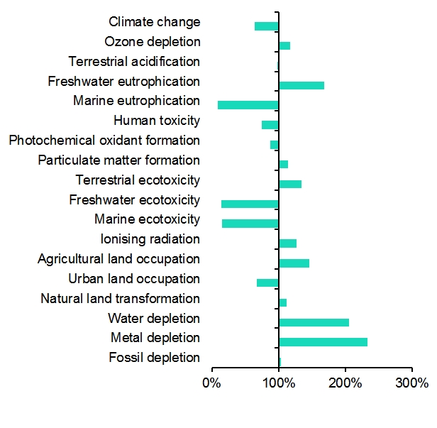
Site 1 Results
Performance of XL monopile in comparison to gravity base across all categories

Slide 7
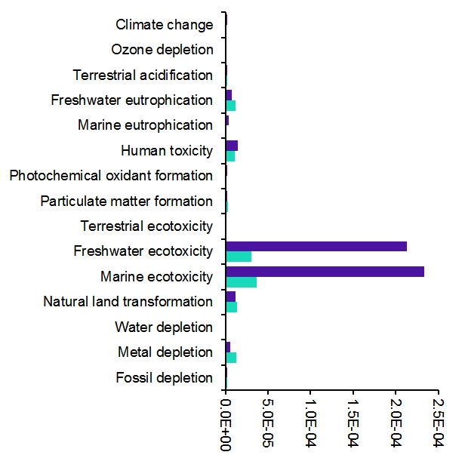
Site 1 Results
Performance of XL monopile in comparison to gravity base across all categories
Normalised comparison

Slide 8
Site 2 Results
Performance of jacket in comparison to gravity base across all categories

Slide 9
Site 2 Results
Performance of jacket in comparison to gravity base across all categories
Normalised comparison

Slide 10
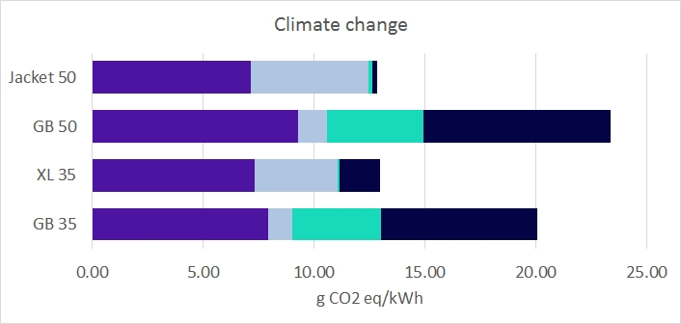
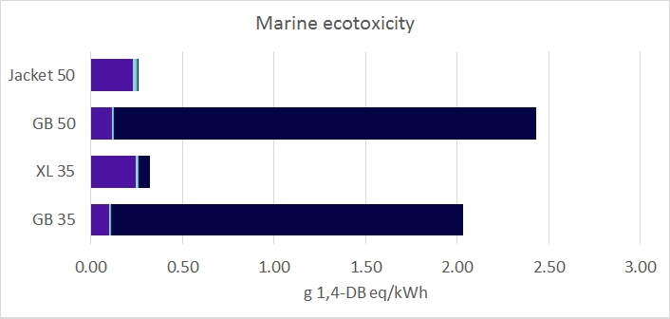
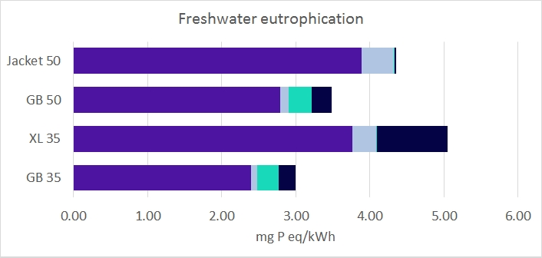
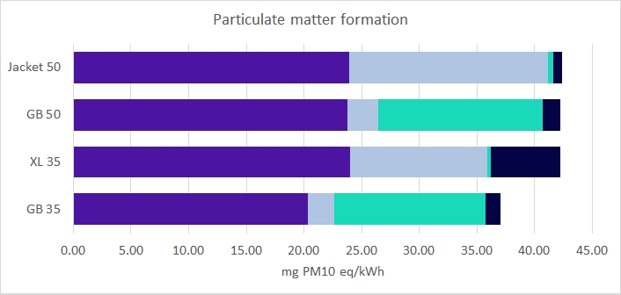
Selected Impact Categories

Slide 11
Conclusions
Steel foundations (XL monopile and Jacket) perform better than gravity base foundations in most categories.
Further investigation is required to identify the significant impacts of gravity base foundations at disposal stage.
These results are not necessarily based on the foundation designs being considered in LEANWIND – more definitive conclusions will be possible when input data is refined.

