Slide 1
SWIP
DNV GL
Koen Broess; Bart in ‘t Groen; Alma Tiggelman,
Greenovate! Europe
Simon Hunkin
CIRCE
Leo Subias
Thanks: Nikos Lelis, Anastasia Nikolopoulou

Slide 2
SWTs in urban and industrial areas
International IEC definition: Rotor swept area less than 200 m2
Residential 0.3 - 5 kW
Agricultural 10 - 50 kW
Industrial 10 – 50 kW
Community sites 1 – 10 kW

Slide 3
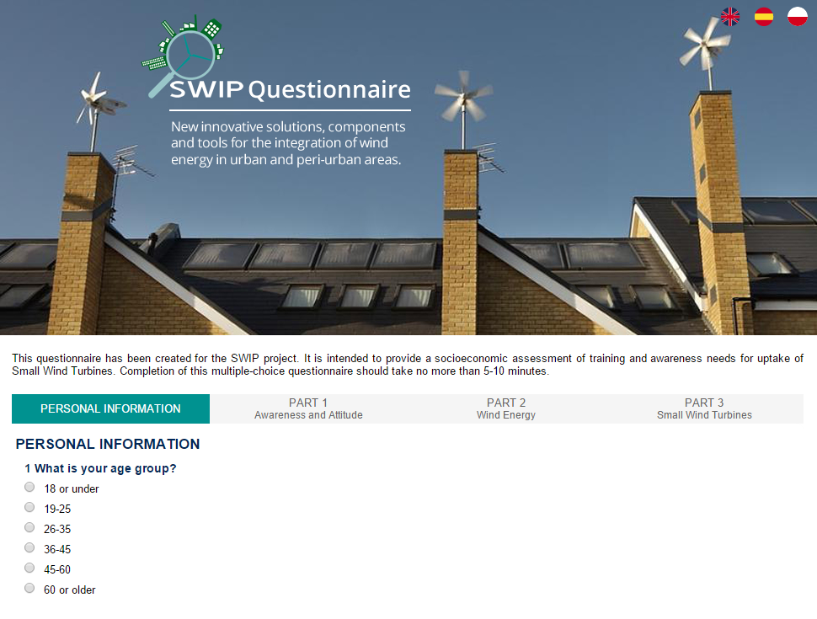
Questionnaire
Questionnaire consisting of 20 questions – available in English, French, German, Polish and Spanish
Online Questionnaire at:
http://swipproject.eu/
Aim
To inform communications efforts by illuminating perceptions of SWTs and differences amongst stakeholder groups

Slide 4
Profile of respondents
Age
19-25 – 52
26-35 – 126
36-45 – 52
45-60 – 42
60+ – 10
Gender
Male – 197
Female – 85
Environment
Rural – 52
Urban – 230
Profession
Policy maker – 2
Business owner – 13
Energy prof./student – 61
Agriculture – 2
None of the above - 27

Slide 5
Profile of respondents

Slide 6
Agreement with RES & Wind Statements
 | Important response to Energy needs | Important for Economic Development | Important for Env. & Climate | Good Investments
A Lot | 231 | 221 | 242 | 116
A bit | 47 | 55 | 34 | 133
Not at all | 3 | 6 | 5 | 31
How much do you agree with the following statements on renewable energies?
 | Harmful to wildlife | Attractive | Noisy | Cost Competitive & Reliable
A Lot | 17 | 91 | 24 | 112
A bit | 144 | 125 | 161 | 137
Not at all | 120 | 65 | 95 | 31
How much do you agree with the following statements about wind turbines?
Would potential co-ownership of a turbine with neighbours or your community increase your interest in wind energy generation?
Yes – 100
No – 3

Slide 7
SWTs
Reaction to wind turbine in your neighbourhood?
Negative – 32
Indifferent – 56
Positive – 194
Reaction to SWT in neighbourhood?
Negative – 15
Indifferent – 45
Positive – 220
SWT Installation Preference
Industrial sites – 234
Roofs in residential areas – 187
Ground level – 125
Integrated in building facades – 117
Nowhere – 9
Would the following developments increase your interest in Small Wind Turbines?
 | Reduced noise | Integration into architecture | Reduced vibration | Improved performance | Reduced costs
Yes | 250 | 224 | 252 | 261 | 263
No | 31 | 62 | 28 | 19 | 17

Slide 8
SWTs
How much do you agree with the following statements for explaining what prevents you from investing in a Small Wind Turbine?
 | Insufficient information | Investment is too high | Concerned about … Noise | Safety | Flicker | Visual impact | Performance | Vibrations
A lot | 96 | 95 | 74 | 51 | 12 | 37 | 104 | 69
A bit | 111 | 137 | 117 | 84 | 33 | 84 | 124 | 100
Not at all | 84 | 48 | 89 | 145 | 19 | 122 | 55 | 111

Slide 9
Interest in Competing Solutions
How interested would you be in the following decentralised energy solutions for your home?
 | SWTs | Solar PV | Solar Thermal Collectors | Combined Heat & Power
A lot | 168 | 207 | 197 | 187
A bit | 89 | 62 | 70 | 66
Not at all | 23 | 11 | 15 | 25

Slide 10
Conclusions questionnaire
Investment boundaries:
Not seen as good investments;
Image of poor performance;
Lack of awareness.
Turbines only partly seen as cost competitive and reliable;
Limited concern about visual impact for SWTs;
People view prospect of SWTs in their region slightly more favourably than large turbines;
Preference is for installation of SWTs in industrial sites and on roofs;
Other energy solutions, e.g. Solar PV, looked upon more favourably.

Slide 11
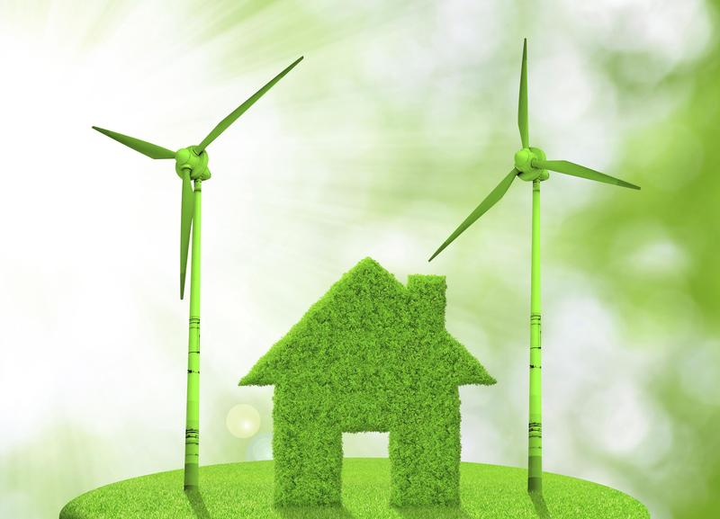
Why SWTs?
+ CO₂ savings
+ Decentralization of energy
+ Independence from energy providers
+ Complementarity to solar energy
+ Green symbol
Constraints
- Cost of technology
- Wind resource evaluation
- Regulation
- Social acceptance and safety
- Aesthetic, noise & vibration
- User friendliness

Slide 12
Value propositions SWTs
1
Financial output
Capital costs and support schemes determine the energy production cost.
2
Energy yield
Higher energy production than PV systems per m² and kWp.
3
Synergy with PV modules
More stable and durable energy production throughout the year.
4
Green symbol
Symbol for environmental consciousness for both building owners and companies.

Slide 13
SWT LCOE for different economic lifetimes
Discount rate: 2%
Capital costs: € 12000
Power: 1.9 kWp

Slide 14
Cumulative cash-flow for different average wind speeds

Slide 15
Financial output in selected locations
UK – Glasgow
NL - Schiermonnikoog
Wind speed: 4,6 m/s
LCOE: 0,17 €/kWh
PBP: 17 years*
Wind speed: 7,5 m/s
LCOE: 0,12 €/kWh
PBP: 12 years*
FR - Brest
PT- Lagos
Wind speed: 7,2 m/s
LCOE: 0,12 €/kWh
PBP: 12 years*
Wind speed: 6,1 m/s
LCOE: 0,17 €/kWh
PBP: 12 years*
IT - Lecce
GR - Kos
Wind speed: 4,3 m/s
LCOE: 0,17 €/kWh
PBP: 17 years*
Wind speed: 7,1 m/s
LCOE: 0,09 €/kWh
PBP: 13 years*
*Generally, support schemes vary significantly between countries. This results in different financial outputs from one country to another under similar wind resources.
Notes:
Fix the tables, either PBP or NPV or LCOE, comparison with PV moduels

Slide 16
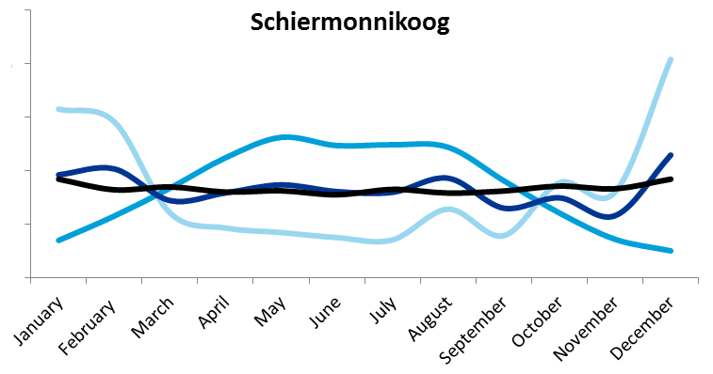
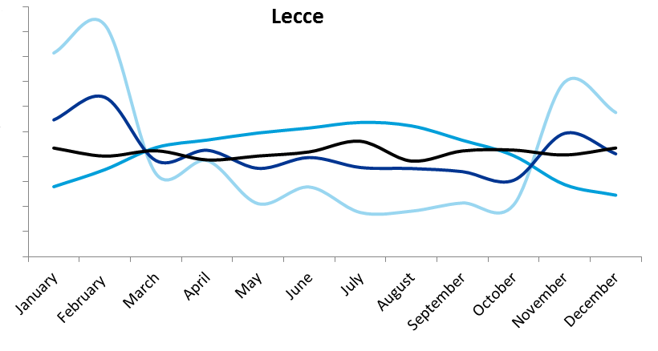
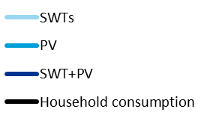
Autarky in combination with PV per location

Slide 17
Indicative autarky rate of households in selected locations of different countries
In all case studies: Annual electricity consumption = Annual production by PV and SWT technology. Energy storage is a fixed value

Slide 18
Business models for SWT
1
The SWT market is less attractive than the PV market.
The research verifies that SWTs are not economically appealing
High capital costs, no targeted legislations
2
Price competitiveness does not depend on a single factor.
Wind speed, electricity prices and subsidies
SWTs >10 kW can be profitable, but more suitable for industrial and rural areas
3
SWTs need financial support to be an attractive investment.
Policy driven technology
Not distinguished from large turbines regarding support schemes
4
SWTs can be used for increased autarky.
SWT+PV systems can economically compete with PV+ storage systems for increased electricity autarky

Slide 19
Thanks!
koen.broess@dnvgl.com Tel: +31263566290

