Slide 1
Low Scale Grid Emulator Test Bench For In-house Validation Of High Power Converters Oriented To Offshore
Speaker: Markel Zubiaga
www.ingeteam.com

Slide 2
INDEX
INTRODUCTION
GRID EMULATOR TEST BENCH
CONVERTER UNDER TEST CHARACTERISTICS
VALIDATION PROCESS
CASE EXAMPLES
CONCLUSIONS

Slide 3
INTRODUCTION
Why Grid emulator based test bench ?
2 MW
12 MW
5 MW
8 MW
OFFSHORE INDUSTRY TREND
+Bigger wind turbines
+Less cost
+Higher efficiency
CONSEQUENCE: LONGER PROJECT DEVELOPMENT PROCESS

Slide 4
INTRODUCTION
Why Grid emulator based test bench?
To improve efficiency and reduce costs
Less conservative solutions have to be implemented
High power solutions:
MV
Low commutation frequency
Multi-stator generators
Several conversion lines
New semiconductors
GOING OFFSHORE IS A BIG STEP
FOR POWER CONVERTERS

Slide 5
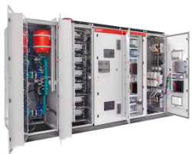
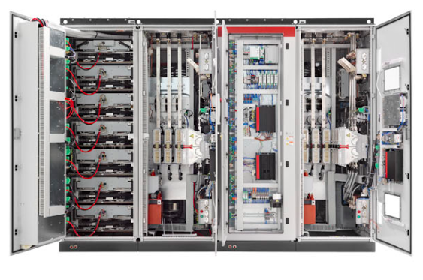
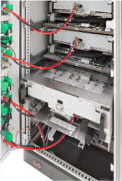
INTRODUCTION: PRODUCT CHARACTERISTICS
Ingecon Wind MV100 family
 | 2 CONVERSION LINES ARRANGEMENT
 | GRID |  |  |  | MACHINE
 | WT power [kW] V(pu) / PF 0,9/0,9 | WT power [kW] V(pu) / PF 0,9/0,95 | WT power [kW] V(pu) / PF 0,95/0,95 | WT power [kW] Vn@PF=1 | WT Power [kW] Vn@PF=0,95
INGECON WIND MV100 5600 | 9100 | 9600 | 10100 | 11200 | 11400
 | 10000 | 10600 | 11200 | 12400 | 12500
INGECON WIND MV100 4600 | 7500 | 7900 | 8300 | 9200 | 9300
 | 8300 | 8700 | 9200 | 10200 | 10300
INGECON WIND MV100 3400 | 5500 | 5800 | 6100 | 6800 | 6800
 | 6200 | 6500 | 6900 | 7600 | 7600
RATED POWER
OVERLOAD

Slide 6
PROBLEM BASICS
Facing the design of MV100 family for offshore
High power converter
+
Not friendly environment for on site tests
+
Big design challenges
________________
x
Expensive and special testing power labs
=
Low scale test bench in-house
Low scale test bench
Grid emulator to replicate easily grid conditions
Low voltage / power MV100 replica
Simple turbine environment (Drive-generator + WTC)

Slide 7
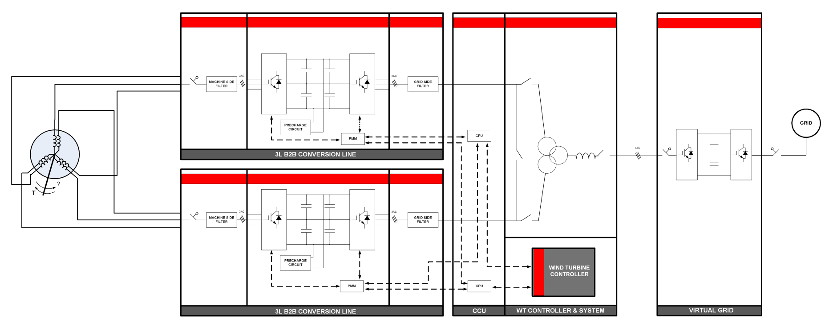
GRID EMULATOR TEST BENCH SCHEME
Power Converter Testing
Configurable low scale test bench: 1 & 2 CL
MULTIPHASE MACHINE
CCU + WT CONTROLLER & SYSTEM
GRID EMULATOR
2 x CONVERSION LINES (3L B2B)
A
B
C

Slide 8
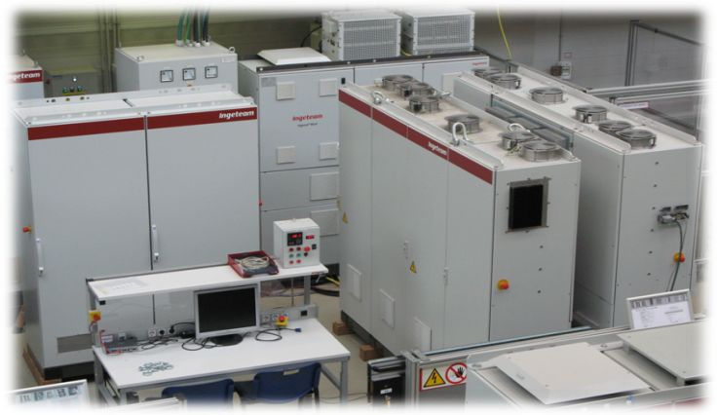
GRID EMULATOR TEST BENCH OVERVIEW
Configurable low scale test bench: 1 & 2 CL
2 Converter Line B2B (3L)
V_{BUS}=1100V e I_{RED}=150A
Several filter options
Several taps to configure inductors
Test bench modeled and translated to a simulation scenario
C
B
A

Slide 9
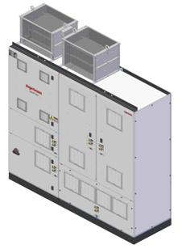
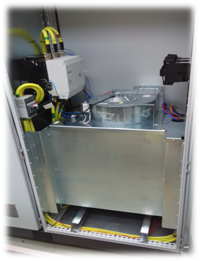
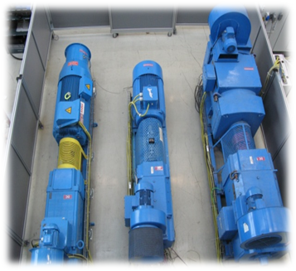
GRID EMULATOR TEST BENCH: 3L-B2B CONVERTER
3L-B2B Converter to emulate a grid
Power range: 775 kW
Input voltage: 690V
Output current: 650A
Additional cabinet composed by:
Grid transformer (possibility of several winding connections)
Grid impedance configuration
Contactors
Drives and several generators:
Multi-phase PMG generator (Configurable angle between stators)
SCIG generator
Synchronous generator

Slide 10
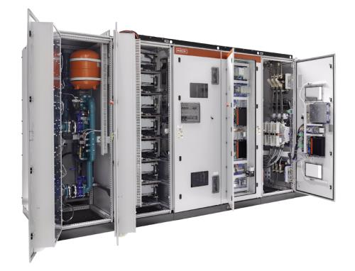
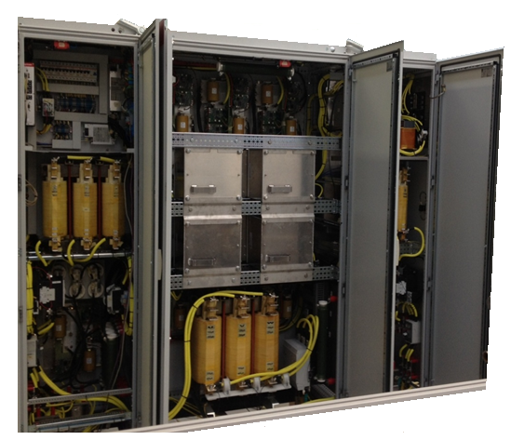
CONVERTER UNDER TEST CHARACTERISTICS
Low Voltage / Power Replica
WIND AREA SCALED REPLICA
INVERTER TOPOLOGY 3L-NPC
SEMICONDUCTORS IGBT
COOLING Natural convection
CHOPPER Yes
VBUS 1100 V
INPUT VOLTAGE 690 V
OUTPUT CURRENT 150 A

Slide 11
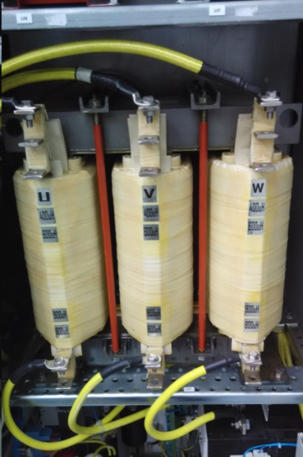
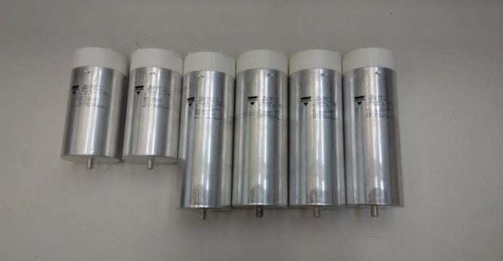
CONVERTER UNDER TEST: POWER CIRCUIT CHARACTERISTICS
Low Voltage / Power Replica
The control hardware and the control code in the real equipment and the scaled one are the same
Same control logics, auxiliary equipment and input/output signals
A simple wind turbine level Control (WTC) system is also implemented in order to test dynamic operations
Power Circuit
The components of the power circuit are scaled maintaining the same per unit value
The equipment under test (EuT) can represent the whole range of converter product family (5 – 10MW)

Slide 12
VALIDATION PROCESS
Control Code Validation
Control code is always in constant evolution
new environments, new requirements, new regulations, new products, new hardware, etc
As important as developing new software capabilities is integrating them into the control code
Fast
Reliable
Generic validation plan: / Specific validation plan:
Tests every issue in the grid codes focused on a specific aspect.

Slide 13
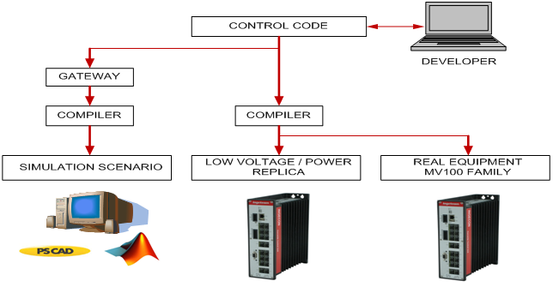
VALIDATION PROCESS: SIMULATION TEST SCHEME
Simulation – Test - Prove
SIMULATE
PROGRAM
TEST

Slide 14
VALIDATION PROCESS
Grid Emulator capabilities
Symmetric & Asymmetric voltage dips (97% depth)
Voltage dips with specific phase-angle jumps
Voltage dips with specific start phase-angle
Frequency deviations
Grids with high harmonic components
HVRT up to 1.5 pu
Weak grids with negative sequence voltage
·
·
·

Slide 15
CASE EXAMPLES: EVALUATED CONTROL ASPECTS
Developments made by using grid emulator
Development of new FOM (Filter Oriented Modulation)
Upgrade control code for LVRT due to requirement changes
TRANSFORMER ENERGIZATION
REDUNDANCY
EVALUATION OF TWO CONVERTER LINES (RECIRCULATION, ETC)…
GENERATOR CONTROL OPTIMIZATION
AND MANY MORE…

Slide 16
CASE EXAMPLES: NEW MODULATION
Development of new FOM
Offshore MV applications require high power
Commutation frequency Vs Output power
Improving modulation allows to achieve higher output power in converters
Modulation changes affect almost every aspect of the converter
Control techniques, filter, step response….
Extensive tests have to be performed

Slide 17
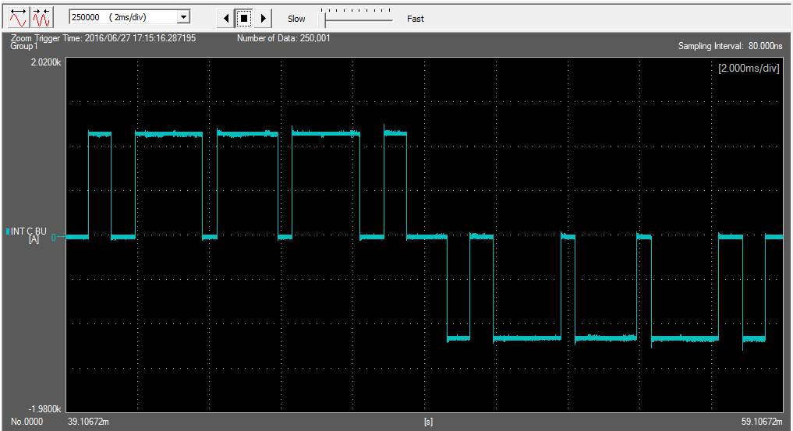
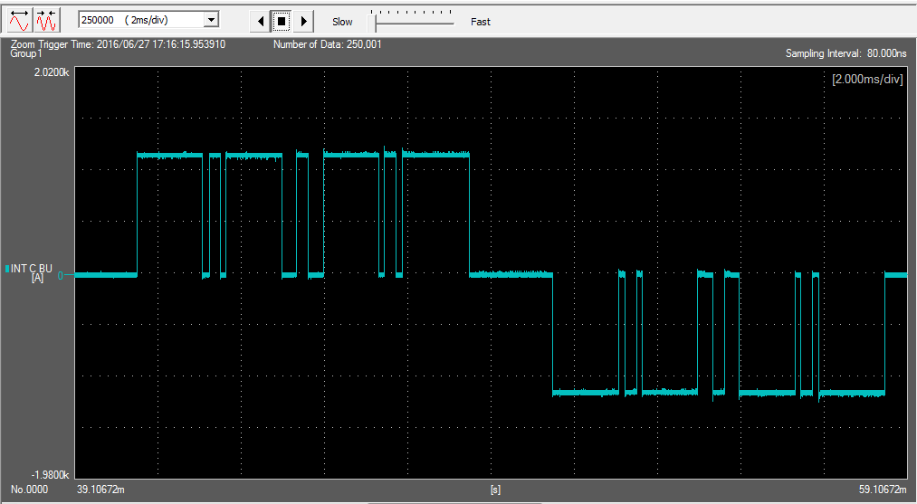
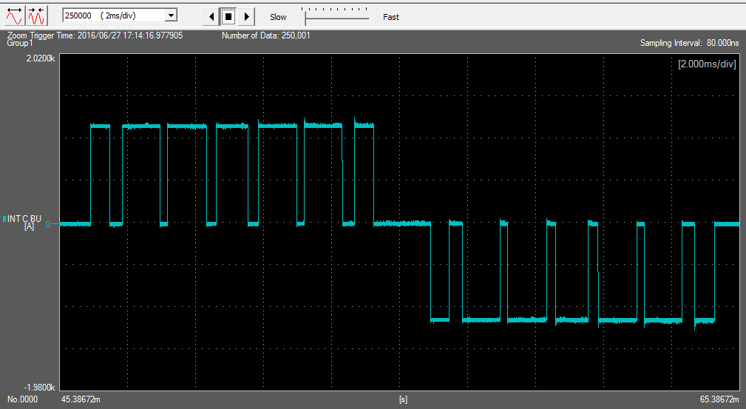
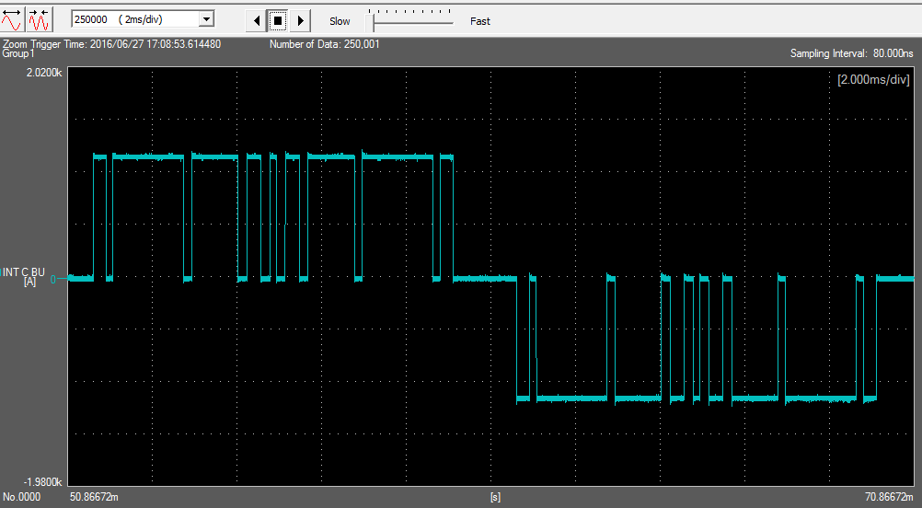
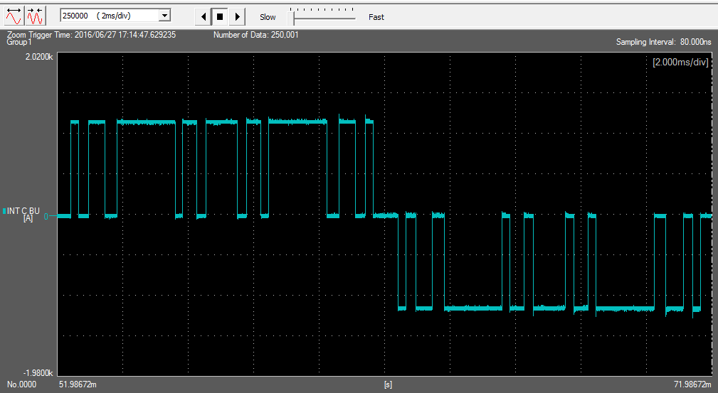
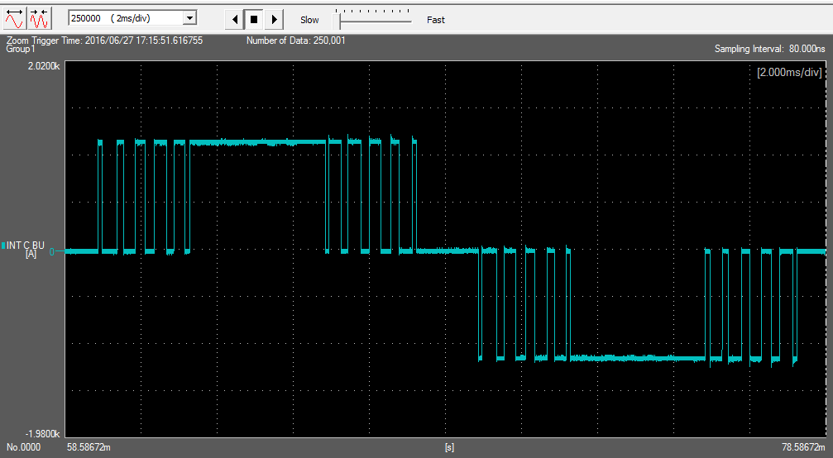
CASE EXAMPLES: RESULTS FOR NEW MODULATION
Development of new FOM

Slide 18
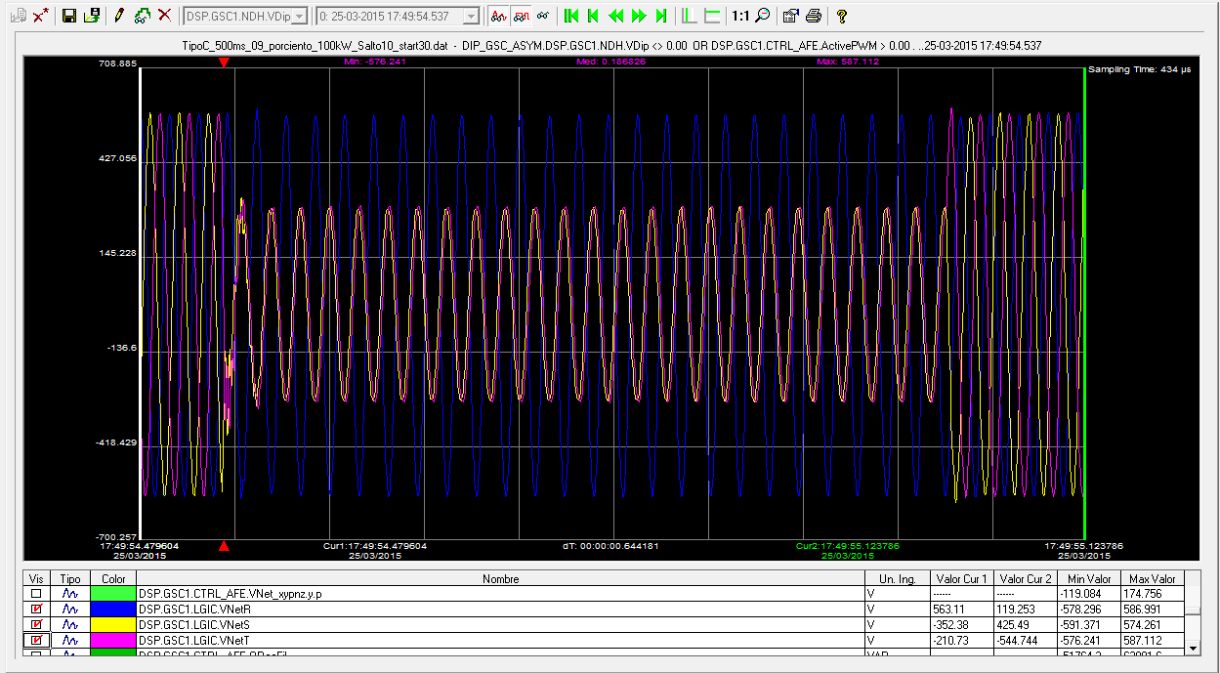
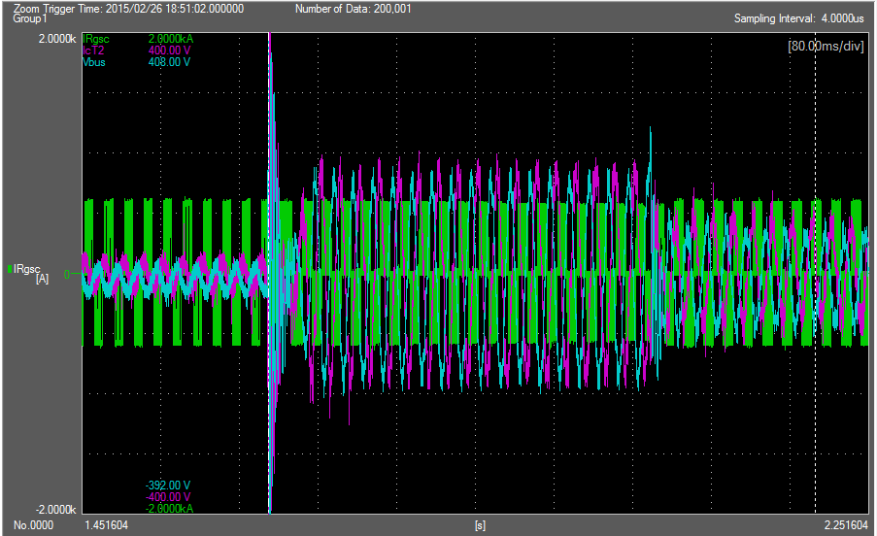
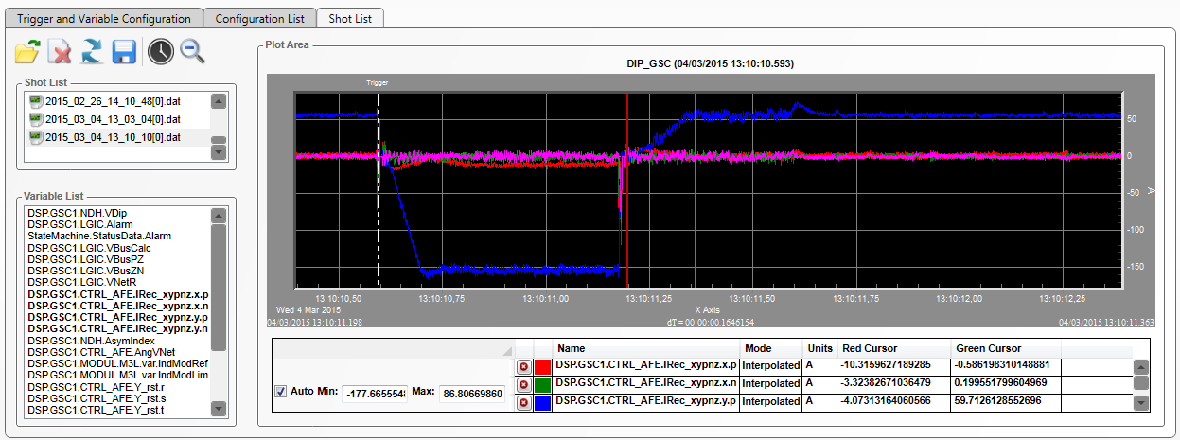
CASE EXAMPLES
Upgrade control code for LVRT
Specific tests of voltage dips

Slide 19
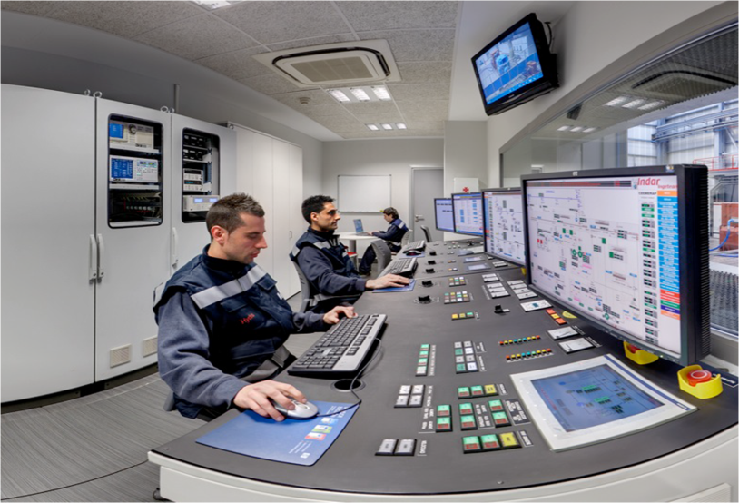
CONCLUSIONS
Translation to real equipment
Test bench results have been contrasted with real equipment.
Normal operation tests
LVRT
Power lab up to 12 MW
Beasain, Spain
In-house power lab
Zamudio, Spain
Performed tests have shown successful results

Slide 20
CONCLUSIONS
Conclusions
Grid emulator test bench is located in-house close to code developers and the whole system has been modeled and translated into simulation. So, the access to both, makes the product development process shorter and performed with more guaranties.
Validation process with real equipment is shorter.
Simulation models can be improved by comparing the results in the test bench with the results in the simulated scenario.

Slide 21
CONCLUSIONS
Additional advantages
More accurate and validated simulation models of the converter can be used by the wind turbine manufacturer to optimize the wind turbine and the transmission system.
Scaled replica with the grid emulator gives the opportunity to provide support to turbine manufacturer going offshore.

Slide 22
FIN

