Slide 1
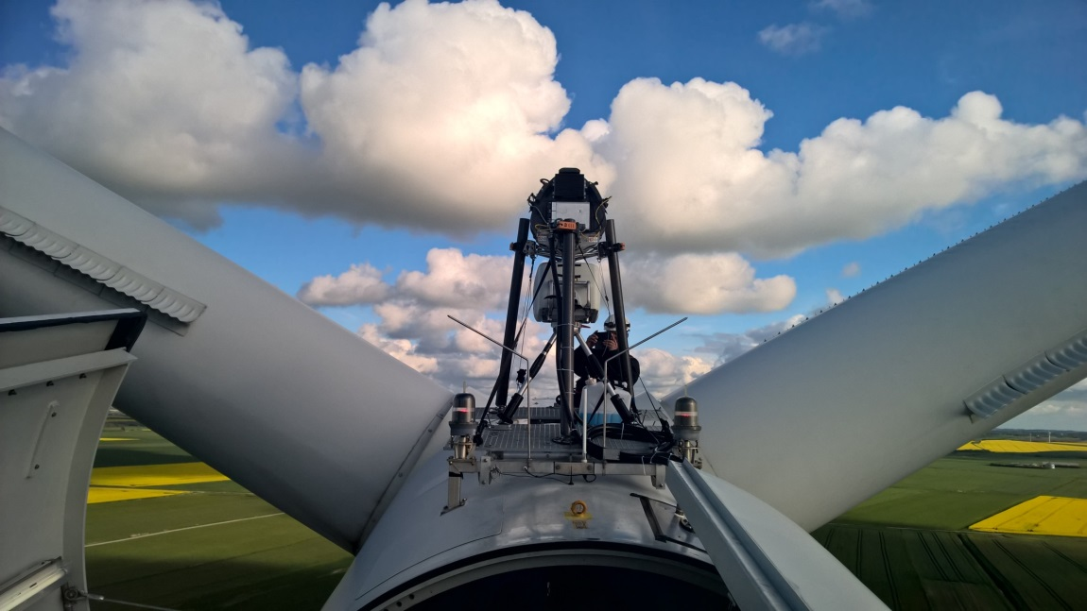
Near flow measurements with nacelle lidars: the future of power performance verification?
ZephIR Dual-Mode
5-beam Avent demonstrator
A. Borraccino, R. Wagner, DTU Wind Energy, borr@dtu.dk D. Schlipf, F. Haizmann, Stuttgart Wind Energy

Slide 2
Searching for free stream wind speed
$V_{∞}$ ??
$$V_{2.5D}$$
Modern turbines: 2.5D ~ 200-400m
Decorrelation WSpeed / power
H_{hub} speed insufficient?
2.5D not really free wind …
Add Presentation Title in Footer via ”Insert”; ”Header & Footer”

Slide 3
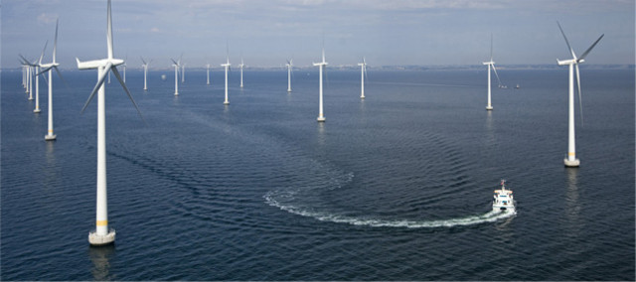
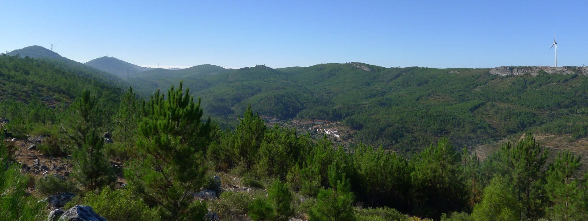
Does this make it any easier?
Perdigão. credit: N. Vasiljevic
In complex terrain:
any ”free stream” wind speed idea?
site calibration? Maybe
Offshore:
mast expensive
free wind may not be measurable due to wakes
Add Presentation Title in Footer via ”Insert”; ”Header & Footer”

Slide 4
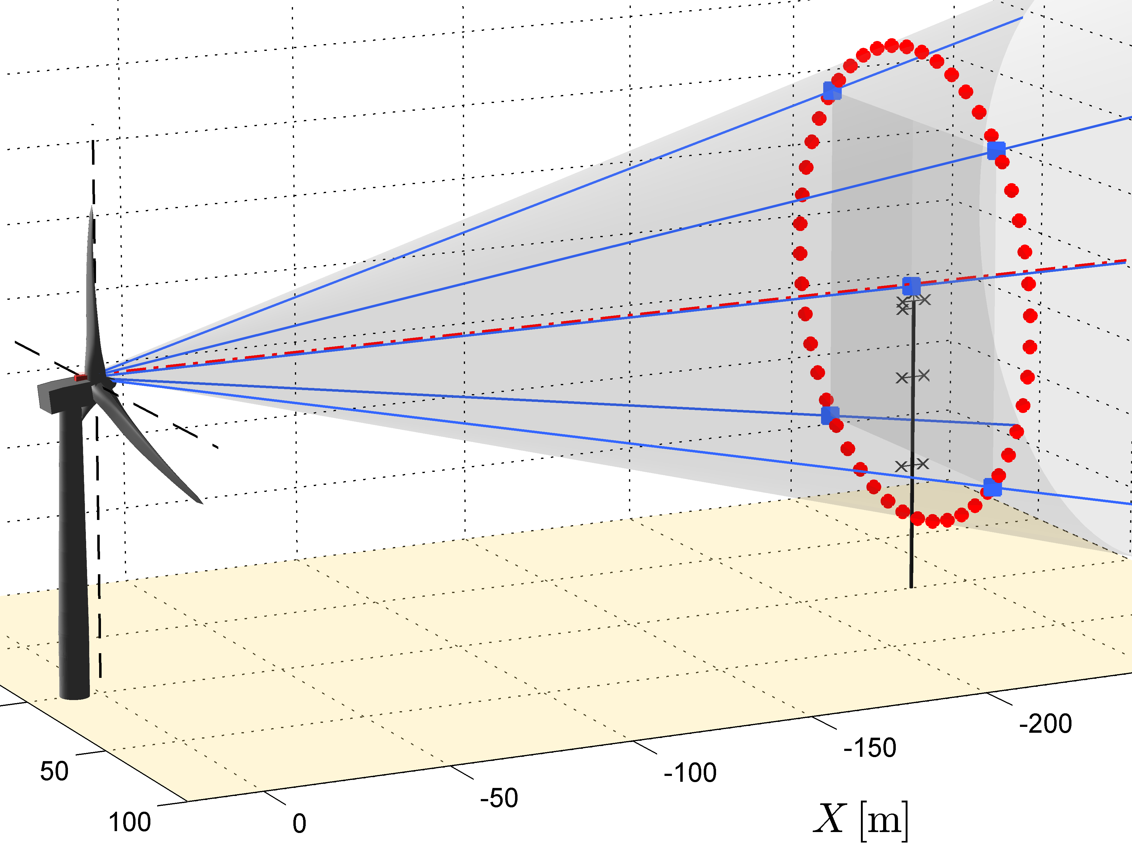
Power performance verification: nacelle-mounted lidars, the future?
Several possibilities for lidar measurements:
2.5D distance fitting wind speed + direction + shear to lidar-measured LOS velocities
lidar measurements
Add Presentation Title in Footer via ”Insert”; ”Header & Footer”

Slide 5
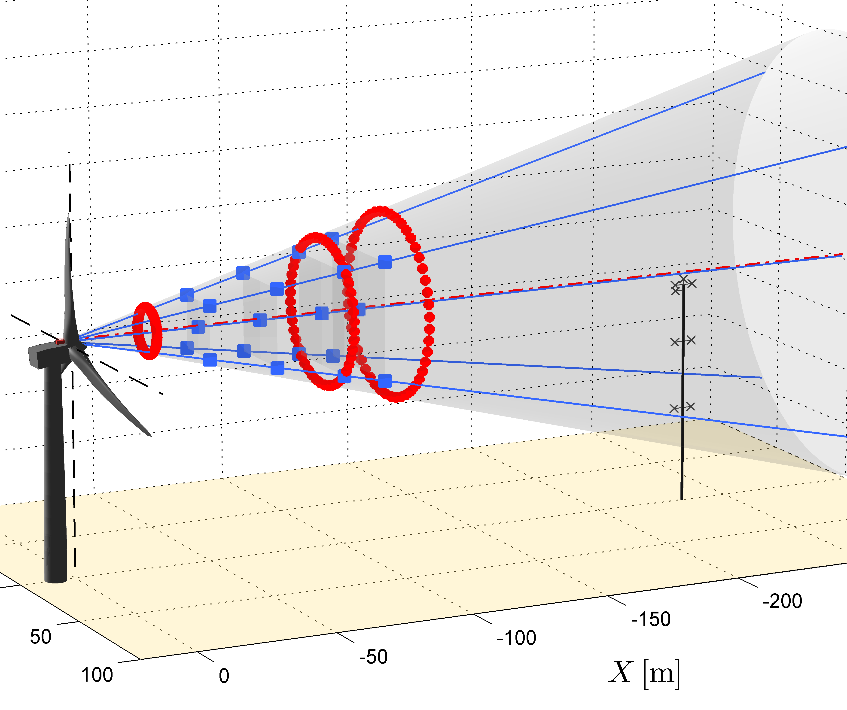
Power performance verification: nacelle-mounted lidars, the future?
Several possibilities for lidar measurements:
2.5D distance fitting wind speed + direction + shear to lidar-measured LOS velocities
Multiple distances close to rotor induction integrated in wind field reconstruction
$\frac{U\left(x\right)}{U_{∞}}=1−a\left(1+\frac{ξ}{\sqrt{1+ξ^{2}}}\right)$ $a=\frac{1}{2}\left(1−\sqrt{1−C_{t}}\right)$
lidar measurements
induction transfer function to retrieve $V_{∞}$
Add Presentation Title in Footer via ”Insert”; ”Header & Footer”

Slide 6
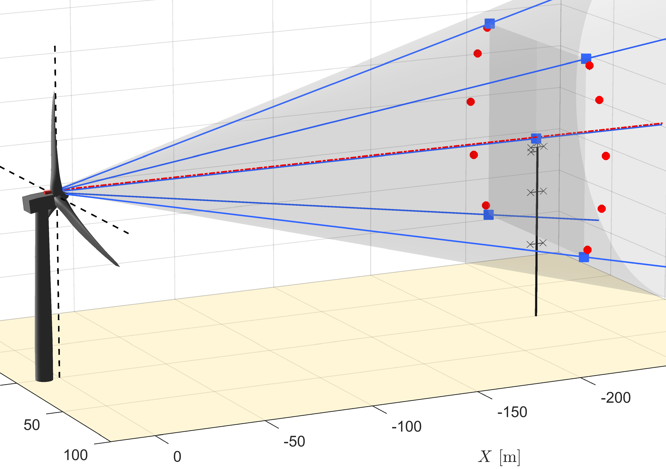
Case 1: lidar meas. @2.5D
5B-Demo: use the 5 pts ZDM: use 10 pts
lidar measurements
Add Presentation Title in Footer via ”Insert”; ”Header & Footer”

Slide 7
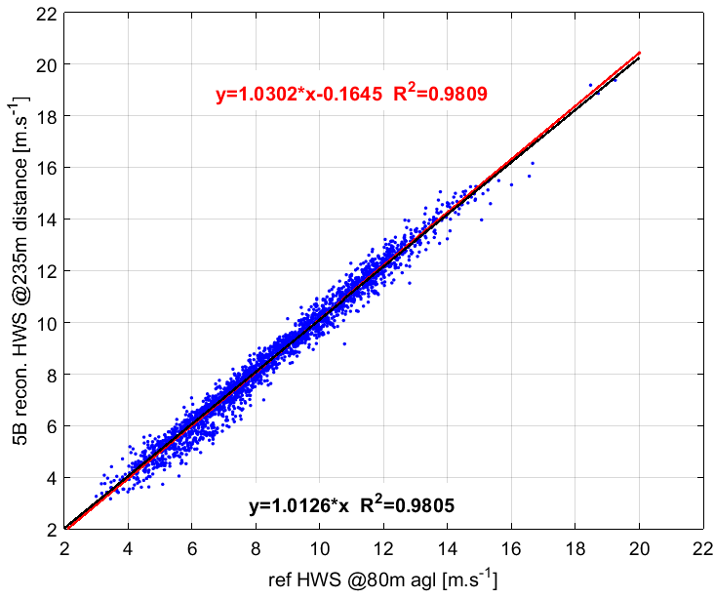
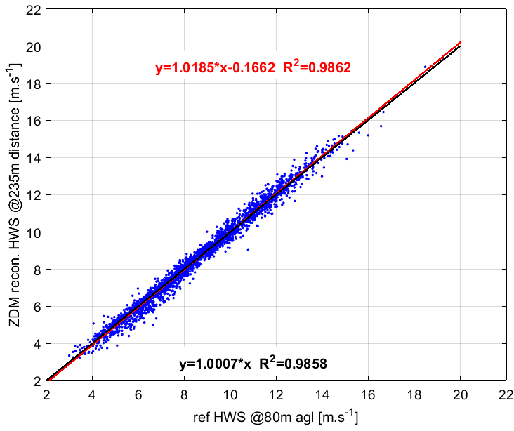
Case 1: lidar meas. @2.5D Mast comparison
5B-Demo: use the 5 pts ZDM: use 10 pts HWS estimated @hub height
$$y=1.0302x−0.1645 R^{2}=0.9809$$
$$y=1.0185x−0.1662 R^{2}=0.9862$$
$$y=1.0126x R^{2}=0.9805$$
$$y=1.0007x R^{2}=0.9858$$
$$N_{points}=2563$$
Add Presentation Title in Footer via ”Insert”; ”Header & Footer”

Slide 8
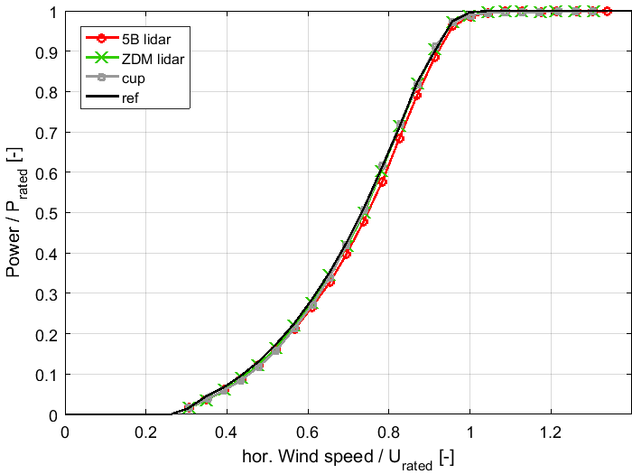
Case 1: lidar meas. @2.5D Power curves
Add Presentation Title in Footer via ”Insert”; ”Header & Footer”

Slide 9
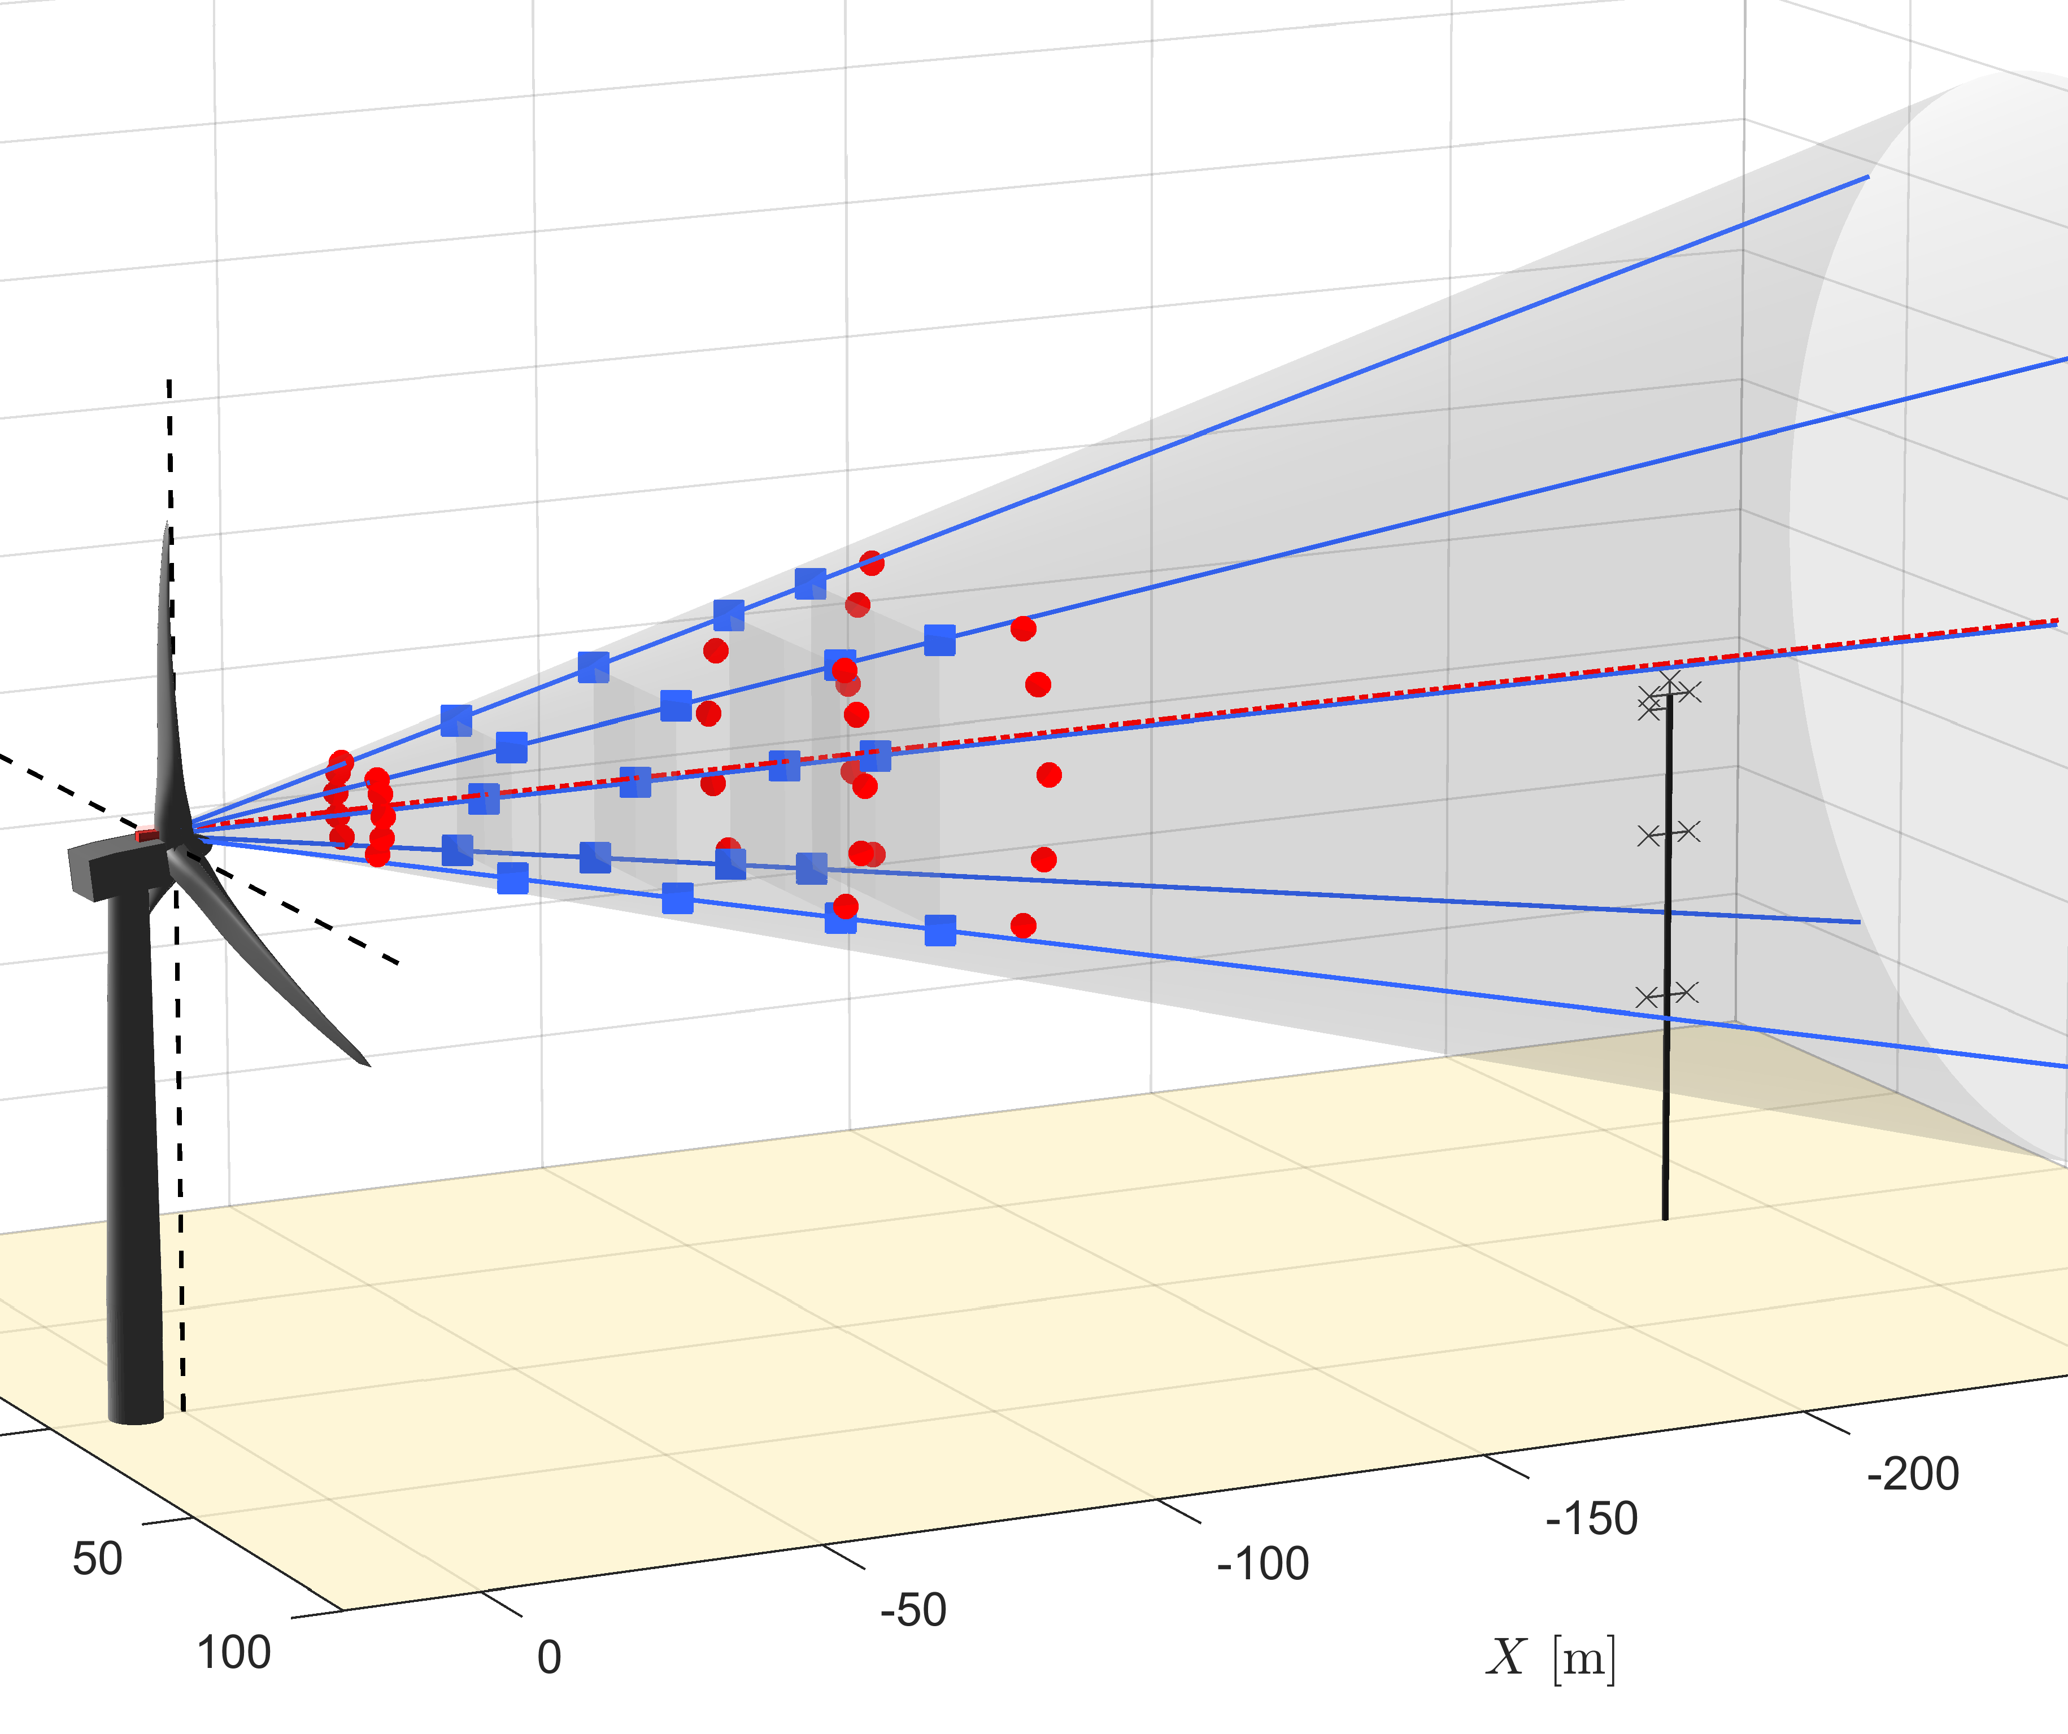
Case 2: lidar meas. @ multiple distances close to rotor
5B-Demo : use the 5 pts ZDM: use 10 pts @[0.5 0.75 1.0 1.15] D @[0.3 1.0 1.25] D
lidar measurements
induction transfer function to retrieve $V_{∞}$
Add Presentation Title in Footer via ”Insert”; ”Header & Footer”

Slide 10
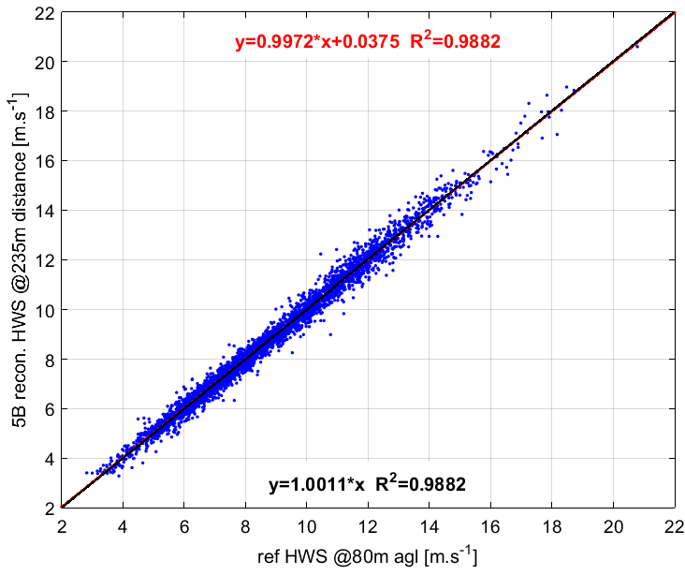
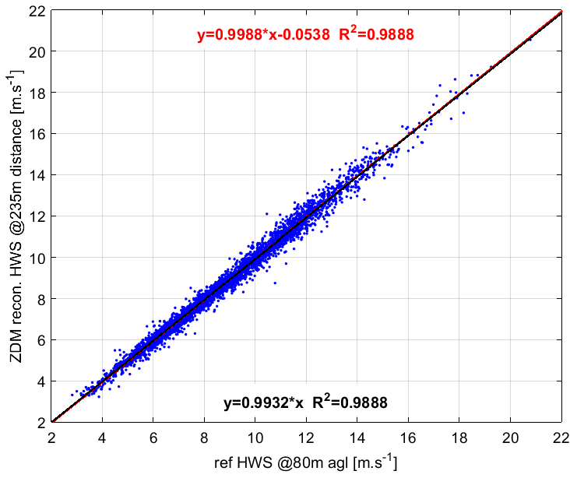
Case 2: lidar meas. @ multi-dist (near flow) Mast comparison
5B-Demo: use the 5 pts ZDM: use 10 pts @[0.5 0.75 1.0 1.15] D @[0.3 1.0 1.25] D HWS estimated @hub height and @2.5D distance
$$y=0.9972x+0.0375 R^{2}=0.9882$$
$$y=0.9988x−0.0538 R^{2}=0.9888$$
$$y=1.0011x R^{2}=0.9882$$
$$y=0.9932x R^{2}=0.9888$$
$$N_{points}=4028$$
Add Presentation Title in Footer via ”Insert”; ”Header & Footer”

Slide 11
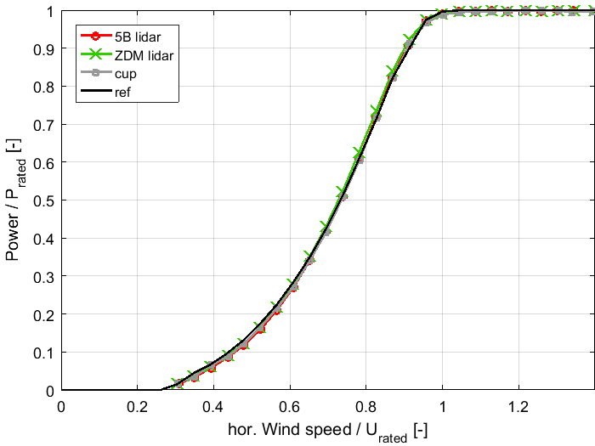
Case 2: lidar meas. @ multi-dist (near flow) Power curves
Add Presentation Title in Footer via ”Insert”; ”Header & Footer”

Slide 12
AEP results
IEC -12-1 methodology
extrapolated AEPs
0.5 m/s bin width
Relative difference in % of cup-based AEP
➔AEP estimations as good with the “multi-distances” method as with the 2.5D (<1.5% difference)
Lidar measurements | @2.5 D (case 1) |  |  | @multiple distances (case 2)
Rayleigh avg wind speed | 6 m/s | 8 m/s | 10 m/s | 6 m/s | 8 m/s | 10 m/s
Avent 5-Beam demonstrator lidar | Wspeed difference: +1.2% |  |  | Wspeed difference: +0.1%
 | -2.0% | -1.6% | -1.2% | -0.4% | -0.1% | +0.0%
Zephir Dual Mode lidar | Wspeed difference: +0.1% |  |  | Wspeed difference: -0.7%
 | +0.4% | +0.2% | +0.1% | +2.0% | +1.3% | +0.9%
Add Presentation Title in Footer via ”Insert”; ”Header & Footer”

Slide 13
Take-aways
$V_{∞}$ is found! The solution: measurements close to rotor, within the induction zone, at multiple distances, e.g. with nacelle lidars
Wind Field Reconstruction algo. provide estimates comparable classic mast instrumentation ($<1\%$ difference)
Power curves in flat terrain verified accurately, reduced scatter (as usual with nacelle lidars)
next generation of IEC61400-12-1 standards? (NWIP)
Further work :
Two-dimensional induction? (ongoing)
Adaptation and testing of method in complex terrain (campaign in Hill of Towie, Zephir DM+4-beam Wind Iris)
Uncertainty assessment of Wind Field Characteristics: speed, direction, shear, induction factor / Ct, …
Add Presentation Title in Footer via ”Insert”; ”Header & Footer”

Slide 14
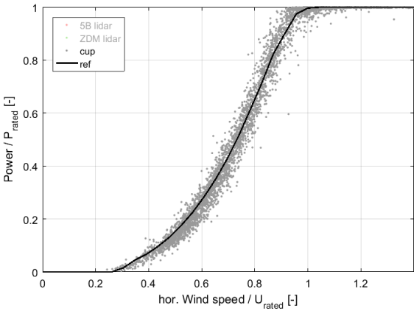
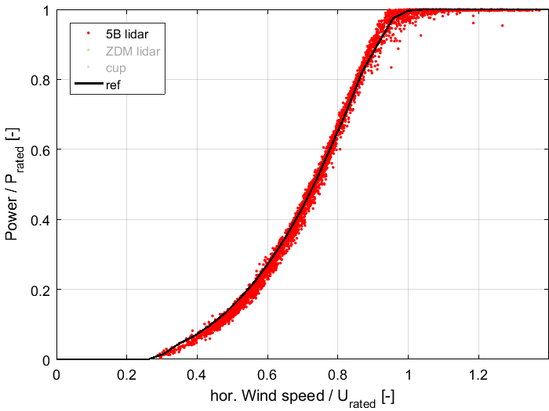
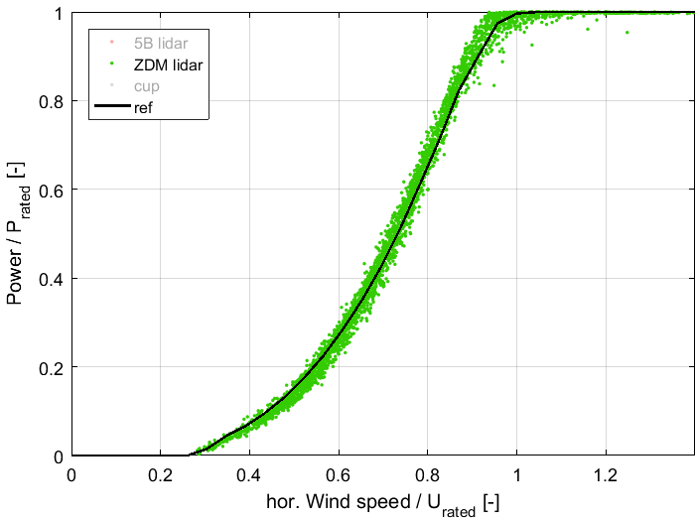
Thanks for your attention!
Mast
5B-Demo
ZDM
More info:
website www.unitte.dk
contact borr@dtu.dk
Add Presentation Title in Footer via ”Insert”; ”Header & Footer”

Slide 15
Acknowledgements
This work was performed within the UniTTe project (www.unitte.dk) which is financed by Innovation Fund Denmark.
Add Presentation Title in Footer via ”Insert”; ”Header & Footer”

Slide 16
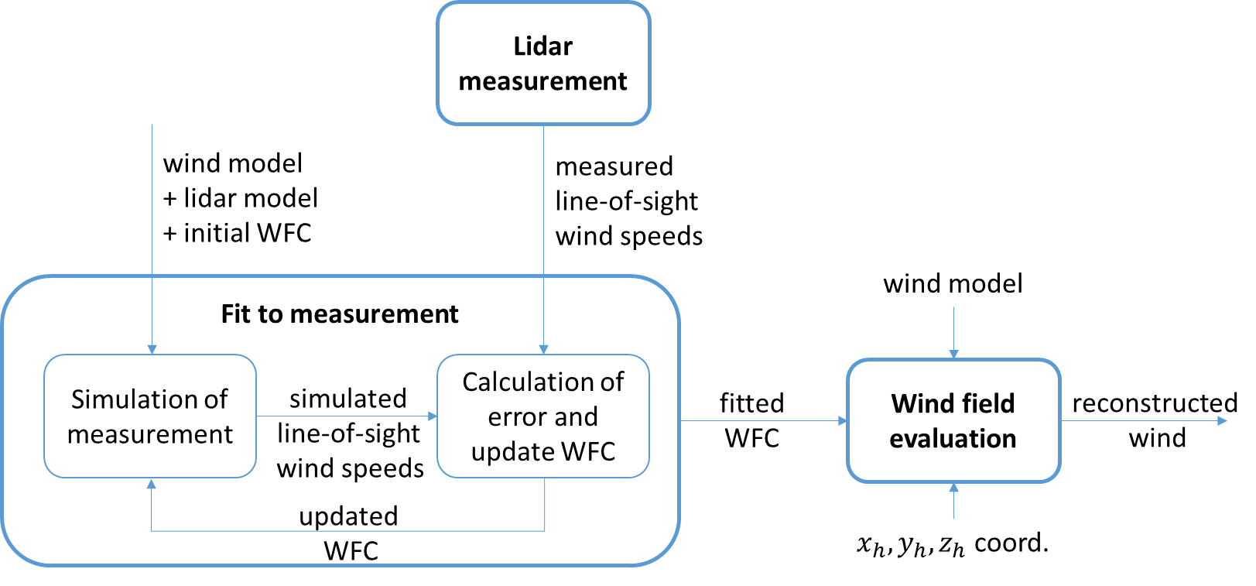
Model-based wind field reconstruction
Doppler wind LiDaRs do not…
…measure wind speed, wind direction, shear, …
see Hardesty, 1987 (wonderful description of lidar principles)
They:
only measure LOS velocities
estimate/reconstruct wind field characteristics (WFC)
Add Presentation Title in Footer via ”Insert”; ”Header & Footer”

Slide 17
Model-based wind field reconstruction
Modelling the wind field
choose a wind model that fits the application & site characteristics
the reconstruction should be performed either in the WIND coordinate systems or in the HUB
For power performance: static models
i.e. no time dependency
use 10-min averages of:
LOS velocities
inclinometers readings
use knowledge of the trajectory (opening angles, ranges config) and of lidar position
Add Presentation Title in Footer via ”Insert”; ”Header & Footer”

Slide 18
Model-based wind field reconstruction
Wind models
fitted wind characteristics are:
HWS $v_{0}$
yaw misalignment $α_{H}$ (relative wind dir)
shear exponent $α_{exp}$
Model | $$U$$ | $$V$$ | $$W$$ | comment
Homogeneous 2D | $$U_{w}=cst ↔U_{I}=U$$ | $$V_{w}=0 ↔V_{I}=V$$ | $$W_{w}=0 ↔W_{I}=0$$ | Does not depend on X, Y, Z
Homogeneous 3D | $$U_{w}=cst ↔U_{I}=U$$ | $$V_{w}=0 ↔V_{I}=V$$ | $$W_{w}=0 ↔W_{I}=W$$ | Does not depend on X, Y, Z
Inhomogeneous 2D + linear V shear | $$U_{w}=v_{0}+δ_{V}∙\left(z_{W}−z_{hub}\right) \\ ↔U_{I}=f(z)$$ | $$V_{w}=0 ↔V_{I}=V$$ | $$W_{w}=0 ↔W_{I}=0$$ | Yaw misalignment $α_{H}=cst$
Inhomogeneous 2D + linear V shear + linear V veer | $$U_{w}=v_{0}+δ_{V}∙\left(z_{W}−z_{hub}\right) \\ ↔U_{I}=f(z)$$ | $$V_{w}=0 ↔V_{I}=f(z)$$ | $$W_{w}=0 ↔W_{I}=0$$ | Yaw misalignment $α_{H}=f(z)$
Inhomogeneous 2D + power law shear | $U_{w}=v_{0}{\left({z_{w}}/{z_{hub}}\right)}^{α_{exp}}$ $$↔U_{I}=f(z)$$ | $$V_{w}=0 ↔V_{I}=V$$ | $$W_{w}=0 ↔W_{I}=0$$ | Yaw misalignment $α_{H}=cst$
Add Presentation Title in Footer via ”Insert”; ”Header & Footer”

Slide 19
Model-based wind field reconstruction
Wind models
fitted wind characteristics are: free stream HWS $U_{∞}$ , yaw misalignment $α_{H}$, shear exponent $α_{exp}$, induction factor $a$.
Model name | $$U$$ | $$V$$ | $$W$$ | comment
Homogeneous 2D | $$U_{w}=cst ↔U_{I}=U$$ | $$V_{w}=0 ↔V_{I}=V$$ | $$W_{w}=0 ↔W_{I}=0$$ | Does not depend on X, Y, Z
Homogeneous 3D | $$U_{w}=cst ↔U_{I}=U$$ | $$V_{w}=0 ↔V_{I}=V$$ | $$W_{w}=0 ↔W_{I}=W$$ | Does not depend on X, Y, Z
Inhomogeneous 2D + linear V shear | $$U_{w}=v_{0}+δ_{V}∙\left(z_{W}−z_{hub}\right) \\ ↔U_{I}=f(z)$$ | $$V_{w}=0 ↔V_{I}=V$$ | $$W_{w}=0 ↔W_{I}=0$$ | Yaw misalignment $α_{H}=cst$
Inhomogeneous 2D + linear V shear + linear V veer | $$U_{w}=v_{0}+δ_{V}∙\left(z_{W}−z_{hub}\right) \\ ↔U_{I}=f(z)$$ | $$V_{w}=0 ↔V_{I}=f(z)$$ | $$W_{w}=0 ↔W_{I}=0$$ | Yaw misalignment $α_{H}=f(z)$
Inhomogeneous 2D + power law shear | $U_{w}=v_{0}{\left({z_{w}}/{z_{hub}}\right)}^{α_{exp}}$ $$↔U_{I}=f(z)$$ | $$V_{w}=0 ↔V_{I}=V$$ | $$W_{w}=0 ↔W_{I}=0$$ | Yaw misalignment $α_{H}=cst$
Inhomogeneous 2D + power law shear + induction model | $$U_{w}=f\left(x, z\right) \\ ↔U_{I}=f(x, z)$$ | $$V_{w}=0 \\ ↔V_{I}=f(x,z)$$ | $$W_{w}=0 ↔W_{I}=0$$ | 1D Biot-Savard for induction fct
Add Presentation Title in Footer via ”Insert”; ”Header & Footer”

Slide 20
Power performance verification: “standard” procedure, what’s the problem?
$$V_{2.5D}$$
$V_{∞}$ ??
Modern turbines: 200-400m
Decorrelation WSpeed / power
H_{hub} speed insufficient?
2.5D not really free wind …
Too expensive: e.g. offshore
Add Presentation Title in Footer via ”Insert”; ”Header & Footer”

Slide 21
Power performance verification: “standard” procedure, what’s the problem?
$V_{2.5D}$?
$V_{∞}$ ??
Modern turbines: 2.5D ~ 200-400m
Add Presentation Title in Footer via ”Insert”; ”Header & Footer”

Slide 22
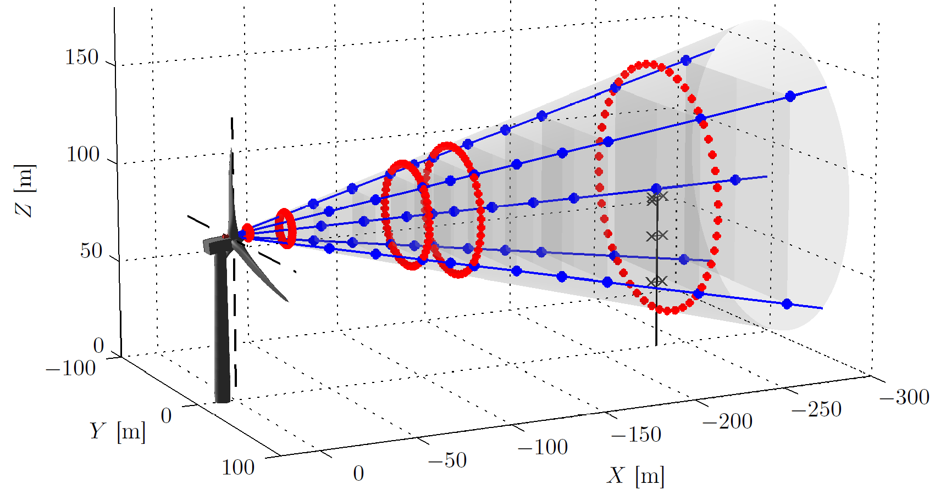
Nørrekær Enge campaign (NKE), 7 months
Two nacelle lidars: Avent 5-beam (5B) in blue, ZephIR Dual Mode (ZDM) in red
IEC compliant mast + SCADA + full loads
Add Presentation Title in Footer via ”Insert”; ”Header & Footer”

Slide 23
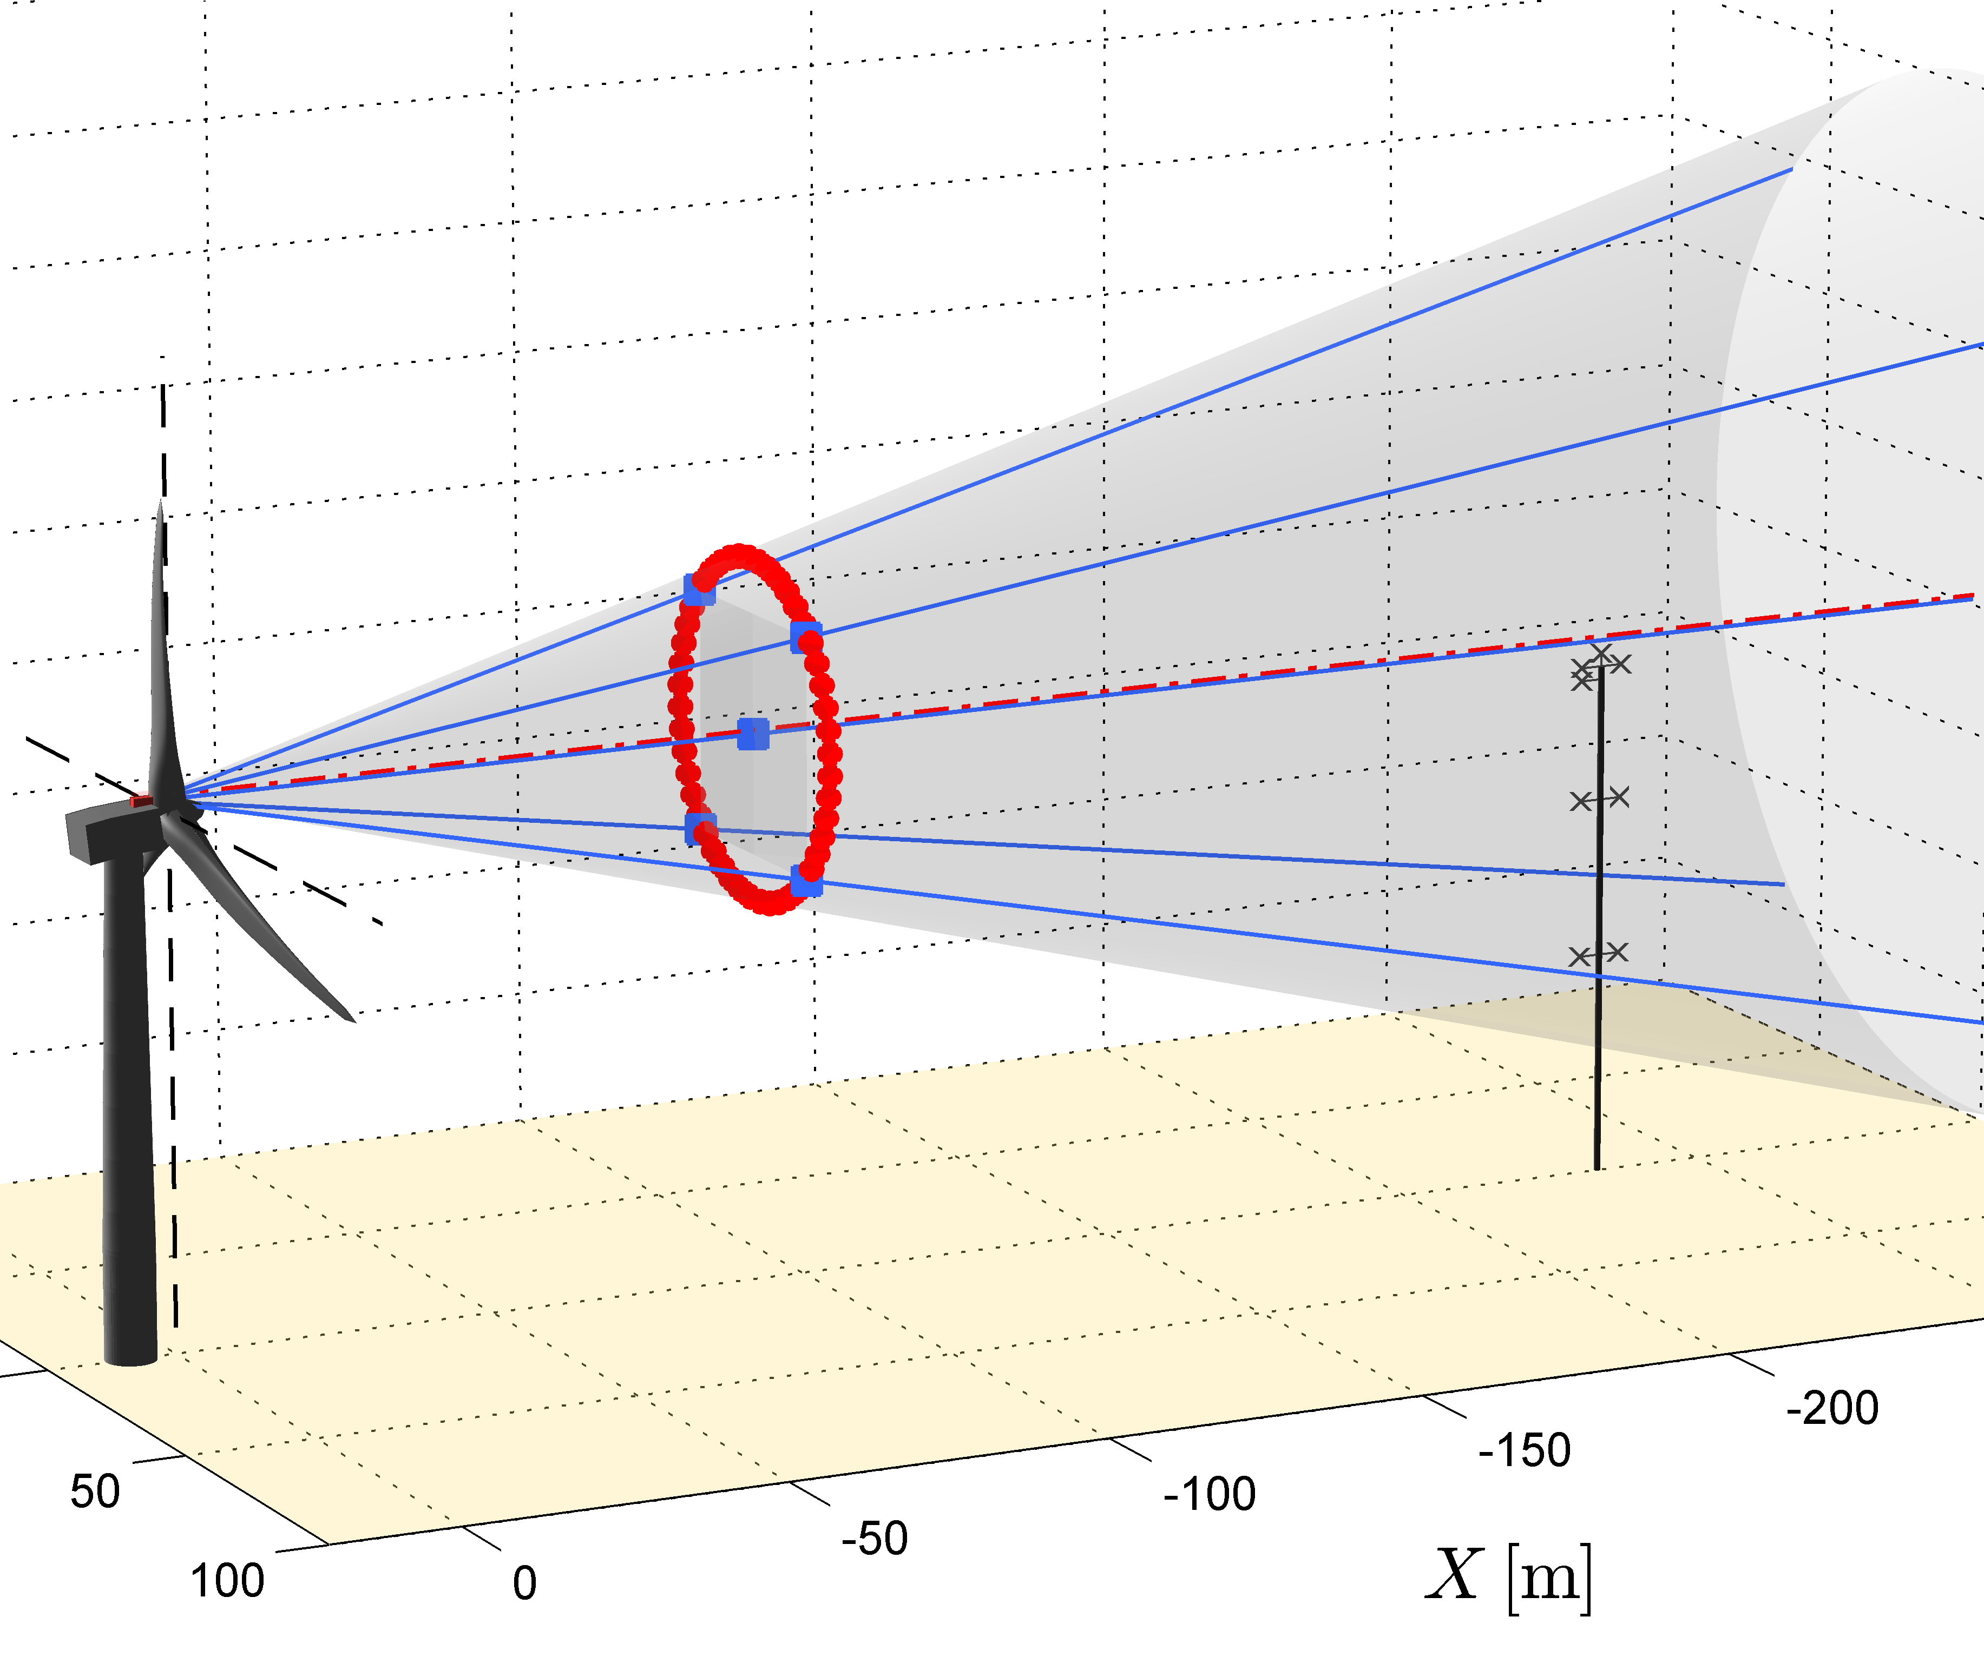
Power performance verification: nacelle-mounted lidars, the future?
Several possibilities for lidar measurements:
2.5D distance incl. shear
1D distance (only) + correct with induction transfer function
Multiple distances from 0.5 to 1.5D induction integrated in wind field reconstruction
Add Presentation Title in Footer via ”Insert”; ”Header & Footer”

Slide 24
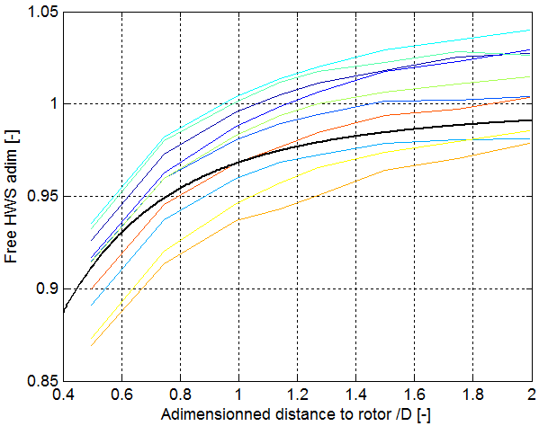
A simple induction model
Derived from the Biot-Savart law
see The upstream flow of a wind turbine: blockage effect
two parameters: induction factor $a$, free wind speed $U_{∞}$
$\frac{U}{U_{∞}}=1−a\left(1+\frac{ξ}{\sqrt{1+ξ^{2}}}\right)$, with $ξ=\frac{x_{W}}{R_{rot}}$
What does the induction looks like in NKE?
Black: theoretical, $a = 0.3$
Colored lines: different 10min periods
Fitting $a$ and $U_{∞}$ should be possible
Add Presentation Title in Footer via ”Insert”; ”Header & Footer”

