Slide 1
GIS-BASED 3D LANDSCAPE VISUALIZATION FOR IMPROVING SOCIAL ACCEPTANCE AND PUBLIC PARTICIPATION OF WIND FARMS
27-29.09.2016, Hamburg
Dr. Stefano Grassi

Slide 2
Outline
Motivation
Scope
State of the Art of 3D Visualization
Data and Method
Workflow
Visual impact
Results and Visualization

Slide 3
Motivation
Wind farm projects hampered due to multiple environmental-social constraints
Visual impact is significant concern within local population
Visual impact is element of welfare/well-being
Communication between stakeholders and local communities not always efficient
Visual representation of wind turbines often limited to static frames
Source: wind-works.org

Slide 4
Scope of the research project
How to improve the local acceptance of wind energy projects?
Local population not familiar with wind energy projects have more conservative attitude
How to enhance the communication between project developers and local communities?
How to let local communities to experience an increased 3D virtual reality of wind farm projects?
How to visualize an augmented 3D representation of environment?
Generalized approach

Slide 5
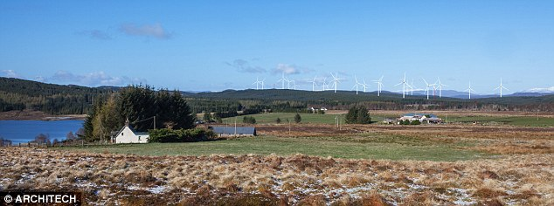
State of the Art
Source: www.dailymail.co.uk
Superimposition of images to represent landscape from limited number of position
Limited overview on visual impact of WTs
Do local communities get convinced with it?
Previous work demonstrated that fixed images are not efficient for improving communication with stakeholders

Slide 6
Source: www.greenrhinoenergy.com

Slide 7
Spatial data
Spatial data enables 3D visualization of landscape
GIS data of land
Satellite images
Combination in order to represent landscape with augmented reality
Integration with spatial geoprocesses for supporting planners in the greenfield activities
Game engine used for landscape visualization and navigation

Slide 8
GIS process for land identification
GIS data enable to identify suitable location where to install wind turbines
Multi-Criteria decision Analysis
Preliminary quantitative assessment of visual impact from landmarks or building
Indication of possible critical regions due to visual impact
Optimization of WTs layout can be also included

Slide 9
Spatial distribution of viability from buildings
Visual impact estimated from landmarks or buildings
Distance observer – object
Height of object (i.e. Wind turbine) selected by user
Spatial elements on ground (e.g. trees or buildings) used to identify obstructions

Slide 10
GIS process for land identification
Platform integrating geoprocesses and 3D visualization is missing
Interactive visualization with augmented reality
Fully adaptatable for public participation
Real-time navigation at ground-level or “in the air”
Real perspective from any position in the landscape
Adaptable to transmission line planning supporting wind energy projects

Slide 11
3D Visualization with augmented reality

Slide 13
Conclusions
3D interactive visualization platform allows a user to navigate through more realistic representation of the landscape
It can be applied to any region and for any wind farm size, layout and wind turbine model overcoming the limitations of fixed images
Flexibility of platform allows integrating also additional tasks to support planners
Enhancement of public participation and interaction between all stakeholders of wind project and local communities

Slide 14
Thank you for
your attention

