Slide 1
Dynamic data exchange method between DSO and wind farms for smart grid applications
Wind Europe 2016, Hamburg, Germany
Peng Li Maia Eolis
Thierry Coste EDF R&D
Olivier Carré Enedis
Nicolas Girard Maia Eolis
pli@maiaeolis.fr

Slide 2
Summary
Traditional data exchange system between DSO and DER in France - DEIE
The next generation of data exchange system we are working for - eDEIE - Main ideas
- Architecture and achievements in 2015-2016 - Future possible evolutions
Conclusion
Benefits, lessons and perspectives

Slide 3
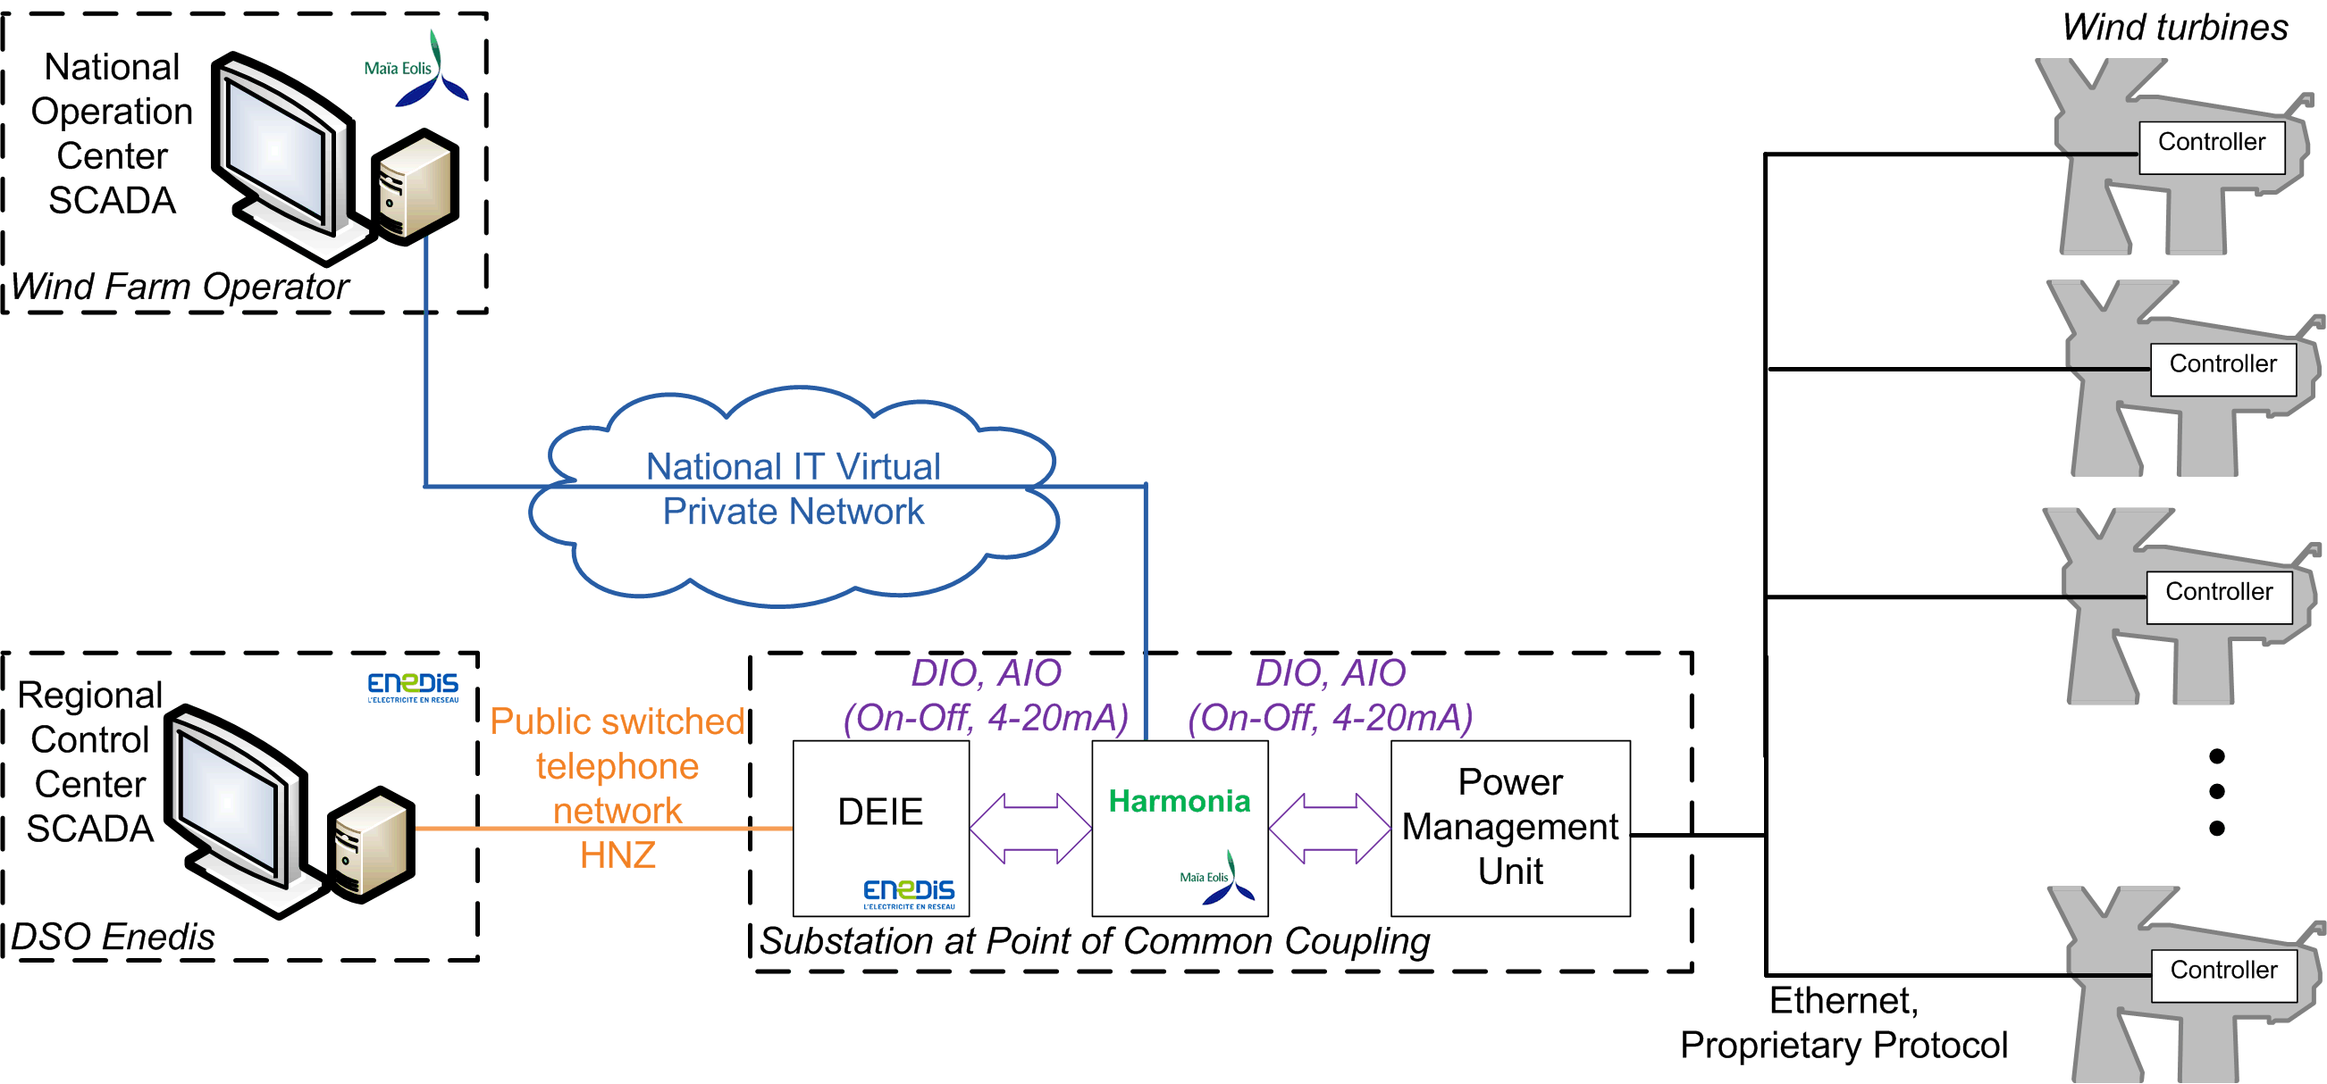
Standardized in 2005, and deployed in France since 2010
Traditional Data Exchange System - DEIE
Example architecture deployed in Maia Eolis
* HNZ denotes a number of national standards, defined by the EDF (Electricité de France) in 1982.

Slide 4
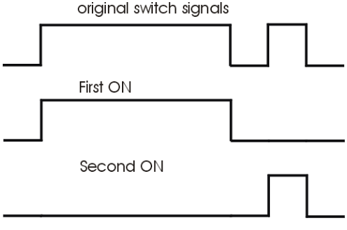
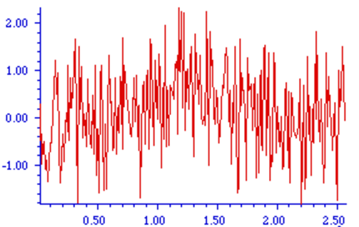
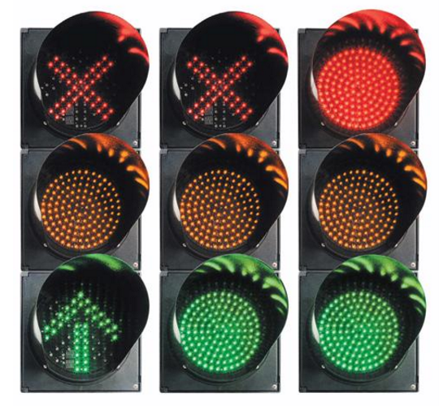
Traditional Data Exchange System - DEIE
Key features :
Point-to-point data link via dial-up modems
HNZ protocol for the interface with DSO
- DIO contacts and AIO 4-20mA signals for the interface with DER
“Wake up” for use several times a year according to the grid maintenance needs
Main functionalities :
Status ex. MV connection, Wind Farm Controllable etc.
Measurements (P1min, Q1min, and U10min)
Control signals
Normal or emergency disconnection and reconnection
Real power curtailment
Reactive power limitation order
...

Slide 5
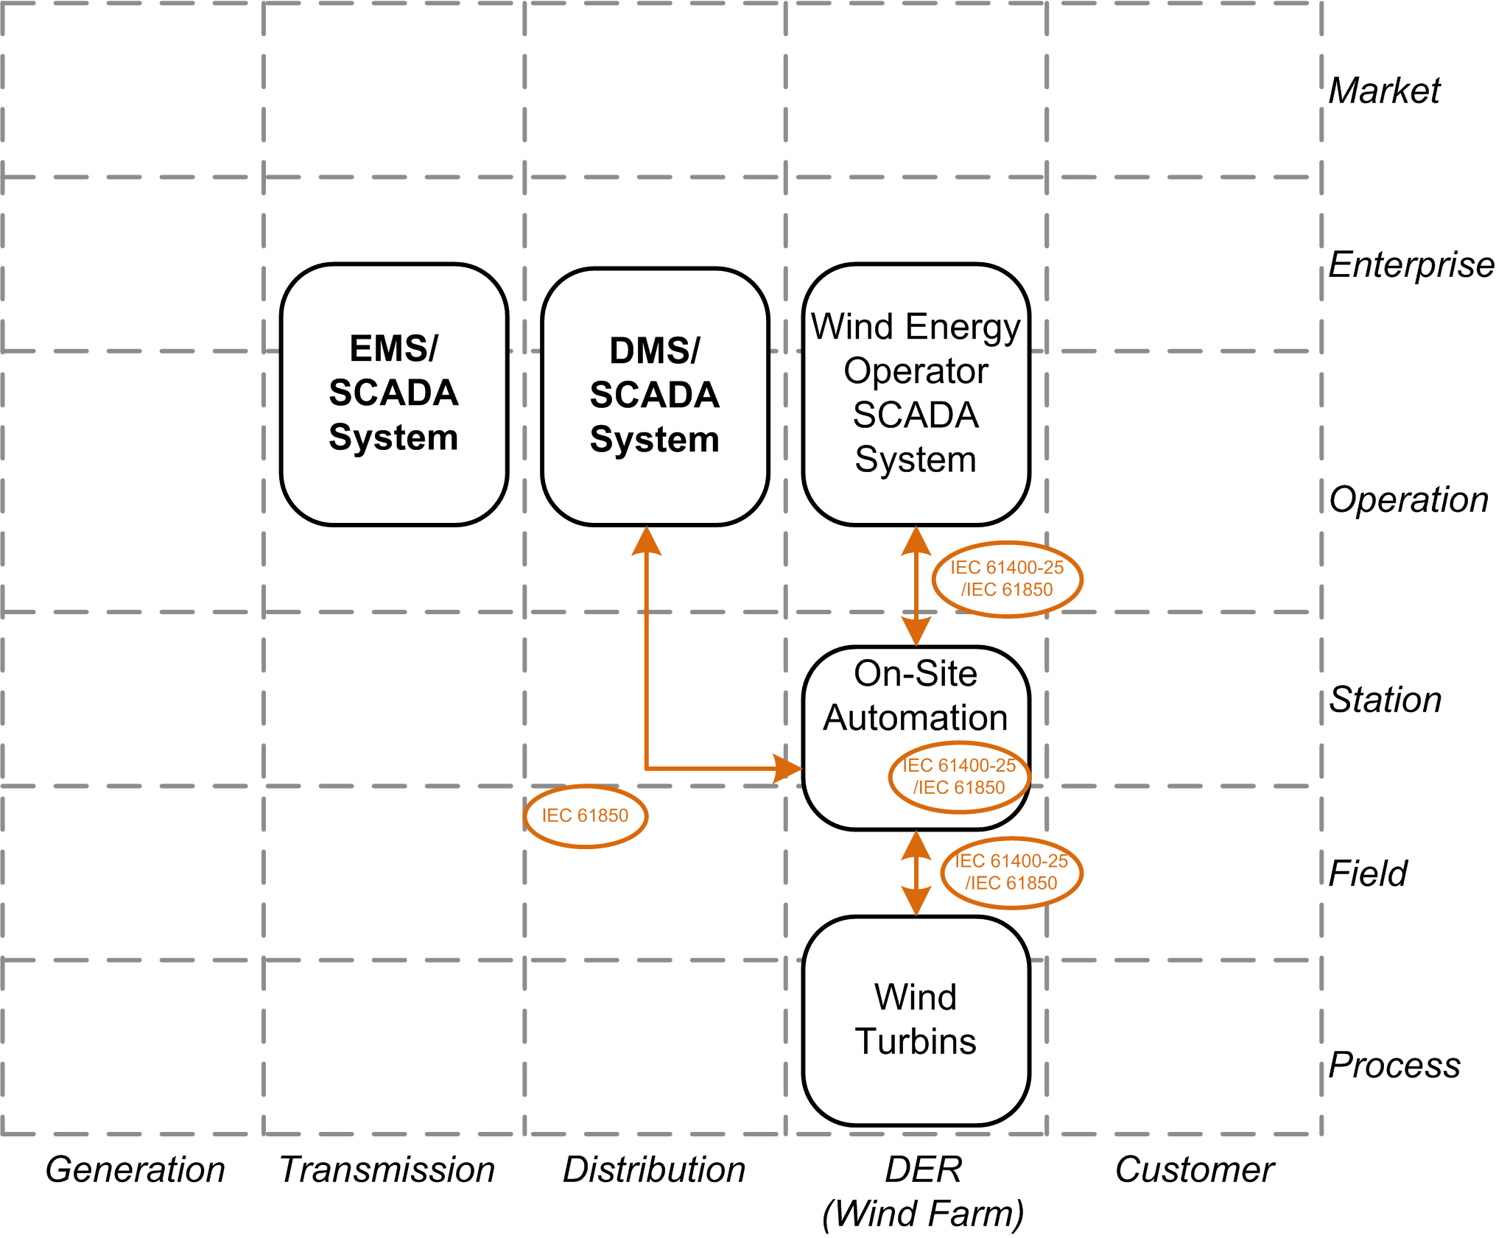
Mean ideas: - A real-time dynamic and continuous communication - Easy expansion for future Smart Grid functionalities - Cyber-security functions integrated
The next generation of Data Exchange System - eDEIE
* IEC 61850: communication standard for electrical substation automation systems.
* IEC 61400-25: uniform information exchange for monitoring and control of wind power plants.

Slide 6
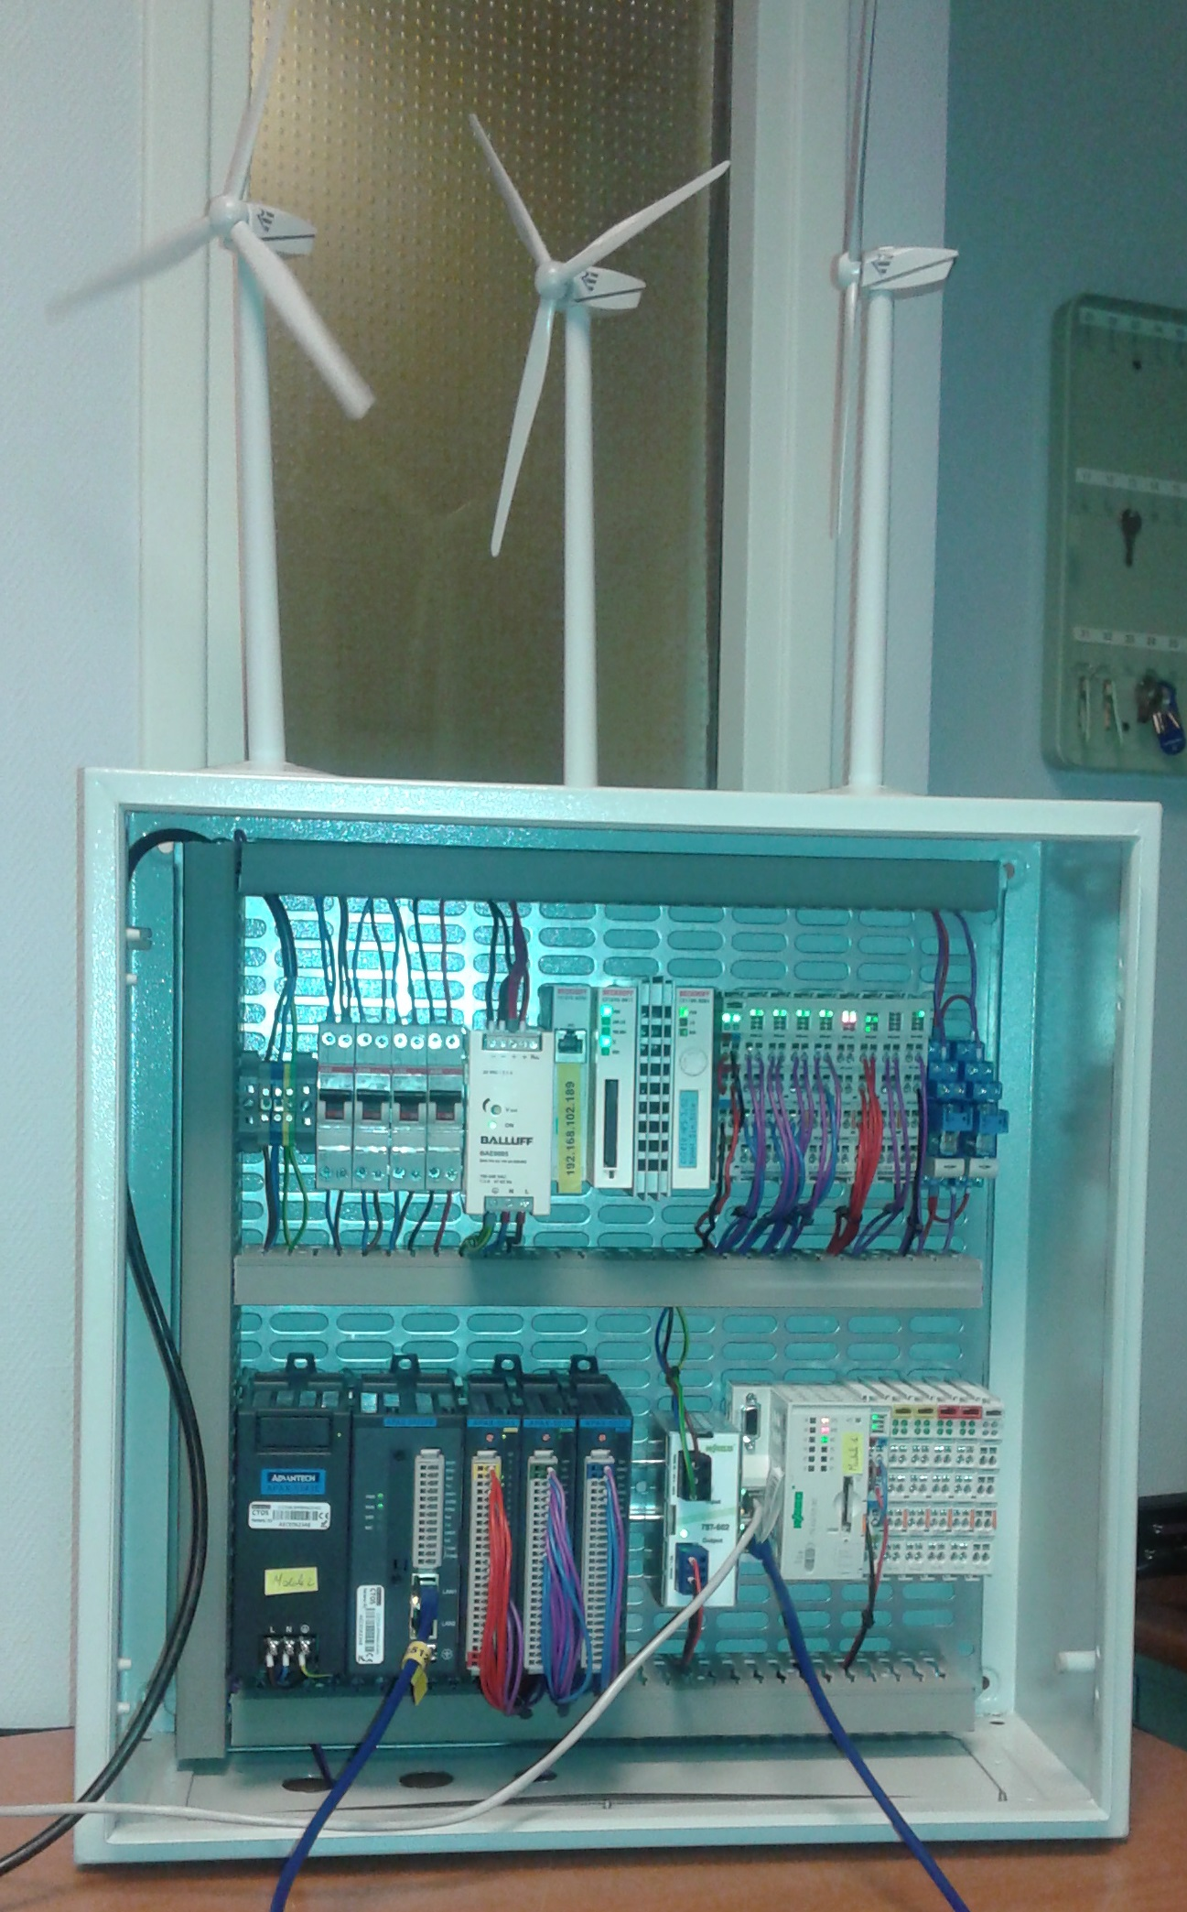
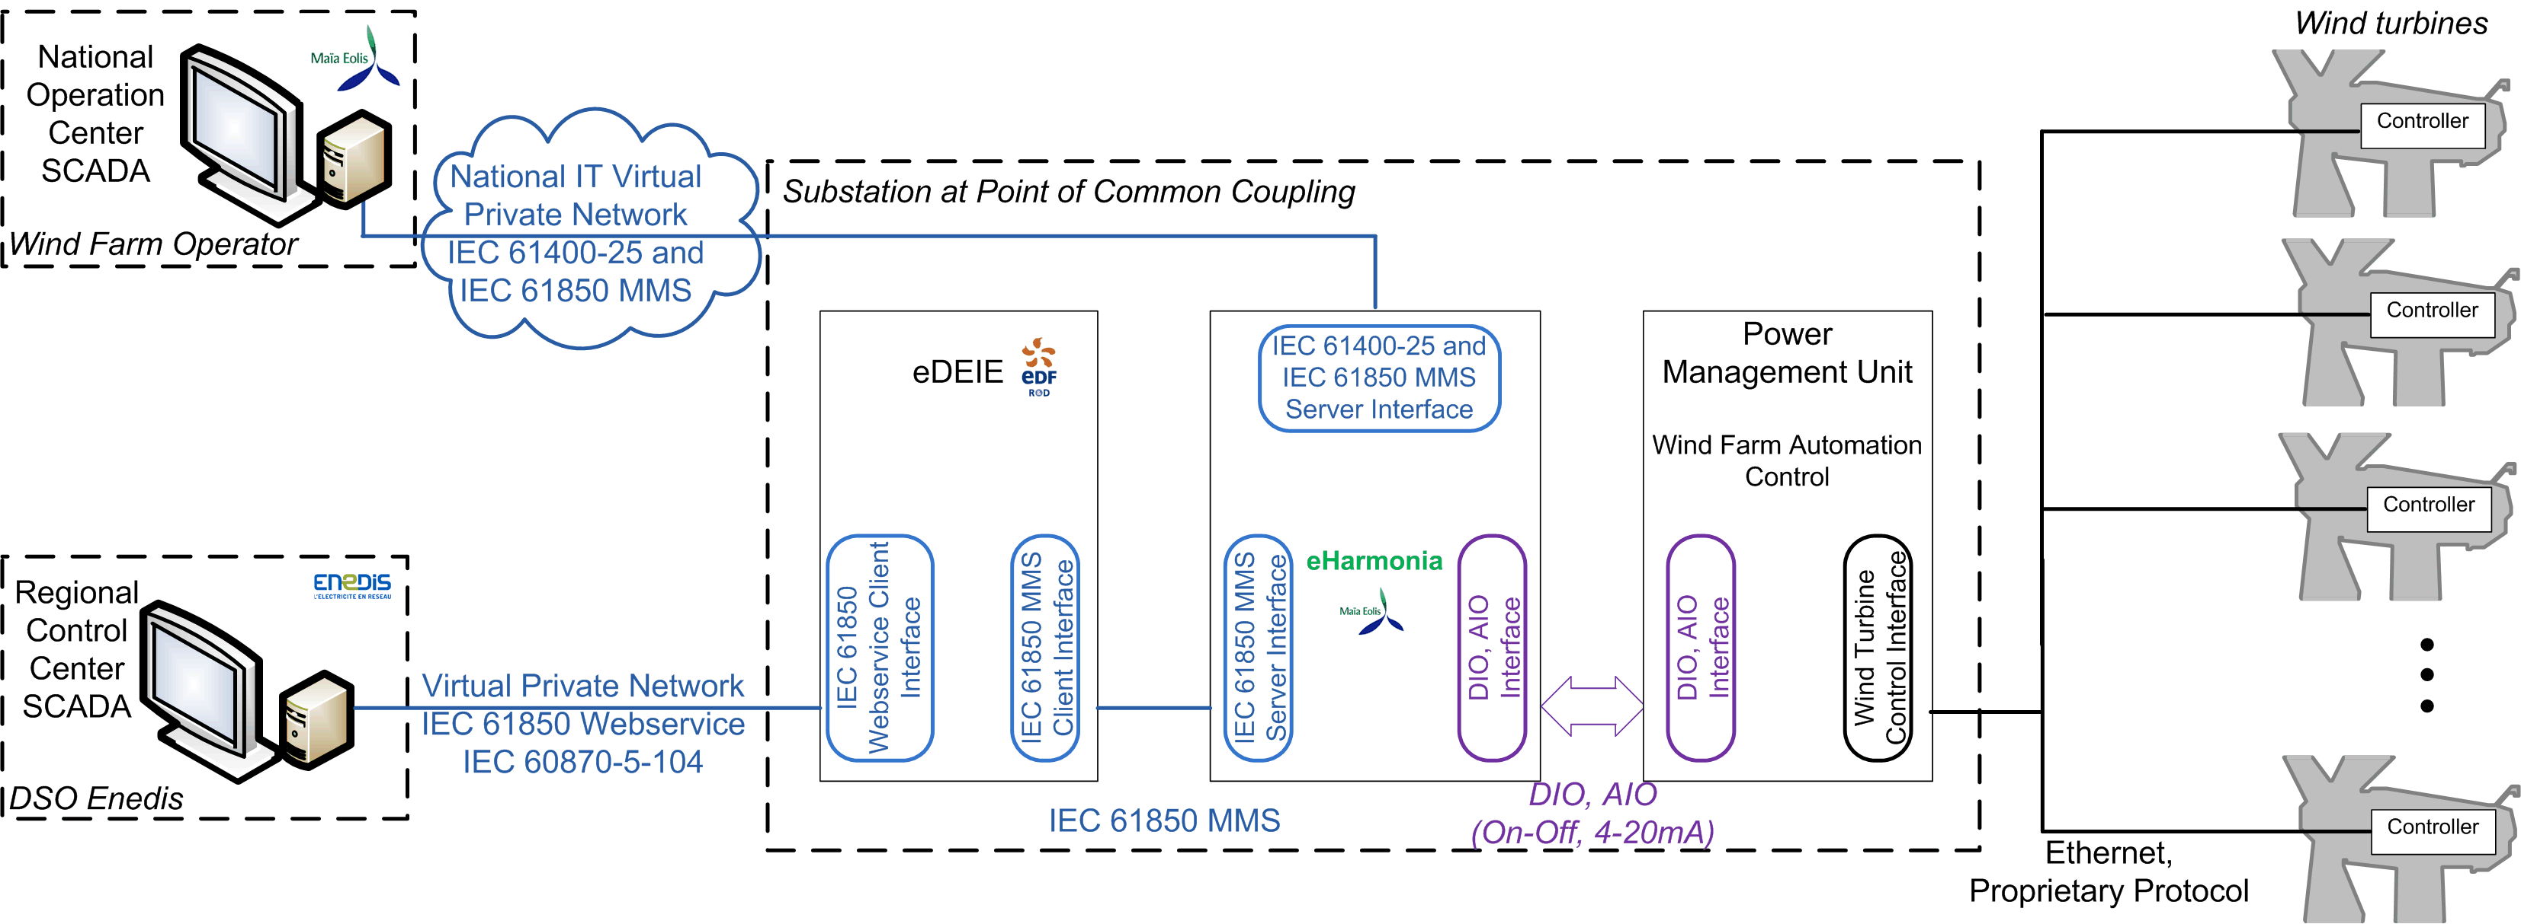
Project started in 2014 First laboratory prototyping in May 2015 (61850 XMPP Webservice version) First on-site prototyping integrated in November 2015 (104 version)
The next generation of Data Exchange System - eDEIE
* XMPP: Extensible Messaging and Presence Protocol * MMS: Manufacturing Message Specification (ISO9506)
* IEC 60870: set of standards which define systems used for telecontrol in electrical engineering and power system automation applications.

Slide 7
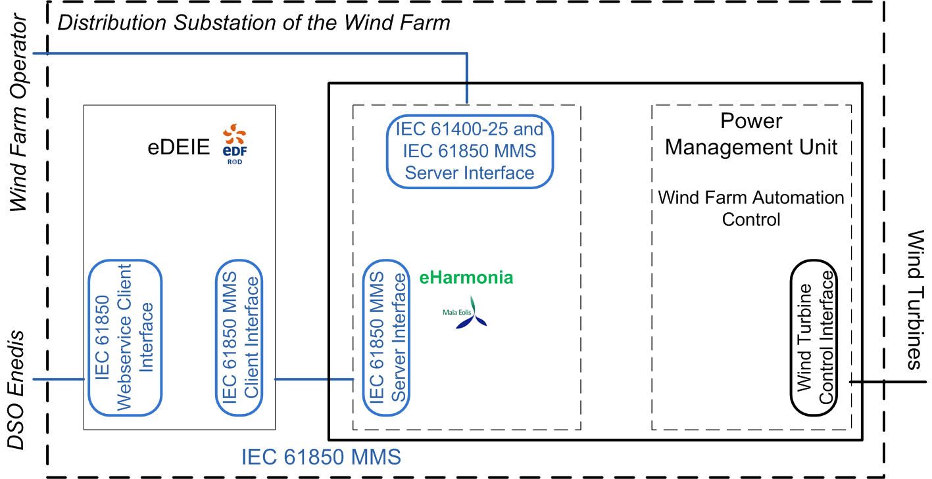
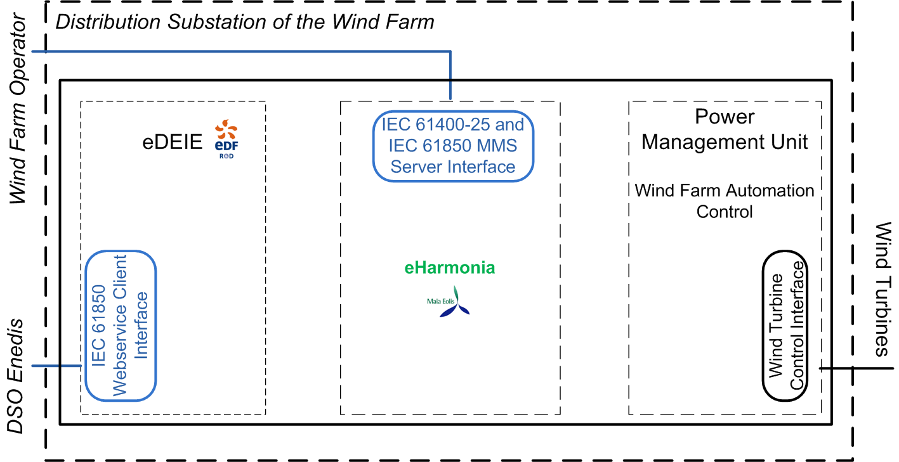
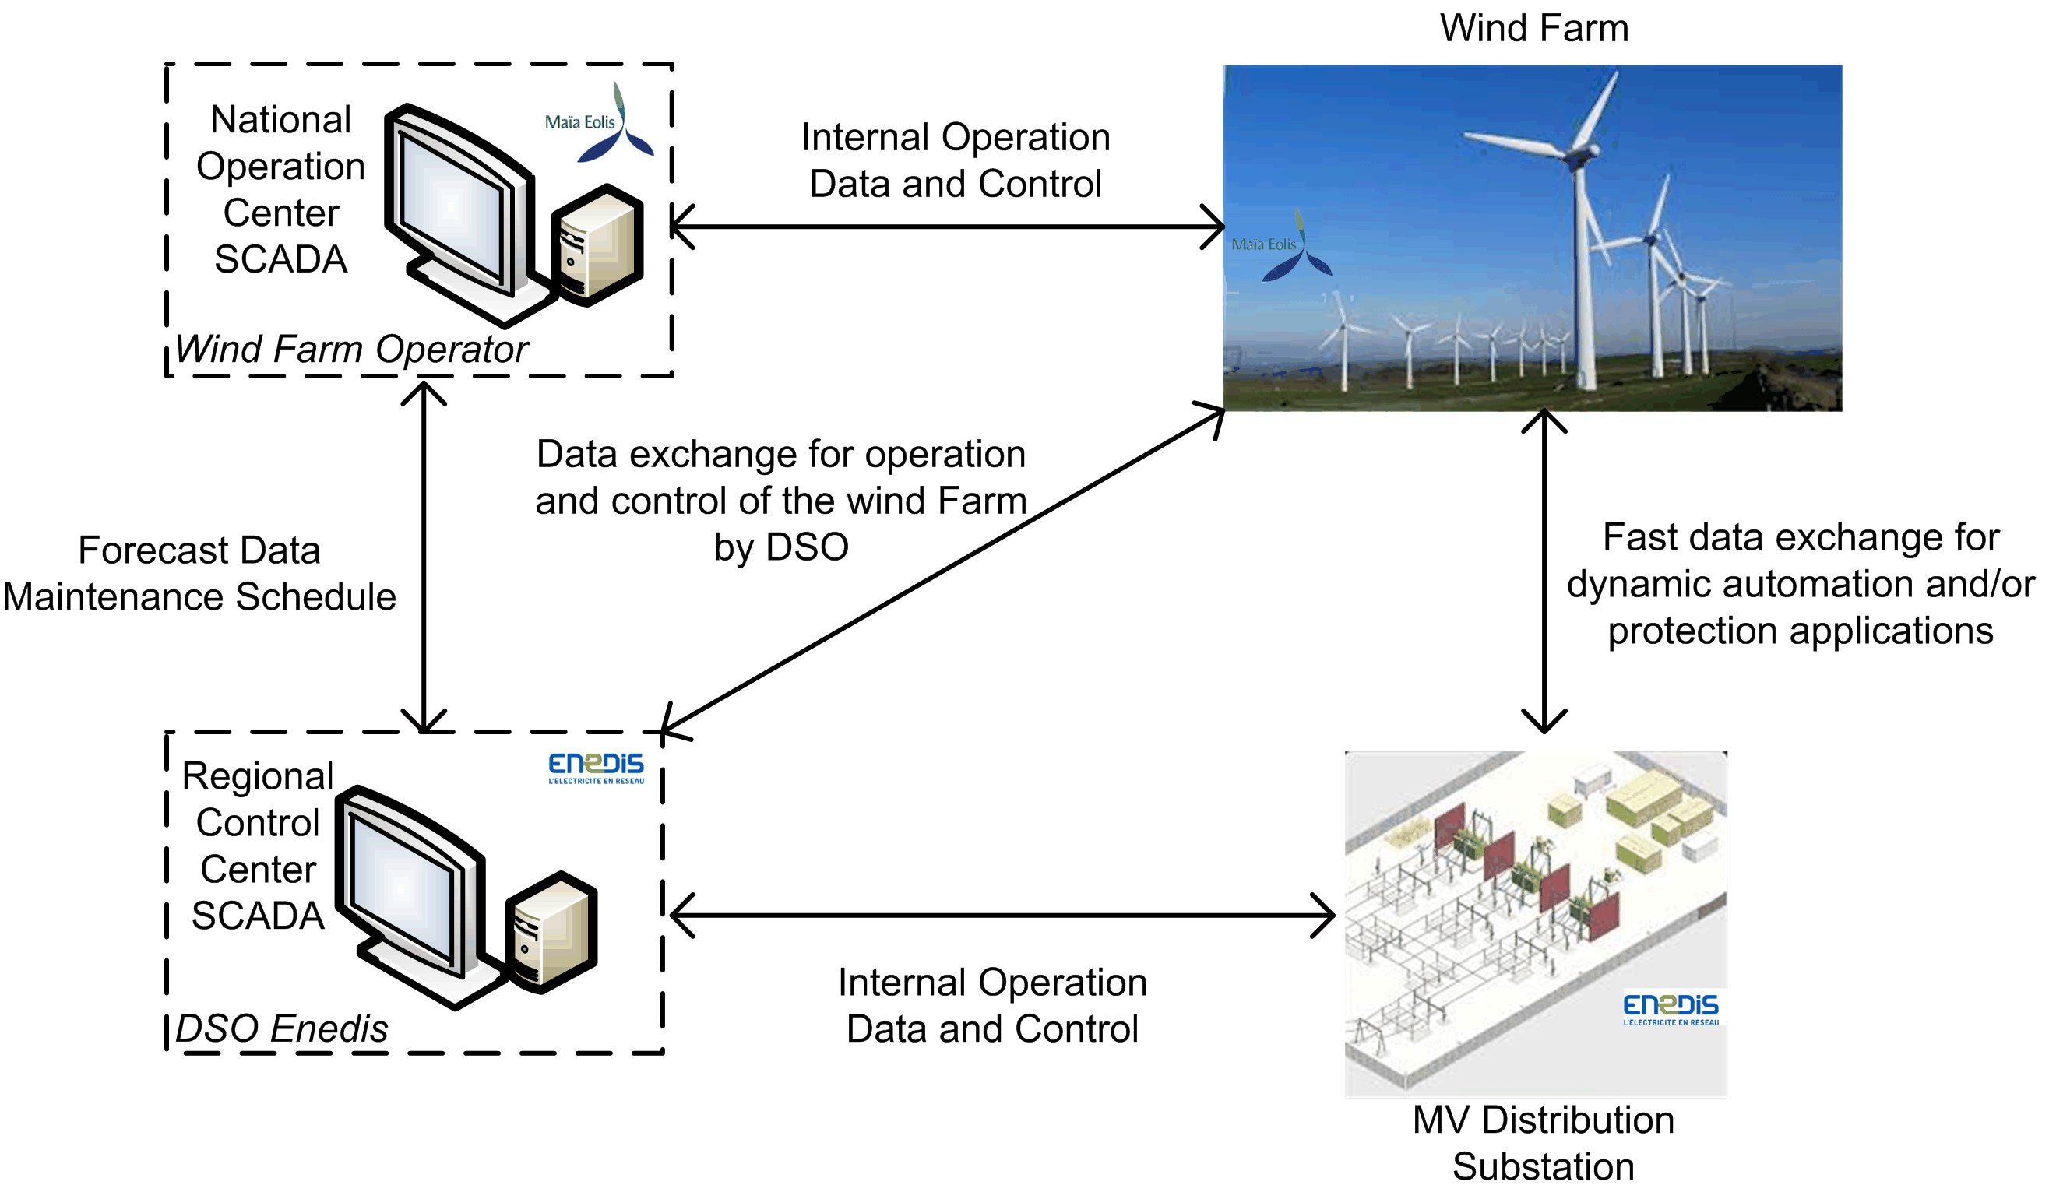
Future possible on-site evolutions of the eDEIE structure
The next generation of Data Exchange System - eDEIE
Future possible evolution of the central communication structure

Slide 8
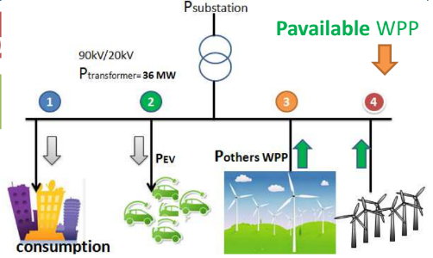
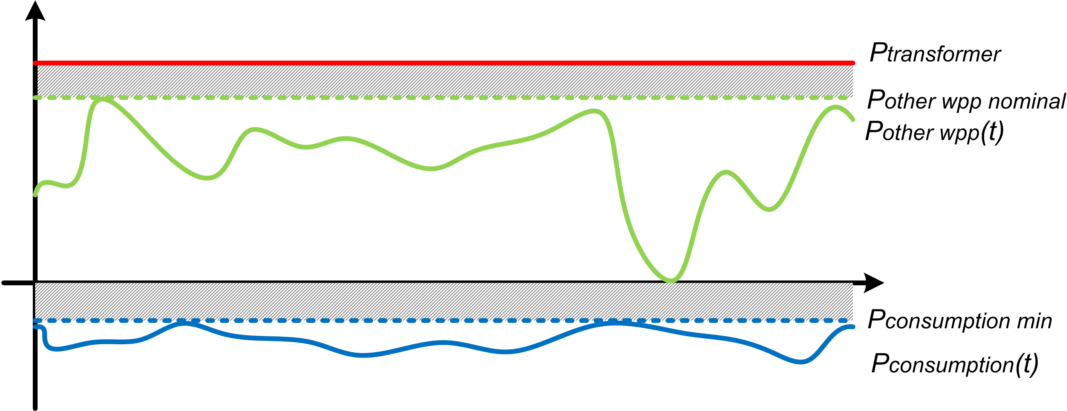
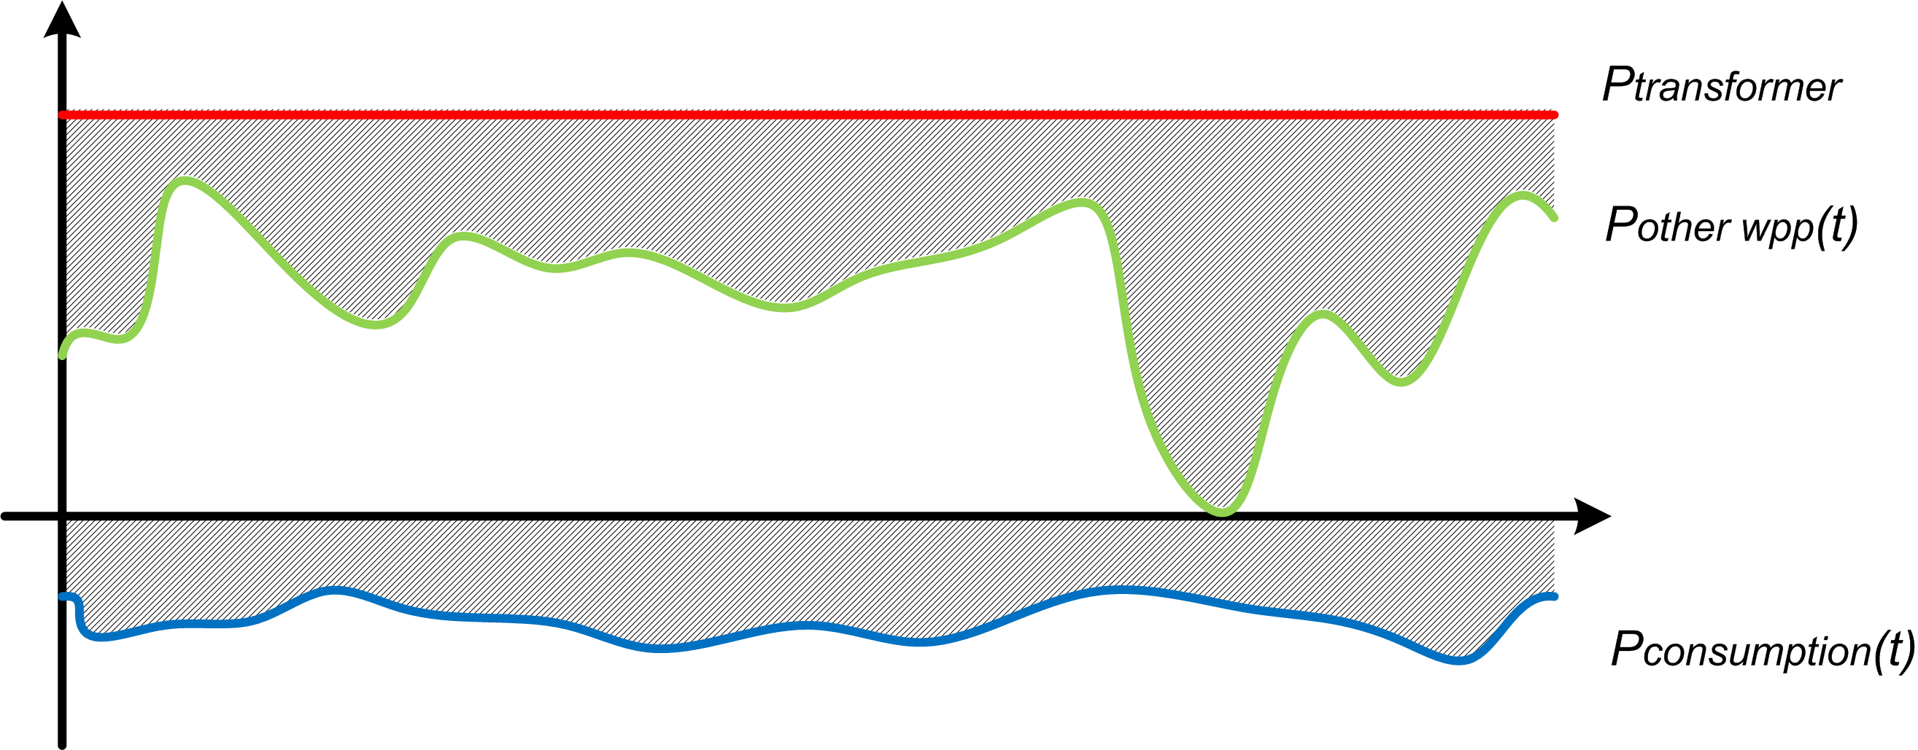
Future functionalities for a better data link between DSO and Wind Farms
Case study: increase the power connection availability and penetration (PO. 309)
The next generation of Data Exchange System - eDEIE
Static method
Dynamic method
Pavailable = Ptransformer – Pother wpp nominal + Pconsumption min
Pavailable(t) = Ptransformer – Pother wpp(t) + Pconsumption(t)

Slide 9
Future functionalities for a better link between DSO and Wind Farms
- Participation to frequency and voltage regulation - Dynamic energy control according to the market price - Multi-sources and storage dynamic management - Maintenance schedule exchange - GOOSE message for protection relay applications …
The next generation of Data Exchange System - eDEIE
REX of Communication protocol - MMS based IEC 61850 is ready to use with increasing engineering tools - IEC 61850 XMPP is “lite” for the bandwidth consumption. …

Slide 10
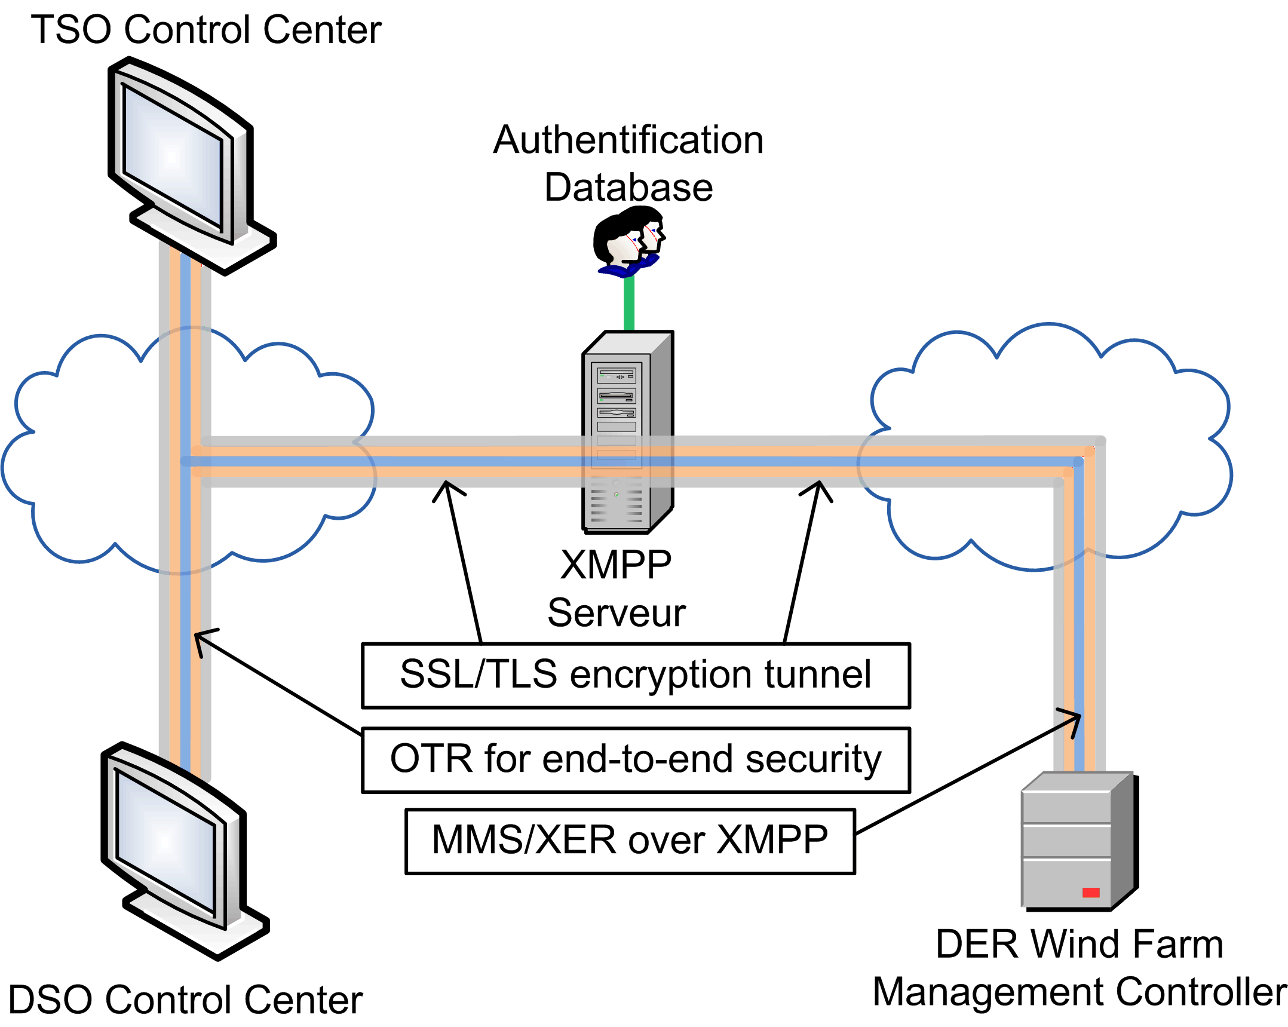
Cybersecurity Implementation of several functionalities according to IEC 62351: - Encryption with SSL/TLS, - End-to-end security with encryption. - Certificate-based authentication
The next generation of Data Exchange System - eDEIE
* IEC 62351: developed by WG15 of IEC TC57. This is developed for handling the security of TC 57 series of protocols.

Slide 11
Conclusion
Industrial R&D application of a dynamic, flexible and secured data exchange method for the real-time communication between DSO and Wind Farms
Prototyping in 2015 for an isofunctional version, wider tests for additional functionalities in schedule - Dynamic power curtailment - Frequency regulation - Voltage regulation - Forecast data - Maintenance schedule ...
- Benefits from IEC 61850 - Electrical security of control is included - Easy expansion for more functionalities and connections, for example TSO data connections. ...

Slide 12
pli@maiaeolis.fr
Thank you!!

