Slide 1
digitalization@windenergy How to harvest the full potential?
Thomas Pump
September 2016
Head of Asset Information Systems ,
E.ON Climate & Renewables GmbH

Slide 2
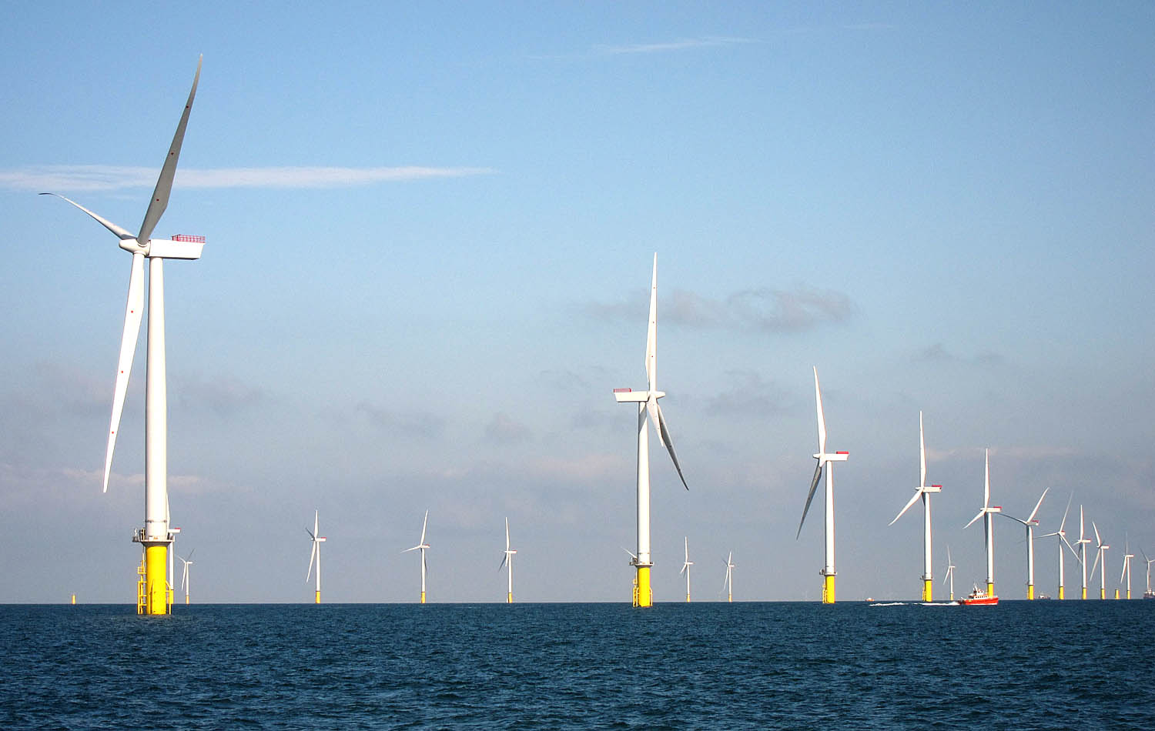
My oil temperature is to high and there is also a strange noise. I should reduce my production
Compared to my peers I´m producing always 10% less at the same wind speed
My health parameters are getting worse. I ´ll call for a service

Slide 3
Project portfolio management
3D simulations
Project origination / development
Array Layout Designer
Documentation
Business case tracker
Wind farm planning
Tendering
Project optimization
Construction
RFID chips
CAD / CAF
certificates
Modelling
E-auctions
Logistic tracking
3D printing
Load test
Drawings
Potential of
Digitalization
Training
Simulations
Digital Copy
Potential of
Digitalization
Quality management
Virtual reality
Manufacturing
Operation
New revenue streams ?
Field force management
RT Monitoring
Smart repairs
Logistic optimizer
BIG UNKNOWN
Project management
Predictive analytics
Mobility
Spare parts management
Forecasting
Blade inspections
documentation
Logistic tracking
O&M optimization
Machine learning for analytics
Decommission
CMS
Connected services
databases
Augmented reality
System integration

Slide 4
We are operating in a box - and how to integrate the box?
“Expand the box”
“Integration into the new energy system”
Increase energetic availability/ reduce down times
Increase efficiency
Reduce O&M costs
Extend lifetime
How to integrate wind farms / Solar PV into a future energy system?
Number of “Prosumer” is increasing
Quo Vadis Grid quality?
Role and potential of block chain technology not clear yet

Slide 5
It is all about data! - a new currency?
New love / new partnerships
Ownership
Data belongs to the owner!
Data
Access
Capability
Open standards & protocols to ensure access

Slide 6
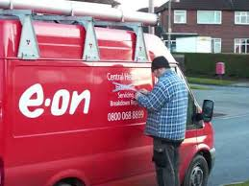
Only if those questions are answered we can create a world of connected services
4
When the data indicates an issue that can cause a problem, a case is created and assigned to the proper skill.
5
Interventions are performed to resolve the issue:
Fleet analysis provides the operators tips and instructions.
Dispatch proactively sends updated schedules
Technical Service is dispatched to perform maintenance or repair.
3
Data is analyzed in real-time to identify issues.
Resolutions are triggered before the operators knows there is a problem.
2
Data from many connected devices is aggregated and stored.
6
The resolution is recorded. Longer Outages are prevented, costs minimised
Higher availability
Lower O&M costs
Longer lifetime
Higher Income
1
Performance and usage data is acquired and transmitted every 10 seconds.
greenbox

Slide 7
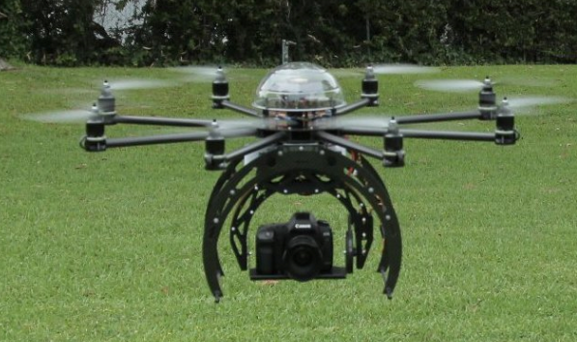
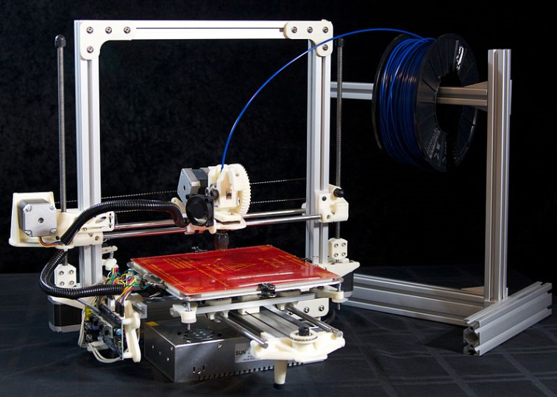
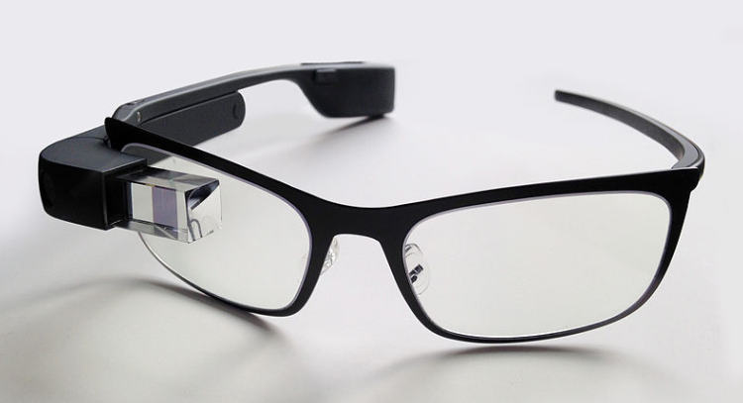
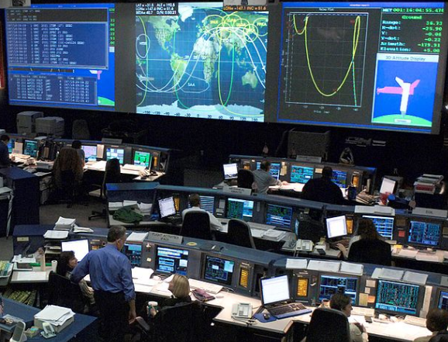
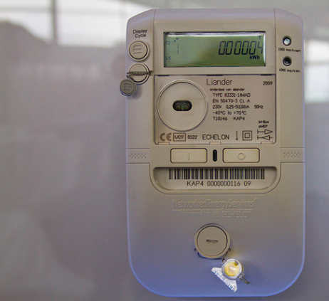
Technology development will not stop - Let’s use it – for a cleaner energy world

Slide 8
Imagine ! What if ……..
Can I please to talk to someone from E.ON – they are providing the best service!

Slide 9
Join the conversation

Slide 10
Thanks for your attention

