Slide 1
Data collection and reliability assessment for O&M optimization of wind turbines
New IEA Wind
recommended practices
WindEurope Summit 2016, 29th Sep, Hamburg, Germany
Berthold Hahn, Fraunhofer IWES, operating agent of IEA Wind Task 33

Slide 2
Main contributors
B. Hahn, Fraunhofer IWES
M. Asgarpour, ECN Energy research Centre of the Netherlands
P. Bangalore, Chalmers University Gothenburg
S. Faulstich, Fraunhofer IWES
K. Harrisson, ORE Catapult
B. Karlson, Sandia National Labs
F. O’Connor, ServusNet
L. Pettersson, Vattenfall Sweden
C. Soraghan, ORE Catapult
C. Stock-Williams, ECN Energy research Centre of the Netherlands
J. Dalsgaard Sorensen, DTU / University Aalborg
G. van Bussel, Delft University of Technology
J. Vatn, NTNU University Trondheim
T. Welte, SINTEF Energy Research

Slide 3
IEA Wind Task 33
Reliability Data -
Standardizing data collection for wind turbine reliability and O&M analyses

Slide 4
Task 33 – Participants
Country | Organisation
China | Chinese Wind Energy Association – CWEA
 | Goldwind Science & Technology Co., Ltd.
Denmark | DTU University Denmark / University Aalborg
Finland | Technical Research Centre of Finland – VTT
France | Maia Eolis
Ireland | ServusNet Informatics
Germany | Fraunhofer Institute for Wind Energy and Energy System Technology – IWES
Netherlands | Delft University of Technology – TUDelft ECN Energy research centre of the Netherlands
Norway | Norwegian University of Science and Technology – NTNU SINTEF Energy Research
Sweden | Chalmers University of Technology
 | Vattenfall Research and Development AB
UK | Offshore Renewable Energies Catapult Atkinsglobal
USA | Sandia National Laboratories

Slide 5
Goal of IEA Wind Task33
1.
for
WIND FARM DATA COLLECTION AND RELIABILITY ASSESSMENT FOR O&M OPTIMIZATION
New ‘Recommended Practices’

Slide 6
Management of O&M data
2
Automatic data acquisition
4
Interfaces of data
communication
1
O&M Management
Standards on:
- Component designation
- Failure/fault description
- Defined data sets
- Communication protocol
Wind energy plant(s)
controller/ SCADA
technical operation
3
Collection of data during maintenance & inspection
Commercial operation
5
Data analyses /
Shared database
WInD-Pool
technician
service/ maintenance
analysis for optimising design and optimising the O&M-process
technical data
independent
authorised expert
plant
manufacturer
component
supplier
forecast (wind
& weather)
laboratory
commercial data
Notes:
Next slide: parameter diversification

Slide 7
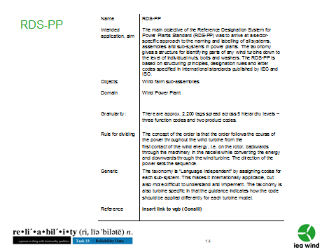
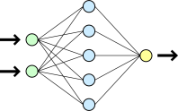
From roles to taxonomies
Standards
Taxonomies
Roles
IEA Wind Task 33 Recommended Practices for Reliability Data
Data
Entries
______
______
______
______
______
Data Groups
Analyses
Objectives

Slide 8
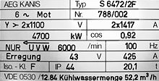
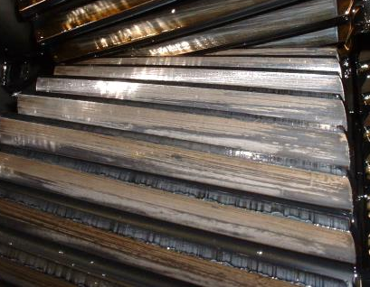
Data groups and sub-groups
Data groups | Sub-groups / objects
Equipment data (ED) | Identification
 | Time data
 | Technical information
Operating data / measurement values (OP) | Time stamp
 | Measurement values (SCADA, etc)
 | Operational states
Failure / fault data (FD) | Identification
 | Time data
 | Failure description
 | Failure effect
 | Failure detection
 | Fault properties
Maintenance & inspection data (MD) | Identification
 | Time data
 | Task / measure / activity
 | Resources
 | Maintenance results

Slide 9
Standards covering data groups and entries
Data groups / taxonomies | Equipment data | Operating / measurement data | Failure data | Maintenance & inspection data
VGB RDS-PP® | o
NERC GADS | o | - |  | -
ReliaWind | o
ISO 14224 | o* |  | +* | +*
FGW ZEUS |  | o | + | +
IEC 61400-25 |  | +
IEC 61400-26 |  | +
+ | entries with a high level of detail
o | entries with a medium level of detail
- | entries on a more general level
* | not wind-specific

Slide 10
Data group equipment data
Equipment data (per hierarchical level of the plant)
Sub-groups/objects | Entries | Complexity level
Identification
 | Identification code | A, B, C
 | Coordinates, location | A, B, C
Time data
 | Start of operation | A, B, C
 | Start of observation | C
Technical information
 | OEM | A, B, C
 | Type | A, B, C
 | Serial number | B, C
 | Design data relevant for each equipment class and item | B, C
 | Maintenance manual | C

Slide 11
Main recommendations
To owners / operators:
Identify your use-case and be aware of the resulting data needs
Start early: make sure you get all data during contract negotiation
Map all WT components to the designation systems RDS-PP® or GADS
Adopt taxonomies of ISO 14224 and ZEUS
Align operating states to IEC 61400-26
Train your staff understanding, what data collection is helpful for
Support data quality by making use of computerized means
Share reliability data to achieve a broad statistical basis
To wind industry in general:
Develop comprehensive wind-specific standard based on existing guidelines/standards, such as ISO 14224-2006 & FGW ZEUS
Develop component- / material-specific definition of faults, severity, and location

Slide 12
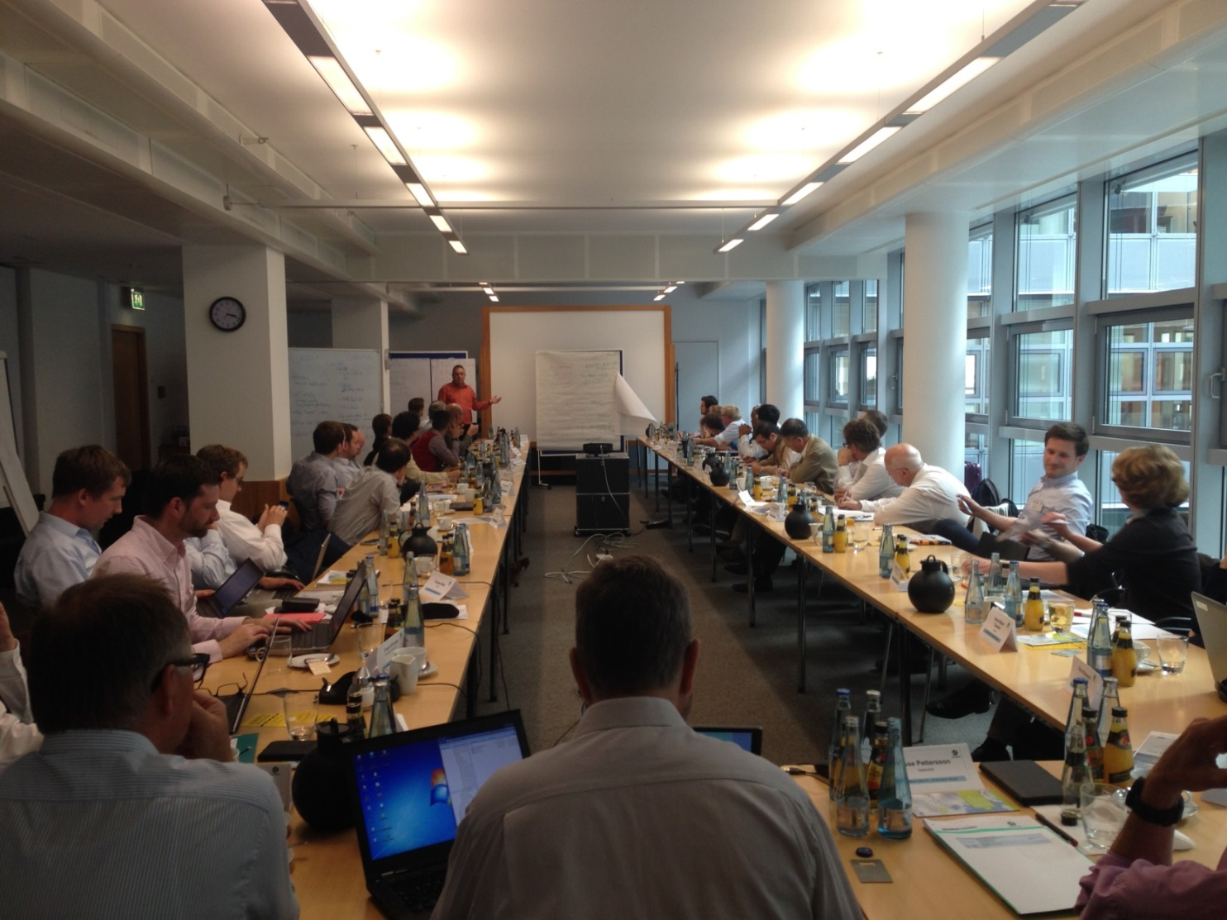
IEA Wind Task 33
Thank you
task33@iwes.fraunhofer.de

