Slide 1
Europe Wind Conference – Floating Roundtable

Slide 2
FOREWORD
fez
floating and bottom-fixed solutions are complementary solutions

Slide 3
FOREWORD
fez
we are all ambassadors of floating offshore wind

Slide 4
WHAT A YEAR !
fez
5MW « Fukushima Hamakaze », 3rd demo floater of Fukushima, Japan
France’s tender for floating pilot farms & selection of 1st winners
U Maine’s 2-unit demonstrator being granted DOE funding
Trident’s progress off California
new concepts moving up theTRL ladder
DNV GL’s Win Win’s JIP progressing to 2nd phase
2MW Windfloat, 5 years of retex
Hywind Scotland in the starting blocks
Ideol’s launch of the construction of its french and japanese floaters

Slide 5
WHAT A YEAR !
fez
FOWT’16: world’s largest floating offshore wind conference
Friends of Floating Wind
across the board acknowledgement of the increasing role of floating wind in the RE mix
not only Japan, Scotland, France, Norway, Portugal or the US !

Slide 6
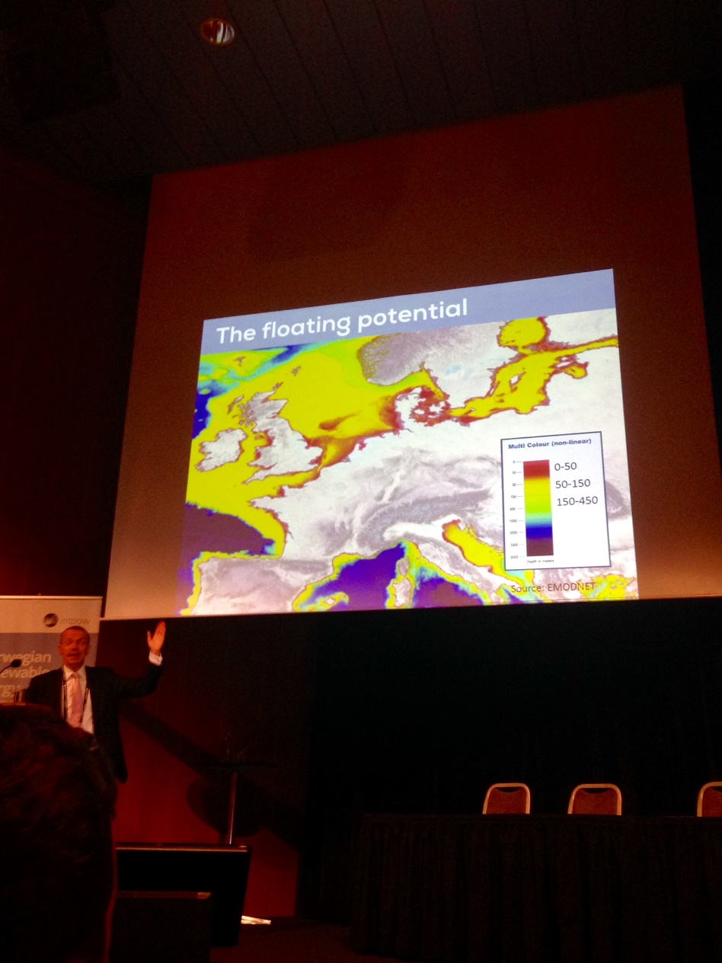
WHAT A YEAR !
fez

Slide 7
WHAT’S NEXT ?
fez
educate the stakeholders
(lower capex ≠ lower LCOE)
floating 2.0: pilot and commercial projects
better integration into marine environment
decommisioning
take advantage of an accelerated momentum
anticipate future challenges now
WTG > 10MW
acceptability through high local content
help the wind turbine mfrs bridge the gap of availability guarantees (risk sharing schemes?)
build on existing european offshore leadership

Slide 8
REMINDER !
fez
www.fowt-conferences.com

Slide 9
THANK YOU FOR YOUR ATTENTION

