Slide 1
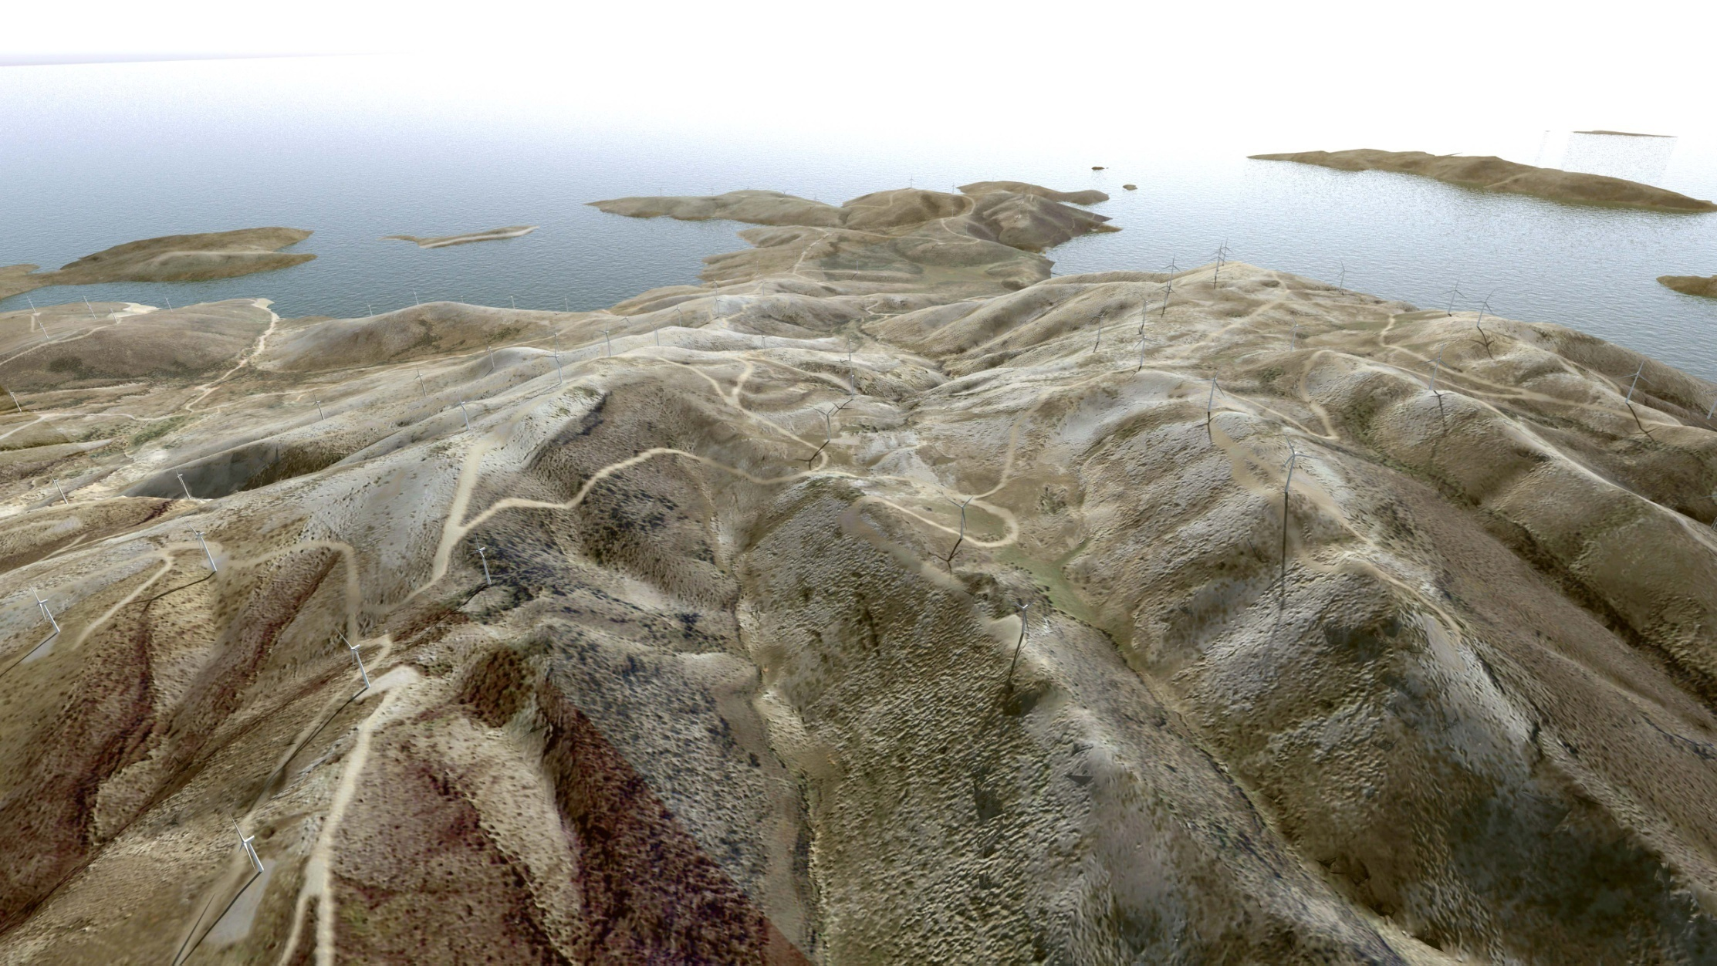
Large scale wind farms in Natura 2000 areas Technical and legislative tools to mitigate potential environmental impacts
Andreas Vlamakis Physicist, MSc ENTEKA S.A. | Konstantinos Loukidis Energy engineer, ΜΒΑ ENTEKA S.A.

Slide 2
The issues addressed
1
Wind energy & Natura 2000
importance to not exclude wind energy from Natura sites
2
Technical and legislative tools
to mitigate environmental impacts
3
Case-studies
Large scale wind farms inside Natura areas

Slide 3
1
Wind energy & Natura 2000

Slide 4
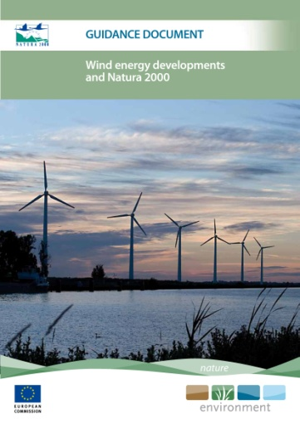
Wind energy & Natural capital
Habitats & Birds Directives
Low carbon economy
RES Directive
Natural capital conservation
Habitats & Birds Directives
Low carbon economy
RES Directive
Natural capital conservation
Mitigation of climate change
Wind energy developments & Natura 2000
Strategic Planning (=find suitable locations)
Case by case approach
Appropriate Assessment (92/43/EEC, Article 6)

Slide 5
The case of Greece
Wind Farms inside
Natura areas
419 Natura sites
27,2% land cover
Wind “likes” Wildlife
Too many Restrictions
(in other areas)
466,5 MW
in Natura
(20% of total capacity)

Slide 6
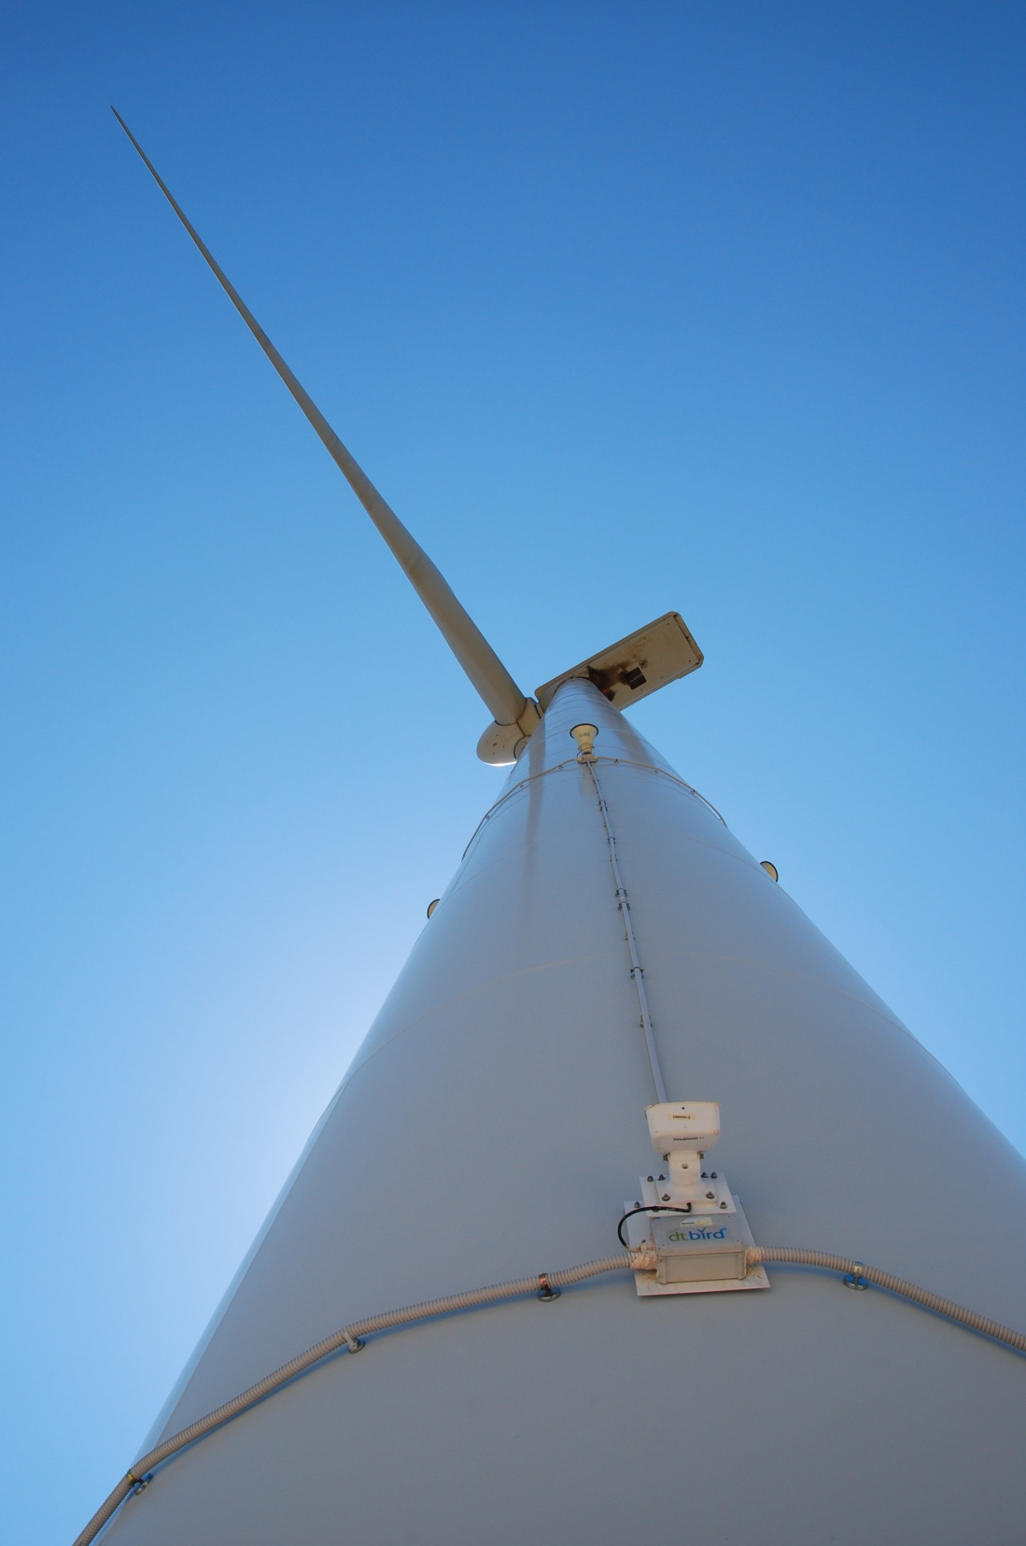
2
Technical & legislative
mitigation tools

Slide 7
Legislative tools
EIA Directive
Environmental
Impact Assessment
Appropriate Assessment
Environmental standards
Conservation objectives
Habitats & Birds Directives
Spatial
Framework
for RES &
SEA Directive
Wind Priority areas
Exclusions areas
max. WTGs density
min. distance from other uses
Environmental
Liability Directive
“Polluter pays”
Necessary preventive or remedial measures
Other environmental
legislation
Road specs
Reforestation works
Waste management

Slide 8
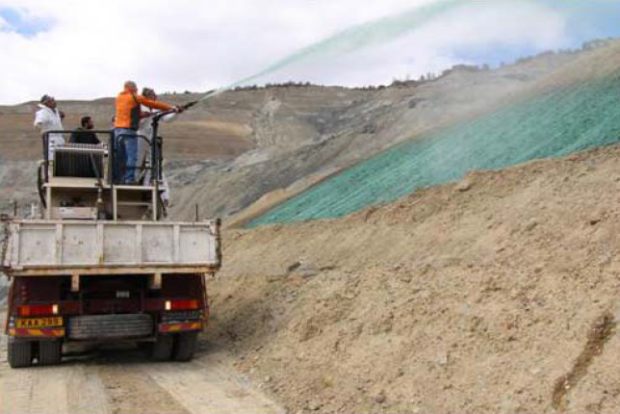
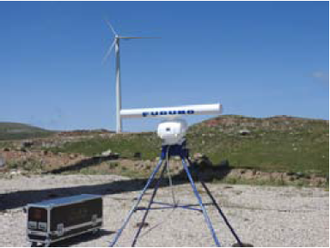
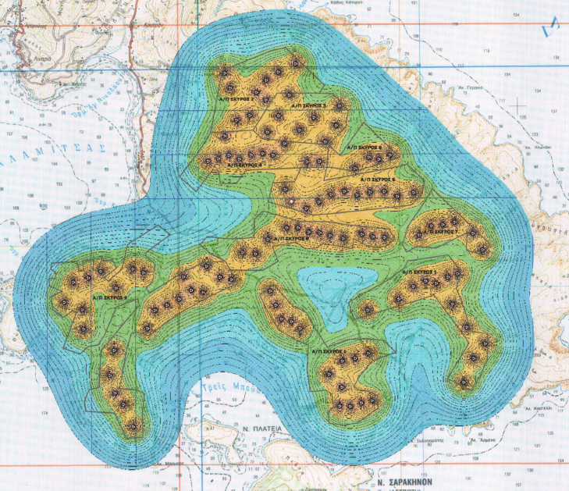
Technical tools
Pre-Construction
Post-Construction
Extended field work
Restoration & Reforestation
Ecological studies
Habitats’ mapping
Birds’ territories
Annual monitoring
Habitats’ status
Fauna activity
Bird Collisions
GIS mapping tools
WF layout is a multi-layer problem!
Other preventive
or remedial measures
(case depended)
Visual & noise
impact tools
Photorealism
Iso-noise maps

Slide 9
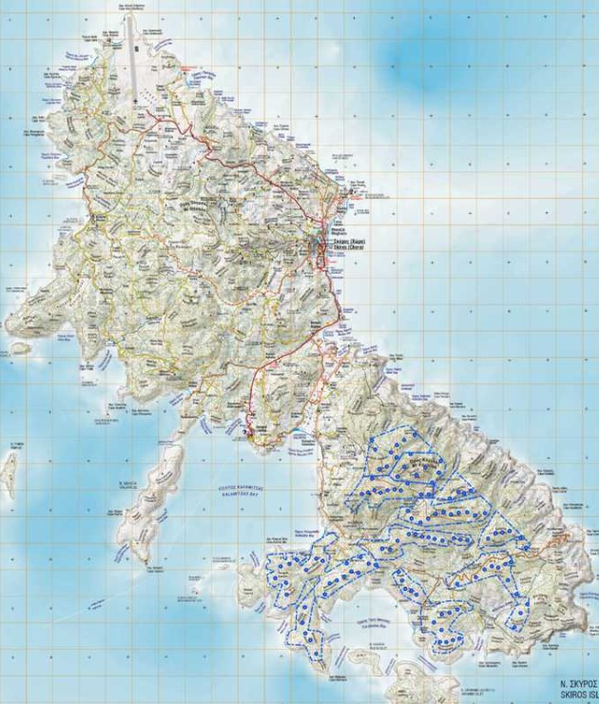
3
Case studies
Skyros Project
Panachaiko Project
SKYROS

Slide 10
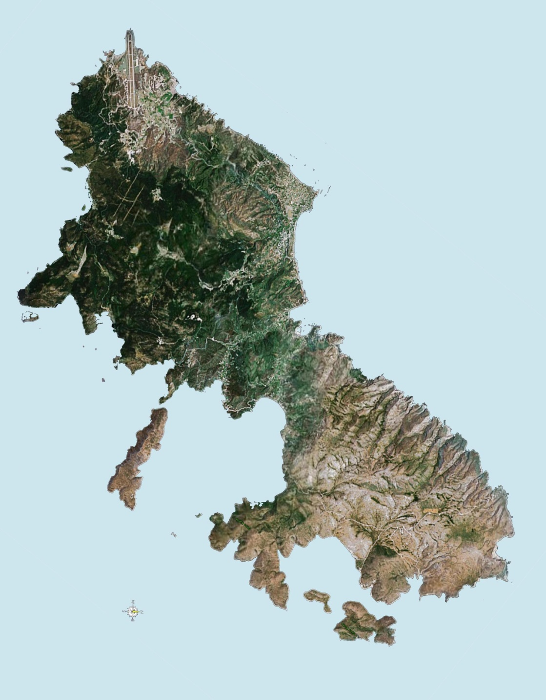
Skyros wind farm
Basic data
Size: 333 ΜW (111xV90-3MW)
Yield: ~1000 GWh/year
Status: EIA (almost complete)
Developer: ENTEKA S.A.
The unique case of Skyros
High wind potential (∼ 9 m/s)
Site remoteness
No conflicts with other local activities

Slide 11
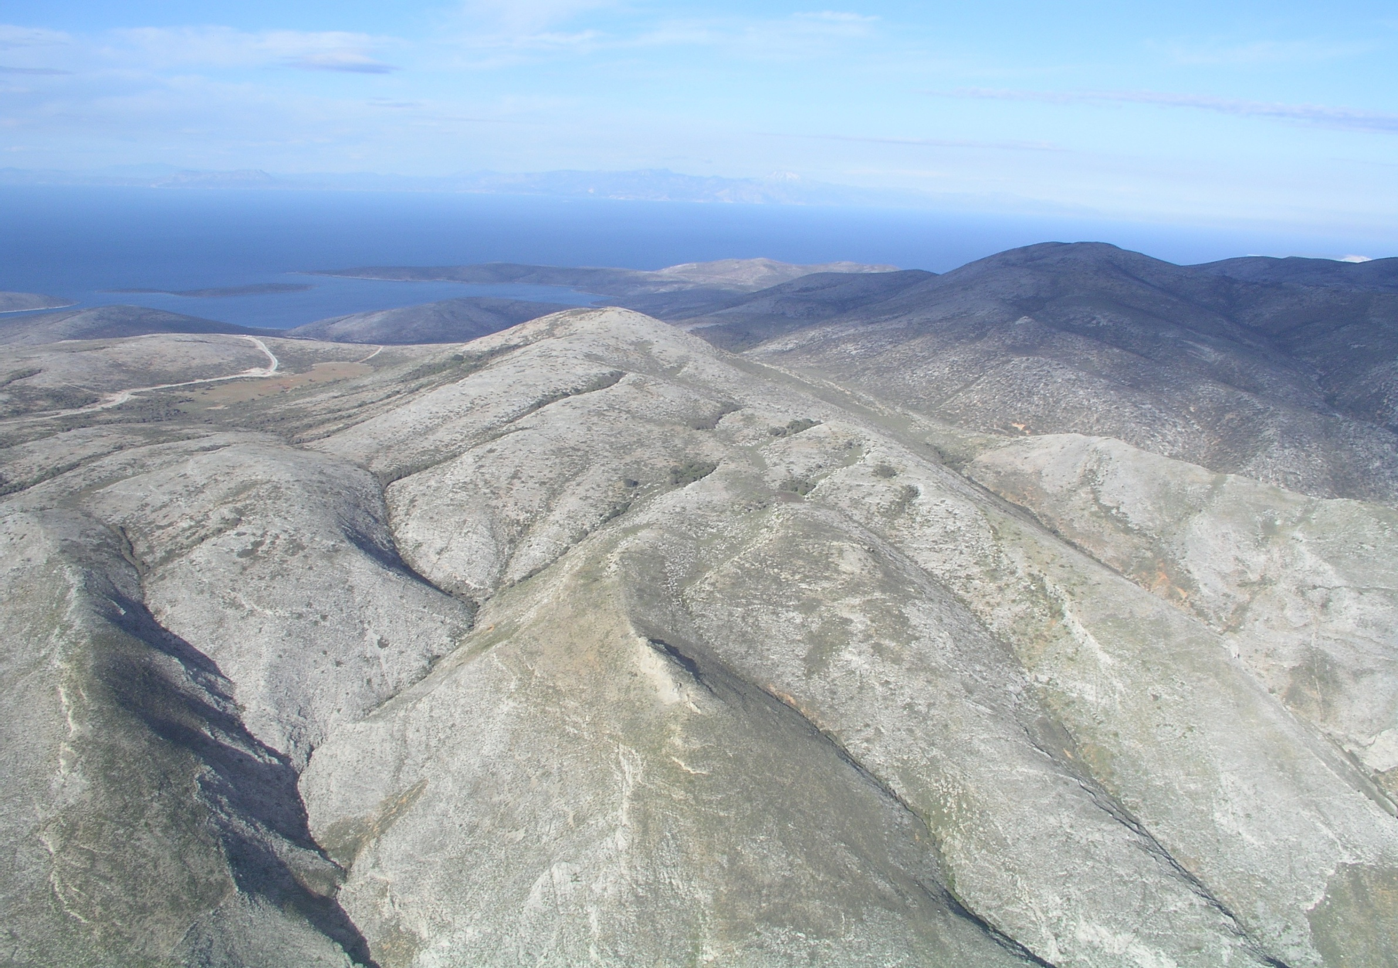
The site

Slide 12
Challenging issues
60 WTGs inside Natura site
Large colony of Falco eleonorae
Endemic flora species & maple groves
Complex terrain
GR2420006

Slide 13
Size limitations
Non-interconnected island
155 km HVDC lines
Min. installed capacity
for a feasible project

Slide 14
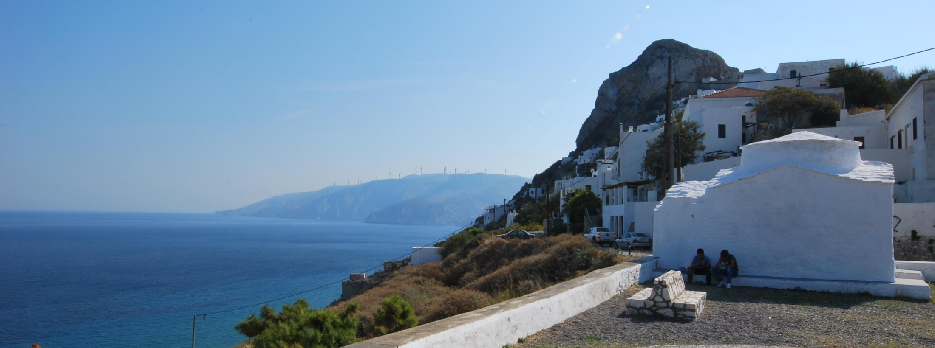
General approach
Multi-annual field work by team of environmental specialists
Special studies to optimize project’s design
Appropriate Assessment was proactively conducted
View from the castle of Skyros

Slide 15
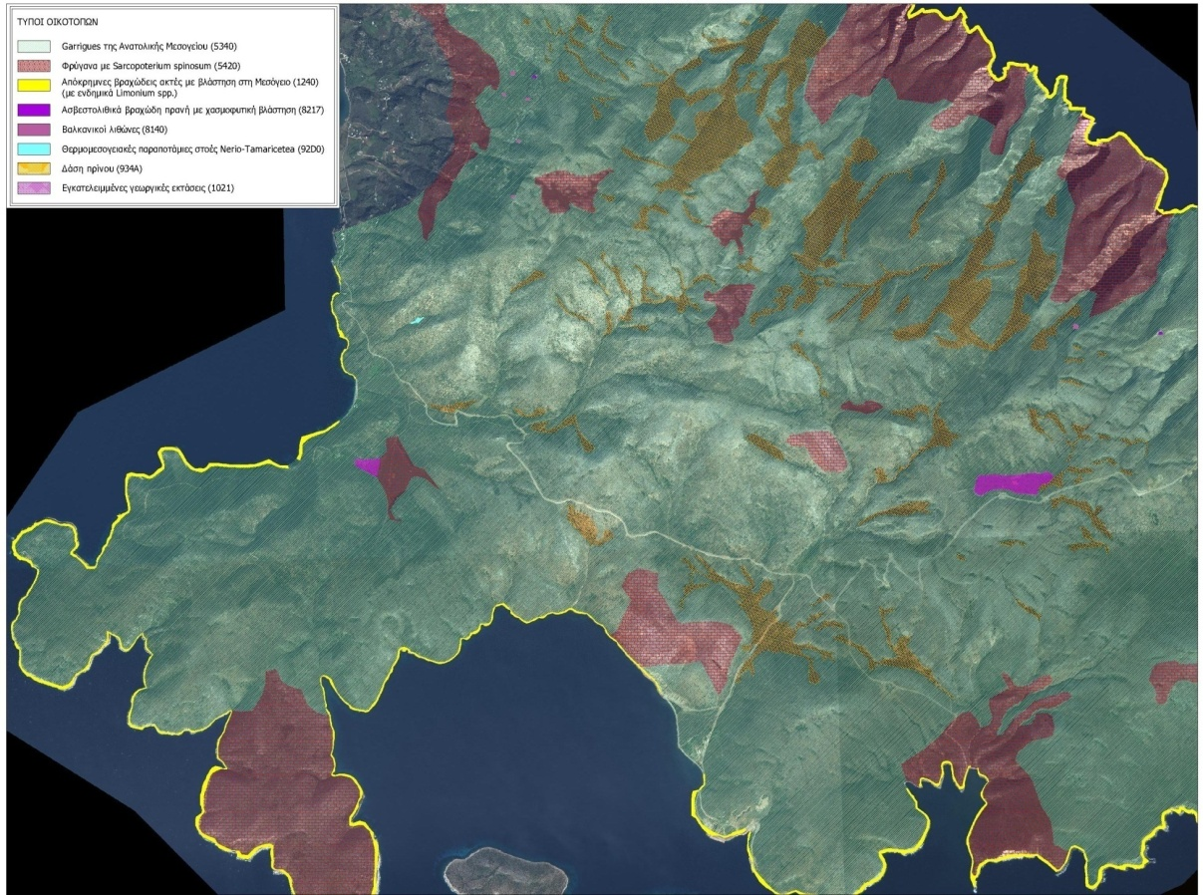
Habitats & flora species
Habitats’ mapping
Endemic flora species
2% limit for land cover actual cover: only 1.13%
Extended reforestation

Slide 16
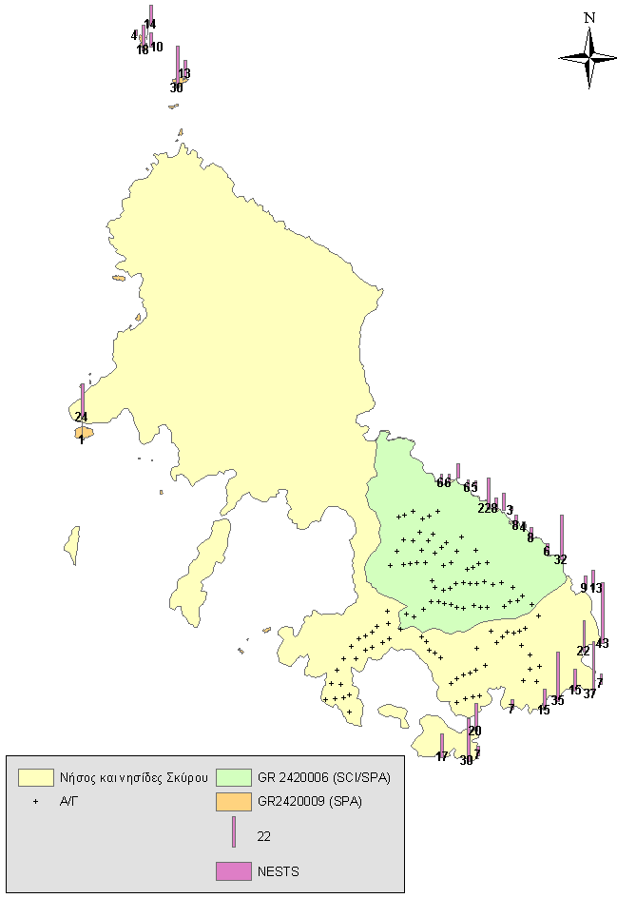
Avian fauna
Falco eleonorae (1050 individuals)
Max. 3 collisions/year
Mitigation measures:
2 km buffer zone
Underground electrical lines
Monitoring & additional measures (radars, artificial nests etc)
EC: the EIA "fulfills all the requirements of EU legislation and Court’s of Justice case-law“
The Project remains feasible

Slide 17
Benefits of the project
plantation of 40.000 endemic plants and trees
Saving of 1,1 mil. ton CO2/year
Integrated program of additional actions (environmental actions, restoration of byzantine church, social actions etc.)
3.5 mio€/year for the local community (RES special tax)
secures island’s electric supply & first step for the interconnection of the islands of north-eastern Aegean Sea
200 local jobs in construction & 40 local jobs in operation
Direct added value to the national economy: 24,6 mil. €/year (construction) and 133,5 mil. €/year (operation)

Slide 18
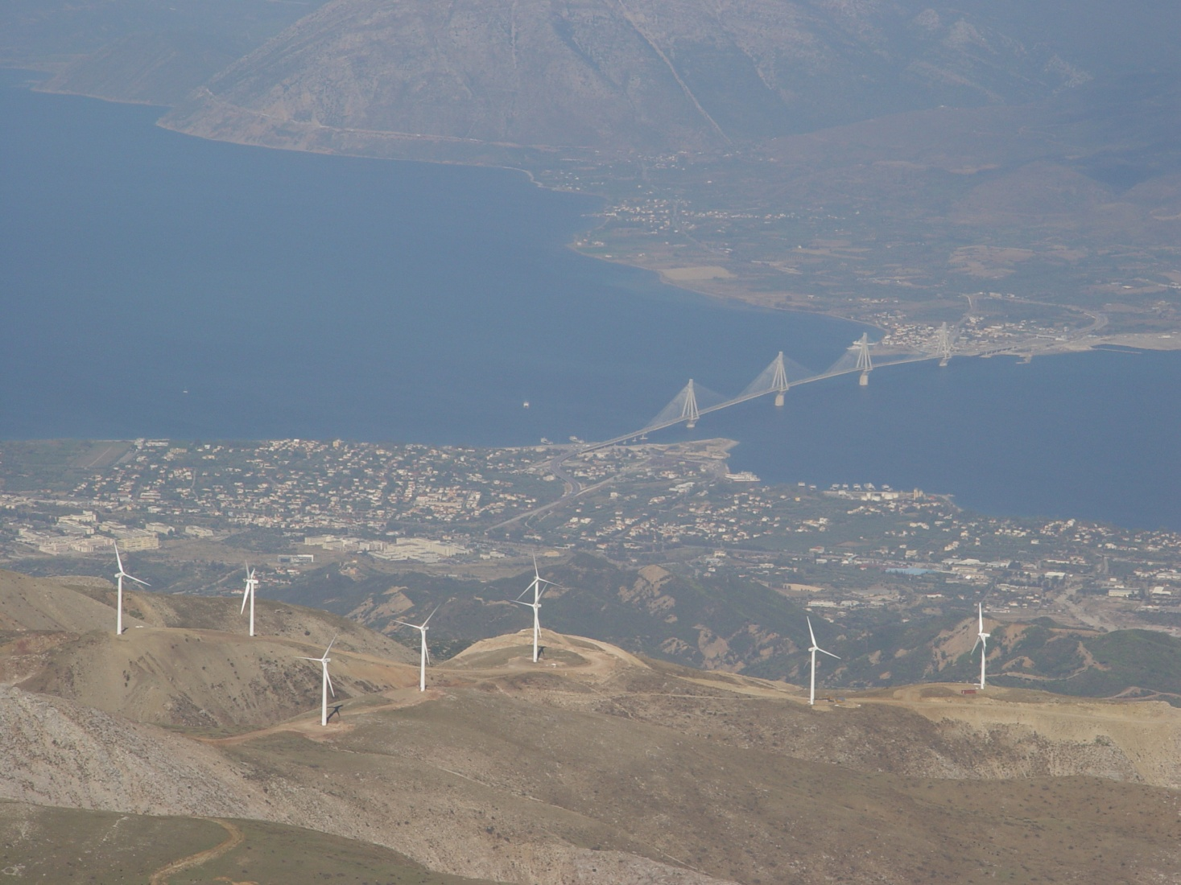
Panachaiko Project
Basic data
Location: Achaia, Peloponnese
Status: Operates since 2006
Capacity: 48,45 MW
(57 WTGs, Vestas V52 & Gamesa G52)
Developer/Operator: ENTEKA S.A.
Environmental info
Restoration works
No habitats deterioration
Annual bird monitoring:
no collision incidents

Slide 19
Discussion
Wind energy and wild life can coexist,
even in the case of large wind farms
Prerequisites:
suitable locations
thorough environmental investigation
application of environmental legislation
implementation of proper mitigation measures
References & deep dives
EU Guidance document: Wind energy developments & Natura 2000
Demonstration of good practices to minimize impacts of wind farms on biodiversity in Greece , LIFE12 BIO/GR/000554: http://windfarms-wildlife.gr
EU Guidance document: Managing Natura 2000 sites: The provisions of Article 6 of the 'Habitats' Directive 92/43/EEC

Slide 20
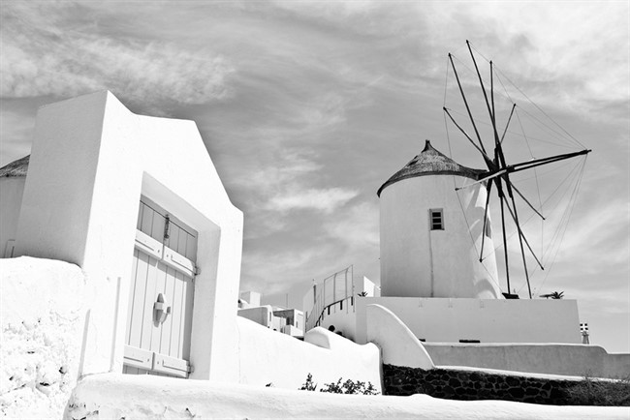
Thank you for your attention!
Andreas Vlamakis Physicist, MSc Email: a_vlamakis@hotmail.com | Konstantinos Loukidis Energy engineer, ΜΒΑ Email: loukidisk@gmail.com

