Slide 1
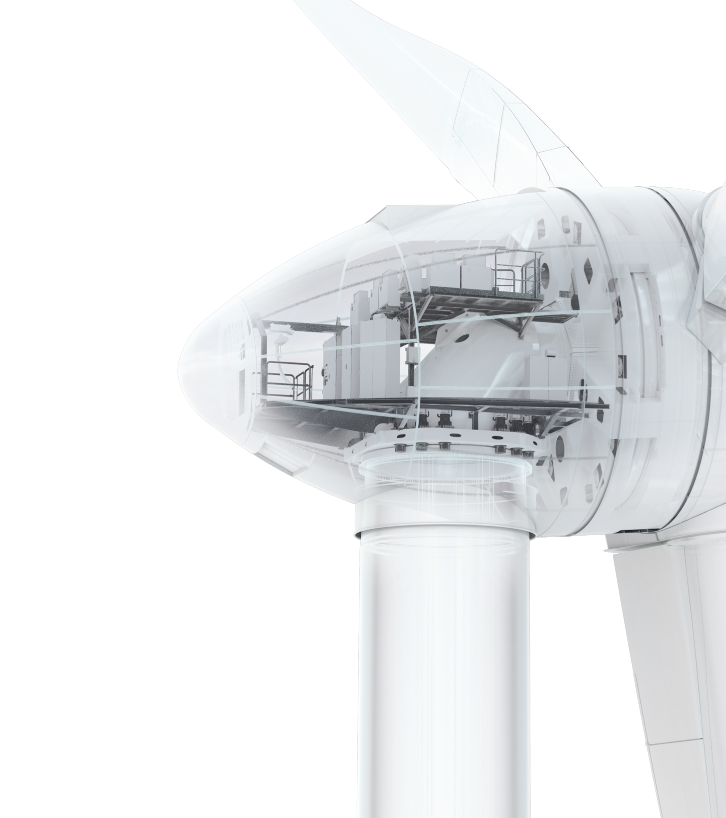
Li-Ion-Batteries
The Cases of Feldheim and Húsahagi
Hamburg, September 28th, 2016 Dr. Jens Winkler Energy Systems

Slide 2
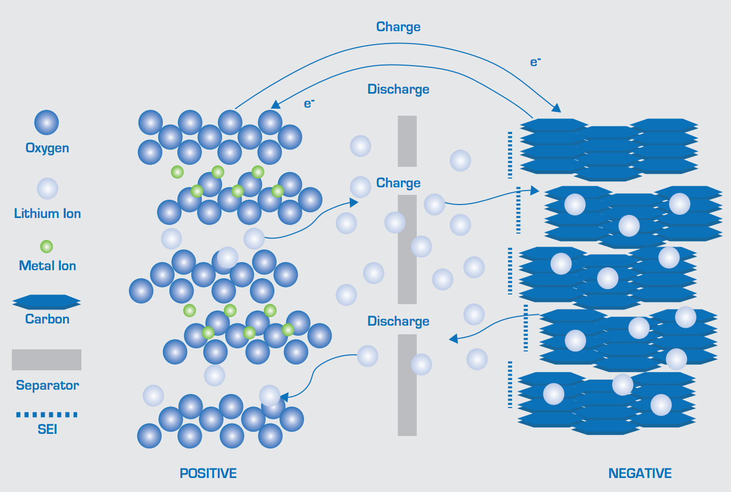
LI-ION-BATTERIES PHYSICAL PRINCIPLES
Source: European Association für Storage of Energy (ease), http://ease-storage.eu/energy-storage/technologies/
Notes:
A Lithium Ion (Li-Ion) Battery System is an energy storage system based on electrochemical charge/discharge reactions that occur between a positive electrode (cathode) that contains some lithiated metal oxide and a negative electrode (anode) that is made of carbon material or intercalation compounds. The electrodes are separated by porous polymeric materials which allow for electron and ionic flow between each other and are immersed in an electrolyte that is made up of lithium salts (such as LiPF6) dissolved in organic liquids. When the battery is being charged, the lithium atoms in the cathode become ions and migrate through the electrolyte toward the carbon anode where they combine with external electrons and are deposited between carbon layers as lithium atoms. This process is reversed during discharge

Slide 3
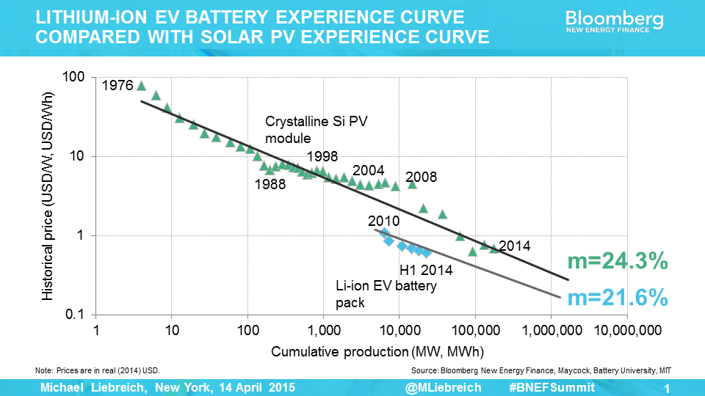
LI-ION BATTERIES PRICE DEVELOPMENT
Target 2020:
100-200 USD/kWh

Slide 4
LI-ION BATTERIES APPLICATIONS
Industrial Loads
Energy Traders
Renewable Power Plant Operators
Grid operators
Lower grid-access fees by peak shifting
Avoid balancing power by charging/discharging storage
Offer ancillary services such as regulating reserve
Avoid investment by T&D infrastructure deferral
Higher security of supply by using uninterruptable power supply
Take advantage of market price fluctuations with energy time shift
Take advantage of market price fluctuations with energy time shift
Have an alternative for n-1-security
Access to other markets („Power-to-X“)
Sell energy otherwise lost (curtailment)
Optimize self-consumption of renewable energy

Slide 5
LI-ION BATTERIES BUSINESS CASES
Regulating Reserve
Ramp Rate Control
Active Power
Active Power
100%
-100%
Frequency
Time
Notes:
Features
Functionalities

Slide 6
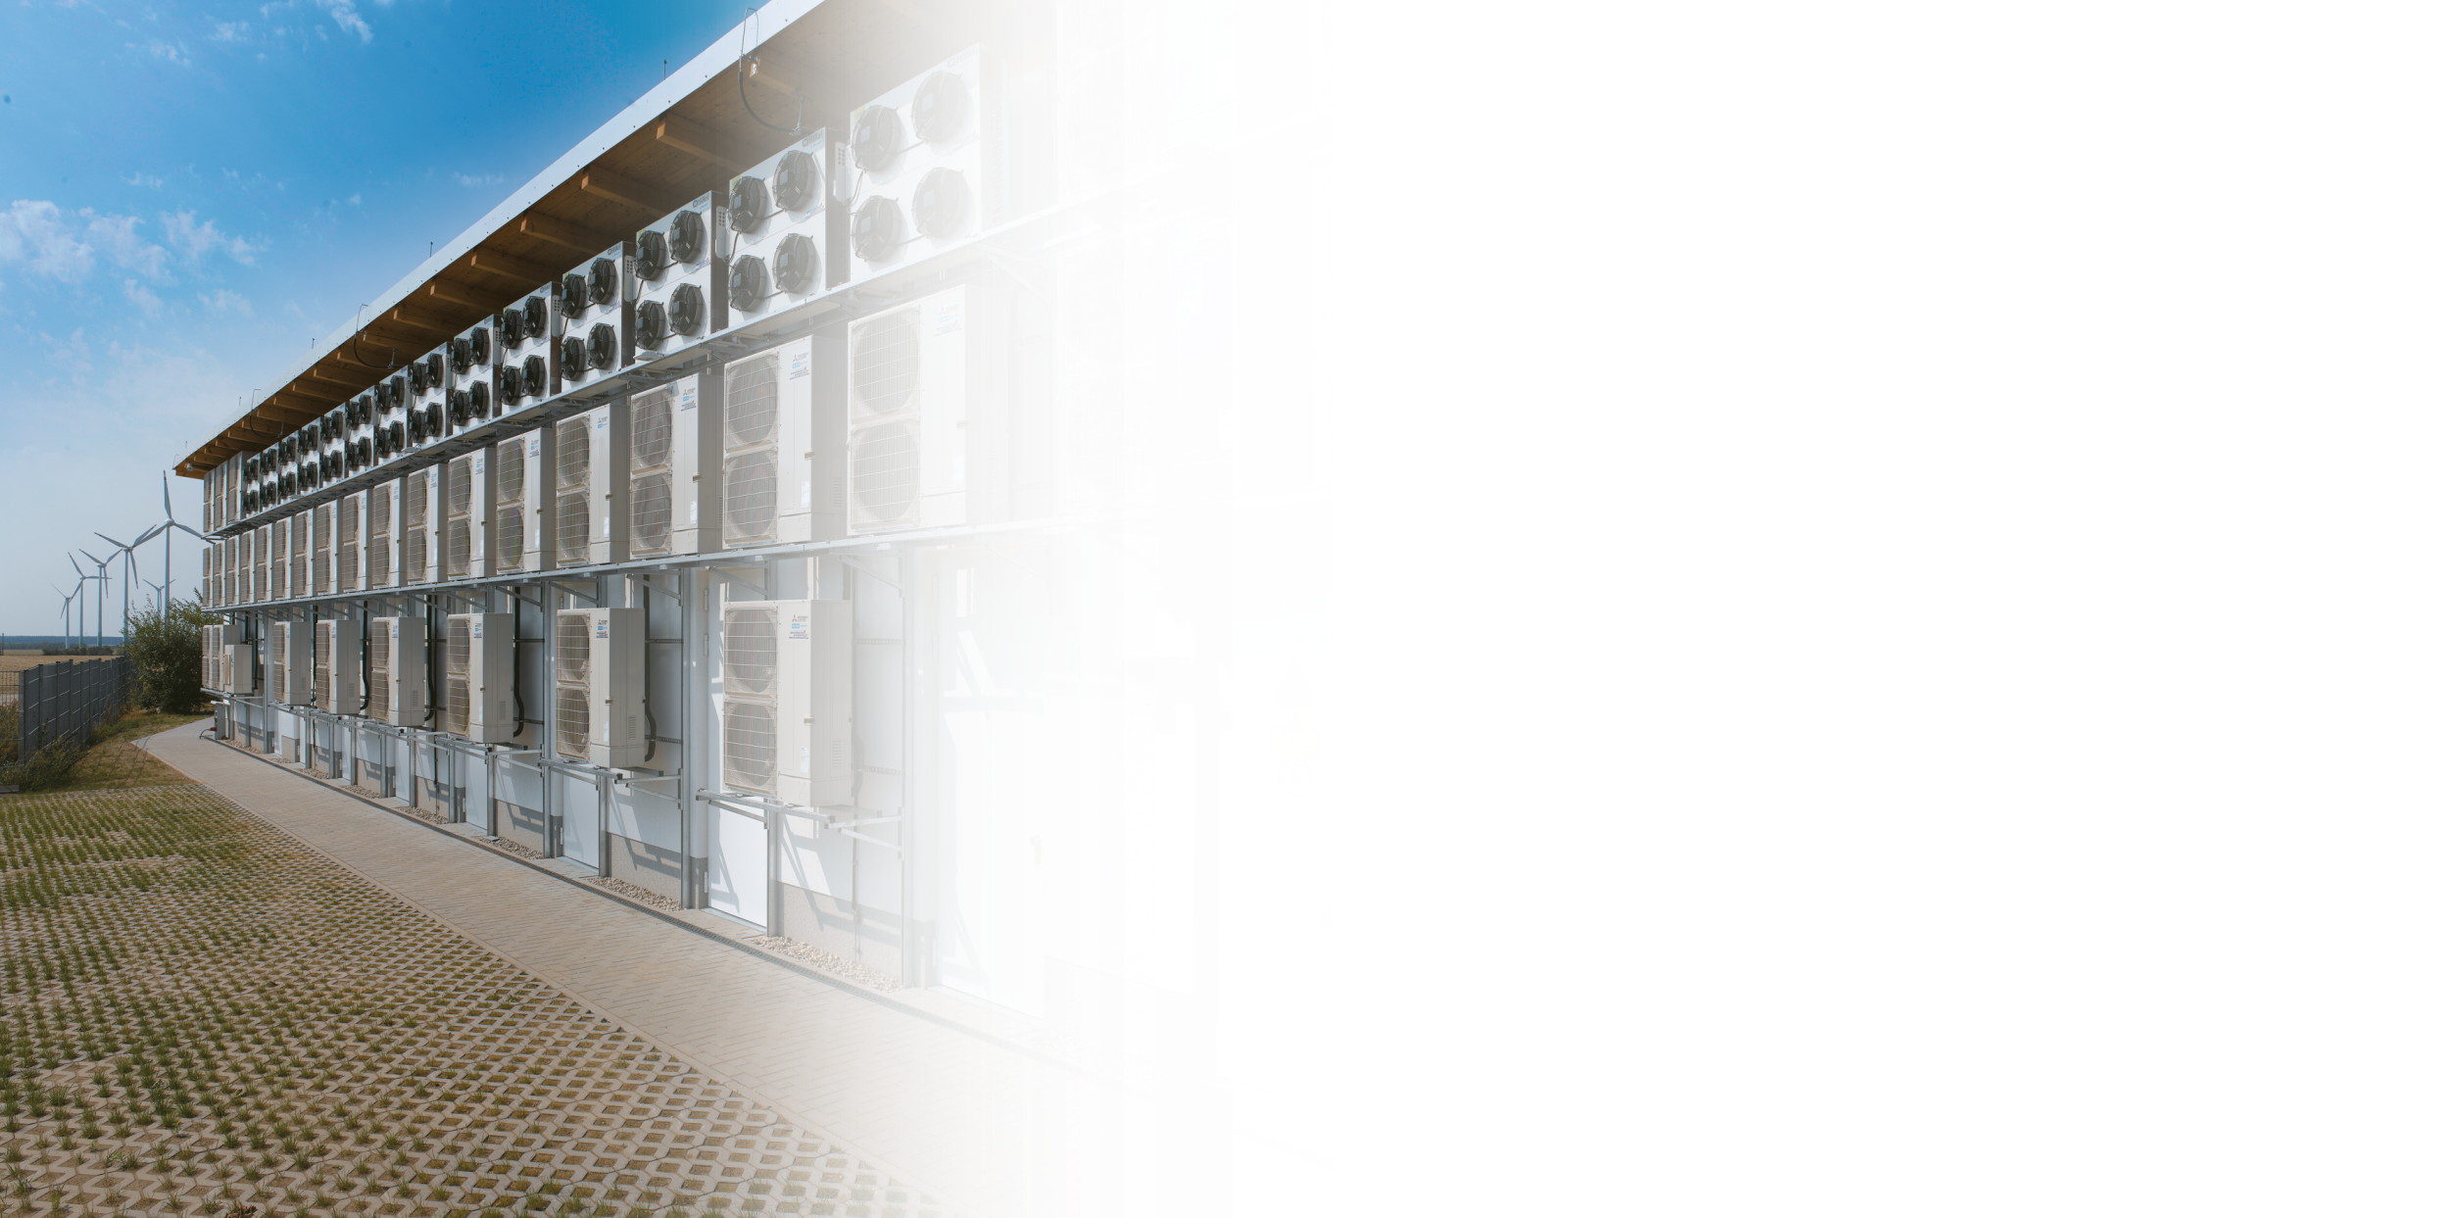
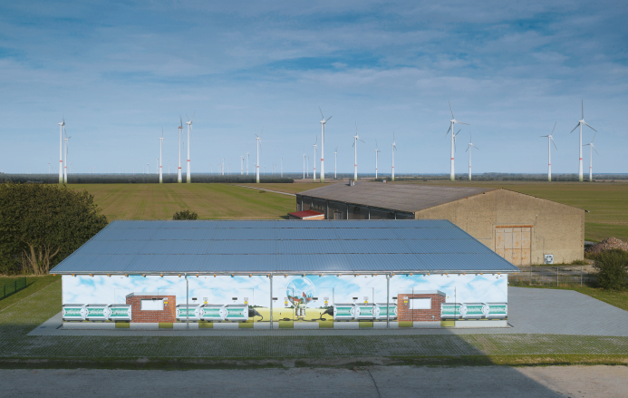
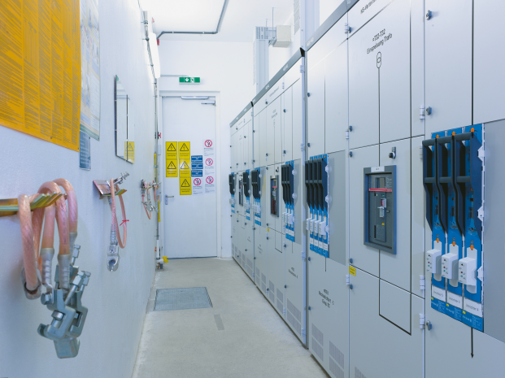
FELDHEIM PRIMARY CONTROL RESERVE
10 MW / 10 MWh Power/Capacity
Providing Primary Control Reserve
Lifetime approximately 15-20 years
One of the largest batteries in Europe
Li-Ion batteries: LG Chem
PCS: ENERCON
EMS: ENERCON
RRKW FELDHEIM NEIGHBORS AN ENERCON WINDFARM
LOW VOLTAGE CABINETS AT RRKW FELDHEIM

Slide 7
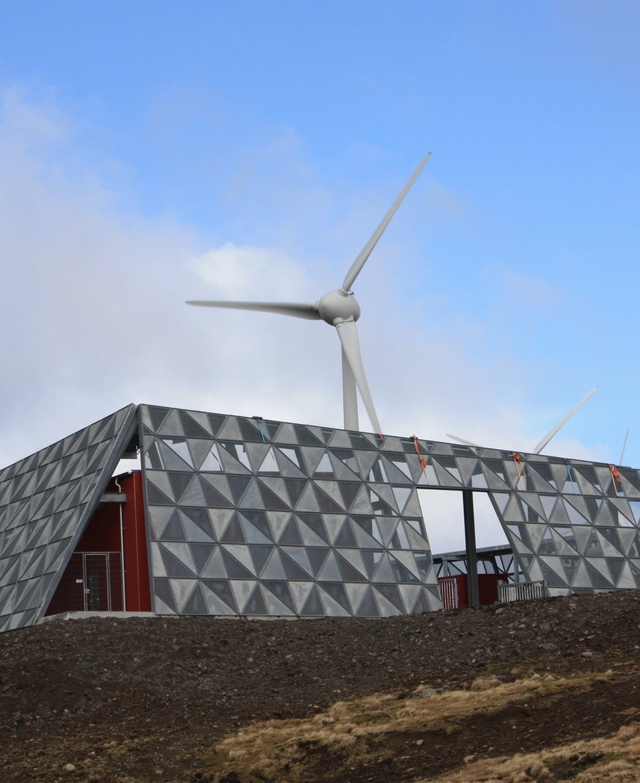
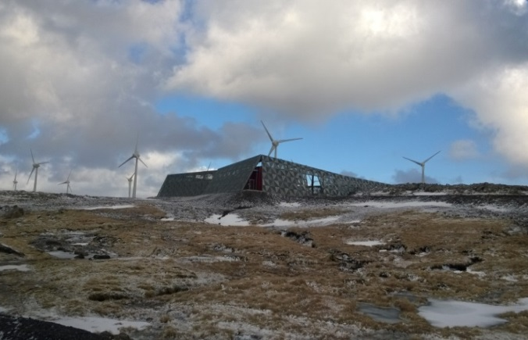
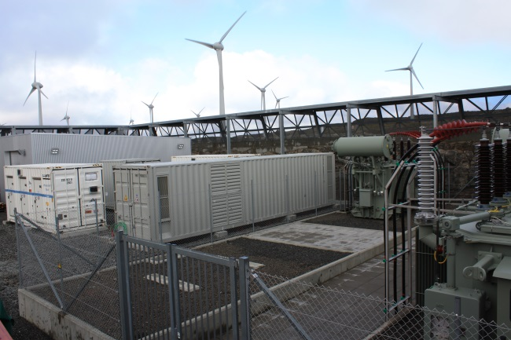
HÚSAHAGI, FAROE ISLANDS RAMP RATE CONTROL
Used for Ramp Rate Control, i.e. demand shifting and peak reduction
Li-Ion batteries: 2,3 MW / 700 kWh
Li-Ion batteries: Saft
Lifetime: 15-20 years
PCS: ENERCON
EMS: ENERCON
HÚSAHAGI COMBINES A WINDFARM AND STORAGE
CONTAINERIZED SOLUTION
Source: SEV
Notes:
2 Li-Ion battery container from Saft
Avoid wind farm shutdown in periods of strong wind and low load = Demand shifting and peak reduction
Proof for lifetime?

Slide 8
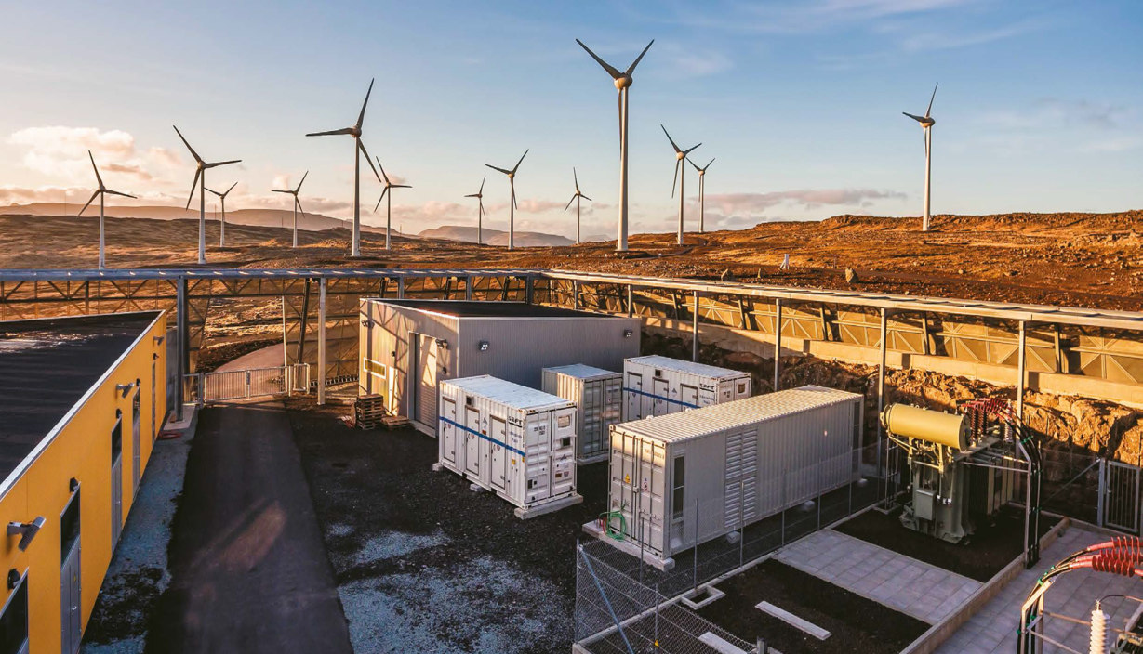
Let’s work as a team!
“ENERCON is shaping the energy transition being a supplier of integrated systems –
storage and renewable generation are ideal building blocks for this purpose.”
Dr. Jens Winkler, Head of Power Systems at ENERCON
Source: SEV
Notes:
“ENERCON is shaping the energy transition being a supplier of integrated systems –
Storage and renewable generation are ideal building blocks for this purpose.“
Dr. Jens Winkler, Head of Power Industries at ENERCON

Slide 9
DESIGN VARIANTS
Different electrochemistries: LiCO2, LiNCA, LiNMC, LiFePO4, LiMn2O4, LiT0,
etc.
Liquid electrolyte or polymeric electrolyte
Different cell shapes: cylindrical, prismatic, pouch
Different electrode thickness according to the Energy/Power ratio
Different battery systems according to the size: case up to container

