Slide 1
Assessment of UK offshore wind speeds – masts and MERRA2 compared
Rolando Soler-Bientz and Simon Watson
Centre for Renewable Energy Systems Technology

Slide 2
Contents
Methodology
Sites and Reanalysis Data
Comparisons Between Mast and Model Data
Conclusions

Slide 3
Methodology
Offshore mast data processed for six sites
MERRA2 reanalysis data extracted for nearest grid points and a selection of other locations
Measured and model data compared by direction, season, time of day and distance from coast
Comparisons made using 50m model data and closest mast level

Slide 4
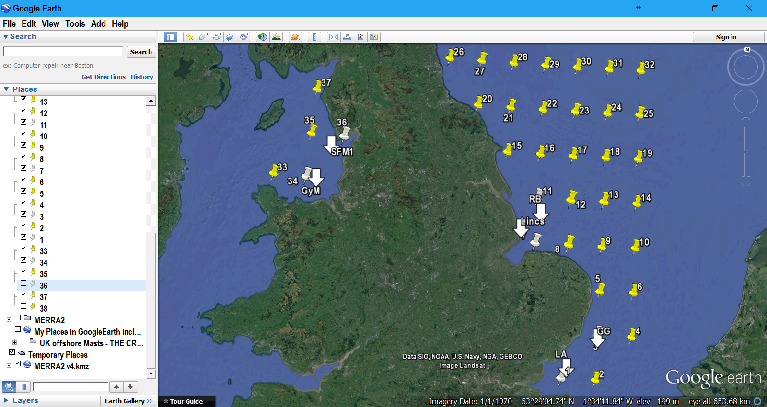
Study Sites and MERRA2 Grid Points
Masts (from coast)
Race Bank (31km)
Lincs (3km)
Greater Gabbard (28.5km)
London Array (26.4km)
Shell Flats M1 (16km)
Gwynt Y Môr (16.6km)
NW
E
SE
White pins=met masts, Yellow Pins=MERRA2 grid points

Slide 5
Data Periods
Region | Offshore Met Mast | Datasets converted periods | Years | Concurrent period per region | Concurrent period all regions
SE | London Array | 13/12/2004 18:00 31/12/2011 18:00 | 7 | 05/09/2005 00:00 30/06/2010 12:00 | 08/06/2006 18:00 09/09/2007 00:00
 | Greater Gabbard IGMMZ | 05/09/2005 00:00 30/06/2010 12:00 | 5
E | Lincs | 01/01/2003 00:00* 04/02/2008 18:00 | 5 | 08/06/2006 18:00 04/02/2008 18:00
 | Race Bank | 08/06/2006 18:00 09/06/2010 06:00 | 4
NW | Shell Flats M1 | 14/06/2002 06:00 09/09/2007 00:00 | 5 | 05/09/2005 00:00 09/09/2007 00:00
 | Gwynt Y Môr | 05/09/2005 00:00 24/04/2008 06:00 | 3
MERRA2 Dataset: Up to 11 years of data used
*Data available from 1999 but quality problems

Slide 6
Directional Distributions

Slide 7
Seasonal Cycles

Slide 8
Diurnal Cycles

Slide 9
Wind Speed vs Coastal Distance
Empirical trend line fit to MERRA grid points:
$${u=u}_{0}∗\left[a−{\left(\frac{x_{0}}{x+x_{0}}\right)}^{1/2}\right]$$
Lincs
$u_{0}$ [m/s] | $x_{0}$[km] | a
2.59 | 55.94 | 4

Slide 10
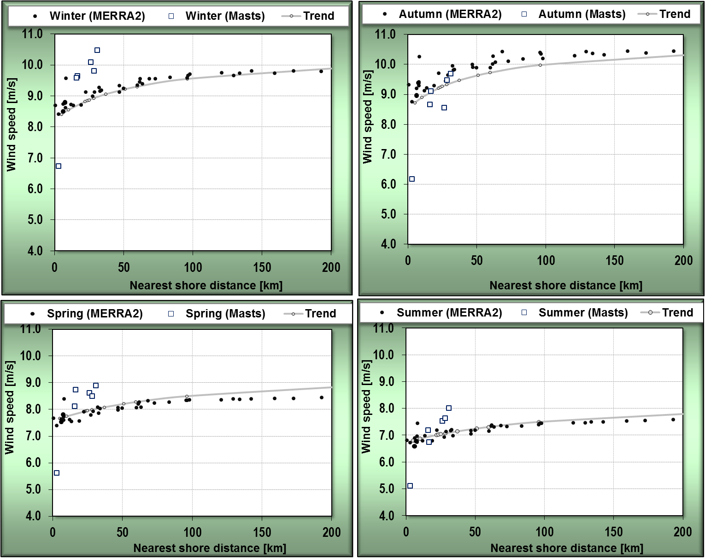
…By Season
Empirical trend line fit to MERRA grid points:
$${u=u}_{0}∗\left[a−{\left(\frac{x_{0}}{x+x_{0}}\right)}^{1/2}\right]$$
Season | $u_{0}$ [m/s] | $x_{0}$[km] | a
Winter | 2.71 | 34.49 | 4
Spring | 2.14 | 1.72 | 4
Summer | 1.84 | 1.17 | 4
Autumn | 2.79 | 9.92 | 4

Slide 11
Diurnal and Seasonal Cycles vs Coastal Distance
London Array
Race Bank
Greater Gabbard
Gwynt Y Môr

Slide 12
Conclusions #1
MERRA 2 tends to underestimate mast wind speeds
Direction Frequencies: NW sites have second peak at 150 deg not seen at SE and E sites not well captured by MERRA2
Form of seasonal cycle captured reasonably well by MERRA2
Some diurnal variation seen at all sites opposite to that seen on land – MERRA2 does not always capture this

Slide 13
Conclusions #2
MERRA2 shows magnitude of diurnal cycle reduces with distance to coast up to 150km – magnitude at 150km half that seen at 90km
MERRA2 shows magnitude of seasonal cycle increases with distance to coast up to 50km, though change small
Mast data only up 30km so trends not so clear
Distance to coast in prevailing wind direction may be more significant than closest distance

