Slide 2
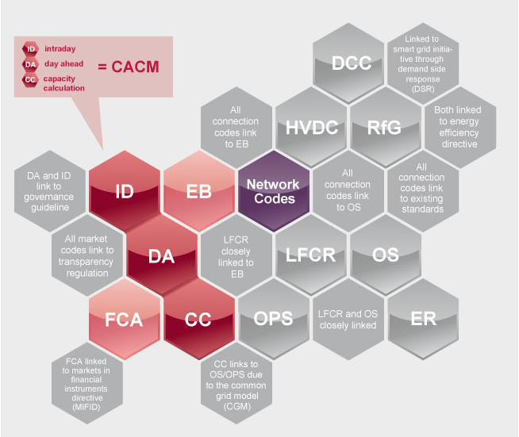
Background: The Target Model
The European Electricity Regulatory Forum (Florence Forum) decided in November 2008 to develop an EU-wide Target Model (TM) and a roadmap for the integration of electricity markets across regions.
Target Model was expected to be fully implemented by 2015:
including day-ahead price coupling
cross-borders intraday continuous trading and
long-term cross-border capacity allocation with harmonized rules at European scale
The Target Model is based in two main principles
Energy only regional markets
Market Coupling linking zonal day-ahead spot markets into a virtual market, where only congestion-constrains limit the trade
Notes:
The Target Model (TM) has been developed by the European Commission (EC) in cooperation with ENTSO-e and ACER represents an attempt to make the penetration of large amounts of renewable generation compatible with the satisfactory functioning of power systems in Europe from a techno-economic point of view. The TM comprises a set of documents, including the Network Codes (NCs), or framework guidelines, related to different aspects of the functioning of the system.
The Target Model has apparently some limitations and shortcomings. This has been slowing down its implementation in Europe (we have passed the planned 2015 implementation target).

Slide 3
Challenges for future electricity markets
Security of supply with even higher RES shares
Today about 1/3 of power generation is renewable (and variable)
Firm supply has problems in recovering costs
Are the current instruments for decarbonisation cost-effective?
Market4RES project discusses how the TM should evolve with respect to:
RES support schemes
Electricity market designs fit for high RES shares
Capacity markets

Slide 4
Market4RES in a nutshell
Market4RES: "Post 2020 framework in a liberalised electricity market with large share of Renewable Energy Sources (RES)"
The project is co-funded by Intelligent Energy Europe (IEE) programme. The total budget is 2.4 M Euro
Duration: April 2014 - October 2016 (M31)
Market4RES Final event: 2016-10-20, Brussels, BE
www.market4res.eu
Notes:
IEE is a research program, which has been parallell with FPs.

Slide 5
Project within the Intelligent Energy Europe (IEE) Programme
Participant name | Country code | Profile of the organisation
SINTEF Energy Research (Coordinator) | NO | RESEARCH
WindEurope (ex European Wind Energy Association) | BE | INDUSTRY
Energy Economics Group (EEG), Vienna University of Technology | AT | RESEARCH
Solar Power Europe (ex EPIA) | BE | INDUSTRY
3E | BE | CONSULTANCY
TECHNOFI | FR | CONSULTANCY
Comillas Pontifical University | ES | RESEARCH
Réseau de Transport d'Électricité | FR | INDUSTRY
Iberdrola Renovables Energia | ES | INDUSTRY
APX Group (until 2015-12-31) | NL | MARKET
Friends of the Super Grid | BE | INDUSTRY
Notes:
Det viktigste her er at vi har partnere fra ulike sektorer, inkludert assosiasjoner til PV, Vind og SuperGrid.
Two partners have changed names dvs. EPIA og EWEA har blitt til SolarPower Europe og WindEurope.
APX decided to withdraw from the project etter sammenslåing med EPEX.

Slide 6
Workflow in the project
Lead EEG TU Wien
Diagnosis of the TM
Lead IIT-Comillas
Lead WindEurope
Identification of promising modifications of TM and designs of new markets
Quantitative assessment of markets
Communication and dissemination
Lead Technofi
Lead SINTEF
Pre-2020 (current generation fleet)
Post-2020 (future generation fleet)
Lead SINTEF
Recommendations and implementation guidelines for market designs
Notes:
We start with diagnoses of the TM defining status quo for the power market.
We continue with identification of the possible modifications
We make a selection of the most promising design options
We make quantitative analysis of the selection long for pre-2020 and post-2020 timeframes in parallel.
We make conclusions and create a roadmap.

Slide 7
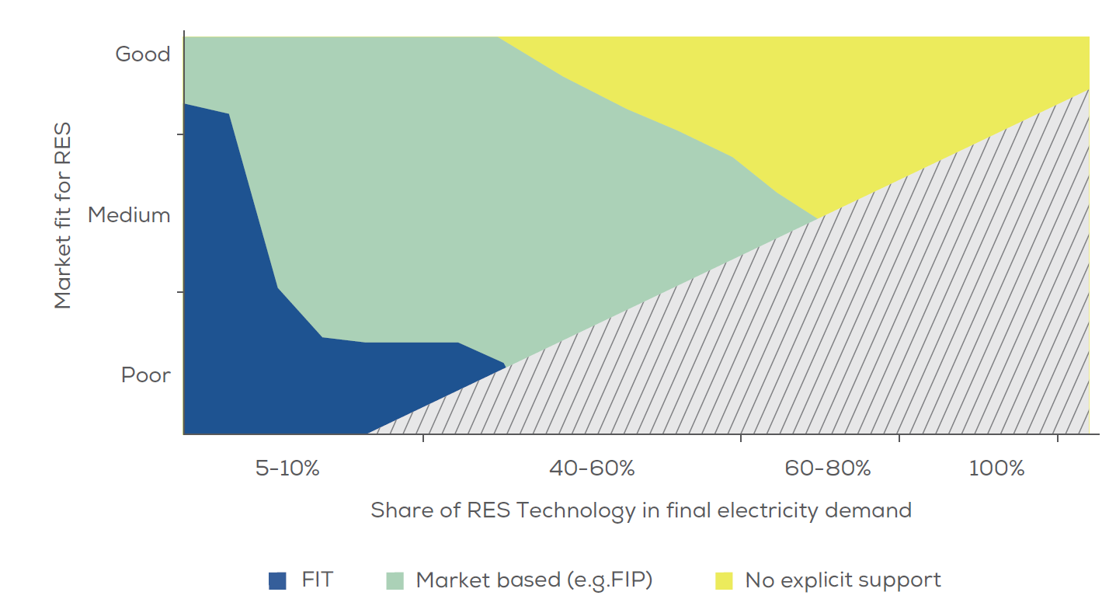
Support schemes and market designs should evolve in parallel

Slide 8
Markets for electric energy: Keep up the momentum in harmonization
Iterative process to develop network codes (NC) / regulations
EC, ACER, ENTSO-E
NC for markets: Capacity Allocation and Congestion Management (CACM), Electricity Balancing (AB), Forward Capacity Allocation (FCA)
Considerable achievements have been made in establishing an integrated day-ahead market
We also need to focus on implementation for intra-day markets

Slide 9
Markets for electric energy: Implementation for the intra-day market
Now, focus should be put on implementing integrated and well-functioning intra-day markets
Gate closure should be close to real time operation
Continuous trading
However, to increase liquidity:
Some organized auctions are recommended
Consider reservation of cross-border transmission capacity for intra-day

Slide 10
RES-friendly environment for electricity balancing is needed
Network code for electricity balancing (EB)
Has good intentions with respect to RES
But much is still left open to be specified in the future
Important elements for RES
Avoid RES curtailment (unless its marginal value is negative)
Effective imbalance netting between control areas
Markets for ancillary services should be open for RES generation and demand to the extent they can provide it,
… and products should be specified with this in mind

Slide 11
A careful approach regarding capacity markets
Over-investment through separate national markets should be avoided.
It should be mandatory to allow the use of cross-border interconnection capacity to contract firm capacity in other countries.
Product: financial option with a high strike price
Firmness requirement & penalty for non-delivery
Contracted amount should be affected by price (to reduce strategic bidding)

Slide 12
Consumers need to be exposed to prices
Demand-side flexibility (incl. storages) is an obvious response to RES variability
Market mechanisms are set to work if:
Consumers are exposed to prices (e.g. day-ahead, intraday)
and automatic metering of consumption exists
Participation in markets for real time balancing (MW)
Legislation should support it, and flexibility products should be developed with this in mind
Advanced control is needed
Roles must evolve (e.g. aggregators or under system operator's control)

Slide 13
Communication and Dissemination
Market4RES Final event: 2016-10-20, Brussels, BE
Keynote session
Panel session
Printed publication
The Final project publication will be distributed at the final event
Policy recommendations will be translated into five languages
All Market4RES Technical Reports and information about the past events are always available at: www.market4RES.eu

Slide 14
14

