Slide 1
Iran Wind Industry “Challenges & Opportunities”
Prof. Dr. Hashem Oraee
President
Iranian Wind Energy Association, IRWEA
WindEurope Summit
September 27-30, 2016
Hamburg, Germany

Slide 2
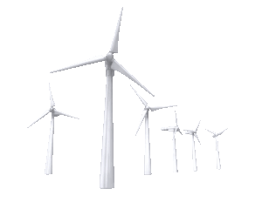
+ve Indicators
Potential
Economics
Laws
No Competition
[WindEurope Summit 2016]

Slide 3
-ve Indicators
Risks
Sanctions
Bureaucracy & Corruption
Lack of Local Finance
[WindEurope Summit 2016]

Slide 4
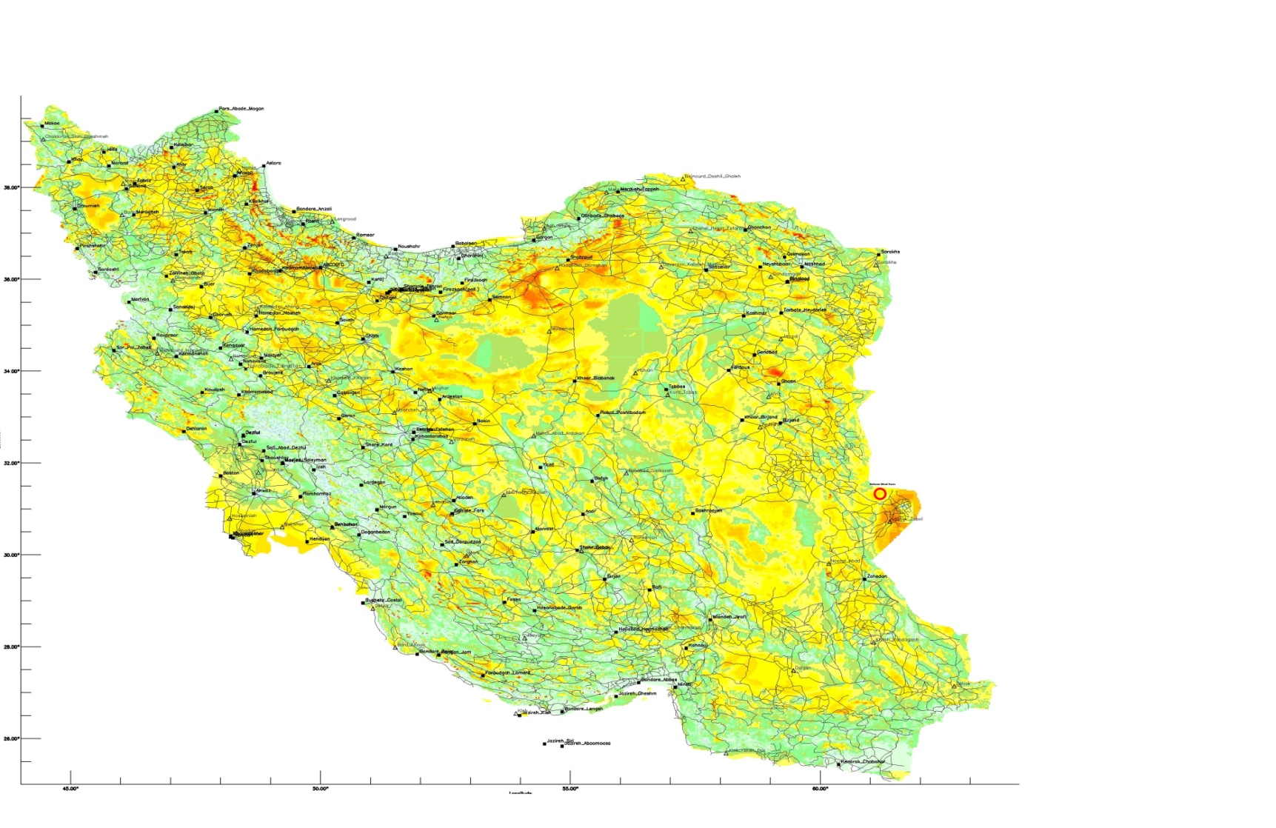
Wind Atlas
[WindEurope Summit 2016]

Slide 5
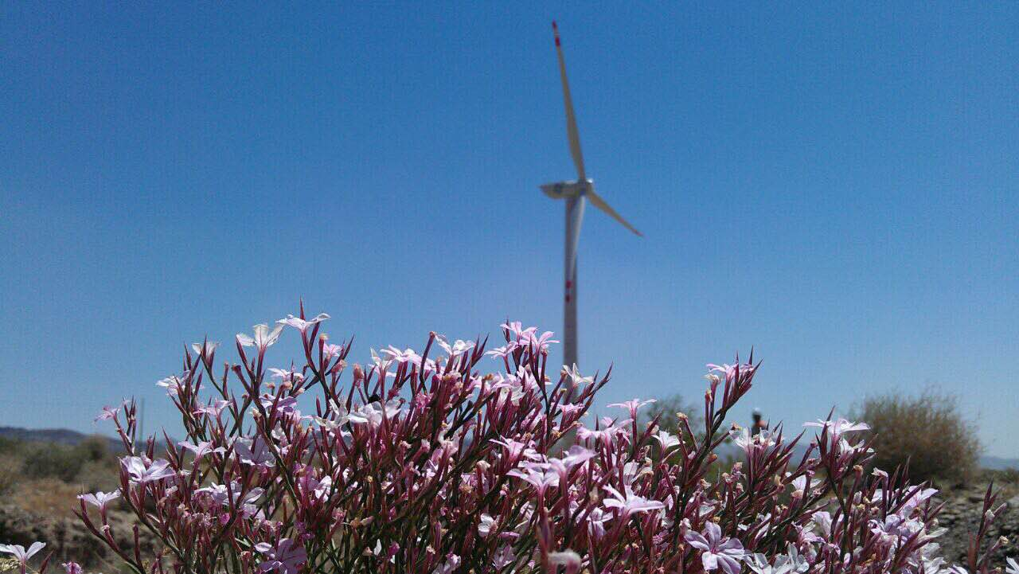
1.5 MW Turbine Commissioned in Khaf in 2012
First Year Capacity Factor 50.83 %
[Courtesy of Beheen Group]
[WindEurope Summit 2016]

Slide 6
Laws & Regulations
Five Year Plan
Annual Budget
Tax on Consumption
FIPPA
Payment Guarantee
Conversion to Hard Currency
[WindEurope Summit 2016]

Slide 7
Wind Energy in Iran
Challenge √ √ √
Economic Return √ √ √
Easy Ride × × ×
[WindEurope Summit 2016]

Slide 8
Thank You For Your Attention

