Slide 1
REserviceS A pan European research project success story Lessons learned from participation
Stephan Wachtel
September 2016
Senior Engineer, GE Renewables

Slide 2
Legal Disclaimer
The content of this presentation was created by the author and reflects his individual opinion and views.
Please note that the presentation is not a statement from the REserviceS consortium and/or EASME and therefore not necessarily reflects their views, opinions and positions. They cannot be held responsible for the use of the information contained therein.

Slide 3
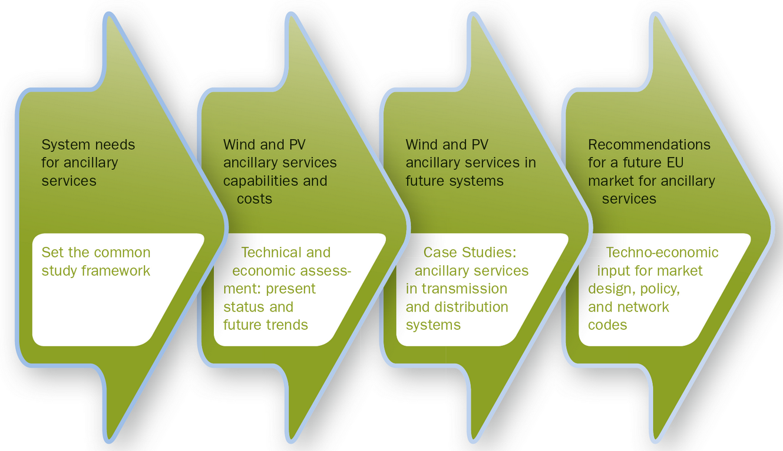
The REserviceS Project
REserviceS (Economic grid support from variable renewables) was the first study to investigate wind and solar based grid support services at EU level.

Slide 4
The REserviceS Project
REserviceS has provided technical and economic guidelines and recommendations for the design of a European market for ancillary services, as well as for future network codes within the Third Liberalisation Package.
REserviceS was funded under the EU FP7 program and ran from Q2 2012 to Q3 2014
Please see also www.reservices-project.eu

Slide 5
Why did GE took part in REserviceS?
Relevant topic at the right time
Renewables system integration is key to achieve high and cost efficient RES penetration
RES already do provide system services today and will need to provide more at higher RES penetration levels
But which and how and within which framework?
This will impact design & operation of RES significantly
REserviceS broke new ground with realistic objectives
Leveraging lessons learned from RES integration studies in the European context
IP development was neither planned nor expected.

Slide 6
Why did GE took part in REserviceS?
GE had the right staff with the needed skillset
… and these resources could be scheduled
Funding from the EU FP7 funding program
Sufficient re amount and schedule
Sufficient added value for the business
The set up of partners in the consortium
EU funded projects were new to the set up GE team
Most partners with long track record of EU funded projects
WindEUROPE as an experienced project coordinator

Slide 7
Lessons learned
Complex Rules, complex application
Understand the funding rules fully
In case of doubt: Look for external support
Run your business case carefully
Match internal processes with funding rules
Fully understand the degree of freedom in the rules
Project coordination
Large project with 14 partners over several WPs needed good coordination
Well align with your project partners

Slide 8
Lessons Learned con’d
Plan your resources well
Project Coordination
Dissemination of results
Reporting and its deadlines
Archiving information
Manage resources well to fulfill your commitments on time
Plan for project management role
Carefully manage budget and schedule
Prepare for audit
How can overhead by minimized?

Slide 9
Summary and Conclusions
REserviceS had the right team for this project
Look for the right partners and …
… get full alignment.
Large projects with long run time drive needs for coordination
For each partner
For the consortium by a strong coordinator
How much efficiency can be gained by having smaller projects?

Slide 10
Summary and Conclusions
FP7 was the right R&I funding program for the goals of the REserviceS project
Project goals matched with the funding rules
Enabled a project the partners could not have worked on in such a way as in this R&I project.
Incentivize performance in future funding programs?
Fully understand the funding rules
Especially if the program is new for your team
Consider external help
Unbureaucratic funding rules fast & transparent approval processes make EU funding programs attractive.

Slide 11
Join the conversation

Slide 12
Thanks for your attention

