Slide 1
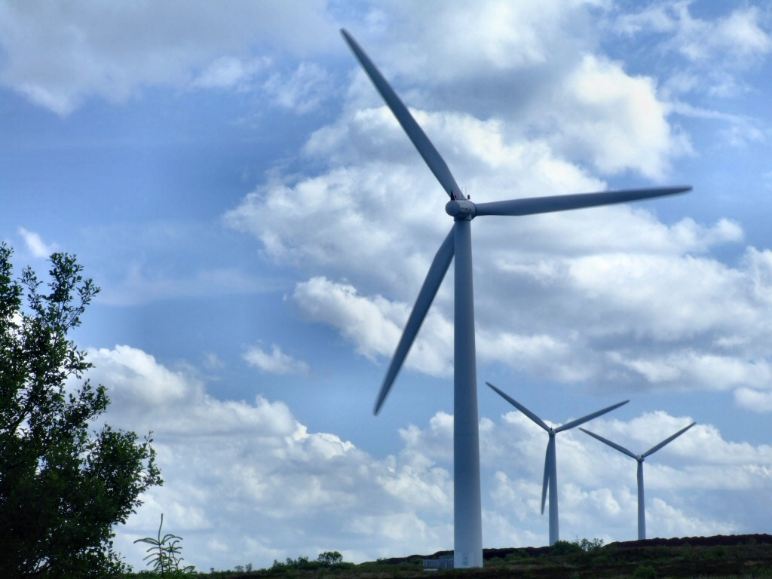
EIB Finance of Repowering/
Life cycle extension projects
Wind Europe Summit 2016 Hamburg

Slide 2
The EIB: the EU bank
Natural financing partner for the EU institutions since 1958
Around 90% of lending is within the EU
Shareholders: 28 EU Member States
Investing in Europe’s growth

Slide 3
The EIB at a glance
Largest multilateral lender and borrower in the world
We raise our funds on the international capital markets
We pass on favourable borrowing conditions to clients
Some 450 projects each year in over 160 countries
Headquartered in Luxembourg and has 33 local offices
Around 2 600 staff:
Not only finance professionals, but also engineers, sector economists and socio-environmental experts
More than 50 years of experience in financing projects

Slide 4
EIB lending since its foundation

Slide 5
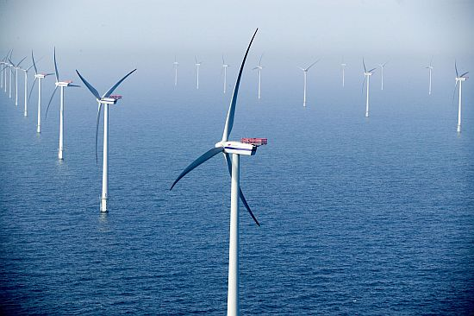
Repowering/Lifecycle extension
Regulatory framework/incentives
Merchant risk
Permits
Capex

Slide 6
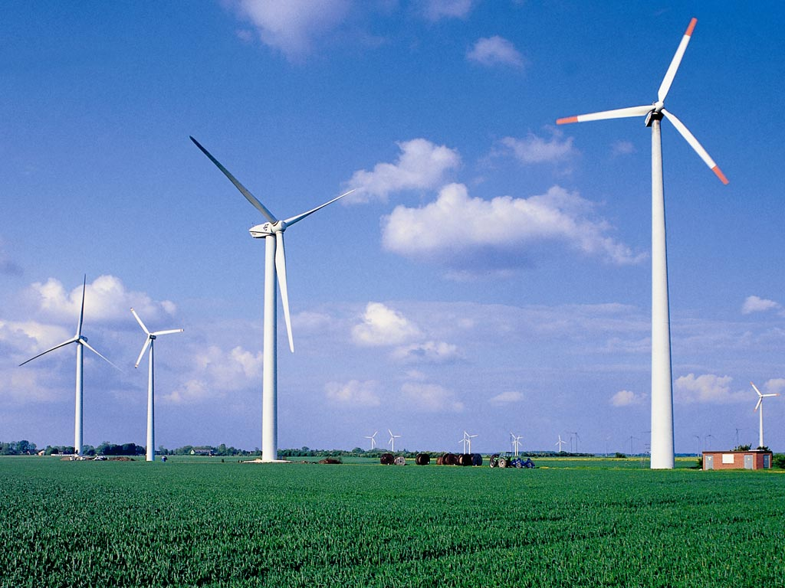
Project Requirements
Projects must:
Meet at least one of the EIB’s objectives,
Be technically sound,
Be financially viable,
Show an acceptable economic return,
Comply with environmental protection and procurement regulations.
Climate change considerations are streamlined along the project appraisal process
(e.g. energy efficiency, mitigation and adaptation measures)

Slide 7
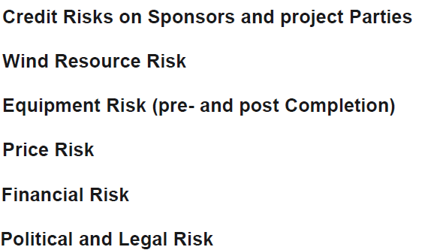

Slide 8
Thank you!
Thank you !

