Slide 1
Scanning LiDAR in Offshore Wind
Field testing scanning LiDAR systems in Dublin Bay
Michael Stephenson and Alex Clerc
Wind Europe Summit, 27th September 2016
Co-authors:
Peter Stuart, Lee Cameron, Alina Burmester, Simon Feeney (RES)
Matthieu Boquet, Philippe Royer, Raghavendra Krishna Murthy (Leosphere)
Keith Barr (Lockheed Martin Coherent Technologies - LMCT)

Slide 2
Presentation Contents
Project Description
Value proposition
Single vs Dual Scanning LiDAR
Dublin Bay experiment
Project Results
Radial, single LiDAR and dual LiDAR validation results
Leosphere and LMCT
Project Conclusions

Slide 3
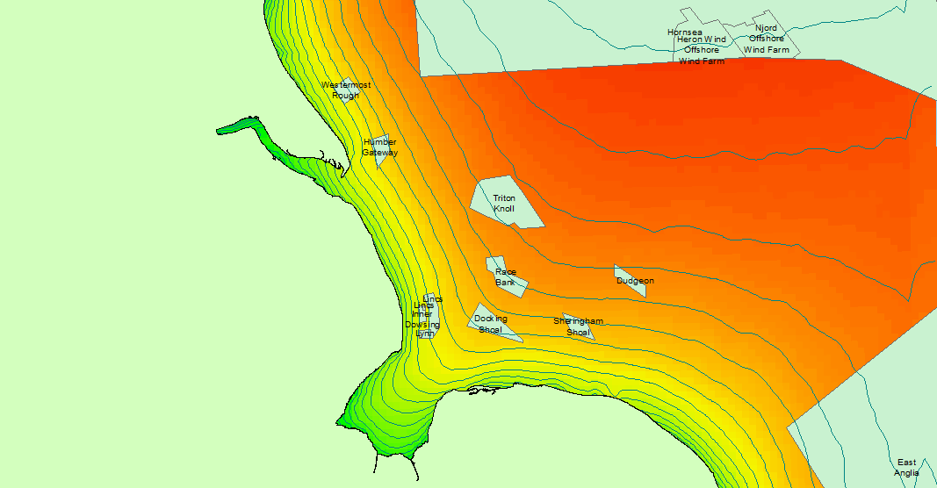
What are we trying to achieve?
Predicted spatial variation of average wind speed (mesoscale model)
The benefits that could be derived from installing Scanning LIDAR(s) include:
Better project decisions (layout design, resource assessment)
Reduction in horizontal wind speed extrapolation uncertainty
In this experiment primary wind speed measurement (e.g. as done by a mast or floating LiDAR) is a secondary objective. Scanning patterns are optimised for spatial variation.
~1% change in wind speed
~1% change in wind speed
~1% change in wind speed
~20km

Slide 4
Definition of Radial and Orthogonal Measurement Data
Measurement
Location
Measured radial wind speed
Kish Lighthouse
Line of Sight (LOS)
Scanning LiDAR
Wind vector
East Pier

Slide 5
Definition of Radial and Orthogonal Measurement Data
Kish Lighthouse
Measured radial wind speed
Wind vector
East Pier
Notes:
Wind vector changed 45 degree

Slide 6
Definition of Radial and Orthogonal Measurement Data
Kish Lighthouse
Measured radial wind speed = 0m/s
… but wind direction can be measured very accurately
Wind vector
East Pier
Notes:
Wind vector changed 45 degree

Slide 7
Wind direction considerations
Across LOS
Along LOS
Kish Lighthouse
LOS = Line Of Sight
East Pier
Along LOS
Across LOS
Notes:
Wind vector changed 45 degree

Slide 8
Scanning LiDAR
Single LiDAR Measurement:
Wind speed and direction calculation based on multiple measurements along an arc
Homogenous flow is a key assumption
Dual LiDAR Measurement
Wind speed and direction calculation based on measurement of two devices
Wind vector can be accurately determined without assuming homogenous flow
BUT higher cost, higher risk of data loss, etc.
Measurement Location
Scanning LiDAR
Measurement Location
Scanning LiDAR
Scanning LiDAR

Slide 9
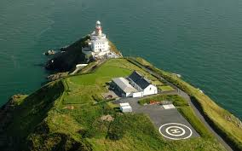
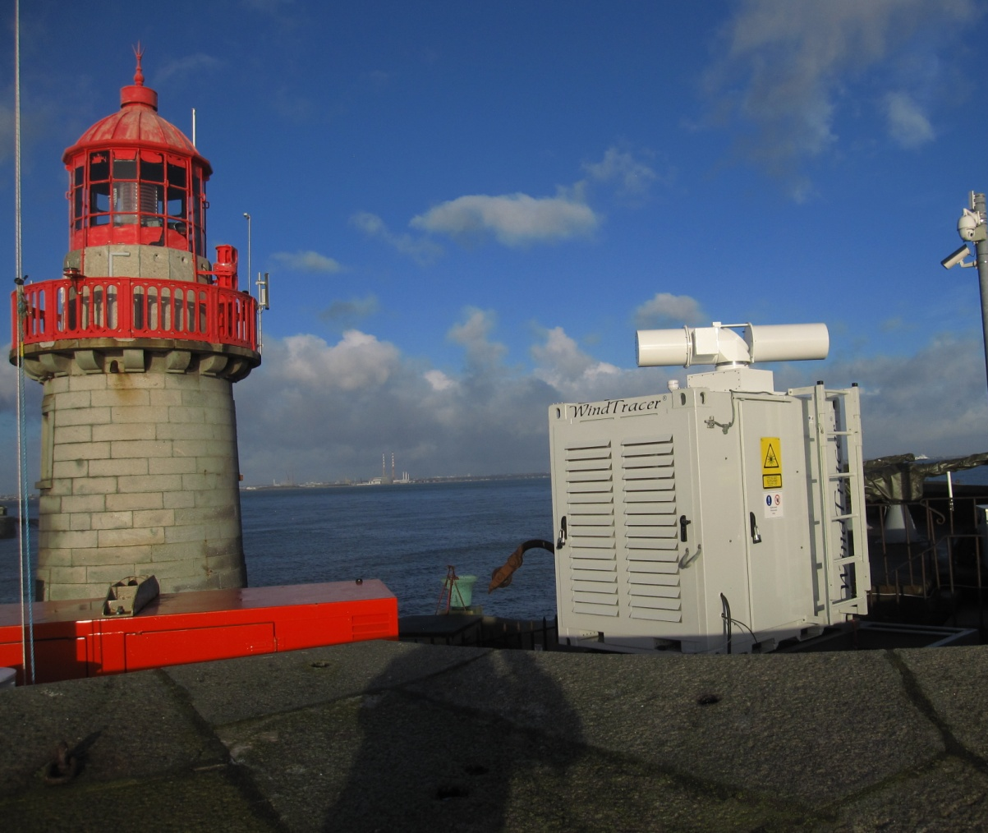
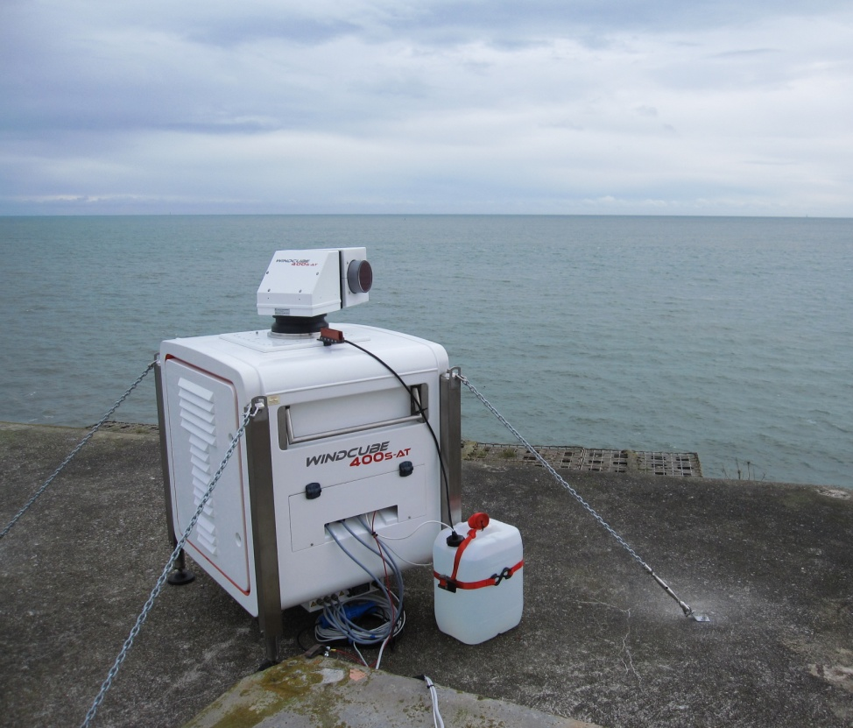
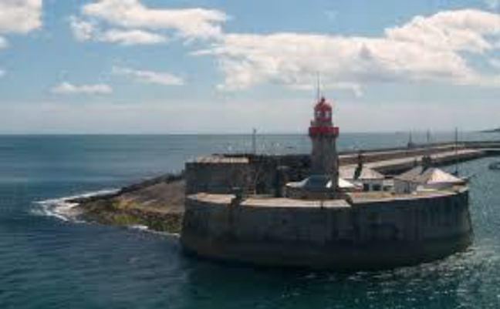
Campaign Overview
Baily Lighthouse
400s
Prototype
East Pier
Scanning LiDAR
Notes:
Time of measurement start end date

Slide 10
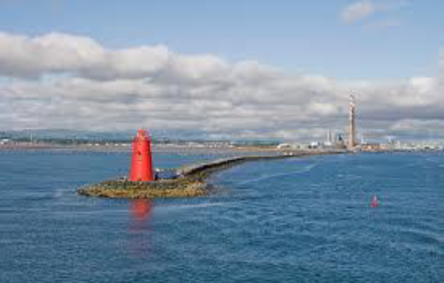
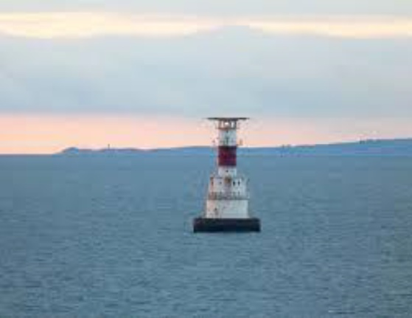
Measurement Location Overview
Baily Lighthouse
Poolbeg
Kish Lighthouse
East Pier
Scanning LiDAR
Validation LiDAR
Notes:
Time of measurement start end date

Slide 11
Demonstration Points
Baily Lighthouse
Poolbeg
Kish Lighthouse
East Pier
Scanning LiDAR
Validation LiDAR
Demonstration Points
Notes:
Measuring points agreed with both manufacturers

Slide 12
Demonstration Points
Baily Lighthouse
~10km
Poolbeg
Kish Lighthouse
East Pier
Scanning LiDAR
Validation LiDAR
Demonstration Points
Notes:
Measuring points agreed with both manufacturers

Slide 13
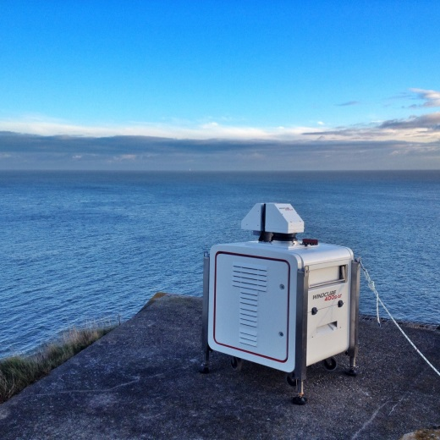
The Validation set up
Kish Lighthouse (30m tall structure) is dot in distance, Windcube Vertical LiDAR on top
150m
100m
Scanning LiDAR
Validation Point (Windcube vertical LiDAR)

Slide 14
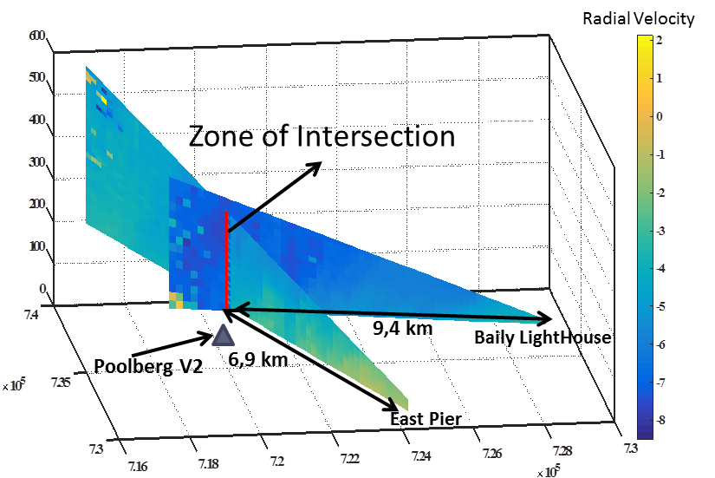
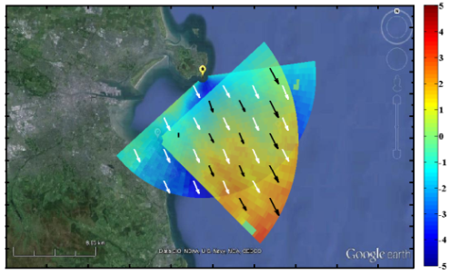
Campaign Details
~4 months of concurrent measurements from all devices
Furthest demonstration point: 15km.
Scan pattern designed by OEMs.
Leosphere: dual RHI at Poolbeg, PPI at all other points
integration time 400s = 1 second, scan rate = 3deg/s PPI, 0.1deg/s RHI
integration time Prototype = 0.5 second, scan rate = 6deg/s PPI, 0.1deg/s RHI
LMCT: PPI at all points. integration time = 1 second, scan rate <= 2.5deg/s
Pictures courtesy of Leosphere

Slide 15
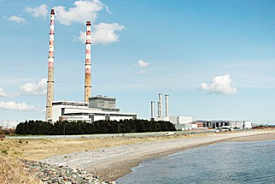
Campaign Details
Hard targets used (Kish lighthouse, Poolbeg towers) to calibrate and verify beam pointing accuracy

Slide 16
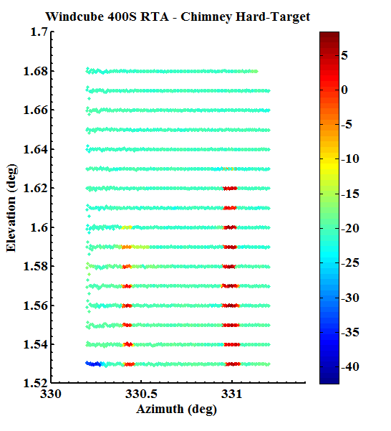
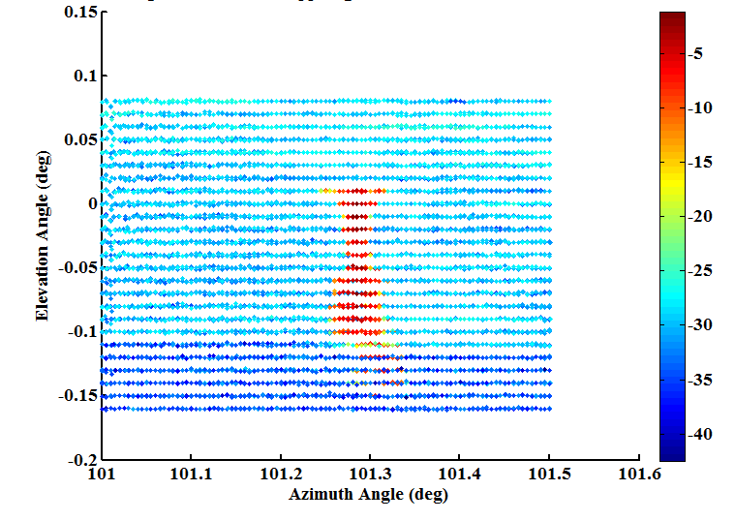
Campaign Details
Hard targets used (Kish lighthouse, Poolbeg towers) to calibrate and verify beam pointing accuracy
Pictures courtesy of Leosphere

Slide 17
Achieved measurement ranges
WindTracer: 70% data coverage at 14km for Baily device
Pictures courtesy of LMCT

Slide 18
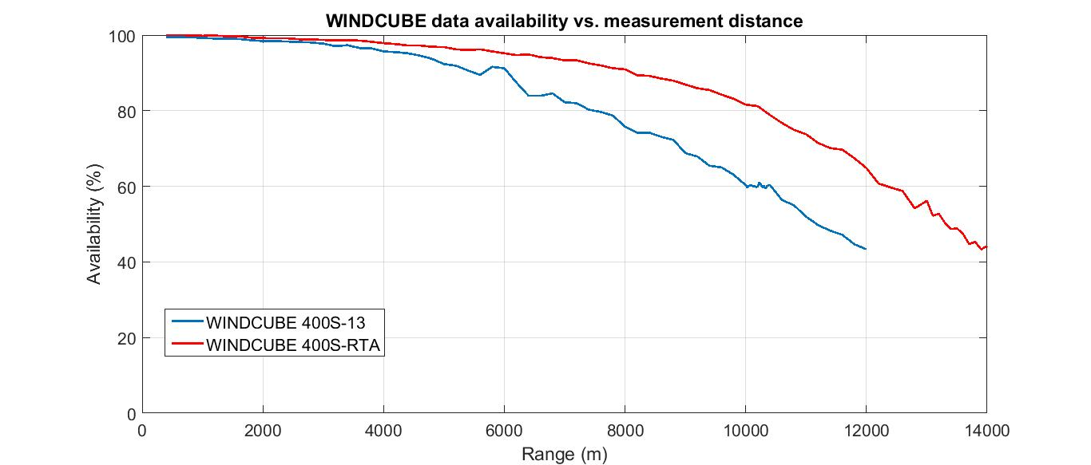
Achieved measurement ranges
WindTracer : 70% data coverage at 14km for Baily device
Leosphere:
70% data coverage at 9km for 400s and 11km for Prototype
Windcube 400S: ~60% data availability at Kish (10.2km distance)
92.3% uptime.
Prototype: ~50% data availability at Kish (13.4km distance).
97.5% uptime.
Graph courtesy of Leosphere

Slide 19
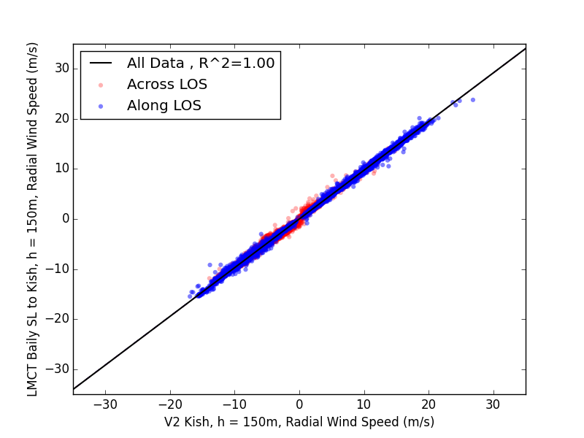
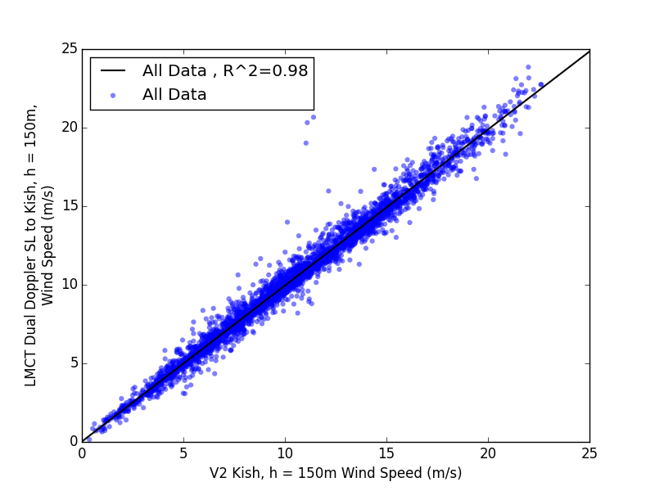
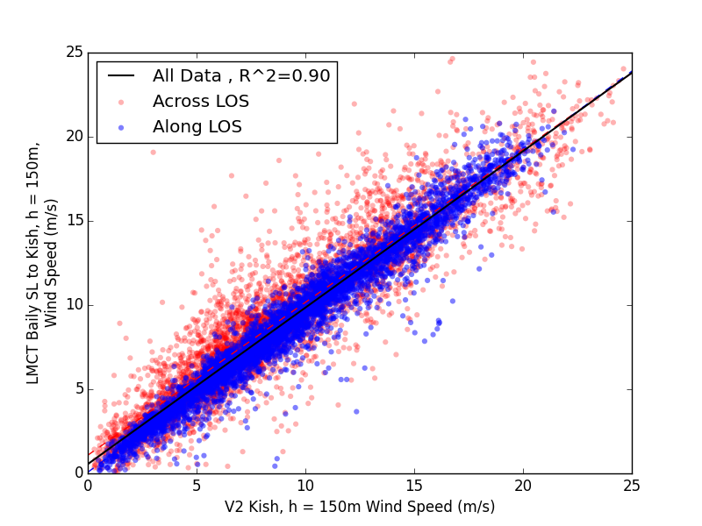
WindTracer results
slope = 0.97
11k points
slope = 0.99
4k points
Radial
Dual LiDAR
slope = 0.95
11k points
Radial results: technology works – radial measurements highly precise and accurate
Single LiDAR results: flow inhomogeneity impacts precision and accuracy
Dual LiDAR results: full vector measured precisely and accurately
Single LiDAR

Slide 20
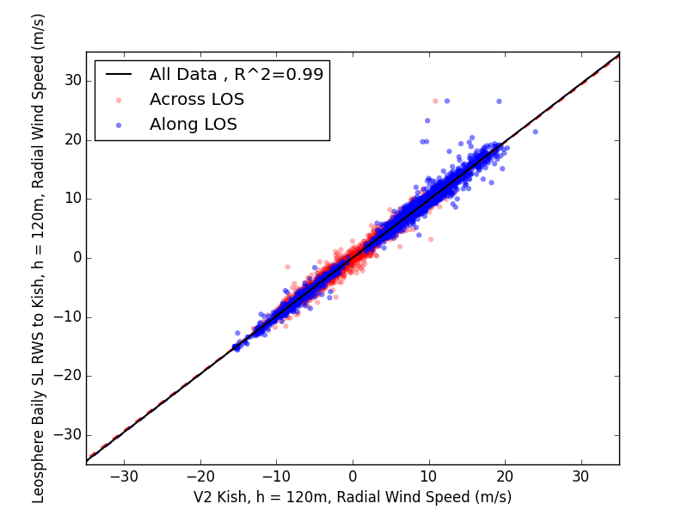
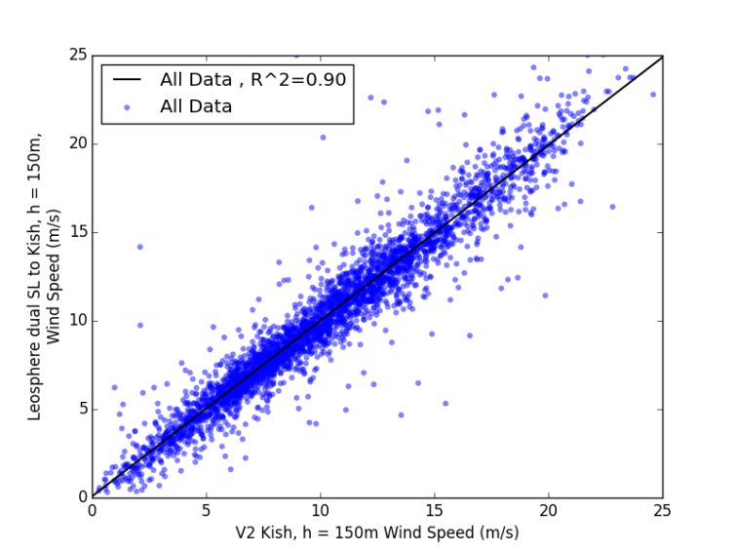
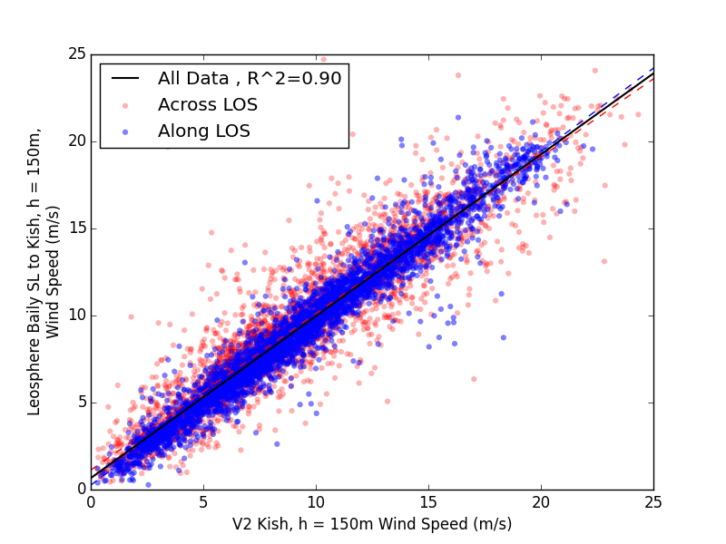
Leosphere results
slope = 0.99
5k points
slope = 0.99
3k points
Radial
Dual LiDAR
slope = 0.93
8k points
Radial results: technology works – radial measurements highly accurate
Single LiDAR results: flow inhomogeneity impacts precision and accuracy
Dual LiDAR results: better accuracy but similar precision as Single
Single LiDAR

Slide 21
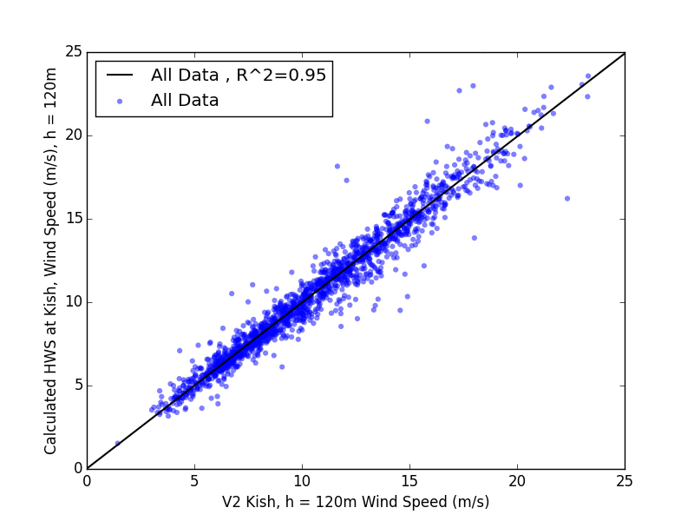
Leosphere results
slope = 0.99
5k points
slope = 1.00
2k points
Radial
Dual LiDAR
Alternatively processed dual results: similar accuracy and better r2, but lower data count
Compromise between data count and precision
Note this is a blind comparison; OEMs now have access to the validation data to improve their algorithms
slope = 0.93
8k points
Single LiDAR

Slide 22
Validation Summary
 | LOS WS | Single LiDAR | Dual LiDAR
Number of Validations | 10 | 10 | 4
Average R² | 0.994 | 0.846 | 0.983
Maximum Speed Up Error | 2.6% | 13.6% | 1.1%
For both devices, the single LiDAR accuracy is insufficient for measuring spatial variation for the distances considered in this project (5km-15km)
Dual LiDAR configuration gives very accurate speed up measurements
Note validation performed blind and scan patterns were designed to measure at 12 points evenly (not focused on any particular point)
LMCT WindTracer
 | LOS WS | Single LiDAR | Dual LiDAR
Number of Validations | 4 | 6 | 4
Average R² | 0.982 | 0.853 | 0.889
Maximum Speed Up Error | 2.3% | 16.6% | 3.7%
Windcube 400S/Prototype

Slide 23
Impact on Yield Prediction Uncertainty
The observed speed up errors using dual LiDAR systems are < 2%
This represents an improvement in uncertainty in spatial variation of wind resource relative to current standard methods (mesoscale modelling)
A conservative estimate suggests dual scanning LiDAR measurements of spatial variation can reduce yield prediction uncertainty by 0.1% - 0.4% for a near shore site like Dublin Bay
Single LiDAR errors are too high at Dublin Bay to reduce uncertainty, likely due to flow inhomogeneity
Uncertainty Term | Without Scanning LiDAR | With Scanning LiDAR
Long Term WS Uncertainty | 3.9% | 3.9%
Other (Wakes, Power Curve, etc.) | 5.4% | 5.4%
Spatial | 2.5% | 1.3%
Total Uncertainty | 7.1% | 6.8%
P90/P50 | 90.9% | 91.3%

Slide 24
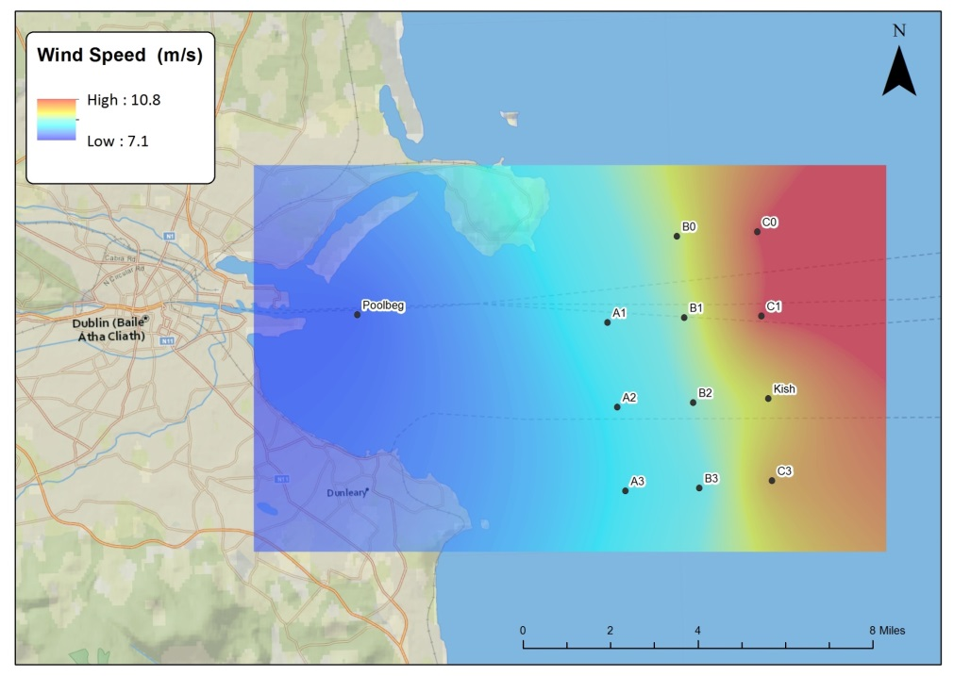
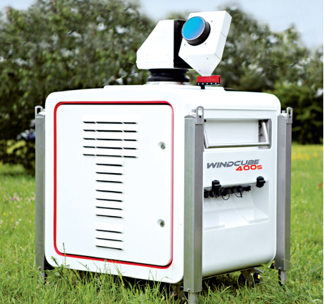
Conclusions
High accuracy measurements validated in a unique experiment
For long measurement ranges dual LiDAR has a substantial accuracy and precision benefit over single LiDAR
For this theoretical wind farm a Scanning LiDAR campaign would
Reduce the yield uncertainty and therefore investment risk
Facilitate better project decisions (eg turbine layout)

Slide 25
Thank you
Thank you to Commissioners of Irish Lights, Carbon Trust, the Offshore Wind Accelerator, Leosphere, LMCT, and RES!
Public paper with further details to follow – please contact Carbon Trust for more information
Dublin Bay is an active test site – please contact RES for more information

Slide 27
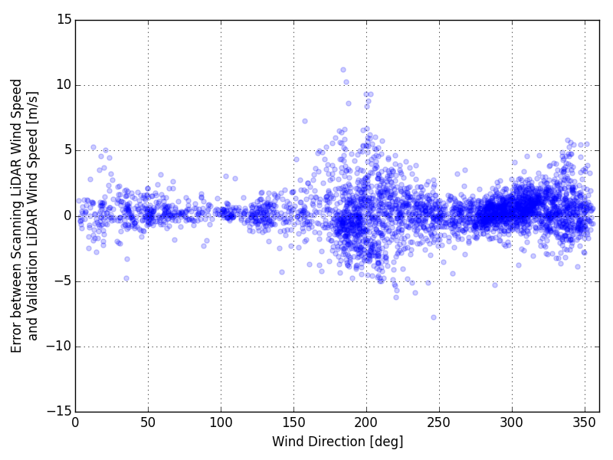
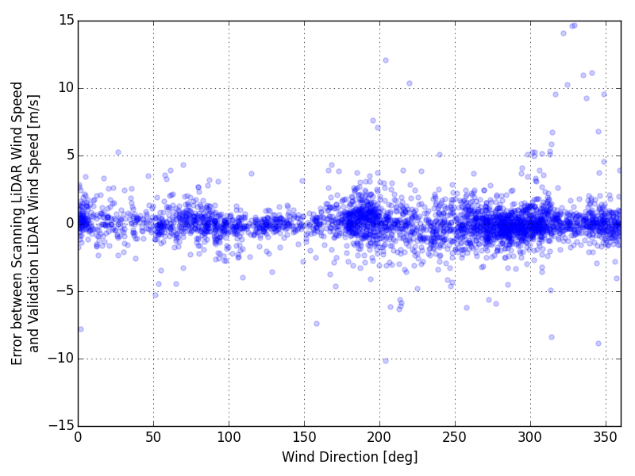
Validation Sensitivity Analysis
Single LiDAR results: high errors apparent for wind directions orthogonal to LOS
Dual LiDAR results: reduction in sensitivity of accuracy to wind direction
LOS East Pier
LOS East Pier
Baily
EP
Baily
EP
Single LiDAR
Dual LiDAR

