Slide 1
Wind Energy in Iran, Opportunities and challenges in the current legal framework
Mohammad H. Ghafouri
Iran Wind Group
Aysa Ltd.
Sep 29th, 2016

Slide 2
Introducing Iran-Wind Group

Slide 3
Content
Relevant institutions for Renewable Energy development in Iran
Relevant policies and support mechanisms
New Feed in Tariffs
New Challenges and Opportunities

Slide 4
Relevant institutions for wind energy development in Iran
Ministry of Energy
Tavanir Holding Company
Deputies
SUNA
Distribution Companies
Office of Private Sector Contribution
Technical & Administrative Deputy
Solar Energy Dept.
SATBA

Slide 5
Current policies and support mechanisms for PV
No. | TITLE | YEAR | POLICY TARGET
1 | Law on Energy Consumption Reform (Article 61) | 2016 | Determining the Feed in Tariffs every year
2 | Electricity Sector Supporting Law (Article 5) | 2015 | Financial Resource for RE Electricity payment and rural electrification
3 | Supporting the Domestic Production Law (Article 12) | 2015 | Financial Resource for RE Electricity payment equal to saved fuel
4 | National Development Fund | 2010 | Private Infrastructure Projects
5 | The 6th National Development Plan (not passed yet) | 2017 | RE Target, new Financial Resources, …

Slide 6
Feed in Tariffs for Wind
Size of Wind Farm | Guaranteed Feed in Tariff
 | (Rials/ kWh) | *(€-ct/ kWh)
Wind Farm > 50 MW | 3400 | 10
Wind Farm <= 50 MW | 4200 | 12
Wind Farm <= 1 MW | 5700 | 16
* Exchange rate: 1Euro = 35.100 Rials
http://www.cbi.ir/ExRates/rates_en.aspx

Slide 7
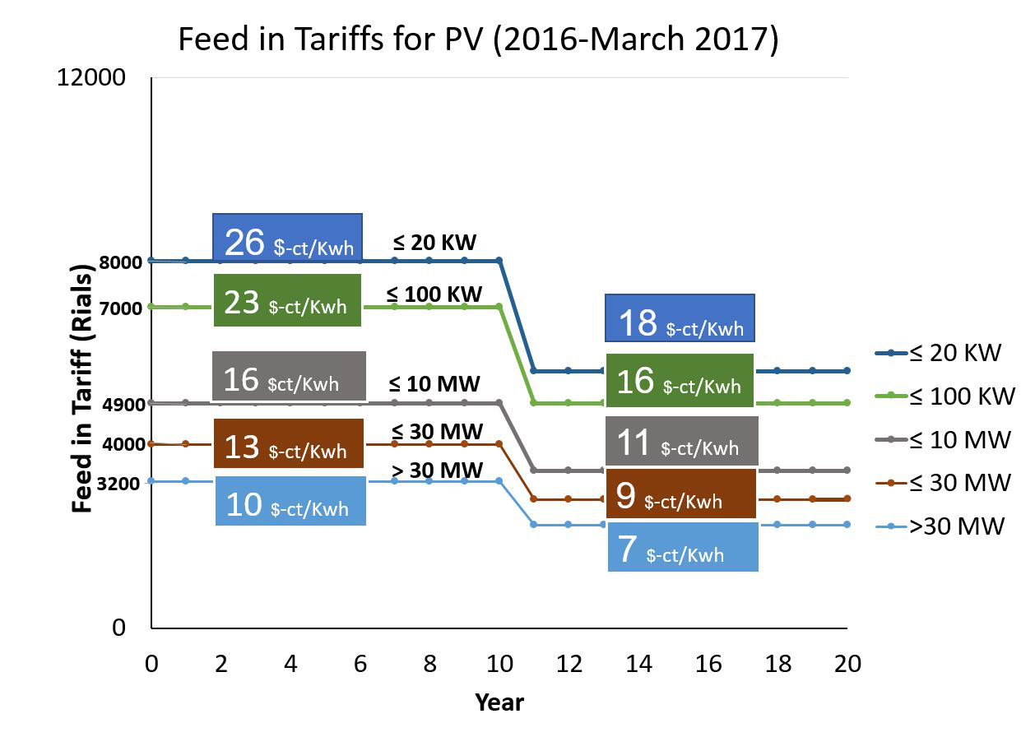
Feed in Tariffs for Wind Farms (valid until 21 March 2017)

Slide 8
Feed in Tariffs for Wind
1. 20 years PPA
First come first served basis
2. Feed in Tariffs in Rials
adjusted every year (according to inflation and exchange rate change)
3. Tariffs multiplied by a decreasing factor in the second 10 years
Feed in Tariffs
4. Extra 148 Rials/ KWh
if the wind farm connected to the distribution grid
5. Up to 30% increase in FIT
if using Iranian manufactured equipment (local content)
6. Two Power plants are considered as one power plant with the corresponding FiT
If they are next to each other
or connected to the same substation
and have any same shareholder
7. 15 months deadline to commission the power plant after signing the PPA
8. The policy of MoE is to reduce the FIT in proportion with the increase of the installed capacity in the country.

Slide 9
New Challenges and Opportunities
Challenges
Opportunities/ Solutions
1. SUNA is not high positioned in the hierarchy of the Ministry
SATBA
RE Association (in the Chamber of Commerce) to stablize the Tariffs, and other laws.
2. Drastic changes in feed in tariffs
3. Enough budget to buy RE electricity?
The 6th five-year Development Plan with new Financial resources
It would be in parallel with FiT system
Only for very big projects
4. Beginning tendering system?
5. >10 GW issued licenses without much progress
??

Slide 10
New Challenges and Opportunities
More than 10.000 MW issued licenses
The lack of progress in project development
The reason?
Everybody could apply for permits and obtain it
easily and free.
SUNA Solution?
New Limitations:
Expiring the license (Construction Permits) after 6 months, if not much progressed in the development.
Each company/ person can obtain only two licenses (Construction Permits)
(Not-announced) CAP of 20MW for PV, and 50MW for wind for the first time applications.
It is kind of filtering system.
What could be the better solution?

Slide 11
Thank you for your Attention!
Mohammad Hassan Ghafouri
Founder of Iran-Wind Group
Managing Director of AYSA Ltd.
Ghafouri@iran-wind.com
Ghafouri.mh@gmail.com
Everything is possible if you realy want!

