Slide 1
Industry meets research: making the match Sjoerd Wittkampf, ECN
Part III

Slide 2
Introduction – Who am I?
Sjoerd Wittkampf (37), Technology Transfer Manager @ECN
Licensing & creation of new ventures (spin-outs)
Energy research Centre of the Netherlands (‘ECN’):
400 Employees;
~100 patent families, ~30 invention disclosures/yr
Overseeing ECN’s technology portfolio in:
Solar PV;
Biomass;
Energy Efficiency;
(Offshore) Wind Energy;
Environmental technologies;
Applied material sciences (e.g. additive manufacturing).

Slide 3
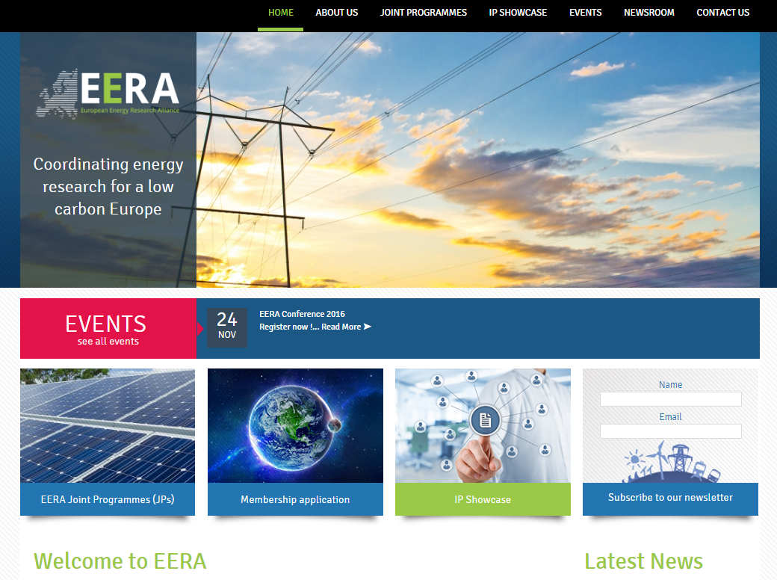
EERA’s platform to showcase IP (1)
www.eera-set.eu
Notes:
First of all I would like to show you the platform that EERA has developed to showcase the results of its research programs.
If you visit their website, www.eera-set.eu you will see this. If you click on IP Showcase, it will take you to this platform

Slide 4
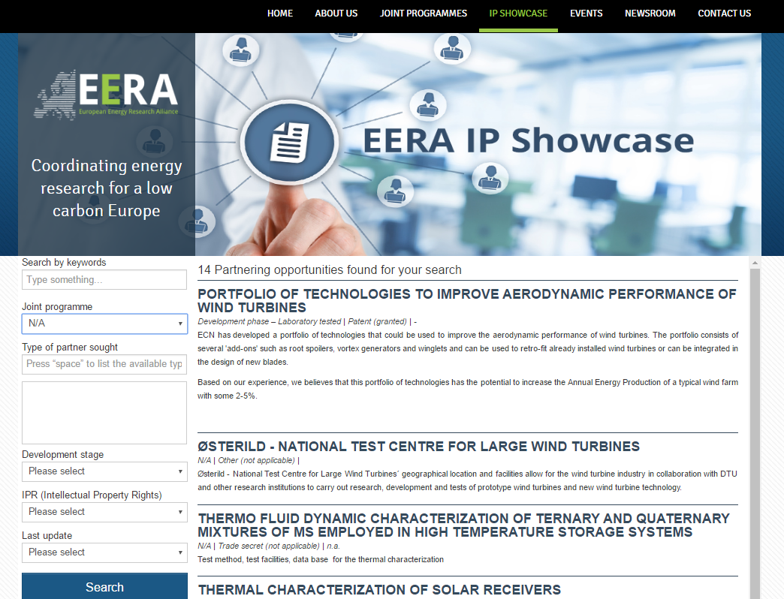
EERA’s platform to showcase IP (2)
www.eera-set.eu

Slide 5
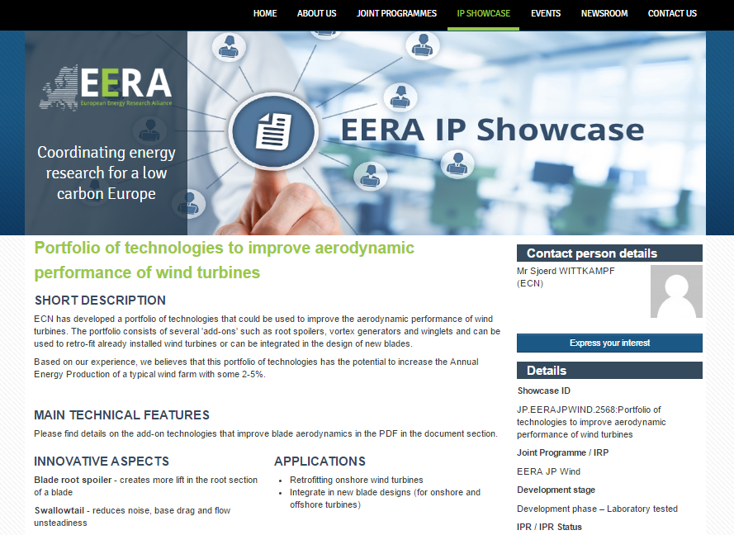
EERA’s platform to showcase IP (3)
www.eera-set.eu

Slide 6
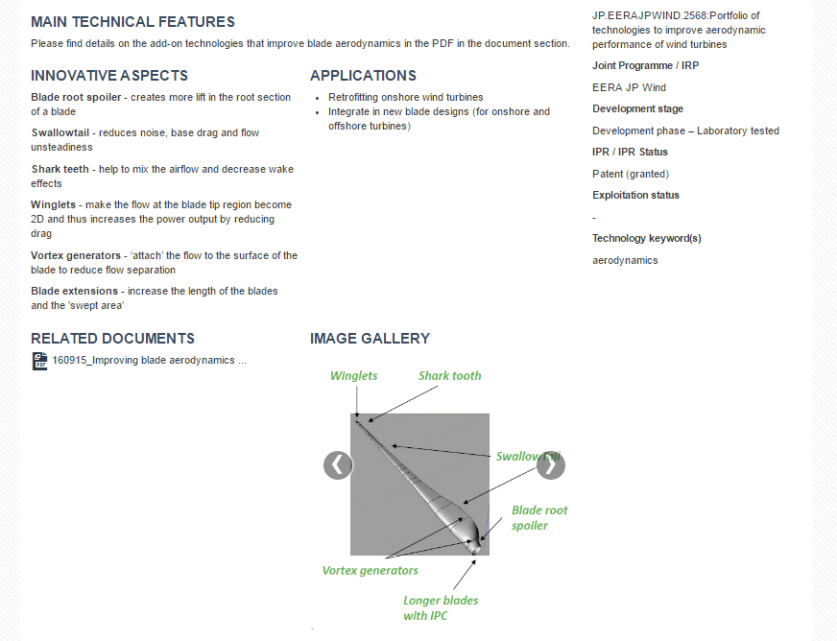
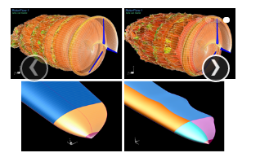
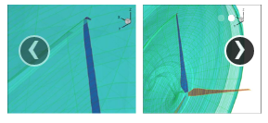
EERA’s platform to showcase IP (4)
www.eera-set.eu

Slide 7
Match making
Online IP platform supported by offline match making sessions
Notes:
The idea is to support the Online IP platform with offline and interactive match making sessions.
We will start with this in a few minutes, but before we do that I would like to manage some expectations

Slide 8
The technology s-curve & venture lifecycle
Technology Creation
Market focused
Product- & business
development
Venturing phase
Early
Commercialization
Growth
Decline
Cashflow
€
Positive
Risk (discount rate / WACC)
TRL level
9
5
Time
€
Negative
1
EAWE
EERA
ETIP (R&D)
Industry
Notes:
But before we start I would like to start by managing your expectations! Most technologies resulting from EERA R&D project and the technologies that will be presented to you today, will not be ‘ready’.
What does that mean?
Most technologies will be at a relatively low technology readiness level (typically TRL 5 or 6);
Besides TRL level, the commercial readiness is on a different axis. The activities presented on this axis, are crucial to bring a technology to the market successfully. However, most R&D institutes do not consider these as their core activities and search for a licensee or spin-of entrepreneur to:
develop a business plan
validate the business case
define a minimum viable product
find launching customers
Because of the low TRL and commercial readiness, the perceived risk profile and the required capital funding will almost always be quite high.
It is my strong believe that the only way to reduce these risks is to start the collaboration with the potential licensee for the technology as soon as possible. And we hope to achieve that by organizing these match making sessions.

Slide 9
Goals of the match making session
We would appreciate to hear your feedback on:
The EERA IP Showcase platform
The individual technologies that will be presented at each table
Hopefully: new business opportunities
Notes:
IP Showcase
- This is the first time that we present this platform. It is not finished yet, in the software industry it would be called a “Public Beta”
Does it fullfill a need for your company? Do you think it will help to bring new technologies closer to the market? What can we improve?
Individual Technologies
Are these interesting to your company?
If so, would you consider to start a collaboration with the R&D institute?
If not, has it the potential to become interesting to your company in the future and what needs to be done to get there?

Slide 10
Match making session
 | Table 1: | Table 2: | Table 3: | Table 4:
Institute | DTU | ECN | IWES | Tecnalia
Pillar | Next generation technology | Next generation technology | O&M Grid | Next generation technology
Technologies | Osterild WAsP | Blade improvements Load measurement system | Enhanced offshore operations via simulation Wind farm cluster management | Floating Wind

