Slide 1
Procurement problems? Not this way - solutions for professionals
The supply chain - thinking ahead!

Slide 2
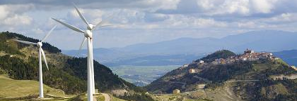
World’s largest certification body for renewable energy
Services:
Component Certification
Type Certification
Project Certification
Training & Seminars
Standards & Guidelines
Customers:
Manufacturers
Project Developers
Owners / Operators
Investors
Government / NGOs
Industries:
Onshore Wind
Offshore Wind
Wave
Tidal
Solar
Notes:
Providing lifecycle support to all stakeholders

Slide 3
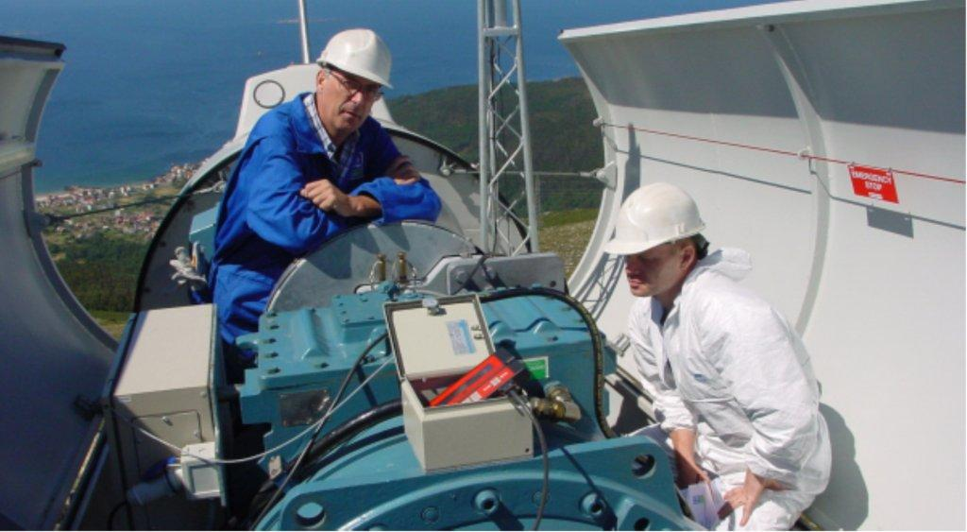
Component certification
Accredited certification of components, structures and systems in renewable energy
Design verification/assessment/evaluation
IPE/manufacturing evaluation
Component certification
Onshore wind
Offshore wind
Wave and tidal
Solar/PV
Certification is based upon:
Internationally accepted standards
Various national certification systems
DNV standards and GL guidelines
DNV GL service documents

Slide 4
Type certification
Accredited type certification of wind turbines is tailored to the stages of the wind turbine product development.
Main services:
Type certification according to DNV GL service documents and GL guidelines
IEC/DNV type certification
IEC/GL type certification
Concept evaluation
Design evaluation/assessment
Prototype approval
Type certification for 0-series
Type certification for serial production
Type certification is based on IEC, DNV GL or
GL certification scheme including:
Review of design documentation
Independent analyses
Full-scale component testing
Prototype measurements and testing
Manufacturing evaluation/IPE
Maintenance of type certificates

Slide 5
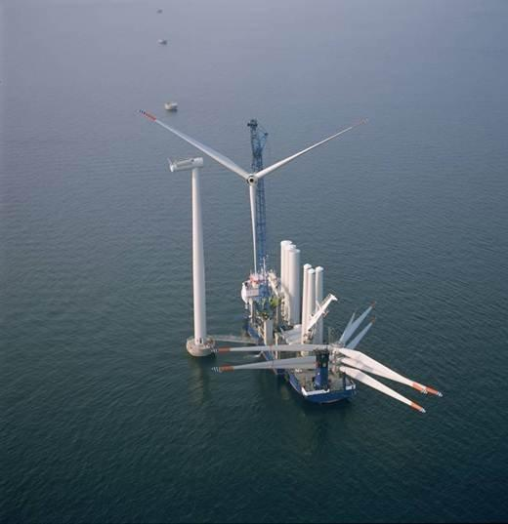
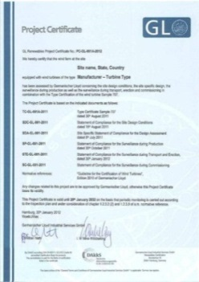
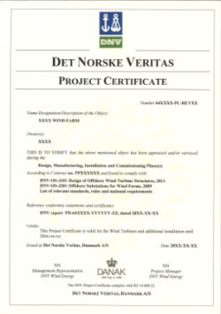
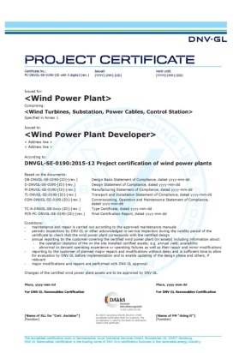
Project certification
Modular service provision for onshore and offshore wind projects based on client’s needs.
Main services:
Site specific design conditions
Site specific design assessment
Surveillance during production
Surveillance of transport and erection
Surveillance during commissioning
Project certificate
Periodic monitoring
Longest history in wind energy
Own standards/guidelines
Biggest workforce and highly qualified teams
Avoiding damages/reducing financial risks/securing investment
Certification is based upon:
International standards
Various national certification systems
DNV GL service specifications, DNV standards and GL guidelines
Customer’s specifications

Slide 6
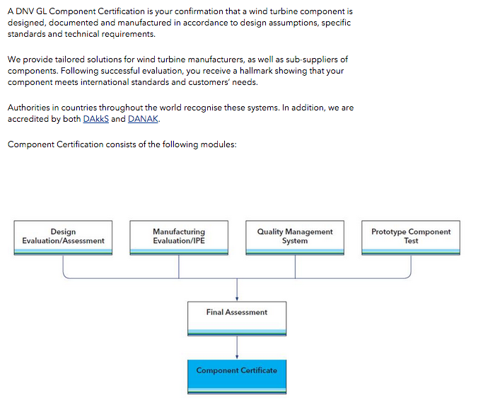
Component certification
A DNV GL Component Certificate is the confirmation that a wind turbine component is designed, documented and manufactured in accordance to design assumptions, specific standards and technical requirements.
We provide tailored solutions for wind turbine manufacturers, as well as sub-suppliers of components. Following successful evaluation, our customer receive a hallmark showing that their component meets international standards and customers’ needs.
Authorities in countries throughout the world recognize these systems. In addition, we are accredited by the accreditation body DAkkS.
Component Certification consists of the following modules:

Slide 7
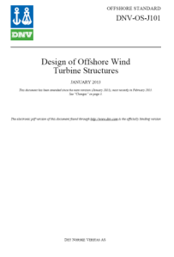
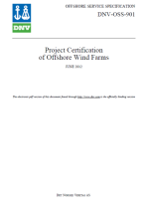
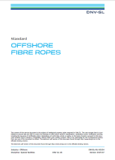
More than 100 standards & guidelines
Certification is based upon:
Internationally accepted standards (IEC)
DNV standards and GL guidelines developed with the industry
DNV GL service documents
Various national certification systems
Extensive work on guideline harmonisation
First wind certification regulation published in 1986
First offshore wind guideline published in 1995
More than 30 standards & guidelines developed together with the industry
DNVGL-ST-0046:2015-03
Design and Manufacture of Wind Turbine Blades

Slide 8
Power plant project and certification - PHASES
Project phases
Simplified phases
Certification phases
Development
Construction
Operation and Maintenance
Decommissioning
Notes:
—Concept: covers the concept development at the beginning of the wind power project.
—Design basis: covers the site conditions and the basis for design.
—Design: covers the steps necessary to achieve final design approval. This includes the site-specific design approval of the integrated structural system of the project related assets.
—Manufacturing: covers the surveillance during manufacturing of the project related assets.
—Transport and installation: covers the surveillance during transport and installation of the project related assets.
—Commissioning: involves all follow-up evaluation and on-site inspections during the implementation and start of operation of the power plant.
—In-service: involves follow-up evaluation and periodic on-site inspections after start of operation and during the subsequent in-service period.
—Lifetime extension: covers the subject to continue to operate a wind power plant over its initial design lifetime.
—Decommissioning: contains the planning and execution of a wind power plant decommissioning and removal.
—Repowering: covers the renewal and reinstallation (typically upgrading) of a wind power plant at a former power plant site.

Slide 9
Wind power plant - ASSETS
Notes:
Defining a wind power plant with the assets:
—wind turbines and their support structures
—substation(s) including topside(s) and support structure(s)
—power cables
—control station.

Slide 10
Definition of offshore and onshore wind turbine components
Notes:
The wind turbines of a wind power plant can be typically distinguished by the components shown.

Slide 11
Definition of offshore and onshore substation components
Notes:
The substation(s) of a wind power plant can be typically distinguished by the components shown

Slide 12
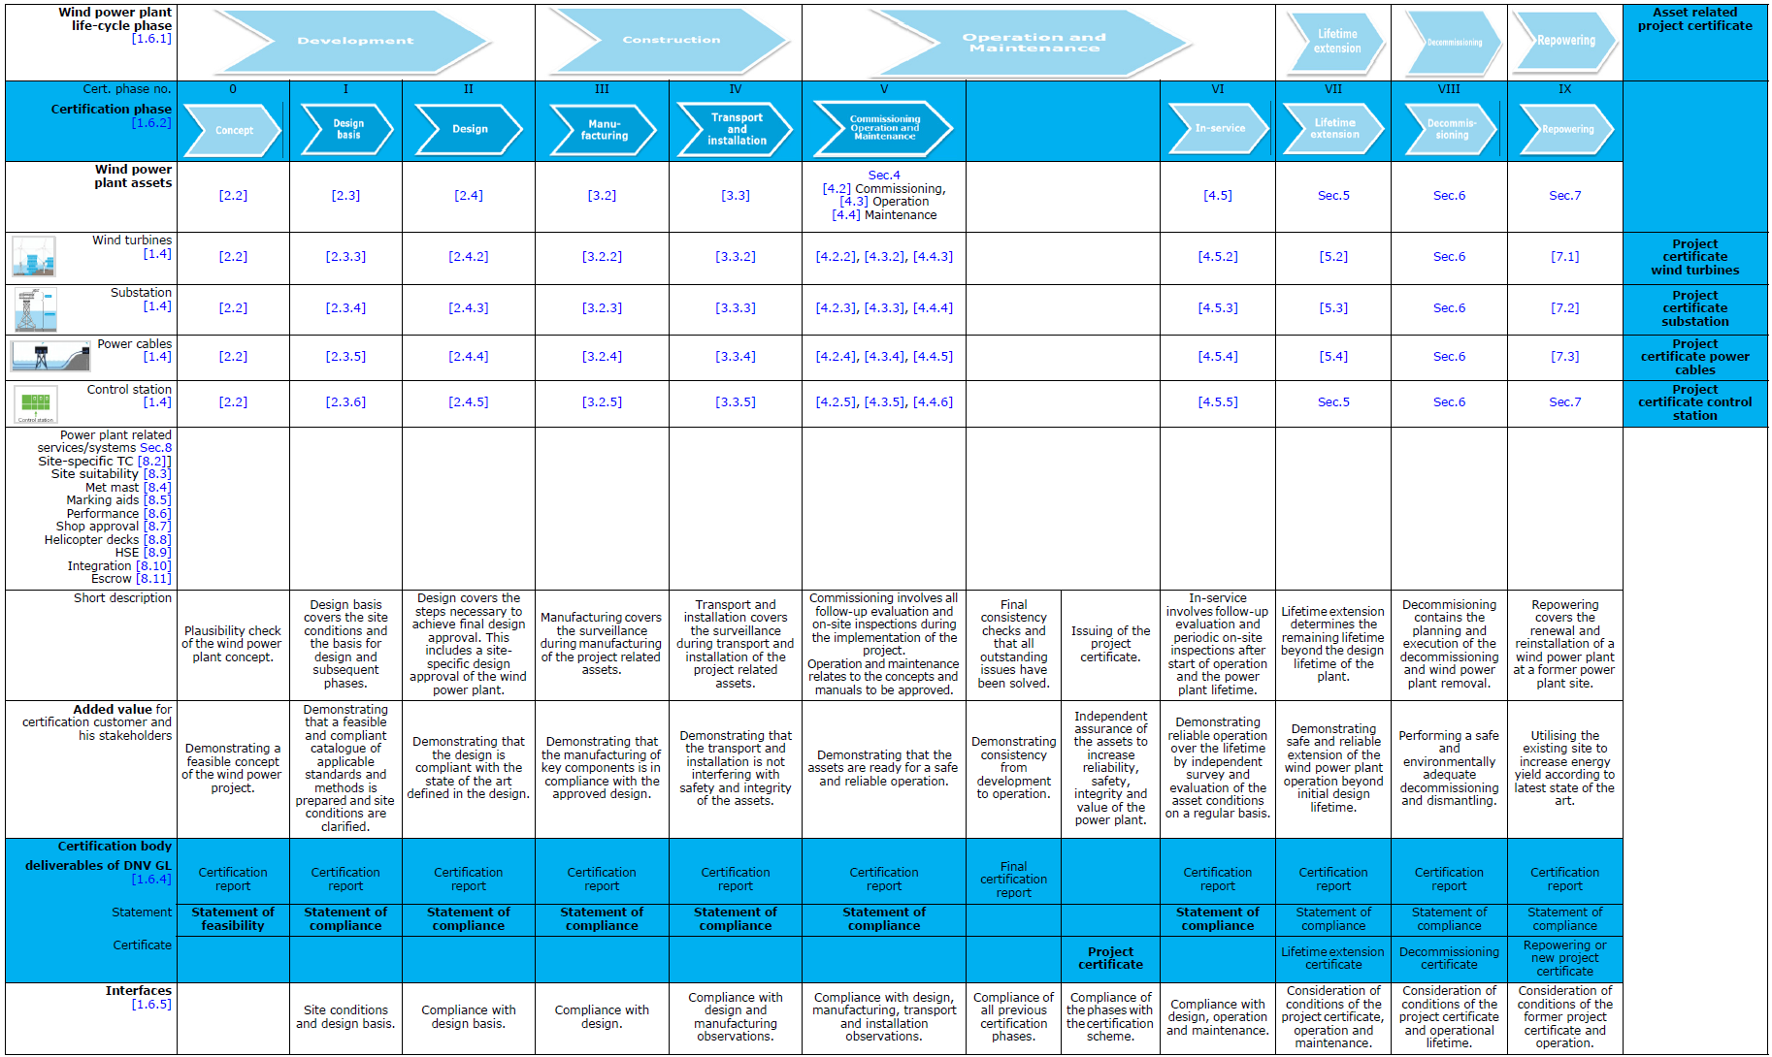
Value added
Feasibility proven for stakeholders
Confidence on site conditions and methodologies
State of the art in design
Manufacturing according expectations
Safety for your assets during transport and installation
Risk mitigation for operation
Heart of the power plant, vital for operation
Operation with reduced down time, asset value assurance
Tools to reduce uncertainties
Extended operation time
Easier orientation
Risk reduced dismantling
Milestones to prove progress
Interface integrity
Increase energy yield of the site

Slide 13
Values
Support financing
Confidence about site conditions catalogue of applicable standards and methods
Design is compliant with the state of the art
Production of key components is in compliance with the approved design
Transport and installation to with no interference with safety and integrity
Assets are ready for a safe and reliable operation
Heart of the power plant covered
Reliable operation by independent survey and evaluation on a regular basis to keep up asset values
Optional, additional certification services relevant for power plants
Safe and reliable extension of operation beyond initial design lifetime
Project certificates per asset
Simplification of introduction and application
Project certificate for wind power plant
Performing a safe and environmentally adequate decommissioning and dismantling
Milestones with deliverables to prove stepwise progress
Integrity between phases and assets
Utilising the existing site to increase energy yield according to latest state of the art.

Slide 14
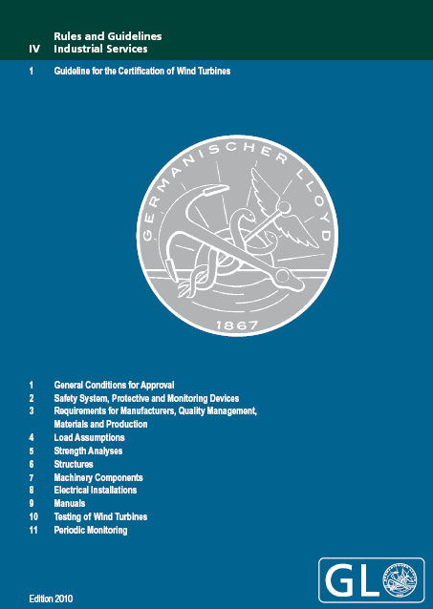
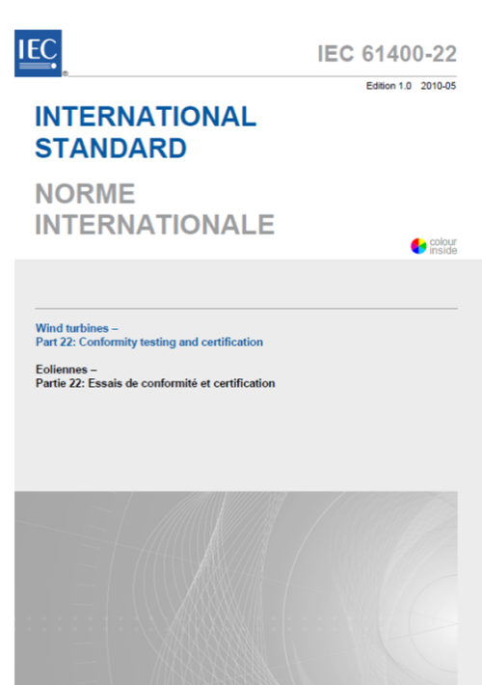
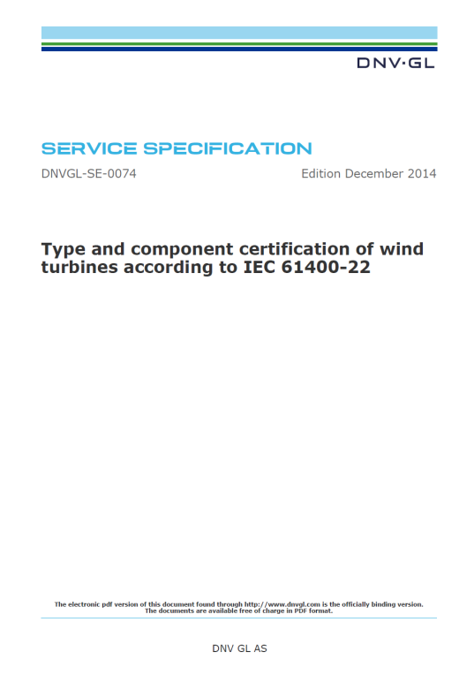
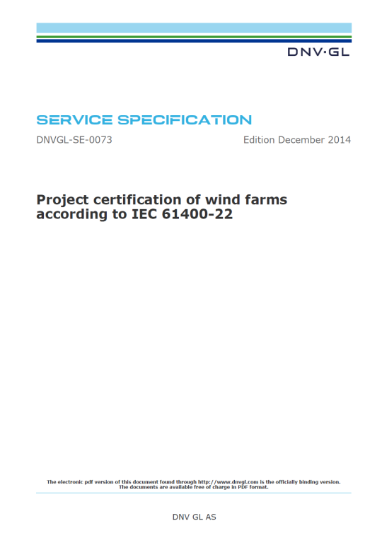
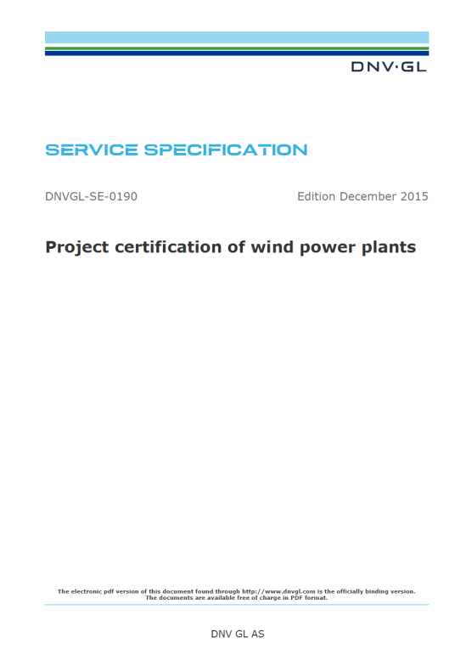
What is Certification?
Do they match???
Notes:
Certification means in short
Confirmation for compliance of a product (e.g. wind turbine) or service with defined requirements (e.g. standard) by a third party
Definition of Certification (ISO / IEC 17000)
Certification
Third-party attestation related to products, processes, systems or persons
Attestation
Issue of a statement, based on a decision following the review, that fulfilment of specified requirements has been demonstrated
Review
Verification of the suitability, adequacy and effectiveness…

Slide 15
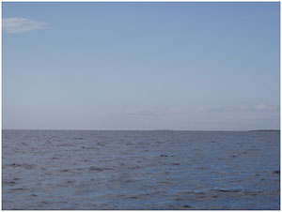
Site-specific Design
Design basis
Repowering
Transport and installation
Manu-facturing
Design
Concept
Commissioning Operation and Maintenance
In-service
Lifetime extension
Decommissioning
Wind Turbine
Wind Farm Site
Do they match???
Turbine Class
Site Conditions
Notes:
Design covers the steps necessary to achieve final design approval. This includes a site-specific design approval of the wind power plant.
Demonstrating that the design is compliant with the state of the art defined in the design basis.

Slide 16
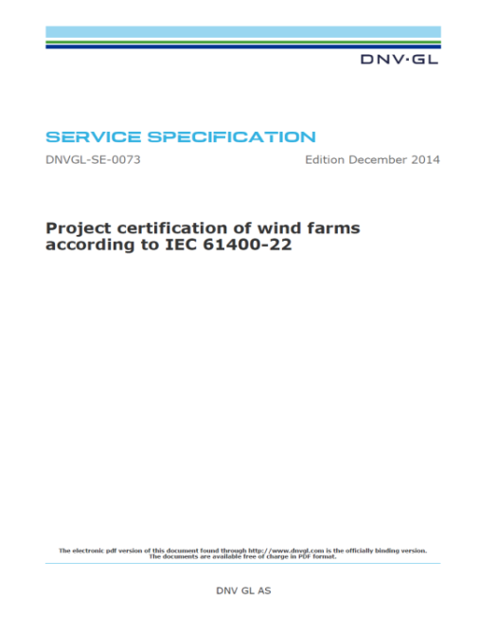
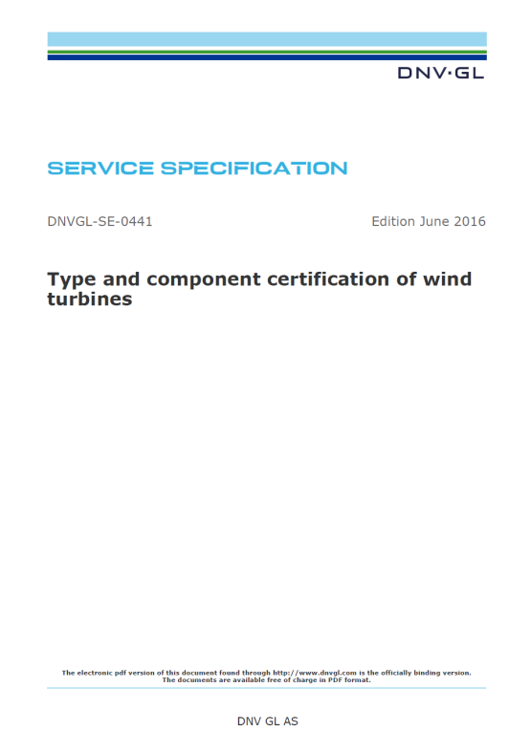
Design basis
Design basis
Repowering
Transport and installation
Manu-facturing
Design
Concept
Commissioning Operation and Maintenance
In-service
Lifetime extension
Decommissioning
Design basis covers the site conditions and the basis for design and subsequent phases.
Demonstrating that a feasible and compliant catalogue of applicable standards and methods is prepared and site conditions are clarified.
Notes:
The design basis shall include all parameters relevant for the wind power plant design, stating the methods to be used.
Design basis covers the site design conditions assessment and the basis for design
Developing the design basis is a combined effort by several parties (contributors) including reports on specialized topics supplied by expert consultants. The coordination of the interfaces between the contributor’s documents is facilitated if this responsibility is clearly anchored in the customer’s project organization.
following site design conditions shall be documented:
—site and wind power plant configuration incl. cable route
—wind conditions
—marine conditions (bathymetry, waves, tides, correlation of wind, waves and current, coastal zone dynamics (for the cable landfall), sea ice, scour, marine growth etc.)
—soil and geotechnical conditions
—other environmental conditions, such as: salt content of the air, temperature, ice and snow, humidity, lightning strike, solar radiation etc.
—electrical grid conditions
—influence of nearby wind power plants
—terrain roughness and terrain complexity
—seismic influence, if present
—other site conditions, such as traffic, disposed matters, pipelines and existing cables.
The objective of the design basis is to compile the information required for design, manufacturing, transport, installation and operation of the support structure and the site-specific approval of the wind turbine.

Slide 17
Design
Design basis
Repowering
Transport and installation
Manu-facturing
Design
Concept
Commissioning Operation and Maintenance
In-service
Lifetime extension
Decommissioning
Design covers the steps necessary to achieve final design approval. This includes a site-specific design approval of the wind power plant
Demonstrating that the design is compliant with the state of the art defined in the design basis
Notes:
A site-specific load analysis based on the design basis shall be performed using an integrated simulation model, which includes aero-elastic and hydrodynamic effects.
DNV GL shall evaluate the final design for compliance with design criteria and design basis

Slide 18
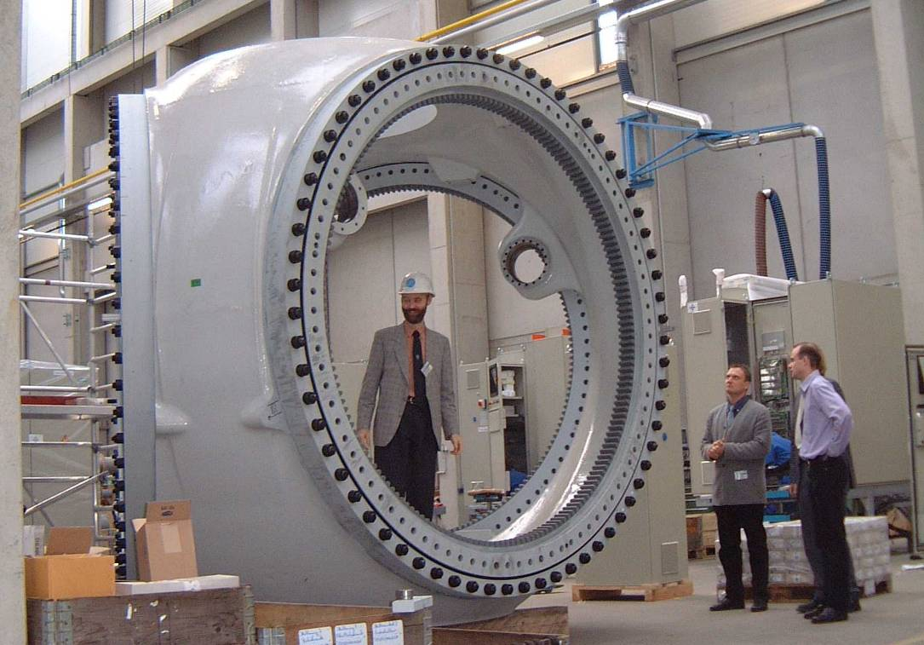
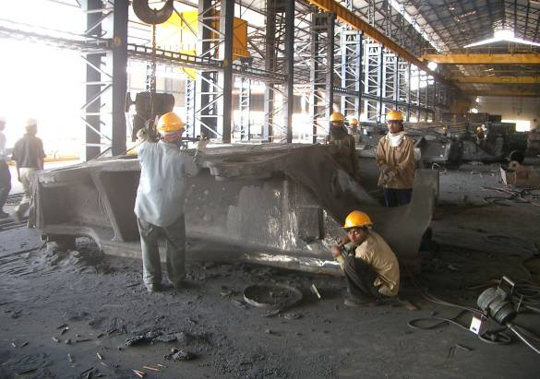
Manufacturing surveillance
Design basis
Repowering
Transport and installation
Manu-facturing
Design
Concept
Commissioning Operation and Maintenance
In-service
Lifetime extension
Decommissioning
Manufacturing covers the surveillance during manufacturing of the project related assets.
Demonstrating that the manufacturing of key components is in compliance with the approved design.
Notes:
DNV GL shall conduct manufacturing surveillance in order to evaluate compliance between the approved design and the product in the workshop. The surveillance shall be conducted at the manufacturer’s premises for production of main components and structures as well as in the rotor-nacelle assembly shop and manufacturing of offshore substations.
Manufacturing surveillance consists of (initial) audits and inspections of project related components. The surveillance activities comprise both on-site inspections and document review. This means that the manufacturing surveillance consists of three main activities, document review, initial audit and inspection.
The risk based approach defines three different verification levels, which depend on the estimated risk for failure, the willingness to take a risk and the involved consequences. The risk level is higher for a component or an assembly the failure of which will lead to severe consequences. On the other hand a higher verification level will help to reduce the risk level.

Slide 19
Manufacturing surveillance
Design basis
Repowering
Transport and installation
Manu-facturing
Design
Concept
Commissioning Operation and Maintenance
In-service
Lifetime extension
Decommissioning
survey of manufacturing
evaluation of quality management system, if ISO 9001 certificate is not available
product related quality audits
survey of contractor’s quality management activities.
The risk level is higher for a component (or an assembly) which failure leads to severe consequences. On the other hand a higher verification level will help to reduce the risk level.
High
No or reduced inspection scope
(verification level: low)
Reduced extent of surveillance
(verification level: medium)
Supplier qualification
Higher scope in the beginning, option to reduce if results are positive
(verification level: medium)
Need for surveillance, particular high scope in the beginning
(verification level: high)
Low
LOW
Relevance of component for structural integrity
HIGH
LOW
Complexity of component
HIGH
Notes:
DNV GL shall conduct manufacturing surveillance in order to evaluate compliance between the approved design and the product in the workshop. The surveillance shall be conducted at the manufacturer’s premises for production of main components and structures as well as in the rotor-nacelle assembly shop and manufacturing of offshore substations.
Manufacturing surveillance consists of (initial) audits and inspections of project related components. The surveillance activities comprise both on-site inspections and document review. This means that the manufacturing surveillance consists of three main activities, document review, initial audit and inspection.
The risk based approach defines three different verification levels, which depend on the estimated risk for failure, the willingness to take a risk and the involved consequences. The risk level is higher for a component or an assembly the failure of which will lead to severe consequences. On the other hand a higher verification level will help to reduce the risk level.

Slide 20
Shop approval

Slide 21
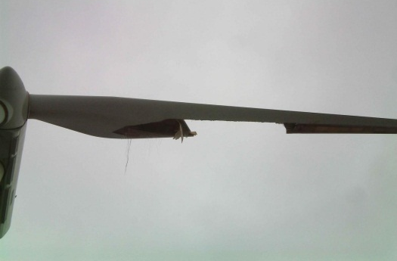
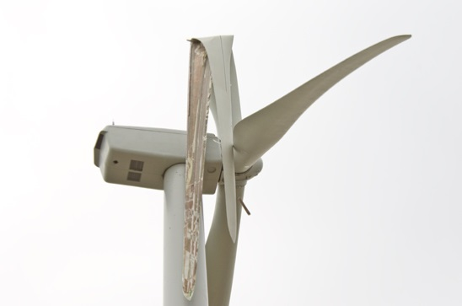
Example scenario #1: Blade damage on 5 turbines due to production error and missing inspection
Impacts
Loss of energy production for 1 month | 750,000 €
Ship rental for 30 days for repair works | 4,500,000 €
Personal offshore for 30 days [Assuming 3 worker for replacement/repair work] | 135,000 €
Component costs [5 new blades] | 500,000 €
Surrounding damages / loss [Environment, people, etc.] | €€€
Image | €€€
Total costs | 5,885,000 €
Investment in project certification of 1,000,000 €
Conclusion
With having inspection after production, avoidance of that error would have a benefit of 4,885,000 €.
Savings
4,885,000 €
Source:eastcountmagazine.org / basinelectric.wordpress.com

Slide 22
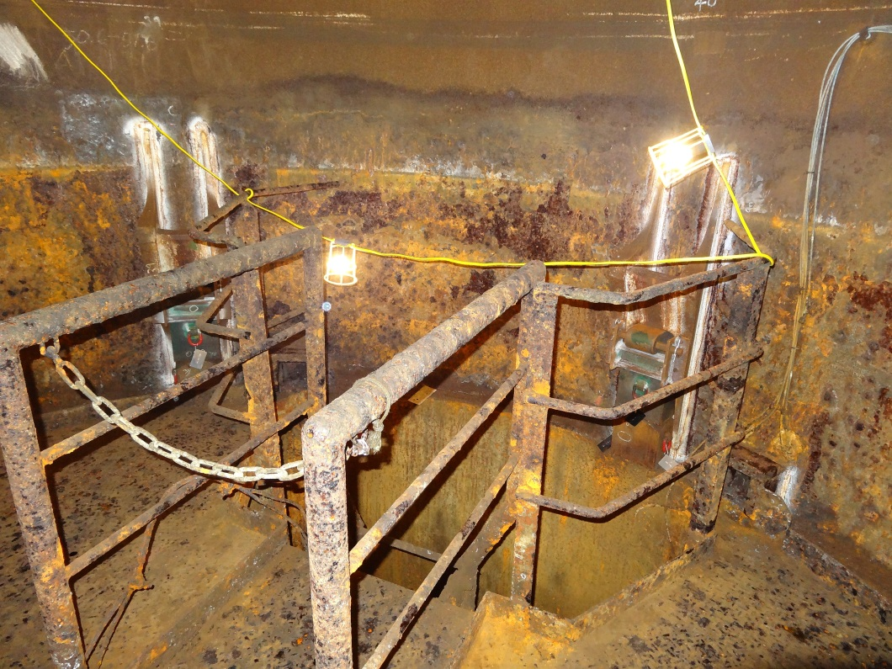
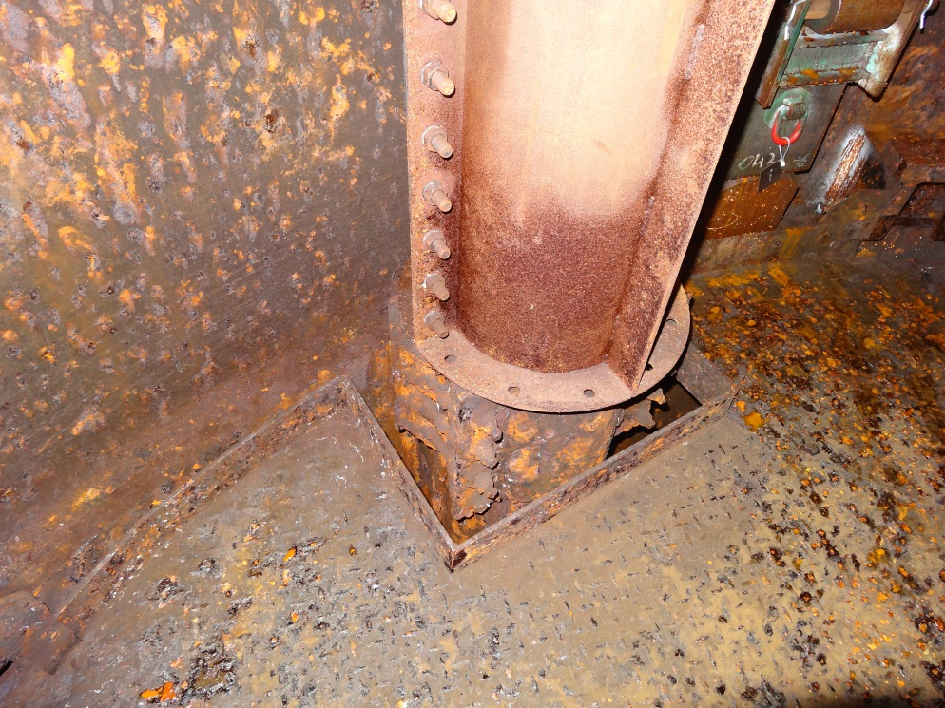
Example scenario #2: Corrosion of components due to insufficient protection and failure in production.
Impacts
Ship rental for 15 days for repair works | 2,250,000 €
Personal offshore for 15 days [Assuming 2 worker will do replacement/repair work] | 45,000 €
Component costs / Repair costs [surface treating / protection] | 50,000 €
Surrounding damages / loss [Environment, people, etc.] | €€€
Image | €€€
Total costs | 2,345,000 €
Investment in project certification of 1,000,000 €
Conclusion
With having inspection after production, avoidance of that error would have a benefit of 1,345,000 €.
Savings
1,345,000 €

Slide 23
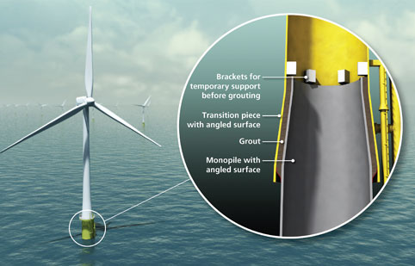
Example scenario #3: Grouted connection in foundation is insufficient.
Worst case scenario
Impacts
Stop turbines 100 days | 50,000,000 €
Ship rental for 100 days | 10,000,000 €
Diving activities for 100 days [Assuming one worker will do the repair work / a turbine a day] | 5,000,000 €
Surrounding damages / loss [Environment, people, etc.] | €€€
Image | €€€
Total costs | 65,000,000 €
Investment in project certification of 1,000,000 €
Conclusion
With having inspection after production, avoidance of that error would have a benefit of 64,000,000 €.
Savings
64,000,000 €

Slide 24
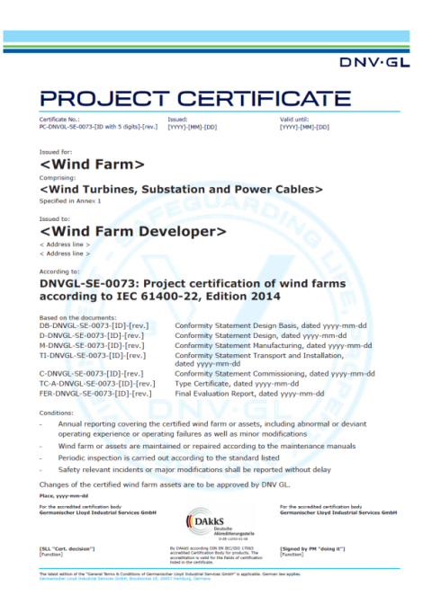
Example: reduced insurance /policy rate
Total volume for park: 1.4bn €
Installation phase: Insurance premium estimation: 7m to 8.4m €
Operation phase: Insurance premium estimation: 4.9m to 6.3m €
Estimation that with a project certificate, a discount of 5-10% on the premium could be realistic.
Certification could help to realize savings in a range of:
Installation phase: 350,000 to max. 840,000 €
Operation phase: 245,000 to max. 630,000 €
Savings help to pay range of certification costs

Slide 25
Overview about the number of issued Component Certificates
issued according to the following schemes:
DNVGL-SE-0074
DSS-904
GL 1999
GL 2003/2004
GL 2005
GL 2010
GL 2012
IEC 61400-22
IEC WT01
Others

Slide 26
Percentage distribution per scheme and year

Slide 27
Absolute distribution per scheme per year (Component Certification)

Slide 28
Absolute distribution per scheme per year (Component Certification)

Slide 29
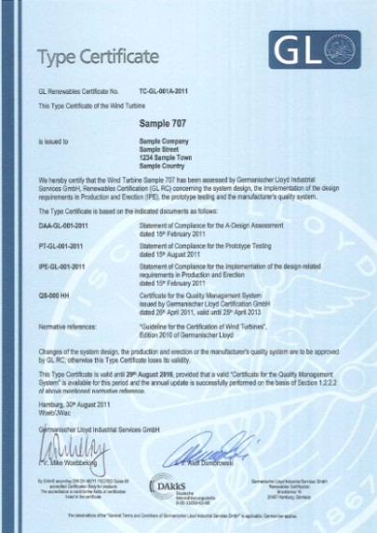
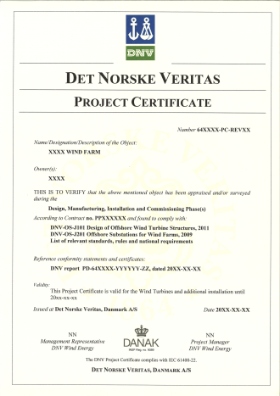
Benefits of Certification
confirmation of requirements to authorities, financiers, insurers, etc.
building of trust in the design and construction (confidence in technical integrity)
assisting in satisfying health & safety requirements
greater confidence of reliability and energy output
aids securing investment
independent expertise by a third party (four-eyes-principle)
support of internal quality management
largest experience in all types, concepts, sizes of turbines – worldwide

Slide 30
Benefits in Renewables Certification
DNV GL Renewables Certification
Accreditations by DAkkS incl. all locations
Nomination for the Type Approval of Wind Turbines according to German regulations by the City of Hamburg
Nomination for the Approval of Wind Turbines by Energistyrelsen, DK
Acknowledgements of accreditations by NOVEM (NL); SITAC (SE); C-WET (India); CRES (GR)
Acknowledgements of accreditations by MCS (SWT); BSH (Offshore Wind); FGW (GCC)
Applied for IEC RE as IEC RE Certification Body (RECB)
ISO 9001 certification
ISO 14001 certification
OHSAS 18001 certification
Notes:
See SharePoint HoCB for furhter acknowledgements (weblinks and pdf)

Slide 31
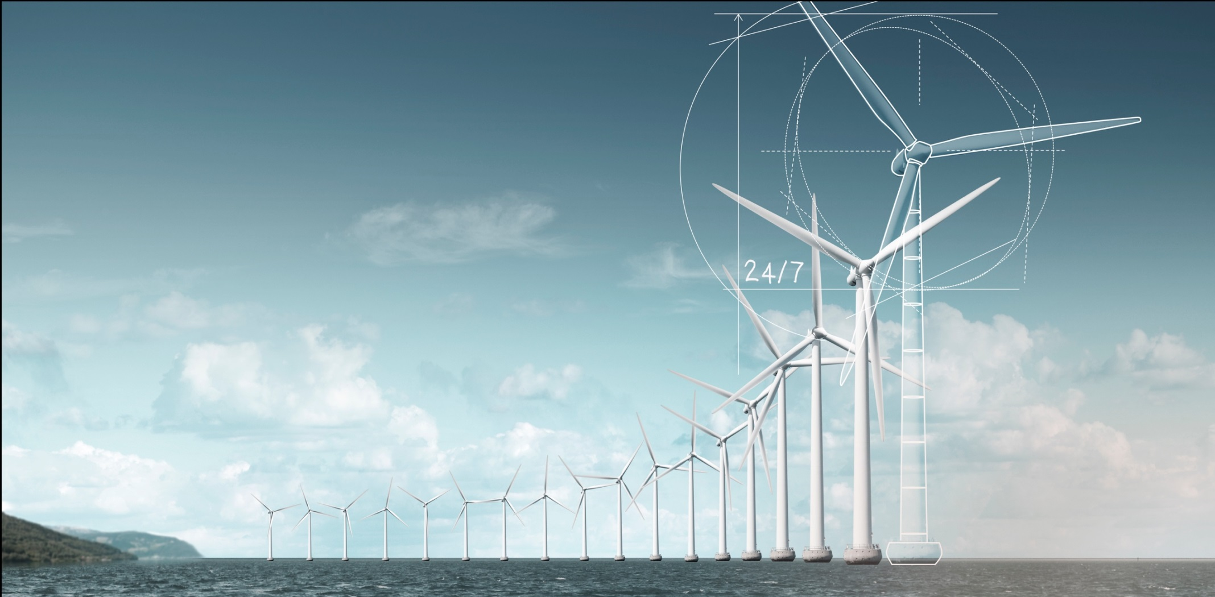
The goal should be certified for 24/7 performance

Slide 32
Thank you for your attention!
Mike Woebbeking
E-Mail: mike.woebbeking@dnvgl.com
Tel.: +49 (0) 40 – 3 61 49 – 33 07 Mobile: +49 (0) 160 – 898 58 49

