Slide 1
Validation of remote sensing methods for ice detection
WindEurope 2016 Timo Karlsson, VTT
Notes:
You can use cover page with one or two photos or without photos

Slide 2
Authors
Timo Karlsson, Ville Lehtomäki, VTT
Juha Paldanius, Vaisala
Jaakko Kleemola, Suomen Hyötytuuli
Martin S. Grønsleth, Kjeller Vindteknikk
Zouhair Khadiri-Yazami, Fraunhofer IWES

Slide 3
Icing and wind power
Ice accretion on turbine blades reduces output power of the turbine
Falling ice is a health and safety risk
Cold climate wind is a substantial market
Cumulative installed capacity by end of 2015 [MW] |  | Forecasted capacity by end of 2020 [MW]
Low temperature | Icing | Low temperature | Icing
40 500 | 86 500 | 62 500 | 123 000
Total 127 000 |  | Total 185 500
Source: V. Lehtomäki, Emerging from the cold, Wind Power Monthly, 29.7. 2016 , http://www.windpowermonthly.com/article/1403504/emerging-cold

Slide 4
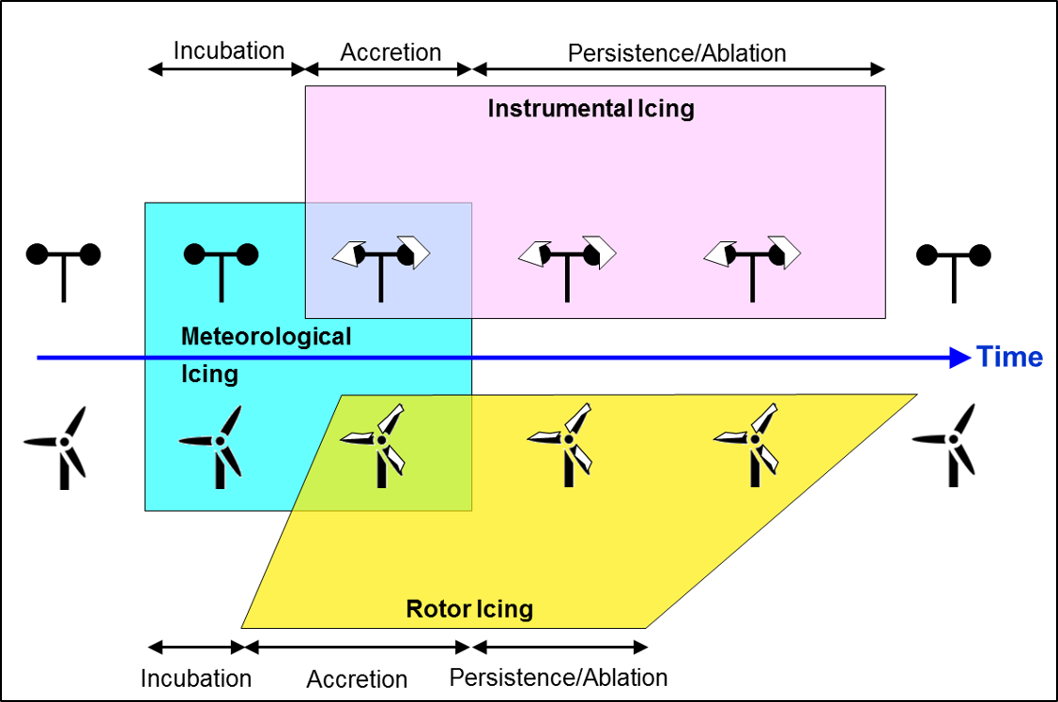
Icing types
Icing needs liquid water & freezing temperature
Low level clouds & T<0°C = in-cloud icing (most typical)
*Source: IEA Wind Task 19 Available Technologies report of Wind Energy in Cold Climates
(2016 edition): http://www.ieawind.org/task_19.html

Slide 5
IEA Ice Classification¹
IEA Ice Class | Duration of Meteorological Icing [% of Year] | Duration of Instrumental Icing [% of Year] | Production Loss [% of AEP]
5 | >10 | >20 | >20
4 | 5-10 | 10-30 | 10-25
3 | 3-5 | 6-15 | 3-12
2 | 0.5-3 | 1-9 | 0.5-5
1 | 0-0.5 | <1.5 | 0-0.5
¹: IEA Wind Recommended Practices for wind energy projects in cold climates edition 2011

Slide 6
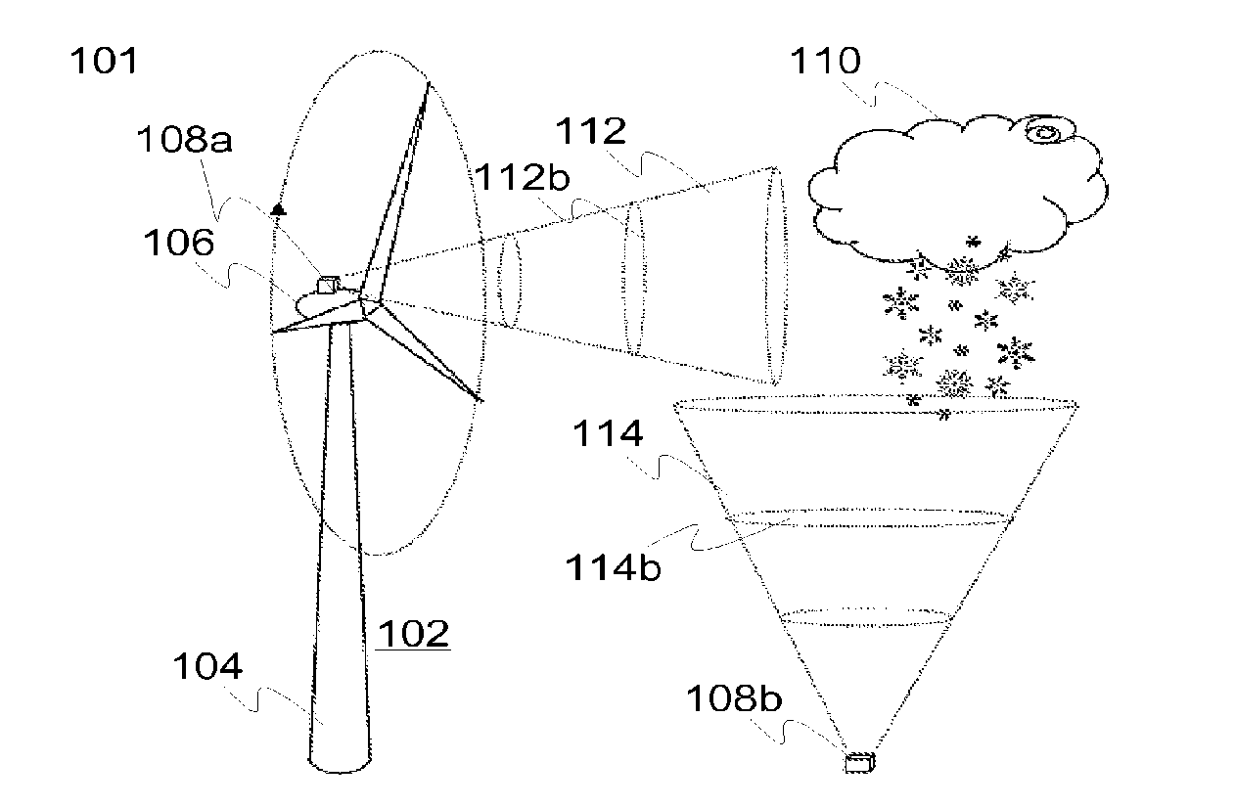
Remote ice detection
Use a LIDAR or ceilometer to determine cloud base height
Combine with meteorological measurements to produce warnings of meteorological icing
Measure icing at almost any height with ground based instrument
Create an icing profile for the measurement location
US Patent 2014/0192356
Arrangement and method for icing detection
Esa Peltola, Petteri Antikainen, Andrea Vignaroli

Slide 7
Method principle
Lidar measures wind speeds with laser
Light reflected back from particles in air
Cloud->more particles in air-> stronger backscatter signal
Ceilometer Based on same priciple
Ceilometer only measures cloud cover height, not wind speed
Measurement signal
Backscatter signal

Slide 8
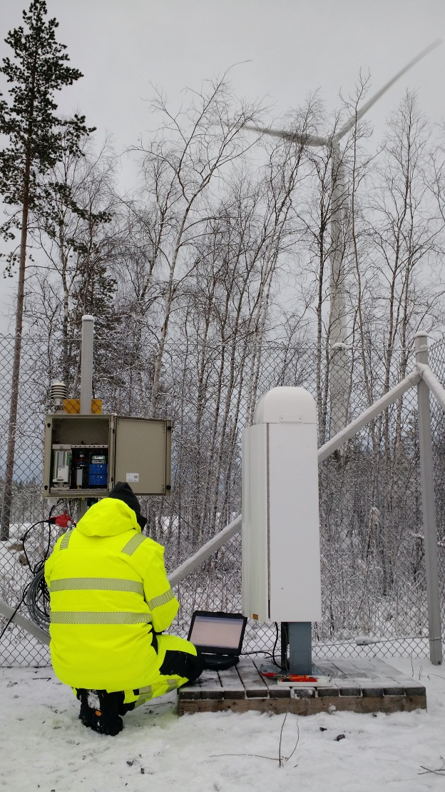
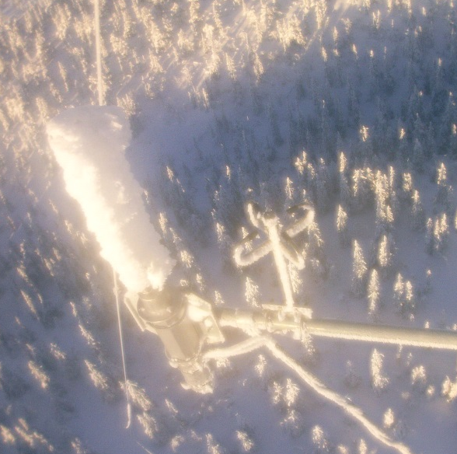
Sites
Site | Country | Instrumentation | Time period
Site A | Finland | Vaisala CL31 ceilometer Wind turbine heated/non-heated anemometers [100 m agl] | Dec 2015-Apr 2016
Site B | Germany | Leosphere WindCube LIDAR Jenoptik/Lufft CHM 15K ceilometer Heated/nonheated anemometers [190 m agl] Webcam | Oct 2012 –Feb 2014
Site C | Norway | Leosphere WindCube LIDAR Combitech IceMonitor ice detector [90 m agl] webcam | Jan 2012- Jun 2014
Site D | Finland | Leosphere WindCube LIDAR Vaisala CL31 Ceilometer | Fed 2016-Jun 2016

Slide 9
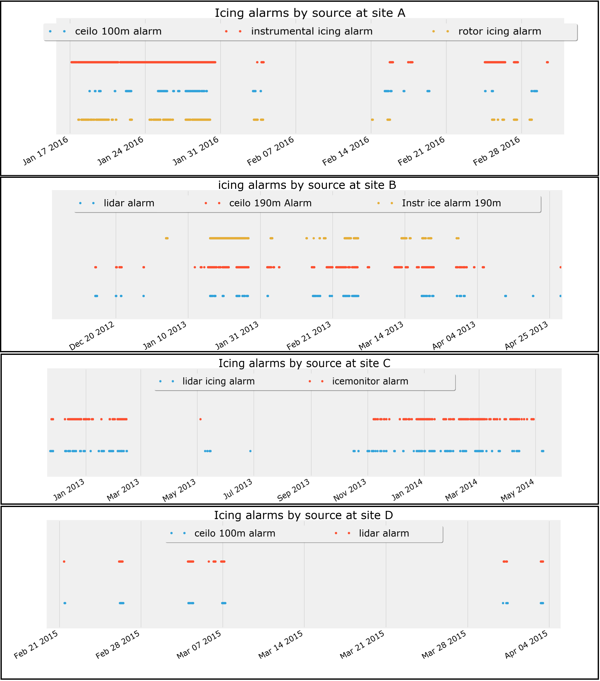
Data overview

Slide 10
Data overview

Slide 11
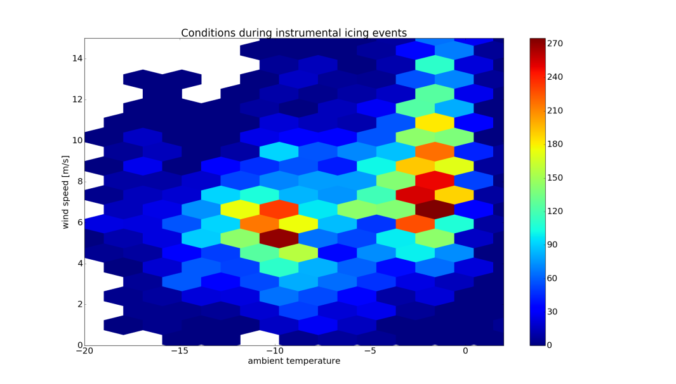
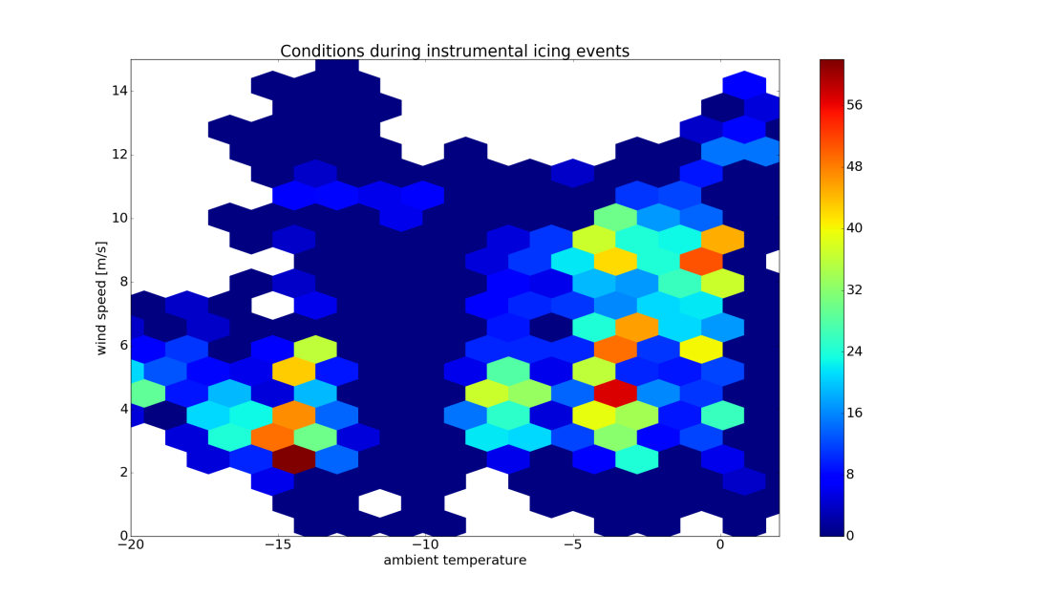
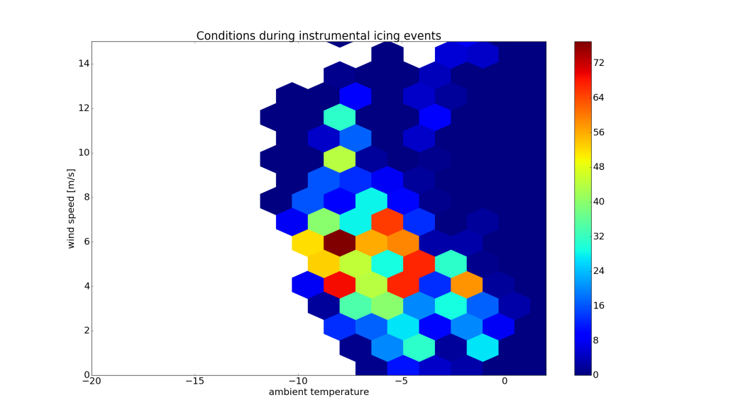
Conditions during icing
Site C
Instrumental icing most common at
temperatures close to 0 °C
Wind speed < 10 m/s
Site A
Site B

Slide 12
Correlation
Correlation between meteorological and instrumental icing measurements
Calulated for different time windows for all sites
Shows that correlation starts to improve only when observation window is long

Slide 13
Site Classification
Site | Meteorological icing from Ceilometer [% of time] | Meteorological icing from wind LIDAR [% of time] | Instrumental icing [% of time]
Site A | 5 %: | - | 11.2 %:
Site B | 3 %: Class 2 (Ceilometer) | 1.8 %: Class 2 (LIDAR) | 3.8 %: Class 2
Site C | - | 2 %: Class 2 | 14.9 %: Class 3
Site D | 1.6 %: | 2.0 %: | -
Ice classification hits same class at site B
Site C way under
Availability also very low
From ice sensor meteorological icing
4.4 %/class 3
Ice class requires at least a year of data

Slide 14
Conclusions and future work
Remote sensing of icing looks promising
Availability an issue when using LIDAR
Better during icing than on average. Might still miss events.
Ceilometer no availability issues, also resolution better
Correlation on a longer timescale
Can give an estimate of conditions
No real time detection
Improve LIDAR data availability
Cloud composition
Water vapor / ice crystals
Now compares Meteorological icing to instrumental icing
Different reference needed
Better transfer from meteorological to instrumental icing

