Slide 1
How to Inspect Rotor Blades Offshore and Reduce Overall O&M Expenses
Andrew Bellamy
Hamburg, September 2016

Slide 2
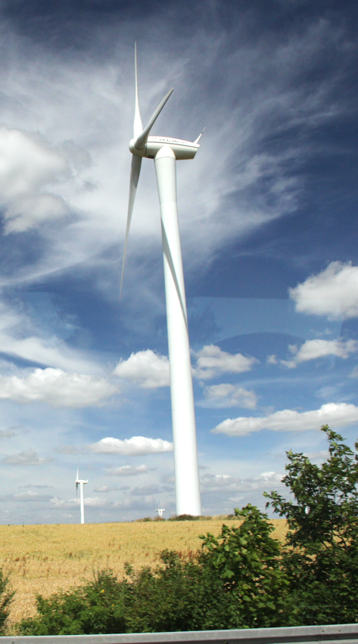
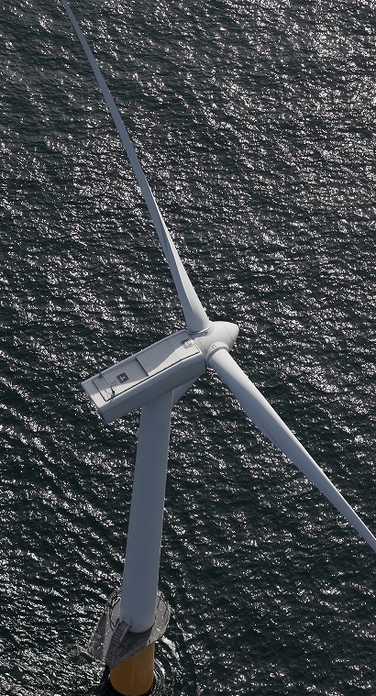
Rotorblade Inspection Basics
Onshore
Offshore
Difficult Access (offshore) + Difficult Access (Blades) + Weather = ☹

Slide 3
The Offshore Difference
Inspections of rotorblades onshore is relatively straightforward:
✔ Easy Access
✔ Wide weather window
✔ Stable Platform (terra firma)
Variables make offshore inspection and maintenance planning more complex
Offshore “seasons” restrict the schedule, and put far greater pressure on the repair planning
Drones have proven to be extremely useful inspection tools

Slide 4
The Complexities of Maintenance
Inspection Requirement
Gather Inspection Data
Ability to Interpret Data
Develop Maintenance Planning
Perform Maintenance

Slide 5
The Offshore Difference
Qualification Criteria
Cost
Time (operation and processing)
Quality
All affected by weather and access to blades
Options for Offshore Inspections
Rope Access
Static Camera
Drone
Helicopter

Slide 6
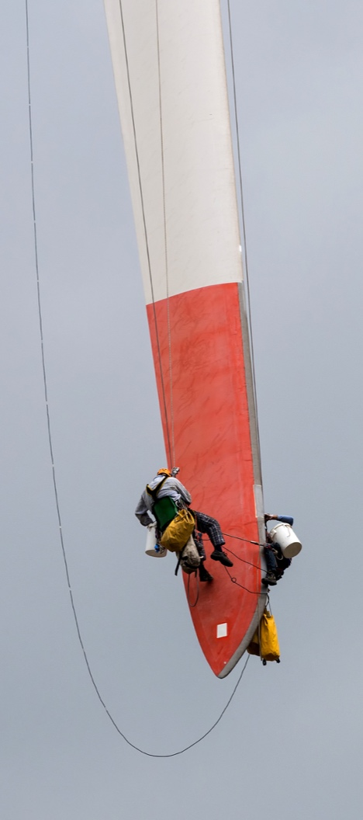
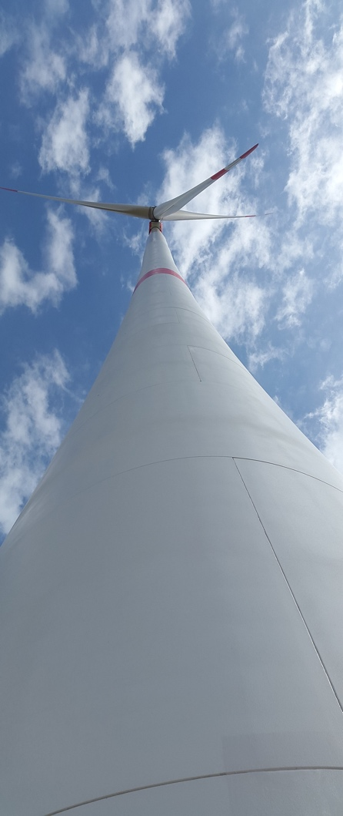
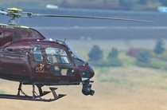
Inspections

Slide 7
Nearshore Economics
Shore-Based CTV Commute
Imaging system can be taken on a daily commute via CTV

Slide 8
Far Offshore Economics
Shore-Based CTV Commute
Imaging system needs to be accommodated offshore for the duration of the campaign

Slide 9
Nearshore – Project of 60 WTG
 | Rope Access | Static Camera | Drone | Helicopter
Team Members | 3 | 2 | 2 | 2
Blades/Day | 3 | 9 | 12 | 30
Weather Loss | 40% | 40% | 40% | 20%
Other Requirement | CTV or Accom Vessel for Duration |  |  | Heli…
Transit Times | N/A | N/A | N/A | N/A
Total Time | 84 Days | 28 Days | 21 Days | 7 Days
Man Days | 252 | 56 | 42 | 15
Cost Ranking | 3 | 1 | 2 | 4

Slide 10
Far Offshore – Project of 60 WTG
 | Rope Access | Static Camera | Drone | Helicopter
Team Members | 3 | 2 | 2 | 2
Blades/Day | 3 | 12 | 15 | 30
Weather Loss | 50% | 50% | 50% | 30%
Other Requirement | Accommodation Offshore/Vessel | Accommodation Offshore/Vessel | Accommodation Offshore/Vessel
Transit Times | 2 Days/Rotation (2 per 14 days) | 2 days/Rotation (2 per 14 days) | 2 Days/Rotation (2 per 14 days) | Minutes
Total Time | 90+12=102 Days | 22+4=26 Days | 18+4=22 Days | 8 Days
Man Days | 306 | 53 | 44 | 16
Cost Ranking | 4 | 3 | 2 | 1

Slide 11
Summary
The economics of far-from-shore projects are often very different to nearshore/onshore
Drone technology has dramatically improved blade inspection – but only in some locations. Will technology deliver a solution?
Ability to reduce the cycle of image capture to repair programming is critical to manage maintenance costs

