Slide 1
Multi-Criteria Assessment Tool for Floating Offshore Wind Power Plants
Presenter: Markus Lerch (IREC)
WindEurope Summit 2016
Hamburg, 29 th September 2016
The research has received funding from the European Union Horizon2020 programme under the agreement H2020-LCE-2014-1-640741.

Slide 2
Contents
Introduction
EU H2020 LIFES50+ Project
Methodology
Multi-Criteria Assessment
FOWAT Tool
Conclusions
29 September, 2016

Slide 3
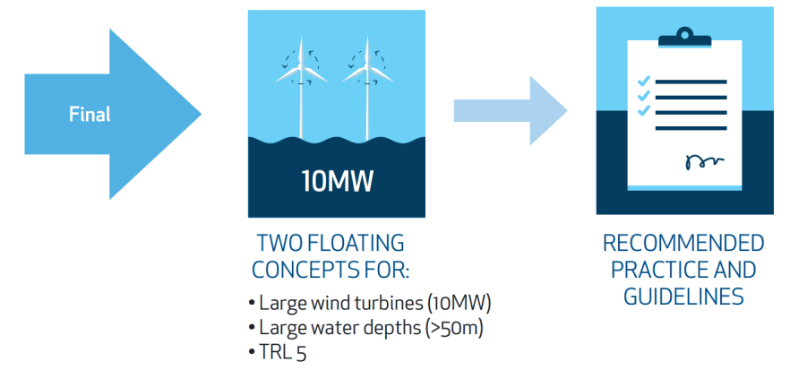
Introduction
EU H2020 LIFES50+ Project
“Qualification of innovative floating substructures for 10 MW wind turbines and
water depths greater than 50 m”
Concept Evaluation
Multi-Criteria Assessment
Cost Reduction Potential
29 September, 2016

Slide 4
Introduction
The research has received funding from the European Union Horizon2020 programme under the agreement H2020-LCE-2014-1-640741.
29 September, 2016

Slide 5
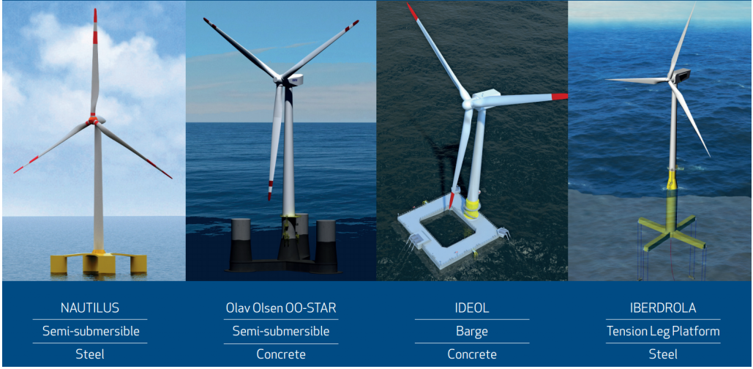
Introduction
Floating Substructure Concepts
29 September, 2016

Slide 6
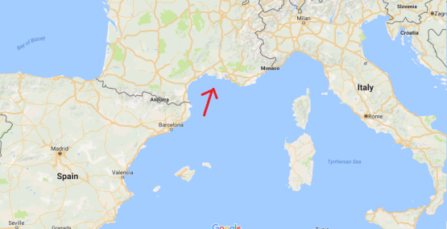
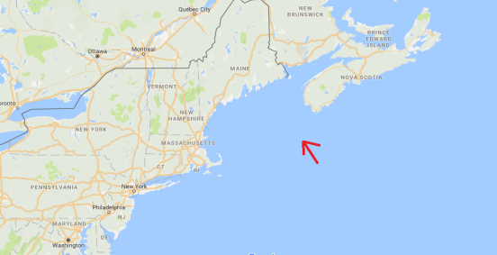
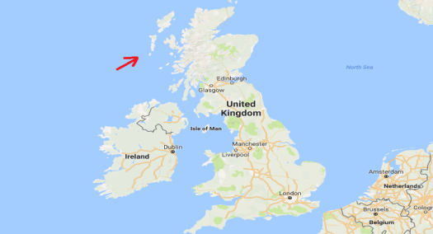
Introduction
Concept Evaluation
Golfe de Fos, France Gulf of Maine, USA West of Barra, Scotland
Moderate Medium Severe
Met-ocean conditions Met-ocean conditions Met-ocean conditions
Evaluation baseline:
Complete offshore floating wind farm consisting of 50 turbines (500 MW)
3 selected sites
Average performance of the concepts according to different sites
29 September, 2016

Slide 7
Introduction
Concept Evaluation
Golfe de Fos, France Gulf of Maine, USA West of Barra, Scotland
Moderate Medium Severe
Met-ocean conditions Met-ocean conditions Met-ocean conditions
Additional evaluation:
1turbine (10MW) and 5 turbines (50MW) configuration
1 selected site
From demonstration to commercialization
29 September, 2016

Slide 8
Methodology
Multi-Criteria Assessment
Objective
Criteria
Indicator
Ranking
Selection of the two best performed concepts
Economic
LCOE
Unit: €/MWh
Economic
70 %
Global Warming Potential
Unit: Kg CO2 equiv.
Environmental
LCA
Primary Energy
Unit: MJ equiv.
Environmental
10 %
Abiotic Depletion Potential
Unit: Kg Sb equiv.
Risk
20 %
Risk
Technological Risk
Unit: dimensionless
Technical KPIs will be considered to verify and check the consistency
of the data provided and results obtained
29 September, 2016
Notes:
Sb = Antimony (Lat. Stibium)

Slide 9
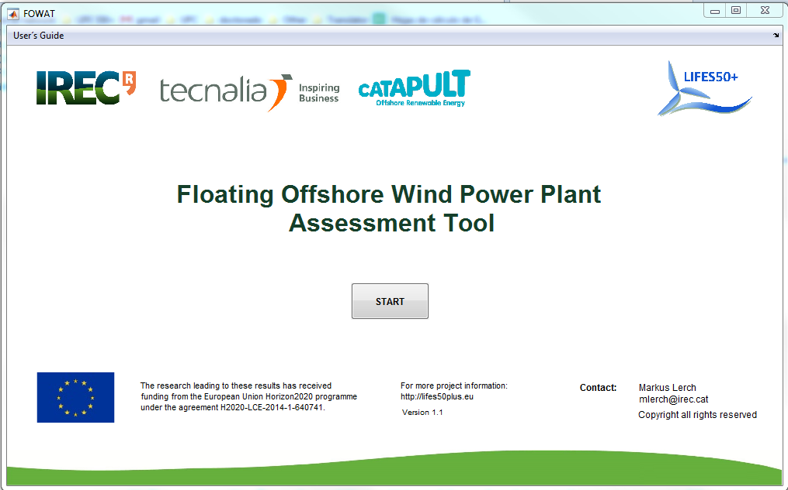
FOWAT TOOL
29 September, 2016

Slide 10
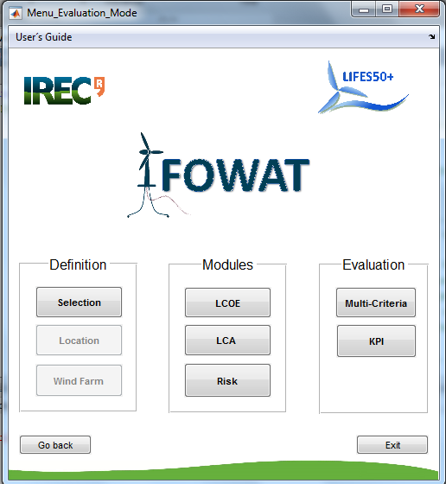
FOWAT TOOL
Menu
29 September, 2016

Slide 11
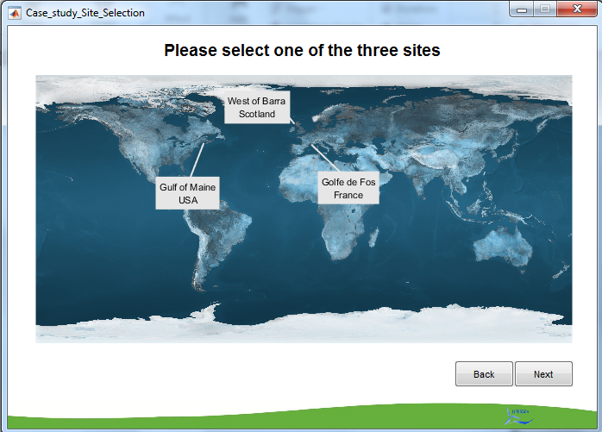
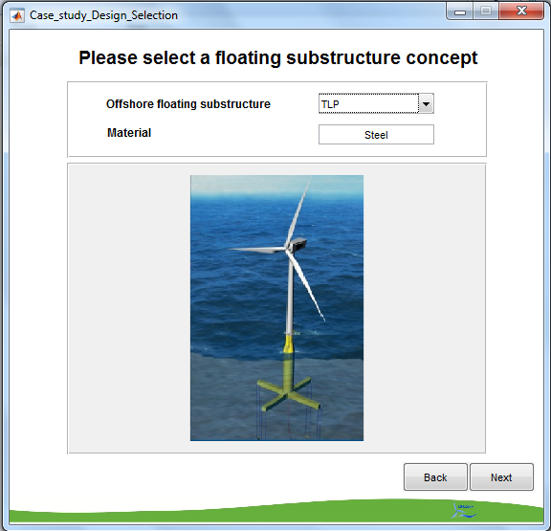
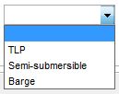
FOWAT TOOL
29 September, 2016

Slide 12
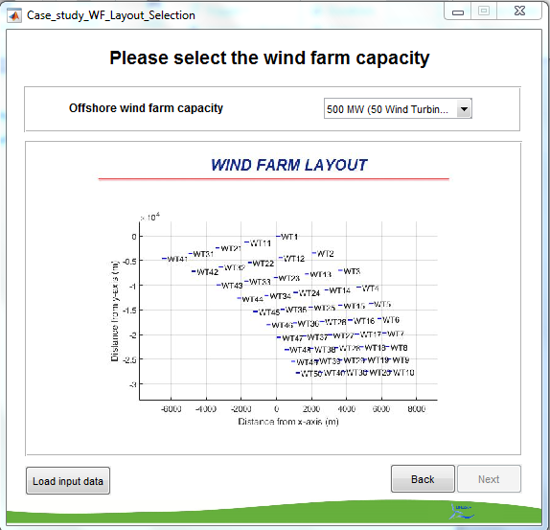
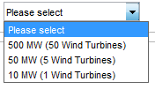
FOWAT TOOL
Import of Data:
1. Automatically - EXCEL file
2. Manually – Tool
29 September, 2016

Slide 13
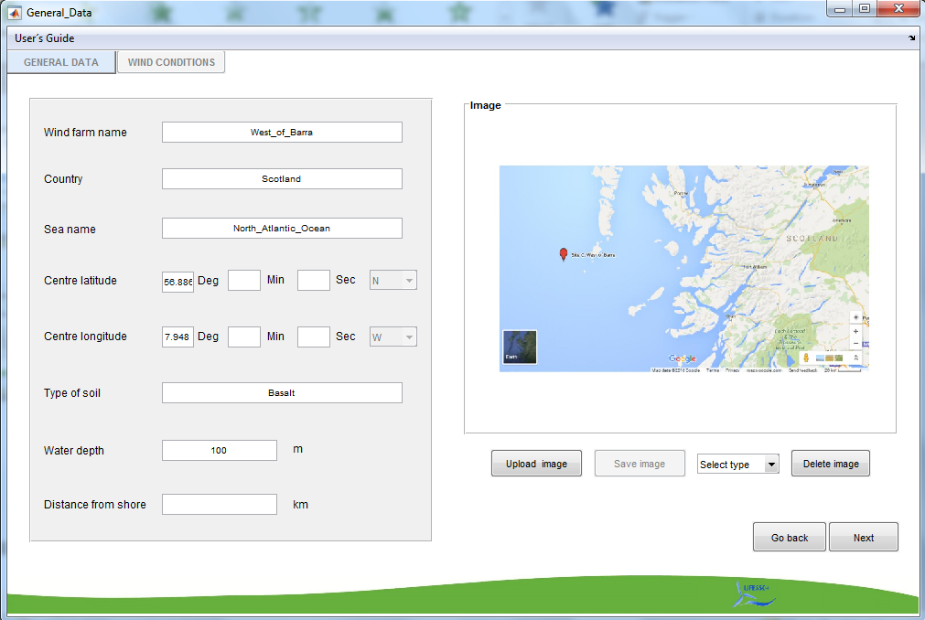
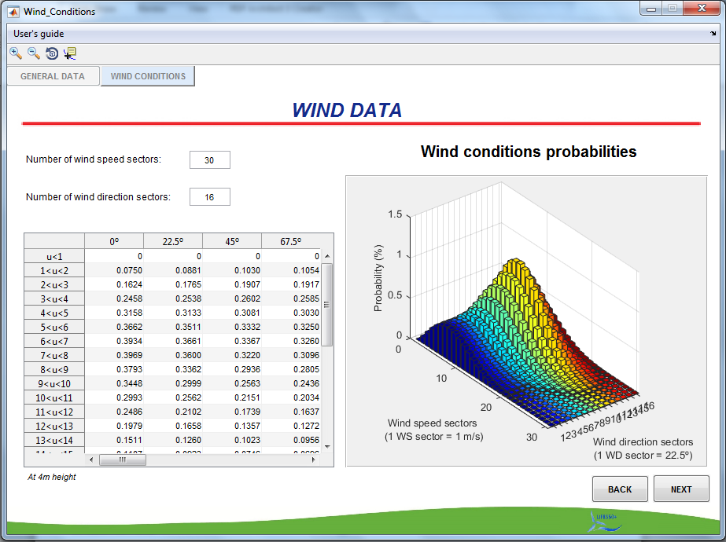
FOWAT TOOL
Location Definition
29 September, 2016

Slide 14
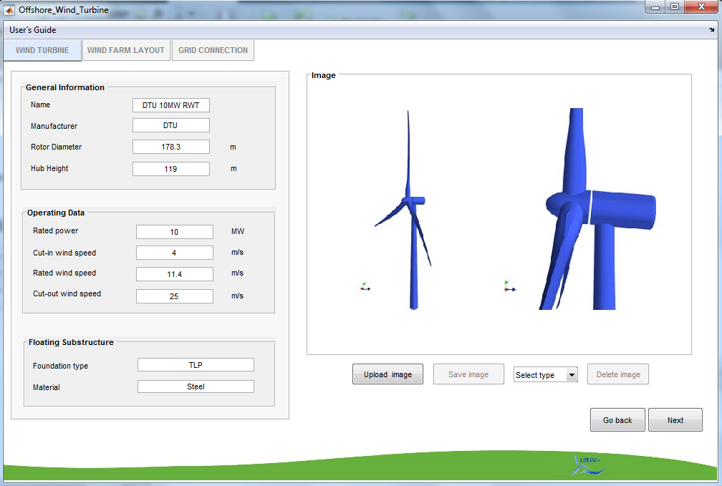
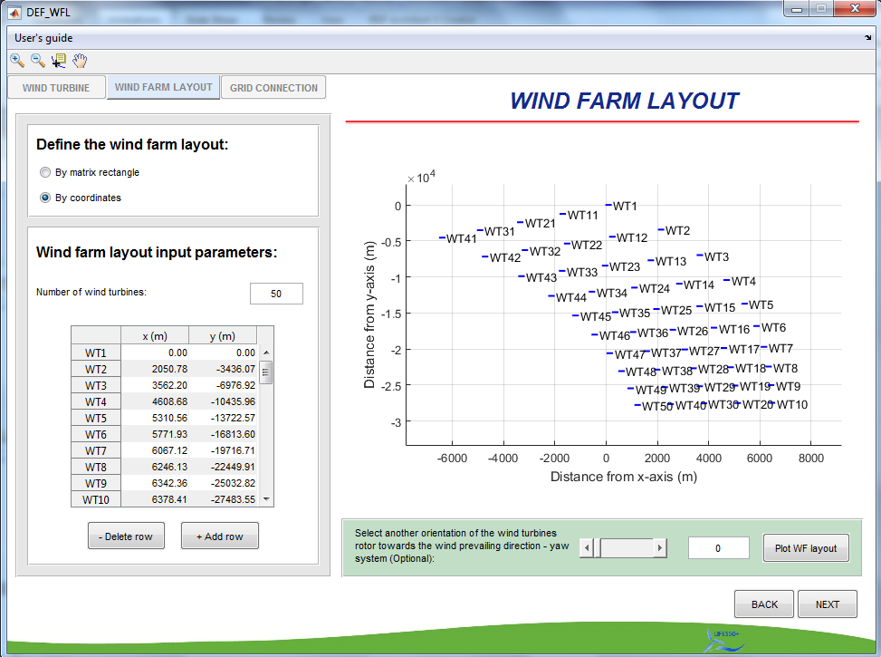
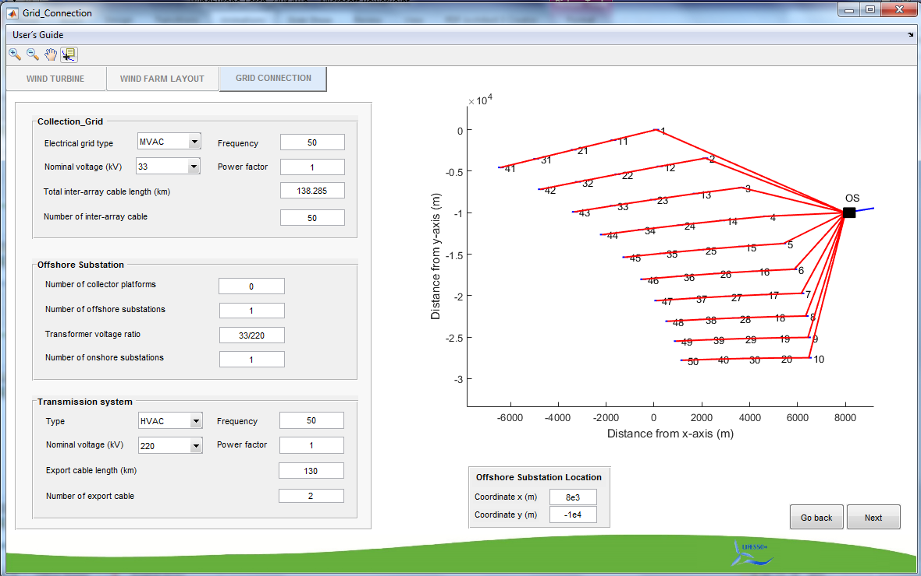
FOWAT TOOL
Wind Farm Definition
29 September, 2016

Slide 15
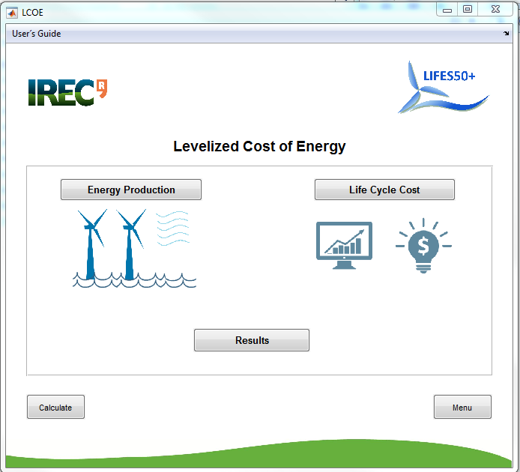
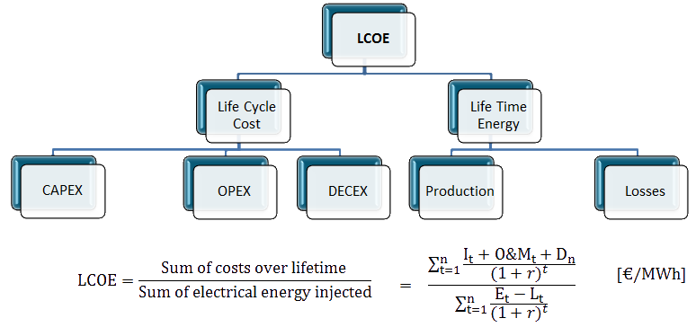
FOWAT TOOL
LCOE Module
29 September, 2016

Slide 16
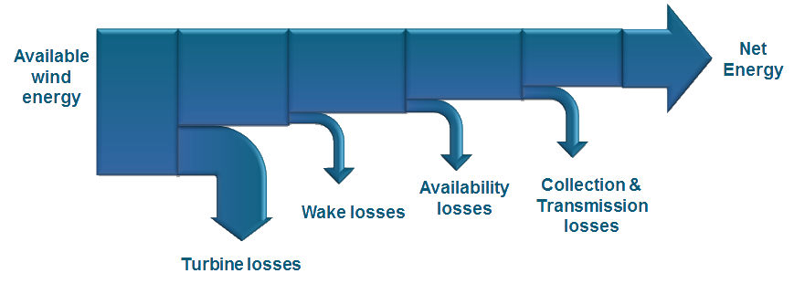
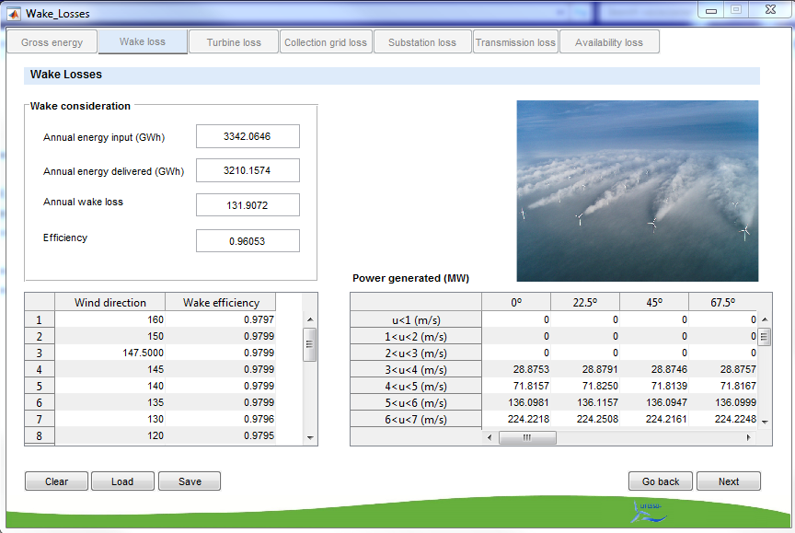
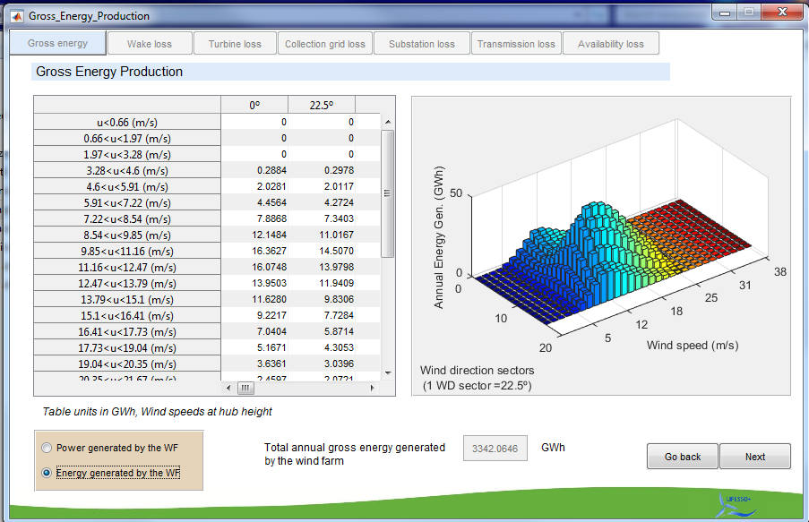
FOWAT TOOL
Energy Production
29 September, 2016

Slide 17
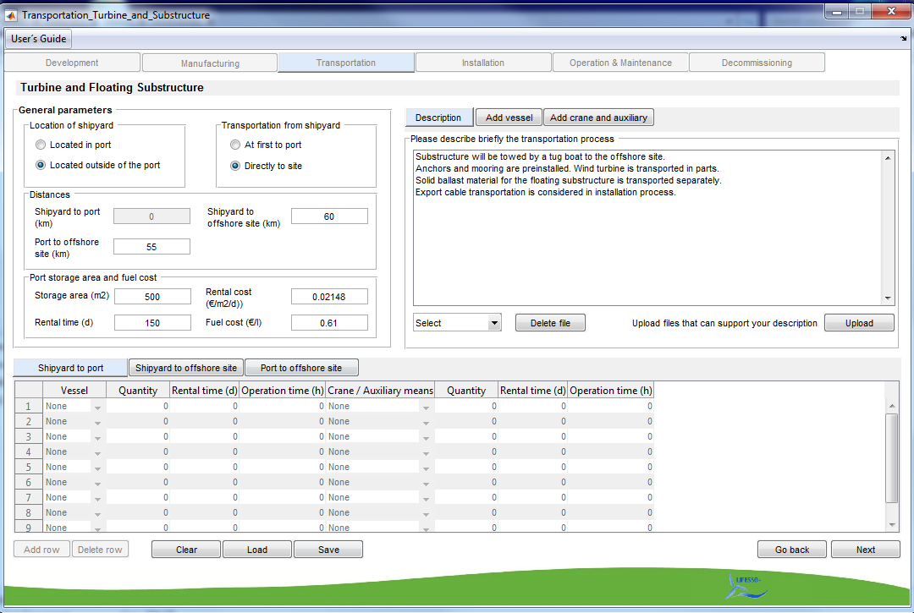
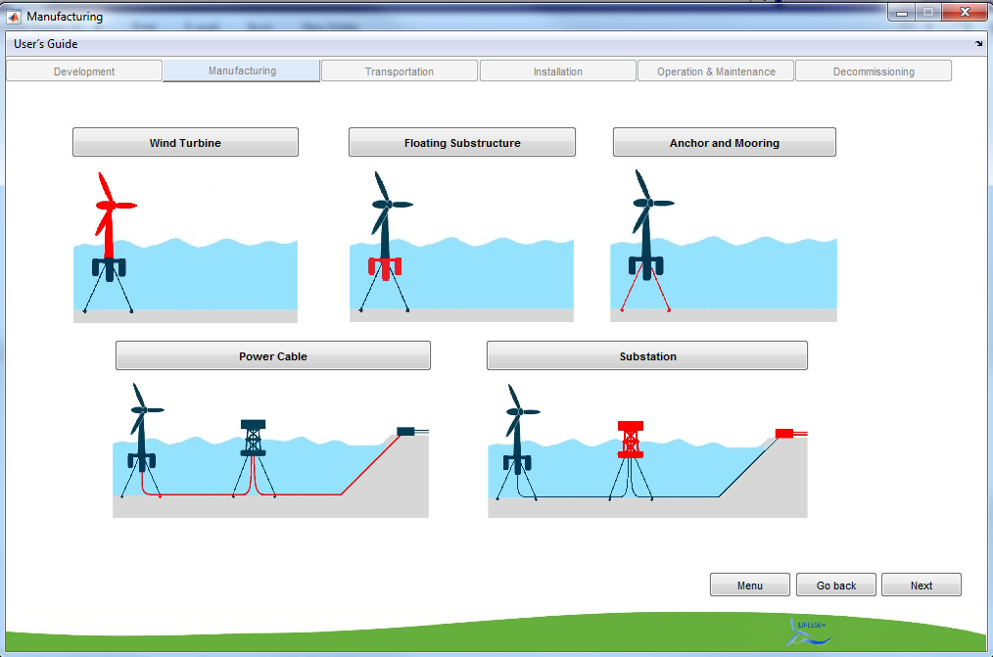
FOWAT TOOL
Life Cycle Costs
29 September, 2016

Slide 18
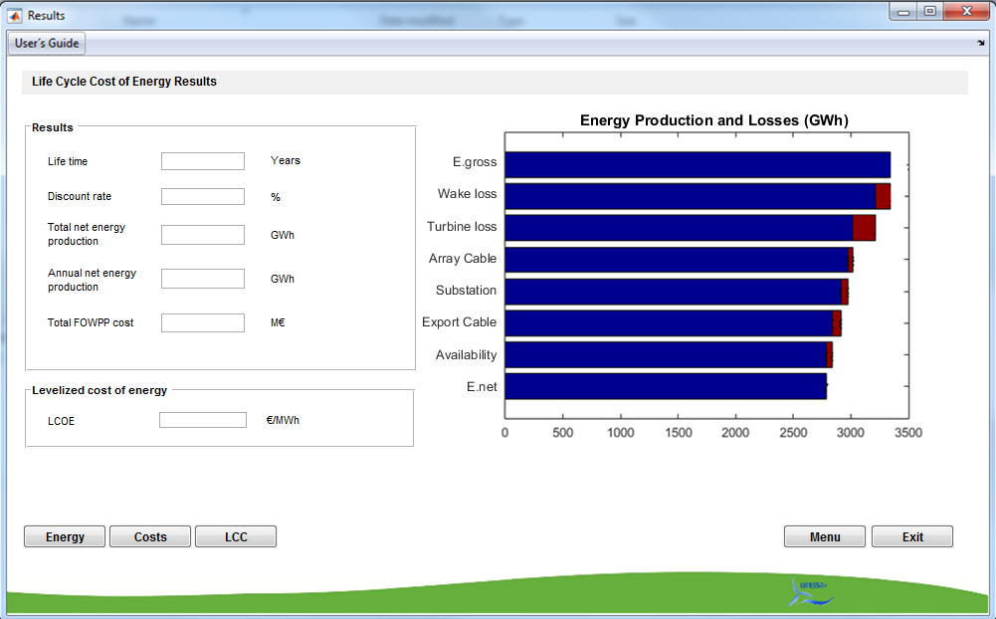
FOWAT TOOL
LCOE
Result
29 September, 2016

Slide 19
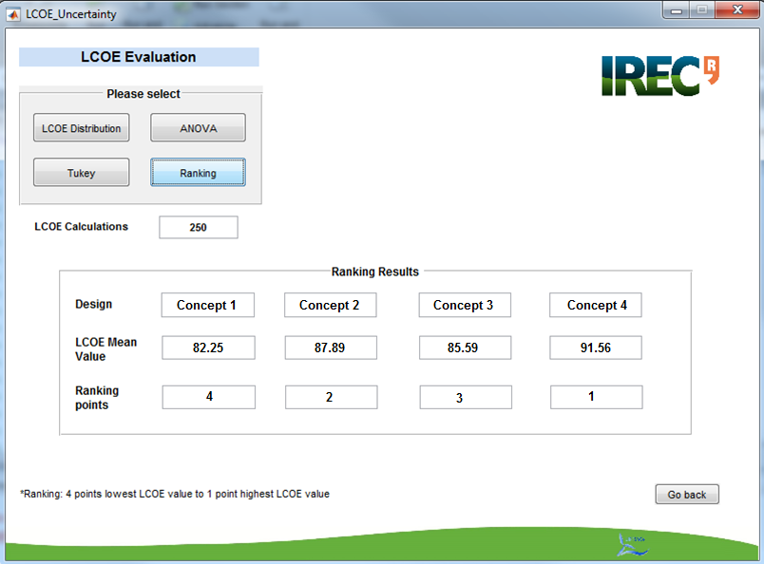
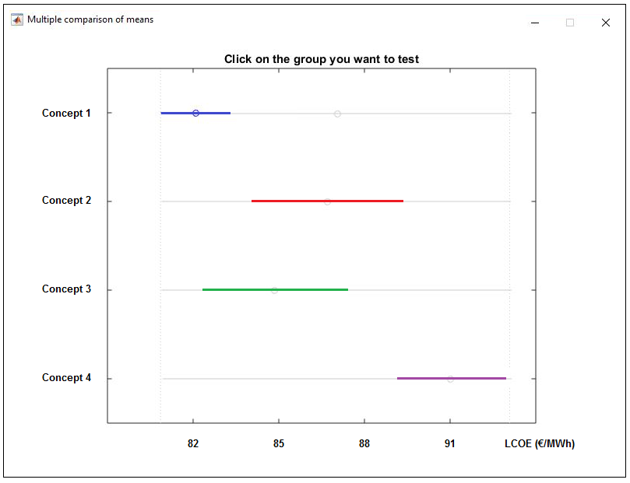
FOWAT TOOL
LCOE Uncertainty Evaluation
Technological uncertainties
Installation costs
Wind turbine costs
Development costs
Etc.
External uncertainties
Energy production
Exchange rates
Discount rate
Etc.
29 September, 2016

Slide 20
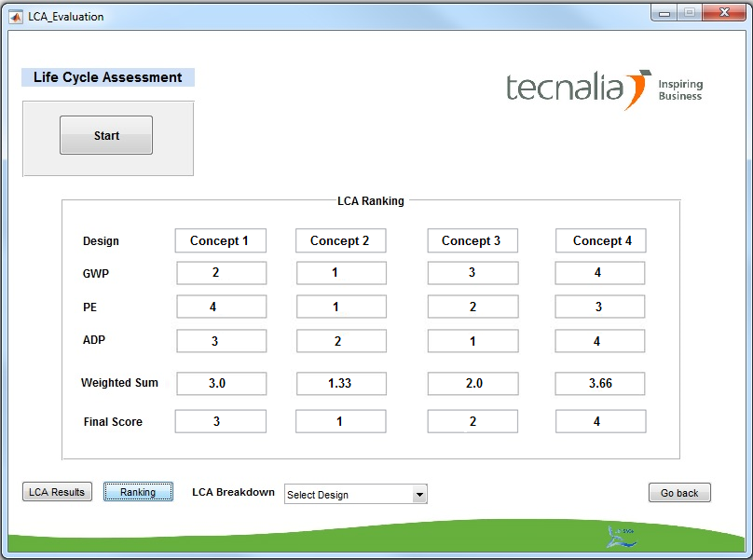
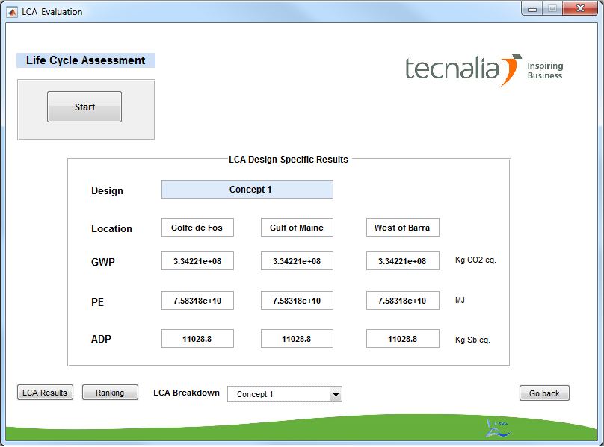
FOWAT TOOL
LCA Criteria
Global Warming Potential
(Kg CO2 eq.)
Primary Energy Consumption
(MJ)
Abiotic Depletion Potential
(Kg Sb eq.)
29 September, 2016

Slide 21
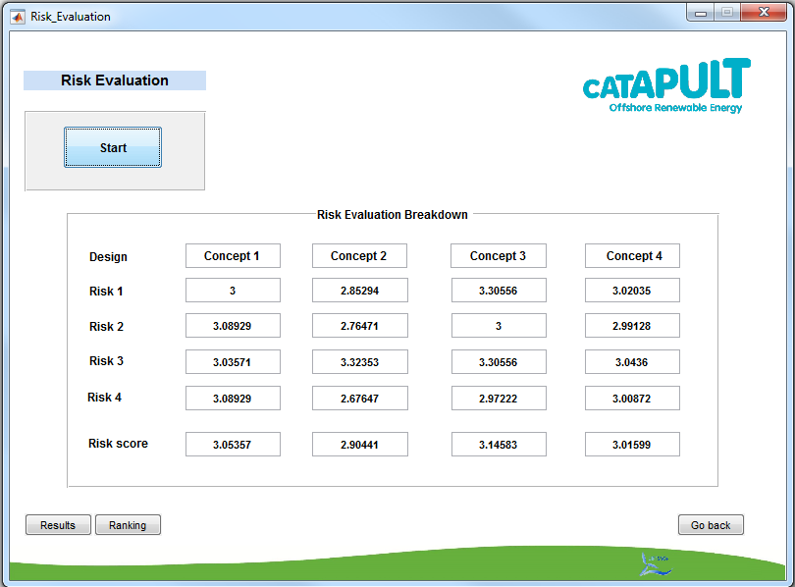
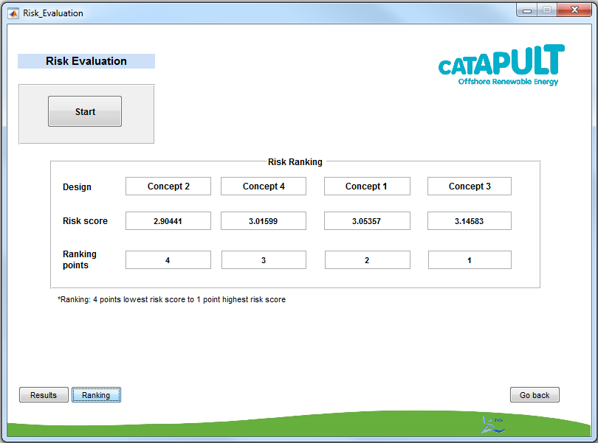
FOWAT TOOL
Technological Risk
Cost
Availability
Health & Safety
Environment
29 September, 2016

Slide 22
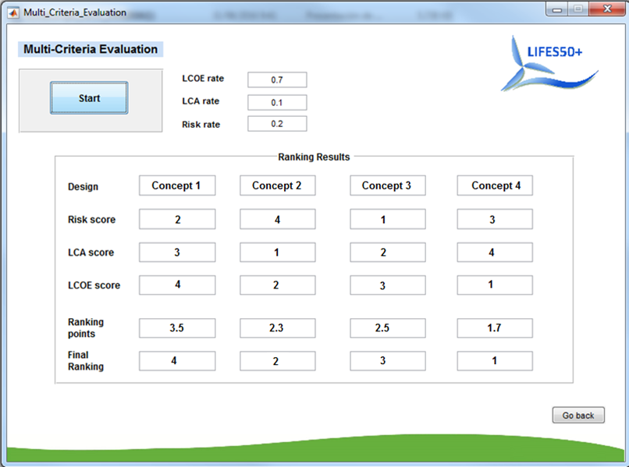
FOWAT TOOL
29 September, 2016

Slide 23
Conclusions
FOWAT enables the performance comparison of multiple floating substructure concepts
Multi-criteria assessment based on LCOE, LCA and Risk
Uncertainty consideration in cost calculation
Different geographical offshore sites can be included
Detailed breakdown of life cycle cost and energy losses
Flexible tool and customization possible
Next steps
Lifes50+ concept evaluation in January 2017
Comparative assessment of bottom-fixed and floating offshore wind farms
Update to include a wide range of wind farm configurations
29 September, 2016

Slide 24
Thank you for your attention!
Vielen Dank für Ihre Aufmerksamkeit!
29 September, 2016

