Slide 1
Continuous noise monitoring to protect residents and improve yield
Moise Coulon, James Mackay and
Jason Baldwin – TNEI
Peter Longbottom – Visual Wind
Notes:
Good morning, I will be talking about the potential for continuous noise monitoring , based on wind farm noise experience in the UK.

Slide 2
CONTENT
Noise curtailment
Challenges of continuous monitoring
Field measurements – results from proxy tests
Notes:
I will be covering ..1 2 3

Slide 3
CONTEXT
Many wind farms start operation with noise curtailment
Downwind
Situation
Notes:
Describe the limit, then he predictions and curtailment

Slide 4
CONTEXT
Crosswind
Situation
Notes:
And we repeat the operation for various wind direction, example here crosswind with less curtailment.

Slide 5
CONTEXT
Based on noise predictions, each turbine’s operation is tailored so that in theory, the wind farm meets its limit.
Low Noise Mode Names: | Full | Low Noise 1 | Low Noise 2 | Low Noise 3 | OFF
Low Noise Mode Key: | Blank | LN1 | LN2 | LN3 | OFF
Turbine Nb | Wind speed @10 | Wind speed @hub
T1 | 4.5-7.5 | 6.3-10.4
T2 | 4.5-7.5 | 6.3-10.4
T3 | 4.5-7.5 | 6.3-10.4
T4 | 4.5-7.5 | 6.3-10.4
T5 | 4.5-7.5 | 6.3-10.4
Wind Direction Sector
1 | 2 | 3 | 4 | 5 | 6 | 7 | 8 | 9 | 10 | 11 | 12
0° | 30° | 60° | 90° | 120° | 150° | 180° | 210° | 240° | 270° | 300° | 330°
LN2 | LN2 | LN3 | LN3 | LN3 | LN2 | LN2
 |  | LN2 | LN2 | LN2
LN3 | LN3 | OFF | OFF | OFF | LN3 | LN3
Notes:
And the main output is a noise curtailment strategy

Slide 6
CONTEXT
Are noise curtailments reviewed during operational phase ?
Notes:
The strategies are implemented from day1 and that is it, often not tested in field.

Slide 7
CONTEXT
Fine tune curtailment
Detect operational issues
Continuous noise monitoring
Isolate temporary noise events
Faster response to residents
Notes:
Continuous monitoring would offer opportunities for fine tuning, detection of operational issues …

Slide 8
CHALLENGES – TECHNOLOGY
Remote communication and cloud computing required to synchronise all data
Notes:
But of course there are challenges, technology wise we acousticians still mostly rely on non-smart meter, SD card reader required. We need to easily sync noise, rain, wind, scada .. The internet of things is happening but slowly

Slide 9
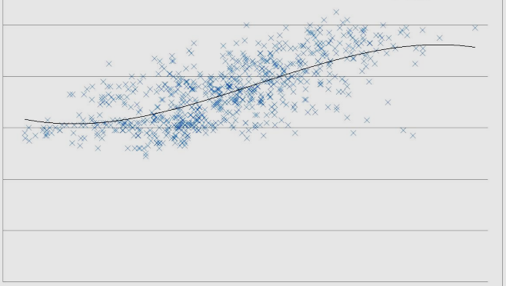
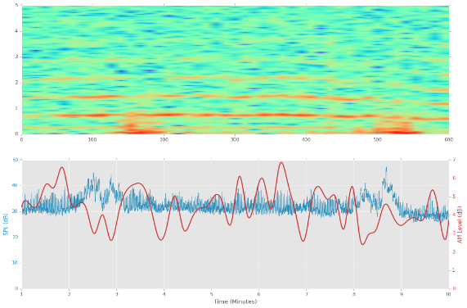
CHALLENGES – TECHNOLOGY
A big data challenge ahead for wind farm noise
Past requirements
New requirements
10 minute data
100ms 1/3 octave
Notes:
And of course, recording 10minute data is not sufficient any more, we need months of 100ms data for AM , a big data challenge ahead.

Slide 10
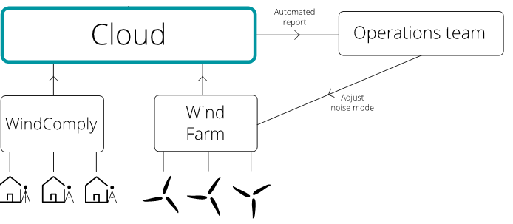
CHALLENGES – METHODOLOGY
Yearly/quarterly/monthly automated results ?
Notes:
We could have automated reports, but would these be based on averaging data yearly. quarterly, monthly ? There are no guidance as most surveys are around 1-2 months and would assume to average the entire data set. The chart describe a route for the operational team to use automated reports to adjust curtailment.

Slide 11
CHALLENGES – LOCATION
Noise kits intrusive for residents when installed in their gardens for long period
Privacy concerns with audio
Residents may interfere with kits
Notes:
In regards to location, … Read quickly the three bullets

Slide 12
CHALLENGES – LOCATION
Monitoring at receptors ~500m to 2000m is far from the noise source (turbines), hard to differentiate on/off
Monitoring at the 61400-11 position ~100m is too close, sound field and character not representative of receptors
In the UK, IOA GPG SGN5 noted: “compliance measurements may need to be undertaken in closer proximity to the wind farm to ensure background noise levels do not unduly influence the readings.”
Notes:
At receptors +600m too far and at 100m too close ? There is a general consensus , as per this quote from the IOA in the UK, that receptors may be too far from the turbines for meaningful measurements.

Slide 13
CHALLENGES – LOCATION
Option 1 – the traditional approach
Notes:
So here is the traditional approach, we have issues with overwhelming background noise. As can be seen in the red area, …Describe briefly the bottom chart.

Slide 14
CHALLENGES – LOCATION
Option 2 – measure close to the development
Notes:
we could measure closer to have a better reading of the specific wind farm noise

Slide 15
CHALLENGES – LOCATION
Option 3 – measure near the development and at receptor
Notes:
Or we could measure at both to provide context and extra information about the results from receptor measurements.

Slide 16
CHALLENGES – LOCATION
Option 4 – measure at two locations near the development
Notes:
And also would could envisage two equipment s near the turbines.

Slide 17
CHALLENGES – LOCATION
Are proxy measurements representative of the receptor?
Notes:
So if we do not monitor at the receptor, …read the question

Slide 18
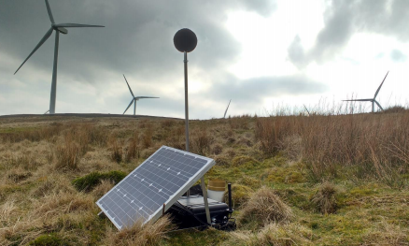
FIELD MEASUREMENTS
Proxy testing measurements, so far data has been collected at four sites:
Site A - single 500kW turbine, coastal location, gently sloping topography
Site B - ~20MW site, gently sloping topography
Site C - >50MW site, rolling countryside
Site D - ~30MW site, gently sloping topography
Notes:
We are collecting data to test the use of proxy measurements

Slide 19
FIELD MEASUREMENTS
For each site, at least two noise kits deployed, one at receptor and one at a proxy between turbines and receptor
For site B, three kits at 250m, 350m and 600m and results presented here
Measured data available with turbines ON (filtered for downwind in analysis) and turbines OFF (background data). Log subtraction done to determine the specific noise of the wind farm
Predictions made to allow comparison with specific noise.
Notes:
I will present data from one of the site, where we have three locations in line and we have data separated for periods ON, period OFF and we also have predictions.

Slide 20
FIELD MEASUREMENTS: NOISE LEVELS, SITE B
Measurement location 1 @ 250m – ON with individual 10minute points
dB L_{A90}
Hub height wind speed standardised to 10m
Notes:
Quick descriptions

Slide 21
FIELD MEASUREMENTS: NOISE LEVELS, SITE B
Measurement location 1 @ 250m – ON, OFF, SPECIFIC, PREDICTIONS
Notes:
Bid difference here with background, turbine noise dominant

Slide 22
FIELD MEASUREMENTS: NOISE LEVELS, SITE B
Measurement location 2 @ 350m – ON, OFF, SPECIFIC, PREDICTIONS
Notes:
A little further and still a major contribution form turbines, but a little closer to background.

Slide 23
FIELD MEASUREMENTS: NOISE LEVELS, SITE B
Measurement location 3 @ 600m – ON, OFF, SPECIFIC, PREDICTIONS
Notes:
and at receptor distance, we can see a huge contribution of background noise.

Slide 24
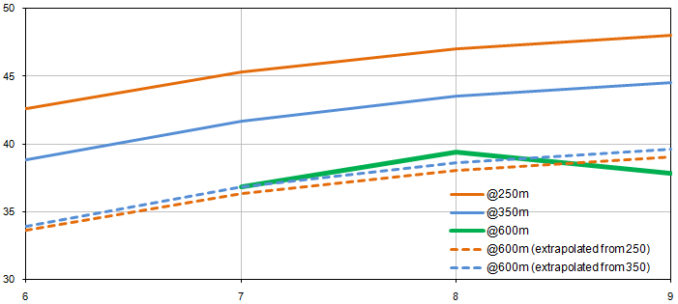
FIELD MEASUREMENTS: NOISE LEVELS SITE B
Notes:
The aim is to represent the receptor location, so a basic extrapolation has been done and these initial results indicate a good correlation.

Slide 25
CONCLUSIONS
Continuous noise monitoring may be a viable alternative to sporadic noise testing
It would allow fine tuning of noise curtailment and better response to residents concerns
The choice of the monitoring location is a very important consideration
Notes:
So to conclude, … read quickly

Slide 26
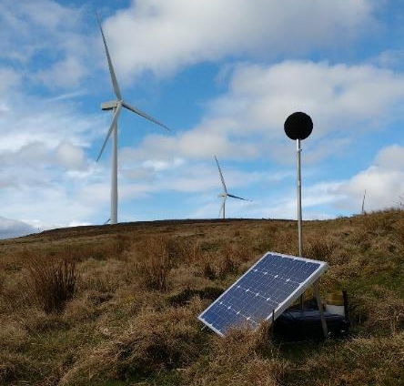
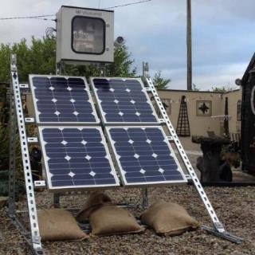
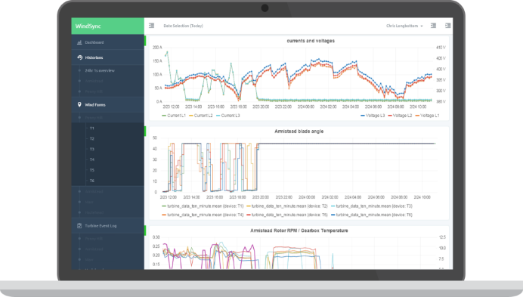
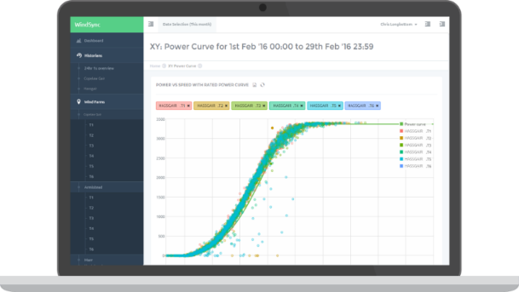
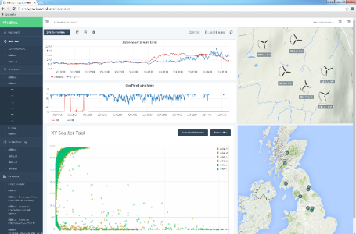
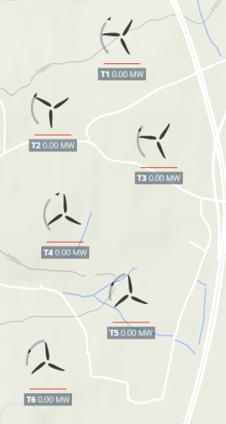
THANK YOU
moise.coulon@tnei.co.uk
www.tnei.co.uk
Moise Coulon, Senior Technical Consultant

