Slide 1
Wind Turbine Control in Icing Climate
Matthew Wadham-Gagnon, eng., M.Eng.
Project Manager / Business Development Coordinator
WindEurope 2016
Hamburg
© TechnoCentre éolien, 2016

Slide 2
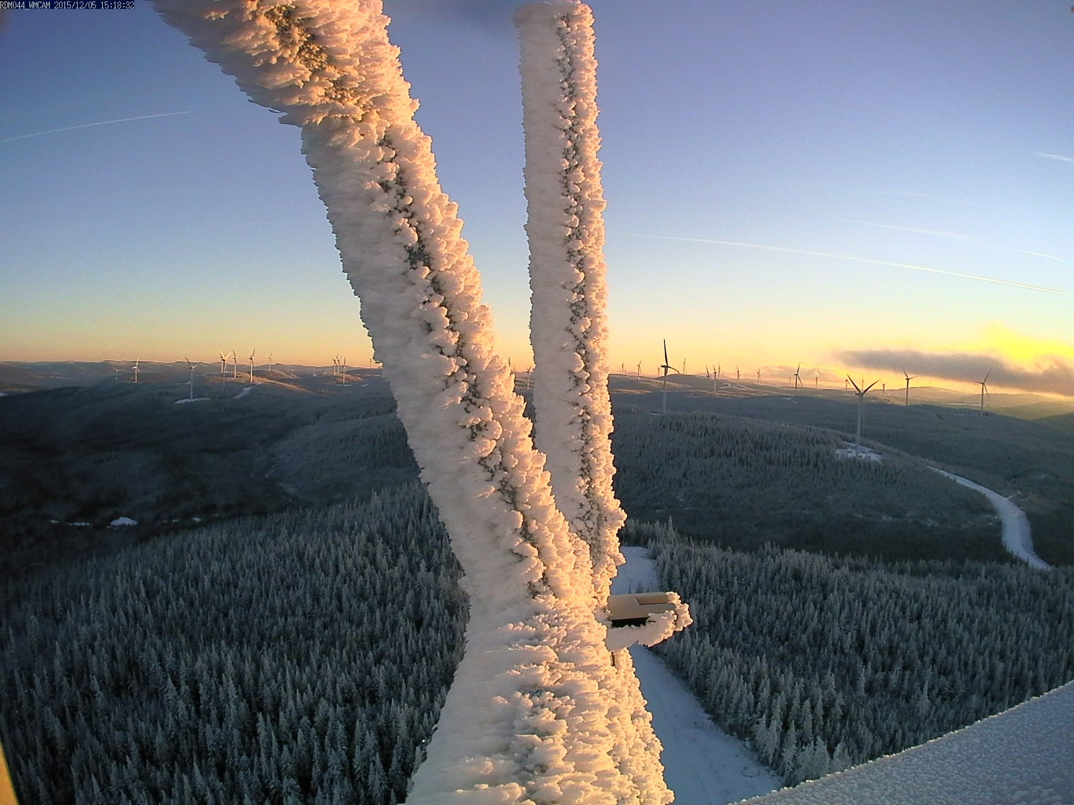
© TechnoCentre éolien, 2016

Slide 3
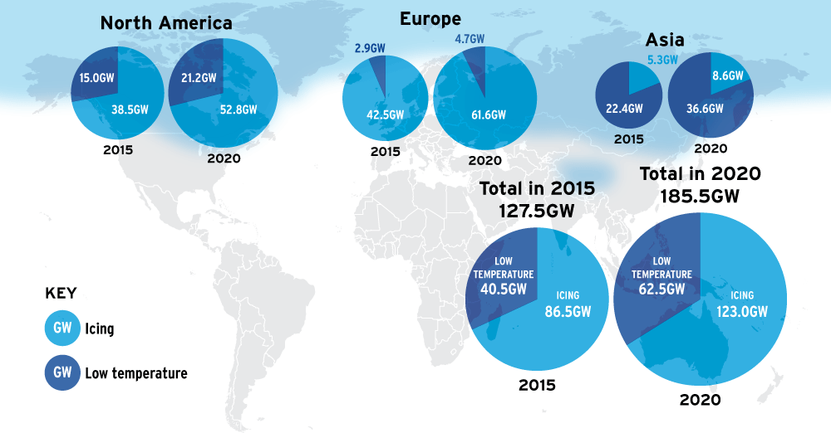
Cold Climate – Global Scale
http://www.windpowermonthly.com/article/1403504/emerging-cold
© TechnoCentre éolien, 2016
3

Slide 4
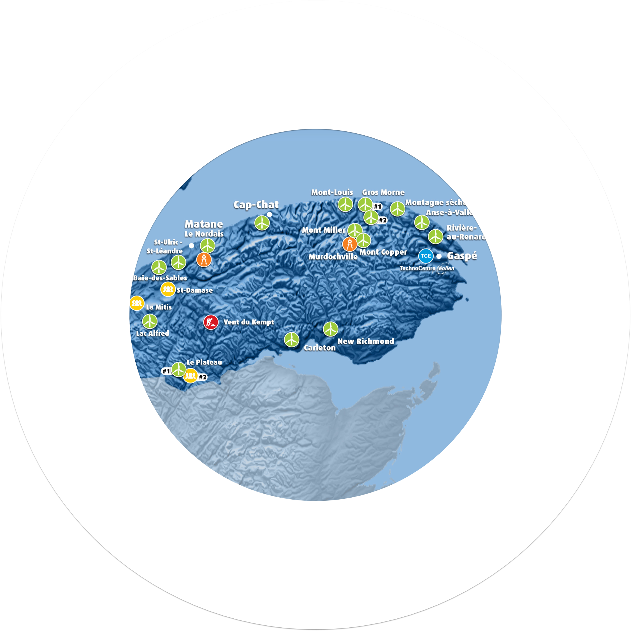
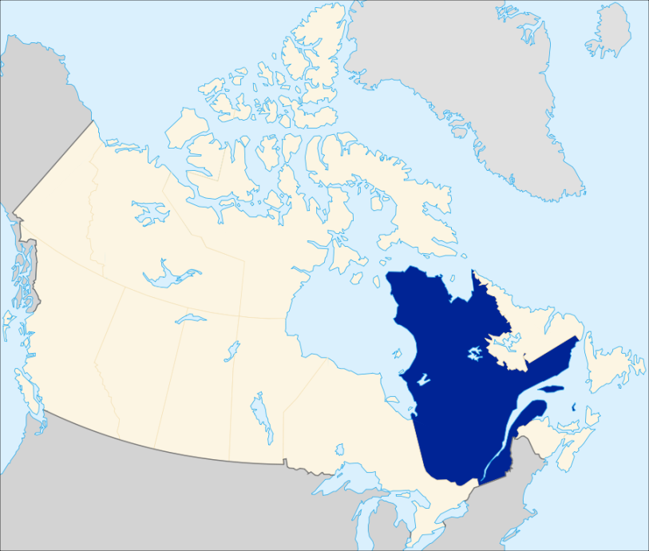
TechnoCentre éolien (TCE)
Wind Farm/Test Site
Office
1 met mast
Over 1500MW in operation (Dec 2013)
© TechnoCentre éolien, 2016
4
Notes:
Non-for-profit research and technology transfer center located on the tip of the gaspé peninsula, in Qc, Canada
Founded in 2000, the TechnoCentre éolien is a research and technology transfer centre that helps companies adapt their technology to withstand the northern climate, develop new products for the wind power industry, and integrate the power supply chain in Québec. The TechnoCentre éolien has four principal areas of endeavour:
technical assistance for businesses
applied research
economic development
communication/events.

Slide 5
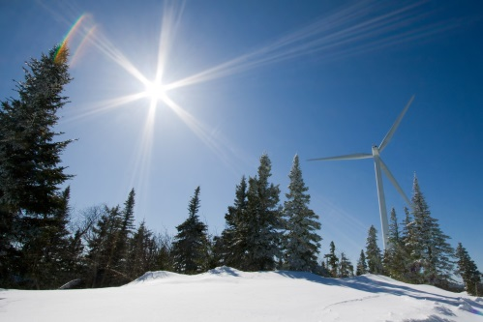
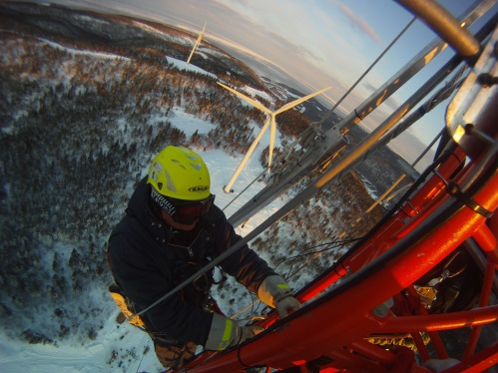
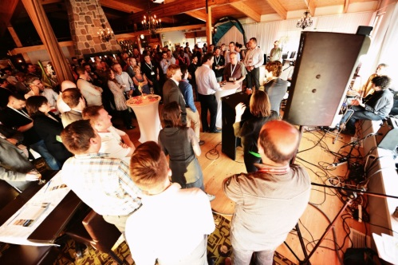
TechnoCentre éolien
Mandate
- Integrate renewable energy to conventional grids
- Optimise wind farm performances
- Support SME growth
Mission
To contribute to the development of a wind industry that is competitive both within North America and internationally.
© TechnoCentre éolien, 2016
5
Notes:
Highly Qualified Personnel
50% with graduate degrees (Masters or PhDs)
25% with undergraduate
25% college
60% in Natural Sciences and Engineering
40% Business Admin Communications

Slide 6
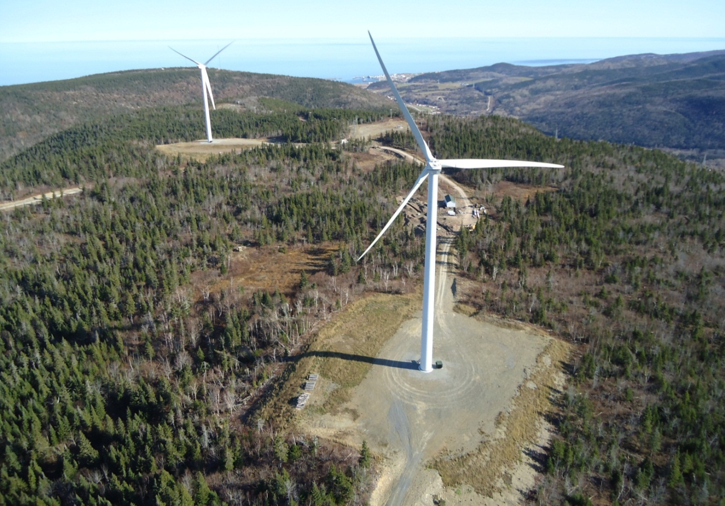
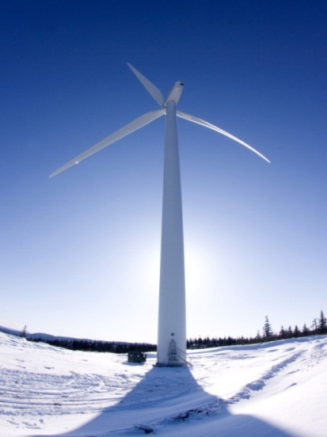
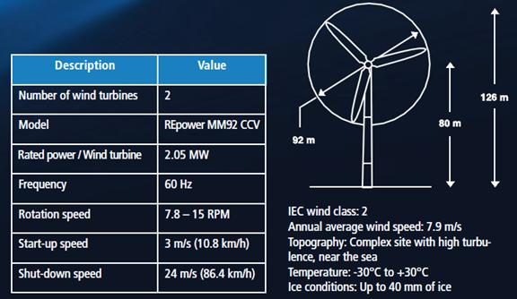
Wind Farm / Test Site
Two 2.05 MW Senvion MM92 CCV
Commissioned March 2010
Icing (IEA Class 2-3)
Complex terrain (IEC Class 2)
R&D, technological transfer, technological validation, performance assessment.
© TechnoCentre éolien, 2016
6
www.eolien.qc.ca
Notes:
Icing Class between 2 to 3 based on IEA classification based on a scale of 5
Between the 2 Senvion turbines we have a recent autonomos Wind/diesel micro grid that include:
2 Eocycle 25kW and 7.5 Bergey turbines
2 50kW diesel genrator
AC and DC bus
Battery bench and compressed air accumulator

Slide 7
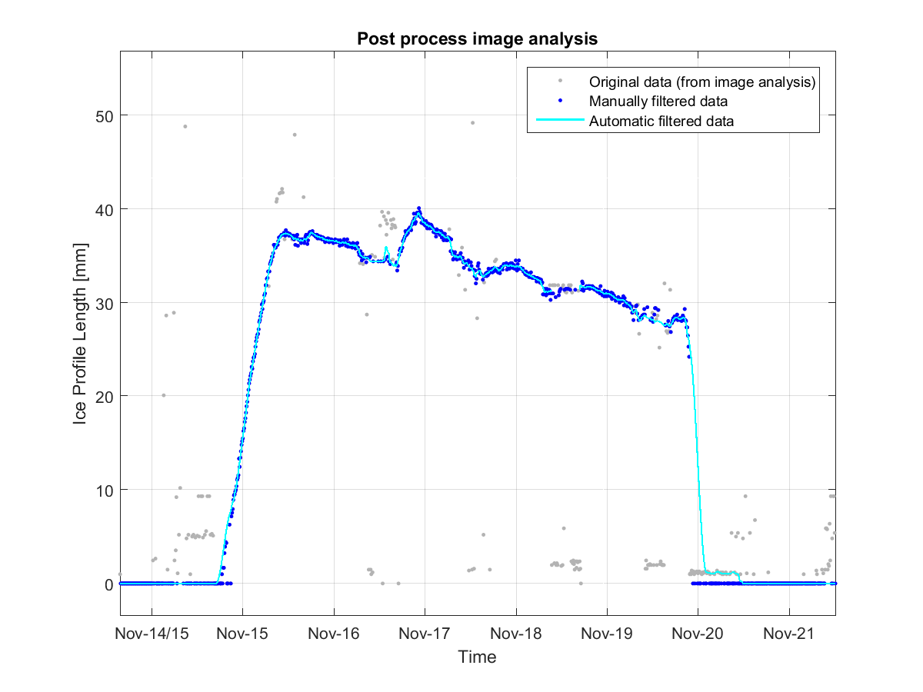
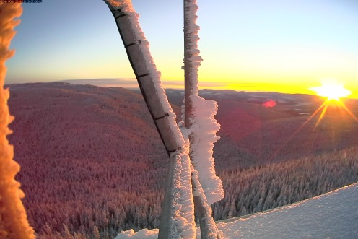
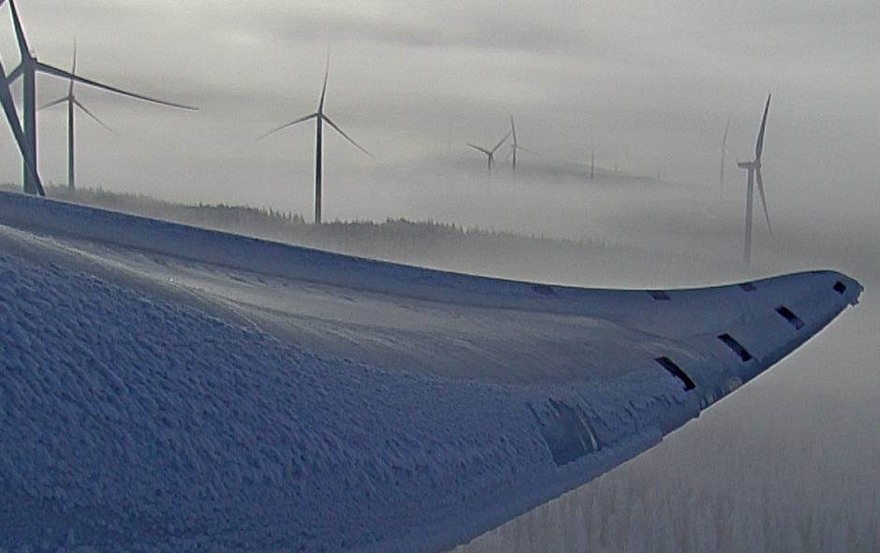
Iced Wind Turbine Control Optimization
© TechnoCentre éolien, 2016
7

Slide 8
Ice Operation Mode Strategy
Ice Detection Ice Detection Ice Detection Ice Detection Ice Detection
Performance
Increase Energy yield
Reduce downtime
Load
Avoid extreme loads
Reduce fatigue loads
© TechnoCentre éolien, 2016
8

Slide 9
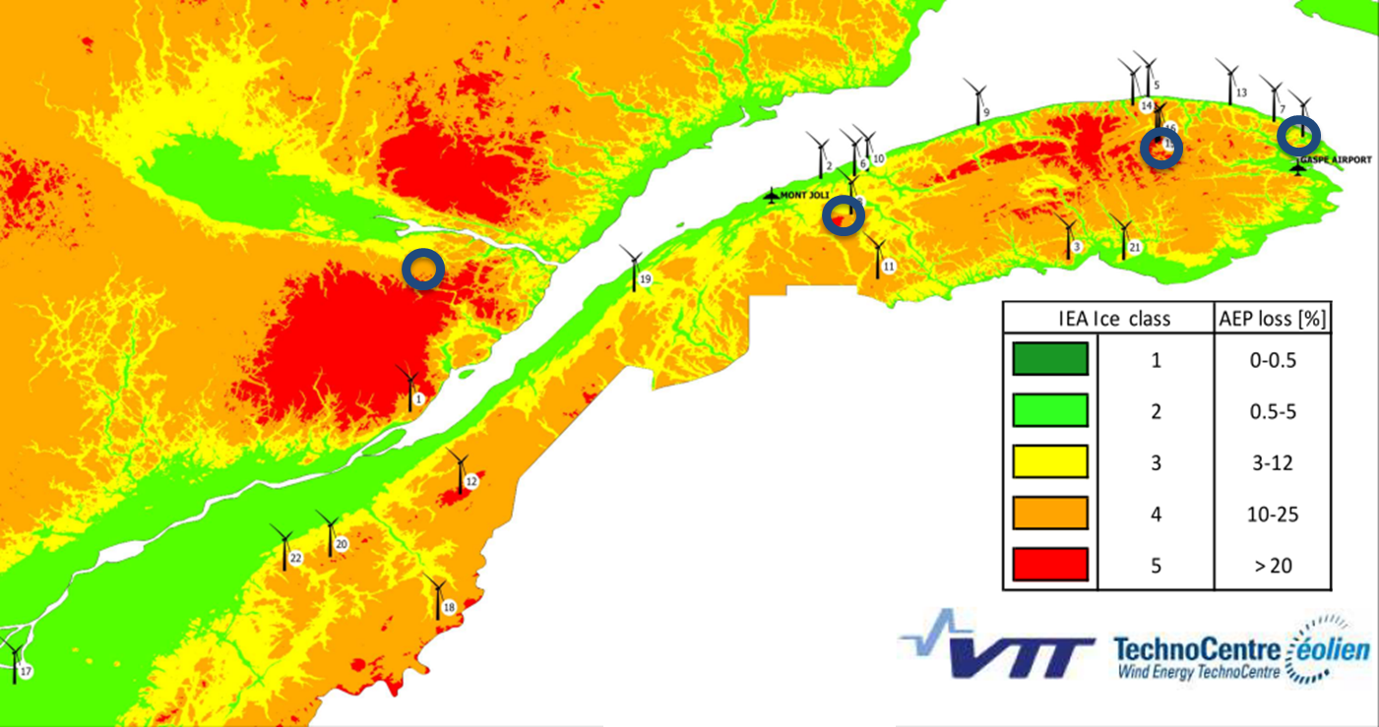
Wind farms in scope of project
© TechnoCentre éolien, 2016
9
Notes:
Hub Cam and nacelle camera
Infrared Hub cam
Meteorological sensors (humidity, solar radiation, precipitation)
Ice blade sensors
Load measurement sensor
Blade
Tower
Shaft

Slide 10
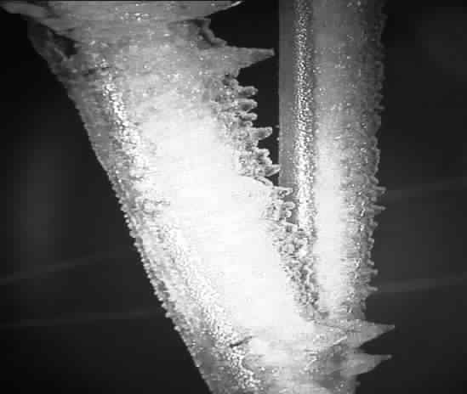
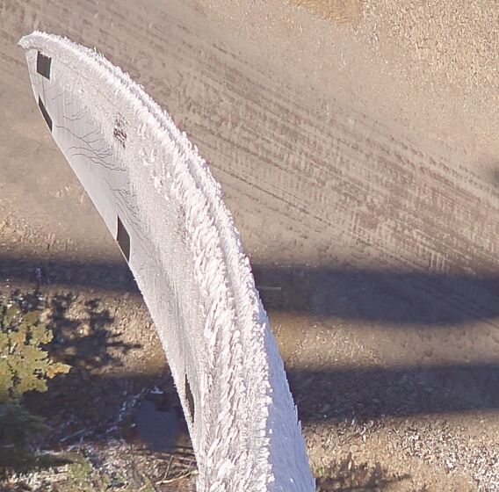
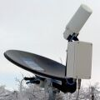
Infrastructure and Sensors
On TCE test site
On the 2 MM92 turbine
On MMV1 weather masts
Camera packages
Blade sensor bench test
Ice detector bench test
Micro Rain Radar
© TechnoCentre éolien, 2016
10

Slide 11
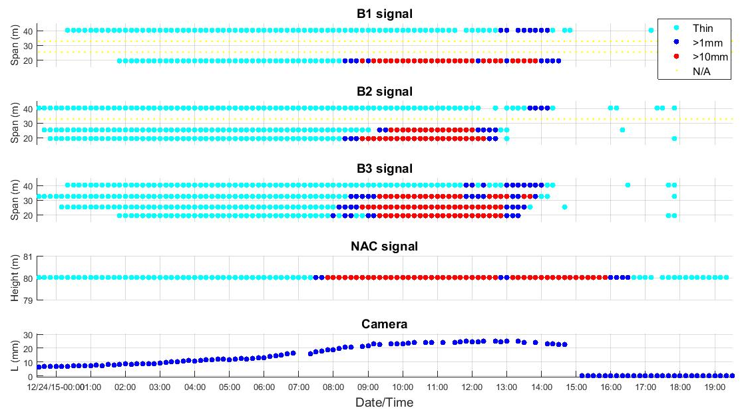
Example of local ice detection on rotor
LE installation
Blade
Nacelle
Ice shed timing:
© TechnoCentre éolien, 2016
11

Slide 12
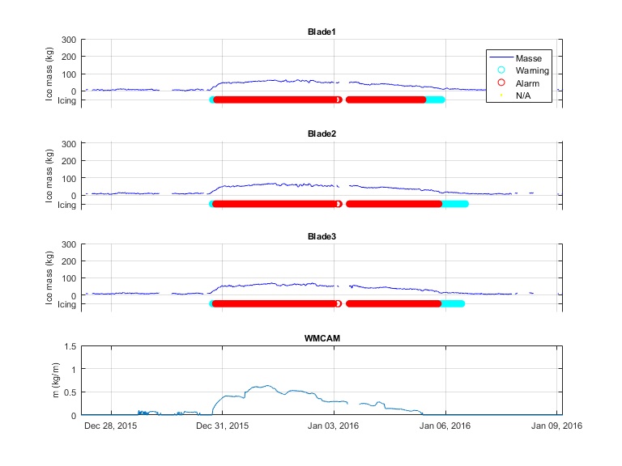
Example of global ice detection on rotor
© TechnoCentre éolien, 2016
12

Slide 13
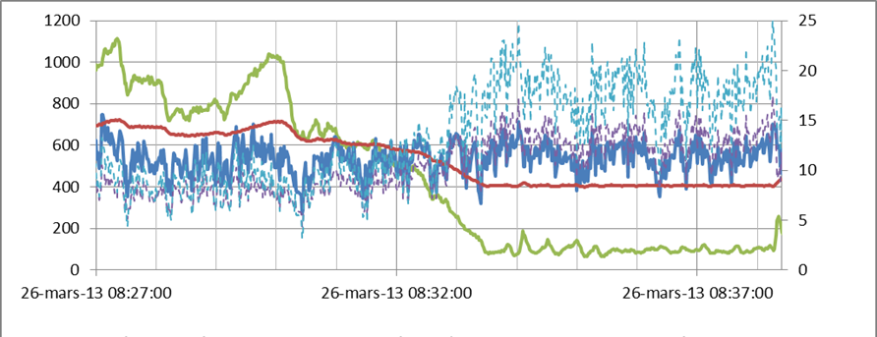
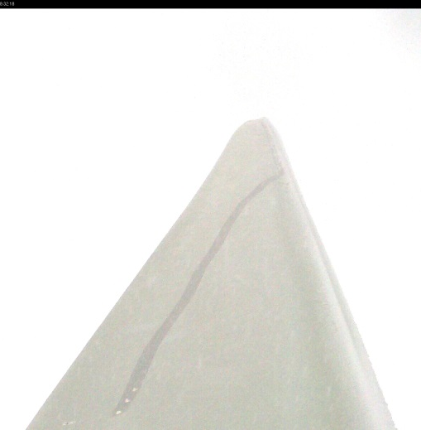
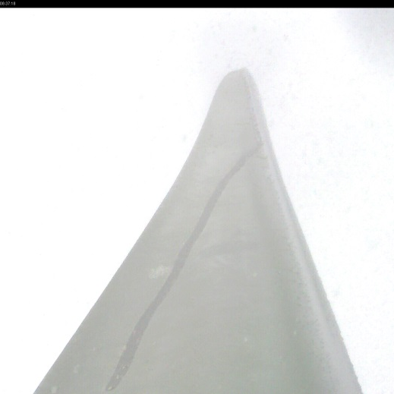
Normal Operation Mode
Without IOM (2013) – mixed accretion
Power
WS (m/s)
Rot RPM
AoA @25m
AoA @40m
8:27 | 8:32 | 8:37
© TechnoCentre éolien, 2016
13

Slide 14
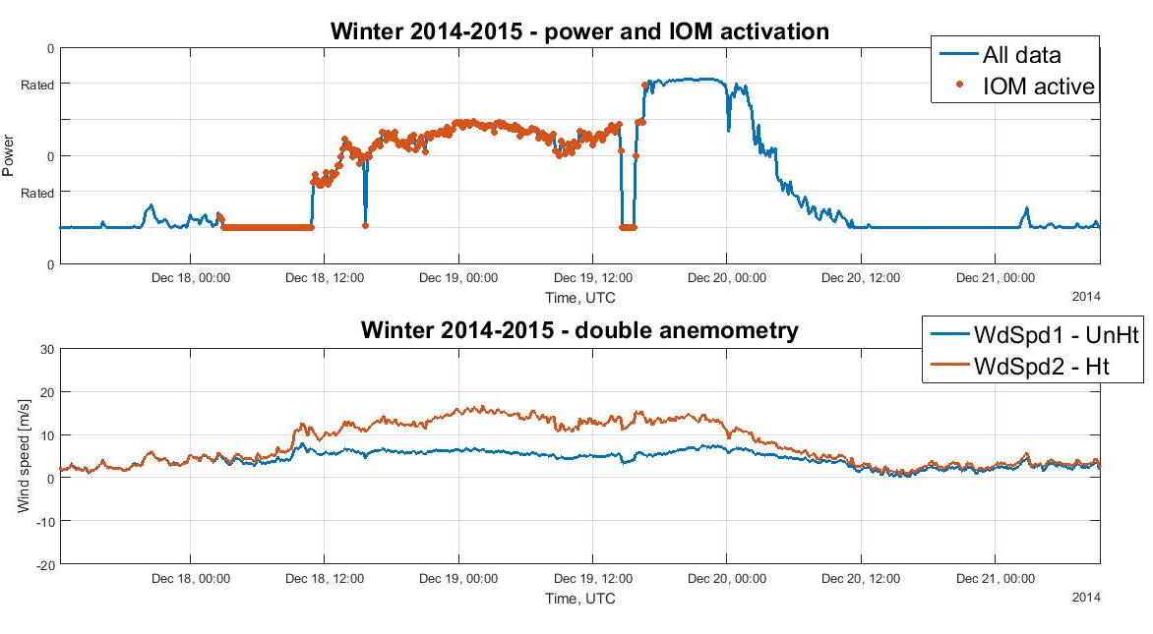
Ice Operation Mode (IOM)
MAX ICR =3.1
Based on MMV1 image analysis
© TechnoCentre éolien, 2016
14

Slide 15
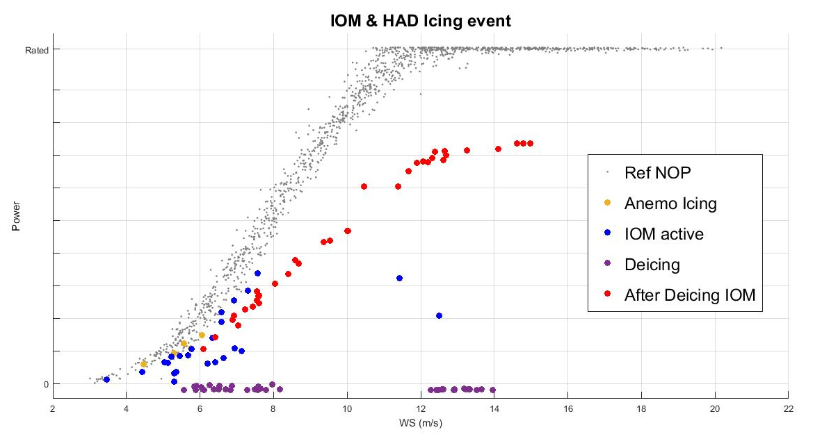
IOM and Hot Air De-Icing (HAD)
With IOM and de-icing
Power curves during the same event
© TechnoCentre éolien, 2016
15

Slide 16
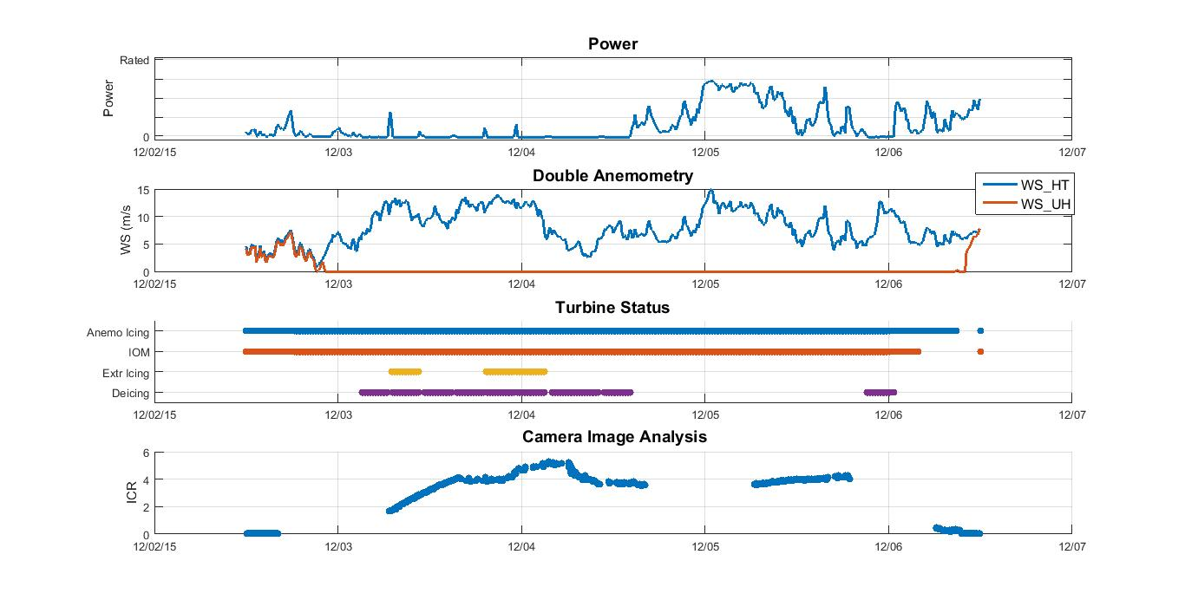
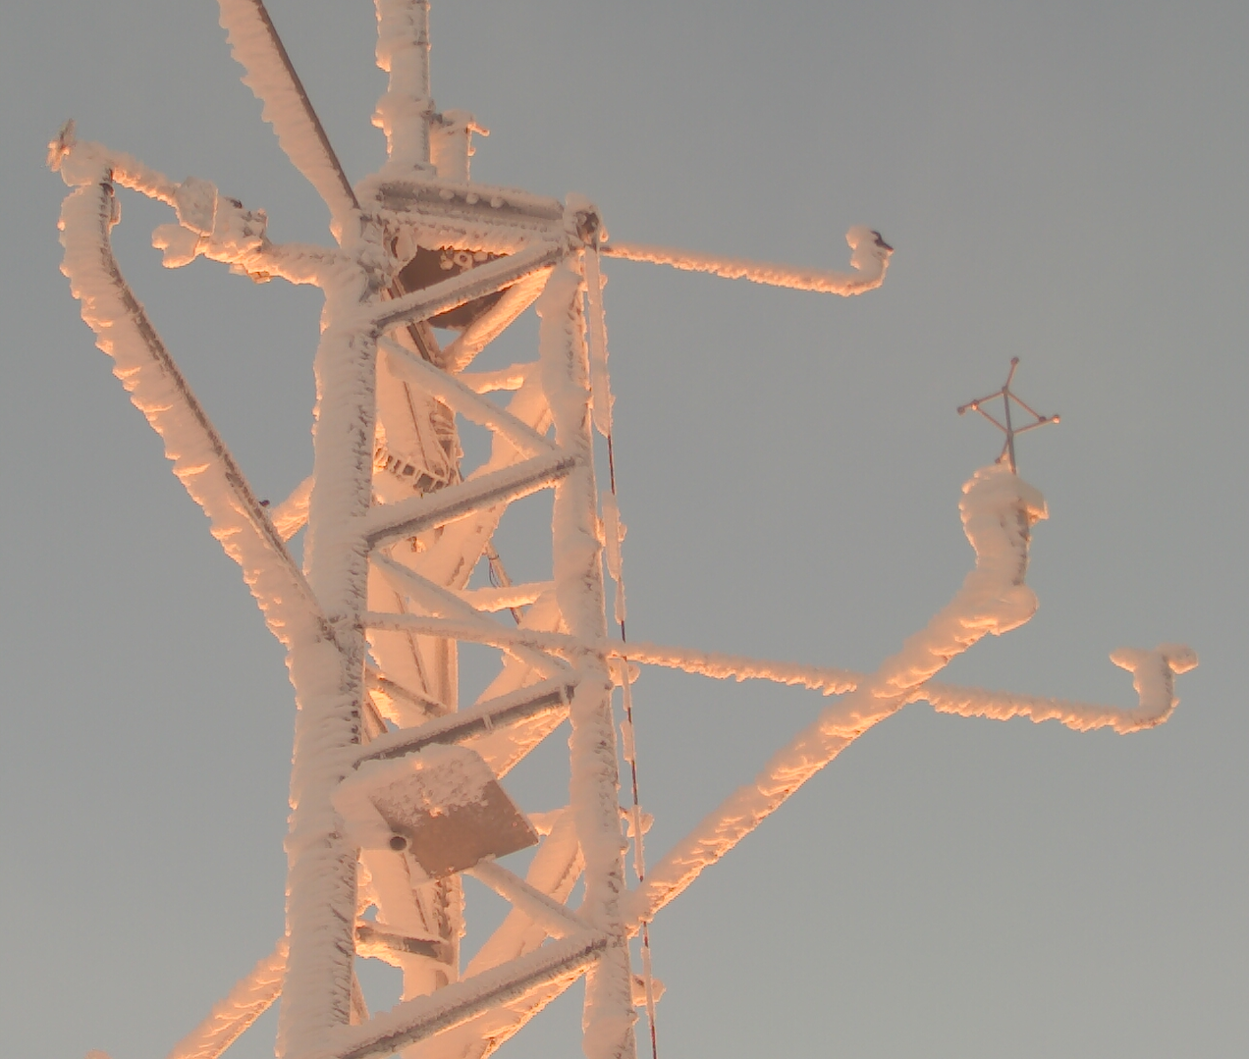
IOM and Hot Air De-Icing (HAD)
Around 24hrs of
active icing ICR~5
Resumption of power
Around 48hrs of stand still saved
© TechnoCentre éolien, 2016
16

Slide 17
Hot Air De-Icing (HAD)
© TechnoCentre éolien, 2016
17

Slide 18
Conclusion
Rotor sensors are an added value for ice detection
IOM alone can prevent stall and reduce down time in light to moderate site
HAD can reduce considerably down time in severe site
© TechnoCentre éolien, 2016
18

Slide 19
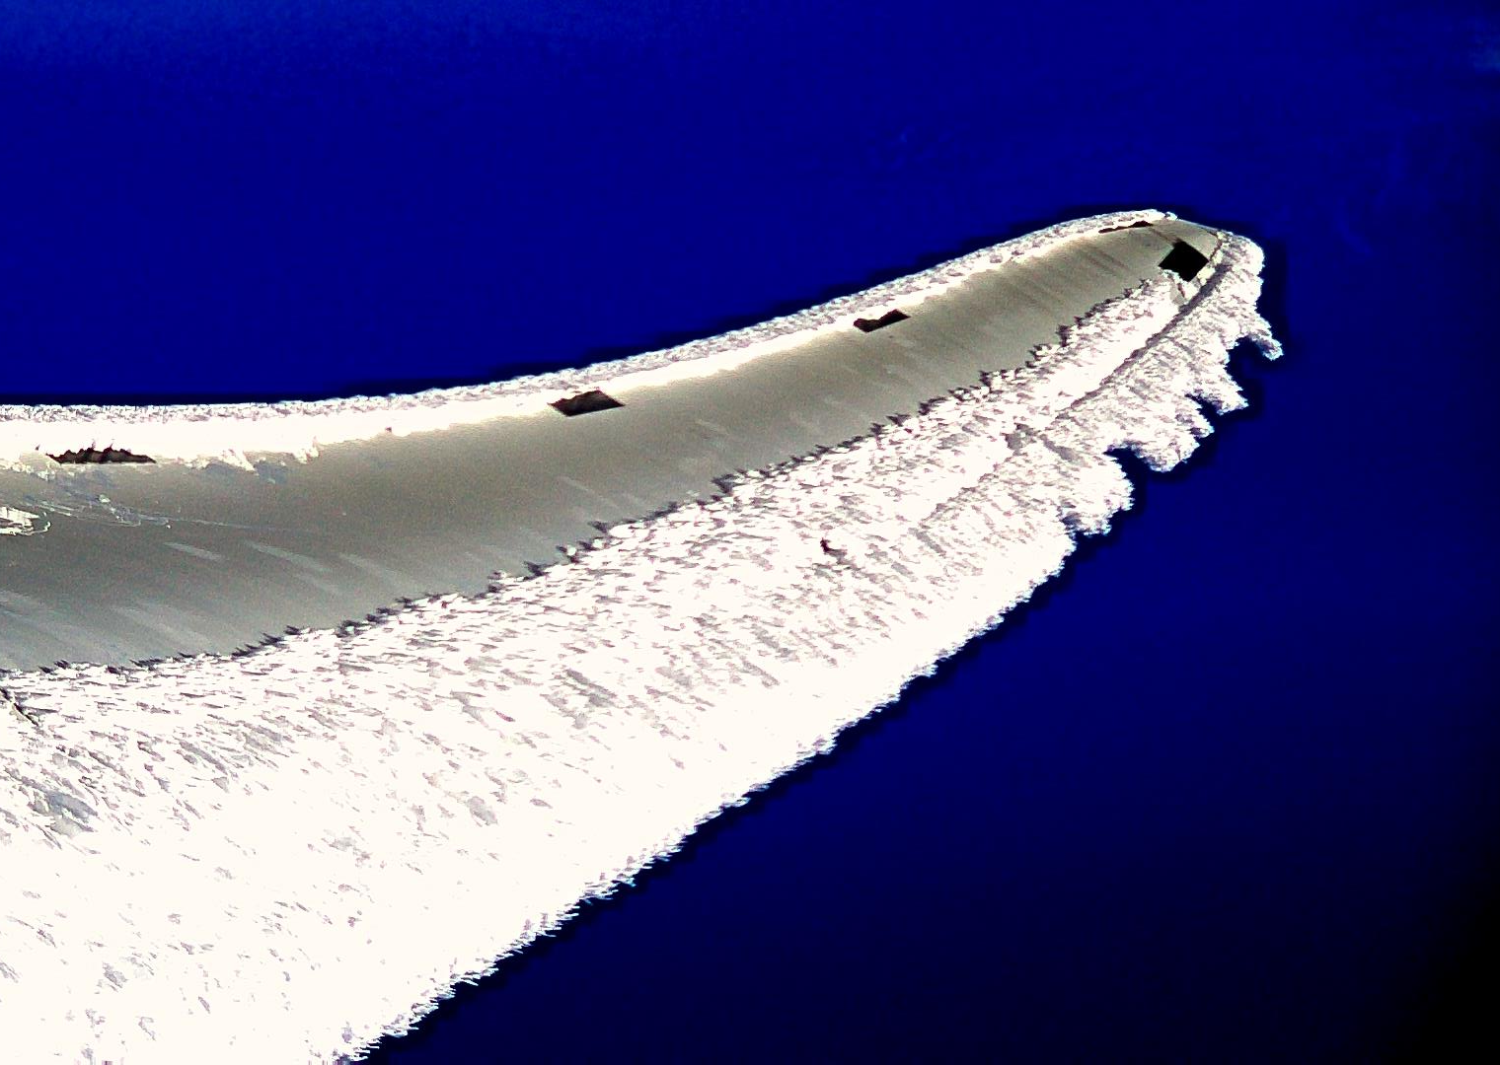
Thank you !
Any questions?
Matthew Wadham-Gagnon, eng. M.Eng.
Project Manager / Business Development
mgagnon@eolien.qc.ca

