Slide 1
Towards Grid Support Services: The contributions of REserviceS
Dr Gustavo Quiñonez-Varela
27th September 2016
Grid Integration Manager (Acciona)

Slide 2
Publicly funded R&I in wind industry
Publicly funded projects enhance R&I efforts and investments from the wind industry
Help bringing novel technologies faster into the market
Also, help setting required adaptation of markets (key to Grid Support Services, GSS)
Facilitate liaison between research and industry peers
Multidisciplinary teams, specific expertise
Traditionally, had played an important role particularly in:
Basic research and knowledge creation
Development of technology and tools
Demonstration of concepts
Setting key references and recommendations

Slide 3
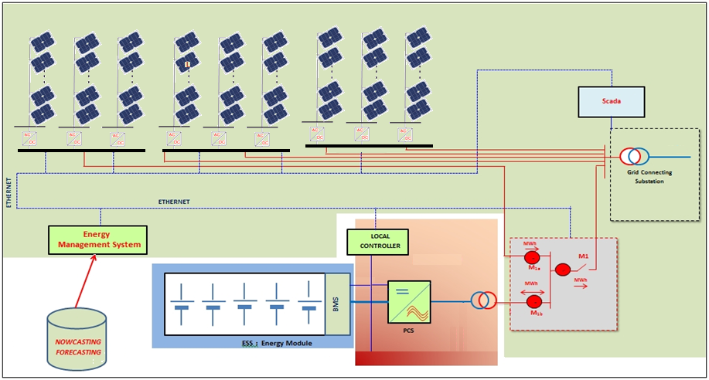
Publicly funded R&I in industry
Example: completed R&I (inputs to REserviceS)
Acciona Energia

Slide 4
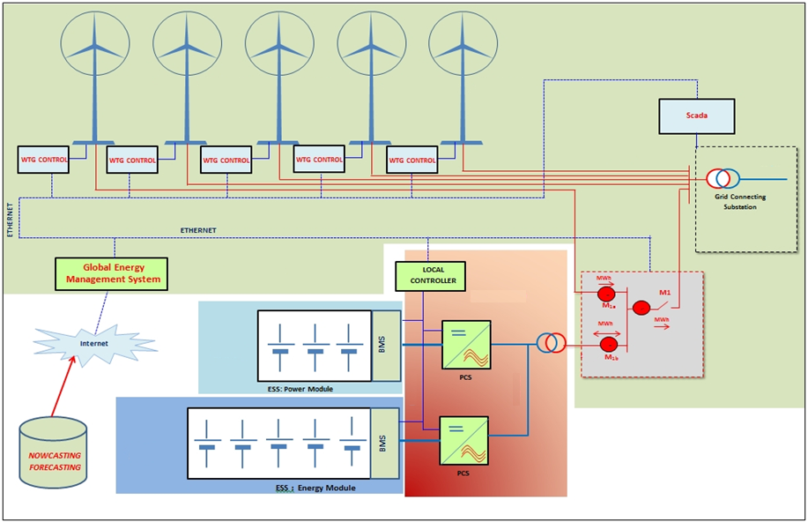
Publicly funded R&I in industry
Example: ongoing R&I
Acciona Energia

Slide 5
R&I in the wind industry
Quoting a dossier from the Spanish government (21/07/16):
National and EU publicly funded projects (FP7, IEE,…) had traditionally play an important role in the development of next generation technologies

Slide 6
Why industry partners joined REserviceS?
Dealt with R&I issues within the strategic research agenda of the wind/renewable industry
High penetration of renewables
Electricity markets design (Grid Support Services)
Timely topic:
New European Network Codes under implementation
From requirements to system services
Technology readiness, additional costs (CAPEX/OPEX), cost allocations,…..
Well balanced Consortium
research institutes, consultancy companies, wind OEMs and power plant operators, DSO’s and industry associations.

Slide 7
REserviceS project
Established a reference basis and policy recommendations for future grid support services from variable renewables.

Slide 8
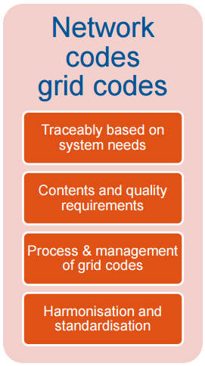
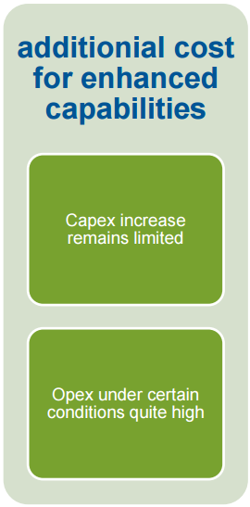
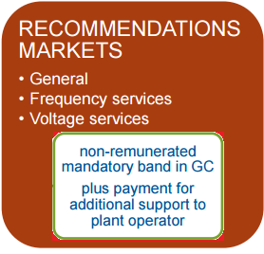
Benifits of REserviceS in the wind industry
Findings and recommendations helping the ongoing national implementation of EU Network Codes

Slide 9
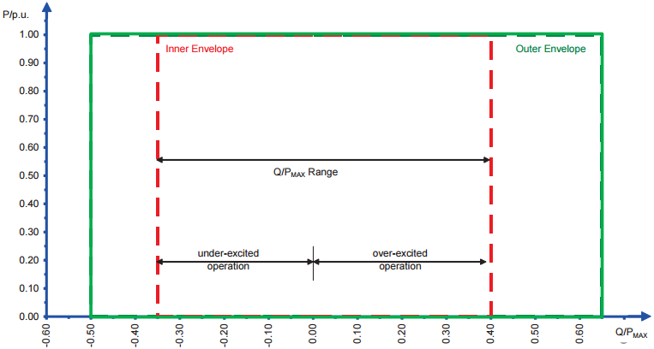
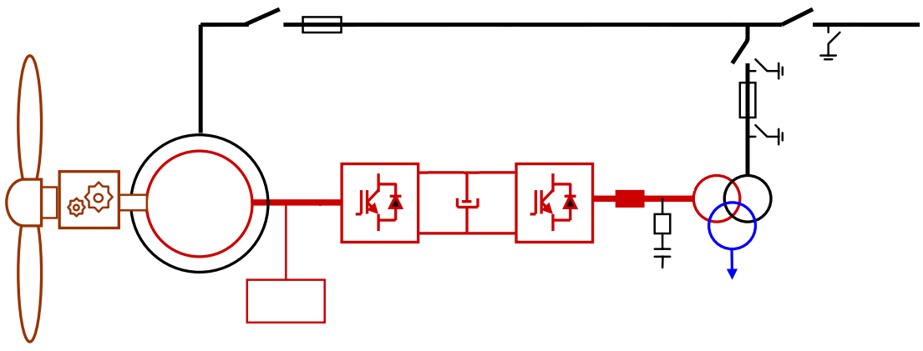
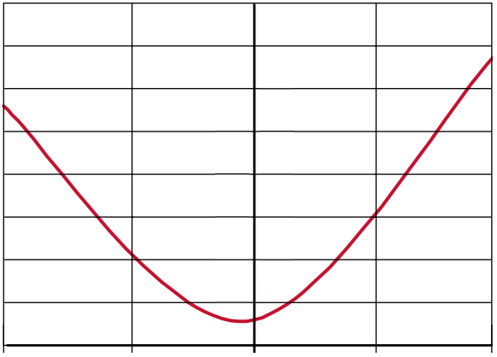
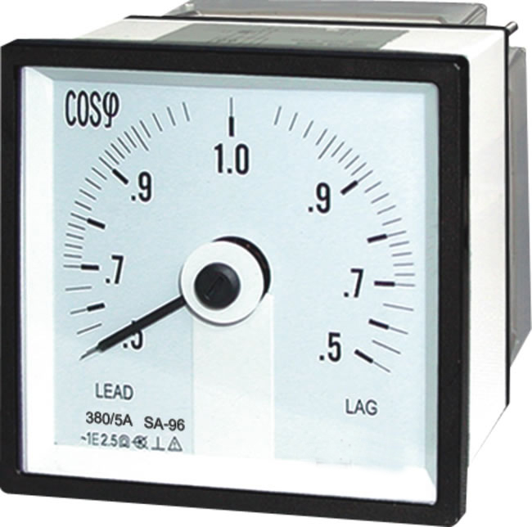
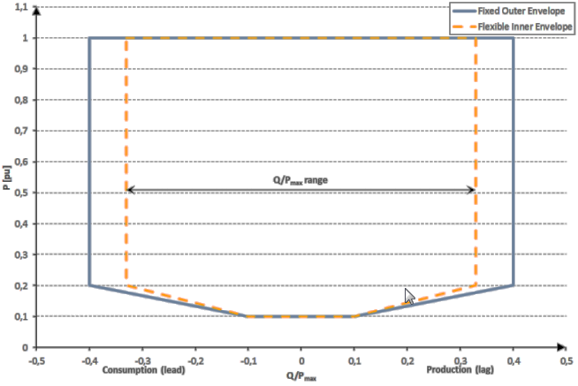
A practical example: Q at P=0
Network Code requirement
Statcom-like
Q (kVAr)
GSU
Q (MVAr)
MPT
P_{loss WF} + Aux_{WF} (kW)
P= 0 MW
P_{loss CONV} + Aux_{CONV}
(kW)
Max P_{loss CONV}
Converter losses
Proposal from TF Grid Codes
Min P_{loss CONV}
1.0
0.5
0.0
0.5
1.0
Current (pu)
Voltage control at P=0 a GSS, Why?
Additional costs?
Changes in existing regulatory framework?

Slide 10
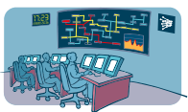
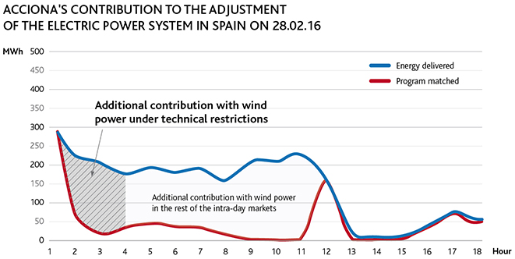
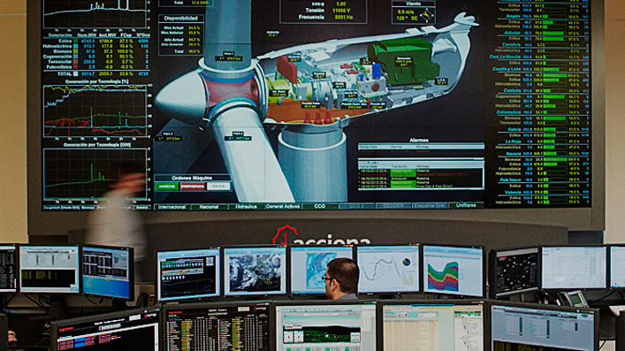
GSS from wind power are a reality….
Spain: new legislation laid down the criteria for participation in GSS and now is legally possible since 10/02/2016

Slide 11
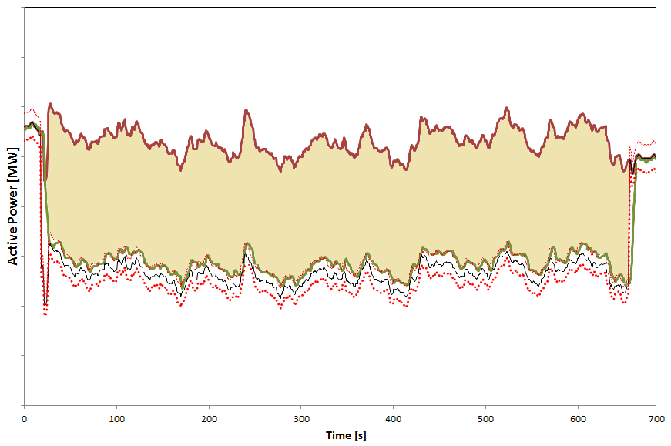
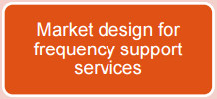
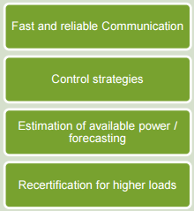
Towards future GSS…..
Provision of services of frequency containment and restoration reserves
P_{available}
Active power reserve = generation loss
P_{output}

Slide 12
Final remarks
Publicly funded projects significantly contribute to R&I of the wind industry
REserviceS is an example of a successful project
Focus on topics align with industry R&I agendas must be maintained
Role of Technology Platforms (ETIPWind)
Shorter time from proposals to start of funded project
Minimise administration, expedite Contract, Consortium Agreement and IPR discussions,….
Keep in mind external competition

Slide 13
Thanks for your attention
http://www.acciona-energia.com/

