Slide 1
Cross-Borders Renewables Auction WindEurope Summit 2017 Fabian Joas on behalf of German Federal Ministry of Economic Affairs and Energy

Slide 2
Key Goals and Guiding Principles
EU compatibility of national support schemes but limited amounts (in Germany 5 % ~ 250 MW)
Regional integration and joint learning
Using regional synergies (e.g. diversification of RES) and more competition
Pilot opening should be a testing ground
Avoid complex administrative structures
Concept should be scalable
2
Notes:
When we go foreward with the opening the KOM would have it so easy us off against each other

Slide 3
Basic Requirements
Cooperation agreement
Reciprocity
„Physical“ Import
3

Slide 4
Models for Reciprocity
6

Slide 5
Level Playing Field
Efficient competition in auction
Bidders must know conditions beforehand
Avoid distortions through local conditions (e.g. taxes)
5
Notes:
Examples:
- cross boarder payments
- Place of jurisdiction

Slide 6
Prequalification for Wind-Auction
In Germany authorization under the Federal Immission Control Act (BImSchG) required
What is equivalent in other countries?
Aim of a level playing field and efficient competition
6

Slide 7
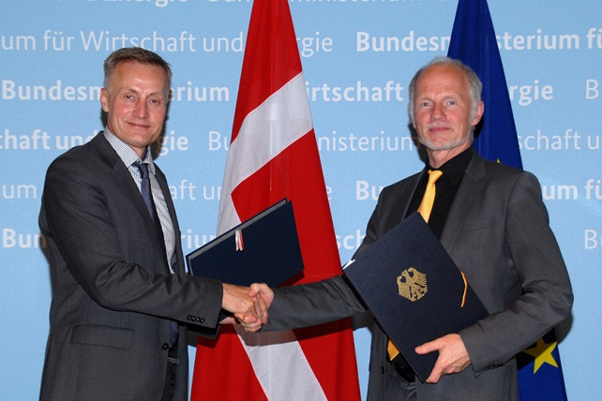
First Cooperation Pilot DNK & GER
Signed in July 20, 2016 for a “Mutual Auction”
German auction round: 50 MW PV
Danish auction round: 20 MW PV (partially opened: 2.4 MW of bids from Germany)
Auction Design: Denmark and Germany determine the auction design individually
Statistical Allocation („you get what you pay“)
7

Slide 8
Contact Information:
Fabian Joas (until end of September) Anne-Maria Ide (BMWi):
fabian.joas@giz.de anne-maria.ide@bmwi.bund.de
From October on:
fabian.joas@agora-energiewende.de

Slide 9
BACKUP SLIDES

Slide 10
Opend Pilot Auction DNK & GER
Mutually-opened auction:
German auction round: 50 MW
Danish auction round: 20 MW (partially opened: 2.4 MW of bids from Germany)
Auction Design: Denmark and Germany determine the auction design individually.
Location Specific Conditions: The regulations of the country where the installation is located apply
Statistical Allocation towards
National Renewable Target (EU 2009/28/EC): Installations financed by Germany („you get what you pay for“)
German installation corridor (Ausbaukorridor): Installations built in Germany
10
Notes:
Auction Design:
Each country carries out its own auction and opens for bid from the partner country
Each country is free to design the auction itself -> Auction design
Local investment conditions (e.g. taxes and levies) are not aligned
Location Specific Conditions:
Very strict rules in Germany where PV-plants can be build
Less strict rules in Denmark
Different rules in different countries should be accepted
Each country decides for itself

Slide 11
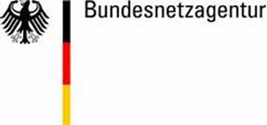
Example: Process to Solve Data Exchange
11

Slide 12
Mutual Opening – Basic Concept
Two countries mutually open their national auctions for bids from the partner country
Relatively easy to implement
Auction Design can be quite similar to national auction
e.g. country A (Germany) opens a 50 MW auction for country B; country B (Denmark) opens 10 MW for country A
12
Notes:
Examples:
- cross boarder payments
- Place of jurisdiction

Slide 13
Joint Auction– Basic Concept
Instead of two separate auction countries agree on one joint auction
Joint auction procedure, joint bidding
Each country supports 50 MW with its own national support system
Allows for joint auction without the need for a new joint financing mechanism by piecing together support schemes
e.g. country A and country B both plan to auction 50 MW PV; they agree on a joint auction of 100 MW
13

Slide 14
Background
Implementing Cooperation Mechanism of the current Directive 2009/28 EG
State aid guidelines call for more intensified use of Cooperation mechanism
Regional cooperation will be key element of the new EU Energy framework
14

Slide 15
“Physical” Import
“real” impact on home market is key for public acceptance
No interference with real electricity flows or market trades
Lump sum approach (availability) based on NTC and De-rating
But stable political figure needed
Lessons learned: individual assessment very difficult, unbalanced, unstable
15

Slide 16
Mutual Opening vs. Joint Auction
 | Mutual Opening | Joint auction
Auction Design (e.g. pricing rule, premium) | Auction design is set by the country who applies the tender Different auction design possible | Joint auction design required
Local Conditions (site restriction; grid connection; congestion) | Rules and conditions of the country apply in which the installation is to be implemented
29

Slide 17
Market Premium
Fixed market premium
Sliding market premium
based on the market prices of the host country
Sliding market premium
based on average market prices of cooperation countries
17

Slide 18
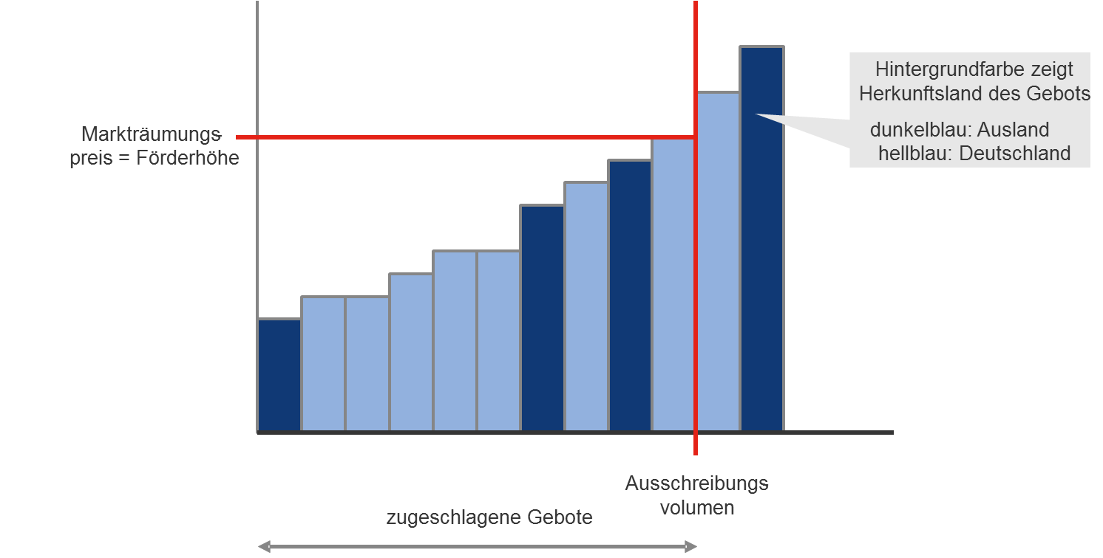
How to “Piece” Support Schemes Together?
Each installation is assigned the support scheme of either one country or the other
Assigning will be done after bids are awarded at random by using a pre-determined key
Colour shows to which country the installation is assigned to (irrespective of their location)
Clearing price = support volume
* Dark blue:partner country
Light blue: Germany
Awarded bids
Auction volume
18

