Slide 1
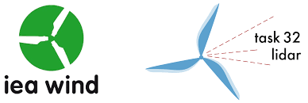
Floating Lidar Systems:
Current Technology Status and
Requirements for Improved Maturity
J. Gottschall (Fraunhofer IWES)
B. Gribben (Frazer Nash Consultancy)
J. Hughes (ORE Catapult)
D. Stein (DNV GL)
I. Würth, O. Bischoff, D. Schlipf (University of Stuttgart)
H. Verhoef (ECN)
A. Clifton (NREL)
Wind Europe Summit 2016, Hamburg – 27 September 2016

Slide 2
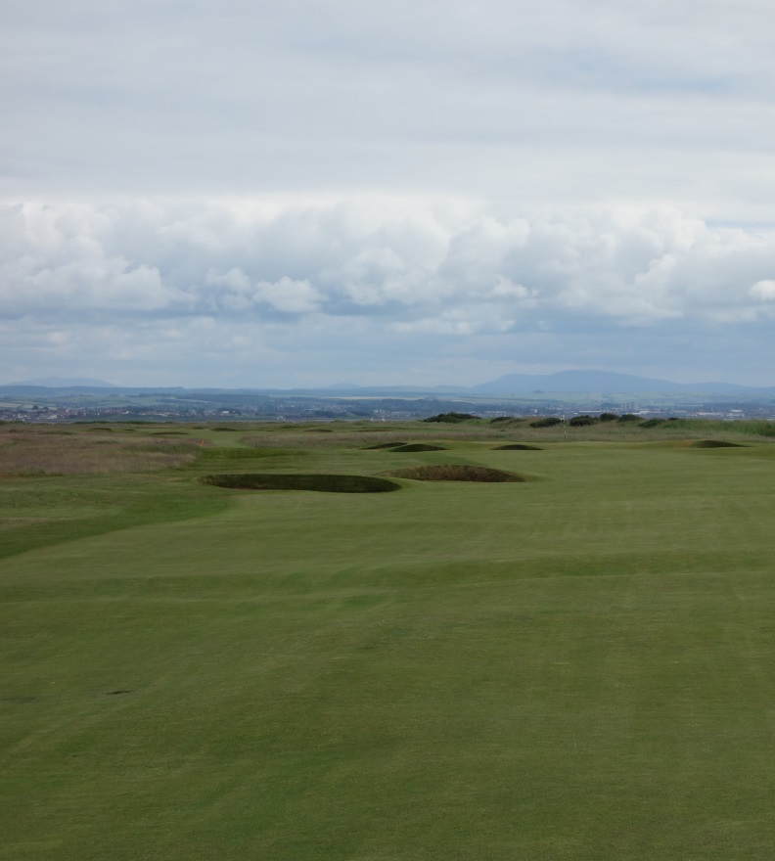
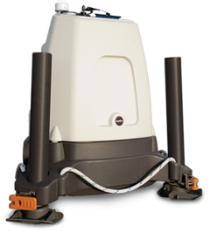
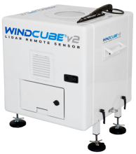
Introduction I
Wind lidar technology… onshore – accepted as (almost) standard tool
… for wind resource assessments
… power curve tests (in flat terrain)
→ cost-efficient, high data quality

Slide 3
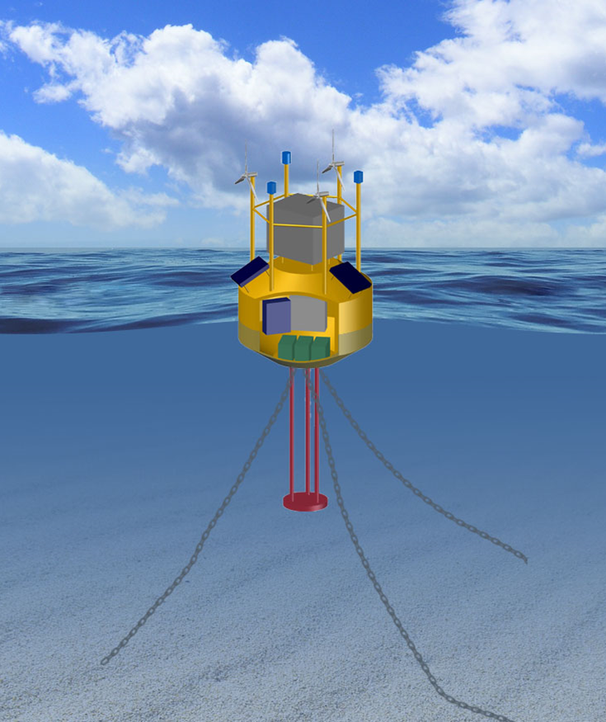
Introduction II
Wind lidar technology…
offshore – even larger cost benefits (!) –
with lidar devices integrated in / on top of
floating platforms or buoys, resp.
(→ floating lidar systems)
Notes:
(1) mention the relative cost could be ~1M Euros for a FLS, more like ~50M for an offshore met mast

Slide 4
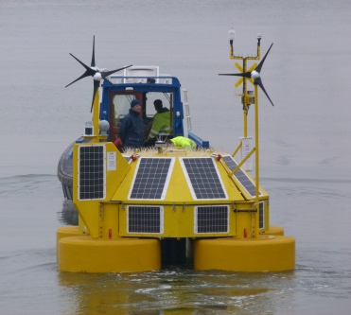
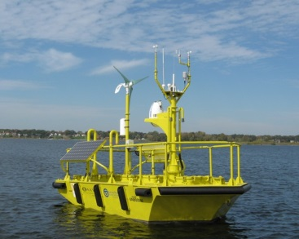
Introduction III
Variety of realisations / designs available today (→ picture
gallery and others)
Recommended configuration, mandatory and optional features?
Requirements of wind industry on systems?
Maturity of technology, and present technology gaps?
IEA Wind Task 32 activity – incl.
▪ collection of RP for the use of Floating Lidar Devices
(with uncertainty assessment approach)
▪ technology review
▪ stakeholder workshop with pre-survey on maturity assessment,
identification of most relevant technology gaps

Slide 5
Introduction III
Variety of realisations / designs available today (→ picture
gallery and others)
Recommended configuration, mandatory and optional features?
Requirements of wind industry on systems?
Maturity of technology, and present technology gaps?
IEA Wind Task 32 activity – incl.
▪ collection of RP for the use of Floating Lidar Devices
(with uncertainty assessment approach)
▪ technology review
▪ stakeholder workshop with pre-survey on maturity assessment,
identification of most relevant technology gaps
For details and outcome… our full presentation!
http://www.ieawindtask32.org/

Slide 6
Floating Lidar Systems:
Current Technology Status and
Requirements for Improved Maturity
J. Gottschall (Fraunhofer IWES)
B. Gribben (Frazer Nash Consultancy)
J. Hughes (ORE Catapult)
D. Stein (DNV GL)
I. Würth, O. Bischoff, D. Schlipf (University of Stuttgart)
H. Verhoef (ECN)
A. Clifton (NREL)
Wind Europe Summit 2016, Hamburg – 27 September 2016

Slide 7
Outline
Current status of floating-lidar technology
Criteria for commercial acceptance
Necessity for offshore trials
Stakeholder assessment
Identification of requirements for improved maturity
Recommended Practices (RP) for application of technology
… in wind resource assessment
Status update and outlook

Slide 8
Current status of floating-lidar technology – OWA Roadmap
Carbon Trust Offshore Wind Accelerator roadmap for the commercial acceptance of floating lidar technology (Nov. 2013) –
proposed three stages of maturity:
baseline – pre-commercial – commercial
status linked to a successful (6-months) trial offshore:
meet KPIs for system availability and data accuracy

Slide 9
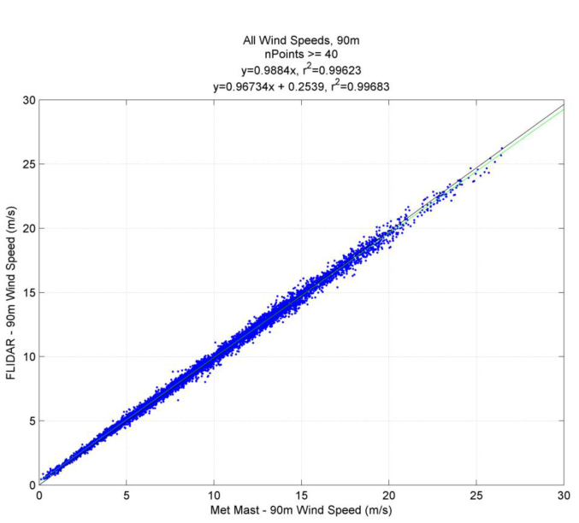
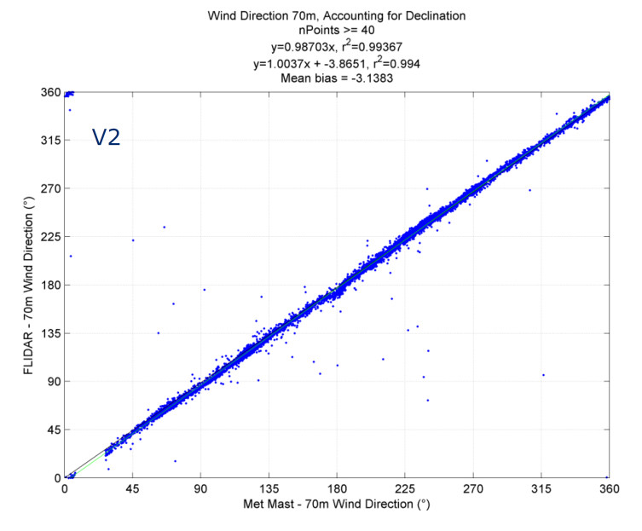
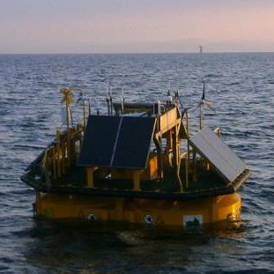
Current status of floating-lidar technology
Carbon Trust Offshore Wind Accelerator roadmap for the commercial acceptance of floating lidar technology (Nov. 2013) …
FLiDAR – as first (almost) pre-commercial floating-lidar system (FLS);
Results of 3-months trial at Gwynt y Mor [presented at EWEA Offshore 2013] show convincing agreement with met mast in wind speed and direction

Slide 10
Current status of floating-lidar technology
Carbon Trust Offshore Wind Accelerator roadmap for the commercial acceptance of floating lidar technology (Nov. 2013) …
Today about six FLS with status ‘pre-commercial‘ from different providers, a few more in the pipeline;
status ‘commercial‘ gains in importance but not yet fully defined.

Slide 11
Current technology status – Assessment of stakeholder acceptance (pre-workshop survey)
IEA Wind Task 32 Workshop on Floating Lidar System
(23-24 Feb. 2016 at ORE Catapult, Blyth)
pre-workshop survey answered by 18 participants (incl. OEMs, Consultants, Project developers, Academics)

Slide 12
Current technology status – Assessment of stakeholder acceptance (pre-workshop survey)
IEA Wind Task 32 Workshop on Floating Lidar System
pre-workshop survey answered by 18 participants (incl. OEMs, Consultants, Project developers, Academics)
How would you rate the present level of maturity (in TRL 1-9) of floating-lidar technology in general?
Answer: between TRL 4 and 9 – average 6.9

Slide 13
Current technology status – Assessment of stakeholder acceptance (pre-workshop survey)
IEA Wind Task 32 Workshop on Floating Lidar System
pre-workshop survey answered by 18 participants (incl. OEMs, Consultants, Project developers, Academics)
How would you rate the present level of maturity (in TRL 1-9) of floating-lidar technology in general?
Answer: between TRL 4 and 9 – average 6.9
How do you judge the current acceptance (0 = not at all, 10 = fully) of FLS data to be used quantitatively for finance-relevant wind resource assessments?
Answer: between 2 and 8 – average 5.8

Slide 14
Current technology status – Assessment of stakeholder acceptance (pre-workshop survey)
IEA Wind Task 32 Workshop on Floating Lidar System
pre-workshop survey answered by 18 participants (incl. OEMs, Consultants, Project developers, Academics)
How would you rate the present level of maturity (in TRL 1-9) of floating-lidar technology in general?
Answer: between TRL 4 and 9 – average 6.9
How do you judge the current acceptance (0 = not at all, 10 = fully) of FLS data to be used quantitatively for finance-relevant wind resource assessments?
Answer: between 2 and 8 – average 5.8
How long will it take for the technology to reach full commercial acceptance?
Answer: 4 out of 18 ‘already reached‘, others between 2 and 10 years

Slide 15
Current technology status – Assessment of stakeholder acceptance (pre-workshop survey)
IEA Wind Task 32 Workshop on Floating Lidar System
pre-workshop survey answered by 18 participants (incl. OEMs, Consultants, Project developers, Academics)
… also asked for ‘most relevant technology gaps’
(gap is defined as an issue that needs to be resolved in order to increase the technology’s maturity)

Slide 16
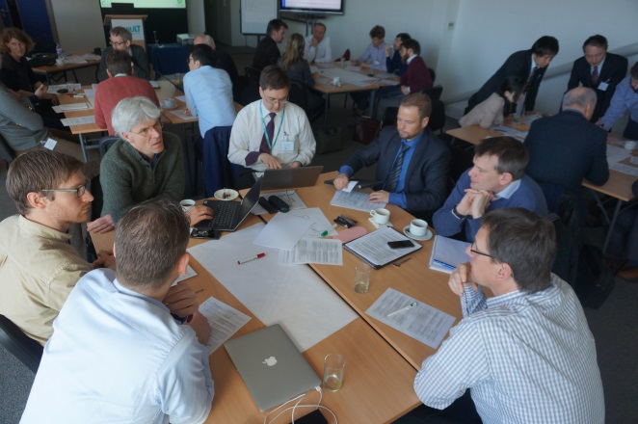
Current technology status – Identification of technology gaps (workshop)
IEA Wind Task 32 Workshop on Floating Lidar System
Outcome of workshop:
(gaps ↔ requirements)
Gap 1: well defined uncertainty framework for FLS wind speed measurements
Gap 2: increase of investors‘ confidence (with appropriate further stakeholder activities)
Gap 3: re-defined validation framework (scope, reference, possibly adjusted to use case)
Gap 4: alternative approaches for validation (?)
Gap 5: Turbulence Intensity (TI) measurements from FLS (transfer of existing knowledge from Lidar TI data, and further work)

Slide 17
Requirement for improved maturity – Example ‘uncertainty framework‘
‘Roadmaps‘ for gaps/requirements as result from group work
e.g. for Gap 1 – ‘uncertainty framework‘:
IEA Wind Task 32 Workshop on Floating Lidar System
Gather experience
share models and data
New IEA Wind Task 32 RP doc.
improve understanding
Sanitize methods
improve methods
merge with Annex L (IEC 61400-12-1)
Q1 2017:
Step-by-step framework

Slide 18
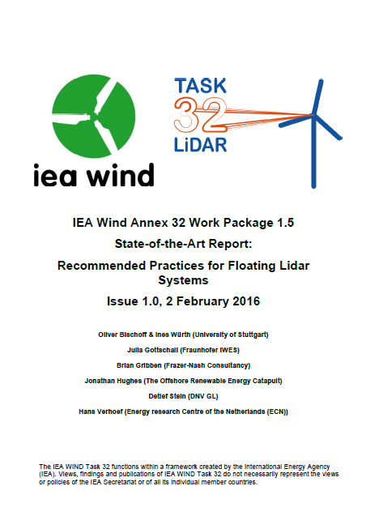
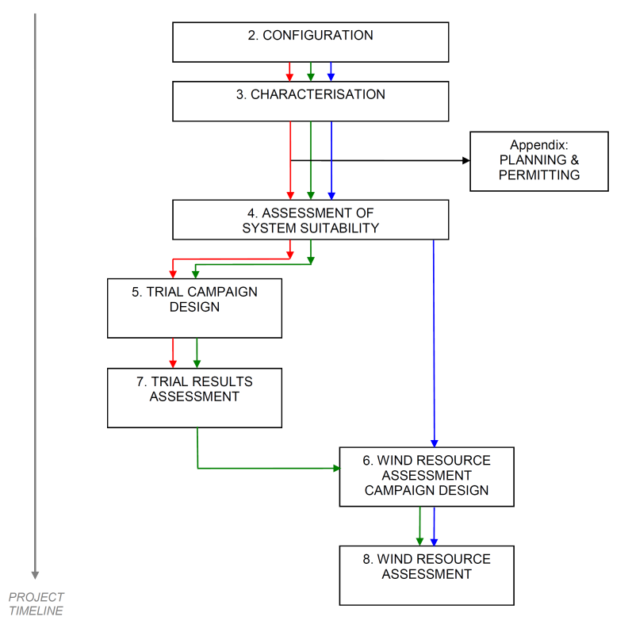
Recommended Practices for application of technology
IEA Wind Annex 32 Work Package 1.5
State-of-the-Art Report: Recommended Practices for Floating Lidar Systems
Issue 1.0, Feb. 2016
+ update of document with additional content
(available online – http://www.ieawindtask32.org/download/task32documents/)
in total 120 RPs
and a number of notes,
all with focus on performing wind resource assessment with FLS

Slide 19
Technology update and outlook
First commercial wind resource assessments based on FLS reported
Market of FLS providers still diverse (different buoy designs, integrated lidar technology etc.) – IEA Wind RPs set minimum standard but do not limit diversity
After general performance has been validated for most systems, uncertainty of measurements requires more consideration. (Do we need refined KPIs for ‘commercial’ status?)

Slide 20
Technology update and outlook
First commercial wind resource assessments based on FLS reported
Market of FLS providers still diverse (different buoy designs, integrated lidar technology etc.) – IEA Wind RPs set minimum standard but do not limit diversity
After general performance has been validated for most systems, uncertainty of measurements requires more consideration. (Do we need refined KPIs for ‘commercial’ status?)
FLS for further application (beyond wind resource assessment)…
Assessment of turbine performance (incl. loads) – use of TI data from FLS (?)
Power curve tests – higher demand on uncertainties and their estimation (?)

Slide 21
Summary / Conclusions
Objectives of this presentation have been to…
give an overview of the current status of floating lidar technology
elaborate on what is needed for the technology to reach full maturity (in terms of acceptance by industry and future applications in commercial projects, resp.)
present activities on floating lidar within IEA Wind Task 32

Slide 22
Summary / Conclusions
http://www.ieawindtask32.org/meetings/workshops/
Objectives of this presentation have been to…
give an overview of the current status of floating lidar technology;
Elaborate on what is needed for the technology to reach full maturity (in terms of acceptance by industry and future applications in commercial projects, resp.)
Present activities on floating lidar within IEA Wind Task 32

Slide 23
Thank you for your attention.
julia.gottschall@iwes.fraunhofer.de

Slide 24
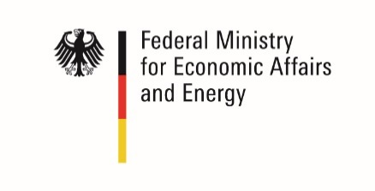
Acknowledgements Fraunhofer IWES is funded by the:
Federal Republic of Germany
Federal Ministry for Economic Affairs and Energy
Federal Ministry of Education and Research
European Regional Development Fund (ERDF):
Federal State of Bremen
Senator of Civil Engineering, Environment and Transportation
Senator of Economy, Labor and Ports
Senator of Science, Health and Consumer Protection
Bremerhavener Gesellschaft für Investitions- Förderung und Stadtentwicklung GmbH
Federal State of Lower Saxony

