Slide 1
New advances in icing measurements and icing predictions
Øyvind Byrkjedal¹, Emilie C. Iversen¹, Bjørn Egil Kringlebotn Nygaard¹, Finn Nyhammer¹, Øyvind Welgaard²
¹Kjeller Vindteknikk AS
²Statnett SF
oyvind.byrkjedal@vindteknikk.no
WindEurope Summit 28.09.2016

Slide 2
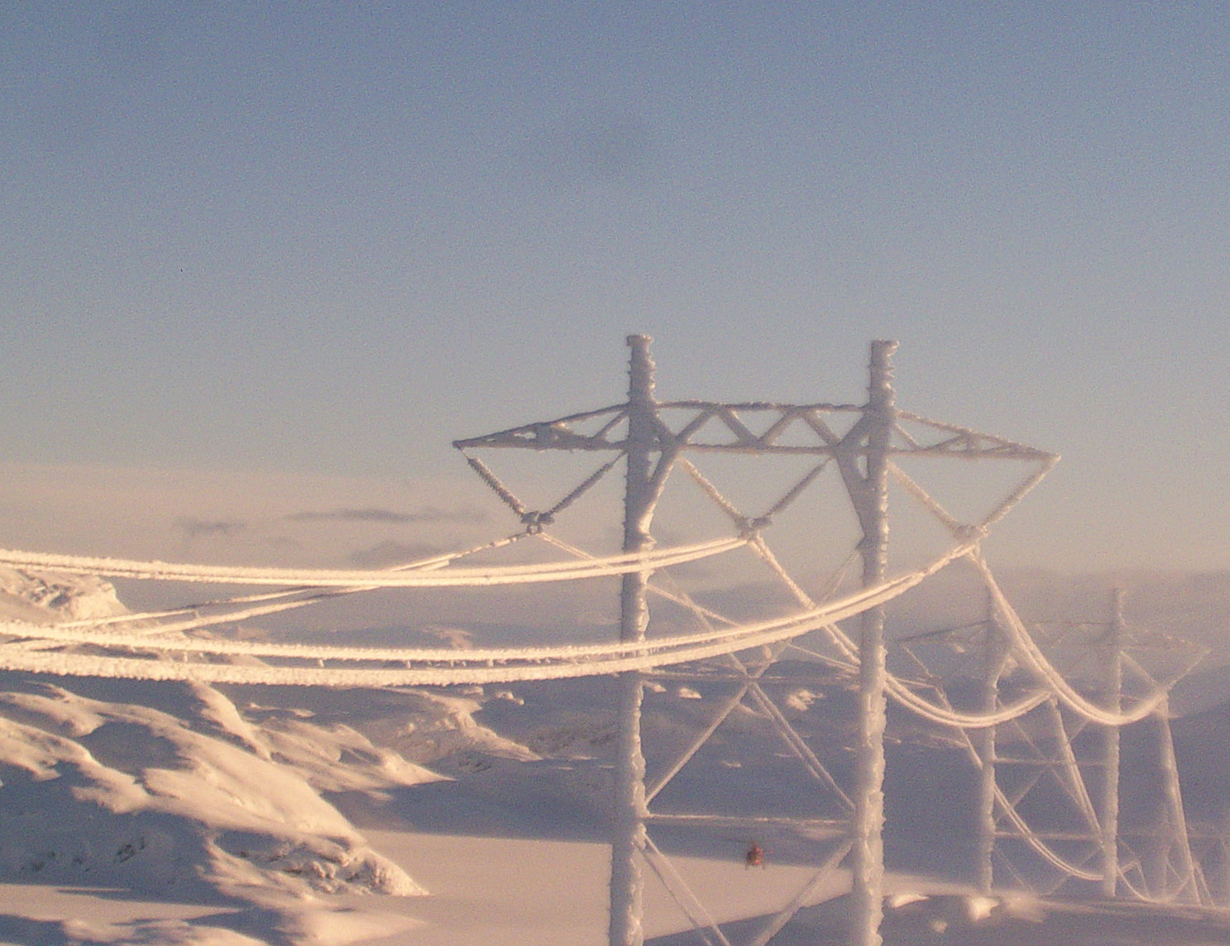
Overview
Motivations
Measurement sites in the Frontlines project
New Ice measurement instrument

Slide 3
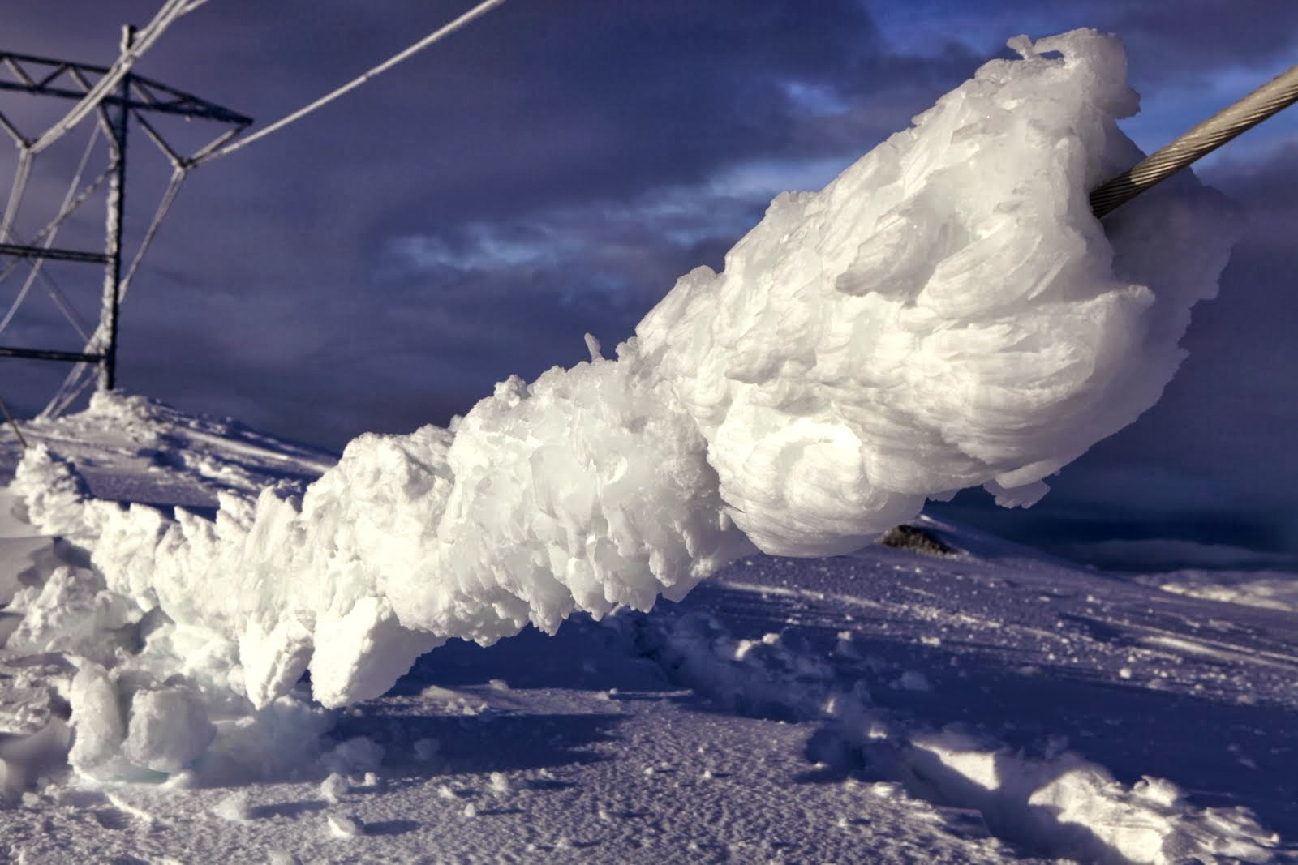
Background for the project
Ålvikfjellet, 420 kV Sima-Samnanger, January 2014
photo: Ole Gustav Berg, Statnett
Notes:
420kV was installed and operations started in December 2013
Design value (50 year) was estimated to be 25 kg/m
Estimated ice load from pic: 50kg/m
Ground wire – simplex
Conductors - duplex

Slide 4
Icing and wind power
Energy losses
Underperformance
Turbine standstill
Risks of ice throw / ice fall
Planning of maintenance
Public safety
Forecasting and modeling of icing:
Model the blade ice accretion
Forecast energy losses
Forecast ice shedding events
Monitoring of power lines
Forecasting to prevent damages
Notes:
As pointed out by the previous talks:
Icing leads to production losses and increased risks.
Today we are able to model ice buildup, but there are some large uncertanties regarding the inputs to the models.

Slide 5
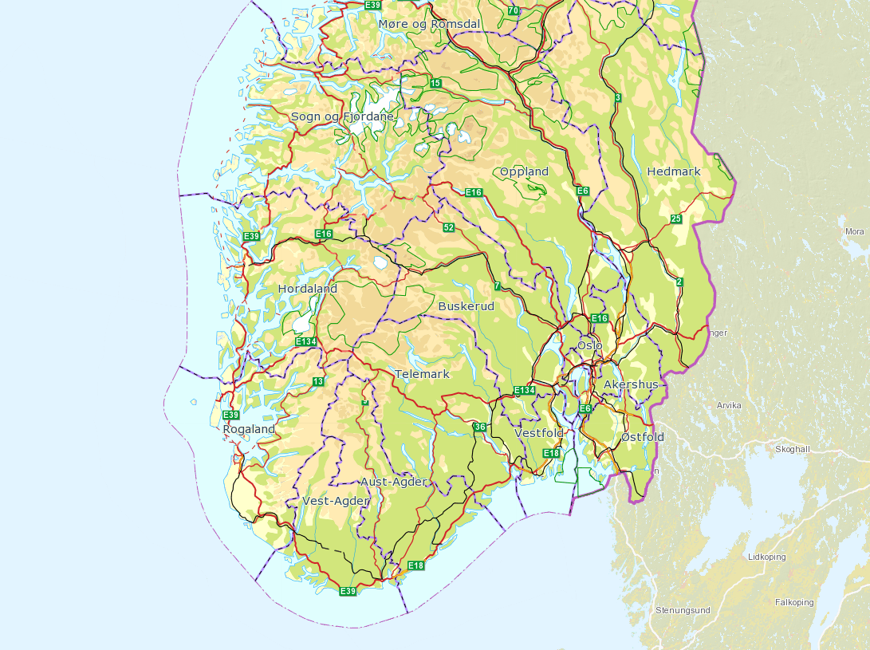
Measurements in the FRonTLINES project
Stølsheimen (1200 m a s l)
Rjukan
(1200 m a s l)
Ålvikfjellet (1100 m a s l)

Slide 6
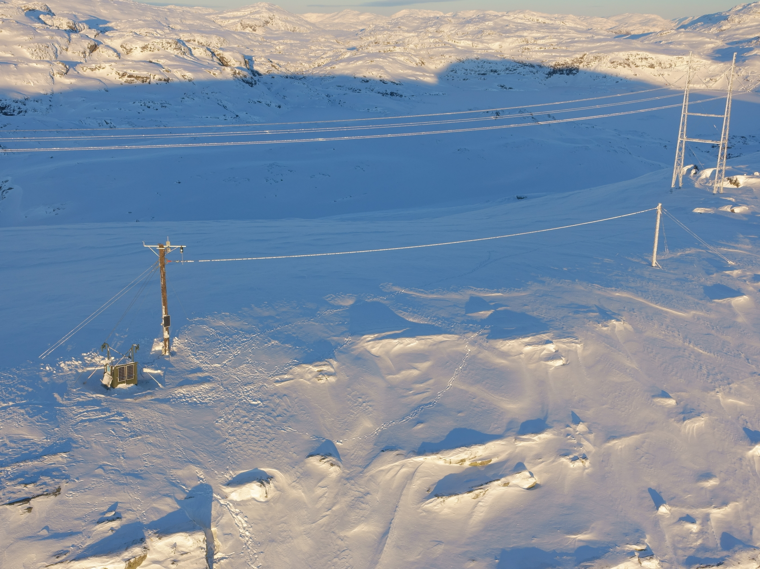
Ålvikfjellet, Hardanger
420 kV line
Measuring mast
Test span
Power supply

Slide 7
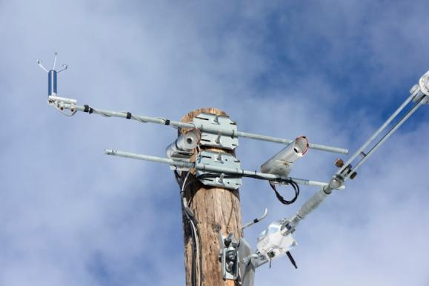
Frontlines - Test sites
Instrumentation at all sites:
Load sensors
Ultrasonic anemometers
Temperature
Heated Web cam
Live monitoring
Load measurements:
Ålvikfjellet (test span + 420 kV)
Rjukan (420 kV + 300 kV)
Stølsheimen (Test spans, simplex and duplex)
Measurements with a rotating cylinder (IceTroll) at Ålvikfjellet and Rjukan
Notes:
Lastsensorene logger islast kontinuerlig samtidig som vind og temperatur blir registrert, dette kan følges i sanntid på KVT sine nettsider. Det er også montert kameraer som tar bilder med jevne mellomrom. Målestasjonen på Ålvikfjellet ble satt opp i forbindelse med havariet på sima-samnanger og sto ferdig rett før vinteren 2014. Bjørn Egil skal fortelle litt mer om denne. Målestasjonen på Rjukan og stølsheimen har blitt satt opp i høst i forbindelse med Frontlines prosjektet.

Slide 8
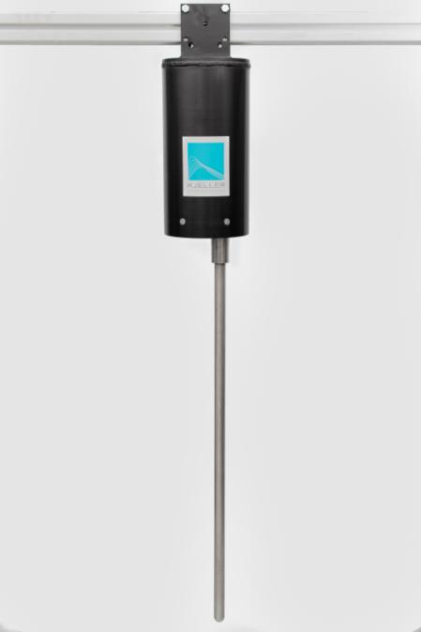
New ice load sensor, KVT IceTroll
Measure weight of accreted ice
Forced rotation - 1 rpm
Cylinder dimensions:
Length = 1m
Diameter = 30 mm

Slide 9
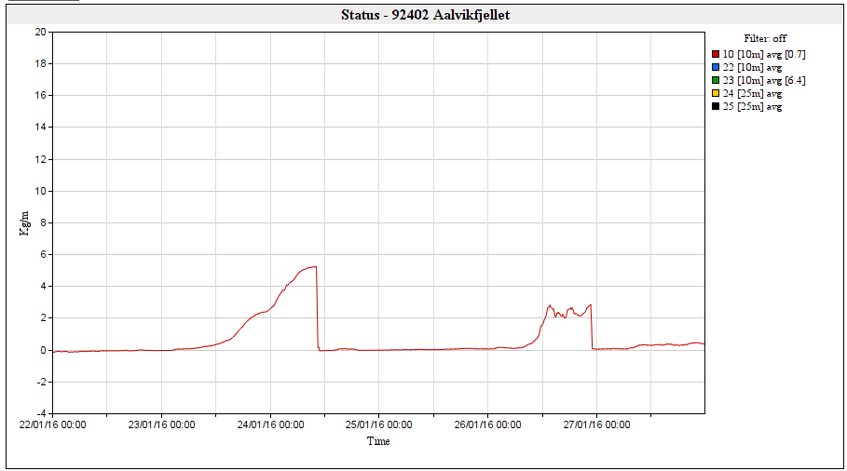
KVT IceTroll, Measurements

Slide 10
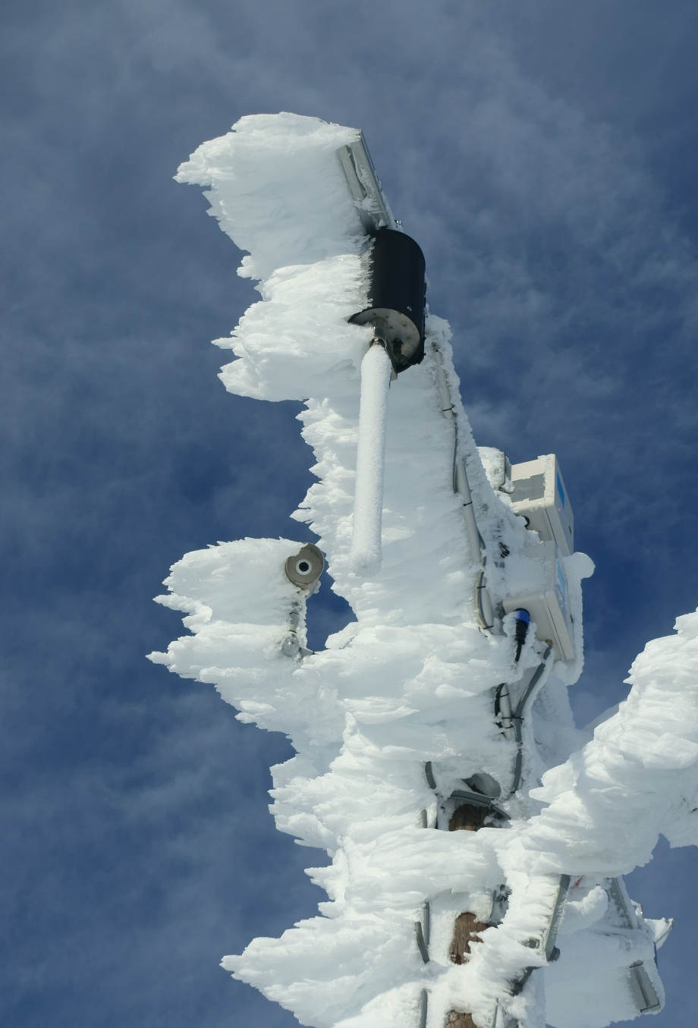
What can we do with the IceTroll?
Better measurements of ice load
Following the ISO standard we measure icing intensity
Possible estimates of Liquid Water Content (LWC)
α₁- collision efficiency, α₁=f(V,d,D)
α₂- sticking efficiency, α₂ ≈ 1
α₃- accretion efficiency, α₃= f(V,d,w,T,e,D,α₁)
w – cloud liquid water content
A – collision area, perpendicular to flow
V – Wind speed

Slide 11
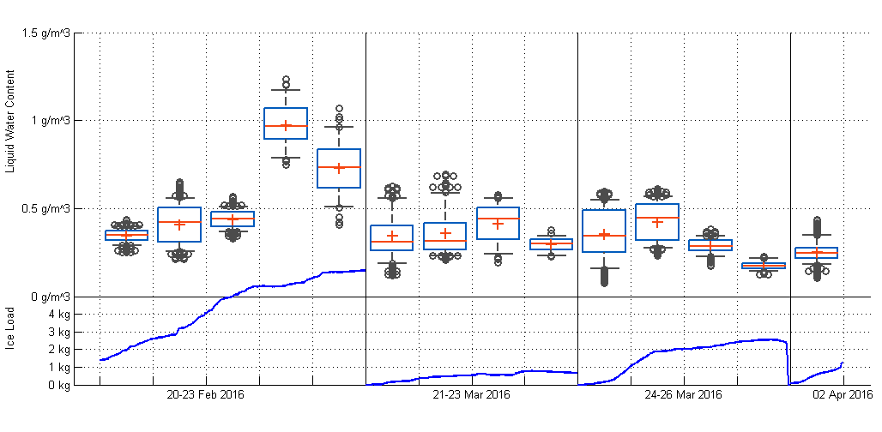
Preliminary calculation of LWC
Quality flag:
Outside of the validity of ISO 12494
Each box represents the distribution of LWC for 12 hours
Notes:
Assumptions:
Droplet concentration 75-125 cm-3 – marine air young clouds
Ice density 700 kg/m3 – estimated based on web images
Dry accretion
Low wind speed – large cylinder: formulation is not valid -

Slide 12
Summary
3 test sites are in operation at 1100-1200 m altitude in Norway
Load tension measurements
Wind measurements
Temperature
Webcamera
A newly developed ice load sensor is tested
Forced rotation
Vertical cylinder
Tested for one winter at two sites
Measurements of:
Ice load according to ISO 12494
Icing intensity according to ISO 12494
Liquid water content (post processing needed)

Slide 13
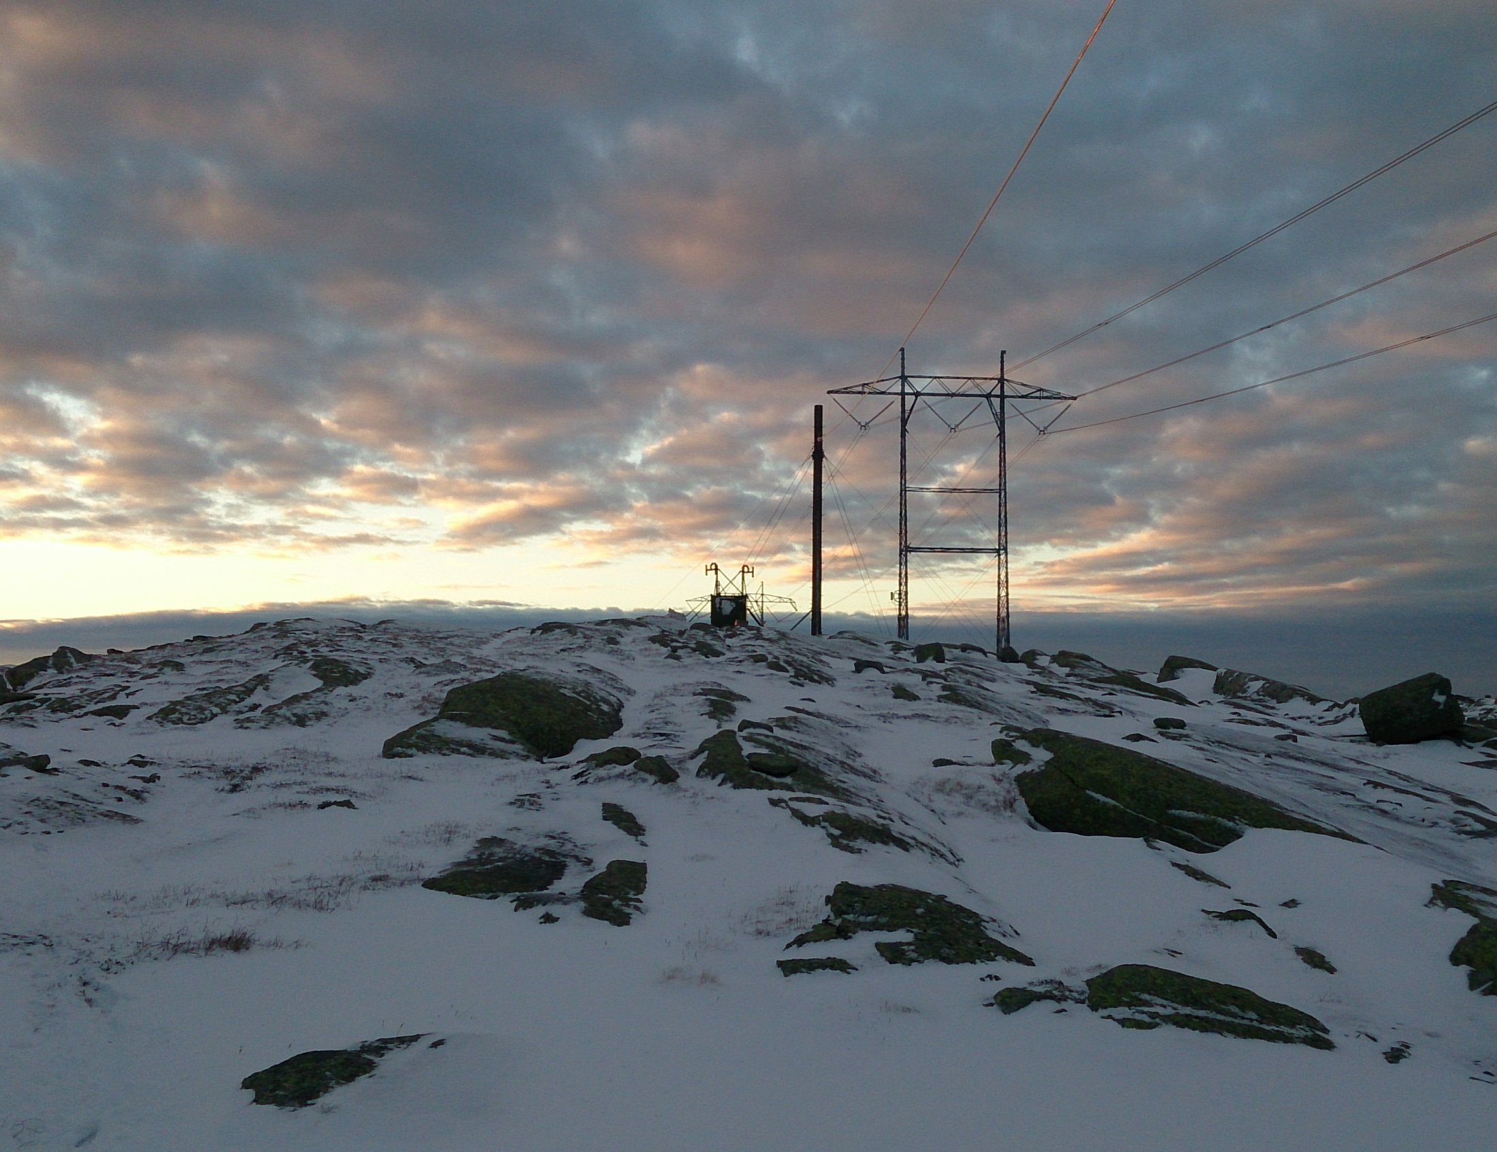
Thank you for your attention!
The partners of the FRonTLINES project:

Slide 15
Assumptions for LWC calculations
Droplet concentration 75-125 cm-3 – marine air
Ice density 700 kg/m3 – estimated based on web images
Dry accretion a3=1

Slide 16
FRonTLINES
R&D Project: 2015-2018
Develop a toolbox to assess the impact from frost and rime ice on overhead transmission lines:
Estabish a new test station
Laboratory experiments of ice accretion on bundle conductors
Develop improved models for ice accretion on bundles
Calculate ond forecast hoar frost and related losses on power lines
Partners:
Statnett
Kjeller Vindteknikk
STRI
VTT
Narvik University College
The Norwegian Meterological Institute
Financed by:
The Norwegian Research Council: 50%
Statnett : 43 %
KVT, STRI, VTT: 7 %

Slide 17
Ice load (from IceTroll) and wind speed is measured
Poor wind measurements during 5 first icing accumulation periods

Slide 18
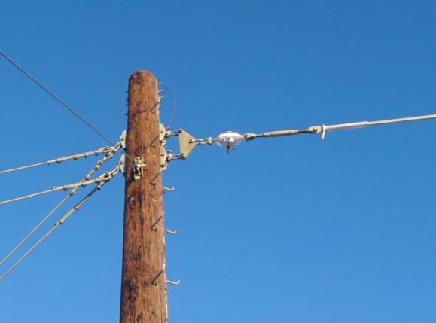
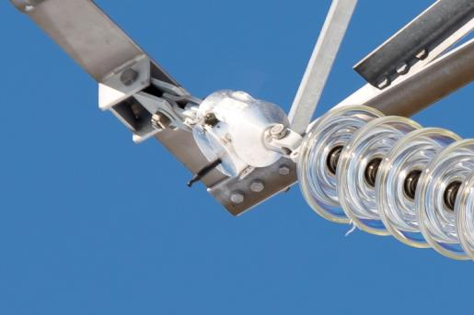
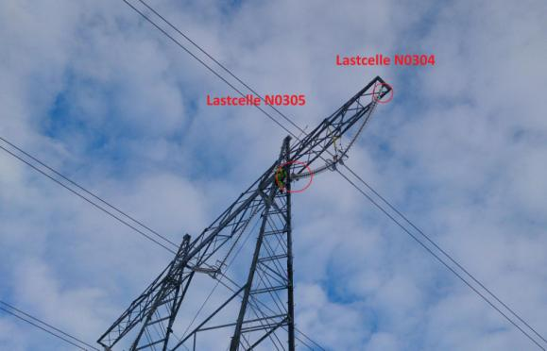
Load sensors
Tension recorders IO-Keys (Iceland)
Installed in insulator strings and test spans
Save avg, min, max every 10 min
Wireless data transmission
Battery power supply

