Slide 1
Rubustness against Overvoltage by Testing the HVRT Capability of Wind Turbines
Dipl.-Wirt.-Ing. Frederik Kalverkamp Division Manager Grid Integration & System Analysis | FGH GmbH
WindEurope Summit 2016, 27-29 September, Hamburg, Germany

Slide 2
Agenda
Introduction and Motivation
HVRT in Grid Codes
Testing of HVRT Capability
Experiences from Prototype Testing
Conclusion

Slide 3
Introduction
Current Situation of Fault-Ride-Through
LVRT capability mandatory requirement for Power Generating Units (PGU) in grid codes
Disconnection threatens grid stability
LVRT testing equipment and procedures have been developed by FGH already in 2003
Internationally standardized about 10 years ago (IEC 61400-21)
Today new challenges with further penetration of dispersed power generators
Temporary overvoltage in high voltage systems
New grid code developments and requirements
2015 in Germany: VDE-AR-N 4120 (110 kV)

Slide 4
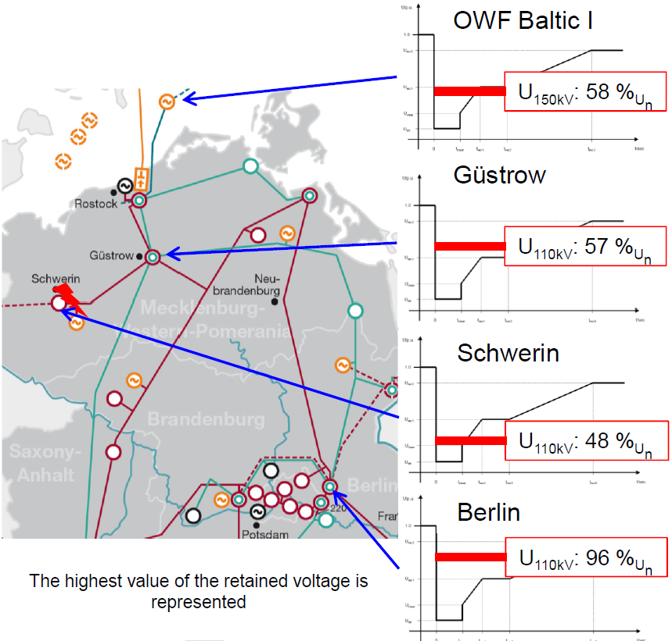
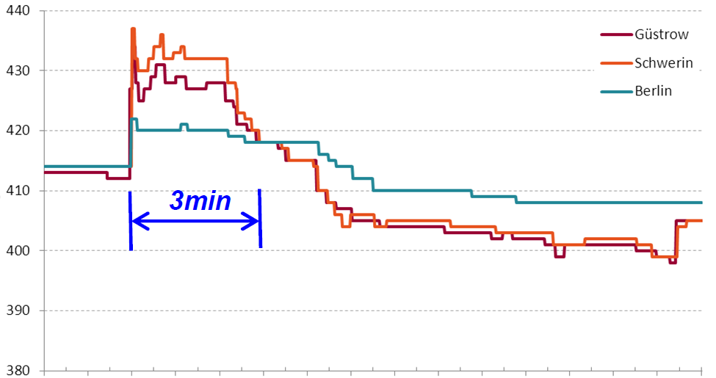
Motivation
Relevance of Overvoltage and HVRT
Overvoltage due to
Line capacities combined with load shedding or generation tripping
Voltage recovery after fault clearance
Difference in terms of
Time duration (ms…min)
Location and propagation
Incident in Germany (2012)
Capacitive voltage boost after 2ph fault with loss of 1.7 GW
➔ HVRT capability reduces risk of generation tripping
voltage in kV
time

Slide 5
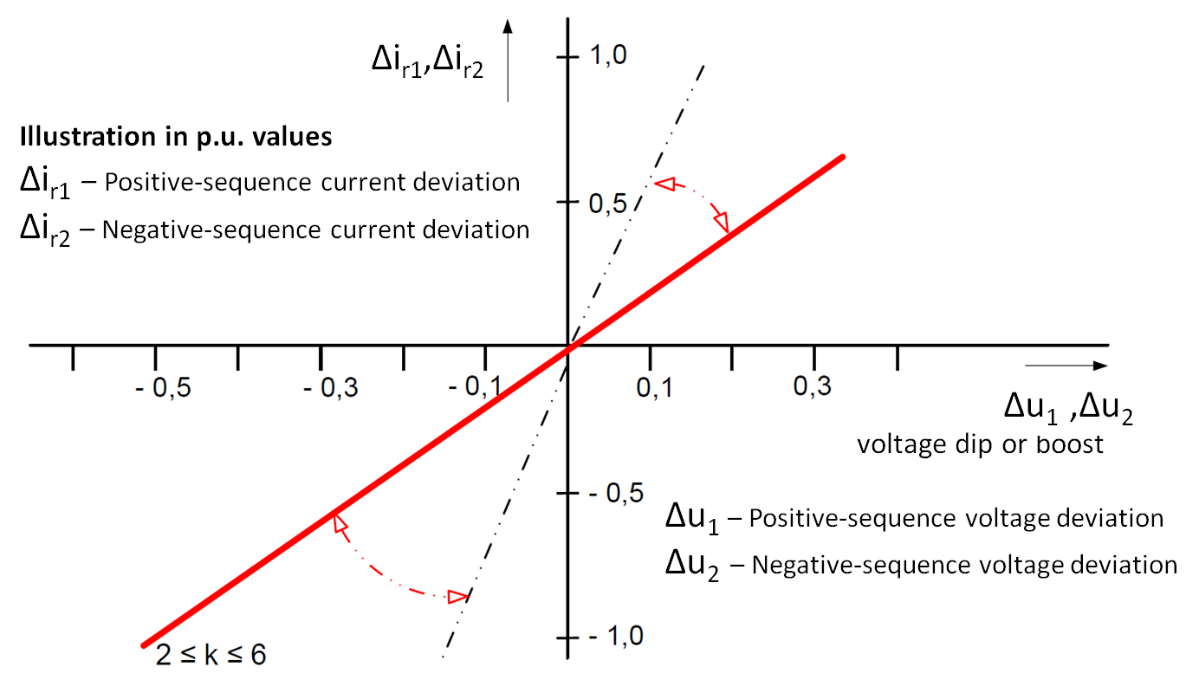
HVRT in Grid Codes
First requirements can be found
Result of incident: HVRT capability required in recent grid codes (comparable with LVRT 2003)
In focus: VDE-AR-N 4120 specifies dynamic system support of PGUs with LVRT and HVRT capability
Up to 130% Un for 100 ms and 125% Un until 60 s
Reactive current injection (HVRT -> under-excited)
HVRT in IT, RSA, AUS (discussed: USA, DK)
European Network Code RfG with no requirement yet (!)
Source: VDE 4120

Slide 6
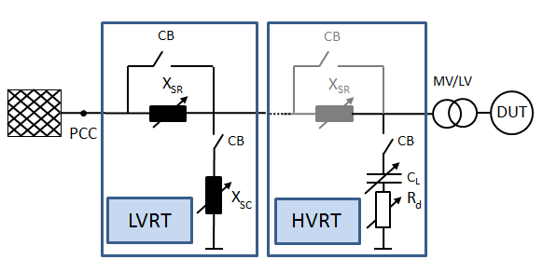
Testing of HVRT Capability
Equipment design
FGH development similar to LVRT setup
Overvoltage with capacitive charging (Ferranti effect)
Also add-on solution (redundant components)
Modular layout, scalable and very flexible
Max. design: 200% Un, 35 kV 10 MVA

Slide 7
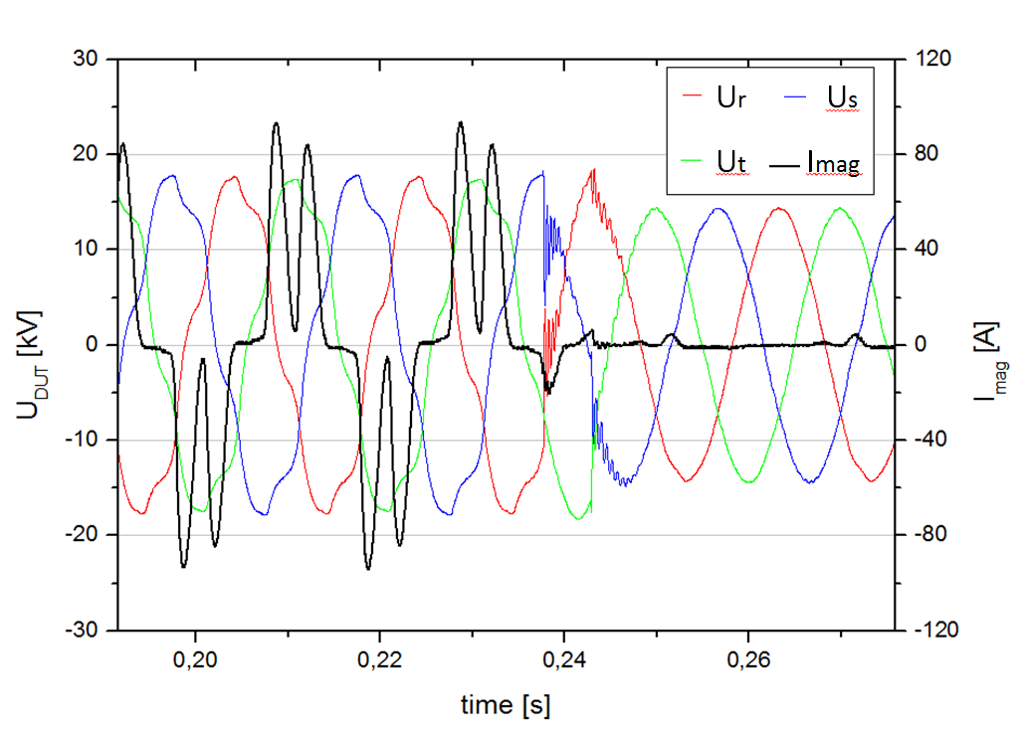
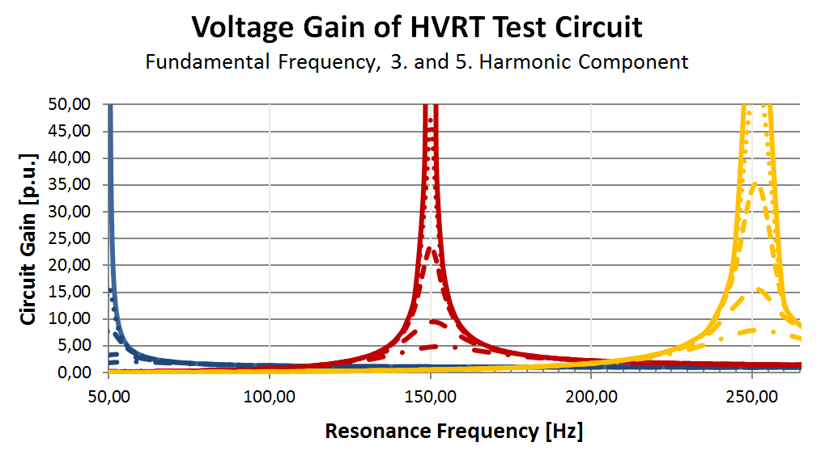
Experiences in HVRT Testing
Pilot Projects
Testing of ENERCON WT with HVRT prototype testlab
>100 tests, up to 140% Un
Modified switching sequence to reach rectangular voltage shape, lower overshooting and transients
Saturation effects of transformer cause distorted and limited secondary voltage (max.124% Un)
Electrical design of the test circuit very crucial to avoid resonances or influences in ripple control
➔ Adequate damping for mitigating resonances is important in system design and test preparation

Slide 8
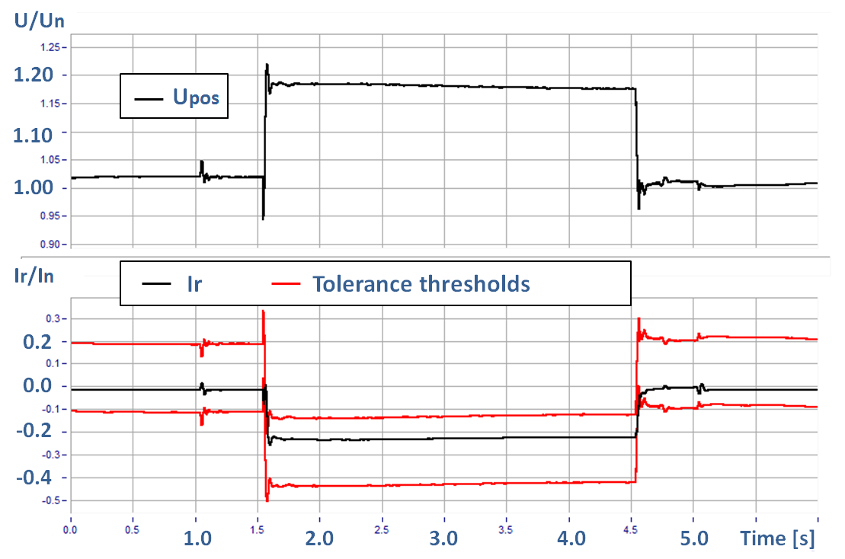
Experiences in HVRT Testing
Grid Code Compliance
Behavior of wind turbine according to requirements
no disconnection
voltage distortion without influence
adequate under-exited reactive current

Slide 9
Conclusion
HVRT is crucial capability and subject to grid codes
Justification due to high decentralization or system characteristics
Compliance testing is needed
HVRT testlabs available and successful in performance
Appropriate setup design important to prevent grid repercussion
Grid codes and testing guidelines shall take saturation effects of transformers into account
Max. overvoltage, time duration, fault types
Further investigation of technologies (DFIG) in terms of configuration and control strategies

Slide 10
Thank you for your attention!
frederik.kalverkamp@fgh-ma.de
www.fgh-gmbh.com |info@fgh-gmbh.com
Visit our booth
Pion
r since 1921

