Slide 1
Optimization of offshore platform transformers
Paweł Pryliński, ABB, BU Transformers, WindEurope 2016, Hamburg
How can they support LCOE targets?

Slide 2
Optimizing Power Transformer for offshore platform substation How can they support LCOE targets ?
Transformers are key electrical components to collect wind power, connect to the grid and transmit it through the electricity network.
The quality of transformers has a major impact on the availability of wind power generation as well as on reliability of the whole network.
So what are the challenges today in deploying the optimal transformer solutions to ensure the highest quality and stability of electricity supply and at the same time to support the initiatives to reduce the levelized cost of offshore wind energy ?

Slide 3
Optimizing Power Transformer for offshore platform substation How can they support LCOE targets ?
The total cost of ownership of transformers incorporates the various costs over its lifetime such as the initial product cost, cost of delivery and assembly and installation, cost of operation (losses) and costs of maintenance.
And specifically for offshore applications – the size and the weight of the transformers have a huge impact on the size, weight and the costs of the offshore platform steel structure and its foundations.
ABB has developed a technical and economic optimization process to minimize the transformer total cost of ownership and in cooperation with electric systems integrators and platform builders support optimization of offshore substation and consequently help the optimization of platform structure and its foundations.

Slide 4
Optimizing Power Transformer for offshore platform substation How can they support LCOE targets ?
There are various transformer design factors, key size, weight and costs drivers and there are various possible solutions to optimize transformers in order to ensure energy-efficient and reliable transformation of wind power and to support systems integrators and platform builders to optimize the offshore substation
There are various possible solutions to reduce the LCOE through using the most appropriate transformer technologies combined with using advanced transformer design and optimization tools.

Slide 5
Optimizing Power Transformer for offshore platform substation How much does a transformer cost?
The real cost of a transformer for the owner is the sum of the initial purchase price (first cost) plus the cost of operation during its useful life time
Purchase price
Cost of Losses
No-Load Loss
Load Loss
Commissioning cost
Maintenance cost
Emissions cost (depending on regulations)
Life Cycle Cost
Purchasing decisions requires the right balance between purchase cost and the cost of operation during expected life time

Slide 6
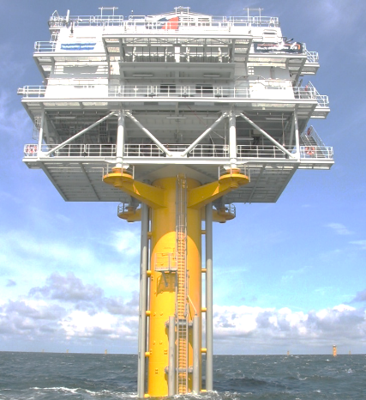
Optimizing Power Transformer for offshore platform substation Various optimization criteria
basic electric system requirements
environmental conditions
loading cycle and overloading
specific application requirements
cooling mode
general arrangement / space & weight limitation
transport limitation
energy efficiency
environmental requirements
fire hazardous
new high-temperature insulation materials
purchasing cost vs costs of losses
Total Costs of Ownership
…
There are very many drivers influencing size / weight and cost of the transformer

Slide 7
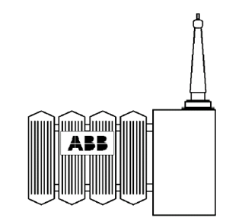
Optimizing Power Transformer for offshore platform substation Basic electrical system requirements
MVA rating
Voltage HV connection (150kV vs 220kV) LV collection array (33kV vs 66kV)
Impedance low impedance high impedance
Short-circuit network capacity
voltage regulation on-load tap changer de-energized tap changer no tap changer
…
The electrical system parameters are key drivers for active part optimization

Slide 8
Optimizing Power Transformer for offshore platform substation Marine environmental conditions
Thermal behaviour due to ambient temperatures: minimum / maximum daily average yearly average
Forces due to platform accelerations
Corrosive conditions materials components treatment
…
Marine environmental conditions shall be carefully considered

Slide 9
Optimizing Power Transformer for offshore platform substation Loading
Lading cycle and overloading short-time long-time emergency
Redundancy consideration one large transformer vs. two small transformemrs
„Booster” cooling capacity in case of emergency loading
…
Forecasted loading conditions including emergency situations are of the highest importance

Slide 10
Optimizing Power Transformer for offshore platform substation Specific requirements
Some specific requirements may significantly influence the design:
Extereme low no-load losses
Extereme low load losses
Extereme low sound level – is it really important at OFFshore location ?
Conservative design, i.e. low flux density limit
…
Some specific requirements may unnecessaryly drive to not-optimized solution

Slide 11
Optimizing Power Transformer for offshore platform substation Cooling mode
Cooling system dylema:
natural ONAN (maintenance free)
forced ONAF (fans)
Forced ODAF (fans and pumps)
Oil-Air -> large radiators bank with large volume of oil
Oil-Water -> compact coolers
…
Cooling system dylema shall be discussed at the early development stage

Slide 12
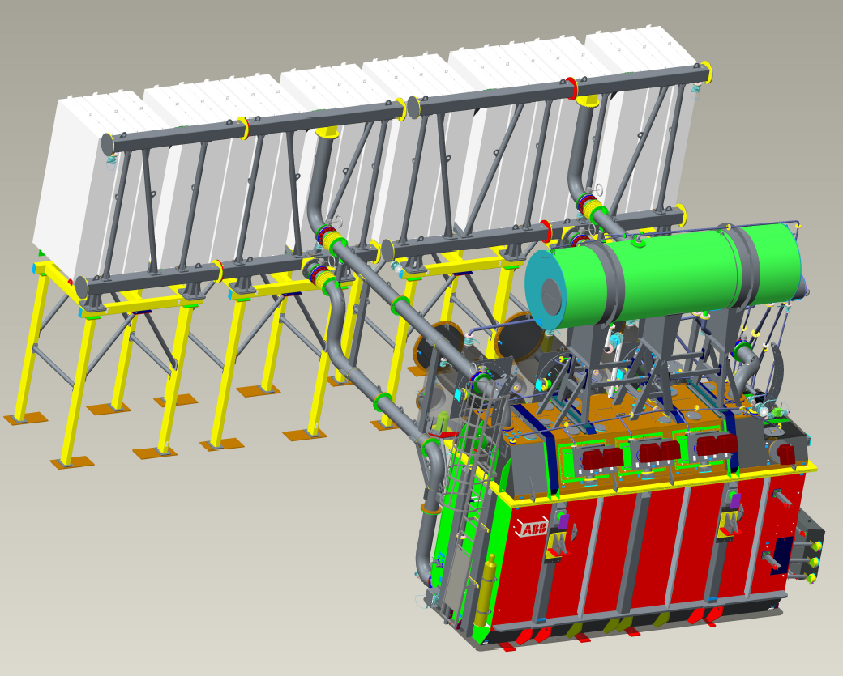
Optimizing Power Transformer for offshore platform substation General arrangement and dimensions & weights limitation
The weight & size of OFFshore platform transformer may be optimized to reduce the weight/size/costs of the platform:
Active part design optimized to the electric system requirements and to minimize TOC taking into account the loss $/kW evaluation criteria
Total weight optimized taking into account the $/kg evaluation ciriteria and/or $/m² evaluation criteria
General arrangement compacted to reduce the footprint
- Compact tank design - Size and location of the cooling bank
- Location of cable connections
- Location of the conservator
General arrangement to simplify assembly and installation works and make easy the maintenance works
Optimized general arrangement may help to save $ for platform and its foundation

Slide 13
Optimizing Power Transformer for offshore platform substation Transport limitation
Transport size & weight limitations due to possible ways of transportation
Railway - railway profile limitation
Road – - maximum permissable load - maximum height
Sea – - forces due to marine accelerations - transport limitations due to weather conditions (wind, waves, ice)
…
Transport limitations may interfere optimization proces but must be taken into consideration

Slide 14
Optimizing Power Transformer for offshore platform substation Energy efficiency
New EU directive introduces the concept of “Minimum Energy Performance Standard” (MEPS)
MEPS are minimum energy efficiency values that transformer manufacturers must guarantee
Local certification agencies in all EU countries must be able to verify MEPS values, which are defined as follows:
For distribution transformatorers (oil & dry): MEPS is defined as max No-Load Losses (Po) and Load Losses (Pk)
For power transformers voltage class > 36 kV: MEPS is defined as PEI (Peak Efficiency Index) based on Cenelec-definition
PEI is not valid for OFFshore applications yet but ABB transformers are designed to follow the highest requirements

Slide 15
Optimizing Power Transformer for offshore platform substation Environmental requirements
Ester fluids instead of mineral oil:
synthetic esters like MIDEL 7131 80% biodegradability within 21 days
natural esters like Cargill FR-3 97% biodegradability within 21 days
No need to built oil spilling tank
…
Ester fluids are environmentaly friendly alternatives

Slide 16
Optimizing Power Transformer for offshore platform substation Fire hazardous
Ester fluids instead of mineral oil:
synthetic esters like MIDEL 7131
natural esters like Cargill FR-3
having much higher flash point and fire point which reduce significantly the risk of fire
qualified as a slow-burning liquid resulting in lower insurance costs
fire barriers may be eliminated
…
Ester fluids significantly reduce risk of fire

Slide 17
Optimizing Power Transformer for offshore platform substation New high-temperature insulation materials
IEC 60076-14 standard for liquid-immersed power transformers using high-temperature insulation materials:
High-temeperature solid insulation (like Nomex) or combination of high-temperature and conventional insulation
synthetic and natural esters
operating at temperatures above conventional limit
higher overloading capabilites
more compact design reduced size reduced weight reduced size/weight of cooling bank
…
Using new materials and technologies allow to increase loading capabilites while reducing size / weight

Slide 18
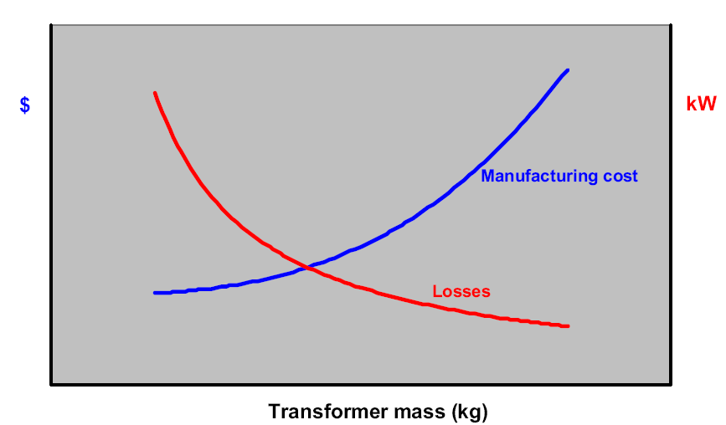
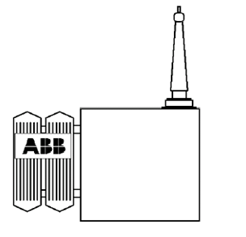
Optimizing Power Transformer for offshore platform substation
Losses – size/weight – cost consideration
+ Coolers
- Tank weight
- Active part weight
(- copper, - core, ..)
”High” losses transformer
- Coolers
+ Tank & Oil weight
+ Active part weight
(+ copper, + core, ..)
”Low” losses transformer
We can find right balance between size / weight / losses / cost of the transformer

Slide 19
Optimizing Power Transformer for offshore platform substation Purchasing cost vs costs of losses
3,000
2,500
2,000
1,500
1,000
0,500
0,000
Cost of losses in MUSD
Purchasing Cost
Cost of Losses
0,000 0,500 1,000 1,500 2,000 2,500 3,000
Purchasing cost in MUSD
Purchasing decisions requires the right balance between purchasing cost and the cost of losses during lifetime

Slide 20
Optimizing Power Transformer for offshore platform substation Total Cost of Ownership (TCO)
3,000
2,500
2,000
1,500
1,000
0,500
0,000
Total Cost of Ownership
Total Cost in MUSD
Lowest
Ownership Cost
=
Purchasing Cost (Price)
+
Cost of Losses
Optimal Design & Purchasing Cost
0,000 0,500 1,000 1,500 2,000 2,500 3,000
Purchasing cost in MUSD
TCO approach allow to find lowest ownership cost

Slide 21
Optimizing Power Transformer for OFFshore platform substation Conclusions
Optimization of transformers can play a key role in reaching the ambitious LCOE targets.
There are various transformer design drivers which have huge impact on performance, weight and size and costs.
The offshore transformer optimization process is available to achieve energy-efficiency, availability and reliability of wind power in the most cost-effective way.
ABB has developed an optimization process to support all offshore wind power stakeholders in reaching their common LCOE goal.
ABB transformers offering is the result of our own research, development, design and manufacturing.

Slide 22
Thank you … and you are welcome to ask questions to …
 | Paweł Pryliński Global Account Manager for Wind Segment BU Transformers Power Products Division ABB Sp. z o.o., Aleksandrowska 67/93, 91-205, Łódź, Poland Phone: +48 42 2993114 Telefax: +48 42 2993120 Mobile: +48 601 252981 ABB Contact Center: +48 2222 3 7777 email: pawel.prylinski@pl.abb.com

Slide 23
Disclaimer
The information in this document is subject to change without notice and should not be construed as a commitment by ABB. ABB assumes no responsibility for any errors that may appear in this document.
In no event shall ABB be liable for direct, indirect, special, incidental or consequential damages of any nature or kind arising from the use of this document, nor shall ABB be liable for incidental or consequential damages arising from use of any software or hardware described in this document.
© Copyright 2015 ABB. All rights reserved.

