Slide 1
Siemens SOV – A success story Wind Europe Summit, Hamburg 2016
siemens.com/energy/wind-service
Restricted © Siemens AG 2016

Slide 2
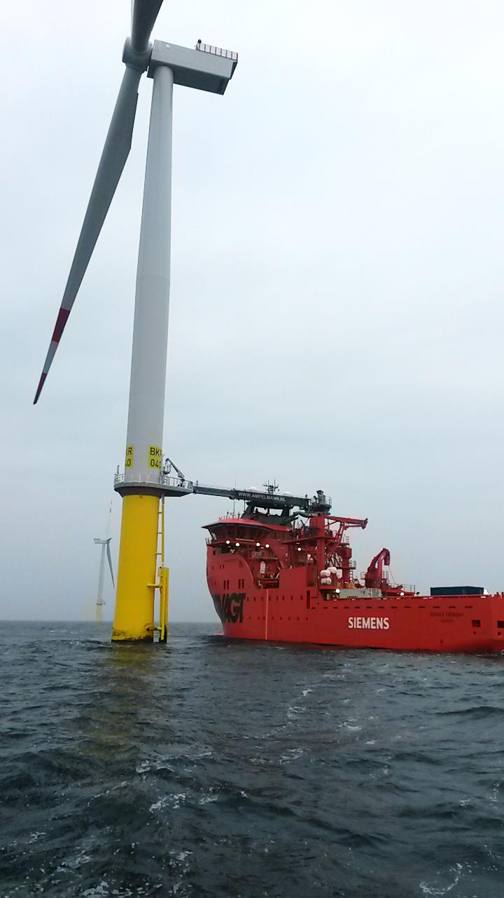
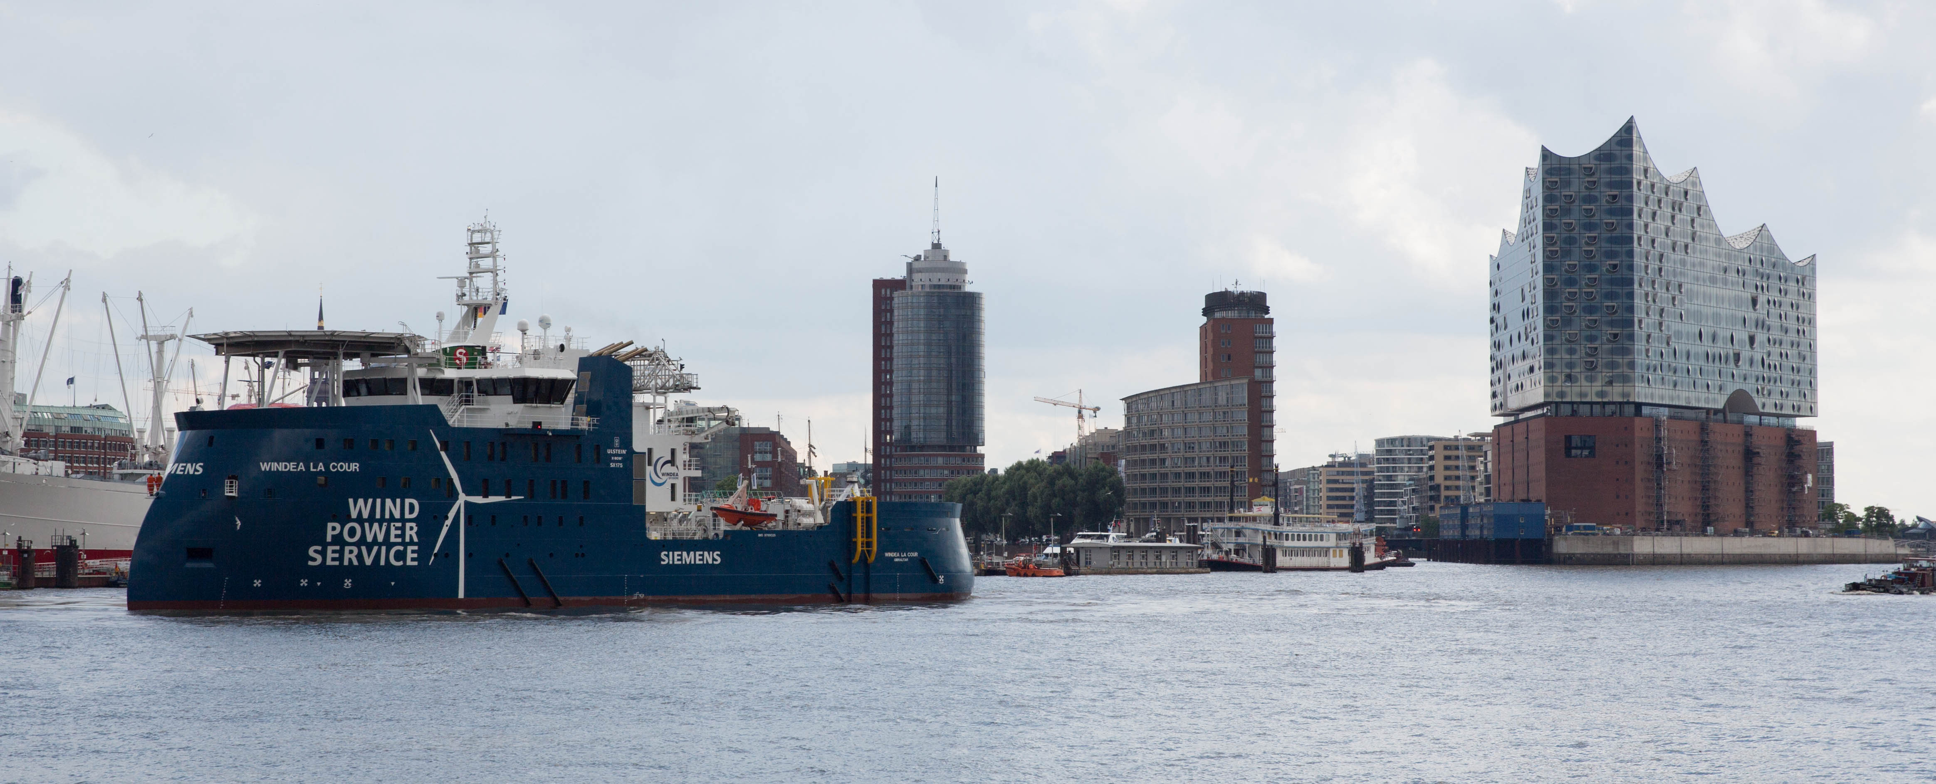
Agenda
Global Maritime & Aviation Solutions
SOV Concept
SOV Operations

Slide 3
Global Maritime and Aviation Solutions Dedicated in-house specialists
14_84
implementation
tender
Logistic STrategy
Asset msansagement & lessons learned
Concept simulation
Monitoring
Market intelligence
Dedicated in-house experts
Wind farm simulation tool
Weather complexity tool
Asset management
Continious improvement focus
Industry supplier network
Long term agreements

Slide 4
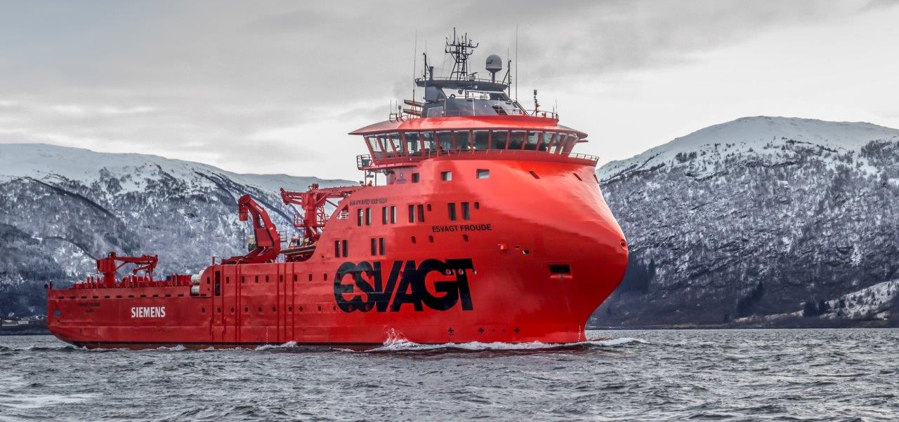
SOV Concept In general
Improving offshore service
Addressing complex offshore projects Siemens now adds a new vessel concept to the maritime logistics portfolio
Using SOV’s “in-field” improves turbine availability due to the extended window of access and less weather downtime
Efficient utilization of working hours
Less downtime equals higher yield
Less idling during transport means more efficient working time in the turbine and fewer technician hours necessary
Less weather downtime means better utilization of working hours, less technicians and shorter response times

Slide 5
SOV Concept In general
Development and design of SOV
We have co-designed and chartered 4 service operation vessels (SOV) aimed at efficient far shore and big scaled service operations for longer periods of which 3 are already operational. In Q2 2017 the fourth SOV will be delivered to SWP.
Siemens SOV Fleet is growing
Employer provided SOV
2015 Esvagt Froude
2015 Esvagt Faraday
2016 Windea La Cour
2017 Windea Leibnitz
Potentially more SOVs in the pipeline
2017 Esvagt Njord – Dudgeon, Statoil
2018 Østensjø – Racebank, Dong

Slide 6
SOV Operations Service activities
Scheduled maintenance
Unscheduled maintenance
Extra Services
Scheduled service
Preventive maintenance
Retrofits campaigns
Team size 3-6 Technicians
Transfer time between turbines: Approximately 30 minutes
Possible performance patterns
Fault finding
Unforeseen events
Minor repairs
Team size 2-5 Technicians
Transfer time between turbines: Depending on distance
Possible performance patterns
Statutory inspections (lifts, safety equipment etc.)
Painting, Maritime coordination (onshore), Navigation equipment, Met equipment service etc.
Other wind farm equipment e.g. BoP²⁾ with ROVs etc.
Transfer time between turbines: Depending on distance
Possible performance patterns
Turbines
Turbine visits
Travel route
1) The SOV will not be able to perform major crane repairs; 2) Work can be offered by Siemens Service

Slide 7
SOV Operations Operations, Technicians and Material Workflow
Operations
Offshore setup → warehouse, all site planners and technicians will be offshore
Crew Exchange bi-weekly or weekly
24/7 operations are possible, bunkering bi-weekly or monthly
Material workflow
All materials, spares and goods are stored in weather protected deck area
Lift brings all materials, spares and goods directly to deck or direct transfer system (gangway)
All workflows are arranged by the stock keeper and/or site planner
Technicians workflow
The layout guarantees an optimal workflow for the technicians.
Meeting rooms (for daily briefing) and changing rooms are on same deck level
Direct access to direct transfer system (gangway)
Material flow
Technicians’ workflow
Waste flow
Acces Unit
Accommodation, Meeting, Galley
Warehouse
Engine room
Bridge

Slide 8
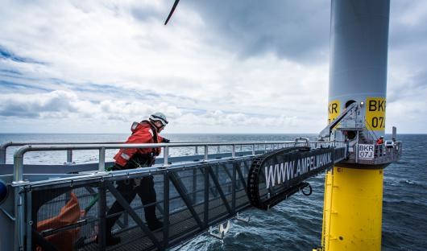
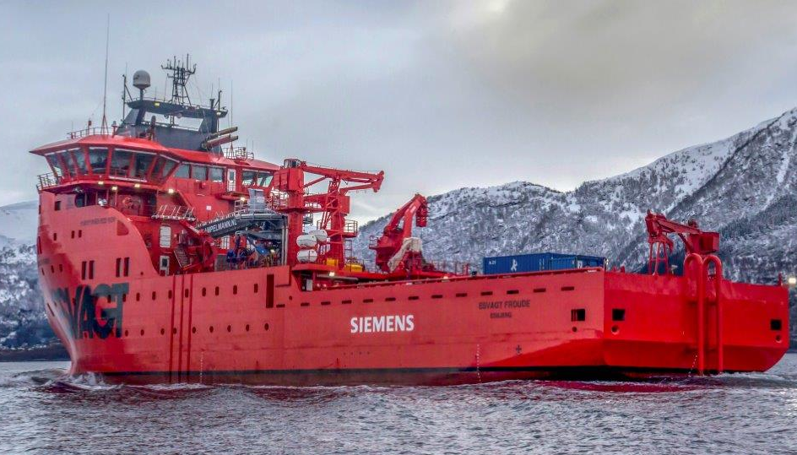
SOV Operations Efficiency – Staggered Shift Patterns
Operations and staggered shift patterns
Hours
Staggered shift patterns
Technicians start approx. 30/50 minutes apart from each other and they can directly walk onto the gangway
The effective working hours per day can be up to 10 hours and more
Fixed transfer period
For scheduled service a fixed time period designated
All scheduled service teams will start staggered according to the fixed transfer period to maximize the effective working hours per day
0
1
2
3
4
5
6
7
8
9
10
11
12
13
14
15
16
17
18
19
20
21
22
23
Teams
00
30
00
30
00
30
00
30
00
30
00
30
00
30
00
30
00
30
00
30
00
30
00
30
00
30
00
30
00
30
00
30
00
30
00
30
00
30
00
30
00
30
00
30
00
30
00
30
Team 1
Effective working time
Team 2
Effective working time
Scheduled Service
Team 3
Effective working time
Team 4
Effective working time

Slide 9
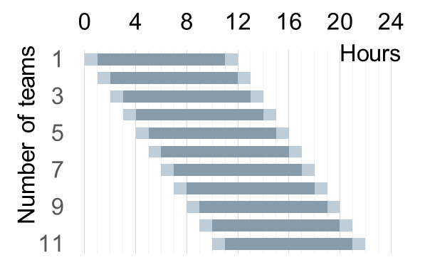
SOV Operations Advantages Employing SOVs
Example Staggered shift pattern
Example Weather downtime compa-rison for an offshore site
Example Effective working hours for a technician in a 12 hours shift
12
Post-processing
40%
10
Transit out
8
Effective work time
6
CTV
SOV
Lunch
22%
4
Climbing within WTG/ get ready to work
2
Transit it/in field
CTV:146 days
SOV:80 days
0
Pre-processing
One vessel to deploy several teams
One vessel to reduce weather downtime
One vessel to reduce waste time
Implications of employing a Service Operation Vessels for Large Far Shore Projects
Staggered shift pattern to reduce waste time during shifts
From 1.5 m Hs to 2.3m Hs waveheight to reduce weather downtime and staff
Living in the wind farm reduces time wasted and increases efficiency of offshore O&M

Slide 10
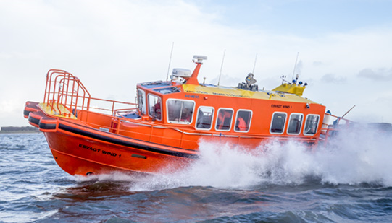
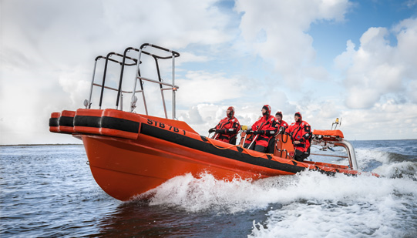
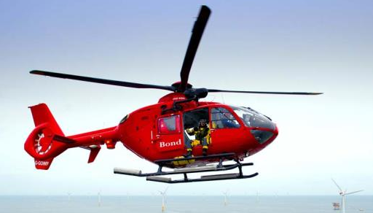
SOV Operations Supporting assets – Daughter craft and helicopter

Slide 11
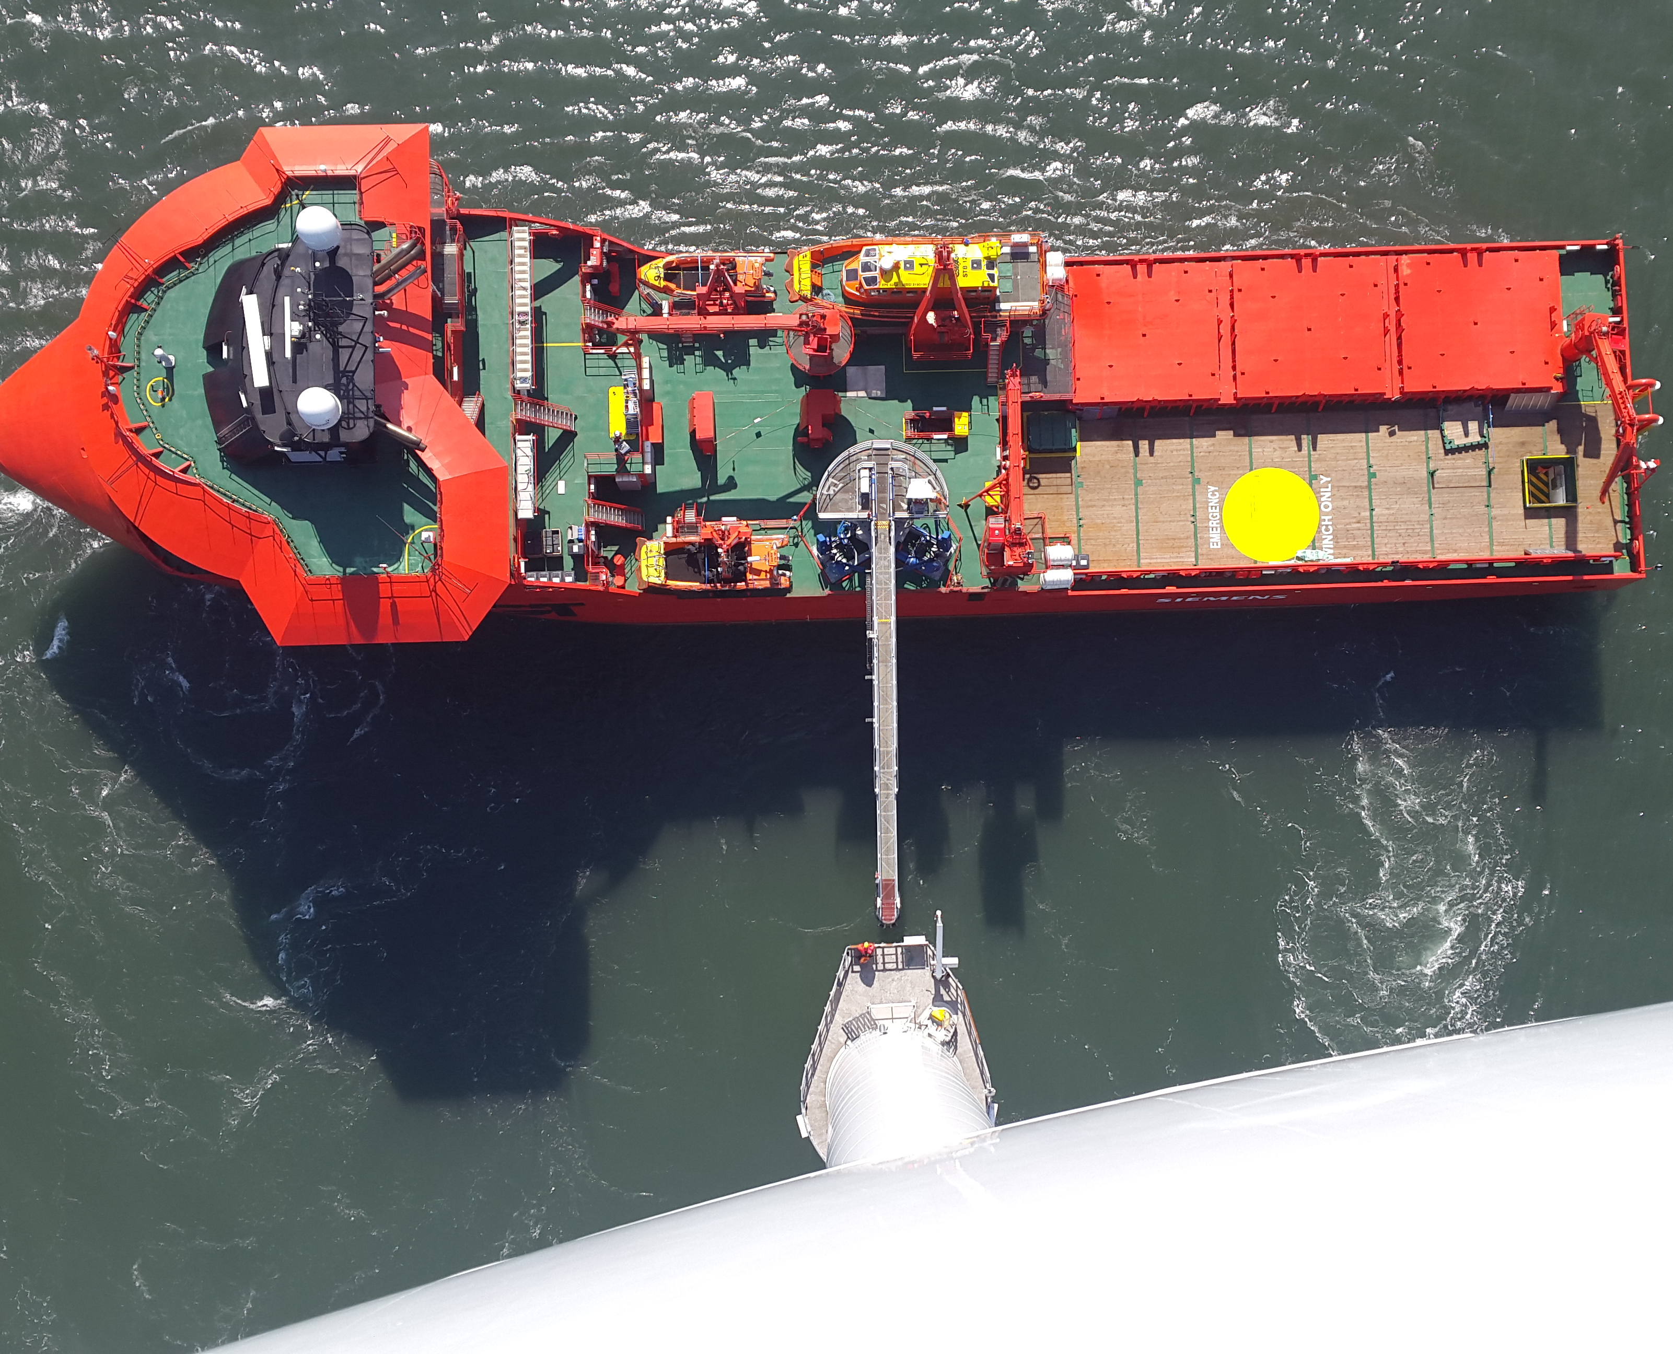
SOV Operations Utilization and Transfers
Daily Operations
Technicians wellbeing
Cooperation on board
Daily transfers (CTVs, direct transfers, cargo transfers)
Transfer times between WTGs
Internet
Crew Exchange

Slide 12
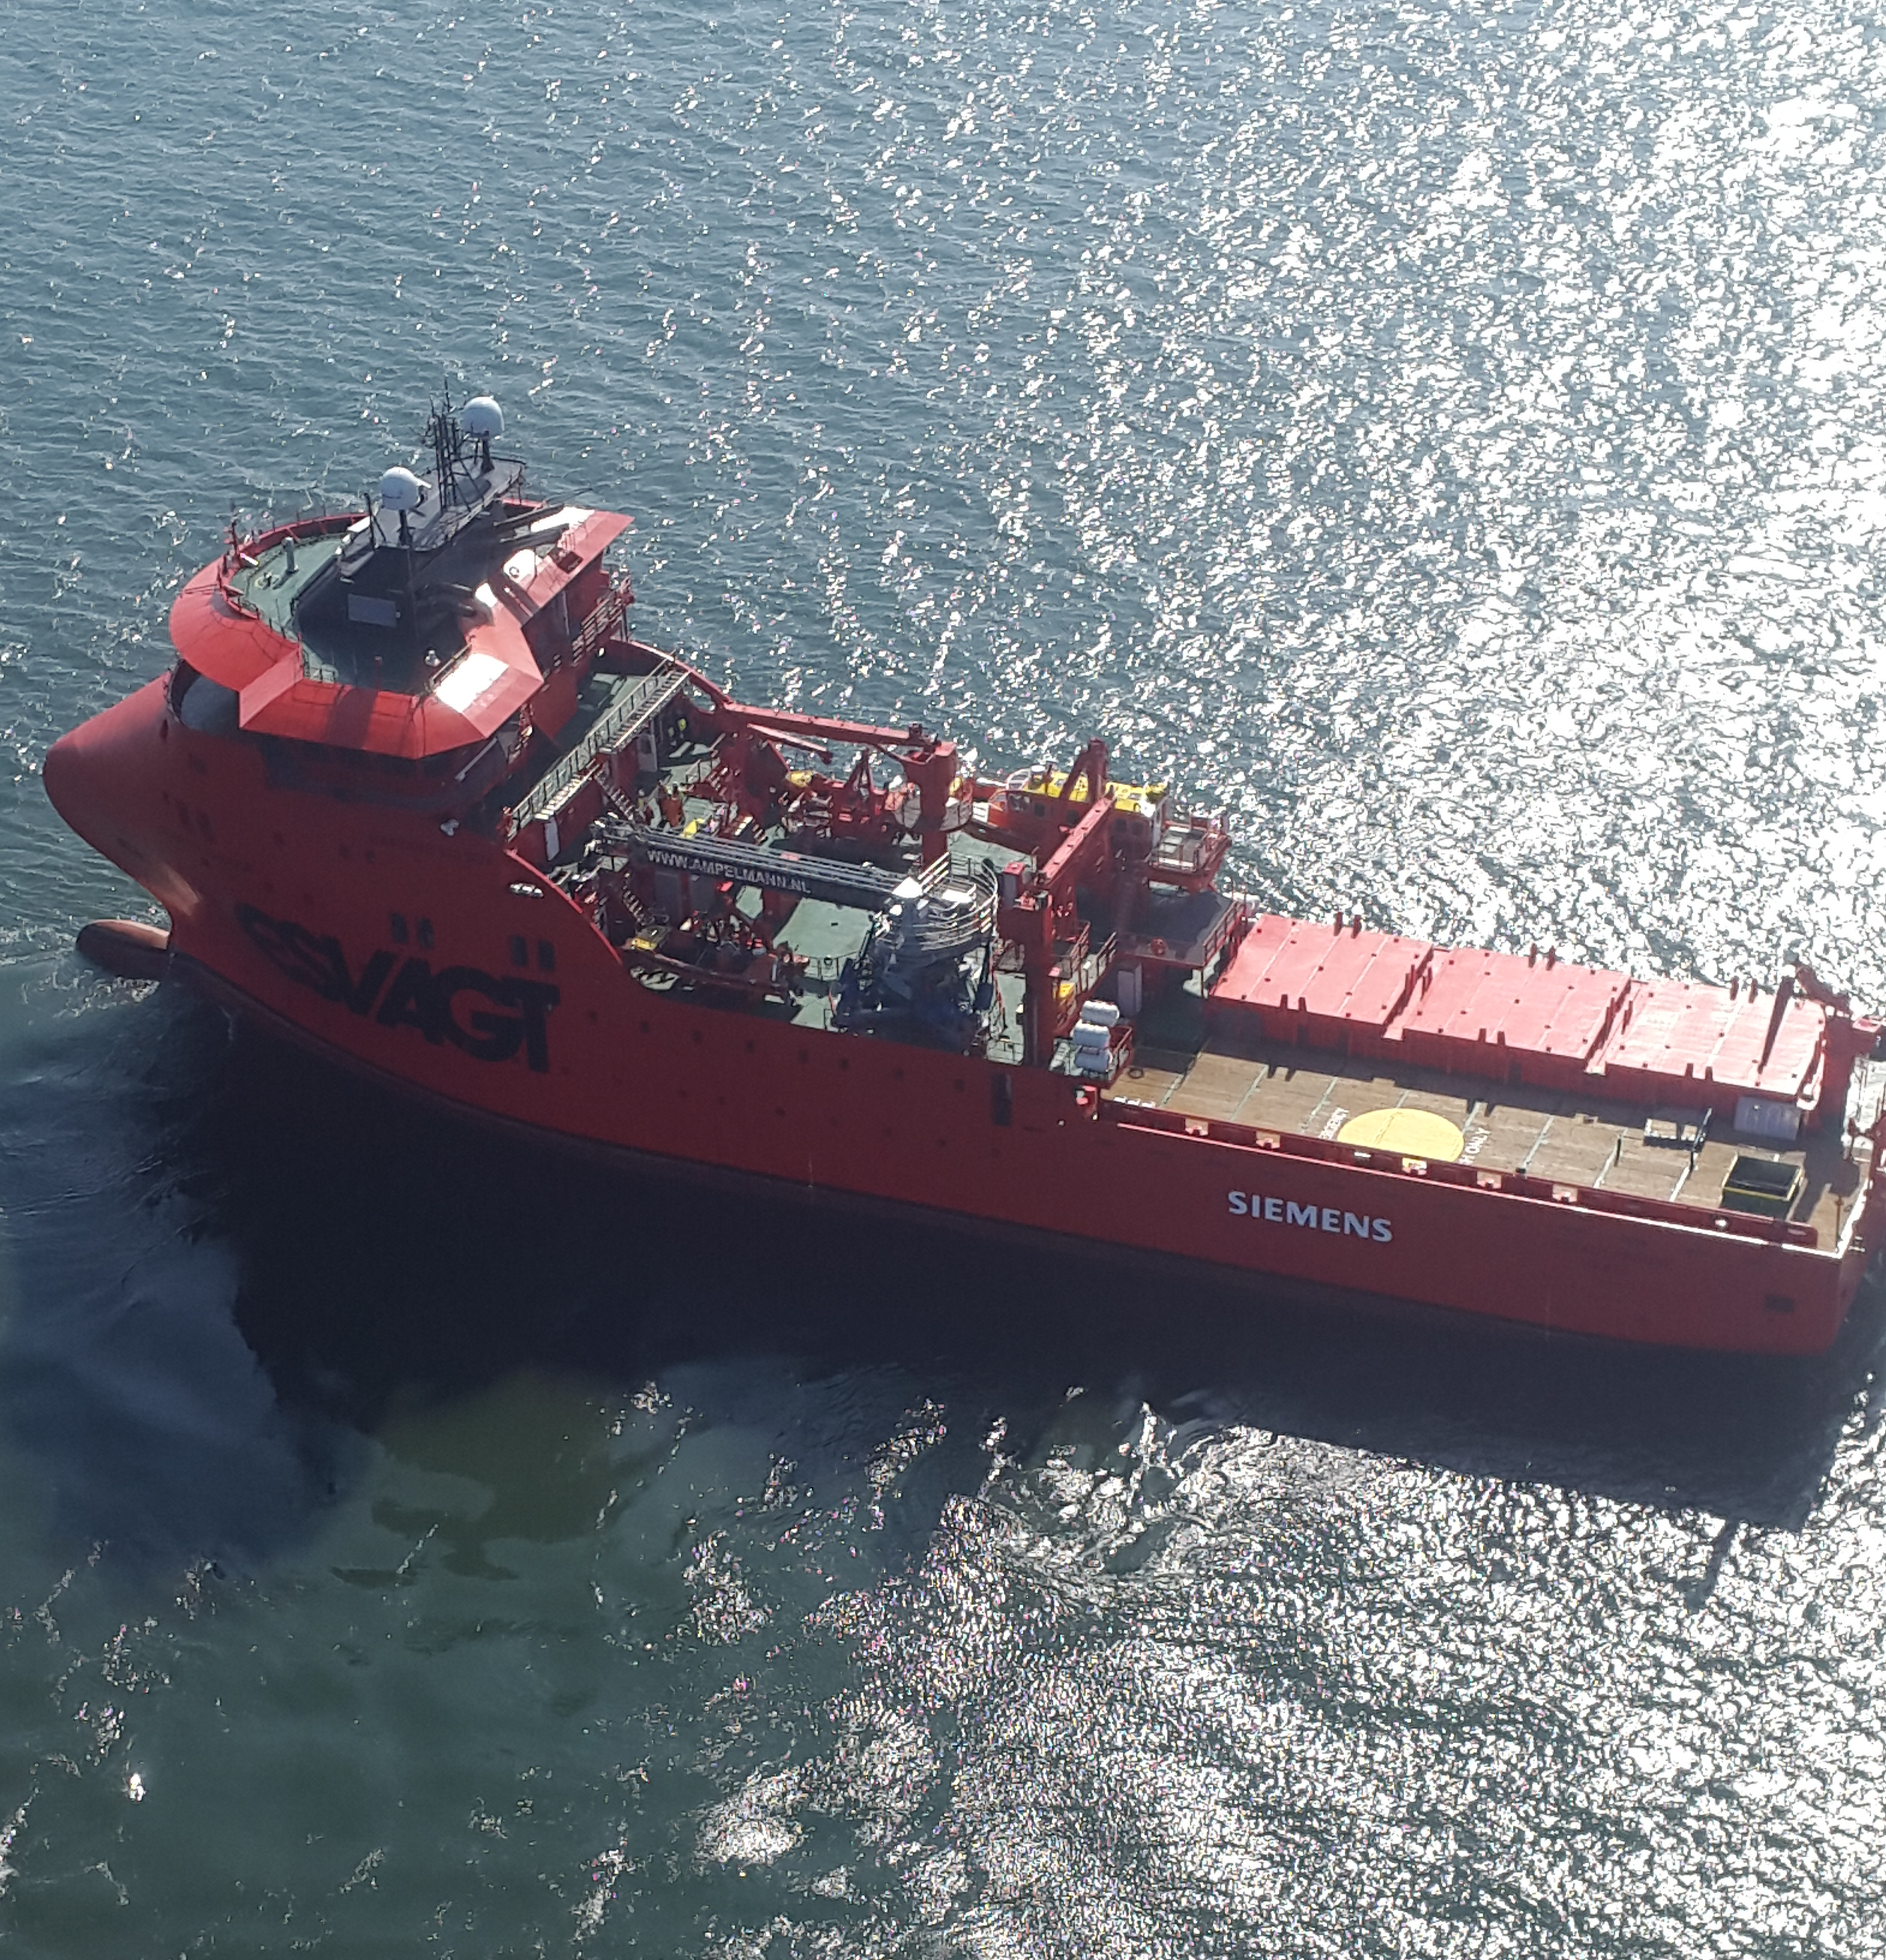
Thank you
René Cornelis Wigmans
Head of Maritime & Aviation Solutions
Siemens Wind Power A/S PS WP PL MAS Borupvej 16 7330 Brande, Denmark
Mobile: +45 30375393 rene_cornelis.wigmans@siemens.com
siemens.com

Slide 13
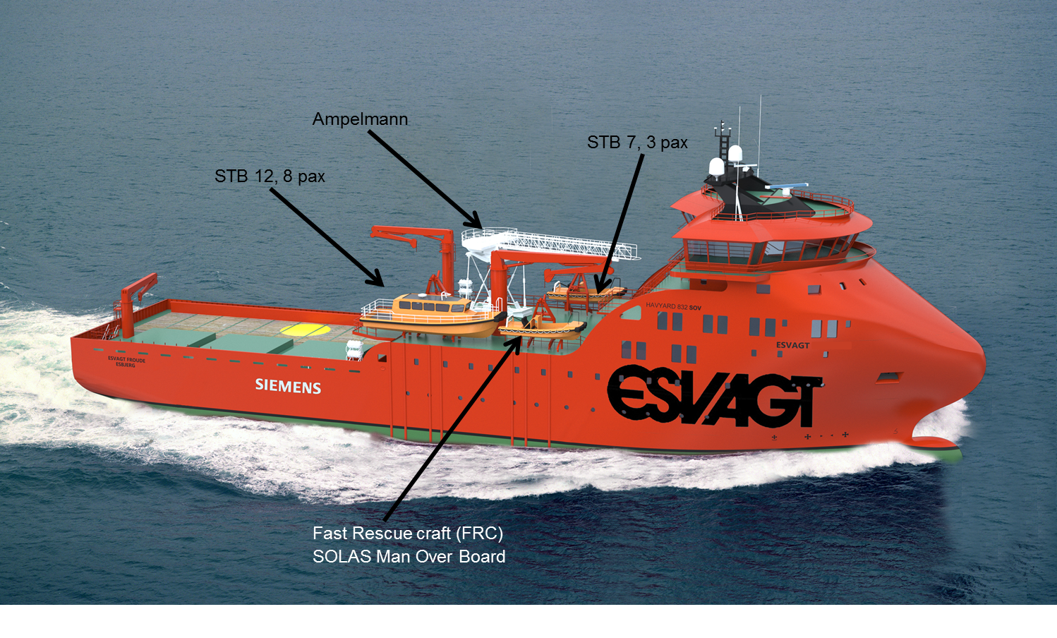
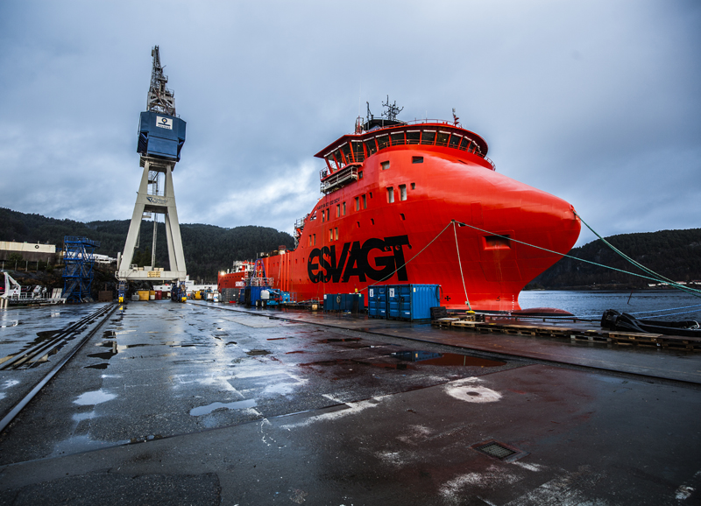
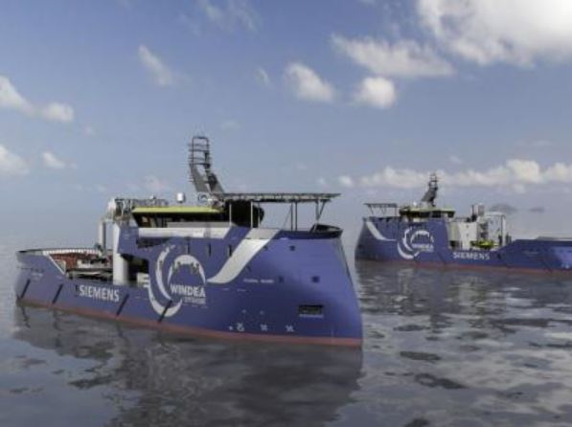
SOV Rethinking Logistics
Pioneering a new vessel: Service Operation Vessel (SOV)
Reducing weather downtime with operations in 2.3m Hs wave height
Hydraulic gangway access and modern crew accommodation
Spare part storage and daughter crafts for in-farm operations
New design(s) conceived: Service Operation Vessel
2 SOVs already delivered
2 additional SOVs ordered for Wind Farms Sandbank and Gemini

Slide 14
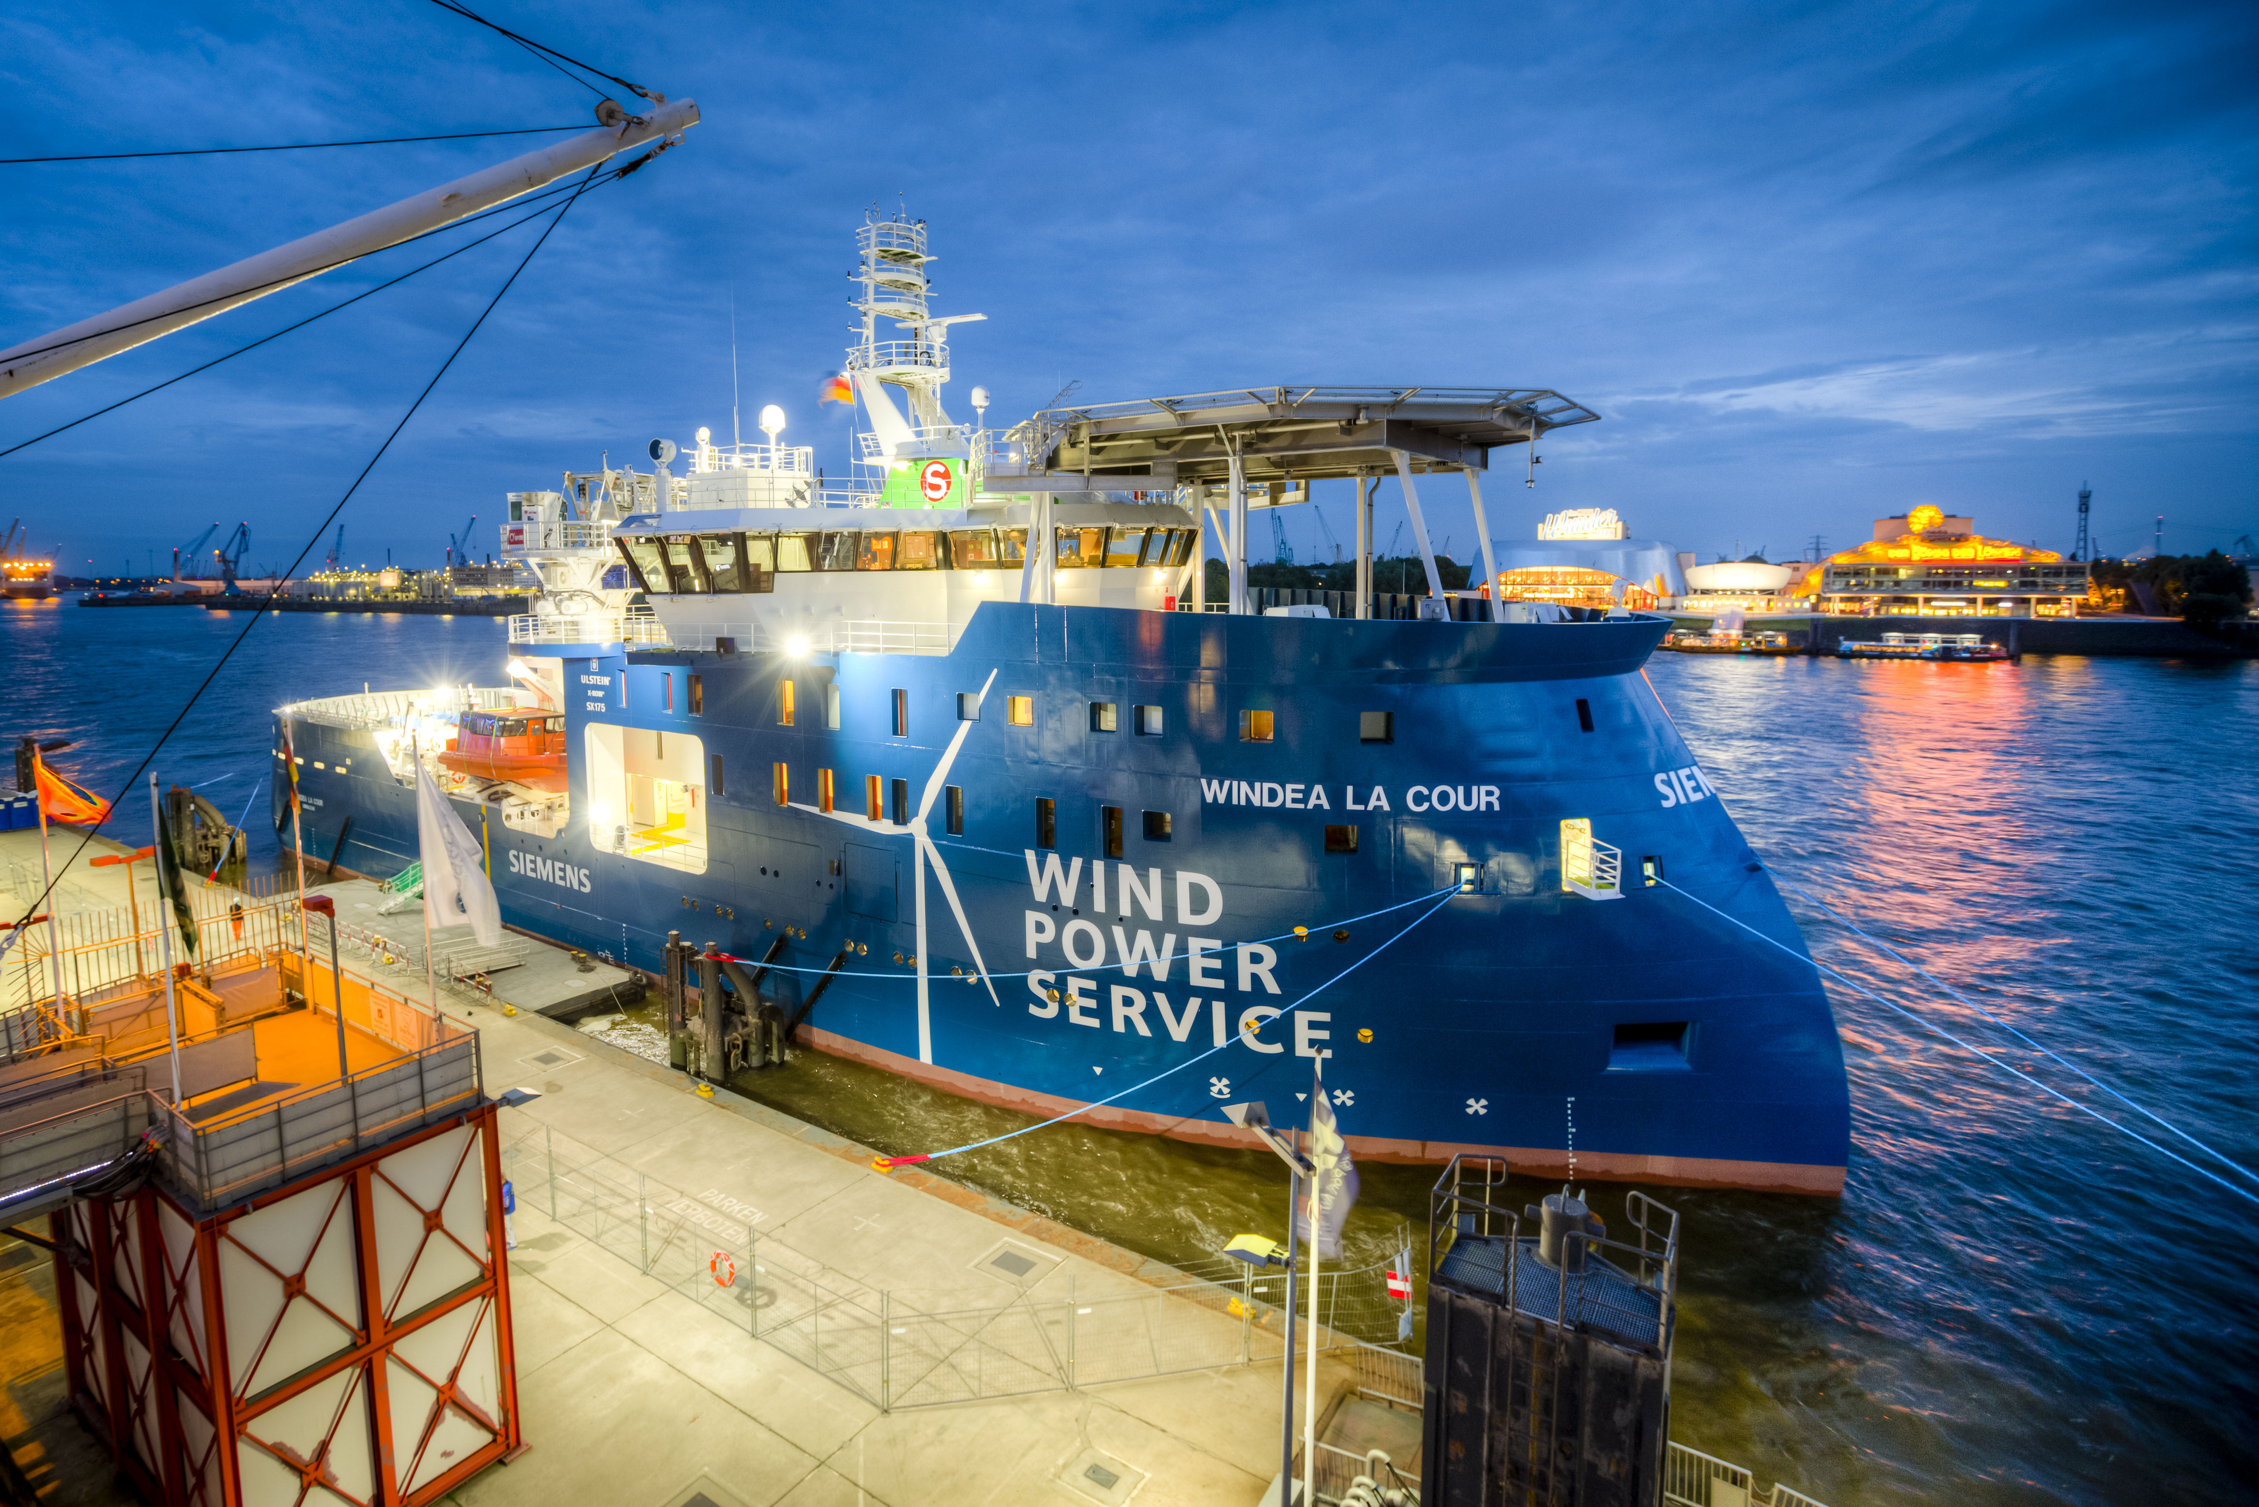
SOV – Characteristics
SOV Deck Area
Gangway system for TP access
DPII position system
Crane for lifting heavy goods
360 sqm main deck: 8x20 ft. Containers
Can include heli hoist area or helicopterdeck
Daughter and fast rescue crafts
Helicopter hoist area is possible
Dimensions & technical specifications
Accommodation and pax
Loa 80 m
Operating wave height: 2.3m Hs
Max payload: 100 t
Pax 60 incl. crew
Sheltered walkways on deck
Accommodation with 40 cabins for Siemens, offices, meeting rooms and Internet/video conference

