Slide 1
A Novel Lidar System –
First Results of Highly Resolved Wind vector measurements
Wind Europe Summit 2016
27 September 2016, Hamburg
Session: LIDARs - the zapping competition
Harald Mueller⁽¹⁾ Michael Eggert⁽¹⁾ Christian Gutsmuths⁽¹⁾
Axel Albers⁽²⁾ Klaus Franke⁽²⁾ Ailt-Wiard Janssen⁽²⁾ ⁽¹⁾ Physikalisch-Technische Bundesanstalt, Braunschweig, Germany
⁽²⁾ Deutsche WindGuard Consulting GmbH, Varel, Germany

Slide 2
Lidar Systems: challenges
Lidar wind speed measurement:
Power curve determination
Wind resource assessment
Challenges:
Traceability
Complex terrain
Wind field inhomogeneities

Slide 3
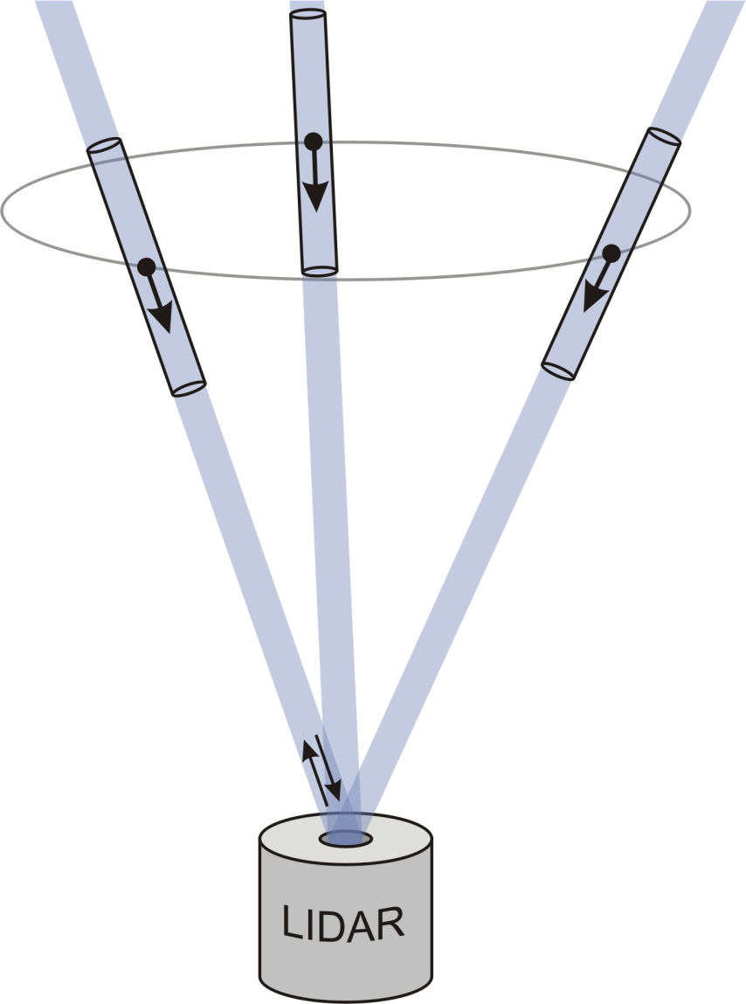
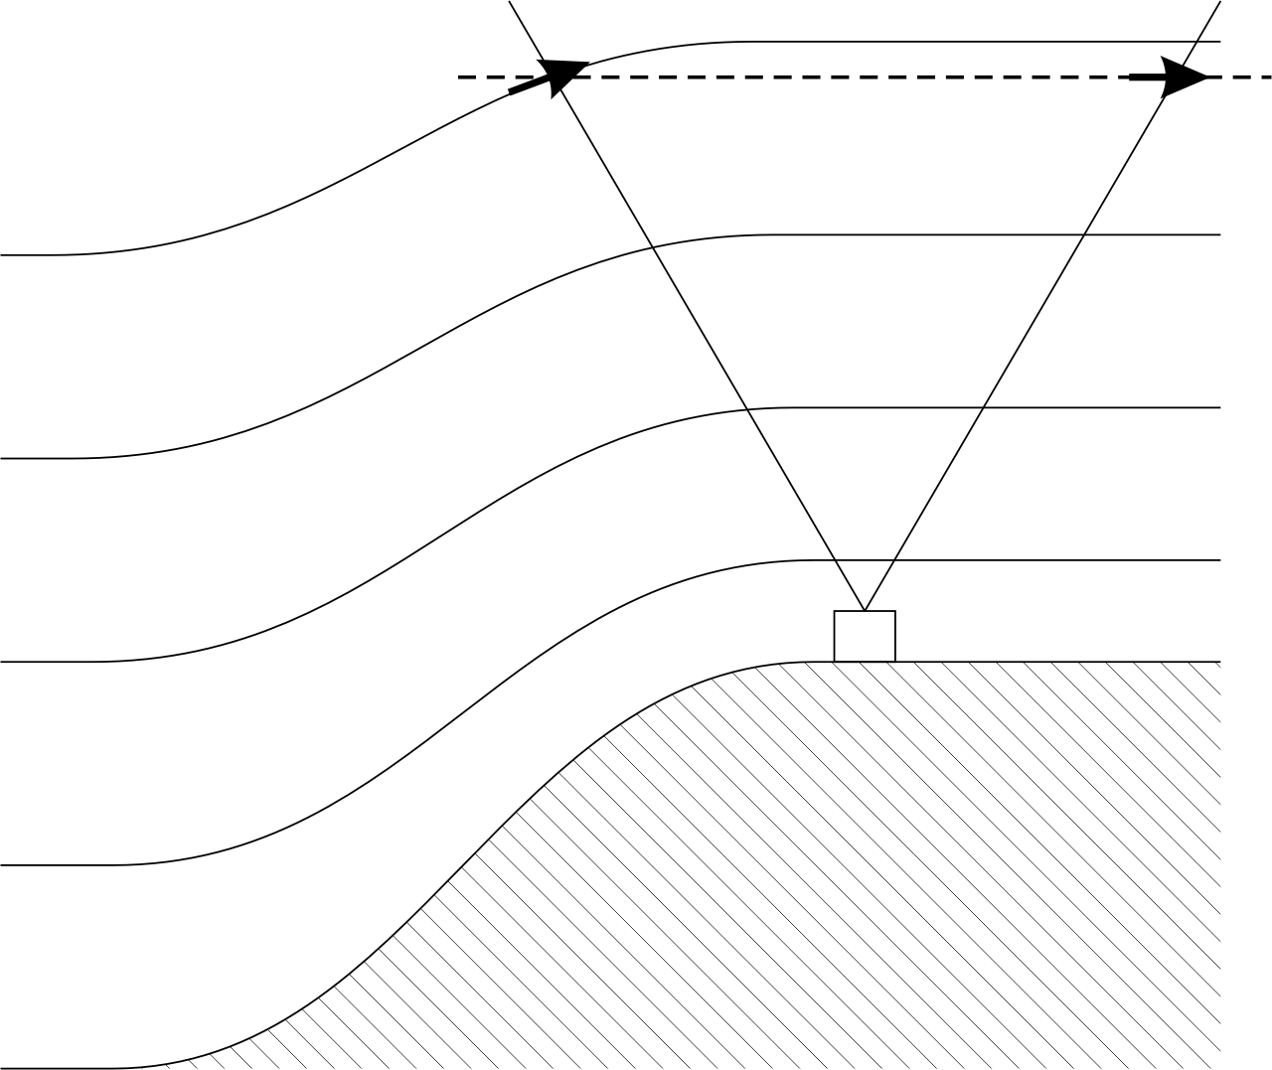
Monostatic Lidar Configuration
One beam tilted into different directions: Significant errors in complex terrain

Slide 4
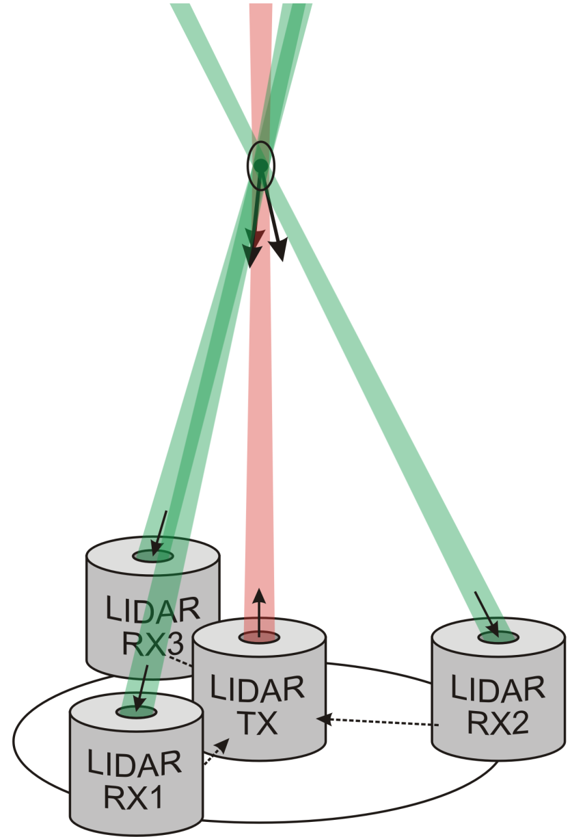
Bistatic Lidar Configuration (PTB)
Small measurement volume
at 100 m height:
6 mm diameter x 0.6 m length
at 200 m height:
12 mm diameter x 2.4 m length
- One transmitter beam
- Three receiver beams
- Complete wind vector
of a single particle
(aerosols in the air)
r = 1 m

Slide 5
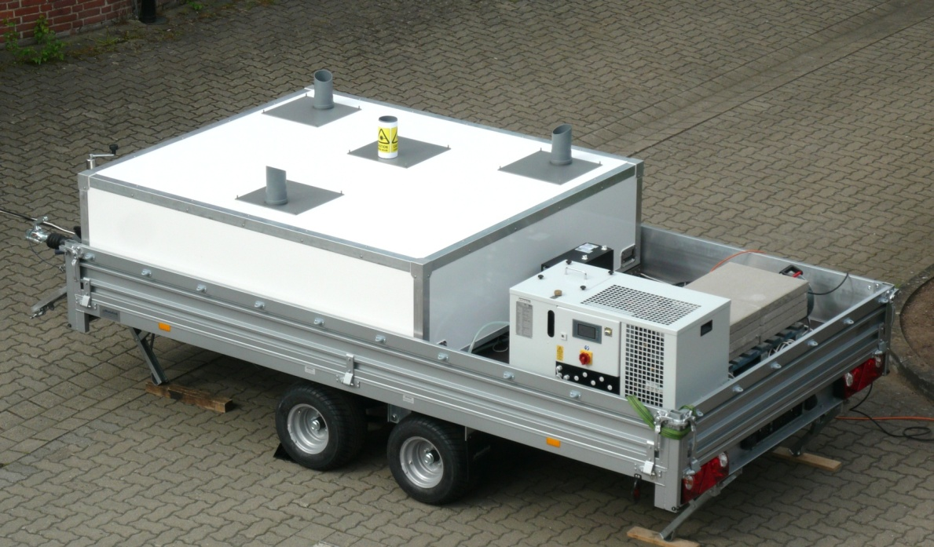
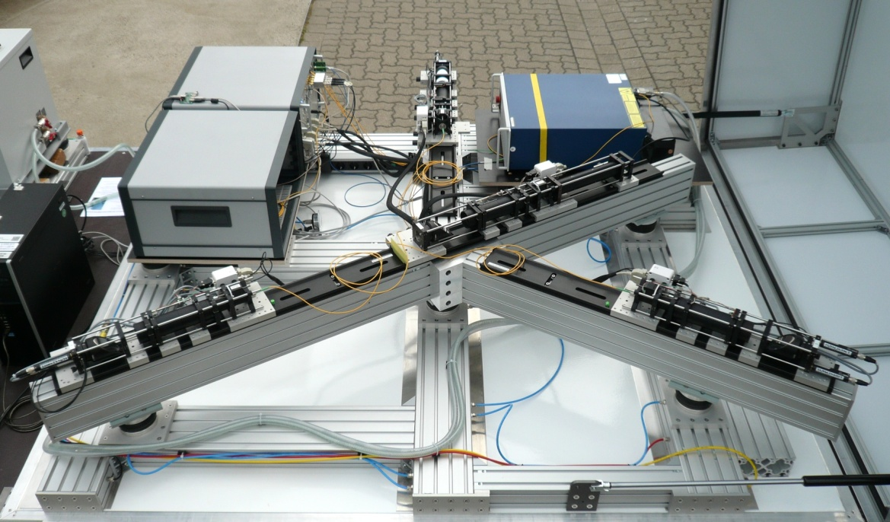
Mobile bistatic Lidar system
Lidar trailer
Weather-proof, air-conditioned housing

Slide 6
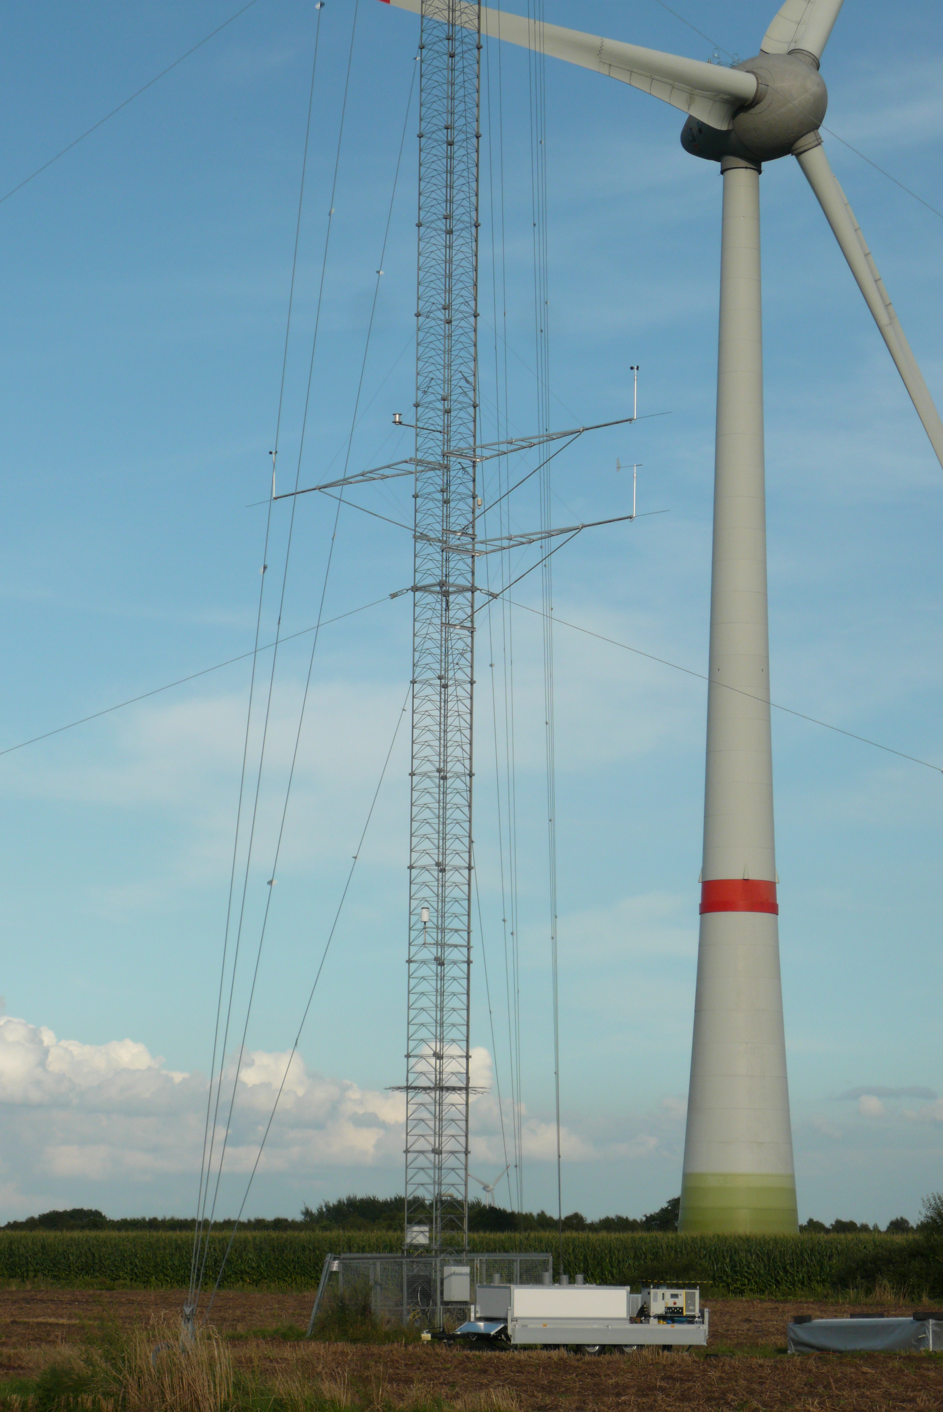
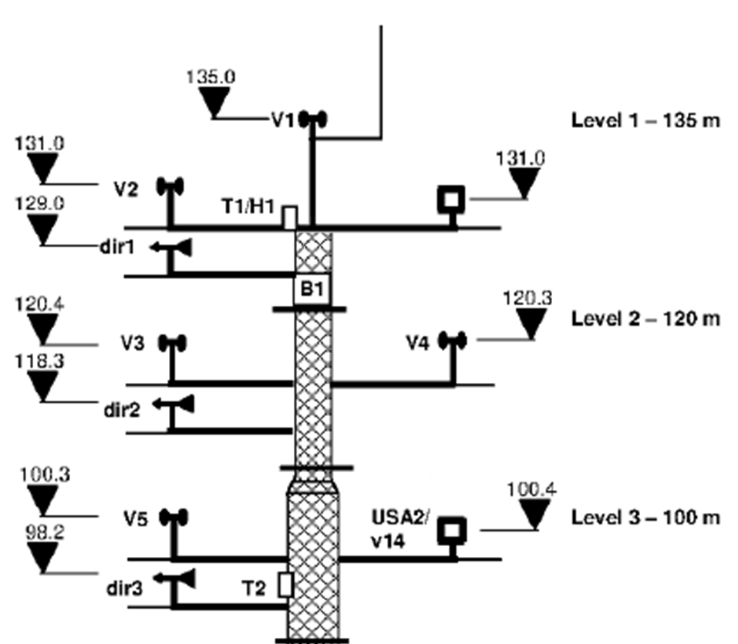
System validation in the test field
Met mast comparison measurements at heights:
- 135 m (top mounted cup anemometer/wind vane)
- 100 m (cup anemometer/wind vane)
Test field of Deutsche WindGuard Consulting GmbH

Slide 7
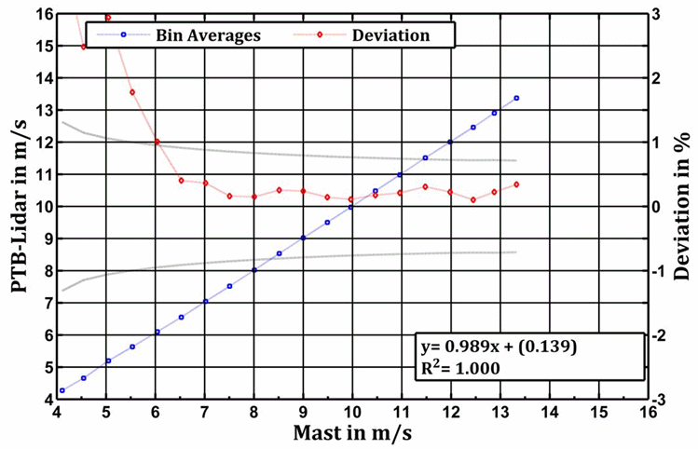
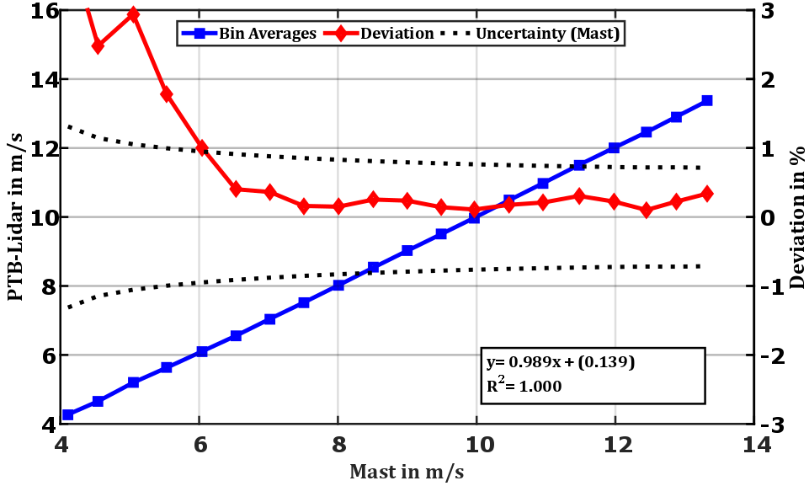
Comparsion with mast top cup
(Measurement period: 28 h, evaluation time intervall: 1 s, time delay: distance correlated 1,1 s)
Observed deviations < 0,5 % - within cup anemometer uncertainties!

Slide 8
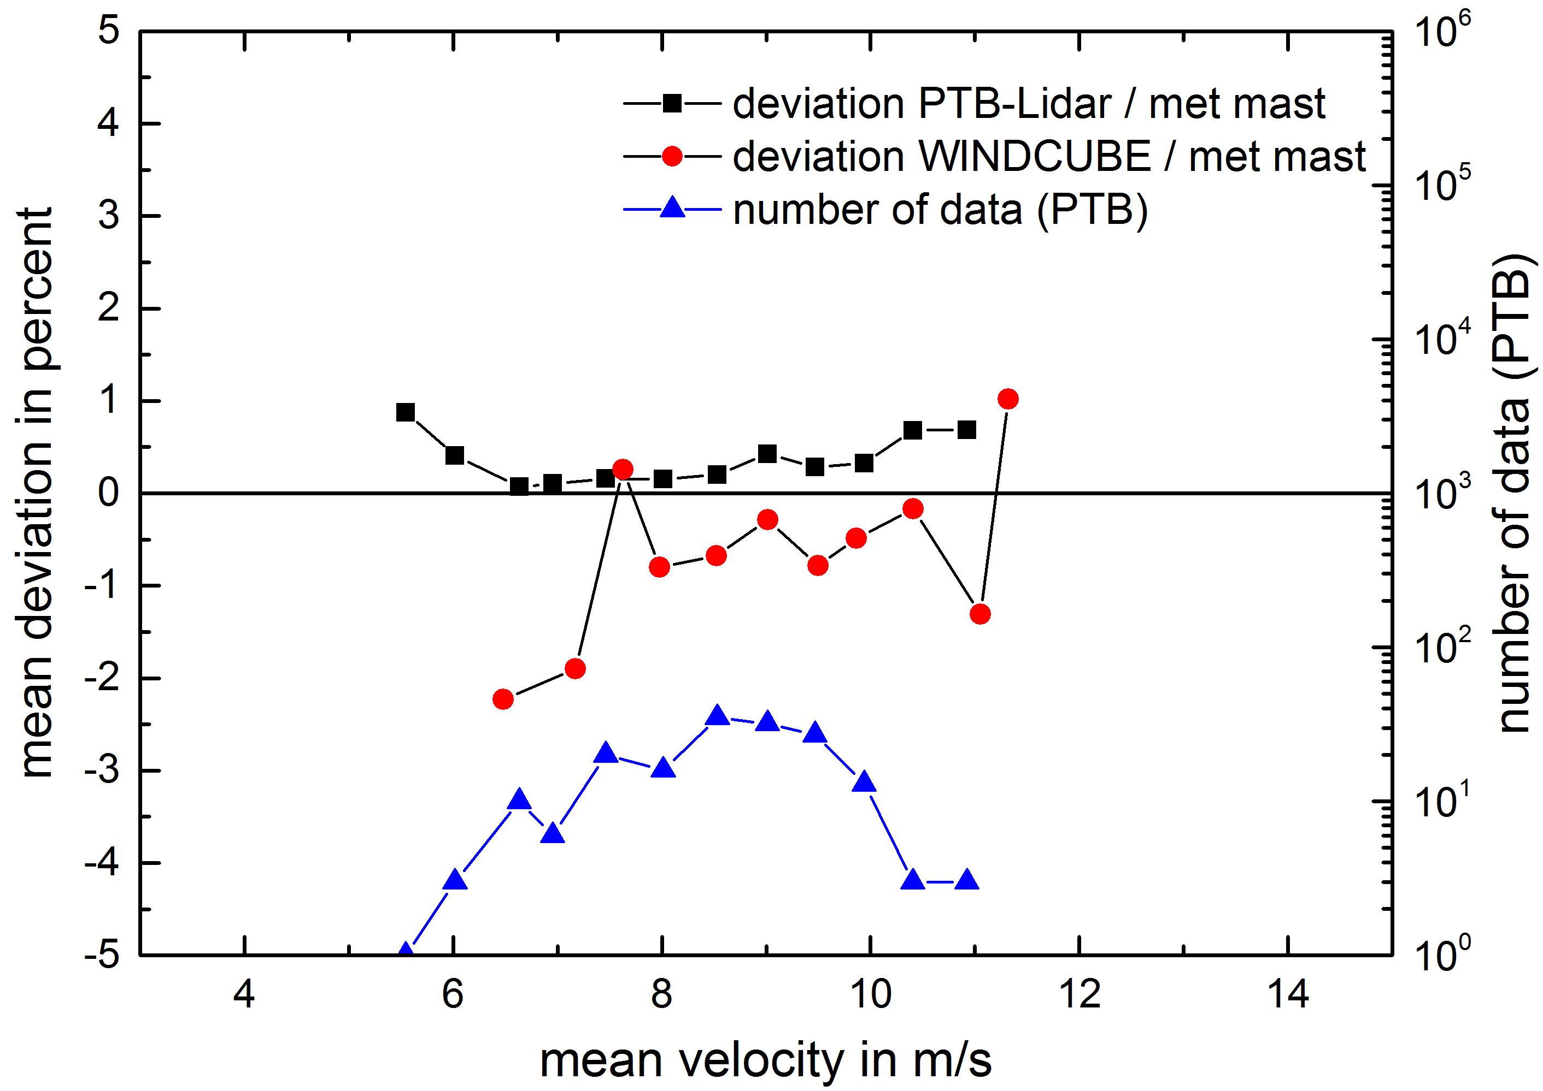
Different Lidars and met mast
Undisturbed wind conditons, measuring height 135 m, mean values of 10 min time slots
black dots: deviation bistatic PTB lidar – met mast (blue dots: number of data)
red dots: deviation monostatic WINDCUBE – met mast

Slide 9
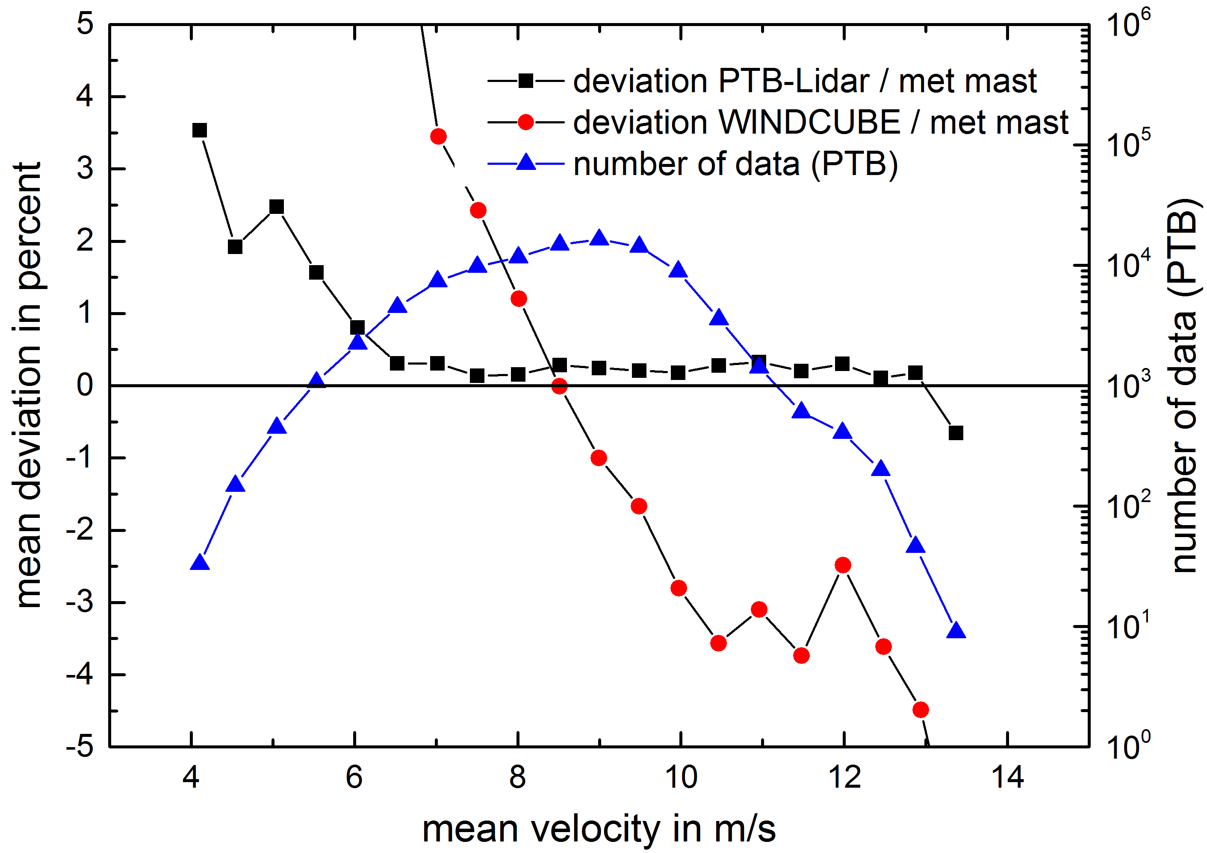
Different Lidars and met mast
Undisturbed wind conditons, measuring height 135 m, mean values of 1s time slots
black dots: deviation bistatic PTB lidar – met mast (blue dots: number of data)
red dots: deviation monostatic WINDCUBE – met mast

Slide 10
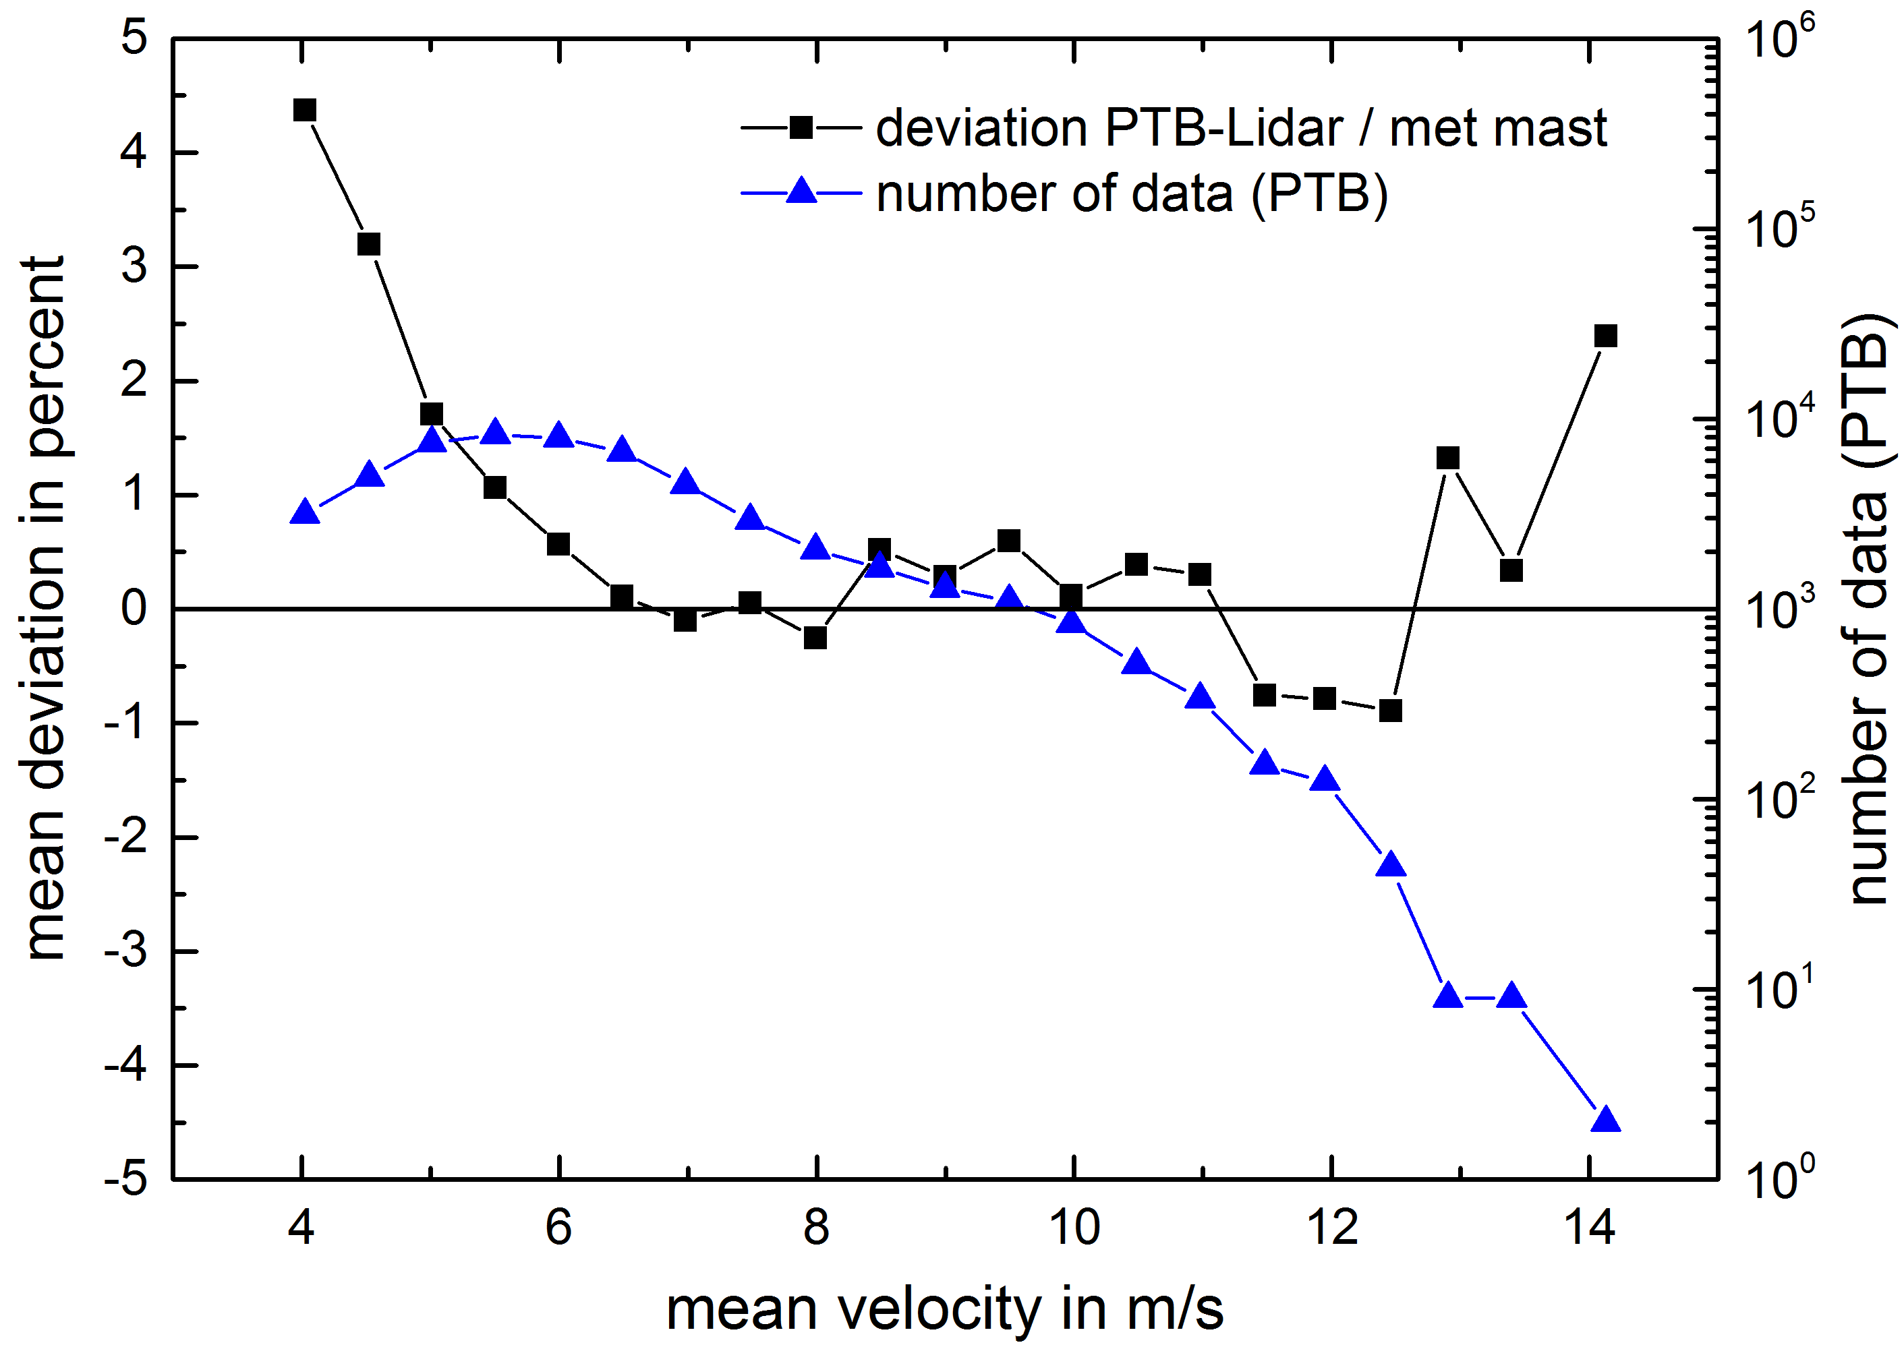
Comparisons with met mast
Disturbed wind conditons, measuring height 135 m, mean values of 1s time slots
black dots: deviation bistatic PTB lidar – met mast (blue dots: number of data)

Slide 11
Conclusions
Advantages of the novel bistatic Lidar system:
Accurate wind vector measurements
High temporal and spatial resolution
Traceability independent of met masts
Accuracy independent of wind field inhomogeneities
Application spectrum:
Wind ressource assessment
Power curve determination
Calibrations and investigations in the field
Next milestone:
Hard and software developement for autonomous operation

Slide 12
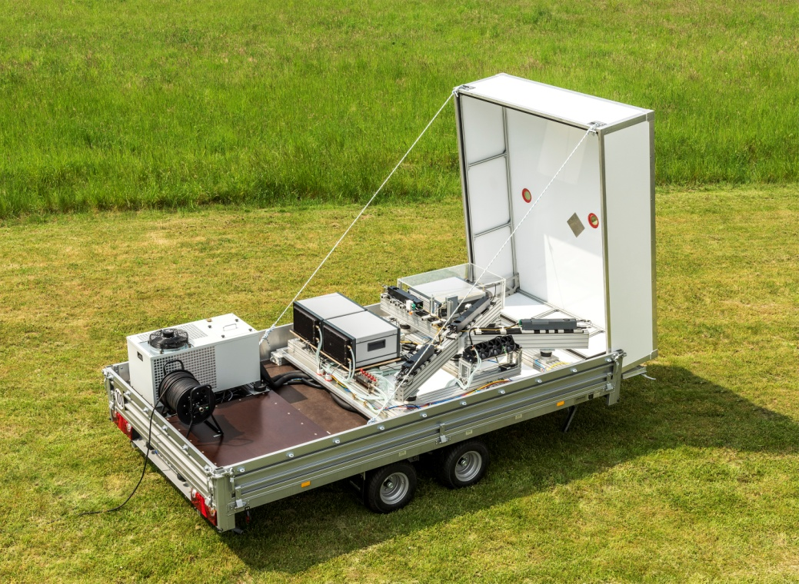
Physikalisch-Technische Bundesanstalt
Braunschweig and Berlin
Bundesallee 100
38116 Braunschweig
Harald Müller
Telefon: 0531 592-1310
E-Mail: harald.mueller@ptb.de
www.ptb.de

