Slide 1
rotor design Approach for extending Wind turbine platform lifecycle
Hamburg / September 27 / 2016
Christian Frank Andersen

Slide 2
agenda
Corporate Presentation Market Trends Design Space and Constraints Building Blocks Approach and Tools Closing Remarks

Slide 3
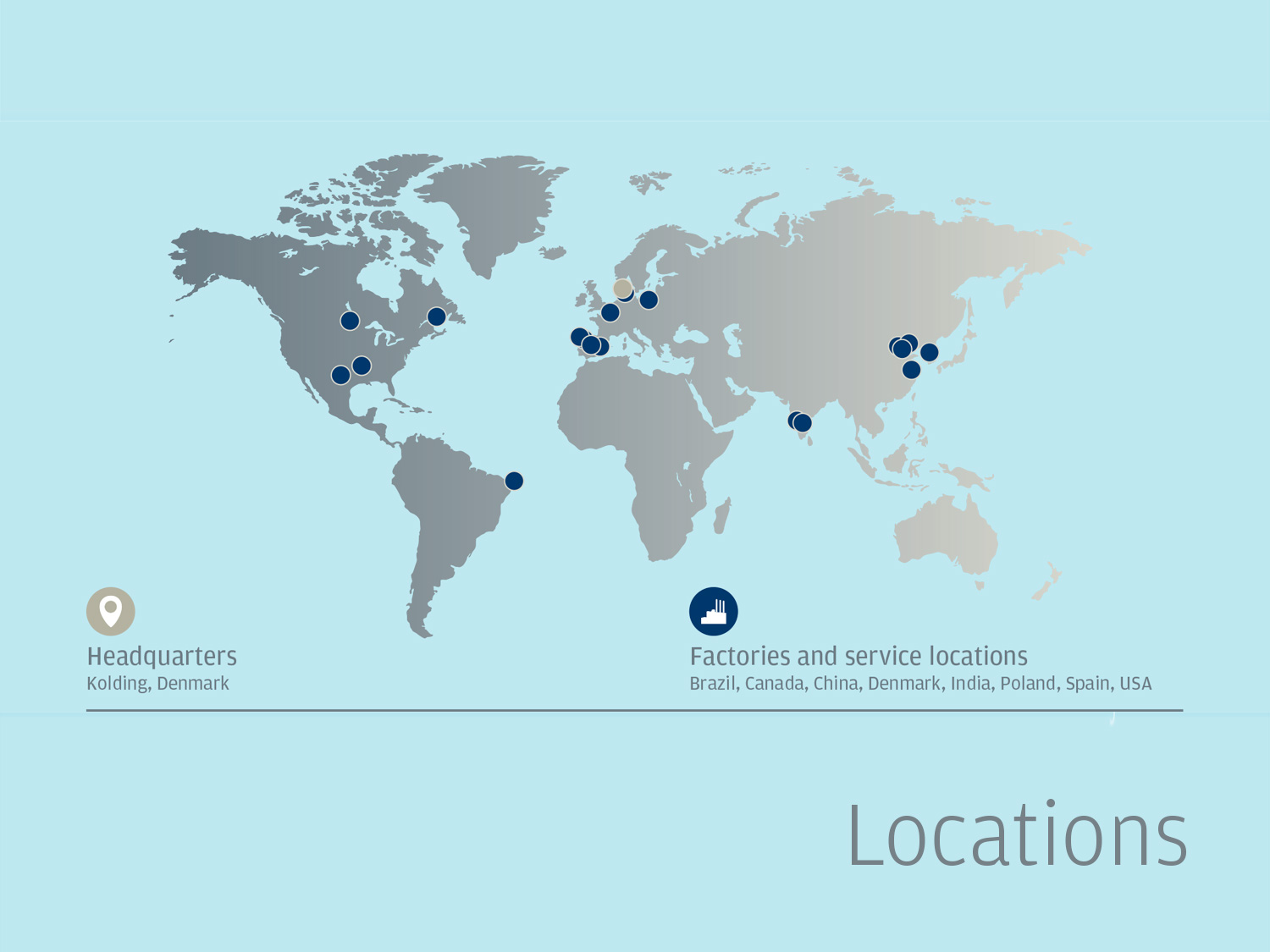
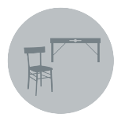
The early years

Slide 4
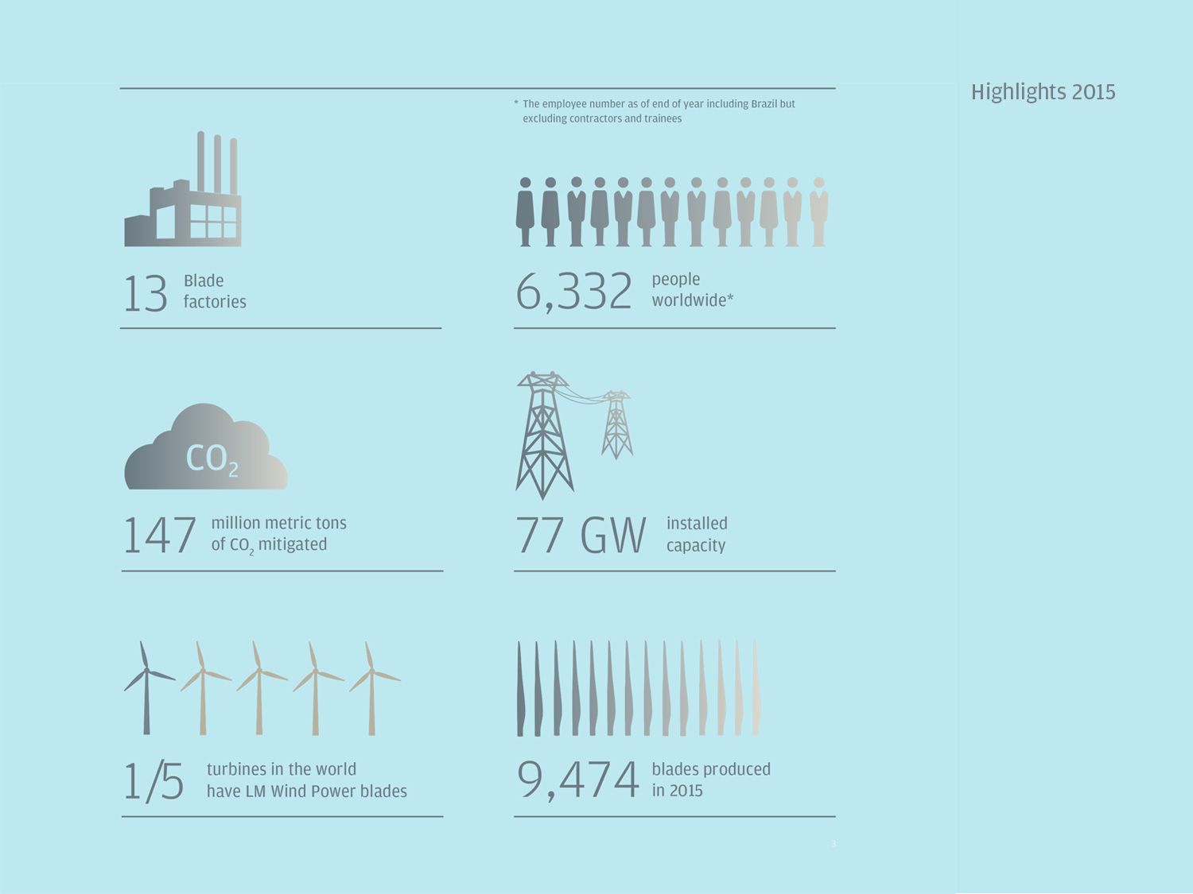
1996 1st generation Lightning-Protection Vortex generators
1999 VARTM vacuum infusion technology
2002 Pre-bending
2003 FutureBlade technology
2004 61.5 m blade introduced (world’s longest blade at the time)
2012 73.5 m blade introduced (world’s longest blade at the time)

Slide 5
LM 88.4 P

Slide 6
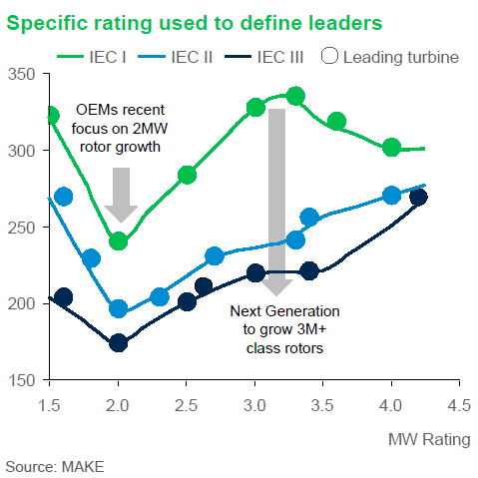
Market Trends in 3-3.5 MW segment
Capacity factor drives the specific rating down, leading to longer and more slender blades
Slender blades open for larger dynamic couplings
Specific Rating [W/m²]
Source: ”Next Generation Wind Turbine Models”,
MAKE consulting, 3 August 2016
MW Rating
~285 W/m²
~200 W/m²

Slide 7
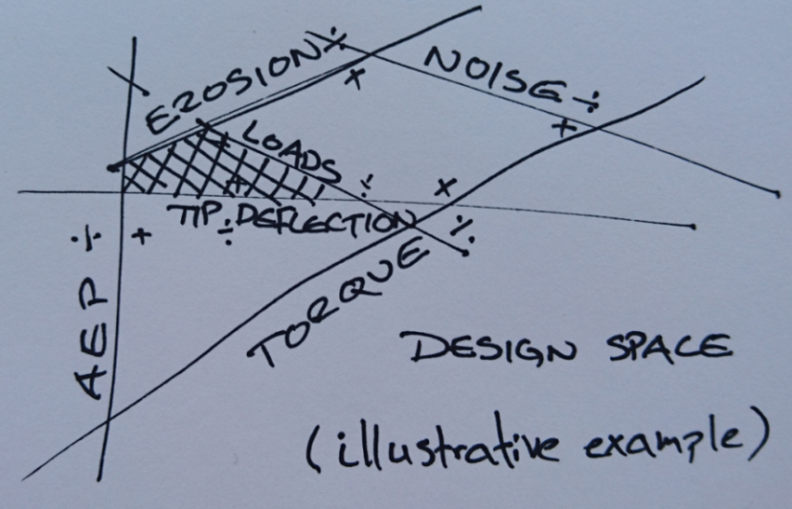
Design Space and Constraints
Design space is smaller and more complex
Designing new blades for existing platforms reduces design space
The number of constraints is increasing, e.g., due to the increased aero-elastic behavior, higher tip speed and turbine frequencies
High fidelity turbine loads tool is a must to quantify turbine impacts!

Slide 8
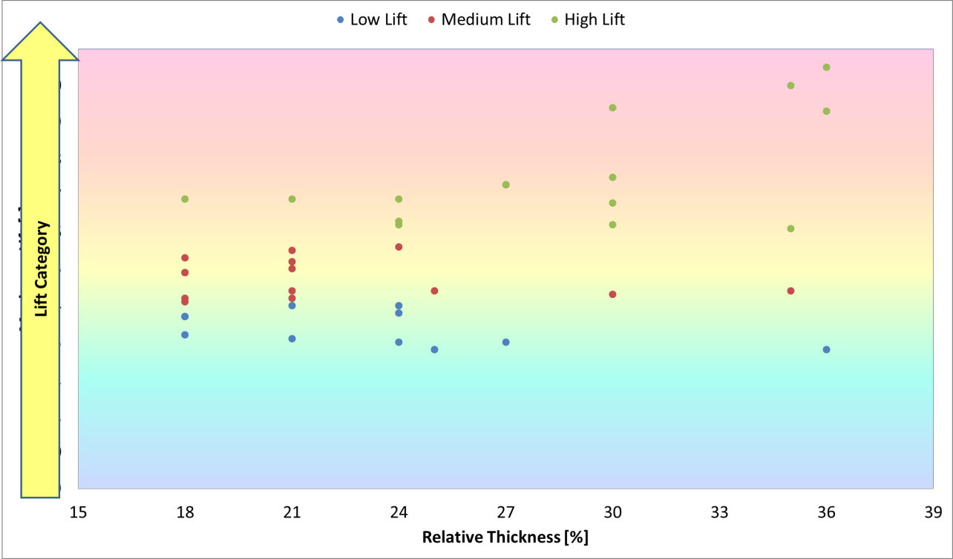
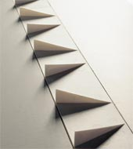
Building Blocks I
VG’s
Serrations
Spoiler
Tape/ProBlade
Stall Strips
...
Rough/Clean, AOA @ 180°, Add-ons, RE/Ma Corrected,...

Slide 9
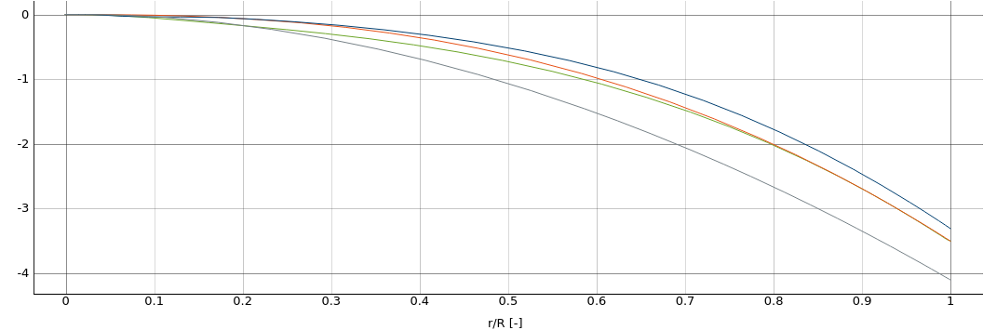
Building Blocks II
Materials
Design Rules
Shape
E-glass, H-glass, Hybrid
Balsa, PET, PVC
Polyester, Vinylester
Std.Lam.Plan
”The Aero Rules”
Ocean of DSs
Planform, Thick.rel
Pre-bending
The more building blocks, the easier it is to reach the optimum blade!

Slide 10
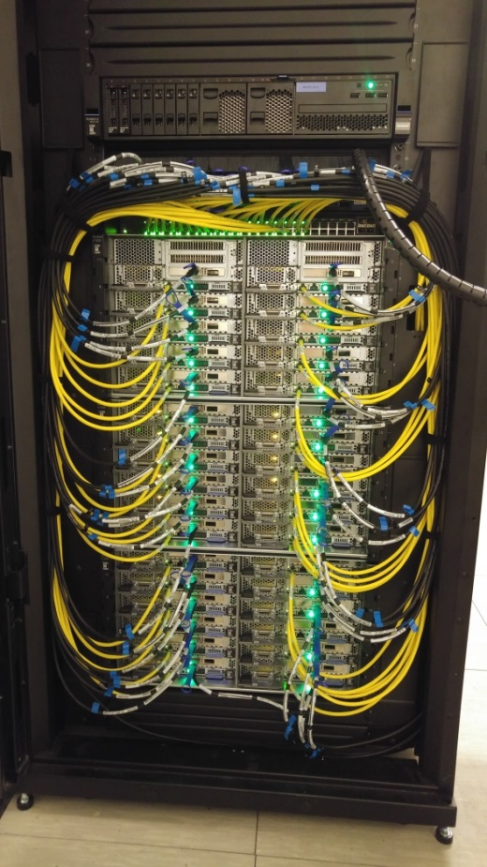
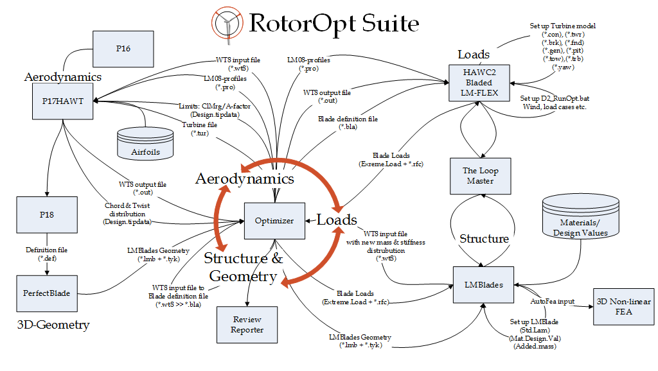
Approach and Tools
Utilizing all the blade properties and building blocks quickly becomes very complex. Using RotorOpt is a must

Slide 11
Closing remarks
Using advanced tools and a wide range of building blocks, innovative designs can emerge and take blade designs to the next level
Blade designs today are so much more complex than a few years ago. Mastering these will make the difference

Slide 12
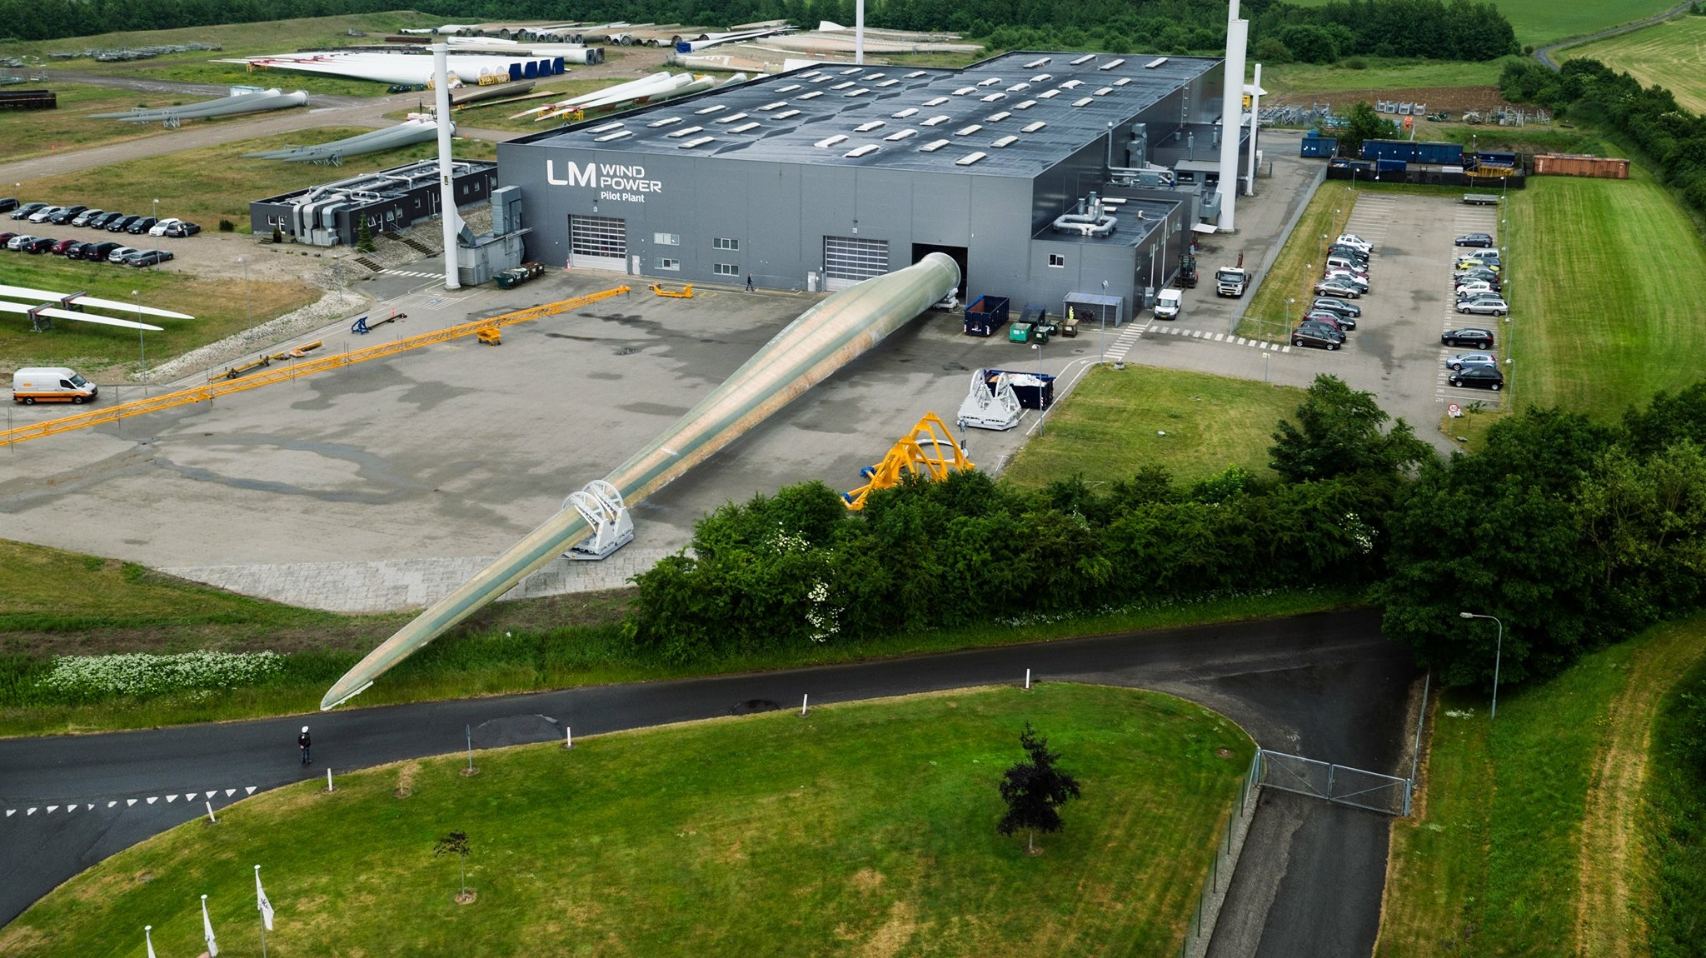
Q&A

Slide 13
Thank you for your time
Contact details: |  | Head quarters:
Christian Frank Andersen |  | LM Wind Power
Director |  | Jupitervej 6
Conceptual Design |  | 6000 Kolding
 |  | Denmark
 |  | Tel | +45 79 84 00 00
Mob | +45 51 38 83 61 | Fax | +45 79 84 00 01
E | cfa@lmwindpower.com | E | info@lmwindpower.com
 |  | W | lmwindpower.com
Note:
The contents of this presentation are confidential and may not be copied, distributed, published or reproduced in whole or in part, or disclosed or distributed by recipients to any other person.

