Slide 1
Leidenschaft für 100% Erneuerbare Energien
Community wind farm Südliche Ortenau
Presentation of an inter-municipal model project

Slide 2
Topics
Our company: Green City Energy
Our project: Community wind farm Südliche Ortenau

Slide 3
Our origin: the non-profit environmental organisation Green City e.V.
Green City Energy AG emerged as a subsidiary of Green City e.V. a non-profit environmental organisation
Since 25 years our partent organisation Green City e.V. is involved in green urban issues, renewable energy and sutainable mobility
Since our foundation in 2005 Green City Energy AG stands for: 100% renewable energy in the hands of citizens!

Slide 4
Green City Energy stands for 100% renewable energy
Ecologic Investments
Pre-financing of projects through GCE-profit participation right or bond capital
Conception of closed end funds
GCE Power parks enables financial citizen participation
Project Development
From the idea to the power plant we cover all.
Solar power plants
Wind energy plants
Hydro power plants
Biogas plants
Municipality Consulting
Full consulting services
Climate protection plans
Development of implementation strategy
Citizen participation

Slide 5
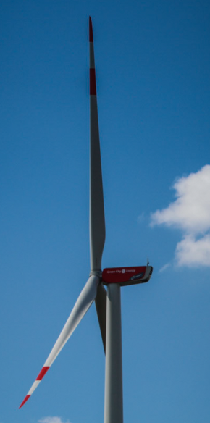
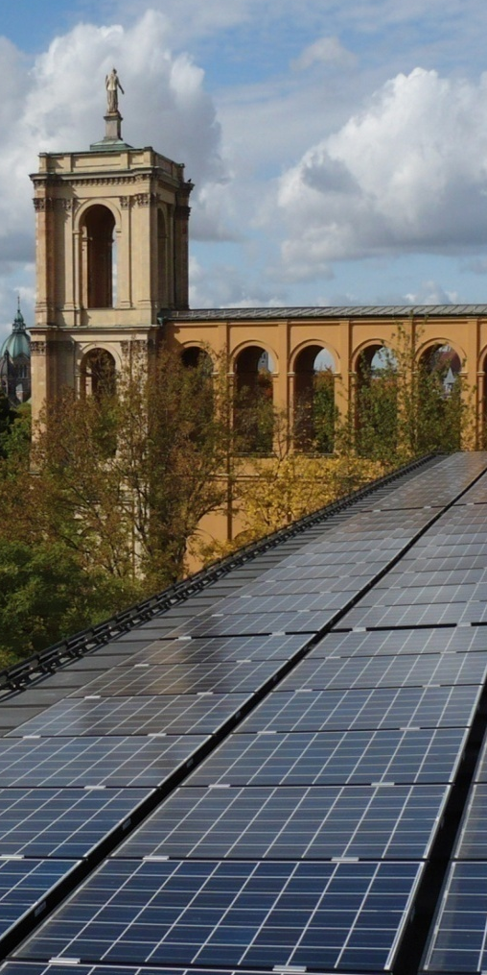
Anniversary: 10 years of experience and 350 projects finalized
Building and financing energy power plants
is our core business
Wind Power
Solar Power
Hydro Power
Biogas

Slide 6
Topics
Our company: Green City Energy
Our project: Community wind farm Südliche Ortenau

Slide 7
Our project: Community wind farm Südliche Ortenau
An inter-municipal model project
Between autumn 2015 and June 2016, the civic wind farm was built on the territories of the municipalities of Ettenheim, Schuttertal and Seelbach (Black Forest)
Strong local energy cooperatives wanted to be involved
Municipalities and local energy cooperatives will held a permanently strong position
But: without the corresponding construction risk and capital investment

Slide 8
What makes this project unique?
Ownership and financing concept
Property ownership / voting rights and equity financing are decoupled from each other:
Founding of a project holding with a capital stock of 100.000 €
Civic energy cooperatives and municipalities have the option on 25,5% of the operating company to the price of the capital stock (each 25.500 €) -> together 51 %
The rest of the equity (11 Mio €) comes from Green City Energy as shareholder loan
25,5% energy cooperatives (optional and realized)
49% GCE (KWP II)
25,5% municipalities (optional)

Slide 9
Advantages to all local partners
to the municipalities:
Option of co-ownership without the corresponding risk and capital investment
Lower conflict potential through the involvement of local stakeholders
Increased acceptance because value is created locally
A potential 100 percent of business tax revenue for the local communities

Slide 10
Advantages to…
…the citizens:
Representation by the municipalities and, where applicable, by the local energy cooperatives.
Possibility to participate in decision-making processes and get involved via the municipalities as well as the local energy cooperatives, where applicable.
„Together with GCE we developed the model of our civic wind farm. For our local energy cooperatives it brings a lot of advantages“
Jörg Bold, managing comitee of Ettenheimer Bürgerenergie eG

Slide 11
Advantages to…
…Green City Energy:
More support when acquiring and implementing new projects through strong collaboration with local / regional stakeholders
Company mission: energy in the hands of the citizens!

Slide 12
How the project used information and engagement measures?
Transparency and partnership
All important decisions were made with the consensus of the involved partners
The local energy cooperatives were also involved in doing publicicty work
Citizens were offered information in a great varity of ways:
Regular local meetings of an roundtable
Drop-in centre as the wind farm`s local office
Guided tours of the construction site
Information events focusing on the option of financial participation

Slide 13
How the project used financial measures?
Direct and indirect partizipation
Municipalities and local energy coop. can become 51 % majority owners
Citizens are involved in decision-making even if they do not participate financially
3 options for the citizens to participate directly:
Saving bonds for the inhabitants
Shares in local energy coop.
Fixed interest bonds form KWP II (GCE)

Slide 14
And the power?
Direct partizipation for the citizens
Civic energy cooperative has the right to sell the generated power directly
They have to give preferential conditions to the local citizens
For local citizens, energy generated by the civic wind farm will be cheaper than the energy they can purchase from regular providers
This is a real unique selling point

Slide 15
Do you have questions? We would be happy to get in contact with you…
Contact:
Tobias Natt
tobias.natt@greencity-energy.de

Slide 16
Green City Energy AG

